Slide 1


Dr. A. Vijayaraman, Deputy Director,
VHS-CDC Project ASPIRE, India
Leaving no one behind –
Implementation of Intervention among Informal networks of Women who engage in Commercial Sex work (i-WECS) for Fast-Tracking HIV Case Detection in Andhra Pradesh
A Sustainable, Scalable Program Experience from India

Slide 2

Summary
What is your main question?
Reaching out to informal networks of WECS who are left out of response
HIV prevention strategy tailored to the needs of WECS not soliciting in traditional physical domains, but through network-based, virtual and uncovered by the current national program.
What did you find?
Demonstrated a differentiated model to reach the uncovered i-WECS in a high-prevalent state (Andhra Pradesh) in India.
During May 2022 to March 2025, reached 4,689 i-WECS, detecting 313 new HIV-positives (9% positivity), 97% were initiated on ART.
Why is it important?
Offers a scalable approach to reach i-WECS helping India accelerate towards epidemic control.
Outreach through network operators and virtual medium play a key role in delivering HIV services to WECS not covered under the national response

Slide 3



HIV/AIDS Scenario
Estimated population: India: 2.54 million | Andhra Pradesh (AP): 0.3 million
Adult HIV prevalence: India: 0.20% | Andhra Pradesh: 0.62%
KP HIV prevalence
Progress on 95-95-95 (Andhra Pradesh)
India
WECS
1.85%
MSM
3.3%
PWID
9%
Project Period
AP
WECS 1.78%
MSM 2.06%
PWID 1.32%
Estimated KP (in million)
WECS
MSM
PWID
India
0.99
0.35
0.28
AP
0.12
0.02
0.01
Source AP: Sankalak 2024
Notes:
The adult HIV prevalence in AP is 0.62% which is three-times more than the national average (0.20%).
The HIV prevalence among WECS is 1.78% which is almost equal to the national average (1.88%) signaling the need for intervention among WECS who are left behind the HIV response in the state.
In collaboration with the state, the first 95 gap was closed from 76% to 87% in a span of four years by demonstrating various models including i-WECS.

Slide 4
Building a strong prevention response to reach the underserved people at higher risk for HIV
Findings revealed
National program aims for innovative demonstrable models to reduce new HIV infections
Community- listening exercise carried out to understand sexual dynamics & needs
Economically disadvantaged
Remain anonymous
Do not identify themselves as people at higher risk for HIV
Their perception for HIV and STI is low, hindering their acceptance to register in the national HIV program
Vast number of women who are married and were engaged in sex work for extra income without the knowledge of their husbands or family.
Involved in sex through network operators, through peers or independently
Health is a low priority for them
Informed the design and roll out
VHS-Project ASPIRE is demonstrating strategies to reach underserved i-WECS
Notes:
Wherein, NACP Phase-V aims to accelerate reduction in new annual HIV infections through a basket of strategies tailored to the high-risk, at-risk, and low-risk population groups.
A community listening exercise was conducted before the initiation of the intervention with i-WECS in the state of Andhra Pradesh to increase understanding of their sexual dynamics and needs.
The consultation also highlighted that the informal networks of WECS were women who do not identify as people at higher risk for HIV, while their risk perception for HIV and STI is very low, therefore hindering their acceptance to register at a TI project.
It also highlighted that there is vast number of women who are married and were engaged in sex work for extra income without the knowledge of their husbands or family.
The exercise generated critical information for designing and developing the intervention, i.e.:
women engaging in sex work seek anonymity
They are economically disadvantaged
Their perception for HIV and STI is low, hindering their acceptance to register in the national HIV program
There are vast number of women who are married and were engaged in sex work for extra income without the knowledge of their husbands or family
Informally sex work happens at three level – through network operators, through peers or independently
Health is a low priority for them
Based on the findings, the project demonstrated strategies to reach underserved i-WECS

Slide 5








Who is an informal WECS and
network operator
Informal WECS
Network operator
Married, staying in family/separated, engage in part-time sex work to supplement income
Manages i-WECS networks (average 8-9) connected to them
Solicit clients through network operators, social media, friends, etc
Play a pivotal role in navigating the i-WECS’ with their clients
Seek anonymity
Engaged in other professions
Not part of national HIV program
Notes:
Informal WECS:
Married, staying in family / separated, engage in sex work as part-time for supplement income
Solicit clients through network operators, virtual medium, social media, friends, etc
Seek anonymity as the work offers them perceived safety along with higher returns
Not part of any national HIV program
Network operator
Has sizable (average 8-9) i-WECS population connected to them
Play a pivotal role in navigating the i-WECS’ with their clients
Engaged in other professions

Slide 6


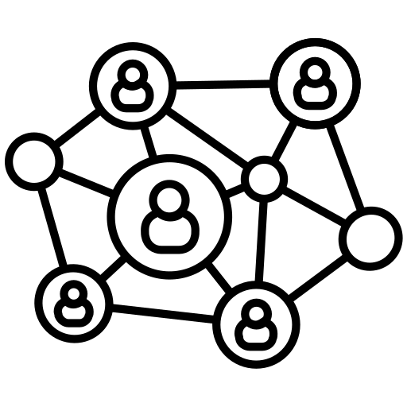
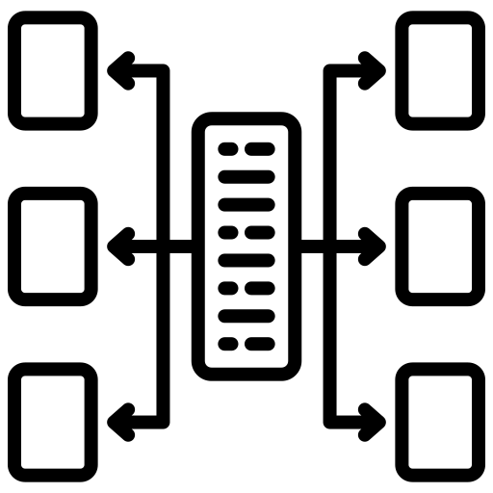


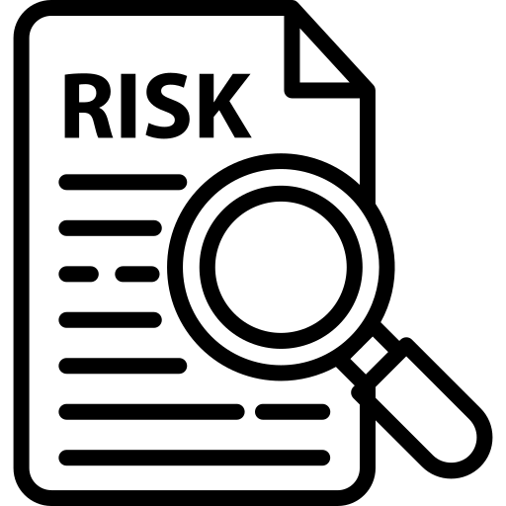
Addressing the service delivery gaps in national program
SERVICE DELIVERY GAP
ADDRESSED THROUGH
WECS not linked in the national program
Have more inconsistent use of condoms in sex practices
Engaging network operators in prevention response
Access for i-WECS to package of services catering individual needs
Harnessing social media & awareness campaigns to increase health seeking behaviour
Developing strong linkages to STI, HIV and other health programs
  Have inadequate knowledge about HIV and other safe sex practices
  Possess high risk of STIs and HIV
Notes:
The national program aims to accelerate reduction in new annual HIV infections through a basket of strategies tailored to the key population groups based on their vulnerability and risk.
When compared to WECS who access services under the national program, those who were not linked
- have more inconsistent use of condoms in various sexual activities
- have inadequate knowledge about HIV and other safe sex practices
These WECS are termed as “informal” women engaging in commercial sex work (i-WECS).
The gap in the service delivery were addressed through
Engagement of network operators in prevention response
Offering a package of services catering their individual needs
Harnessing the social media and awareness campaigns to increase health seeking behaviour
Developing strong linkages to STI, HIV and other health programs

Slide 7
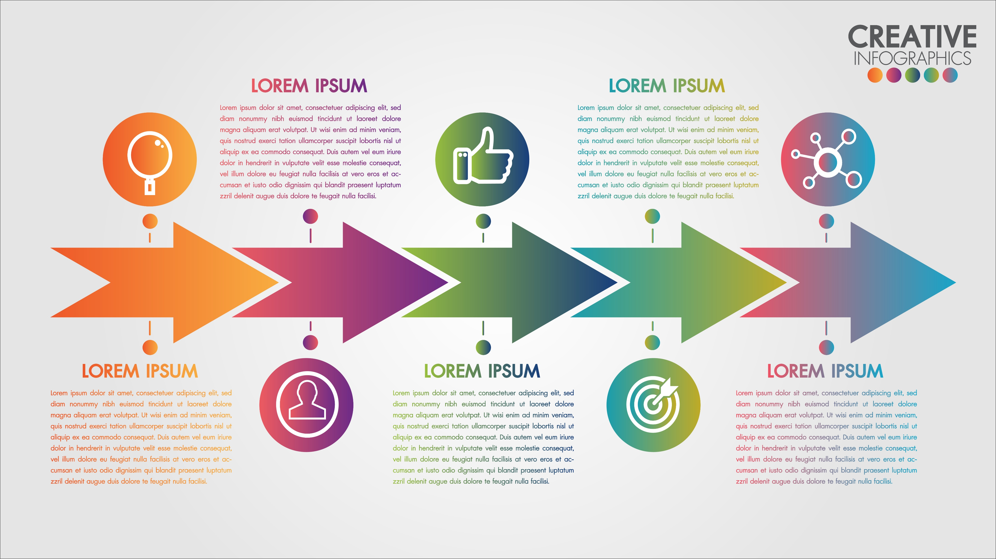
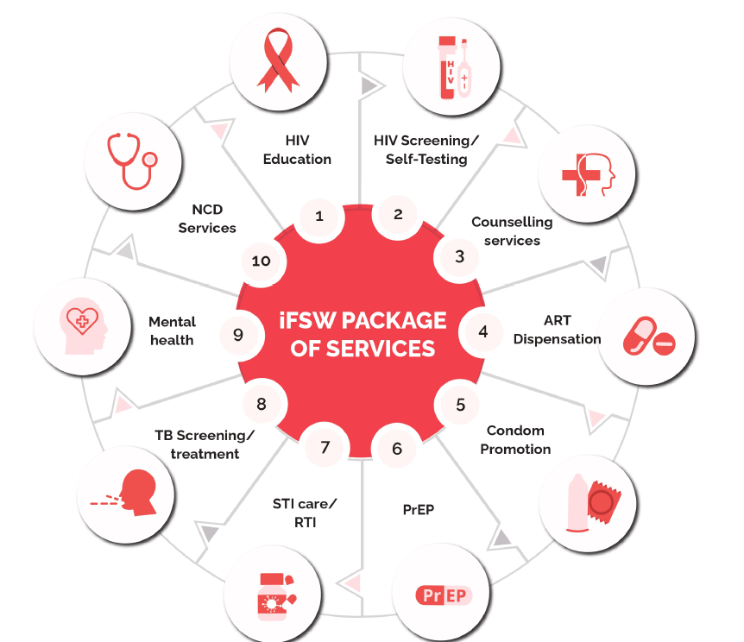
Implementation steps
Identifying network operators
Mapping the estimated population
Providing package of services
Networking & Linkages
Follow-up
Networks are intervention sites through which, the outreach activities are focused
i-WECS Package of Services
Notes:
The implementation steps include
Identifying the network operators and mapping the estimated i-WECS population through them
The i-WECS were then contacted and offered package of services suiting their individual needs
Adequate networking and linkages to various health services including HIV was ensured
Constant follow-up through NWOs ensured that the i-WECS registered in the program, get tested for HIV.
Core strategies
Developing networks as intervention sites through which the outreach activities are focused
Access for i-WECS to package of services catering individual needs.
Design and roll out social media and awareness campaigns to increase their health seeking behaviour.
Develop strong linkages to HIV and other health programs
Developing community-preferred private health care providers
The package of services include
HIV prevention education, counselling, testing and navigation to treatment
STI / RTI referral and care
Referral for TB screening / treatment
Referral for mental health, non-communicable disease (NCD) services

Slide 8
Lean, skilled, equipped: The efficiency edge
Staff structure
Capacity building on
Project coordinator oversees implementation
One Community Lay counsellor per district
Community mobilization
Basic counseling
Networking, and linkages support for health service delivery
Use of social media campaigns to raise awareness and promote service uptake
Job aids such as STI pamphlets, flyers, posters, and gifs, were developed to support the field team in delivering consistent and effective services
Job aids
Notes:
The project efficiently implemented the program through a lean staff structure of one Project Coordinator and one community lay counsellor per district.
A project coordinator oversees implementation, while community lay counsellors conduct outreach activities at the intervention areas.
Regular training sessions and capacity-building workshops ensured that the team is equipped with the necessary knowledge and skills in
- community mobilization
- basic counseling
- networking, and linkages support for health service delivery
- Use of social media campaigns like ‘know your status’ to raise awareness and promote service uptake
Job aids, such as STI pamphlets, flyers, posters, and gifs, were developed to support the field team in delivering consistent and effective services.

Slide 9
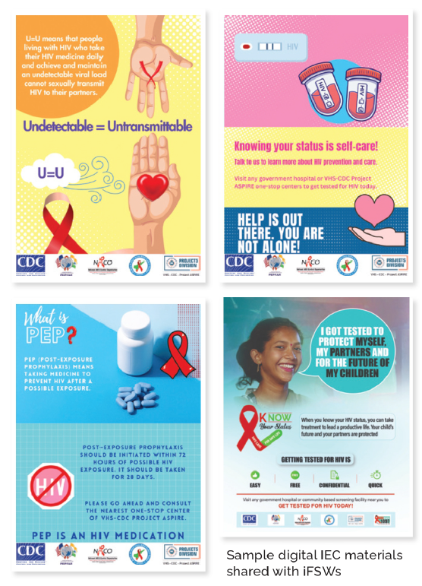
Demand creation through community-led approach
Demand creation
Virtual counseling for testing to those living in far-flung areas
Community based screening
Social media platforms for disseminating information
Mobilize young i-WECS for government health camps
Meetings at NWO residence
Continuous engagement with NWOs
Notes:
Virtual counseling to i-WECSs to motivate those living in far-flung areas for testing
Community based testing at the one-stop centers
Using social media platforms for reaching the i-WECS and disseminating information
Focusing on young i-WECS by organising health camps in collaboration with government health departments
Organising meeting at the network operators’ residence and continuous engagement with the network operators in seeking their opinions to enhance project efficacy and provide service effectively
Offering PrEP referral services through preferred private providers

Slide 10

Approaches adopted for bridging service delivery gaps
Earning trust of NWOs and i-WECS
Purposive outreach through comprehensive outreach plan and regular reviews
Continuous preventive education to i-WECS
Appropriate counselling and linkage with government for mental health related issues
Addressing the myths and misconceptions
PEOPLE CENTERED
EVIDENCE BASED
SUPPORTIVE SUPERVISION
Notes:
The project focus and adopt people-centered, evidence-based, supportive supervision during its implementation.
Following are the approaches adopted for bridging the service delivery gaps:
- Earning trust of network operator and i-WECS
- Purposive outreach through comprehensive outreach plan
- Addressing the myths and misconceptions is important and urgent.
- Enhancing the knowledge levels of i-WECS through continuous dissemination of key messages related to HIV, STI, condom use, etc
- Appropriate counselling and linking with government to mental health related issues like depression, anxiety, self-pity, etc

Slide 11

Community voices
“Everyone who works like us have entered this business willingly to earn some additional monies. Our dependency on network operator is high and we have to keep her also in good humor as much as we keep our clients satisfied” - i-WECS
“Reaching i-WECS through network operators is a good idea that allowed the sex workers to feel more relaxed, open to talk and share their experiences, Network operator facilitated the reach and helped us in motivating the i-WECS for testing also” – community staff
Notes:
This slide exhibits the community voices as verbatim
“Everyone who works like us have entered this business willingly to earn some additional monies. Our dependency on network operator is high and we have to keep her also in good humor as much as we keep our clients satisfied” - i-WECS
Reaching i-WECS through network operators is a good idea that allowed the sex workers to feel more relaxed, open to talk and share their experiences, Network operator facilitated the reach and helped us in motivating the i-WECS for testing also” – community staff managing i-WECS program

Slide 12
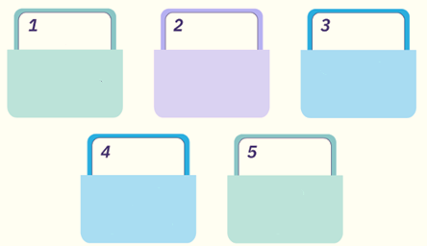
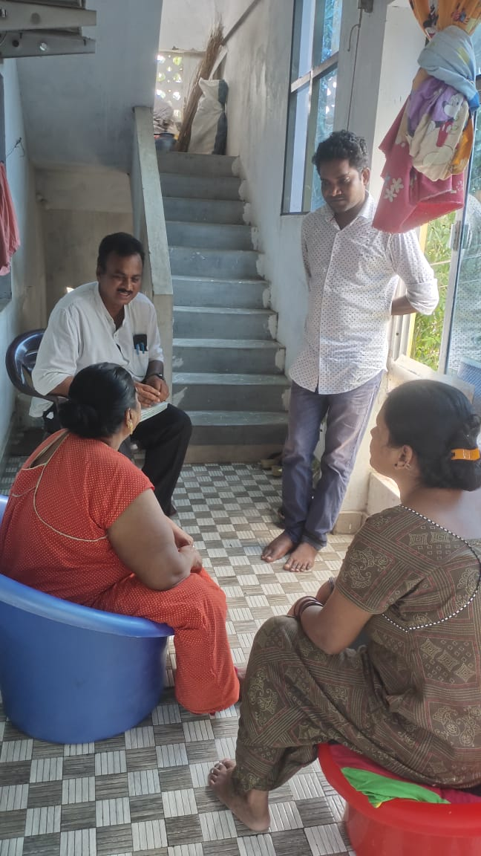
Differentiated model of building intervention into the community, led to significant coverage of i-WECS
i-WECS registered
Prevention education
Tested
4689 (100%)
3391 (72%)
95% of the i-WECS are reached through NWOs
4689
Linked to ART
Positive
313 (9%)
305 (97%)
Period: May 2022 – March 2025
Prevention education to informal WECS
Notes:
During the period May 2022 to March 2025, 4689 i-WECS registered and all of them were offered prevention education.
Among the 3391 (72%) who were tested for HIV, 313 (9%) were detected as positives and 305 (97%) were linked to life-saving ARV treatment.
It is worth to mention that 95% of the i-WECS were reached through NWOs.

Slide 13
Vital to reach early & test young i-WECS
to prevent spread
20-34 yrs
Test: 2,837 (84%) Positives: 107 (4%)
84% of the individual are identified and tested in the age group 20-34 years
High positivity of 29% among older i-WECS who were left out
HTS_TST-3,391, HTS_POS-313 (9%)
Period : May 2022 to March 2025
Notes:
It is vital to reach and test early. Under the i-WECS intervention, around 2837 (84%) of the individuals tested were in the age group 20-34 years and 107 (4%) were detected HIV positives.
It is equally important to test the i-WECS who otherwise would have been left out in the HIV response. A high positivity of 29% that was found among the 35-39 years confirms this statement.

Slide 14



Understanding characteristics of i-WECS is essential to design
Marital Status
Registered
Tested
Found positive
Link to ART
Married
4457 (95%)
3291 (74%)
309 (9%)
301 (97%)
232 (5%)
100 (43%)
4 (4%)
4 (100%)
50% took 27.7 days while the remaining 50% took 1-2 days from registration to undergoing HIV testing
n=4689
Notes:
Women engaging in commercial sex work who are not soliciting in the traditional physical domains, but through virtual and network-based client solicitation and adopted for i-WECS implementation was an effective and results-oriented approach to reach uncovered populations and provide access to HIV services.
A total of 520 network operators were identified, through reach the 4,689 i-WECS, facilitating access to HIV services.
82% of i-WECS are operating sex work through network operators within the district
Among those reporting informal WECS, the duration of engagement varies: 82% have been involved for 1-2 years, 17% for 1-5 years, and 2% for more than 5 years.
84% of the individual are identified and tested in the age group 20-34 years and 4% positivity
Marital status analysis among i-WECS under the intervention reveals that 95% are married
Almost 50% of the i-WECS take an average 27.7 days from registration to undergoing HIV testing.

Slide 15

Lessons learned
Listening exercise is vital to capture lived experiences of i-WECS - informs the program
Tapping NWOs effective to mobilize & motivate for testing
Prevention education empowers i-WECS to access services
i-WECS DSDM critical to close gaps among KPs
Effective intervention to reach WECS seeking anonymity soliciting clients through networks and virtual medium
Case-based approach is necessary to provide services tailored to the needs of i-WECS
Notes:
It is vital to capture the lived experiences that informs the program’s key strategies
This is an effective intervention to reach those women who seek anonymity and solicit clients through network and through virtual medium
The NWOs are to be effectively tapped and motivated for mobilizing the WECS for HIV testing
Prevention education empowers the WECS to access services
A case-based approach is necessary to provide services tailored to the needs of i-WECS.

Slide 16



Challenges
Follow-up for HIV testing
(average time 27.7 days from registration to testing)
Identifying network operator is a challenge as they fear their identity may get revealed among the society
Outreach among all the NWOs of a specific geography is a challenge considering the distance
Due to anonymous nature, follow-up through NWOs – difficult and time consuming
Mitigation measures
Mitigation measures
Mitigation measures
Mitigation measures
Outreach testing ensuring confidentiality
Improving access - Integrating with local govt testing facilities
Creating trust and assurance of confidentiality
Sharing STI related information and importance of their role
Importance of micro outreach plan like cluster approach based on the geographies for outreach team
Building trust & confidence
Intensifying follow-up
Notes:
Average time taken for i-WECS from registration to HIV testing is 27.7 days. Follow-up of i-WECS for HIV testing is a challenge. Improving the access by integrating with existing government testing facilities could reduce the time.
Identifying network operator is a challenge as they fear their identity. Building trust and assuring them confidentiality, explaining the importance of STIs.
Considering the distance of a geography, outreach follow-up with all the NWOs is a challenge. This can be overcome through effective outreach micro-plans
Due to the anonymous nature, follow-up of i-WECS through NWOs for preventive education and other HIV services, remains a challenge. This could be overcome by intensifying follow-up and building trust and confidence.

Slide 17

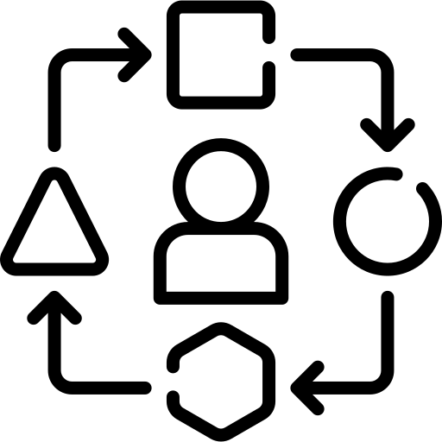


Recommendations
This intervention is critical so as to reach those population with higher risk to HIV and STI and having high vulnerabilities
Feasible and effective strategy complementing program efforts
The simplified processes can be replicated in the national program
Notes:
The intervention is demonstrated as a feasible and effective strategy complementing the program efforts for prevention, testing and life-saving ARV treatment.
The intervention is critical so as to reach those with higher risk to HIV and STI and having high vulnerabilities
The process adopted is simple to adapt and can be replicated in the national program.

Slide 18
Acknowledgement
We express our thanks to
U.S. PEPFAR – CDC
Government of India
Government of Andhra Pradesh
&
Communities
13 – 17 July • Kigali, Rwanda
ias2025.org

Slide 19

Thank you

