Slide 1
Outcomes from a Community-led Monitoring (CLM) Intervention in Malawi and South Africa
D. Kamkwamba, Network of Journalists Living with HIV, Malawi
Co-Authors: G. Oberth, K. Lauer, J. Bozinovski, D. Mseu, H. Kachepatsonga, M. Soboyisi, D. Mnkandla, M. de Vos & S. Baptiste

Slide 2

The Citizen Science Approach
THE IMPACT – More men living with HIV know their status
ITPC’S COMMUNITY-LED MONITORING MODEL
Notes:
What was the intervention?
a) We engaged clinic committees to help us find solutions.
b) They encouraged the Ward-based Outreach Teams to conduct health talks for women of childbearing age.
c) They also advocated for the enhanced use of the NHLS LabTrak—a system used to telephonically trace unreachable recipients of care—to monitor foreign nationals visiting the clinics.
d) Finally, we worked with facility managers to implement a practice of documenting reasons for late ANC visits in patient files.

Slide 3
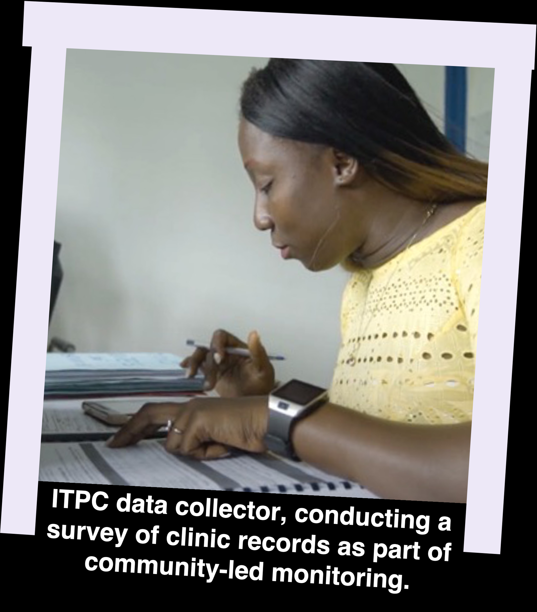
The Citizen Science Project – At a Glance
2 Countries: Malawi and South Africa
6 Partners: ITPC (Project Lead), NACOSA (South Africa Lead), Access Chapter 2 (South Africa Implementer), Rotanganedza Care Center (South Africa Implementer), MANERELA+ (Malawi Lead), JONEHA (Malawi Implementer)
33 Health Facilities:
  14 in Malawi (eight in Kasungu and six in Dedza)
  19 in South Africa (all in the West Rand)
  INCLUDING: 6 non-governmental service providers (2 in Malawi and 4 in South Africa)
58 Data Collectors, 40 of whom are PLHIV, key populations, or young people.
989,848 Service Users in the facility catchment areas
4 Years of continuous monitoring (November 2020 – October 2024)
50+ Indicators: 30+ indicators in Malawi and 20+ indicators in South Africa.
  Qualitative (KIIs and FGDs) and quantitative (monthly clinic records surveys)

Slide 4





Top-line CLM Outcomes in 2023 – MALAWI
People accessing ART at sites with a CLM-informed DSD strengthening intervention were six times more likely to be in a DSD model (6.79 OR 95% CI 6.04-7.63) and twice as likely to be virally suppressed (2.34 OR 95% CI 2.16-2.54) as sites without DSD strengthening.
The number of HIV tests among young sex workers doubled (from 217 in 2022 to 434 in 2023), as did HIV positivity (from 1.7% to 2.4%), following CLM engagements with district hospitals to designate key population focal points and KP clinic spaces.
CLM data was used to engage District Condom Coordinators and train condom distributors, which led to a 23.4%
increase in condom distribution in 2023. This contributed to fewer new infections in the two districts, which fell from 868 in 2022 to 632 in 2023.
CLM advocacy secured a commitment from the Global Fund to procure 50 new GeneXpert machines. As a result, 39% of TB tests at our CLM sites in 2023 were Xpert tests, up from 18% in 2022. People diagnosed with TB and enrolled onto treatment nearly tripled, from 320 in 2022 to 907 in 2023.
Following CLM advocacy to expand static VMMC sites, the proportion of circumcisions among men aged 15 years and older increased from 77% in 2022 to 82% in 2023. According to the Naomi model, there were 205 new HIV infections among men in this age group in the two districts in 2023, down from 284 in 2022.

Slide 5
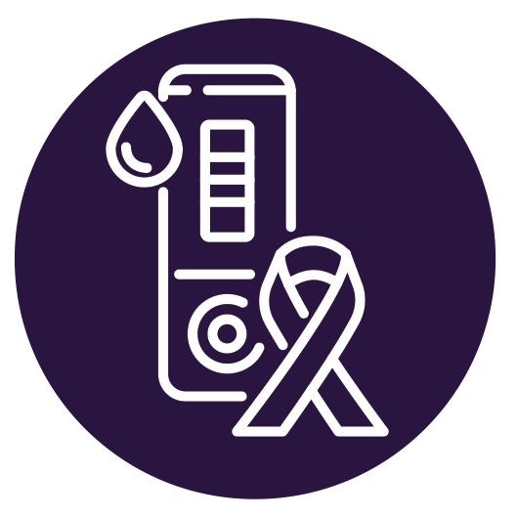




Top-line CLM Outcomes in 2023 – SOUTH AFRICA
Following PrEP-related CLM feedback sessions with facility managers, people who visited our 19 monitored sites were 32% more likely to initiate PrEP following an HIV test compared to the other 70 West Rand health facilities (1.32 OR 95% CI 1.27-1.38).
The percentage of older men living with HIV who know their status increased from 86.8% in 2022 to 88.9% in 2023, following a CLM data-driven campaign to increase community-led HIV testing from 20.4% in 2022 to 33.6% in 2023 (UN target achieved).
After using CLM data to alleviate stockouts of TB medicines, the treatment success rate at our CLM sites increased from 88% in 2022 to 91% in 2023, surpassing the End TB target of 90% by 2025 as well as South Africa’s national treatment success rate of 79%.
Enhanced patient tracking for pregnant foreign nationals was implemented based on CLM insights. In 2023, women at our monitored sites were twice as likely to deliver in the health facility as compared to other West Rand facilities (1.99 OR 95% CI 1.51-2.62), reducing risk of vertical transmission.
When CLM data suggested HIV/SRHR service integration would increase HIV testing uptake (r = 0.36, p = < 0.001), we promoted this approach. In 2023, the cost to diagnose one AGYW living with HIV was cheaper at our CLM sites, at $2,852, compared with $4,154 at non-CLM sites (in terms of numbers needed to test).

Slide 6


CLM In Focus — Malawi
Increasing Viral Load Suppression by Promoting Differentiated ART Service Delivery Models

Slide 7

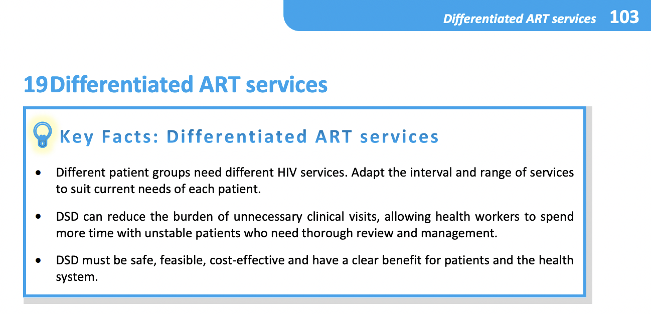
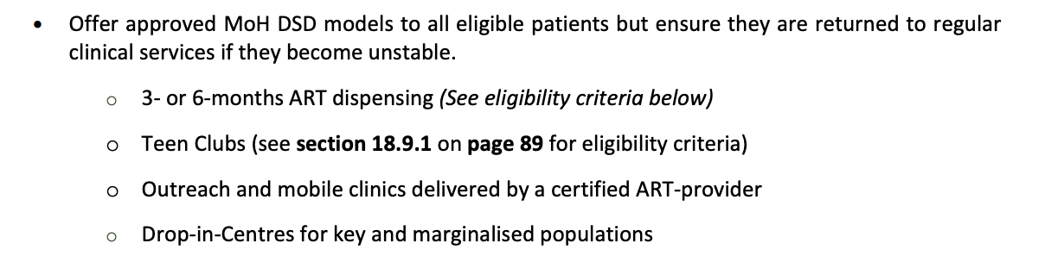
THE ISSUE – Differentiated service delivery coverage is limited
THE ISSUE – Differentiated service delivery coverage is limited
  Differentiated service delivery (DSD) models have been shown to improve viral load suppression (Long et al., 2020).
  In Malawi, DSD guidelines exist but coverage of DSD models remains low.
  There is a need to scale up enrollment in DSD models to improve treatment outcomes.
Source: Malawi 2022 Guidelines for Clinical Management of HIV in Children and Adules https://www.differentiatedservicedelivery.org/wp-content/uploads/Malawi-Clinical-HIV-Guidelines-2022-edition-5.pdf
Notes:
What was the intervention?
a) We engaged clinic committees to help us find solutions.
b) They encouraged the Ward-based Outreach Teams to conduct health talks for women of childbearing age.
c) They also advocated for the enhanced use of the NHLS LabTrak—a system used to telephonically trace unreachable recipients of care—to monitor foreign nationals visiting the clinics.
d) Finally, we worked with facility managers to implement a practice of documenting reasons for late ANC visits in patient files.

Slide 8
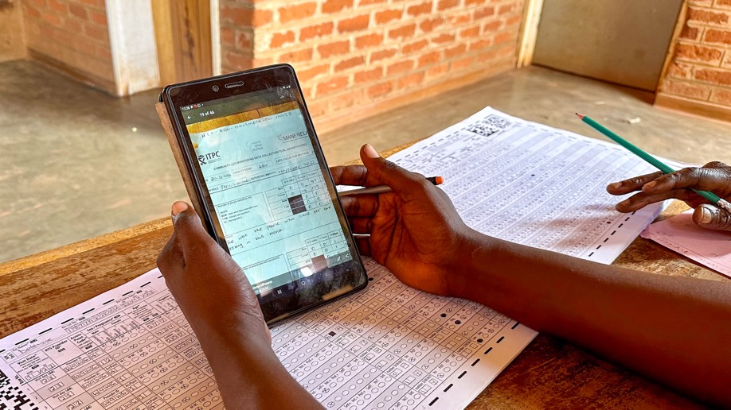
THE INSIGHT – Facilities need support to implement DSD guidelines
THE INSIGHT – Facilities need support to implement DSD guidelines
We monitored those accessing ART through DSD models, including 6-month dispensing, teen clubs, after hours, and alternative pick-up points.
In January 2023, just 2,936 people were enrolled in a DSD model out of 10,837 people on ART at our 14 monitored sites (27% coverage).
Despite being part of Malawi’s HIV Clinical Guidelines since 2018, one healthcare worker told us in May 2022, “We have not started providing services by using differentiated service delivery” (male 48, healthcare worker, MW03, 25 May 2022).
Another spoke about avoidance of healthcare: “This has also affected DSD, as we are failing to reach the targeted groups” (female nurse, 23, 7 October 2022, MW08).
There were clearly gaps on both the supply and demand side for DSD, and a need to strengthen this approach.
Photo: Citizen Science data collectors analysing HIV registers at the Bua Health Center in Kasungi, Malawi, April 2023
Notes:
What was the intervention?
a) We engaged clinic committees to help us find solutions.
b) They encouraged the Ward-based Outreach Teams to conduct health talks for women of childbearing age.
c) They also advocated for the enhanced use of the NHLS LabTrak—a system used to telephonically trace unreachable recipients of care—to monitor foreign nationals visiting the clinics.
d) Finally, we worked with facility managers to implement a practice of documenting reasons for late ANC visits in patient files.

Slide 9
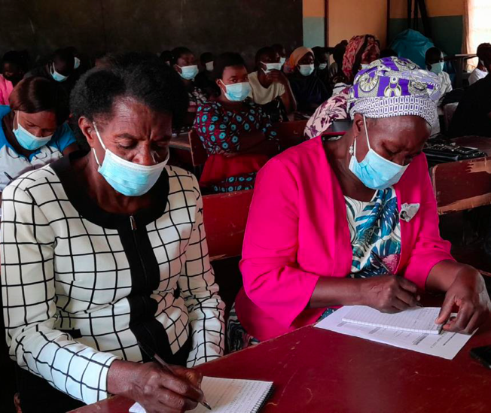
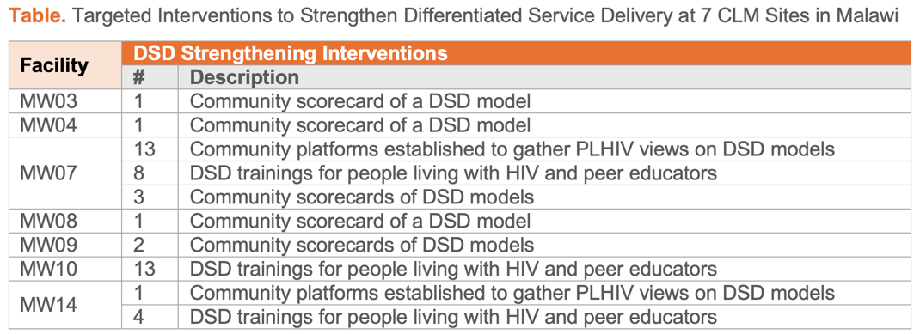
THE INFLUENCE – Funding mobilized for DSD strengthening interventions
THE INFLUENCE – Funding mobilized for DSD strengthening interventions
We used our CLM data to mobilize additional funding from ViiV Positive Action, with a main focus on increasing access to differentiated service delivery for adolescent mothers living with HIV.
“This is a brainchild of the CLM findings”, according to CLM implementers in Malawi.
With this additional funding, we supported three DSD strengthening interventions in 7 of our 14 monitored sites (Table). We supported the establishment of 14 community-level platforms aimed at gathering the views of people living with HIV on various DSD models, organized 25 trainings for peer educators and people living with HIV on DSD, and implemented 8 community score cards and/or client satisfaction surveys for DSD.
Photo: CLM data feedback session & training for people living with HIV on differentiated service delivery models in Kasungu District, September 2022.
Notes:
What was the intervention?
a) We engaged clinic committees to help us find solutions.
b) They encouraged the Ward-based Outreach Teams to conduct health talks for women of childbearing age.
c) They also advocated for the enhanced use of the NHLS LabTrak—a system used to telephonically trace unreachable recipients of care—to monitor foreign nationals visiting the clinics.
d) Finally, we worked with facility managers to implement a practice of documenting reasons for late ANC visits in patient files.

Slide 10
THE IMPACT – DSD coverage and viral load suppression improved
THE IMPACT – DSD coverage and viral load suppression improved
TABLE. Odds Ratio for DSD Access Based on Exposure to DSD Strengthening Interventions, December 2023 (6.79 OR 95% CI 6.04-7.63)
Facilities with DSD
  By December 2023, people accessing ART at facilities with a DSD strengthening intervention were six times more likely to be in a DSD model (6.79 OR 95% CI 6.04-7.63).
  As a proportion of total viral load tests done, people at the DSD strengthening sites were twice as likely to be virally suppressed than at sites without DSD strengthening (2.34 OR 95% CI 2.16-2.54).
 | Facilities with DSD strengthening Interventions | Facilities without DSD strengthening Interventions
People accessing ART though a DSD model | 2,290 | 334
People accessing ART through standard care | 17,389 | 17,221
Notes:
Why was the DSD enrollment so low?
Both a “supply” and a “demand” issue:
Supply side: Despite being part of Malawi’s HIV Clinical Guidelines since 2018, one healthcare worker told us in May 2022, “We have not started providing services by using differentiated service delivery” (male 48, healthcare worker, MW03, 25 May 2022).
Demand side: Another healthcare worker spoke about avoidance of healthcare: “This has also affected DSD, as we are failing to reach the targeted groups” (female nurse, 23, 7 October 2022, MW08).
There were clearly gaps on both the supply and demand side for DSD, and a need to strengthen this approach.
In 2023, in collaboration with the HIV Coverage, Quality, and Impact Network (CQUIN), we supported three DSD strengthening interventions in 7 of our 14 monitored sites:
Established 14 community-level platforms aimed at gathering the views of people living with HIV on various DSD models
organized 25 trainings for peer educators and people living with HIV on DSD, and
implemented 8 community score cards and/or client satisfaction surveys for DSD.

Slide 11

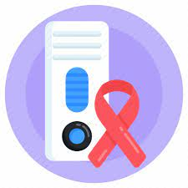
CLM In Focus — South Africa
Diagnosing More Men Living with HIV Through Early Achievement of the 2025 Targets on Community-led Service Delivery

Slide 12
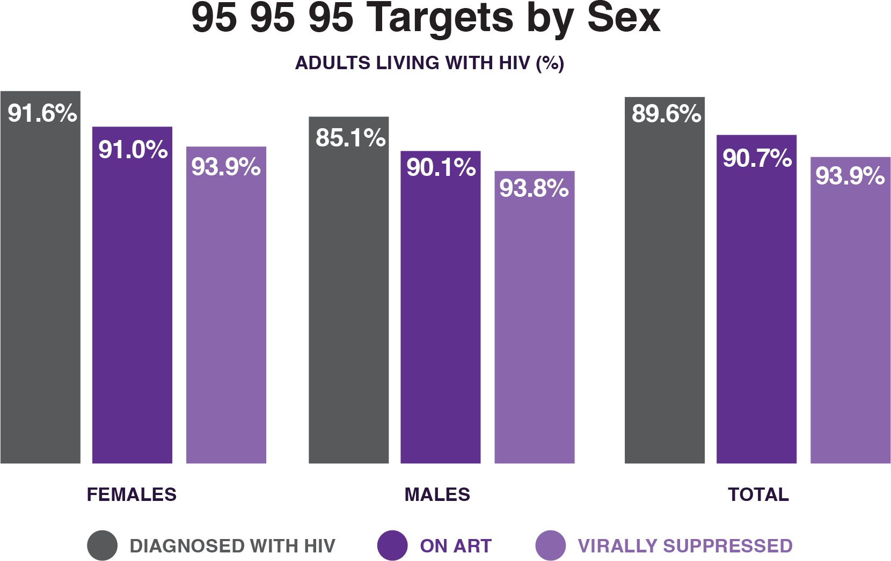
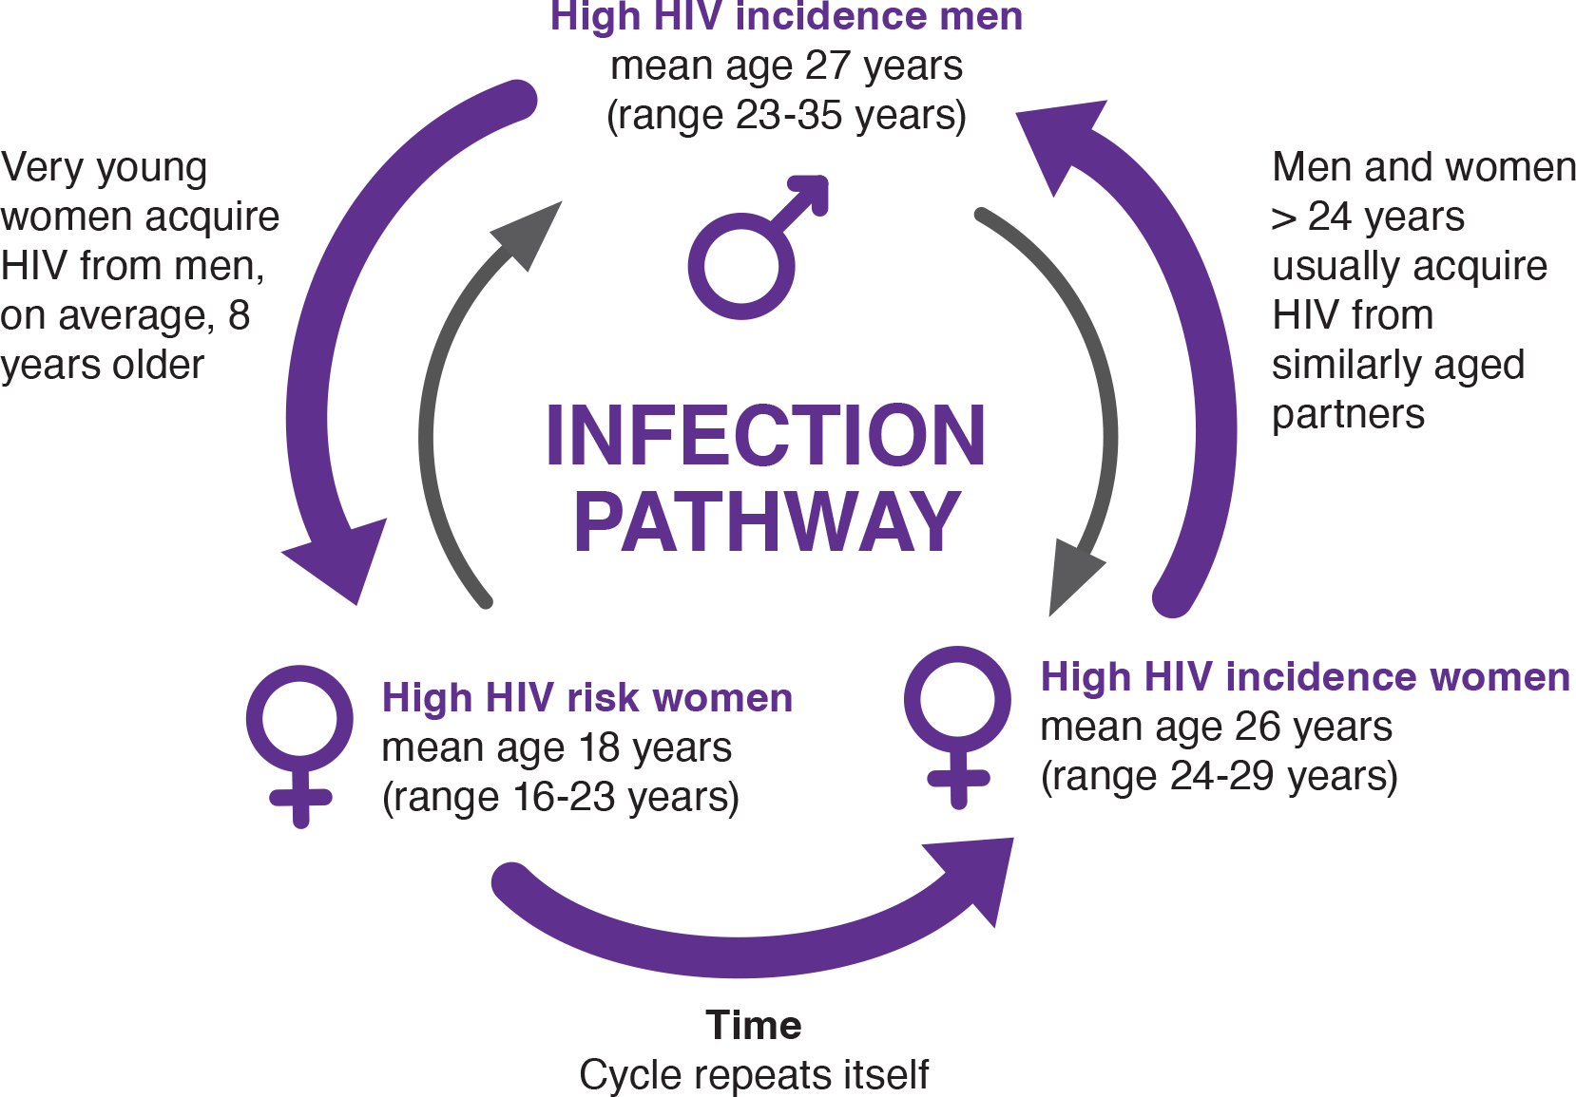
THE ISSUE – Men living with HIV have low knowledge of their status
Men have a poor treatment cascade compared to women. The main gap for men is with HIV testing.
Low ART coverage and viral load suppression among men in their late 20s/early 30s has been shown to perpetuate a cycle of transmission to adolescent girls and young women.
Source: 2022 SABSSM VI https://hsrc.ac.za/special-projects/sabssm-survey-series/sabssmvi-media-pack-november-2023/
To achieve epidemic control, it is critical to increase testing, treatment, and viral suppression among this group.
Source: NSP 2017-2022 https://www.gov.za/sites/default/files/gcis_document/201705/nsp-hiv-tb-stia.pdf
Notes:
What was the intervention?
a) We engaged clinic committees to help us find solutions.
b) They encouraged the Ward-based Outreach Teams to conduct health talks for women of childbearing age.
c) They also advocated for the enhanced use of the NHLS LabTrak—a system used to telephonically trace unreachable recipients of care—to monitor foreign nationals visiting the clinics.
d) Finally, we worked with facility managers to implement a practice of documenting reasons for late ANC visits in patient files.

Slide 13
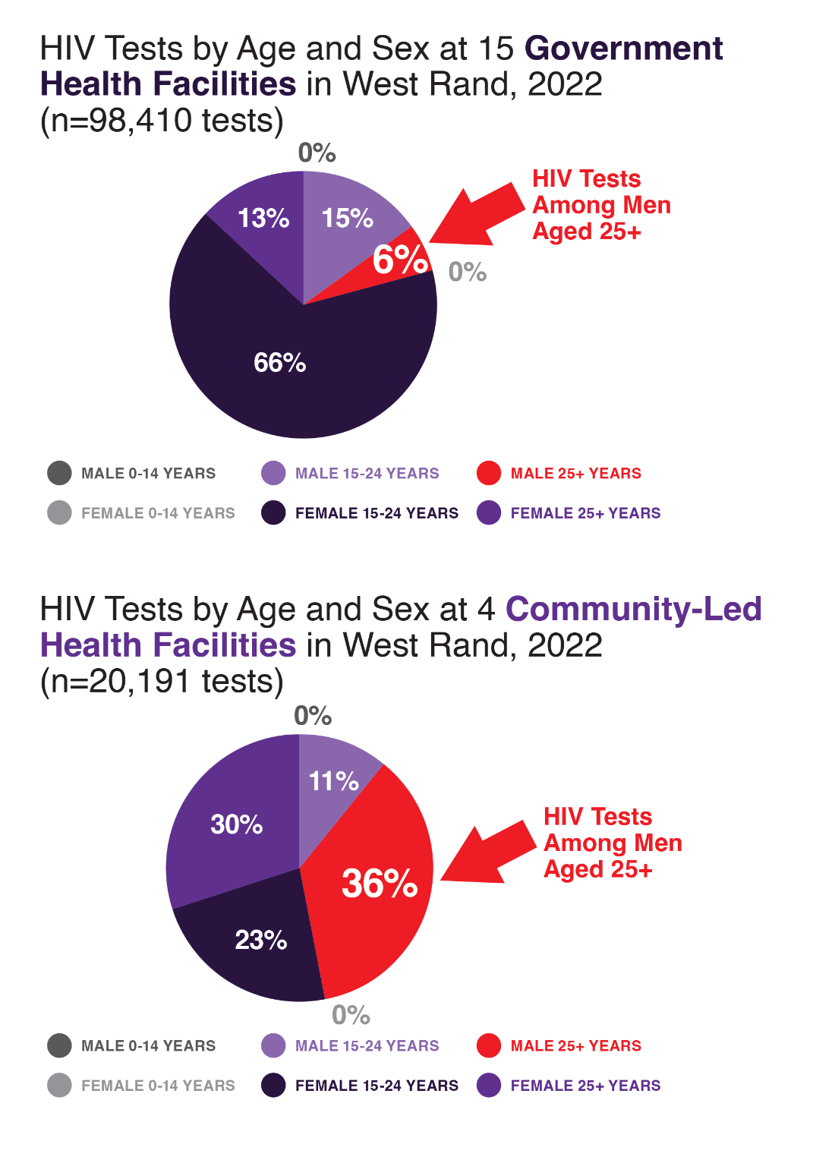
THE INSIGHT – Men prefer community-led HIV testing sites
Through our CLM, we discovered a strong preference for community-led HIV testing services among men aged 25 years and older.
At our monitored government sites, just 5.6% of HIV tests in 2022 were among men aged 25 years and older, compared to 35.5% of tests at our monitored community-led sites.
We also discovered that community-led testing was below target across our monitored sites: just 20.5% of HIV tests in 2022 were done by community-led implementers, below the UN target of 30% by 2025.
We performed a sub-analysis of the 47 interview transcripts among men aged 25-34 years to understand their barriers to HIV testing. Participants expressed views that the non-governmental organizations are ‘specialists’ in HIV testing, so they prefer to go there (male, 30, ZA14, 19 July 2022).
Increasing community-led testing appeared to be a good strategy to reach and diagnose more men living with HIV.
Notes:
What was the intervention?
a) We engaged clinic committees to help us find solutions.
b) They encouraged the Ward-based Outreach Teams to conduct health talks for women of childbearing age.
c) They also advocated for the enhanced use of the NHLS LabTrak—a system used to telephonically trace unreachable recipients of care—to monitor foreign nationals visiting the clinics.
d) Finally, we worked with facility managers to implement a practice of documenting reasons for late ANC visits in patient files.

Slide 14
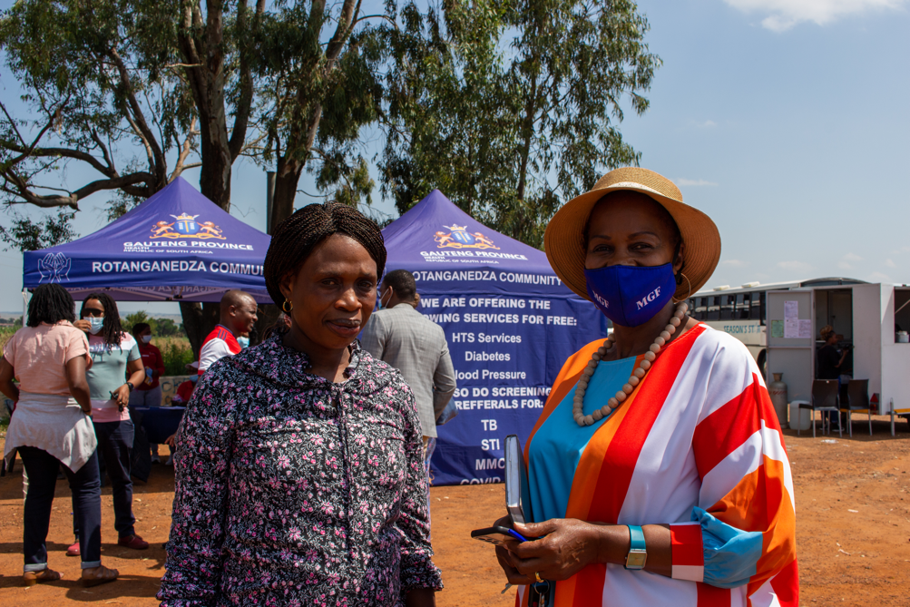
THE INFLUENCE – Advocacy to scale up community-led HIV testing
THE INFLUENCE – Advocacy to scale up community-led HIV testing
In the following year, we used our CLM data to further promote community-led HIV testing among older men, engaging local government officials and recommending the strategic placement of community-led testing sites along busy transport routes, reaching long-distance truck drivers.
We also advocated for health facilities to distribute more test kits through community organizations with whom they work in partnership.
Photo: Citizen Science CLM implementer, Caroline Tiba (Rotanganedza Community Care) (left) with local government HIV secretariat member Lulu Kotobe Sosibo (right) at the RCC community-led testing site at the busy intersection 5 minutes from Badirile Clinic in West Rand, South Africa (February 2022). This testing site strategically targets men by being situated at a busy intersection with a truck stop, and by offering integrated services for men including HIV testing alongside TB, diabetes and blood pressure screening.
Notes:
What was the intervention?
a) We engaged clinic committees to help us find solutions.
b) They encouraged the Ward-based Outreach Teams to conduct health talks for women of childbearing age.
c) They also advocated for the enhanced use of the NHLS LabTrak—a system used to telephonically trace unreachable recipients of care—to monitor foreign nationals visiting the clinics.
d) Finally, we worked with facility managers to implement a practice of documenting reasons for late ANC visits in patient files.

Slide 15
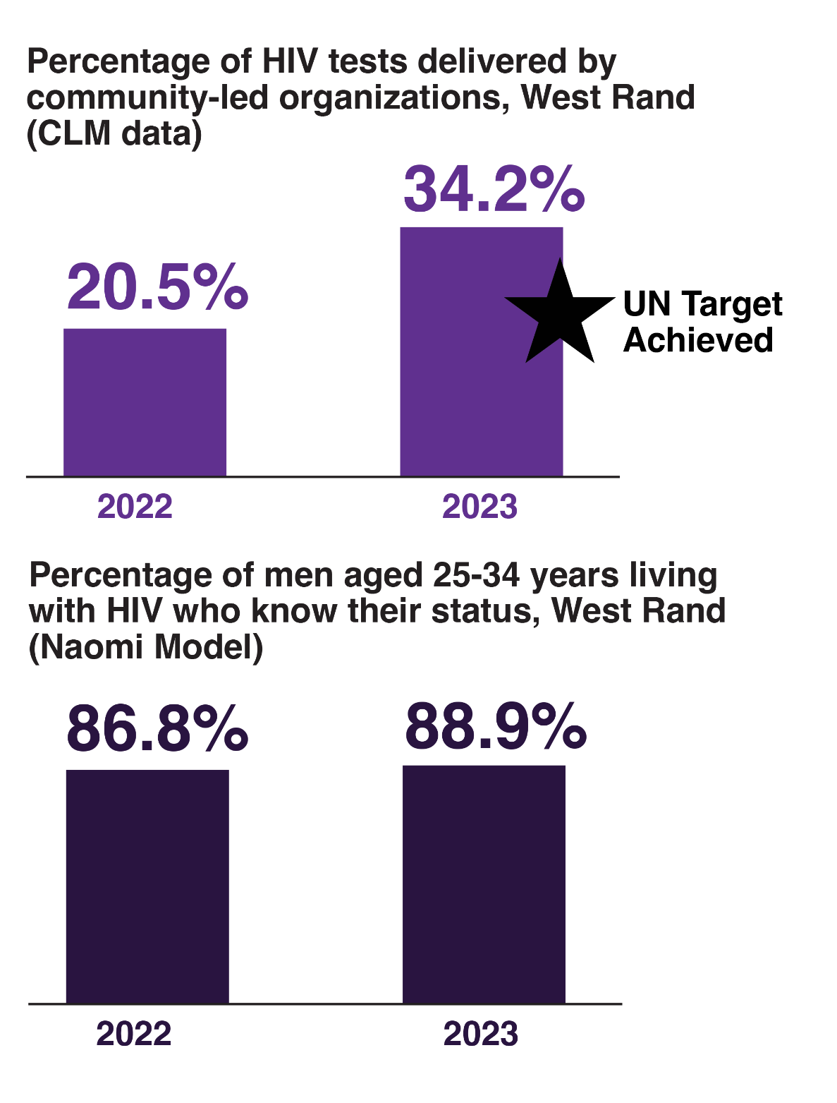
THE IMPACT – More men living with HIV know their status
THE IMPACT – More men living with HIV know their status
The district prioritized community-led testing in 2023.
The number of HIV tests at community-led sites more than doubled, from 20,191 in 2022 to 46,891 in 2023, while testing at government sites declined slightly, from 98,410 in 2022 to 89,896 in 2023.
Community-led testing at our monitored sites increased from 20.5% in 2022 to 34.2% in 2023.
This demonstrates early achievement of the UN target of 30% by 2025.
As a result, more older men accessed HIV testing services.
The percentage of men aged 25-34 years in the West Rand with HIV who know their status increased from 86.8% in 2022 to 88.9% in 2023 (Naomi Model estimates).
Notes:
What was the intervention?
a) We engaged clinic committees to help us find solutions.
b) They encouraged the Ward-based Outreach Teams to conduct health talks for women of childbearing age.
c) They also advocated for the enhanced use of the NHLS LabTrak—a system used to telephonically trace unreachable recipients of care—to monitor foreign nationals visiting the clinics.
d) Finally, we worked with facility managers to implement a practice of documenting reasons for late ANC visits in patient files.

Slide 16
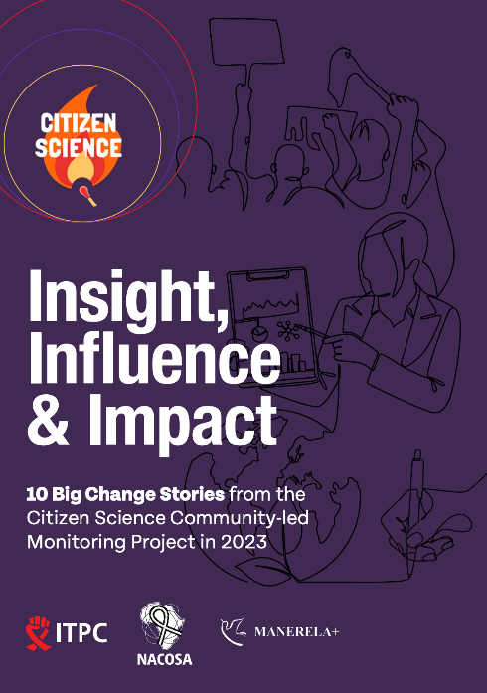
THANK YOU!
VISIT US AT:
www.clmhub.org
www.itpcglobal.org
CONTACT
admin@itpcglobal.org
Insight, Influence & Impact:
10 Big Change Stories from the Citizen Science Community-Led Monitoring Project in 2023
LINK TO REPORT: itpcglobal.org/resource/insight-influence-impact-clm-report/
Notes:
What was the intervention?
a) We engaged clinic committees to help us find solutions.
b) They encouraged the Ward-based Outreach Teams to conduct health talks for women of childbearing age.
c) They also advocated for the enhanced use of the NHLS LabTrak—a system used to telephonically trace unreachable recipients of care—to monitor foreign nationals visiting the clinics.
d) Finally, we worked with facility managers to implement a practice of documenting reasons for late ANC visits in patient files.

