Slide 1
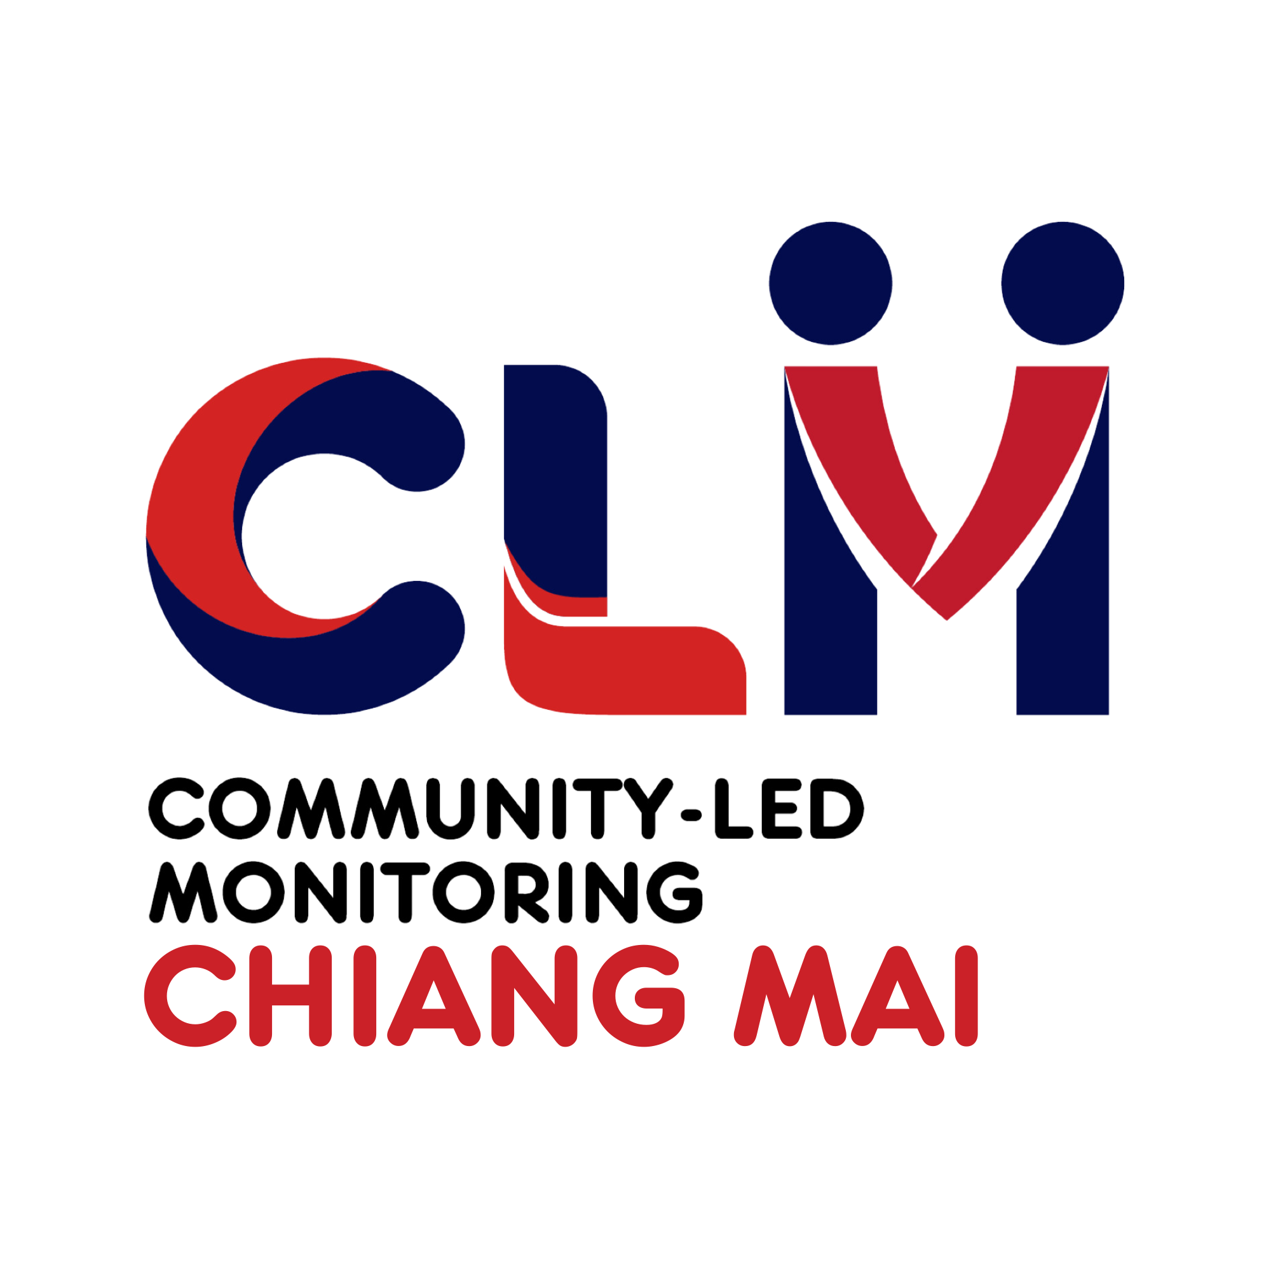
Advancing HIV Service Quality Through Community-Led Monitoring System in Chiang Mai, Thailand
Thursday, July 17, 2025 (10.45 am - 11.45 am)
Satayu Sittikarn, CAREMAT Foundation, Thailand
S Sittikarn¹, C Wongwaiphanit¹, P Patpeerapong², L Mahawan³, S Sangtong³,
K Khomkaew³, P Palee³, P Chaisopa³, K Singchaichit ³, S Janla³, N Suwanphatthana³, K Sirisup⁴,
S Santayakul⁴
1.Caremat Foundation, Chiang Mai, Thailand 2.MPLUS Foundation, Chiang Mai, Thailand 3.Chiang Mai Community-Led Monitoring Committee, Chiang Mai, Thailand 4.FHI 360, Bangkok, Thailand

Slide 2
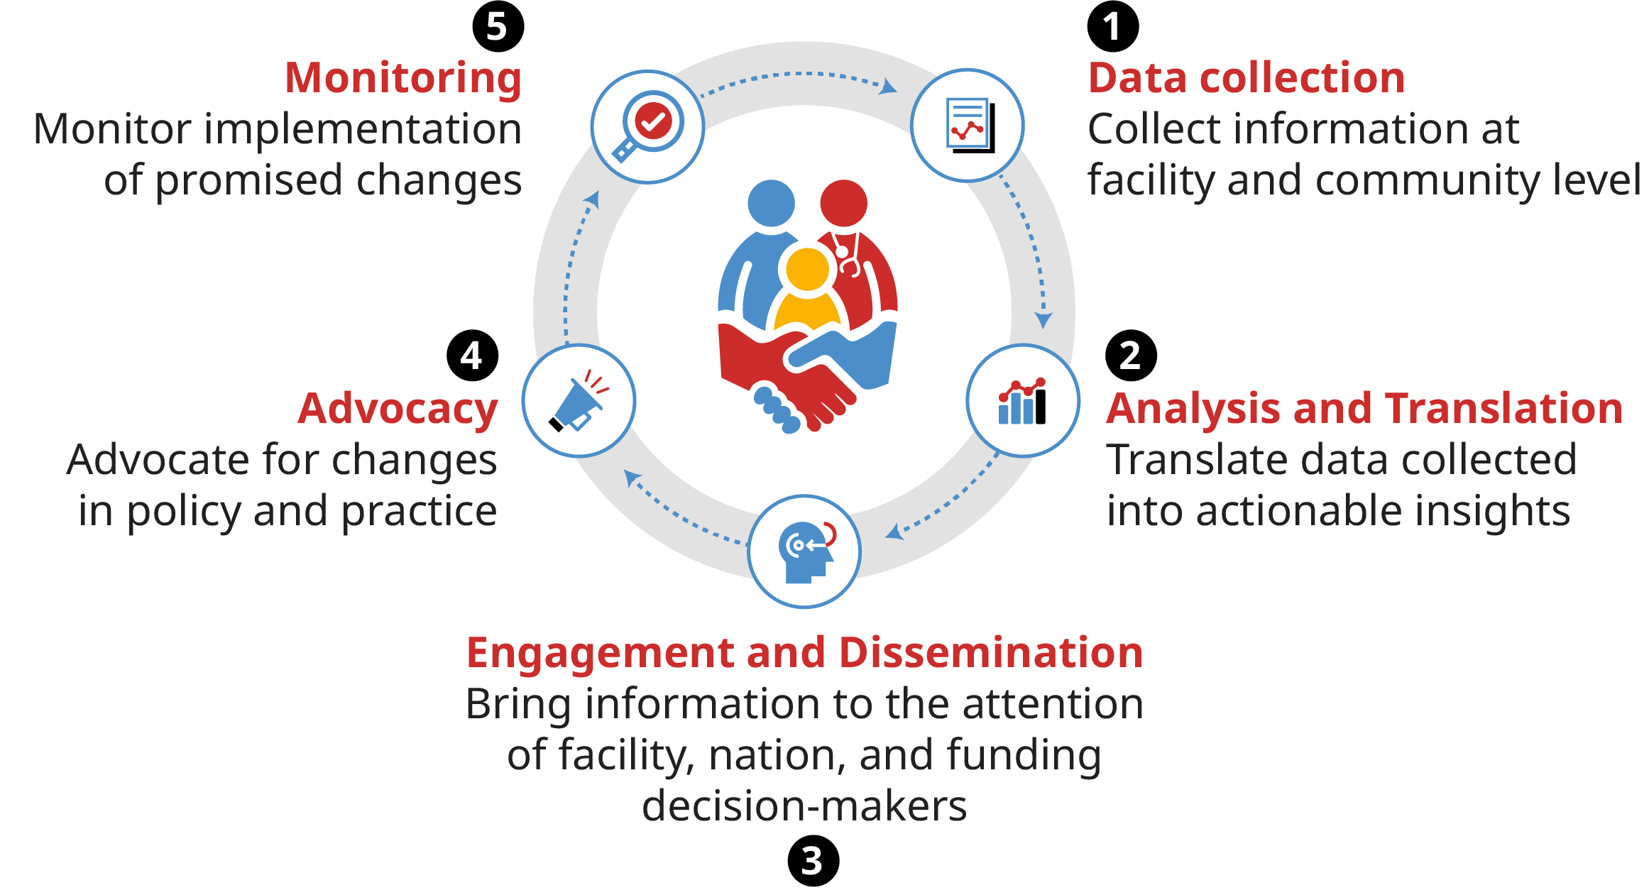
Community-Led Monitoring Overview
Accountability mechanism for HIV response, led and implemented by local community organizations of people living with HIV, networks of at-risk populations, and other affected groups to monitor trend of service quality.
Provides evidence of what works well, what is not working and what needs to be improved through client satisfaction and feedback.
Routine data collection for ongoing quality assurance and quality improvement.
The Community-Led Monitoring (CLM) Cycle
Credit: https://healthgap.org/wp-content/uploads/2020/02/Community-Led-Monitoring-of_Health-Services.pdf

Slide 3
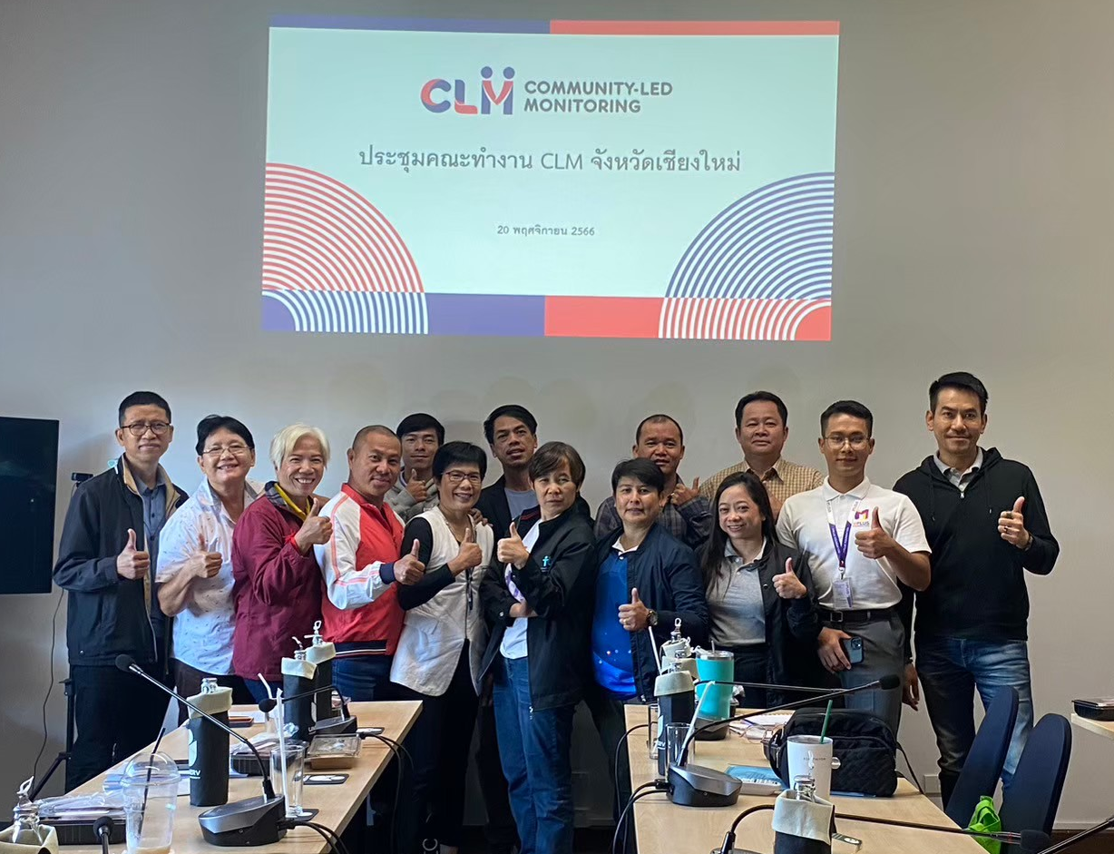
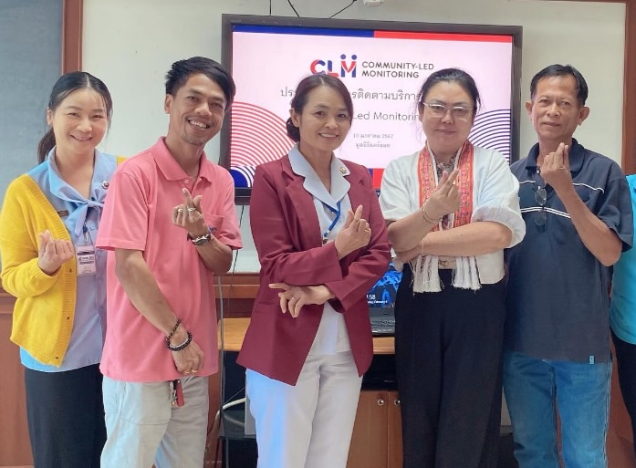
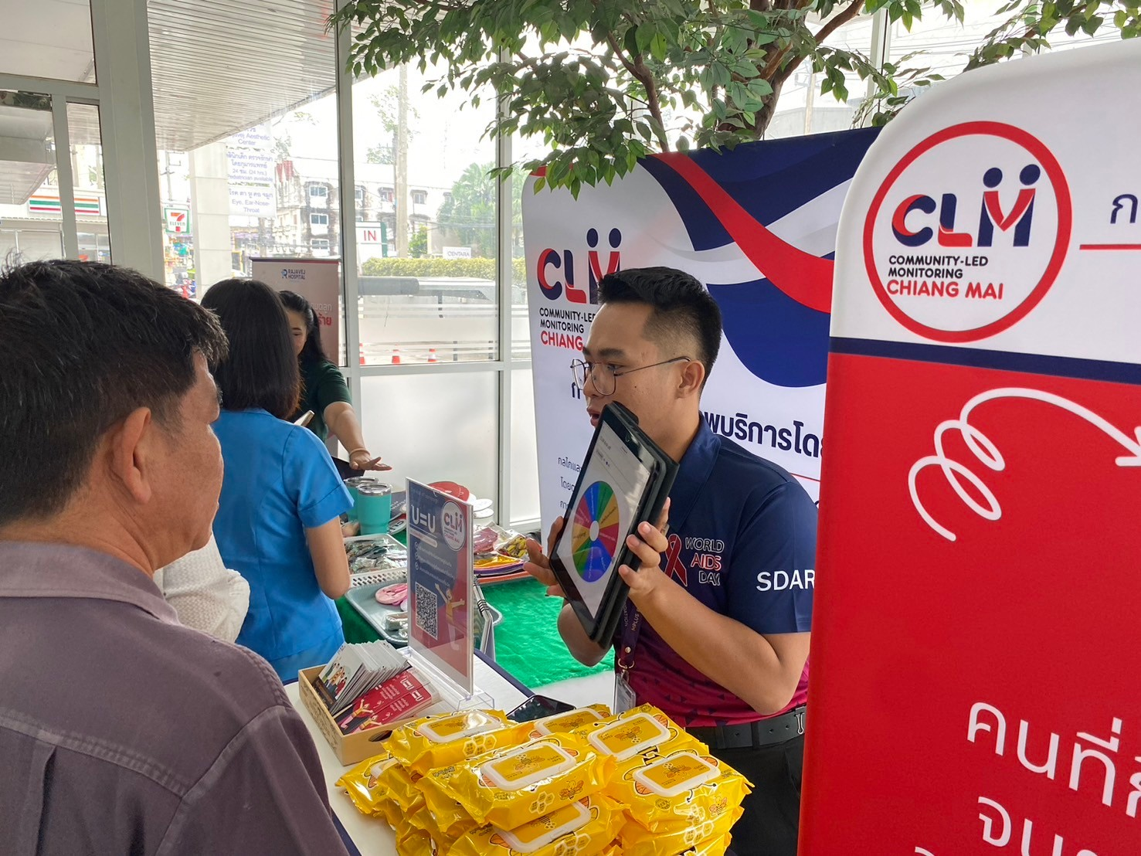
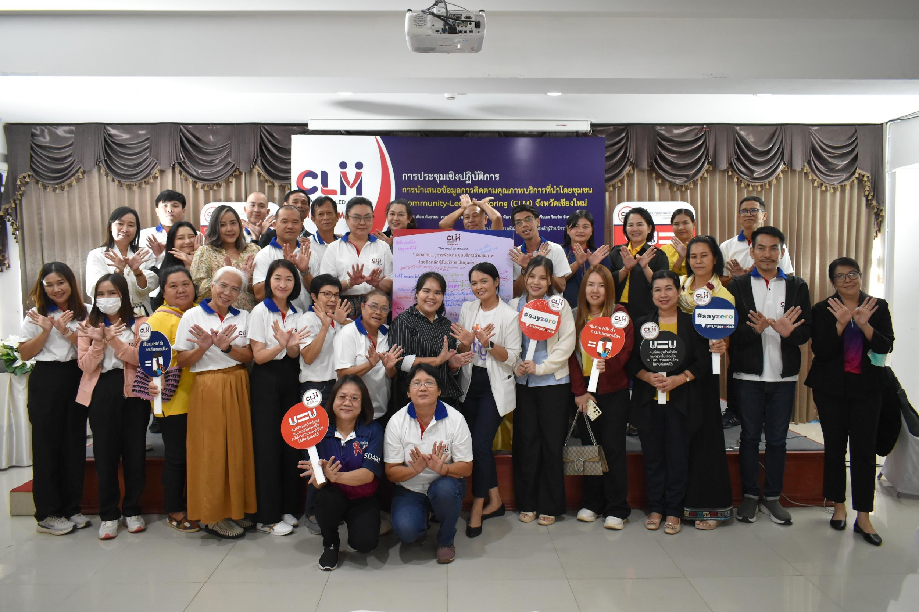
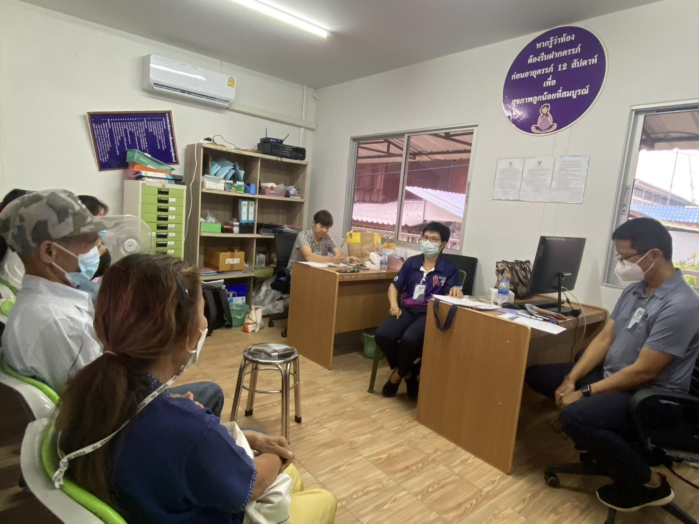
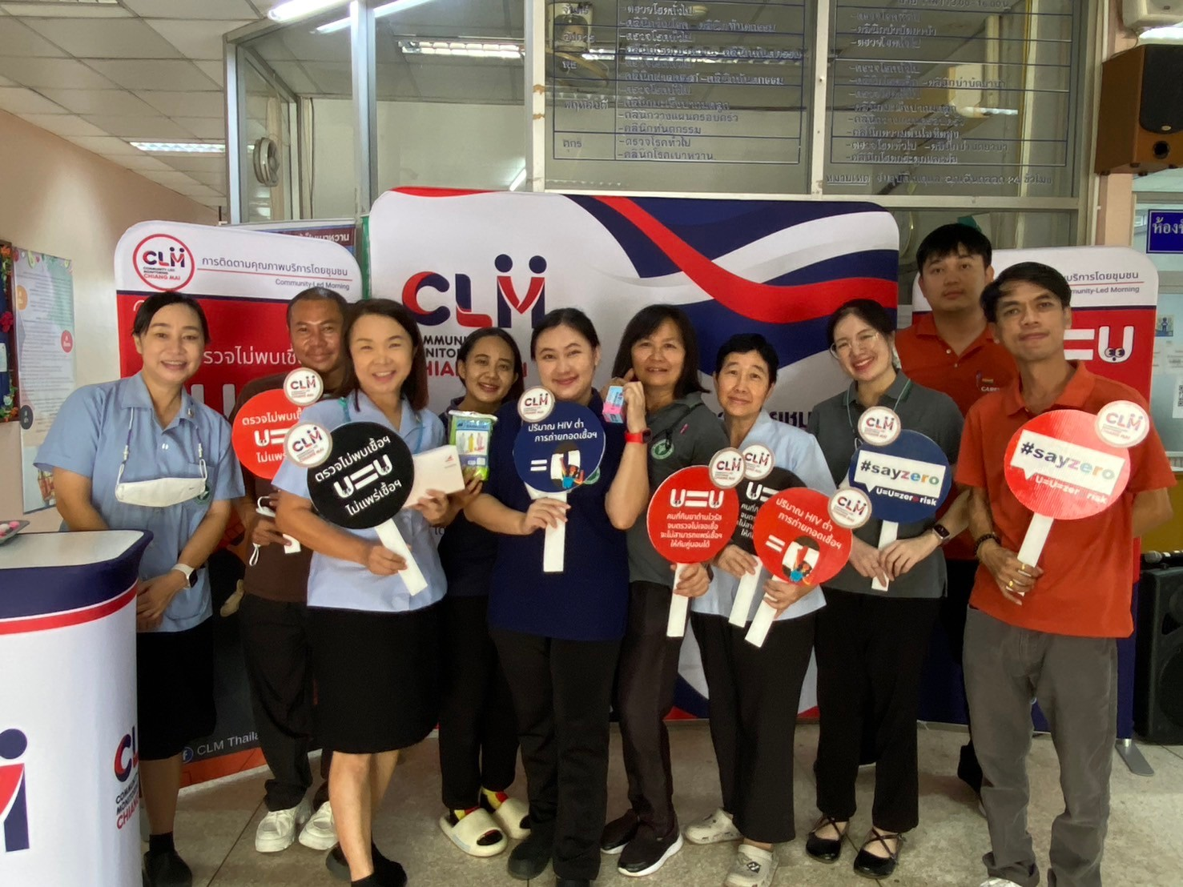
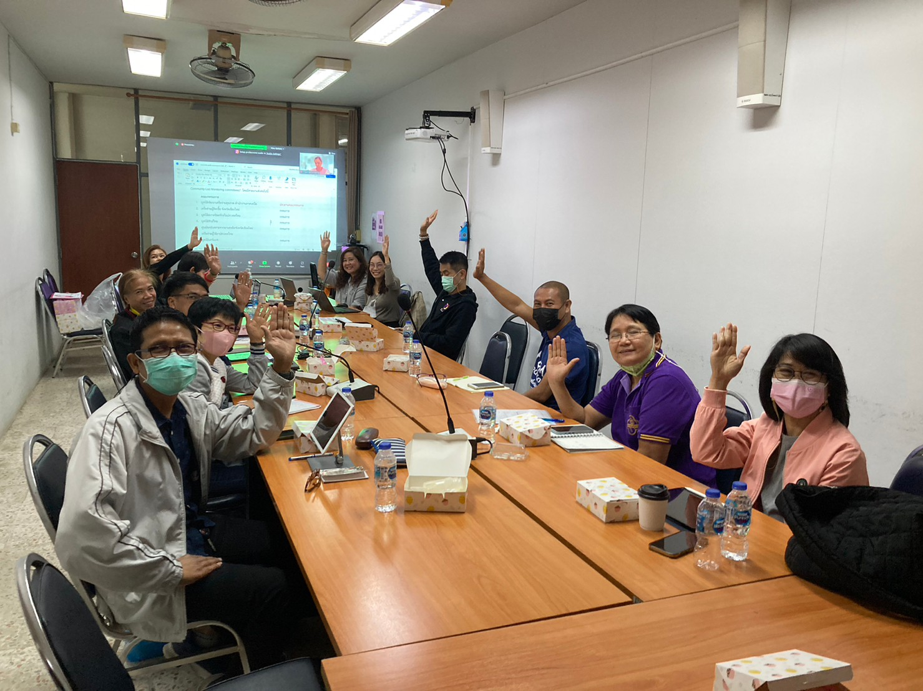
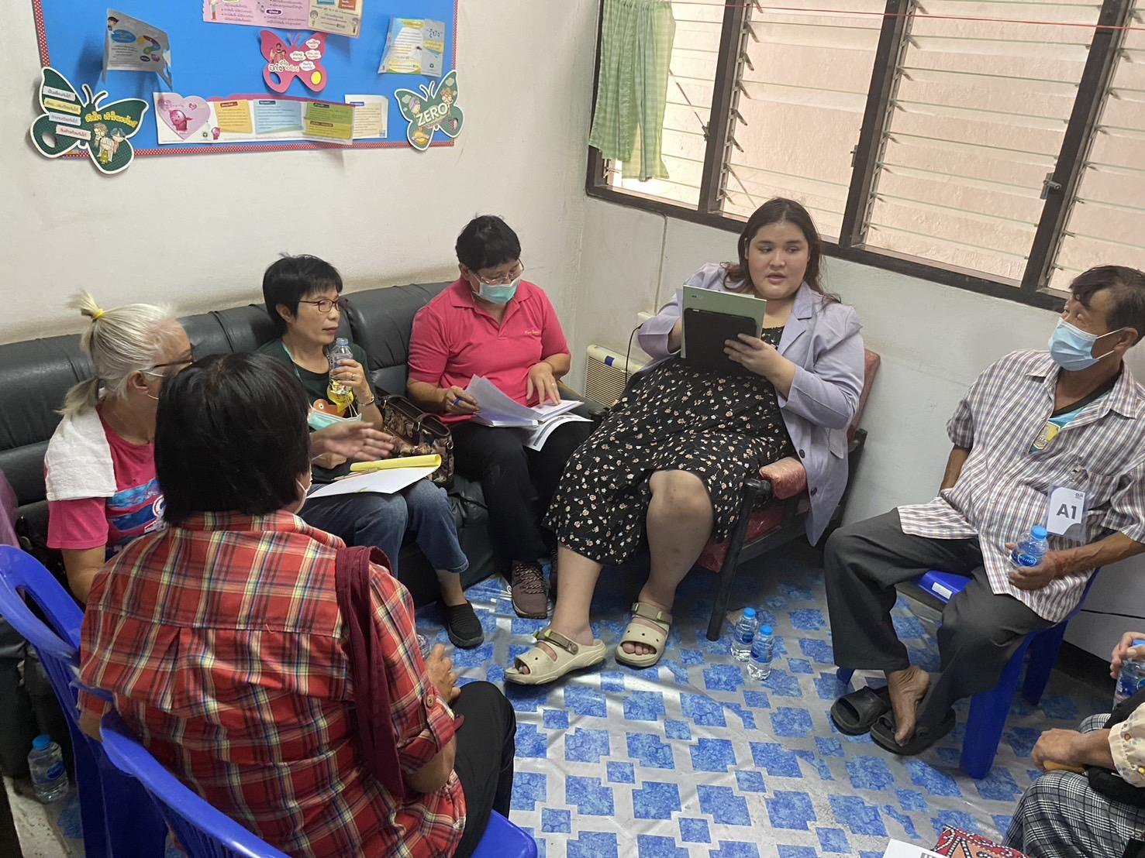
Community-Led Monitoring
Partnerships and Roles
In January 2022, civil society and representatives of at-risk populations, including people living with HIV (PLHIV), launched a people-centered CLM system in Chiang Mai, Thailand.
The initiative brought together 17 committee members and 21 hospitals to improve service quality based on the evolving needs of at-risk populations.
Chiang Mai CLM leverages quality monitoring data to improve HIV services based on local needs, demonstrating meaningful community participation toward ending AIDS in Thailand.
Core activities included defining CLM activities and timelines, developing CLM questionnaire, collecting and analyzing data, and working with healthcare facilities to interpret results and to implement improvement plans.

Slide 4






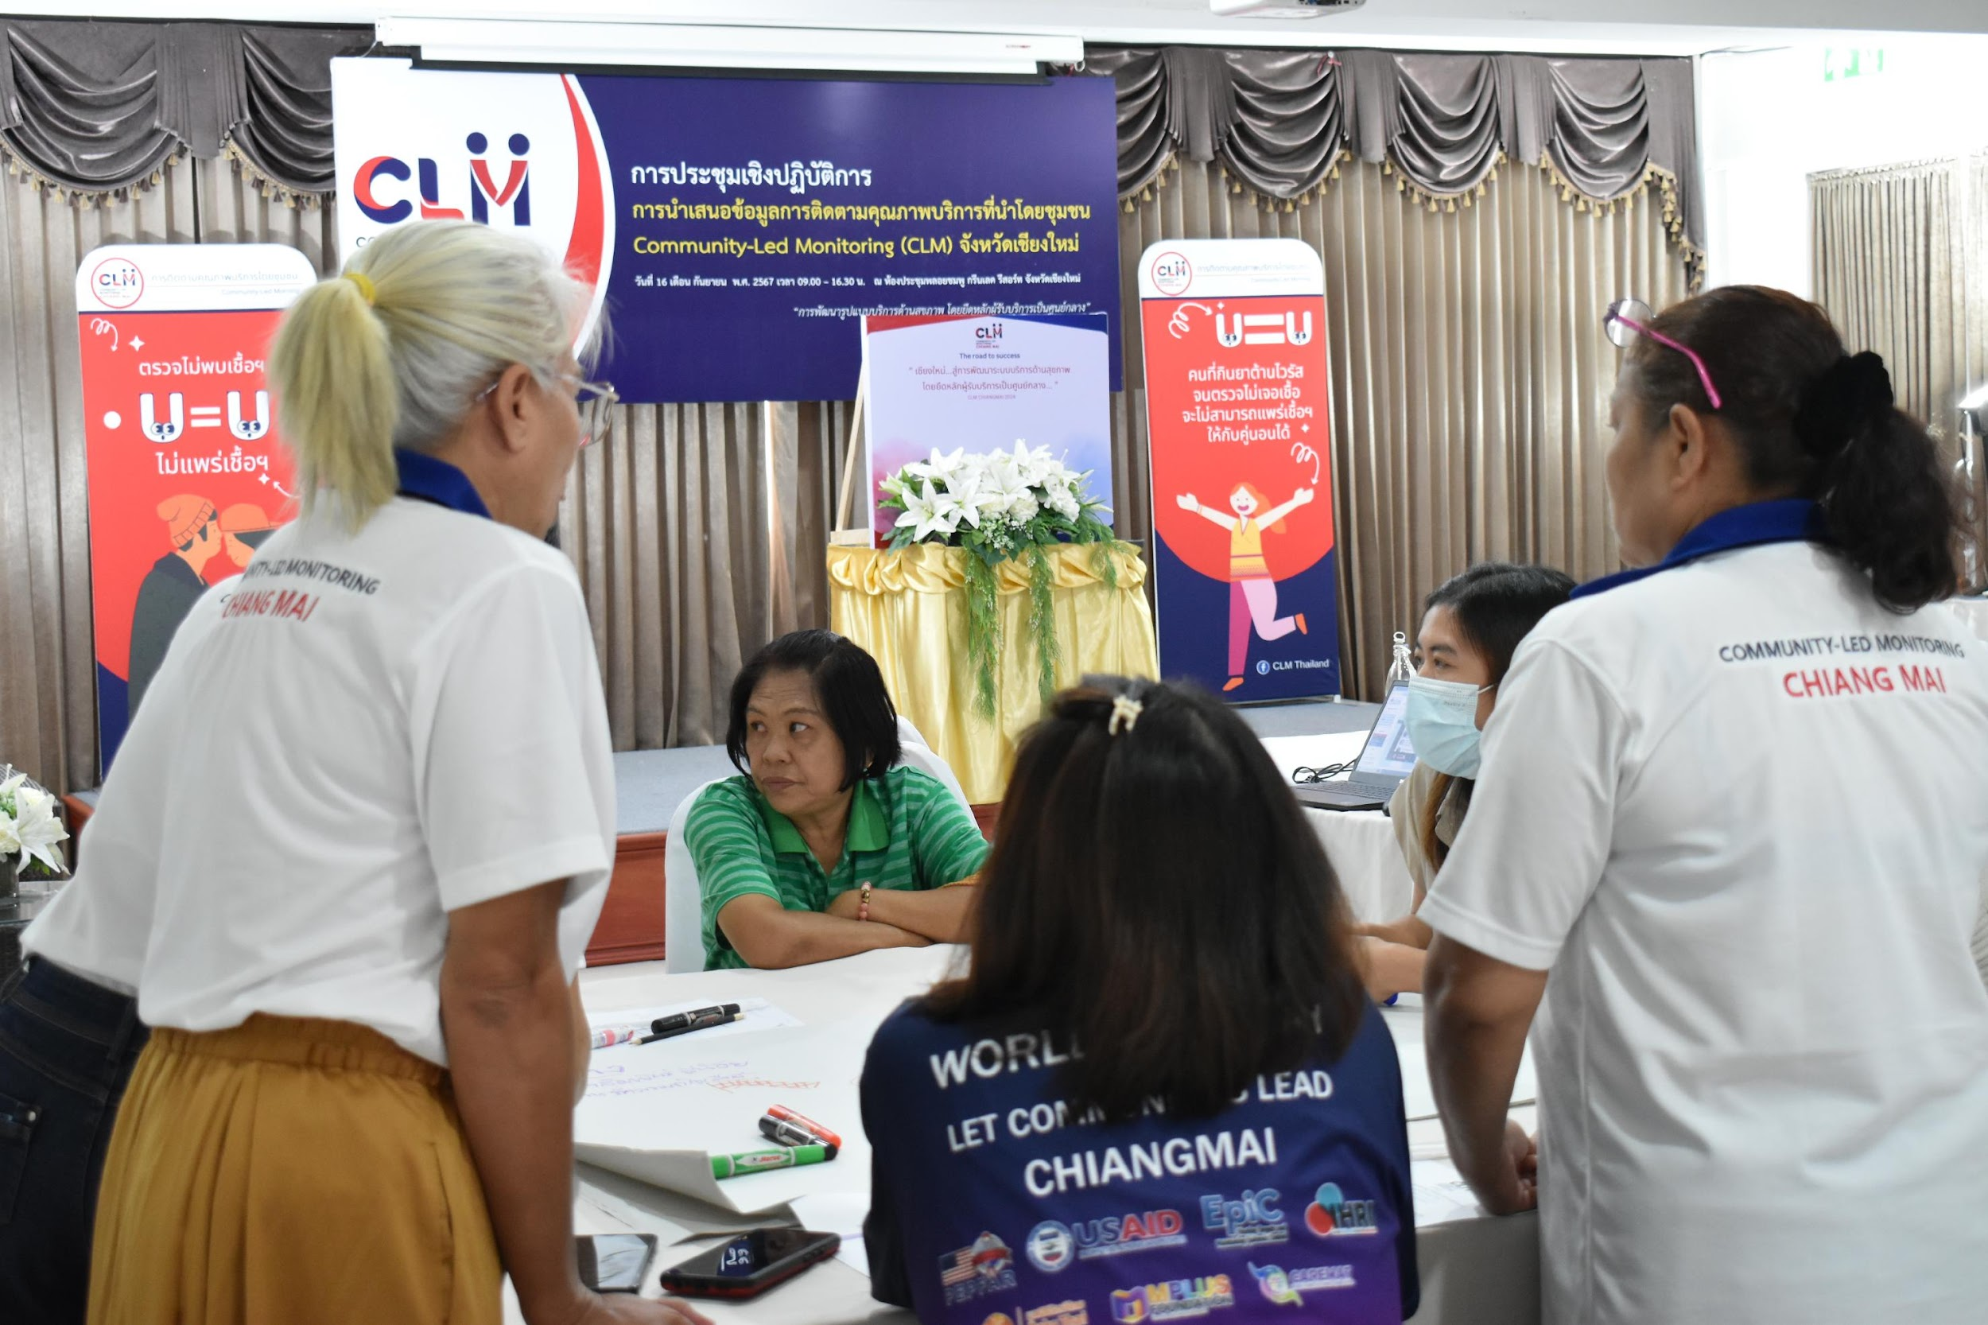






Data Collection and Analysis
Collected data on following topics
Populations and sites
MSM, TGW, SW, PWID, Male, Female
1 facility (2022)
8 facilities (2023)
13 facilities (2024)
VCT (HIV testing, PrEP, PEP, condoms, lubricants and index testing)
Stigma and discrimination
Basic statistical methods such as frequency, percentage, and content analysis.
Treatment services (ARV, VL, MMD, DSD and U=U), STIs
Management issues: hours, confidentiality, safety and security, and complaints
Data analysis methods
Number of responses collected from clients who received HIV services in Chiang Mai (2022-2024)
1,995
1,297
(ART service)
(VCT service)
471
44
27
135
(STIs service)
(MMT service)
(PrEP service)
(PEP service)
Remark: A client may complete more than one service survey if they receive multiple services.

Slide 5
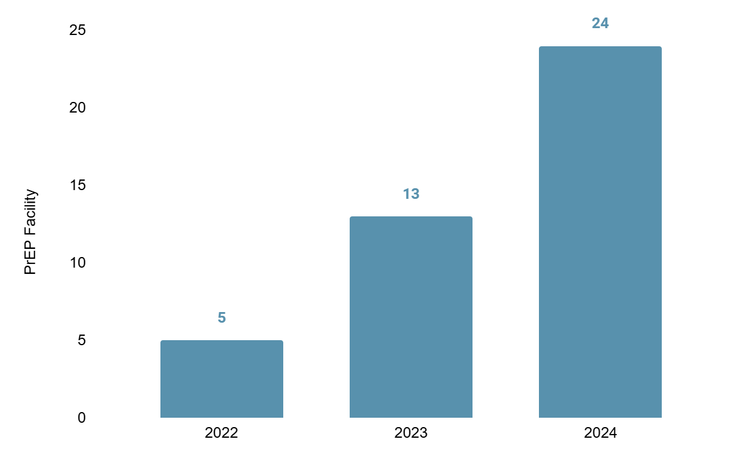
Results and Improvement :
Increased PrEP Availability
Expansion of PrEP facilities from 13 to 24 hospitals across all 24 districts (2024)
Conducted a series of advocacy efforts with partner hospitals, supported by the Chiang Mai Provincial Public Health Office, to expand PrEP availability.
Clients reported low or limited availability to PrEP when visiting
a hospital for HIV testing (2022)
Number of hospitals registered as PrEP service facilities in Chiang Mai province in 2022-2024

Slide 6
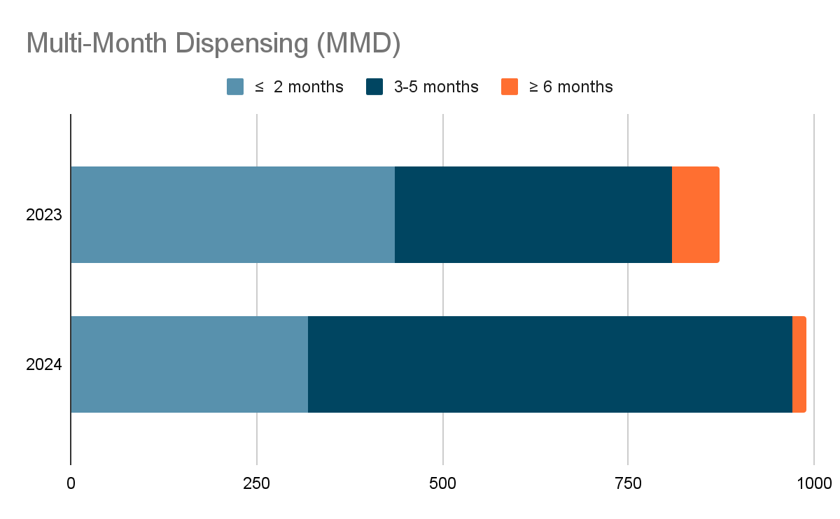
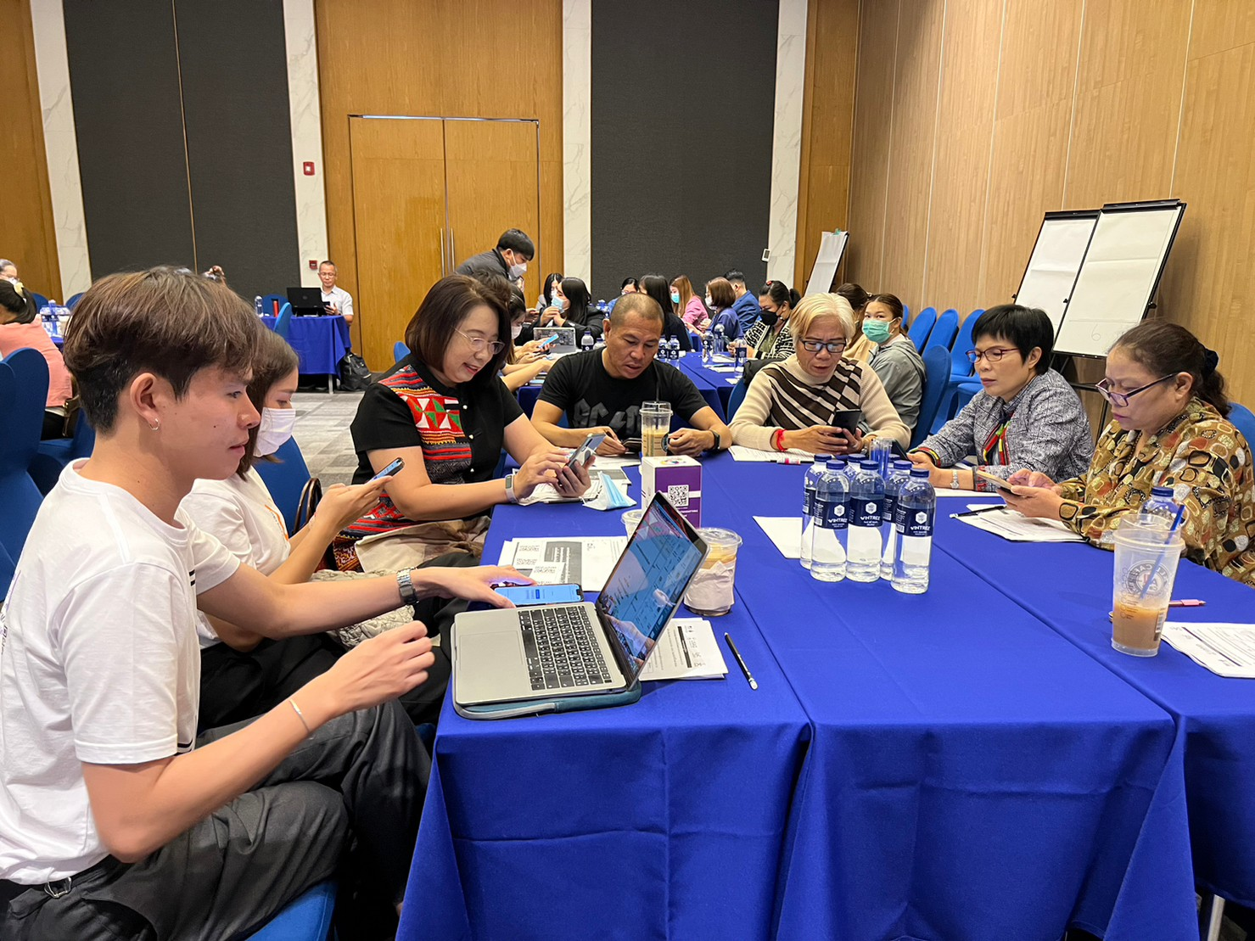
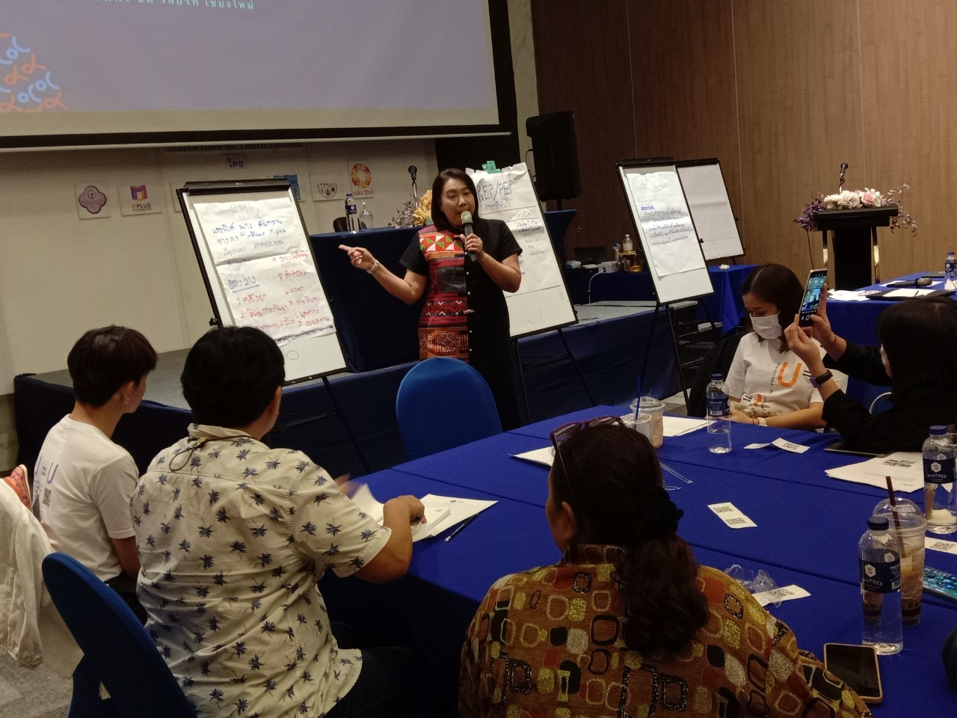
Results and Improvement :
Multi-Month Dispensing (MMD) for ART
Definition: Multi-Month Dispensing (MMD) = ARV supply > 3 months.
2023 Challenge: Only 50% of ART clients received more than a 3-month ARV supply.
50%
Policy Change: Chiang Mai Provincial Health Office set a 30% MMD-ART enrollment target for all 24 hospitals in the province.
68%

Slide 7




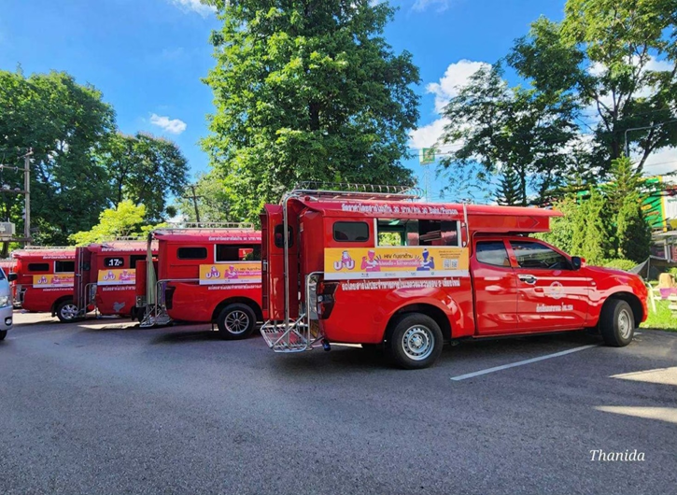
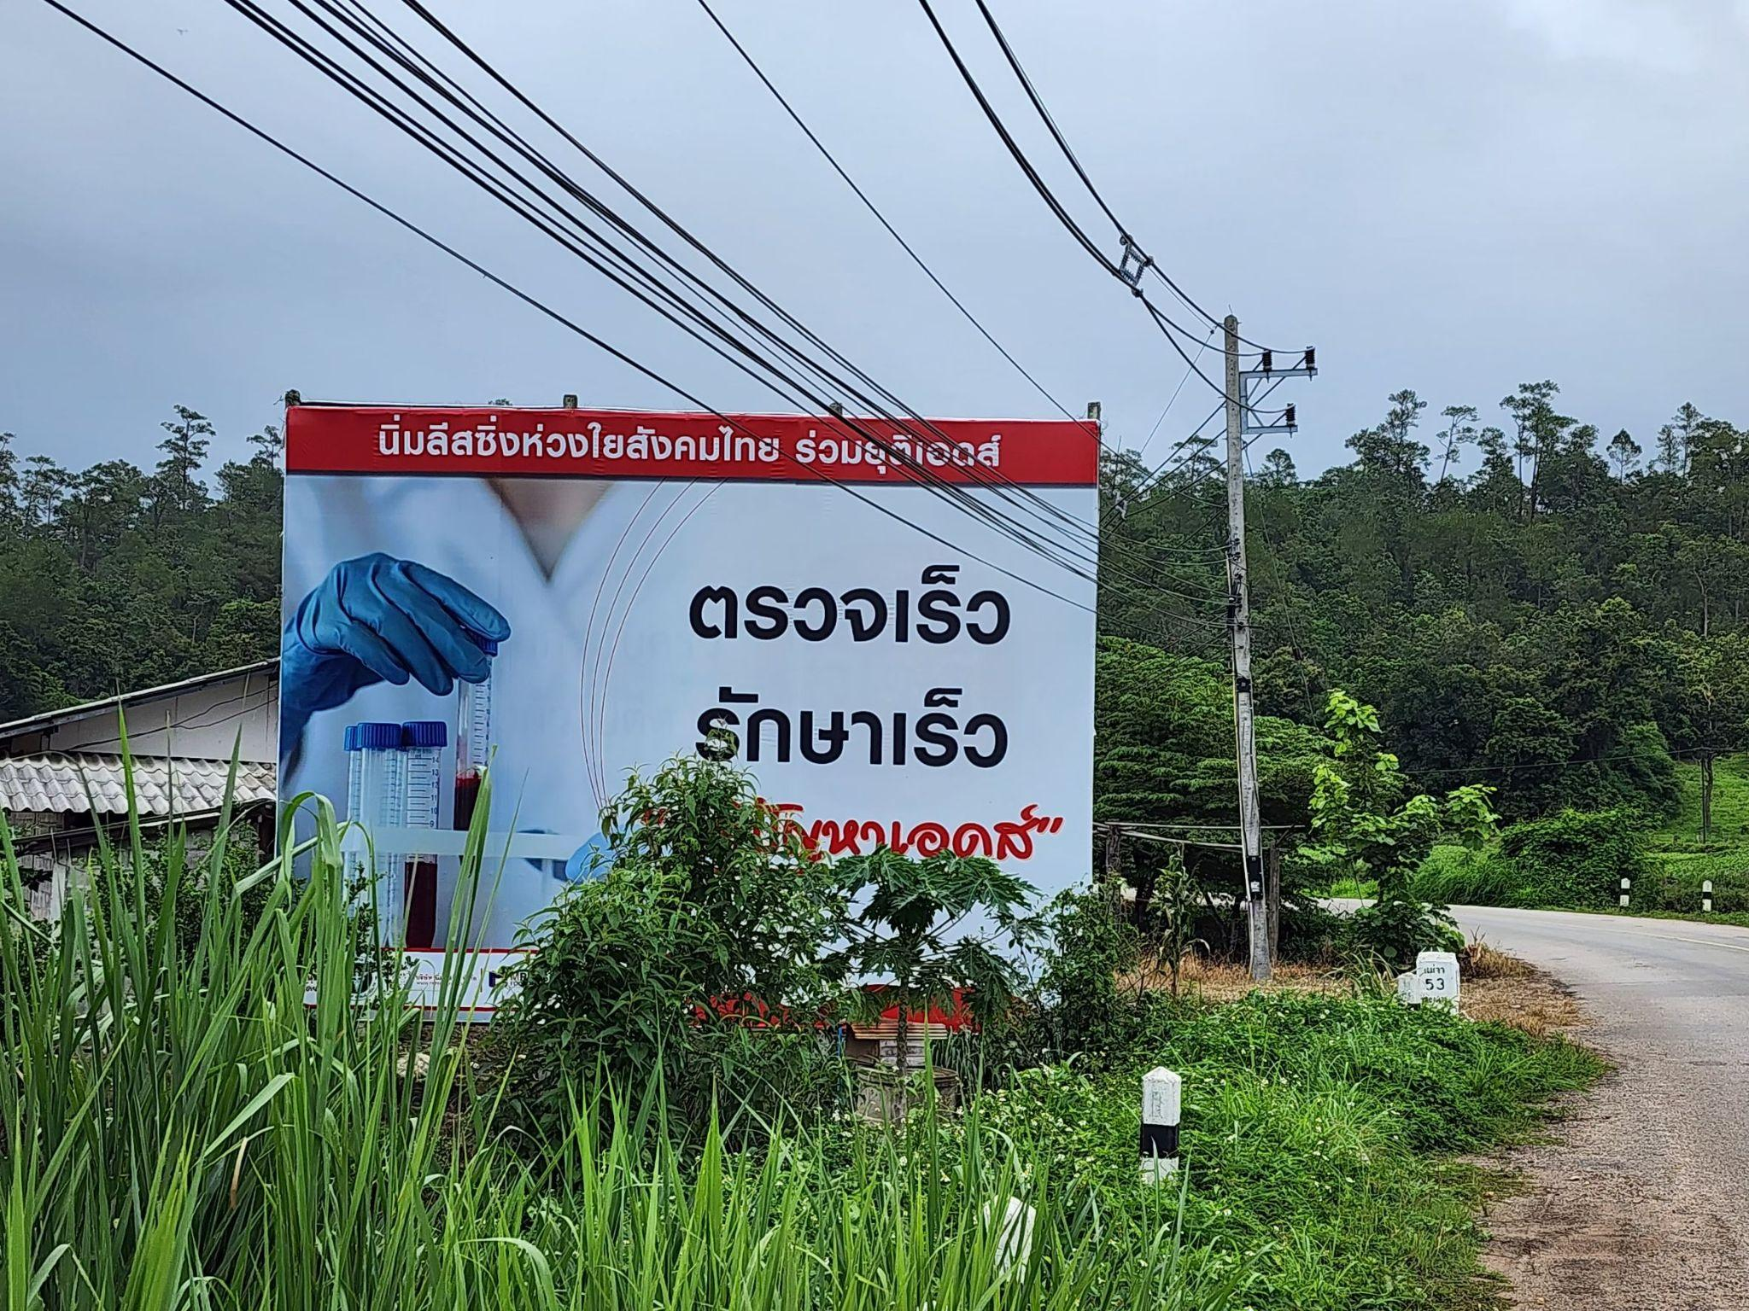
Results and Improvement: Understanding of Undetectable = Untransmittable (U=U)
Challenge: Limited Understanding of U=U Among PLHIV
75% (2023) and 70% (2024) of PLHIV received U=U counseling.
Clients informed about U=U in 2024 (n=691) reported an average understanding score of 8 out of 10, markedly higher than the 2 out of 10 reported by those not informed (n=299)
Improvements:
Hospital level : Introduced U=U counseling and educational materials (standees and videos) in hospitals to strengthen visibility and tackle self- stigma among PLHIV
Public level : Partnered with private sector to launch province-wide U=U awareness campaign.
8/10
Self-Rated Understanding of U=U Among Informed PLHIV

Slide 8
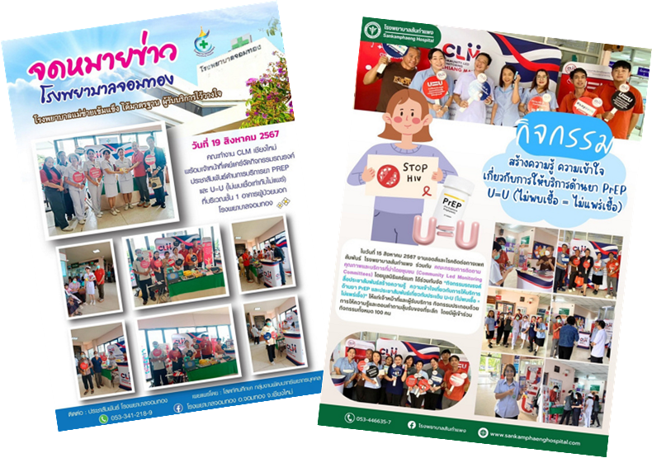
Lessons Learned
Client-centered improvements: CLM-generated data enabled service providers and policymakers to tailor services based on evolving needs of clients in diverse contexts.
Expansion of PrEP facilities from 13 to 24 hospitals.
Scaling up ≥ 3-month MMD at 24 hospitals.
Provincial Health Office launched a comprehensive U=U campaign.
  Positive communication approach: CLM-led campaigns promoted accurate HIV knowledge among health staff, government, and private sectors—shifting from fear-based messaging to understanding.
Limitation: Data were collected at convenient service points, which may not represent all clients but reflect real-world experiences at hospitals.

Slide 9
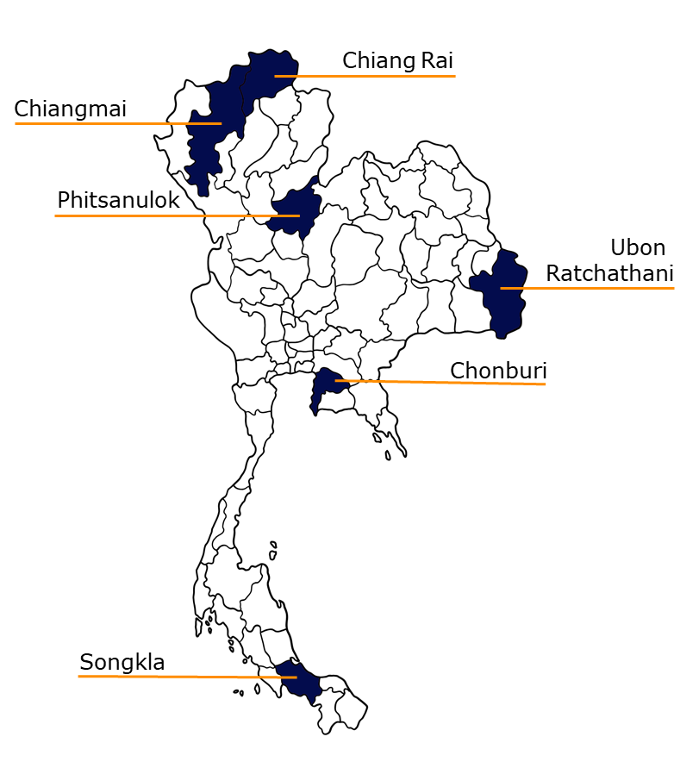
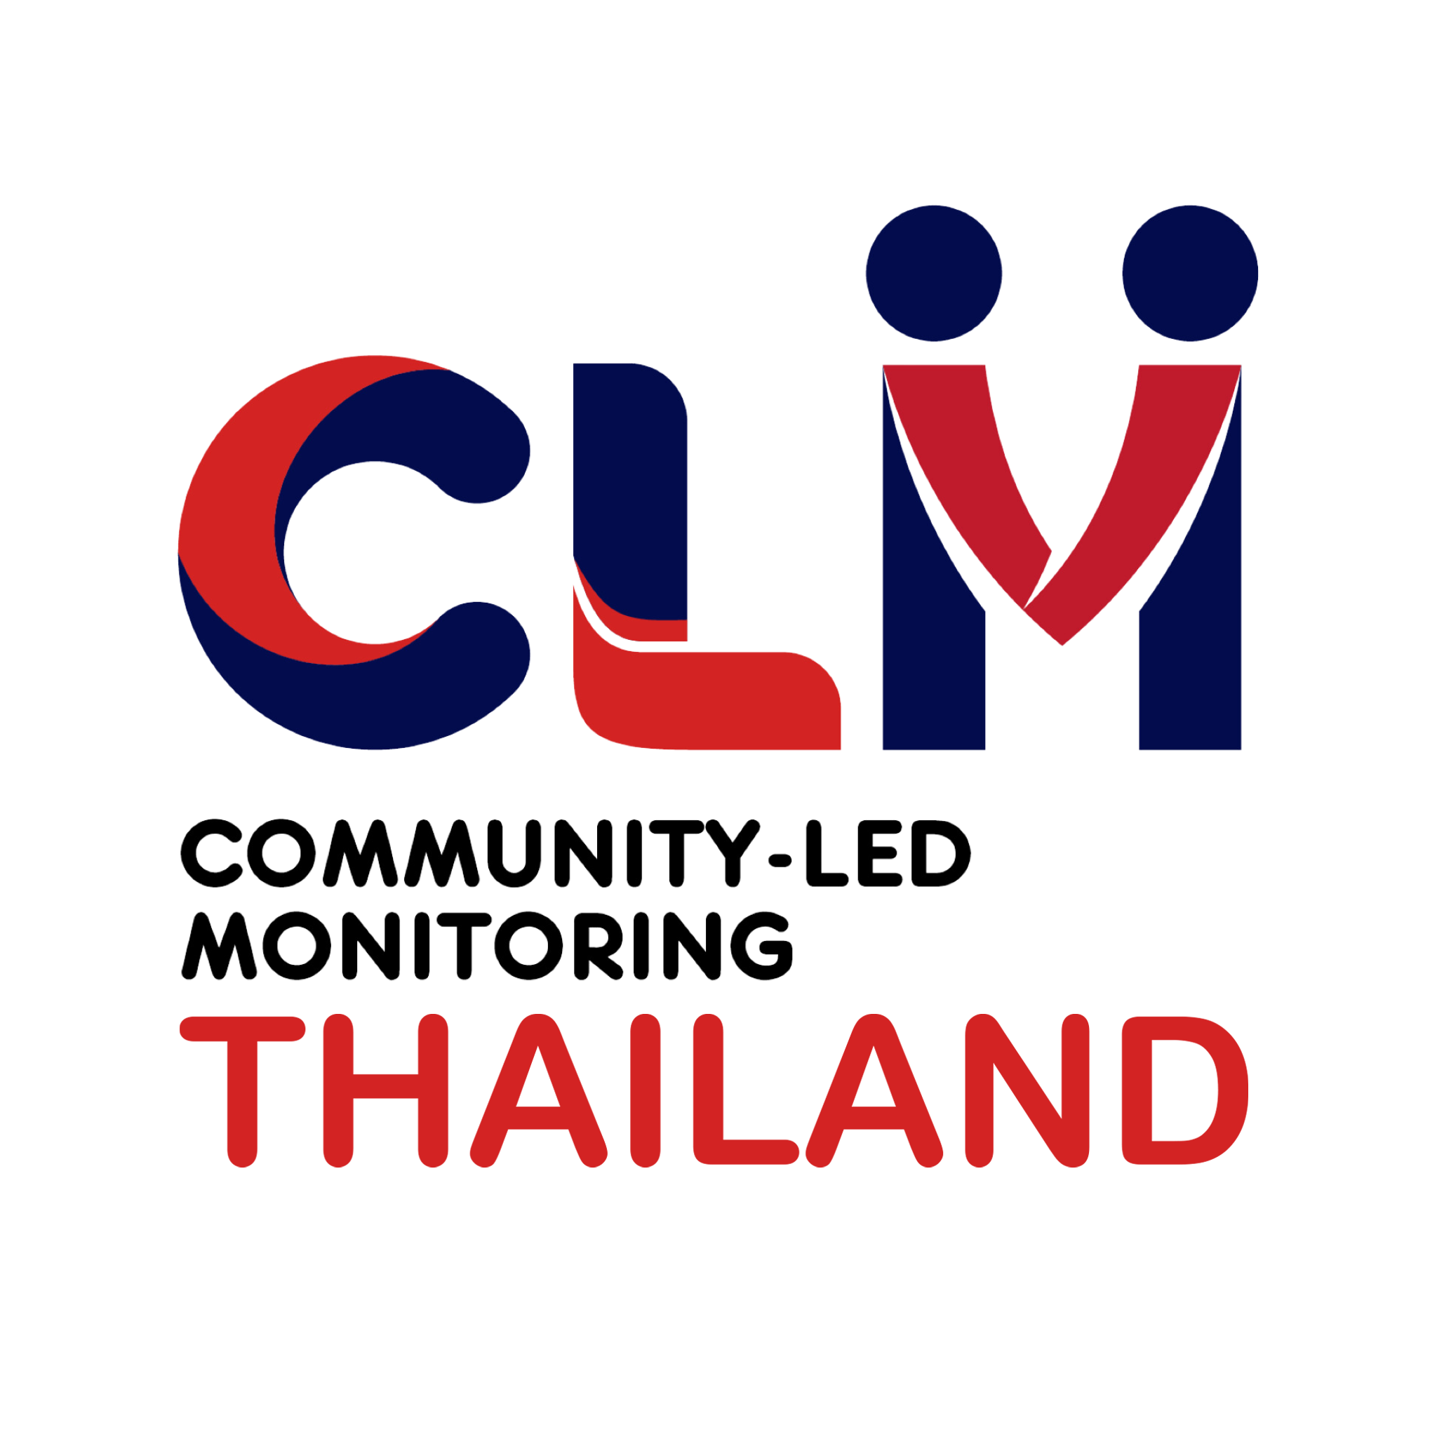
Next Steps
Provincial-Level:
Monitor hospital service improvements based on CLM-provided recommendations.
Develop adaptive follow-up questions to reflect evolving local service conditions and the changing needs of clients, expanding to other diseases.
Develop web-based data collection tools to enhance accessibility for diverse service users and enable real-time data visualization.
National-Level:
Share findings of CLM data in six provinces with the Ministry of Public Health and the national PLHIV network to inform national policy.
Align CLM efforts with national policy frameworks to advance sustainability.

Slide 10

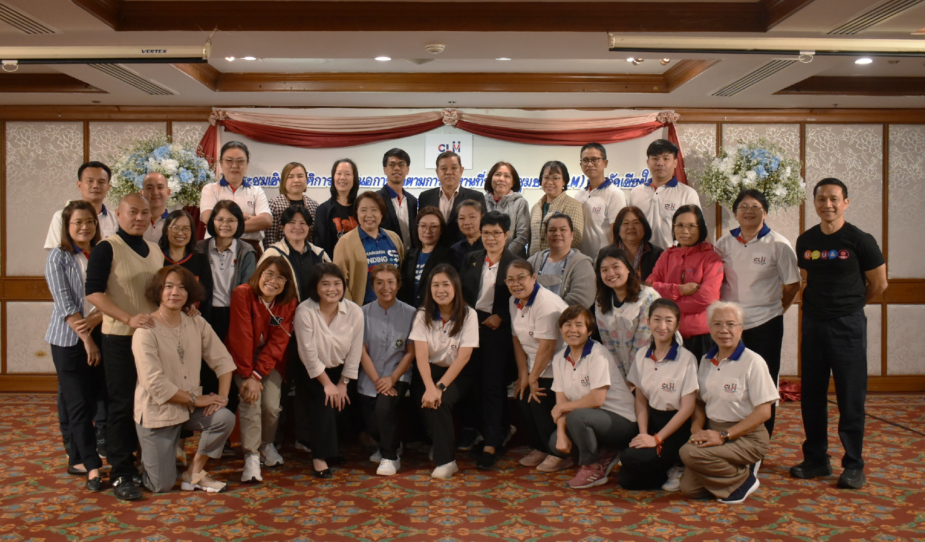
Lead with the Community
Photo: Chiang Mai Community-Led Monitoring Committee Annual Workshop in 2025
(Photo credit: CAREMAT Foundation)

