Slide 1
Enhancing data quality for differentiated service delivery: lessons from Zimbabwe’s Multiregional DSD review
T. Matare1, P. Mujuru 2, C. Gwanzura1, C. Mupanguri 1, T. Apollo1
¹Ministry of Health and Child Care Harare (MOHCC), Zimbabwe
²Zimbabwe Technical Assistance, Training and Education Center (Zim-TTECH), Zimbabwe

Slide 2
Background
Differentiated Service Delivery (DSD)
  Client-centered approach that simplifies and adapts HIV services to reflect clients’ preferences and expectations while reducing unnecessary burdens on the health system
Zimbabwe started implementing DSD models for ART in 2017 and has been conducting DSD Reviews annually since 2018
  They assess implementation progress and peer-learning opportunities to share best practices, challenges and innovations
The 2024 DSD Review was conducted in July – August 2024

Slide 3
Description
A total of 148 facilities in 30 districts from 4 provinces participated
Data was collected using Survey CTO and analysed using PowerBI
A facility survey and individual patient survey tools were used
Data was abstracted from 4,630 patient files for recipients of care (RoCs) in the 12-, 24- and 36-months ART cohorts
Data was collected from paper-based tools and/electronic medical records for services received
  Across HIV continuum of care for HIV testing treatment, management of HVL and integration with TB, FP, Mental Health, OIs and NCDs

Slide 4
Lessons learned
As Zimbabwe nears epidemic control, it is imperative that available data sources are robust, as we provide client centered services, for better data driven decisions
However, the review showed incompleteness on some key patient variables such as DSD model (22%), Date of Birth (4%), Date of HIV Diagnosis (4%), Sex (1%) and Date of ART initiation (1%)
  This is despite having Standard Operating Procedure for recording and reporting

Slide 5
Lessons learned
Zimbabwe intensified development of a module for DSD models with validation rules and subsequent data visualizations within electronic health record (EHR) with support from PEPFAR
The module was refined after several validations and deployed to 795 facilities
Zimbabwe has decommissioned over 26 paper register and Impilo EHR synchronizing data to DHIS2 via Health Information Exchange as in next slide
DSD visits can now be done in Impilo using an improved workflow

Slide 6
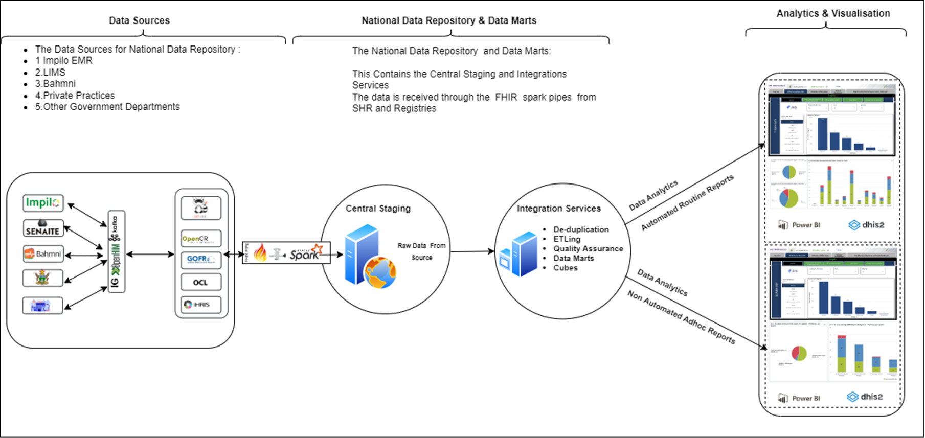
The current implementation of the Impilo (EHR) system is in 3 main stages outlined below
1
Online Site’s data flow
Data Capture & Transmission
Registries & Data Conversion
Central Storage & Monitoring
2
Offline Sites Data Flow
Offline Data Capture
Syncing to Central Database
3
Services Layer
Data Processing
Support & Routing Services
Reporting & Decision-Making
Notes:
Data Capture & Transmission:
Online facilities
The data is then sent through an interchange layer that routes, validates, and orchestrates data flows according to international standards.
Registries & Data Conversion:
Data is directed to relevant registries (e.g., Shared Health Record, Client Registry, Facility Registry, Terminology Service).
Central Storage & Monitoring:
The transformed data goes into a National Data Warehouse where it can be securely stored and accessed.
A monitoring tool (Grafana) keeps track of all data flows, making it easy to see if everything is working smoothly.
Offline Sites Data Flow
Offline Data Capture:
In locations without reliable internet, clinicians use an offline version of Impilo EMR.
Data is stored locally until connectivity is available.
Syncing to Central Database:
Once internet access is available, the offline data is sent to The Central through a mobile application.
This ensures no data is lost even when connectivity is limited.
Services Layer
Data Processing:
A specialized “Service Layer” collects information from both the National Data Warehouse and the central database. This service consists of Construction Services Layer, Shared Services Layer, and Routing Services Layer
It checks the data for errors, cleans it up, and organizes it so it’s ready for reporting.
Support & Routing Services:
Shared services handle common tasks like user security and data consistency.
A routing service makes sure each piece of information goes to the right place.
Reporting & Decision-Making:
The processed data is moved into “Data Marts,” which are set up for easy analysis.
Finally, data flows into DHIS2, a system used to create dashboards and reports, supporting timely decisions and strategic planning.

Slide 7
Conclusions
The review provided an opportunity for assessing data quality
  We learnt that data quality was sub-optimal on some variables
  EMRs provide an opportunity for improving data quality
There is a need for governments and implementing partners to tackle challenges
  Connectivity, power, hardware, software development and HRH capacity building to sustain the system for better data quality

Slide 8
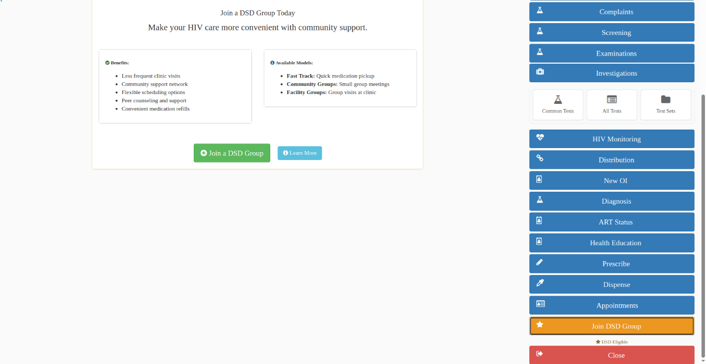
DSD Module in Impilo EHR
The developers are currently working on modifying the functionality of the Differentiated Service Delivery (DSD) module. Key changes include:
Eligibility Criteria: The DSD workflow will only activate for clients who have been on Antiretroviral Therapy (ART) for at least six months and have a suppressed viral load.
Group Selection: Clinicians can select the group that the client is joining from an existing list, with a search function available by group name. They can also create a new group.
Visit Initiation: To start a DSD visit, clinicians must first admit the client representing the group to a queue.
Group Visit: Information given by the group representative for each member can be added on the visit.
Medication Dispensation: Medication can be dispensed during the visit for each member..
Appointment Scheduling: An appointment will be added for each member of the group, streamlining the scheduling process.

