Slide 1
Decentralizing HIV care: blockchain solutions for client data integrity and pharmaceutical supply chain resilience
P.C.D. Rupasinghe, Ichan Medical School at Mount Sinai, NY, USA
Innovations in data collection, monitoring, and evaluation

Slide 2
Summary
Main Research Question
“Can blockchain technology address systemic barriers in HIV care to improve data security, treatment adherence, and supply chain integrity?”
Key Findings
• Improved adherence (25%) in Kenya
• Increased trust and reduced errors in the US
• Strengthened supply chain resilience in Malawi and Ghana
• Enhanced rural access and reduced counterfeit risks
Why is this important?
Blockchain offers an equitable, patient-centered, and scalable solution for HIV care and beyond. Its integration with AI and IoT can revolutionize global health delivery and data security.

Slide 3
Blockchain’s Transformative Potential and Role in Healthcare
Blockchain is transforming HIV care by strengthening data security, improving treatment adherence, and securing pharmaceutical supply chains. Its decentralized, tamper-proof design addresses major challenges such as fragmented systems, privacy risks, and global inequities in care delivery.
Understanding Blockchain in Healthcare: As a decentralized, distributed ledger, blockchain offers a secure and transparent way to manage sensitive health data. Its immutability ensures data integrity, while cryptography protects patient privacy. Beyond centralized systems, it provides a trustworthy, patient-centered foundation for global health solutions.

Slide 4

Revolutionizing Client Data Management
One of blockchain's most significant impacts is in securing and streamlining client data. By replacing outdated paper-based systems, blockchain enables real-time data tracking, improving the efficiency and accuracy of health records.
Kenya: Immunify.Life Initiative:
In Kakamega, Kenya, the Immunify.Life initiative improved treatment adherence by 25% among non-adherent clients over 12 months by transitioning from paper to blockchain-enabled real-time data tracking.
USA: PrEP Access in Houston:
In Houston, Texas, blockchain platforms for pre-exposure prophylaxis (PrEP) access achieved 83% user trust and reduced administrative errors by 40% through secure, decentralized health records.

Slide 5
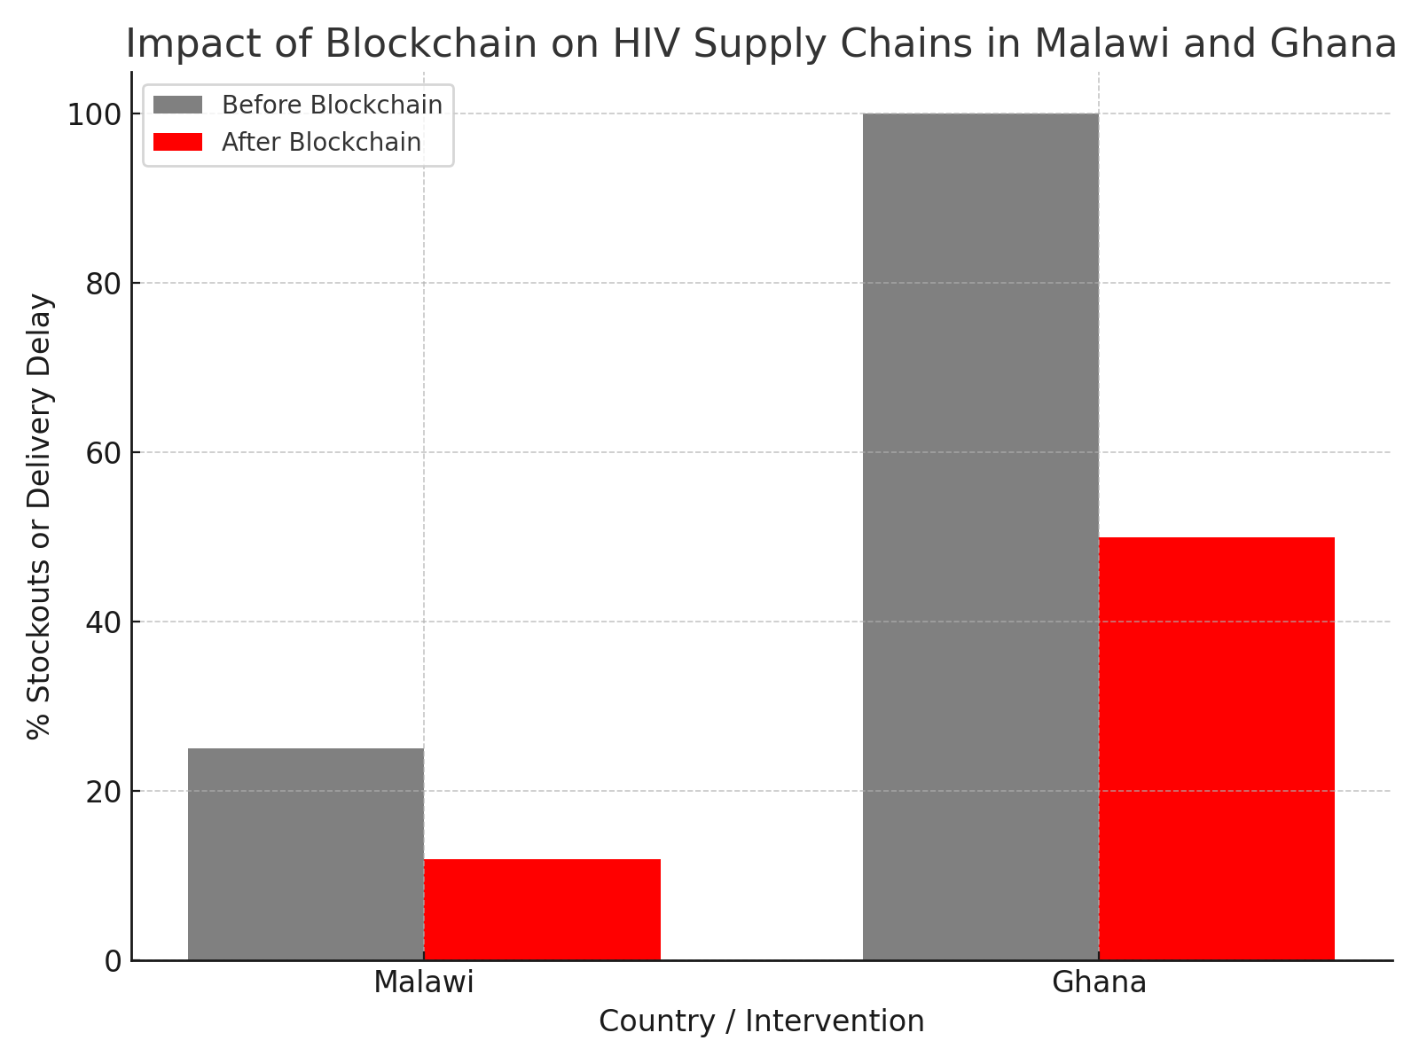
Strengthening Pharmaceutical Supply Chains
Blockchain enhances supply chain resilience by providing end-to-end visibility, combating counterfeit drugs, and reducing stockouts. Its transparent ledger ensures that every step of a drug's journey, from manufacturing to patient, is verifiable.
Malawi: ARV Drug Tracking
Tracking of ARV drugs in Malawi reduced clinic stockouts from 25% to 12% and lowered counterfeit drug rates by 35% across 150 clinics. This ensured more consistent access to life-saving medication.
Ghana: HIV Test Kit
Delivery Ghanaian pilot cut HIV test kit delivery delays by 50% in rural areas through blockchain-monitored shipments. This dramatically improved the accessibility of critical diagnostic tools.

Slide 6
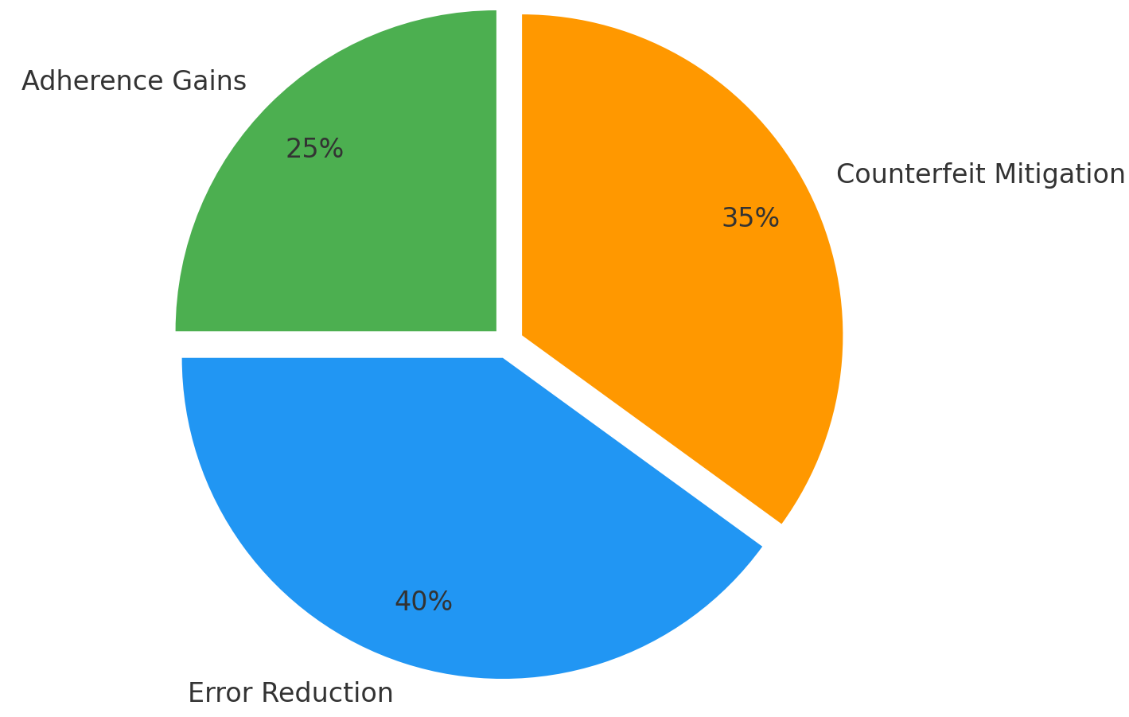
Key Successes and Benefits
The diverse implementations of blockchain in HIV care highlight its transformative potential, delivering measurable improvements in various critical areas.
Adherence Gains: Improved treatment adherence in Kenya, leading to better patient outcomes and reduced disease progression.
Error Reduction: Decreased administrative errors in the U.S., enhancing data accuracy and operational efficiency.
Counterfeit Mitigation: Reduced counterfeit drug rates in Malawi, ensuring the authenticity and safety of medications.

Slide 7
Navigating Challenges: Infrastructure and Regulation
Infrastructure Gaps
Regulatory Complexities
Scalability
Challenges such as limited internet access in rural areas hinder the adoption and seamless operation of blockchain systems, necessitating robust offline capabilities and hybrid models.
Compliance with stringent healthcare regulations like HIPAA requires careful implementation to balance data transparency with patient privacy.
Achieving widespread adoption demands solutions that can seamlessly integrate with existing healthcare systems without disruption.
Achieving widespread adoption demands solutions that can seamlessly integrate with existing healthcare systems without disruption.
Despite its promise, scaling blockchain solutions in healthcare faces significant hurdles, primarily related to infrastructure gaps and complex regulatory environments.

Slide 8
Towards Scalability: Hybrid Models & Partnerships
Hybrid Blockchain Models
Balancing transparency with compliance, these models can offer both public and private blockchain elements.
Infrastructure Investment
Investing in digital infrastructure, particularly in underserved regions, to ensure equitable access.
Stakeholder Training
Educating healthcare professionals and policymakers on blockchain's benefits and operational requirements.
Public-Private Partnerships
Fostering collaboration between governments, NGOs, and technology firms to pool resources and expertise.
To overcome existing challenges and unlock blockchain's full potential, a strategic approach involving hybrid models and robust collaborations is essential.

Slide 9

Blockchain's Role in Global Health Equity
Blockchain technology is poised to become a cornerstone of equitable, client-centered healthcare worldwide, especially in the context of HIV programs.
Key Contributions:
Improving client adherence to treatment protocols
Significantly reducing the circulation of counterfeit drugs.
Streamlining complex pharmaceutical supply chains.
Enhancing data security and patient privacy.
These advancements contribute to building more resilient and accessible healthcare systems globally.

Slide 10
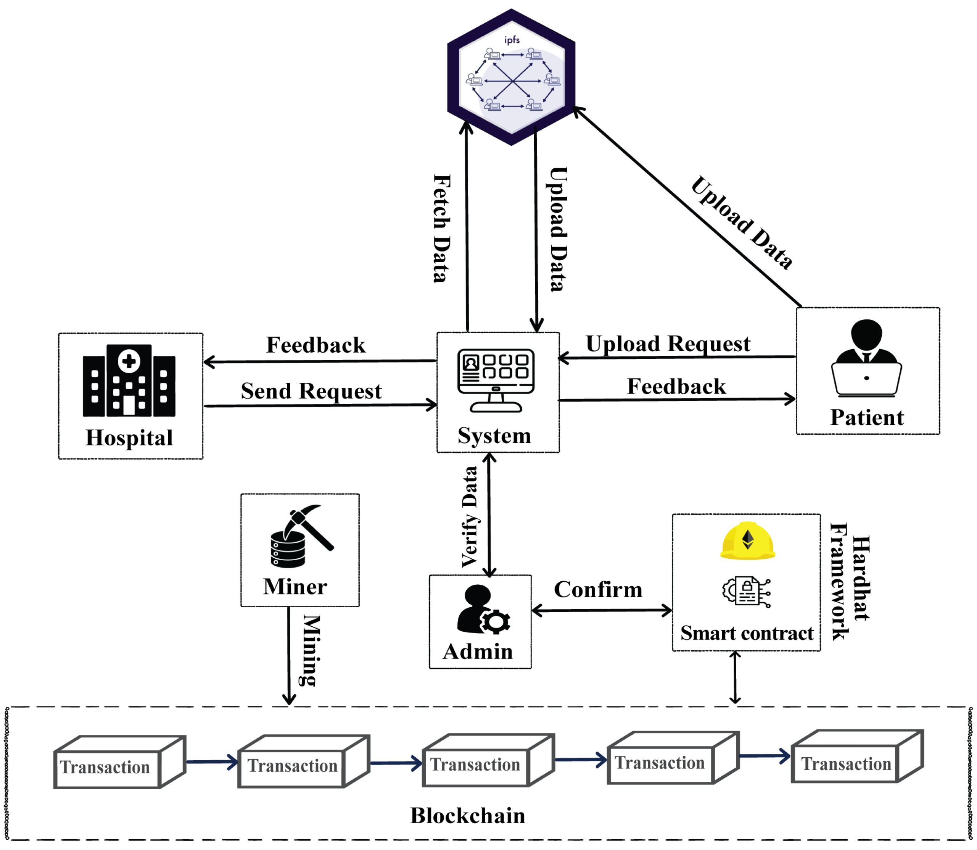
Future Directions: Integration with AI
The true power of blockchain in healthcare will be unleashed through its synergistic integration with emerging technologies like Artificial Intelligence (AI).
Predictive Analytics for Supply Chains
AI algorithms can analyze blockchain data to predict demand fluctuations, optimize inventory, and identify potential disruptions, ensuring a steady supply of medications.
Personalized Client Care
Combining secure patient data from blockchain with AI-driven insights can lead to highly personalized treatment plans, improving patient outcomes and adherence.

Slide 11

Key Takeaways & Next Steps
Blockchain offers a robust solution for enhancing HIV care. Its proven ability to improve data security, streamline supply chains, and boost treatment adherence makes it an invaluable tool.
Prioritize Hybrid Models:
To balance transparency with regulatory compliance and ensure broad applicability.
Foster Cross-Sector Collaboration:
Engage public and private entities to expand solutions and share resources.
Explore Broader Applications:
Extend blockchain's use to chronic disease management and cross-border health data sharing.

Slide 12
THANK YOU
“Blockchain technology can become a cornerstone of equitable, patient-centered healthcare worldwide. Its power to improve data security, streamline supply chains, and strengthen treatment adherence makes it a transformative force in HIV programs and beyond.”
- P.C. Rupasinghe, Ichan Medical School at Mount Sinai, NY, USA
Questions & Discussion

