Slide 1
Title:
Innovative use of mobile digital Chest-Xray equipped with artificial intelligence to improve TB diagnosis among people living with HIV at primary health centres (PHCs) in Lagos, Nigeria
Authors Name: Udunze Obioha
Affiliations: KNCV Nigeria

Slide 2
Acknowledgement
I want to begin my presentation by acknowledging and thanking the people living with HIV who generously shared their experiences and perspectives for this research.
Your contributions are deeply valued

Slide 3
Summary
Early detection of TB among People living with HIV through screening allows for timely diagnosis and treatment, which can improve overall health outcomes for people living with HIV
The use of Artificial Intelligence powered Mobile Digital CXR has demonstrated efficiency in TB diagnosis particularly among PLHIV that are asymptomatic for TB.
Leveraging on an A.I powered Mobile digital CXR will adequately improve early diagnosis and treatment of TB among PLHIV, while fostering adequate integration and collaboration of TB/HIV services.

Slide 4
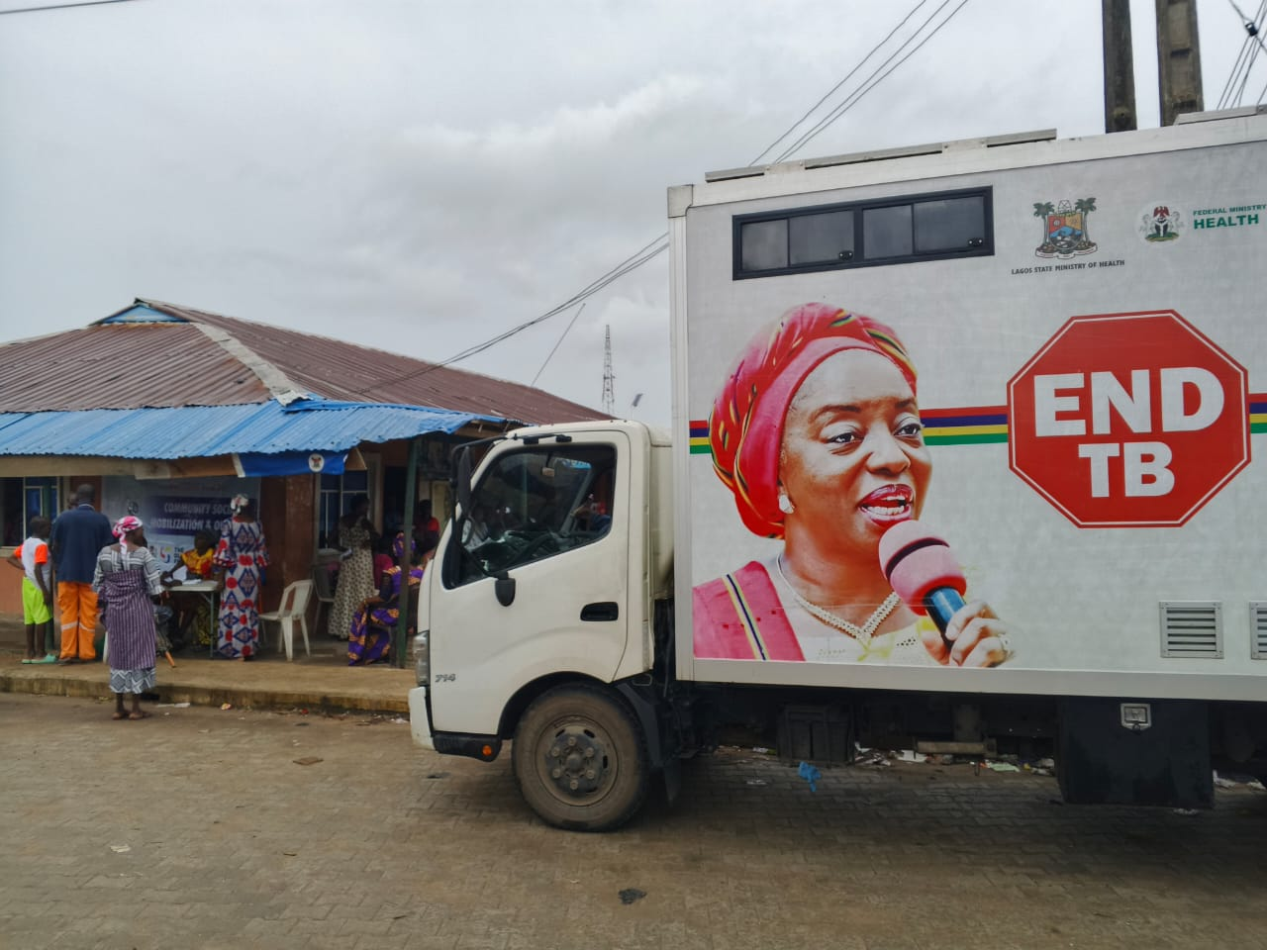
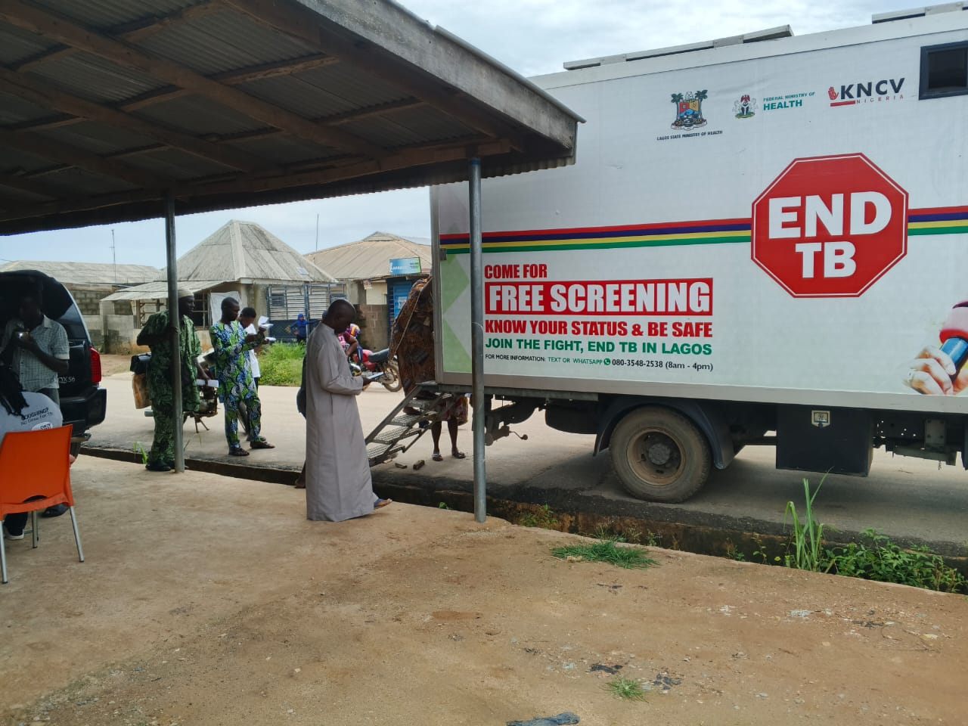
Background
Deployment of Mobile digital Chest X-Ray (CXR) vans equipped with artificial intelligence (CAD4TB) is a joint investment of the State Government and Global Fund to complement other interventions in TB program, to find and treat the missing persons with TB.
The CXR intervention will further increase access to free TB screening and treatment as part of the Global Strategy to end TB. Three mobile CXR Vans, equipped with artificial intelligence (CAD4TB) was used for this activity.
This provided an opportunity for adequate TB/HIV integration and collaboration at the PHCs.

Slide 5
Objectives:
To improved early diagnosis and treatment of TB using A.I among PLHIV.
Identification of Asymptomatic TB clients thereby, improving TB yield among PLHIV.
To highlight the effectiveness of TB/HIV service integration.

Slide 6
Methods:
The use of the of mobile digital CXR at the PHCs for active TB case finding was conceptualized and conducted from January–December 2024 to address the existing 32% TB notification gaps in Lagos Nigeria.
This however, provided an opportunity to adequately screen PLHIV for TB at PHCs.
DHIS2 was used to determine the PLHIV currently on Treatment across 8 flagship sites (PHCs) in the State, following facility assessment and advocacy visit.

Slide 7
Methods Cont..:
iii. TB Facility Cascade Management Team Meeting were conducted and CXR mobile Vans deployed.
iv. WHO 3B TB screening algorithm was adopted. Specimen were collected and sent for GeneXpert test.
v. Chest radiographs of eligible presumptives were sent to Radiologist through the digital platform (XMAP) for clinical evaluation.

Slide 8
Results
Type of TB Screening | No. of PLHIV screened for TB | No. of TB presumptive among PLHIV | No. of TB presumptive clinically evaluated | No. clinically diagnosed with TB | No. linked to care | % TB yield | No. needed to screen (NNS) | No. needed to test (NNT)
TB screening using A.I powered Digital CXR machine | 1,128 | 203 | 203 | 47 | 47 | 23% | 24 | 4
Symptom screening at other Secondary facilities | 7,898 | 789 | 789 | 64 | 57 | 8% | 123 | 12

Slide 9
Results Cont..
For the A.I supported TB screening among PLHIV, the average TB yield is 23%, NNS and NNT were 24 and 4 respectively given a better yield compared to the conventional TB screening (symptom screening at 8% TB yield, 123 NNS and 12 NNT respectively.

Slide 10
Conclusion
Artificial Intelligence powered Mobile Digital CXR has demonstrated efficiency in TB diagnosis particularly among PLHIV that are asymptomatic for TB, who would have otherwise been missed using the W4SS and conventional CXR evaluation.
Therefore, the expansion of Mobile digital CXR equipped with A.I, will strengthen integration of TB/HIV collaboration and improve quality of care among PLHIV in Nigeria.

Slide 11


