Slide 1
Ethical concerns and suggested mitigations surrounding access to and use of SMS and social media data in sentiment analysis, for HIV prevention among young women in Western Kenya
Alfred Odira – Kenya Medical Research Institute

Slide 2
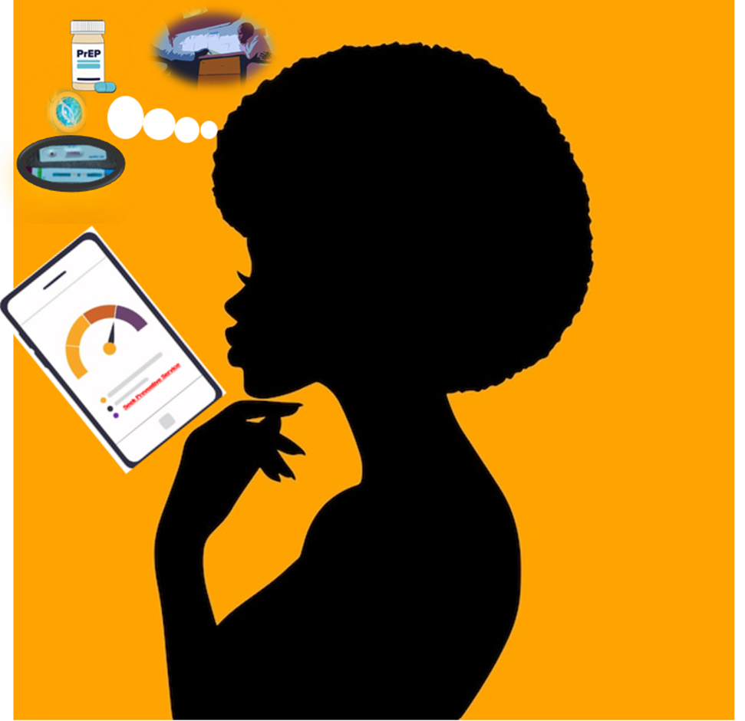
Summary
Main questions
How would people respond to HIV prevention if they were aware of their risk based on artificial intelligence (AI) prediction?
What are the ethical concerns in development and use of AI tool to assess HIV risk from smartphone data?
What we found
Enthusiasm by potential users to seek HIV testing and preventive services, and to address primary drivers of HIV risk.
Concerns emerged around privacy, confidentiality, embarrassment, data access and security.
Why it matters
Options such as PrEP are most effective when target beneficiaries are aware of their individual risk and take deliberate preventive action.
AI holds promise but, such tool, must be developed with ethical safeguards to gain trust and acceptance.
Notes:
The main question this study wishes to answer is:
How would populations respond to proven effective HIV preventive services if they were aware of their level of risk for acquiring the virus, based on AI projections?
The problem this abstract is addressing is:
What (though) are the ethical considerations in the development and use of an AI tool that assesses a user’s HIV risk based on their social media and SMS chats smartphone data?
Effective HIV prevention options—PrEP, condom use, male circumcision, testing, and counseling— would be more impactful when adopted by intended beneficiaries, like adolescent girls and young women (AGYW). However, uptake remains limited, as many individuals remain unaware of their level of risk to contract the virus.
Initial responses point to possibilities of deliberate action by users of AI technology-based HIV risk predicting tool to seek HIV testing and preventive services, and to address primary escalators of risk. Yet we can only speculate on how populations would most likely respond to such a tool the moment it becomes available.
There is need for more novel approaches to help populations be aware of their individual HIV acquisition risk levels; and, hopefully, thereby spark deliberate preventive action. Yet, any such innovations must make sure to uphold ethical standards, for acceptability that leads to it achieving it’s objective.

Slide 3
Introduction
AI-powered smartphone apps are increasingly popular for learning, problem-solving, and commerce.
AI-powered smartphone apps are increasingly popular for learning, problem-solving, and commerce.
These apps can analyze vast interpersonal data (e.g., SMS, social media) to infer users’ health risks.
Hypothesis:
If individuals know their predicted HIV risk, they may be more likely to adopt preventive measures like PrEP.
Study Focus – SMaaRT:
The Social Media as a Risk Tool (SMaaRT) Study explores how AI and sentiment analysis can identify HIV prevention needs.
It also examines ethical concerns and safeguards when accessing young women’s phone data for this purpose.
Notes:
Sentiment analysis was used during covid 19, to map out hot-spot areas. Given the amount of authentic interpersonal data which is transacted over everyday interactions, Artificial Intelligence has a promise of providing such an innovative platform, through sentiment analysis.
SMaaRT Study posits that, if individuals are aware of their predicted risk levels for contracting HIV: they will most likely take action to seek preventive measures and address causal factors.

Slide 4
Objectives
Main Study Aim: To develop a smartphone-based predictive algorithm for HIV prevention needs that users can easily access and use to seek appropriate services.
Our objective: Explore ethical concerns around accessing personal data on a user’s phone to aid in development and use of AI-based HIV risk predicting tool.
Notes:
The overall goal of SMaaRT is to develop a Smartphone-based HIV risk predicting tool, which users can easily access and run from wherever to inform them of their level of HIV risk; thus need to seek preventive services. The goal is to develop a tool that can complement the existing tools for HIV needs prevention assessment such as the RAST tool.
The Objective of this paper is to explore the ethical concerns in the development and operationalization of such a SMaaRT tool.

Slide 5
Methodology
The SMaaRT study follows a sequential exploratory design.
Aim 1: Ethical Considerations:
Investigate ethical concerns around accessing and analyzing SMS/social media data for tool algorithm development.
Approach:
Conducted in-depth interviews (IDI) with young women accessing sexual and reproductive health (SRH) services at four public clinics in Kisumu County, Kenya.
Held focus group discussions (FGD) with bioethicists to explore privacy, autonomy, beneficence, non-maleficence, and justice themes.
Notes:
The Social Media as a Risk Tool, SMaaRT Study design is a Sequential Exploratory Design. In Sequential Exploratory Qualitative Design, one study aim informs the next aim or step; in prototype development.
At AIM1 We Explored ethical concerns that may influence access to and analysis of SMS and social media messages: whereby we conducted 2 FGDs with 11 bioethicists, and in-depth interviews with 32 young women

Slide 6
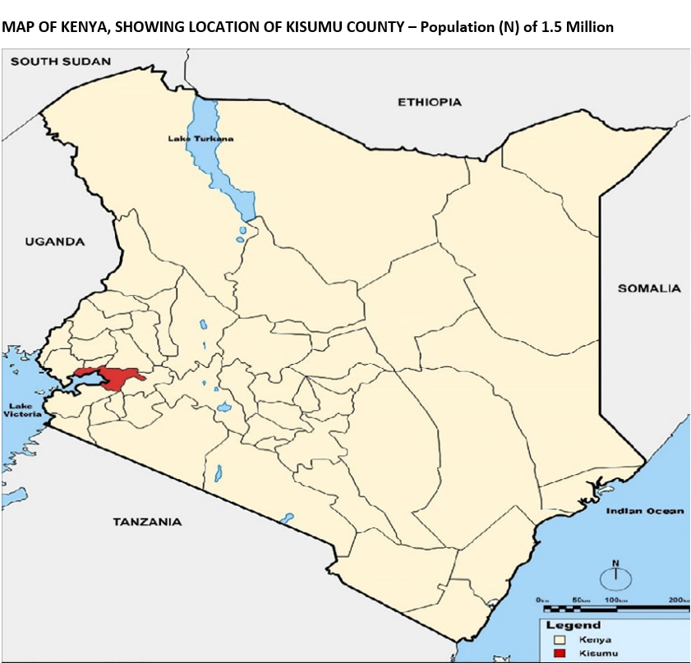
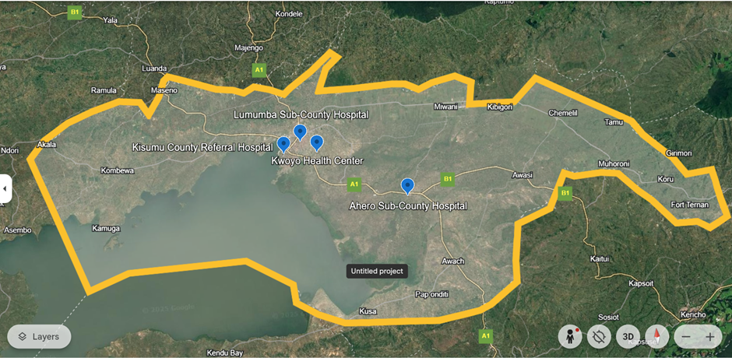
Study Location
Kisumu County, Kenya (population 1.5 million)
Map of Kisumu county, Displaying Study Facility Locations
Notes:
AGYW participants were recruited while seeking SRH services from 4 public health facilities, within Kisumu county – Kenya; namely Kuoyo health center, Ahero sub-county hospital (serving semi-urban population), and Lumumba sub-county and Kisumu County referral hospitals (serving urban population)

Slide 7
Data Collection and Analysis
Period: February–April 2024
Participants:
32 young women (ages 18–24) from Lumumba sub-county, Ahero sub-county, Kisumu county referral, and Kuoyo health center; public facilities
11 Kenyan bioethicists – 6 female, 5 male
Methods:
In-depth interviews: 16 hypothetically willing and 16 not willing to give access to their social media/SMS messages
Focus group discussions (2 FGDS – 5/6)
Analysis:
Deductive analysis based on framework approach
Notes:
Between February and April 2024, we conducted in-depth interviews (IDIs) with 32 young women aged 18 to 24 who sought sexual and reproductive health services from four public facilities. Half of them were willing to share their SMS and social-media messages for HIV prevention analysis. Additionally, two focus group discussions were held with 11 bioethicists. Ethical concerns were explored through questions covering privacy, confidentiality, autonomy, beneficence, non-maleficence, justice, and power. Data were thematically analyzed using a deductive approach, based on Systems Framework model.
The resultant Aim 1 data was analyzed using a framework system, in identifying and grouping the key thematic areas.

Slide 8
Other aspects of SMaaRT Study
Aim 2: Data Collection for Tool Development
Collected social media content and survey responses from 400 young women accessing HIV/SRH services, to support topic modeling and network analysis.
Conducted follow-up IDIs with 8 Aim 1 participants to assess their post-data-sharing experience.
Aim 3: Implementation Feasibility
Assessed how the AI-based HIV risk tool could be integrated into routine care.
Held 4 focus groups with 20 clinical staff and 2 with 10 young women, 2-3 from each facility, to explore effective staffing and implementation strategies.
Notes:
In Aim 2 phasee of the study, we engaged 400 young women across four clinics to analyze social media content and survey responses for training the algorithm to run the HIV risk prediction. We also conducted follow-up in-depth interviews with 8 participants from Aim 1 to evaluate their experience post data sharing. Under Aim 3, we’re assessing real-world feasibility of integrating the sentiment analysis tool—Jijue SMaaRT—into routine HIV prevention services. So far we’ve conducted 6 fFGD’s; 2 with 10 AGYW from Aim 2, and 1 with 5 healthcare providers from each facility; to explore staffing and implementation strategies.

Slide 9
Findings
Concept | Concerns | Quotes
Autonomy | Understanding informed consent and data sharing choice | “There are certain messages which you feel, like, they belong to you alone; you do not want someone else to see them.” ~19-year-old, high school student, data-sharing acceptor “So, the process of obtaining consent needs to be very detailed and it needs to divulge the information… there would be need to… re-consent… so that they are participating in the study while being aware of the risks… they could be exposed to.” ~Bioethicist, 2nd FGD
Beneficence | Harms, benefits, and behavior change among users | “You are having, maybe, 5 sexual partners- it will impact you… you are at risk! … it will make you decide and say, ‘let me reduce’ or ‘let me have 1.’ So, I think, at that, it has impact, because it has made you to change.” ~19-year-old, secondary completed, data-sharing decliner
Notes:
Autonomy explored concerns around understanding informed consent and data sharing. Themes under beneficence included harms, benefits, and behavior change. A 19 year-old participant who was not open to the idea of sharing her phone data stated:

Slide 10
Findings
Concept | Concerns | Quotes
Confidentiality | Trust in researchers, anonymity precautions, accountability measures | “I feel encoding and keeping the names and contacts a secret is the best way… some of the researchers are our family or friends. They might acquire our information… And maybe some of the information might disturb them. So, if you encode… Information won’t go out. Won’t leak.” ~20-year-old, secondary completed, data-sharing acceptor
Justice | Bystander messages, inclusivity and diversity in participation, language barriers | “…even the older people can have that infection… it should be for every person… old and the young… It should not only be for those who have smartphones… not everyone has smartphone… to those who [don’t] have smartphones, they should… check theirs at the hospital.” ~19-year-old, secondary-incomplete, data-sharing acceptor
Notes:
Confidentiality elicited themes including: trust in researchers, anonymity precautions, and accountability measures.
While justice discussed bystander messages, inclusivity and diversity in research participation, and concerns around language barrier.

Slide 11
Findings
Concept | Concerns | Quotes
Non-maleficence | Criminality implications, mitigation of concerns, and data falsification | “…would data that would indicate criminal activity be reported or not… The issue of… collecting all data and using a filter- the filtering itself is a methodologic issue, whereas the disclosure is the ethical issue. The issue of ethical disclosure of criminal activity is the pertinent question.” ~Bioethicist, 1st FGD “…maybe you have told me that messages are getting analyzed. I may begin to constantly delete messages... You will then analyze them and say that I am not at risk, when maybe I am at risk, and I have been hiding them.” ~21-year-old, college student, data-sharing decliner
Privacy | Data protection, breaches, and opinion on deleted messages | “I do not know whether anybody did a benefit-risk analysis of just this sharing of the data… I think we are really dealing with a very high-risk sort of study, although it might not be so obvious. Because with the level of life we have now, when you get somebody’s phone, you’ve sort of really gone into their personal space.” ~Bioethicist, 1st FGD
Notes:
Non-maleficence themes included criminality, implications, mitigation of concerns, and data falsification. A bioethicist made this observation during the first FGD:
Privacy tackled data protection, breaches, and opinions on deleted messages.

Slide 12


Weighing Key Concerns to Mitigations
Ethical Concerns
1. Privacy Intrusion and potentially embarrassing situation
2. By-stander (third party contact) messages
3. Confidentiality of sensitive information
4. Potential for exposure and data leaks
5. Obtaining Truly informed consent from young participants – voluntariness of information without undue influence
6. Dealing with evidence of criminality or abuse
Suggested Mitigations
1. Users independently determine which files are shared or scanned, including deleted content, and initiate the prompt
2. Could contextualize conversations but not reflective of user risk - ignore
3. Security enhancement by automated technology targeting specific data
4. Anonymize participants, de-identify data; codes for phone numbers, deleting images
5. Iterative consent development process: incorporate young people, to tame and frame language for understanding
6. Define, in consent forms, ethical threshold & legal obligation permitting confidentiality breach to report criminality
Notes:
Both young women and bioethicists raised serious concerns about privacy risks linked to accessing third-party and deleted messages, potential embarrassment, data leaks, and breaches during AI algorithm development. Bioethicists questioned the feasibility of achieving truly informed consent due to the complexities of sentiment analysis.
Young women recommended strong data protections, including anonymization and involving non-Kenyans in handling sensitive data. Bioethicists emphasized the need for participant-centered, iterative consent form development and proposed using publicly available social media data instead of personal content. They also called for ethical bodies to establish legal guidelines around breaches, especially when criminal activity may be uncovered.

Slide 13
Discussion
Conventional HIV risk tools
  Rely on self-reporting, which may be skewed by social desirability and recall bias,
  Depends heavily on subjective interpretation, and lacks privacy
  Travel and time opportunity costs are incurred to access
Sentiment analysis
  Introduces an AI-driven approach that reduces user bias and enhances privacy-aware automation
  Can complement existing HIV risk assessment tools like RAST, VOICE
  Is convenient and can be accessed outside of clinical facilities
With ethical safeguards in place, sentiment analysis could extend to other health interventions beyond sexual and reproductive health
Notes:
In a nutshell,
Traditional HIV risk tools often rely on self-reporting, which may be limited by social desirability bias.
The SMaaRT Study introduces an AI-driven approach that minimizes user bias and enhances privacy-aware automation.
Draws inspiration from models like WAND for STI prediction and aims to complement existing tools like RAST.

Slide 14
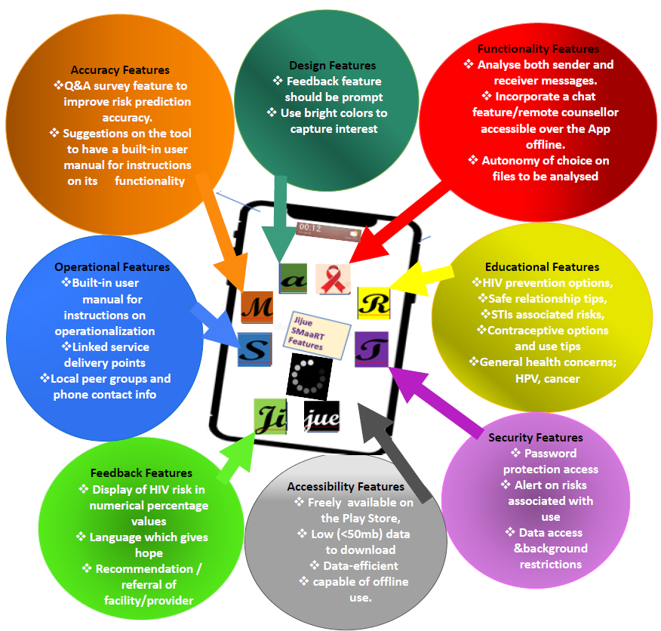
Implementation
Jijue SMaaRT can be implemented both within the public clinic healthcare delivery system, and at community based health service points; including pharmacies, drop-in-centers, and other safe spaces.
Peer influencers and community health promoters could lead sensitization, adoptability, and use campaign initiatives.

Slide 15
Limitations
Data Manipulation Risk: Participants may intentionally delete or alter chats to appear at lower HIV risk or meet social expectations.
However, sustained app usage over time will most likely scatter the consistency of such falsification.
Limited Perspectives: The study did not include input from young men or older adults.
Their perspectives could offer valuable insights and should be incorporated in future clinical trials.
Notes:
There were certain limitations to our study, which we have to acknowledge:

Slide 16
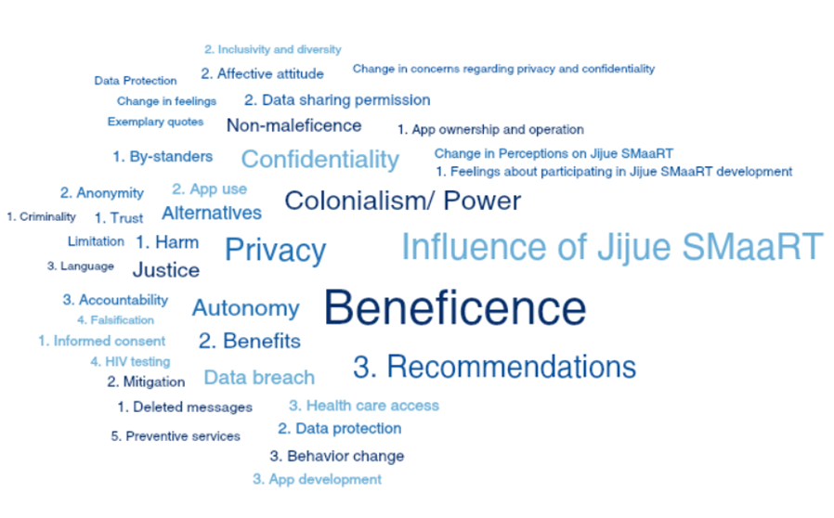
Conclusions
Ethical Guidance for Innovation:
The findings provide valuable ethical direction for researchers developing AI-based tools for HIV prevention and broader health applications.
Implications for Ethics Review:
Highlights the need for clear standards to protect participants when studies involve smartphone data and sentiment analysis.
Call for Responsible Design:
Emphasizes that ethical integrity must guide AI health tool development.
The SMaaRT study offers practical insights for informed consent, data stewardship, and responsible innovation in HIV risk prediction.
Notes:
Ethical integrity is key to designing AI health tools. The SMaaRT study contributes actionable insights to guide consent, data handling, and responsible innovation in sentiment-based HIV risk prediction.
These findings provide guidance for researchers developing AI-based prediction tools in HIV prevention and health behavior analysis. They highlight the importance of safeguarding ethical principles such as privacy, confidentiality, and non-maleficence. The study urges ethical review boards to establish clear standards for participant protection in sentiment analysis research. Publication of these insights aims to inform broader discussions around data ethics in digital health innovation, offering value to future studies on responsible AI tool development.

Slide 17
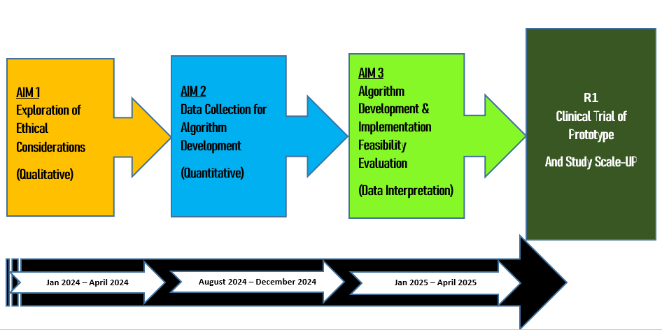
Next Steps
Findings will inform the development of a scalable risk prediction prototype, with potential for full-scale clinical trials.
Broader insights will support ethical frameworks for integrating AI in digital public health globally.
Notes:
These findings will inform the development of a scalable risk prediction prototype, with potential for full-scale clinical trials.
Broader insights will support ethical frameworks for integrating AI in digital public health globally.
The study will inform a future large-scale clinical trial in Kisumu, involving thousands of women and linking app-generated HIV risk insights to real-world incidence.

Slide 18




Acknowledgements
We, the author and co-authors, express sincere gratitude to all our study participants, funders, collaborators, and institutions.
Authors
Alfred Odira¹, Zachary Kwena¹, Kevin Oware¹, Lydia Adiema¹, Perez Ochwal¹, Marion Hewa¹, Josephine Odoyo¹, Bernard Rono¹, Lindsey Garrison², Elizabeth Buk usi¹, Jessica Haberer^{2,3}
Institutions
Kenya Medical Research Institute
Massachusetts General Hospital
Harvard Medical School
US National Institute of Health (NIH): R21MH132436
Contact Information
Alfred Odira Ochiel, aochiel@kemri-rctp.com; alfodira@gmail.com; +254738640649

Slide 19
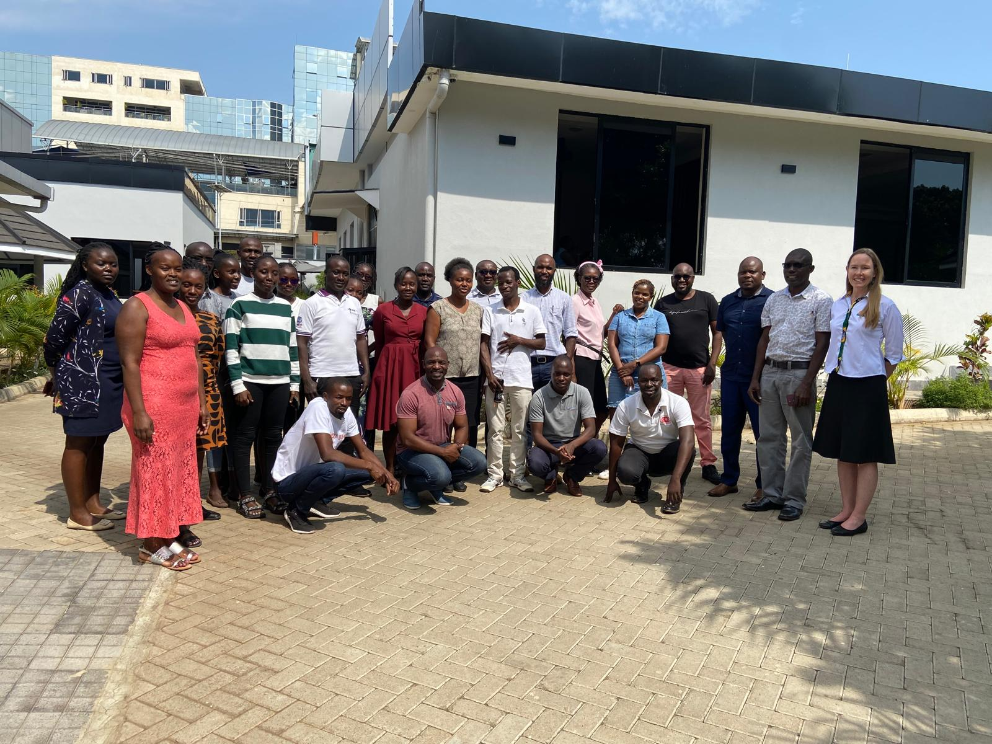
Thank you! Asanteni!
Study Team
There is need for more novel approaches to help populations be aware of their individual HIV acquisition risk levels; and, hopefully, thereby spark deliberate preventive action. There is need for more novel approaches to help populations be aware of their individual HIV acquisition risk levels; and, hopefully, thereby spark deliberate preventive action.

