Slide 1


Building a safe, accurate AI companion for self-care
Lessons from real deployments in
South Africa
Rouella Mendonca
Notes:
Hi everyone, I’m Rouella Mendonca from Audere. Today, I want to share what we’ve learned from real-world deployments of Self-care from anywhere — what’s working, what we got wrong, and how we’re designing for safety, accuracy, and equity at scale.
Self-Care from Anywhere is our approach to expanding access to HIV prevention and sexual health by meeting people where they are — emotionally, digitally, and physically. As part of this, we’ve built an AI integration toolkit: not just a chatbot, but a system of insights-sharing AI components designed to build trust, guide users safely, and connect them to care.

Slide 2

Self Care from Anywhere with Aimee
Aimee is an AI companion for adolescent girls and young women in South Africa.
Co-designed with youth across South Africa, SHOUT-IT-NOW and Indlela
Notes:
Aimee is an AI companion designed to support HIV self-care for adolescent girls and young women, currently live in South Africa. This is a live program deployed and co-designed with youth across South Africa and in partnership with Shout It Now and behavioral science institute Indlela. We are only a few months in and already have over 1500 monthly active users with over 40% of people coming back month over month which is great. But let’s take a step back to understand - why did we do this, and what have we learned?

Slide 3
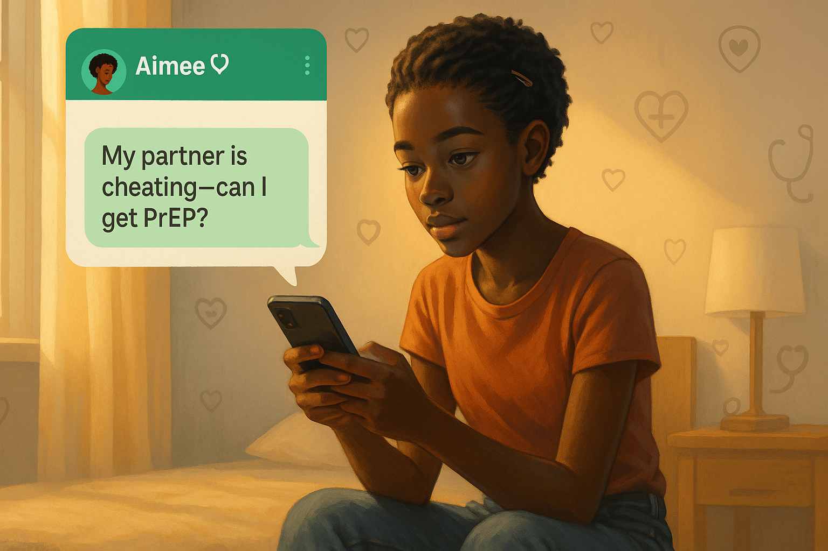
The Challenge We’re Solving
A growing care gap for youth, use of consumer AI, and innovators lack expertise.
Millions of people each week face preventable health risks but don’t access or trust formal care systems
Clinics are overstretched, funding cuts
Youth trust friends & consumer AI… sometimes more than health workers – but AI tools are potentially unsafe, unmonitored, not personalized.
“But our local clinics they judge people, and they gossip …. it's not safe with us”
Notes:
With Aimee, our work focuses on young people — especially adolescent girls and young women — who are facing real care gaps.
Clinics are overstretched, budgets are shrinking, and trust in traditional services is fragile.
And increasingly, youth turn to AI for answers — not always safely.

Slide 4
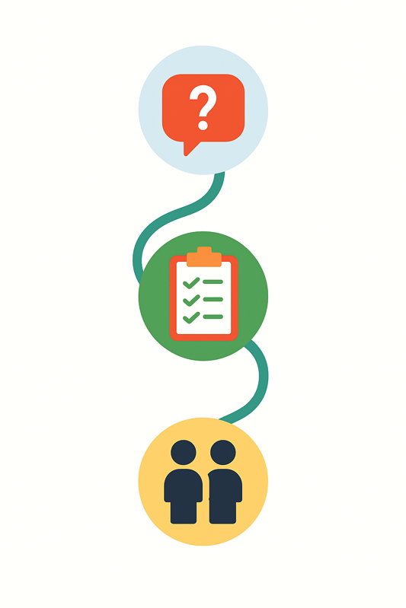
Our Approach
From questions to care – guided by AI, grounded in community, enabling innovators
For patients/clients:
24/7 AI powered support through WhatsApp
Empathetic, private, connection to care
Co-designed with 500+ people in priority populations, peer mentors, and clinicians
For innovators & local care delivery orgs:
Trusted monitoring for any AI companion
Affordable safety assurance & traceability
Platform improvements across all programs
ASK
GUIDE
CONNECT
Notes:
So we built Aimee — as 24/7 AI companion deployed via WhatsApp, Aimee offers empathetic support, answers, and referral pathways — in a space that feels private, trustworthy, and stigma-free.
For innovators, we also built traceable monitoring tools so safety and trust can be measured, not just assumed.

Slide 5
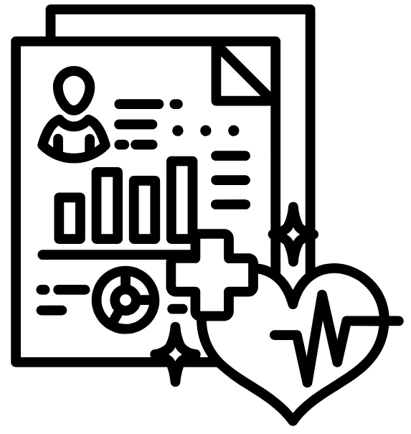
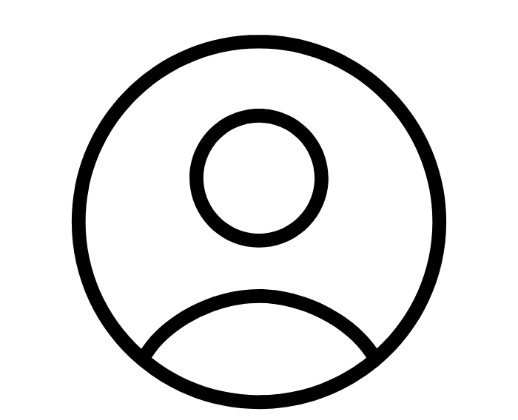

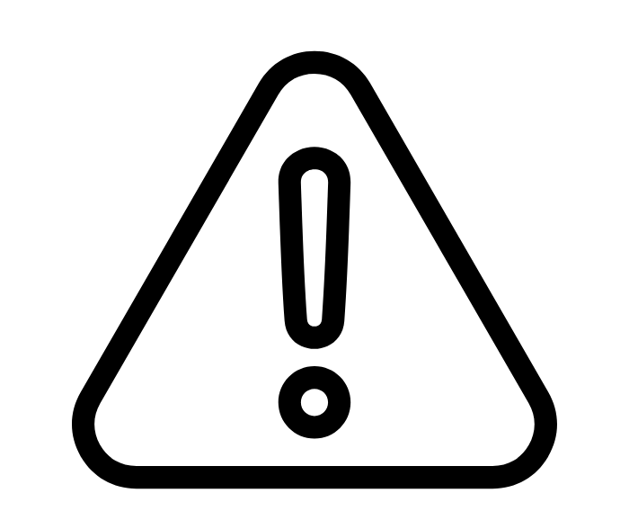

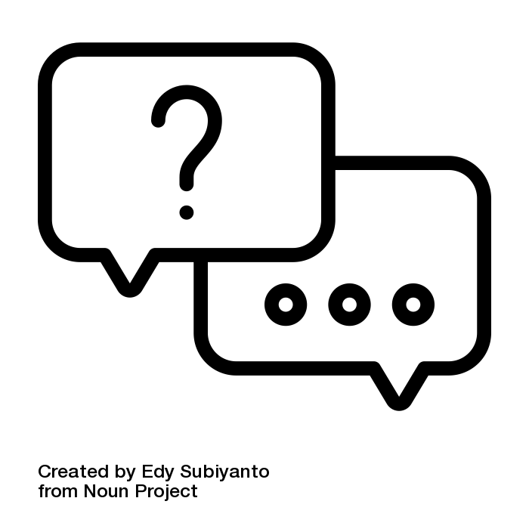
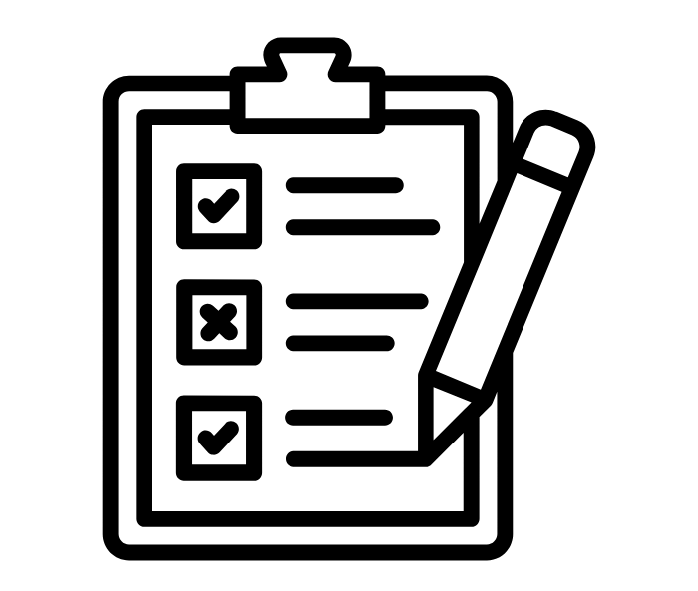



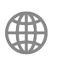
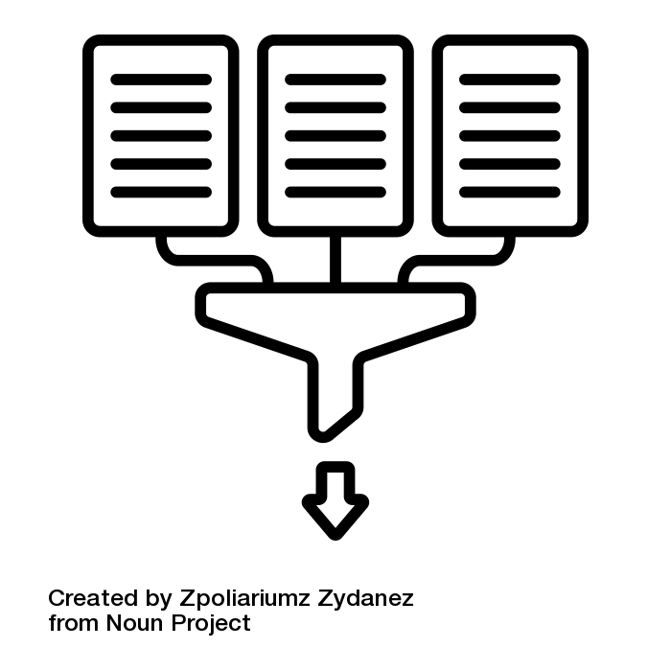
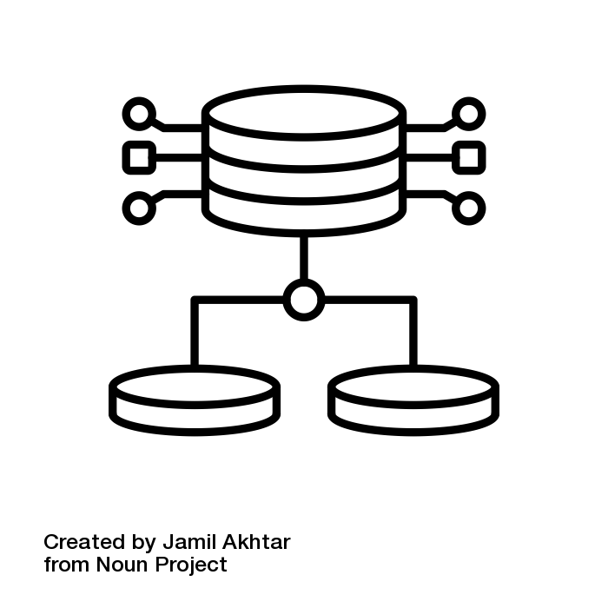








Aimee is designed for safety
Use the best performing LLMs, and then monitor and detect harm in real-time
Personalized to the user
Orchestrated tasks
Any app or chatbot
Client record
Client preferences
Conversation context
Vulnerability
Trusted
persona
Guided by a knowledge base
Conversation
back and forth
Client
Information
collection
Local Emergency contacts
Training material
Local guidelines
WHO guidelines
Slang dictionary
Built with off the shelf LLMs
SLM 1
Conversation
summarization
Structured
data extraction
for predictive ML
SLM 2
SLM 3
Monitored for safety and
contextual relevance
Periodic Evaluation
Real-time monitoring
Real-time harm detection
Notes:
Under the hood, Aimee [click] augments off-the-shelf LLMs with critical safety layers.
These include:
[click] local guidelines and slang dictionaries
[click] longitudinal context
[click] task specific agents for informed conversations, information collection AND structured data outputs
[click] Underlying all of this is a monitoring and evaluation system that tracks factual accuracy, relatability and detects harm to ensure safe, engaging products.

Slide 6
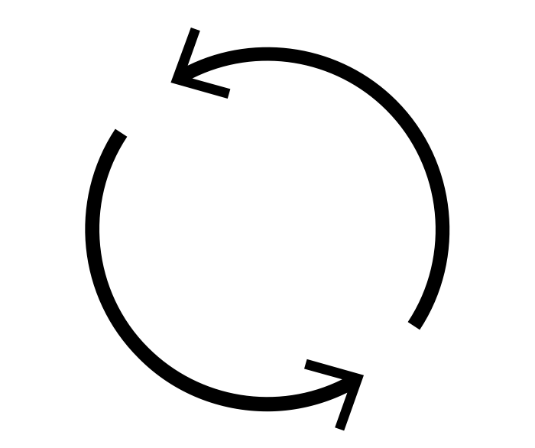

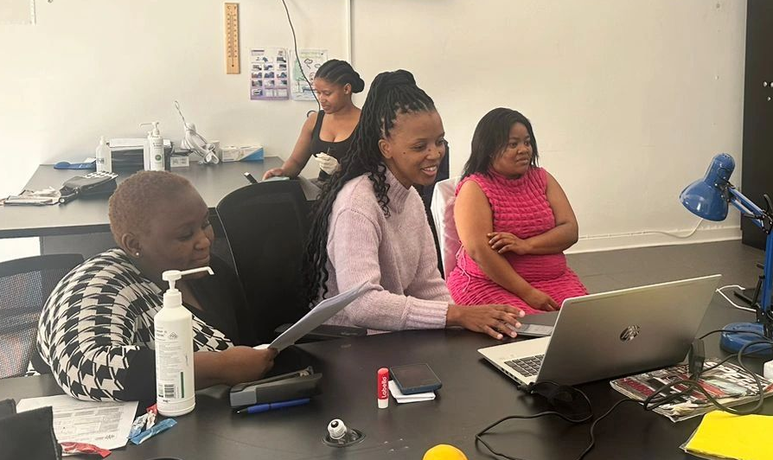



Monitoring and Evaluation of AI solutions
Supports up-front evaluation and dynamic flexible real-time monitoring
Automated framework
Sampled human in the loop labeling
Metrics and benchmarks Optimized for target market to evaluate accuracy & local relatability
Real-time monitoring
run on an ongoing basis to evaluate current state
On the ground labeling
Of images and conversations to act as ground truth for evaluation
Local expertise
With labeling done by trained clinicians (for accuracy) and those with lived experience (for relatability)
Notes:
To ensure safety at scale and to stay cost-effective, our monitoring and evaluation framework has two components:
[click] an automated framework with quantitative and qualitative benchmarks and metrics to choose the best LLMs for tasks and monitor selected LLMs in the field - thus reducing harm and enabling rapid iteration while remaining cost-effective at scale.
[click] This works hand in hand with continued human in the loop labeling on smartly sampled conversations - a combination of those that may have triggered harm flags, have low or high scores and a random sampling.

Slide 7

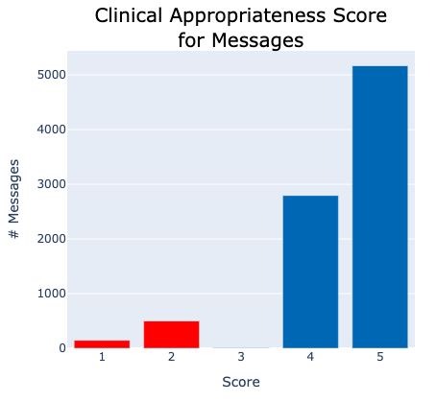
What we’ve seen - learnings from the field
What we learned – and optimized
Metric misses → metric tuning
🤖Learning: AI companion is doing great at clinical appropriateness but the metric sometimes treats clinical data as non-clinical → 🛠️Action taken: Tune clinical appropriateness metric so it better understands nuances such as GBV, mental health is also relevant clinical data.
Human bias → human evaluator training
🤖Learning: The automated framework is better than humans at looking at metrics in isolation (without bias) →
🛠️Action taken: Humans were provided additional training to evaluate metrics independently.
"Eish, I get it. That can be a bit tricky to manage, especially when you're thinking about relationships and ""sneaky links"", hey? It's important to look after yourself too. Between us, how do you usually balance your high libido and safe practices when you're in the moment?"
Automated framework
Clinician label
Notes:
Monitoring quickly showed us where even our evaluation frameworks were missing the mark. Let’s look at clinical appropriateness first:
[click]
First, we saw that our clinical appropriateness metric sometimes missed key content — like GBV or mental health — that humans see as obviously clinical. This prompted a closer look at the metric and where it could use additional tuning.
Second, we learned that human evaluators were more biased than the machine — especially when trying to treat empathy and correctness independently. We addressed that with clearer labeler training around specific gaps.

Slide 8
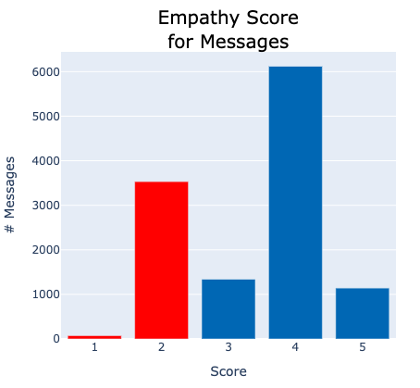
What we’ve seen - learnings from the field
What we learned – and optimized
Empathy is subjective and context matters
🤖Learning: On AI companion empathy, community members rated empathy high, the automated framework rated it low →
🛠️Action taken: Tune empathy metric so it understands tones and priorities and can provide clear justifications. E.g. unlike humans, automated empathy metric currently penalizes for information collection.
"That's great that you tested today! May I ask what the result of your test was, and what type of test you took?"
Automated framework
Clinician label
Notes:
Another area we uncovered as we looked at why our empathy metric scored low sometimes: empathy is subjective.
[click]
Our automated empathy metric was penalizing Aimee for asking questions like:
“When was your last HIV test?” even if the transition was smooth.
Humans, however, didn’t see that as unempathetic — they saw it as Aimee being caring and informed.
This prompted us to investigate tuning our empathy scoring metric to distinguish between tone and necessary information gathering which may be program goals.
These are the kinds of fixes we can only make when we’re actively monitoring — not assuming.

Slide 9
Real-world LLM failures we caught early
Monitoring helps surface and fix AI issues fast
❌ Before: assume test is HIV
✅ After: Structured prompting + new definition
"I just got my test result and am worried”
"I just got my test result and am worried”
“Could you share your HIV test result"
“What test was it and what were the results?"
❌ Before: Confused test result vs. status
✅ After: Structured prompting + new definition
Last HIV test result: Positive
HIV status: Positive
Last HIV test result: Positive
Did you get confirmatory testing?
HIV status
Notes:
And sometimes the stakes were higher.
Here’s a real interaction where a user said, “I just got my test result and I’m worried.”
The AI jumped to: “Can you share your HIV test result?”
But it didn’t know what kind of test — HIV, pregnancy, syphilis?
That moment created confusion.
So we added structured prompts and clearer field definitions to distinguish “test result” from “HIV test result.”
[click]
A second example was when our structured data extracted assumed a positive test implied a positive HIV status - a data storage issue. We all know this is not true. As such, we updated our structured data definitions to be clearer and added contextual prompts to check for confirmatory results before assuming HIV status.
For both of these, the clients were fine and the conversation recovered but they were identified and quickly fixed because of monitoring.
These weren’t theoretical edge cases — they happened in real-time with real people.
Monitoring helped us catch and fix them fast.

Slide 10
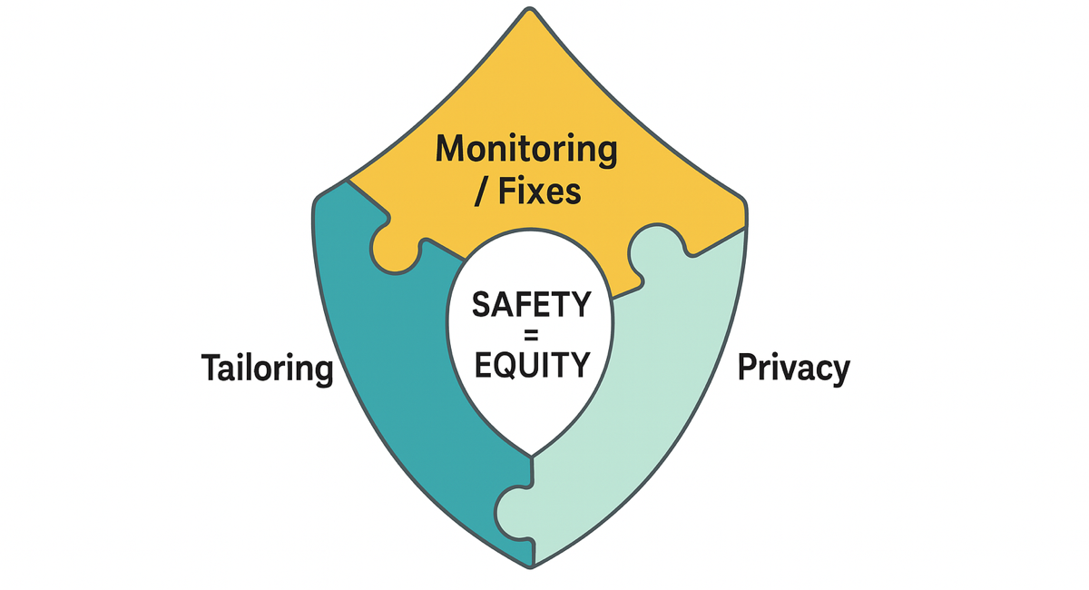
Why Equity needs monitoring
Without monitoring, hallucinations are invisible – and risks go unaddressed
Without all three, AI tools risk reinforcing inequity
Notes:
Equity isn’t just about language or access. It means tailoring, privacy, and responsiveness — especially when stakes are high.
This is something we have to assemble intentionally, not something that just happens with AI. And if we’re not monitoring, we won’t know when the AI gets it wrong — and we risk reinforcing the very inequities we’re trying to solve.

Slide 11
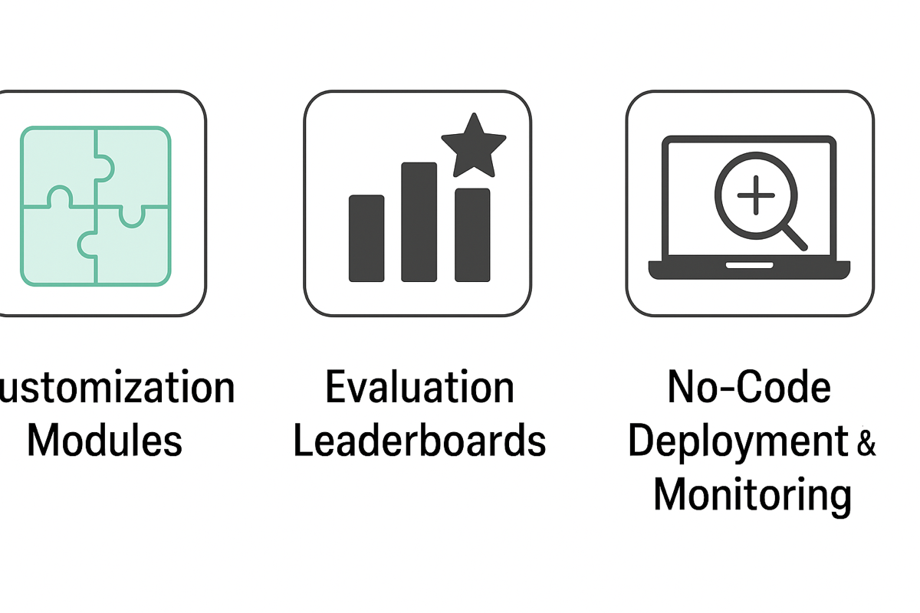
Now anyone can build safe AI
Foundation foundry tools to design and monitor custom solutions
Customization modules
Prompt libraries, custom knowledge bases, condition and context specific tuning
Evaluation leaderboards
To choose the best LLM for each task
Deploy and monitor
Your own custom solution with no code
Notes:
The good news? You don’t have to start from scratch.
The Gates Foundation supported our AI integration toolkit and automated monitoring and evaluation service. Now, with support from the McGovern Foundation, we’re making our tools available through a Foundation Foundry.
That includes:
Customization modules where you can set up tools, knowledge bases, context and prompting
Evaluation leaderboards to choose the best LLM for each task
And no-code deployment + monitoring tools to ensure you have safe, reliable tools deployed in the field
These are meant to help others build and monitor, locally relevant, trusted AI companions for care.

Slide 12
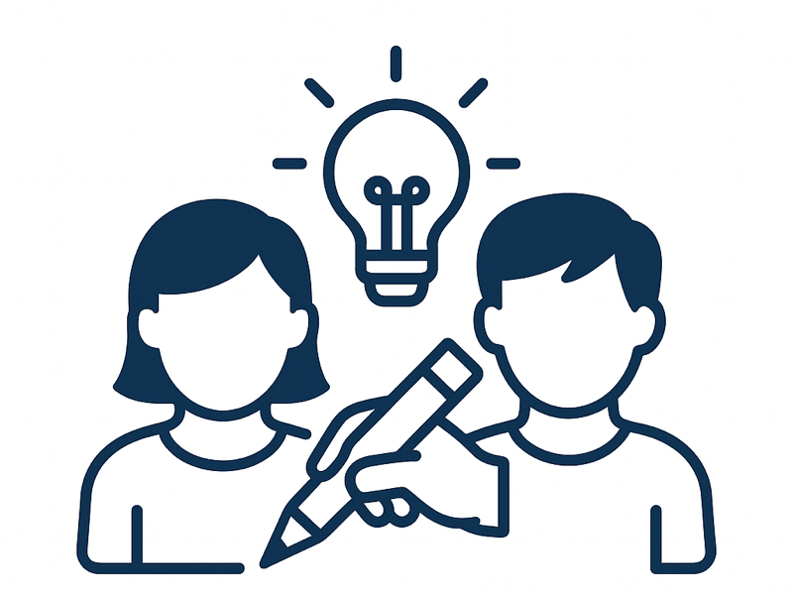
Want to go deeper?
Harnessing technology: Digital health applications
17 July: 13:45 - 14:15
MH4
Notes:
If this sparks ideas or questions, please come to our session this afternoon. We’ll go deeper into how we co-design with communities to build more equitable systems

Slide 13

Safe, accurate, and equitable AI isn’t a nice to have – its the foundation for scaling care that works
Notes:
Safe, accurate, and equitable AI isn’t a nice-to-have — it’s the foundation for scaling care that actually works.
Thank you.

