Slide 1

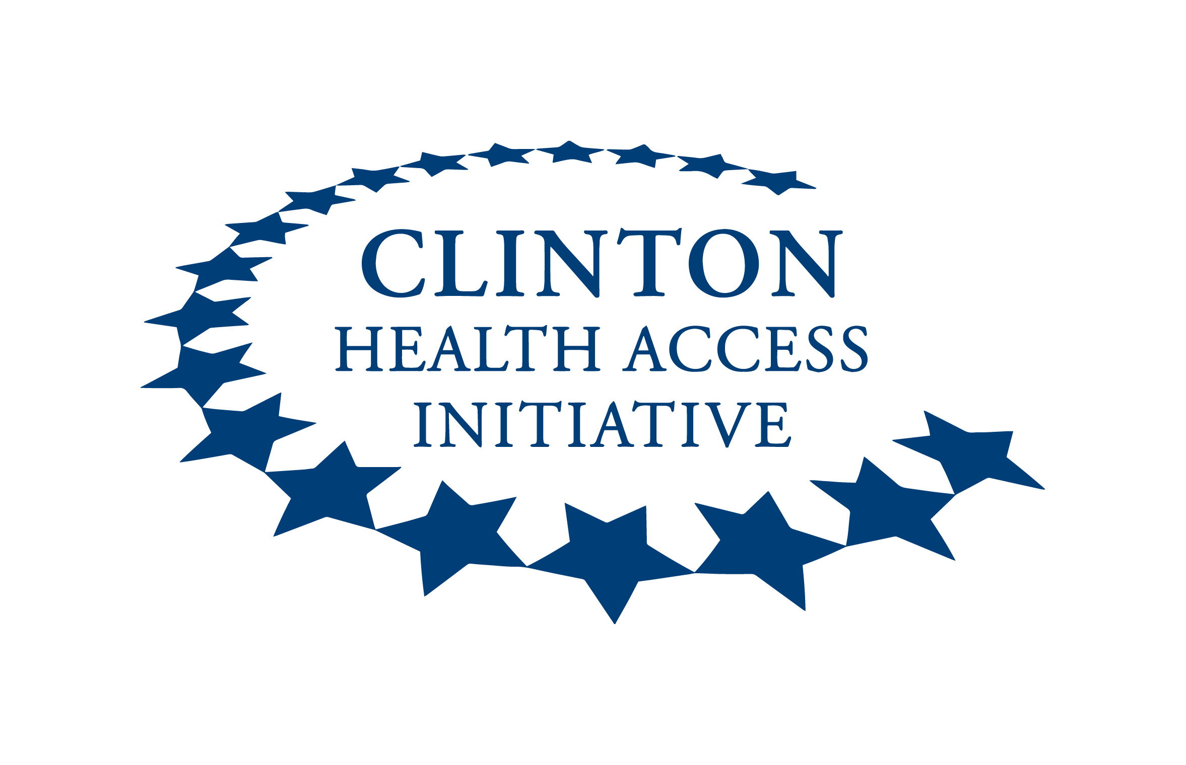

Assessing the impact of USG funding cuts on Zambia’s HIV Prevention programming: a retrospective review of PrEP and VMMC uptake (2024–2025)
Madaliso Silondwa, Clinton Health Access Initiative
Session title: No retreat, no surrender: Sustaining the HIV response in times of turmoil

Slide 2
Summary
Main question:
What was the immediate impact of uptake on PrEP and VMMC following the recent USG funding cuts on HIV programming in Zambia
Findings:
Both PrEP and VMMC uptake declined significantly, with performance falling below 50% of quarterly targets.
ART coverage remained stable, indicating prevention services were more affected than treatment.
Why is it important:
The disruptions reversed key prevention gains, especially in high-burden provinces. This threatens epidemic control and highlights the need for more resilient, government-led systems and diversified financing to sustain HIV programming.

Slide 3

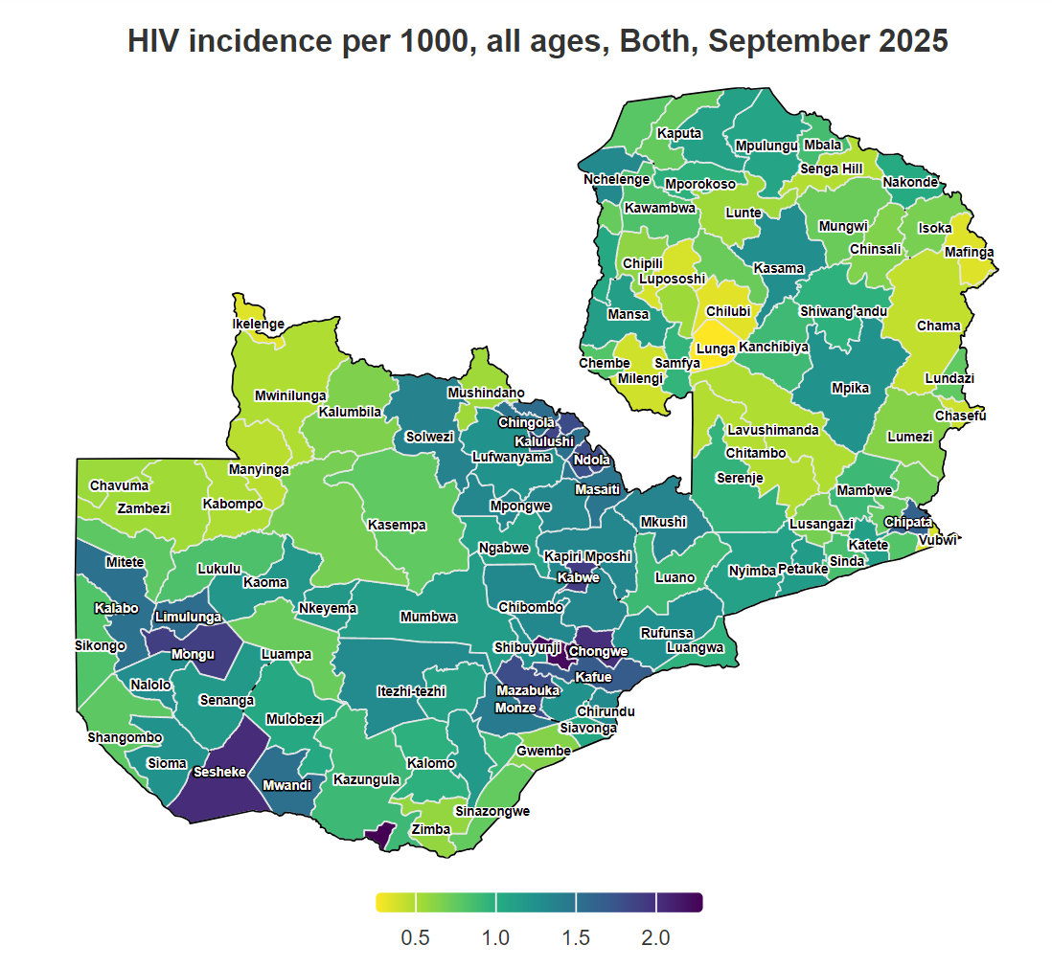
Background
HIV incidence per 1,000, all ages
Total Population: 20 million
Zambia has made strides in reducing the HIV burden with annual new infections dropping by over 50% between 2017 and 2024

Slide 4
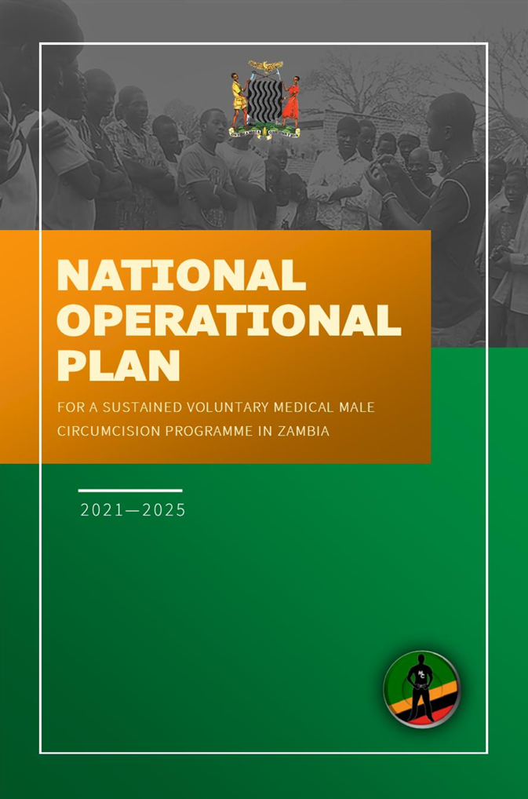
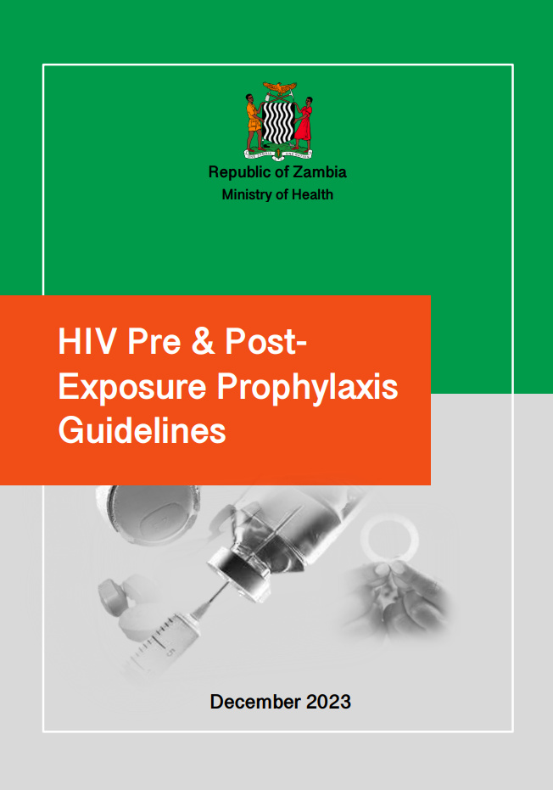

PrEP & VMMC in Zambia
Zambia’s PrEP program has grown rapidly since 2017, with >190K initiations in 2024 through >2.2K sites
Zambia’s commitment to curb HIV has driven strong investments in programs such as VMMC & PrEP
Expansion of these programs has been driven by significant funding from the US government
However, recent funding cuts introduced disruptions, with implications for Zambia’s ability to sustain epidemic control

Slide 5



Methodology Overview
A retrospective observational analysis was conducted using secondary data from Zambia’s Ministry of Health DHIS2 platform, the national HMIS.
  • Timeframe: Quarter 1 of 2024 compared to Quarter 1 of 2025
  • Indicators analyzed: PrEP Initiations, VMMC Uptake, ART Clients
  • Funding model comparisons: USAID/CDC supported provinces
ART
VMMC

Slide 6
Declines in VMMC & PrEP uptake and stability with treatment
HIV Treatment (ART Clients)
VMMC
42% DECLINE
ART
Stable ART following January USG funding cuts compared to a 42% and 59% decline in VMMCs performed and PrEP initiations respectively
While service delivery has continued through government staff, reductions in human resources, demand generation, and community work limited PrEP & VMMC access, with some services fully down​
59% DECLINE

Slide 7
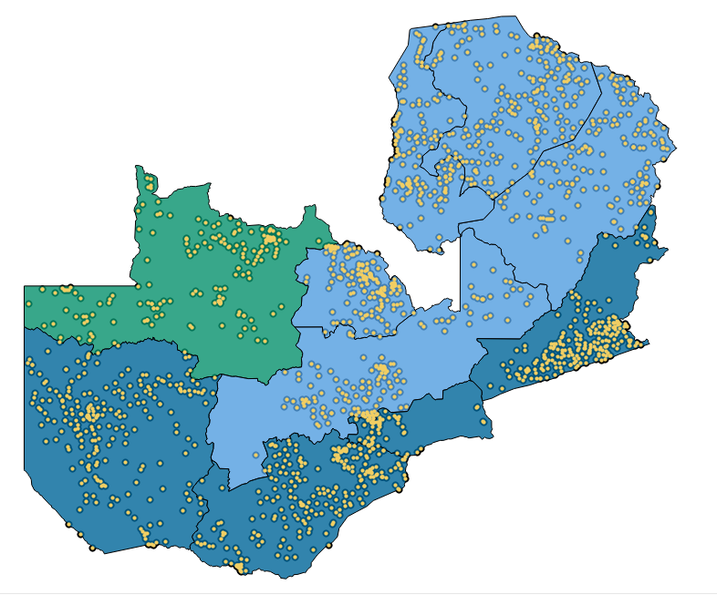
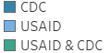
Larger declines seen in USAID supported provinces
66% decline in PrEP & VMMC in USAID-supported provinces
Zambia’s HIV prevention scale-up has been supported through two key USG mechanisms:
  USAID: partner-driven model focused on service delivery and outreach.
  CDC CoAg – Funds Sub-National Health Offices (SNHOs) to strengthen government-led HIV systems.
Greater declines observed in USAID-supported provinces
40% decline in PrEP & VMMC in CDC-supported provinces

Slide 8

Conclusion
To sustain HIV prevention gains and achieve epidemic control, Zambia and other countries must:
Mobilize domestic resources to reduce donor dependency
Re-prioritize HIV prevention in national planning
Adapt delivery and demand models to ensure cost-effectiveness and sustainability
Invest in system resilience to buffer against funding disruptions
ZAMBIA ENDING AIDS

Slide 9
Special Thanks
Belia Longwe
Chimika Phiri
Mwaba Mulenga
Ambele Mwamelo
Janeen Drakes
Danielle Resar
Prudence Haimbe
Hilda Shakwelele
Lloyd Mulenga

