Slide 1


A community of practice of Director Generals of National AIDS Coordinating Authorities of Africa, Asia and Latin America
  COUNTRY HIV TRANSITION READINESS
  A report of Country challenges and opportunities
With the Technical Support of

Slide 2
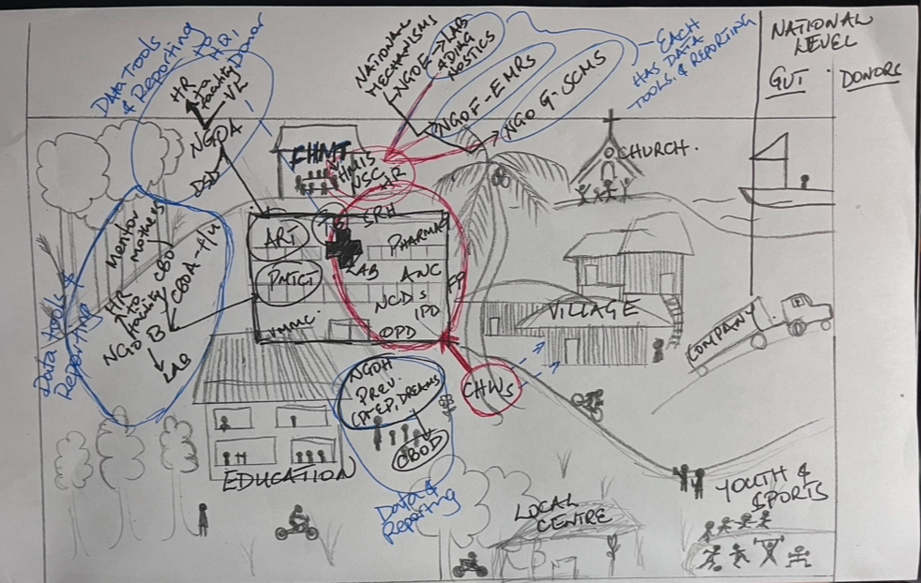
In 2024, the Forum develop a position paper on sustainability- Leveraging Country Leadership to Advance Resilience for a Sustainable HIV response pre and post 2030
A donor driven HIV model that is (WAS) incompatible with government managed services
Vertical model (funded off-budget, delivered directly thro’ NGO implementing partners) has facilitated scale, progress
But
created multiple overlapping parallel programmes and delivery systems- data tools, EMRs & systems, diagnostics platforms, surveillance and supply chains that operate in parallel to the public health infrastructure (even when co-located)
Donor funded, NGO deployed HIV work-force cannot be absorbed in government service due to disparate Ts&Cs across different NGOs & with govt procedures
High and unsustainable costs of delivery
This system, actors, programmes and costs - largely invisible to Government

Slide 3
2025 necessitated a shift from thinking sustainability to focus on immediate Transition..
Position paper on sustainability issues and challenges (October 2024)
Tools for countries to review HIV operating system (December 2024)
Stop Work Order (January 21st 2025)
DGs meeting to share/review status (31st January 2025)
- Determine to adapt tools to focus on current country status & transition readiness
Tools developed and reviewed by the DGs sustainability thought leadership group
Tools sent to countries on 12th February
THE HLF developed tools - Country transition readiness
- Country pain-points
- Country assets and opportunities
Data from 19 countries
- 14 Africa
- 3 LAC
1- EE
(Presentation from 14 African countries)

Slide 4
Governments facilities are operational; and Governments immediately pivoted HIV service delivery to accommodate treatment for PLHIV and to be delivered along-side other health services
100% countries are issuing ARVS; PMTCT shows highest resilience due to integration with essential maternal healthcare
75% of standalone NGO services disrupted or shut down 69% of community services disrupted or shut down
**NGO and community services are on-going in LAC where they are largely locally funded

Slide 5
DATA ECOSYSTEM STATUS
100% countries reported some form of disruption
  Patient data and EMRs supported by NGOs at facilities are not operational and are inaccessible, (some patients were transferred without records)
  Data for supply chain maintenance and management (F & Q, procurement and commodity tracking and distribution data)
Highest disruptions were seen where parallel data systems were in place - NGO funded, or National PEPFAR Mechanisms
NO prevention data (perhaps except the indicator on PEP, PrEP in many countries)
Surveillance systems and historical data are fractured
Countries without an exchequer funded HMIS (relied mainly on PEPFAR) experienced more significant disruption in their data systems

Slide 6
COUNTRY SUPPLY CHAIN FUNCTIONALITY AND COMMODITY STOCKING LEVELS as at April 2025
** these stock levels were residual pre-January shipments
100% countries experienced supply chain disruptions in varied ways
Levels of functionality of supply chain elements differ in country depending on their reliance on NGOs for management
Data limitations for planning and decision-making posed biggest challenges for supply chains restoration
** Countries whose HIV procurement and supply chain relied on national systems reported less disruption
** HIV prevention supply chains which were largely NGO managed are most affected
What happens after 9 months? Given the

Slide 7
HUMAN RESOURCE ATTRITION
12 countries in SSA – HRH attrition from formal and informal health systems: 123,668
  APPROX 60% (67,252) frontline health workers (nurses, clinical officers, pharmacists, lab techs)
  44,502 community health volunteers
  Other donor supported staff refers to technical, administrative and logistics support staff within NGOs, CBOs: 56,416
Retention of this investment for the health sector, for HIV services? – challenges:
Donor funded NGO work-force had disparate terms and conditions from Government systems and therefore cannot be absorbed, even where there are resources
These HRH data (numbers, cadres, facilities they served etc) are locked with NGO partners and not available
Implications for:
  Quality of care
  DSD
  Community integration and follow up
  Programme management
  Self-care implementation

Slide 8
COUNTRY LEADERSHIP PROVIDED THE IMMEDIATE CUSHION AND IS DRIVING REBUILDING, SUSTAINING EFFORTS..
COUNTRIES WHERE NACs HAVE SOCIALIZED KEY INSTITUTIONS ON THE IMPACT OF THE CURRENT FUNDING TRANSITIONS ON THE HIV RESPONSE
OBSERVATIONS
Governments provided leadership with rapid adaptation – political capital, pivoted ART services
Decades of billions of dollars of investments in parallel investments fractured instantaneously
Public facilities struggling with sudden ART client influxes amid systems disruption requiring new models
Impact of Health worker attrition is unknown at this point
HIV Prevention systems –to reach populations, data, supply chain and surveillance will require rebuilding
Others – included Ministries of Foreign Affairs who have organized bi-lateral engagements with US Government as well as other partners

Slide 9
What is needed moving forward..
Government leadership and national systems
Invest in national systems – no more parallel, fragmented uncoordinated programmes and systems
HIV prevention
Prevention Stewardship
Cost and include HIV services (ART, testing, VL monitoring, PMTCT, VMMC) within Universal Health Care and/or social insurance packages
Rethinking partnerships
Self care- yes, with
Systems for data, supply chains and surveillance to decision-making (prevention commodity forecasting, quantification, targeting)
Faith leaders to drive self-care for prevention
Communities of persons living with HIV as partners with government and to drive community health systems
New models
Task-shifting models that leverage and integrate PLHIV networks and CBO services within national community health infrastructure
Leverage private and faith facilities for co-pay models at primary health care levels
The Global HIV Prevention Coalition – drive a Prevention RENAISSANCE
National AIDS Commissions to facilitate coordination across government agencies and institutions such as Parliament, Ministries of Finance to resolve on-going gaps,

Slide 10
  Thank you!
With the Technical Support of

