Slide 1
The impact of the U.S. funding interruption on HIV services and the HIV epidemic in Mozambique
Dorlim Moiana Uetela – Instituto Nacional de Saúde, Mozambique
Co-Chair's choice

Slide 2
Summary
What is our main question?
What is the impact of the U.S. funding interruption on HIV services and the HIV epidemic in Mozambique?
What did we find?
Marked declines in key HIV service indicators (ART initiation and viral load cascade) in February 2025 for male and female clients from all age groups, compared to the same month of the previous year; disproportionate impact on paediatric population.
Estimated increase in new HIV infections and HIV-related deaths by 2030.
Why is it important?
The findings highlighted the critical role of U.S. funding in sustaining the HIV prevention and treatment services in Mozambique. The funding freeze led to an immediate negative impact on HIV service outcomes and the potential alarming effect on the HIV epidemic, in case the funding interruption is sustained. Funding is urgently needed to mitigate these negative impacts.

Slide 3
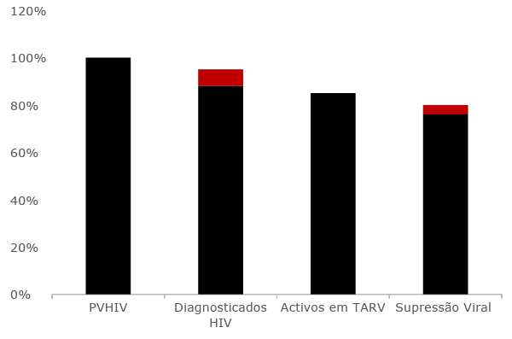
Background
The Country’s Epidemics and Progress
95-95-95 cascade
Mozambique has the 3rd highest number of PLHIV globally and the 2nd highest number of new infections.
ART is available since 2004, now offered in 97% of health facilities and serving approximately 2 million of the 2.4 PLHIV.
2.4 milion
7%
0%
6%
88%
95%
89%
PLHIV
Diagnosed
In treatment
Viral suppression
Source: National HIV Program, First Quarterly Report – 2025

Slide 4
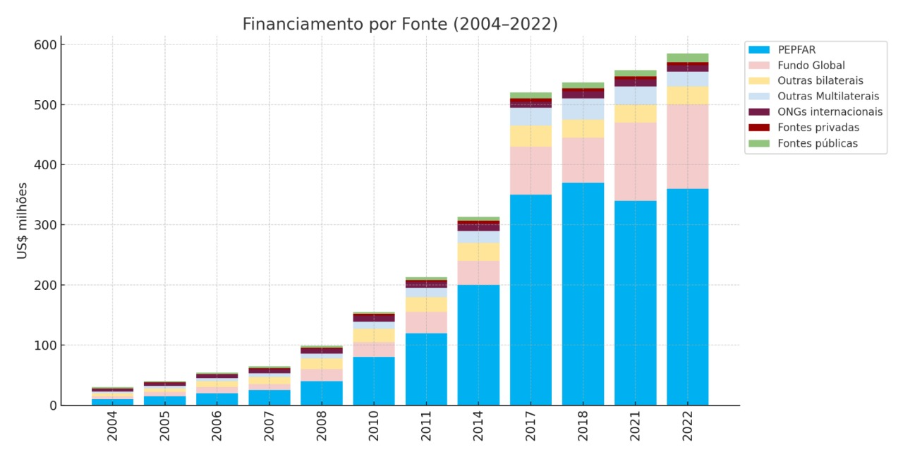
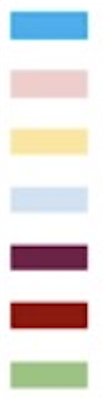
Background
The HIV funding scenario
Mozambique relies heavily on external funds for HIV response, with PEPFAR and the Global Fund being the major funders for over a decade
5%
2%
2%
2%
PEPFAR
Global Fund
Other bilaterals
Other multilaterals
US$ millions
International NGOs
Private sources
Public sources
69%
68%
70%
67%
Source: CNCS, Megas (2008, 2010, 2014, 2016, 2020, 2023)
Notes:
However, the country relies heavily on external funds to ensure HIV service provision, with the U.S. covering approximately 93% of the country’s expenses, mainly through PEPFAR that coveres aproximatedly 70%.
Then came January 2025 with then stop working order and the funding freeze

Slide 5
Aims
Assess the impact of the U.S. Government funding freeze on HIV service provision
Predict the impact of potential fund interruption on the HIV epidemic in Mozambique.
Notes:
At that time, we aimed to Assess the impact of the U.S. Government funding freeze on HIV service provision and predict the impact of potential fund interruption on the HIV epidemic in Mozambique.

Slide 6
The Impact on HIV Service Provision

Slide 7
Methods
Analysed routinely collected data from the national District Health Information System (DHIS-2)
Compared selected health services indicators in February 2024 to February 2025 (later expanded to the most updated available data)
  ART initiation
  Interruption in treatment
  Viral load cascade performance
Measured the absolute variation and relative change

Slide 8
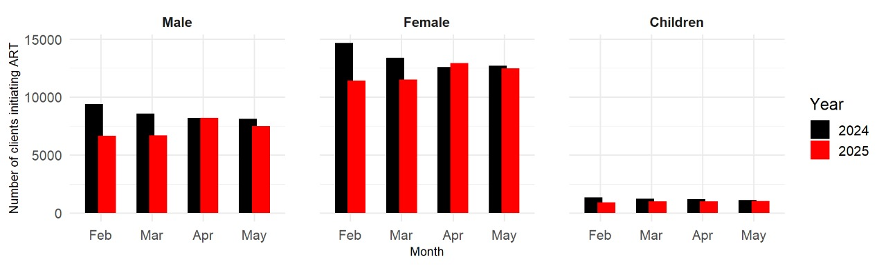
Results
Treatment initiation
There was a 14% decrease (15,727) in ART initiations from February to May 2025

Slide 9
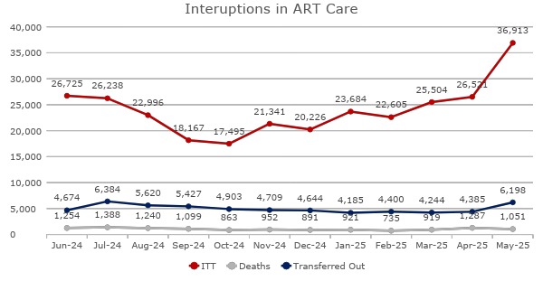
Results
Treatment interruption
Due to treatment interruption definition (59-day of a missed drug pick-up) the effect can only be observed starting in April 2025 – There was a 39% (10,392) increase from April to May 2025
Notes:
We don’t have enough observations to understand the trend

Slide 10
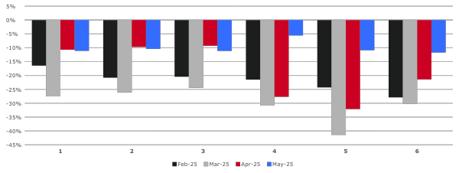

Results
Viral load cascade
For adults
Tests performed: 38% reduction (37,010)
Tests received: 37% reduction (27,656)
Viral suppression: 33% reduction (22,043)
For children
Tests performed: 44% reduction (37,010)
Tests received: 71% reduction (27,656)
Viral suppression: 43% reduction (22,043)
% change 2024 - 2025

Slide 11
The Impact on the HIV Epidemic

Slide 12
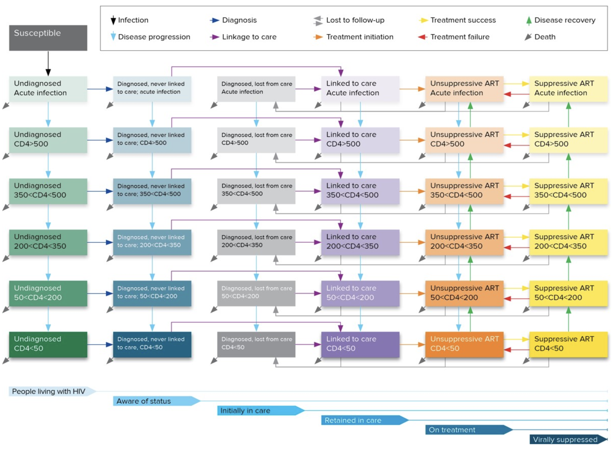
Methods
Used a published dynamic HIV transmission and disease progression model (Optima) calibrated to Mozambique data.
Compared the trend before January 2025 (scenario with funding continuation) to a scenario with funding interruption - assuming stagnation of the described selected indicators observed in February 2025
We simulated the impact of funding interruption on new HIV infections and HIV-related mortality until 2030.
Optima compartimental dynamic model
Source: https://optimamodel.com/hiv/

Slide 13
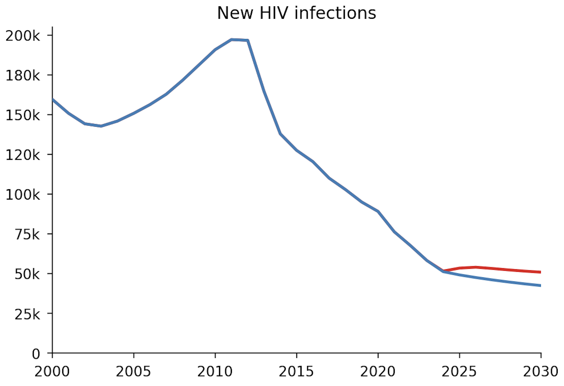
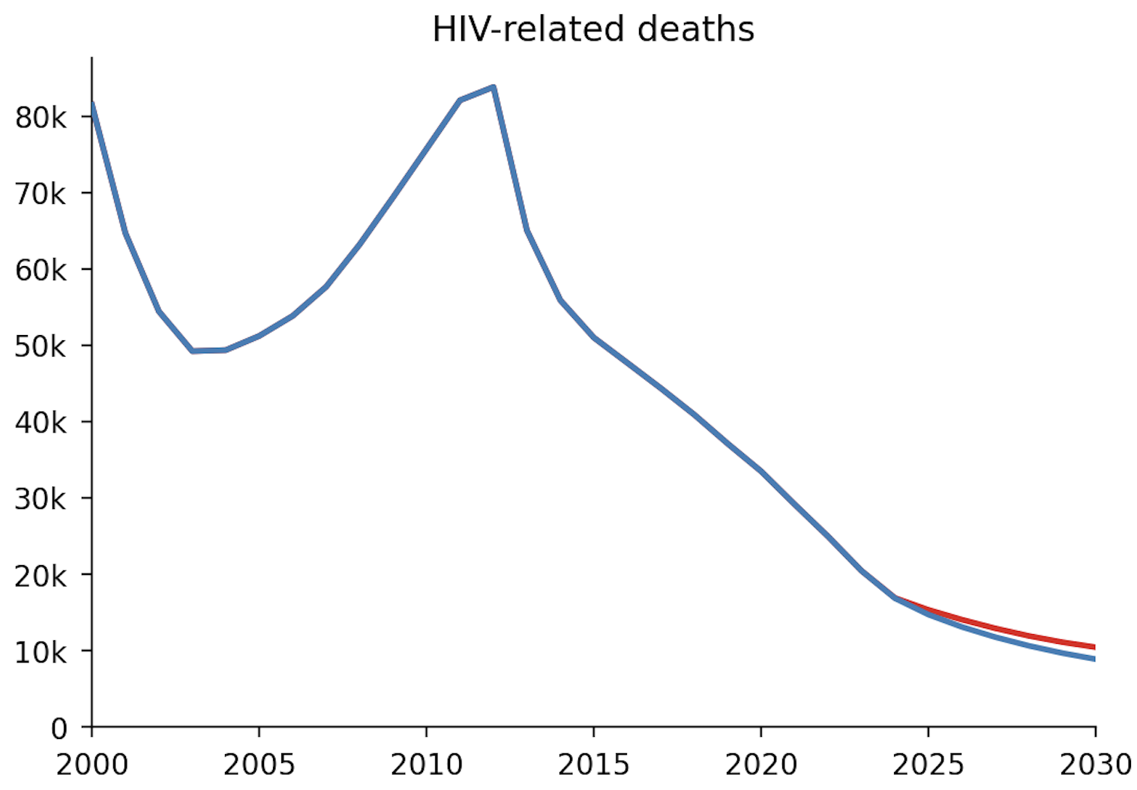
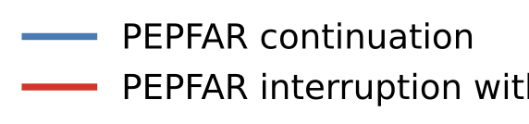
Results
Modelled Scenarios
Estimated increase of 83,000 new HIV infections (15%) by 2030
Estimated increase of 14,000 HIV-related deaths (10%) by 2030
PEPFAR continuation
PEPFAR interruption
Source: Optima HIV model

Slide 14
Discussion and Conclusion
Mozambique’s progress in addressing the HIV epidemic has been driven in large part by the effective collaboration between the Ministry Health and donors like PEPFAR and the Global Fund.
The stop-work order and subsequent change in the funding scenario disrupted the country’s health system (human resources and operations) leading to an immediate impact o HIV service provision.
These are conservative estimates of the impact on the HIV epidemic:
  Not all the parameters affected were modelled
  The possibility of ongoing funding changes
Securing sustainable funding sources is essential to sustaining progress toward eliminating HIV as a public health threat in Mozambique.
Notes:
1. Trabalhadores comunitários

Slide 15
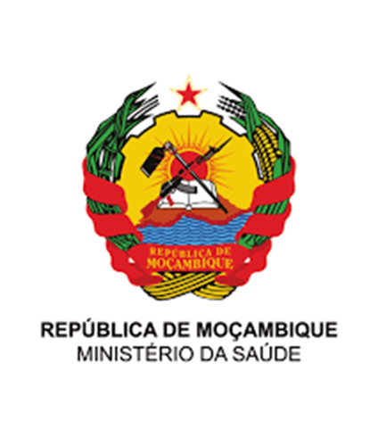




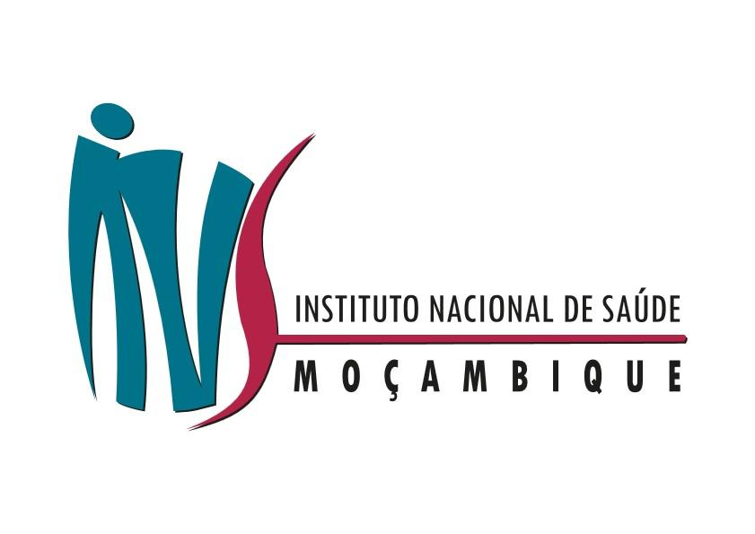






Acknowledgments
Co-authors
Orrin Tiberi
Rachid Muleia
Yara Paulo
Irénio Gaspar
Patrícia Ramgi
Nick Scott
Rowan Martin-Hughes
Natasha Martin

Slide 16
Thank you!

