Slide 1


Modelling the impact of cuts in PEPFAR funding for HIV pre-exposure prophylaxis among key populations in sub-Saharan Africa
Jack Stone – University of Bristol

Slide 2
Summary
What is your main question?
What would be the impact of ceasing PEPFAR’s provision of PrEP for all individuals in sub-Saharan Africa except pregnant and breast-feeding women?
What did you find?
Ceasing PEPFAR’s funding for PrEP in sub-Saharan Africa will remove over 700,000 individuals from using PrEP. If this continued for one year, then 10,000 additional HIV infections could occur over the next five years.
Why is it important?
Highlight the need to find funding to continue and expand PrEP services, particularly among key populations.

Slide 3
Background
PEPFAR accounts for > 90% of global initiations on to oral PrEP
  Key populations account for a fifth of PEPFAR’s provision of PrEP
PEPFAR’s provision of PrEP is in jeopardy due to the US government’s recent stop-work order on all foreign aid at the end of January 2025¹.
Waiver for providing PrEP for pregnant and breastfeeding women
  All other PrEP services were put on pause until further notice^{2,3}
No waiver was given for PrEP among key populations, with funding for PrEP services for these populations largely stopped³
1. Ratevosian et al. Lancet 2025; 2. Lankiewicz et al. JAIDS 2025; 3. UNAIDS Impact of US finding cuts on the global AIDS response

Slide 4
Model
We developed a static model to estimate the short-term impact of ceasing PEPFAR funding of PrEP for everyone except pregnant and breast-feeding women
For different sub-populations, including each key population, the model estimates:
  Proportion of HIV-negative people receiving PrEP funded through PEPFAR (‘coverage’).
  Number of additional HIV infections that would occur over one year if PEPFAR-funded PrEP is suspended for one year – ‘Primary Infections’
  Number of secondary infections that could result from these primary infections over 5 years

Slide 5
Model Parameterisation
Number of people receiving PrEP funded through PEPFAR: PEPFAR monitoring and evaluation data on numbers returning for PrEP follow-up visit during July-Sep 2024
Country-level estimates of Population size and HIV prevalence and incidence
  Global^{1,2} and regional³⁻⁵ systematic reviews for key populations
  Age- and sex-stratified estimates of prevalence (UNAIDS) or incidence from existing nationally representative studies (sub-regional estimates if unavailable⁶)
HIV transmission rates: Sub-regional estimates for each group from model comparison analysis of 15 models in Africa⁷
Assumed different levels of PrEP effectiveness by population
  On average, 75% for MSM and TGW⁸, 49% for PWID⁹, and 39% for FSW^{10,11}
  For non-key populations, we used sex-stratified estimates¹¹: 69% for men and 31% for women
1 Degenhardt et al. Lancet Glob Health 2023; 2 Artenie et al. Lancet Gast Hep. 2023; 3 Stevens et al. Lancet Glob Health 2024;
4 Stannah et al. Lancet HIV 2023; 5 Jones et al. Lancet Glob Health 2024; 6 Rosenberg et al. Lancet HIV 2023; 7 Silhol et al. (Ongoing Work); 8 Murchu et al. BMJ Open 2022; 9 Choopanya et al. Lancet 2013; 10 Mpirirwe et al. BMJ Open 2024; 11 Chou et al JAMA 2023

Slide 6
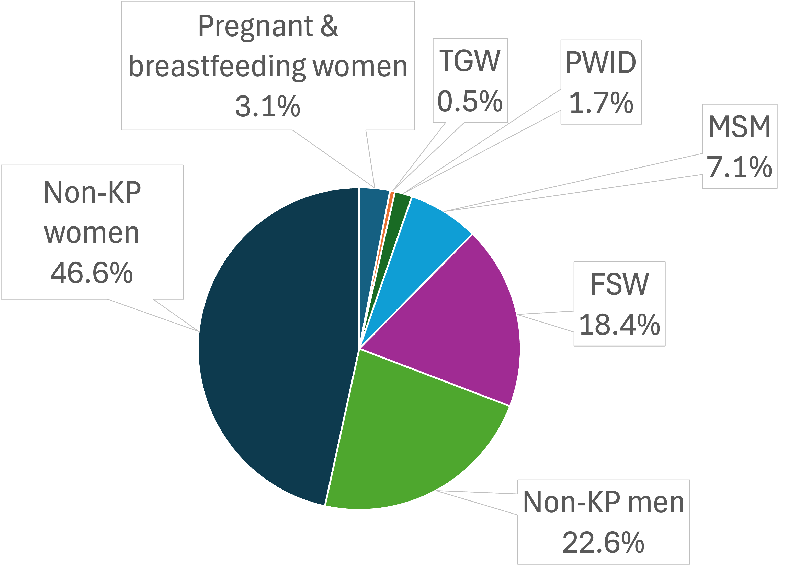
Numbers Receiving PrEP
At the end of 2024, 742,136 individuals received PEPFAR-funded PrEP across 28 countries in Sub-Saharan Africa
  719,384 not covered by waiver
205,868 members of key populations
  3,666 TGW across 16 countries
  12,971 PWID across 15 countries
  52,548 MSM across 26 countries
  136,683 FSW across 28 countries

Slide 7
Coverage of PEPFAR Supported PrEP
Among key population individuals, estimated coverage of 4.4% across countries providing PrEP
  2.6% among PWID
  2.7% among TGW
  4.0% among MSM
  5.0% among FSW
0.075% of HIV-negative non-key populations were receiving PrEP through PEPFAR
  Coverage greatest in women aged 15-24 (0.15%)
Considerable heterogeneity between countries

Slide 8
Increase in new (primary) HIV infections
Removal of PEPFAR’s provision of PrEP over one year would lead to 6,671 (95%UI: 5,032-8,912) additional new HIV infections
85% of these will occur among key populations
  214 (95%UI: 73-314) among PWID
  526 (95%UI: 293-844) among TGW
  2,006 (95%UI: 1,232-3,014) among FSW
  2,909 (95%UI:1,802-3,709) among MSM
68% of new infections will occur in 5 countries

Slide 9
Relative increase in new (primary) HIV infections
Removing PEPFAR PrEP over one-year will lead to 2.1% increase in new HIV infections among key populations
  0.8% among PWID
  1.4% among TGW
  2.2% among MSM
  2.9% among FSW
Impact exceeds 5% in:
  PWID: 2 countries
  TGW: 5 countries
  FSW: 6 countries
  MSM: 8 countries

Slide 10
Increase in new HIV infections

Slide 11
Increase in new HIV infections
Account for secondary infections over next 5 years

Slide 12
Increase in new HIV infections
Account for secondary infections & potential under-reporting of MSM

Slide 13
Summary
Ceasing PEPFAR’s funding for PrEP in sub-Saharan Africa will remove approximately 700,000 individuals from using PrEP
  Could lead to an estimated 6,671 additional HIV infections in the next year
  85% of these infections occurring among key populations.
< 3% increase in HIV infections among key populations, due to low coverage
Crucial that funding is found to not only continue PrEP services but to expand them
Adds to growing evidence projecting considerable impact that cuts could have.
  ->Need to identify alternative sources of funding to offset these cuts.
  ->Ensure interventions are not vulnerable to political shifts and changing priorities of international donors

Slide 14
Acknowledgements
Kennedy Kipkoech
Adelina Artenie
Romain Silhol
Marie-Claude Boily
Jirair Ratevosian
Chris Beyrer
Peter Vickerman
Wellcome Trust [WT 226619/Z/22/Z]

