Slide 1
Short cycle ART with weekends off is inferior to continuous ART in adolescents living with HIV receiving TLD in sub-Saharan Africa:
BREATHER Plus 96-week results
Session: Co-Chair's choice
Abstract code: OAS0104LB
Adeodata R. Kekitiinwa, Angus Jennings, Mutsa Bwakura-Dangarembizi, Cissy Kityo, Abraham Siika, Moherndran Archary, Lungile Jafta, George Akabwai, Moses Chitsamatanga, Shamim Nakabuye, Cecilia Kiilu, Rosie Mngqbisa, Alexandra Green, Janet Seeley, Henry Mugerwa, Simon Walker, Naomi Apoto, David Burger, Simona Salomone, Annabelle South, Carlo Giaquinto, Alasdair Bamford, Margaret J Thomason, Deborah Ford, Sarah L Pett, on behalf of the BREATHER Plus trial team

Slide 2
Conflict of interest disclosure
The author has no conflicts of interest to disclose for this presentation

Slide 3
Summary
Short cycle ART with weekends off is inferior to continuous ART in adolescents living with HIV receiving TLD in sub-Saharan Africa:
BREATHER Plus 96-week results
What is your main question?
Is short-cycle therapy (SCT) non-inferior to continuous therapy (CT) in terms of confirmed viral rebound, defined as 2 consecutive plasma HIV-RNA ≥50 copies/mL, over 96 weeks, in adolescents in sub-Saharan Africa on TLD*, with routine 6-12 monthly VL monitoring
What did you find?
SCT is not non-inferior to CT
SCT is significantly worse than CT
Why is it important?
SCT TLD cannot be recommended as a strategy for adolescents in this setting
*TLD: tenofovir disoproxil fumarate/lamivudine/dolutegravir
Slide 2

Slide 4
BREATHER Plus study design
Study design: open-label non-inferiority (NI) RCT comparing SCT (5 days on/2 days off) to CT (daily ART) in adolescents
Participants were aged 12-19, on ART ≥1 year, on TLD ≥1 month, had no history of treatment failure, virologically suppressed (VL<50 c/mL) for 12 months
Primary endpoint: Confirmed viral rebound, defined as 2 consecutive HIV-RNA ≥50 copies/mL, by the week 96 assessment
Visits were 8/12 weekly, real-time VLs were 6-12 monthly as per in-country monitoring guidelines, retrospective VLs were done at other visits
Employed a ‘smooth away from expected’ (SAFE) non-inferiority margin¹: CI and NI margin changed depending on the proportion of CT participants with confirmed viral rebound
¹Quartagno, M., Chan, M., Turkova, A., Ford, D., & White, I. R. (2023). The Smooth Away From Expected (SAFE) non-inferiority frontier: theory and implementation with an application to the D3 trial. Trials, 24(1), 556.
Slide 3

Slide 5
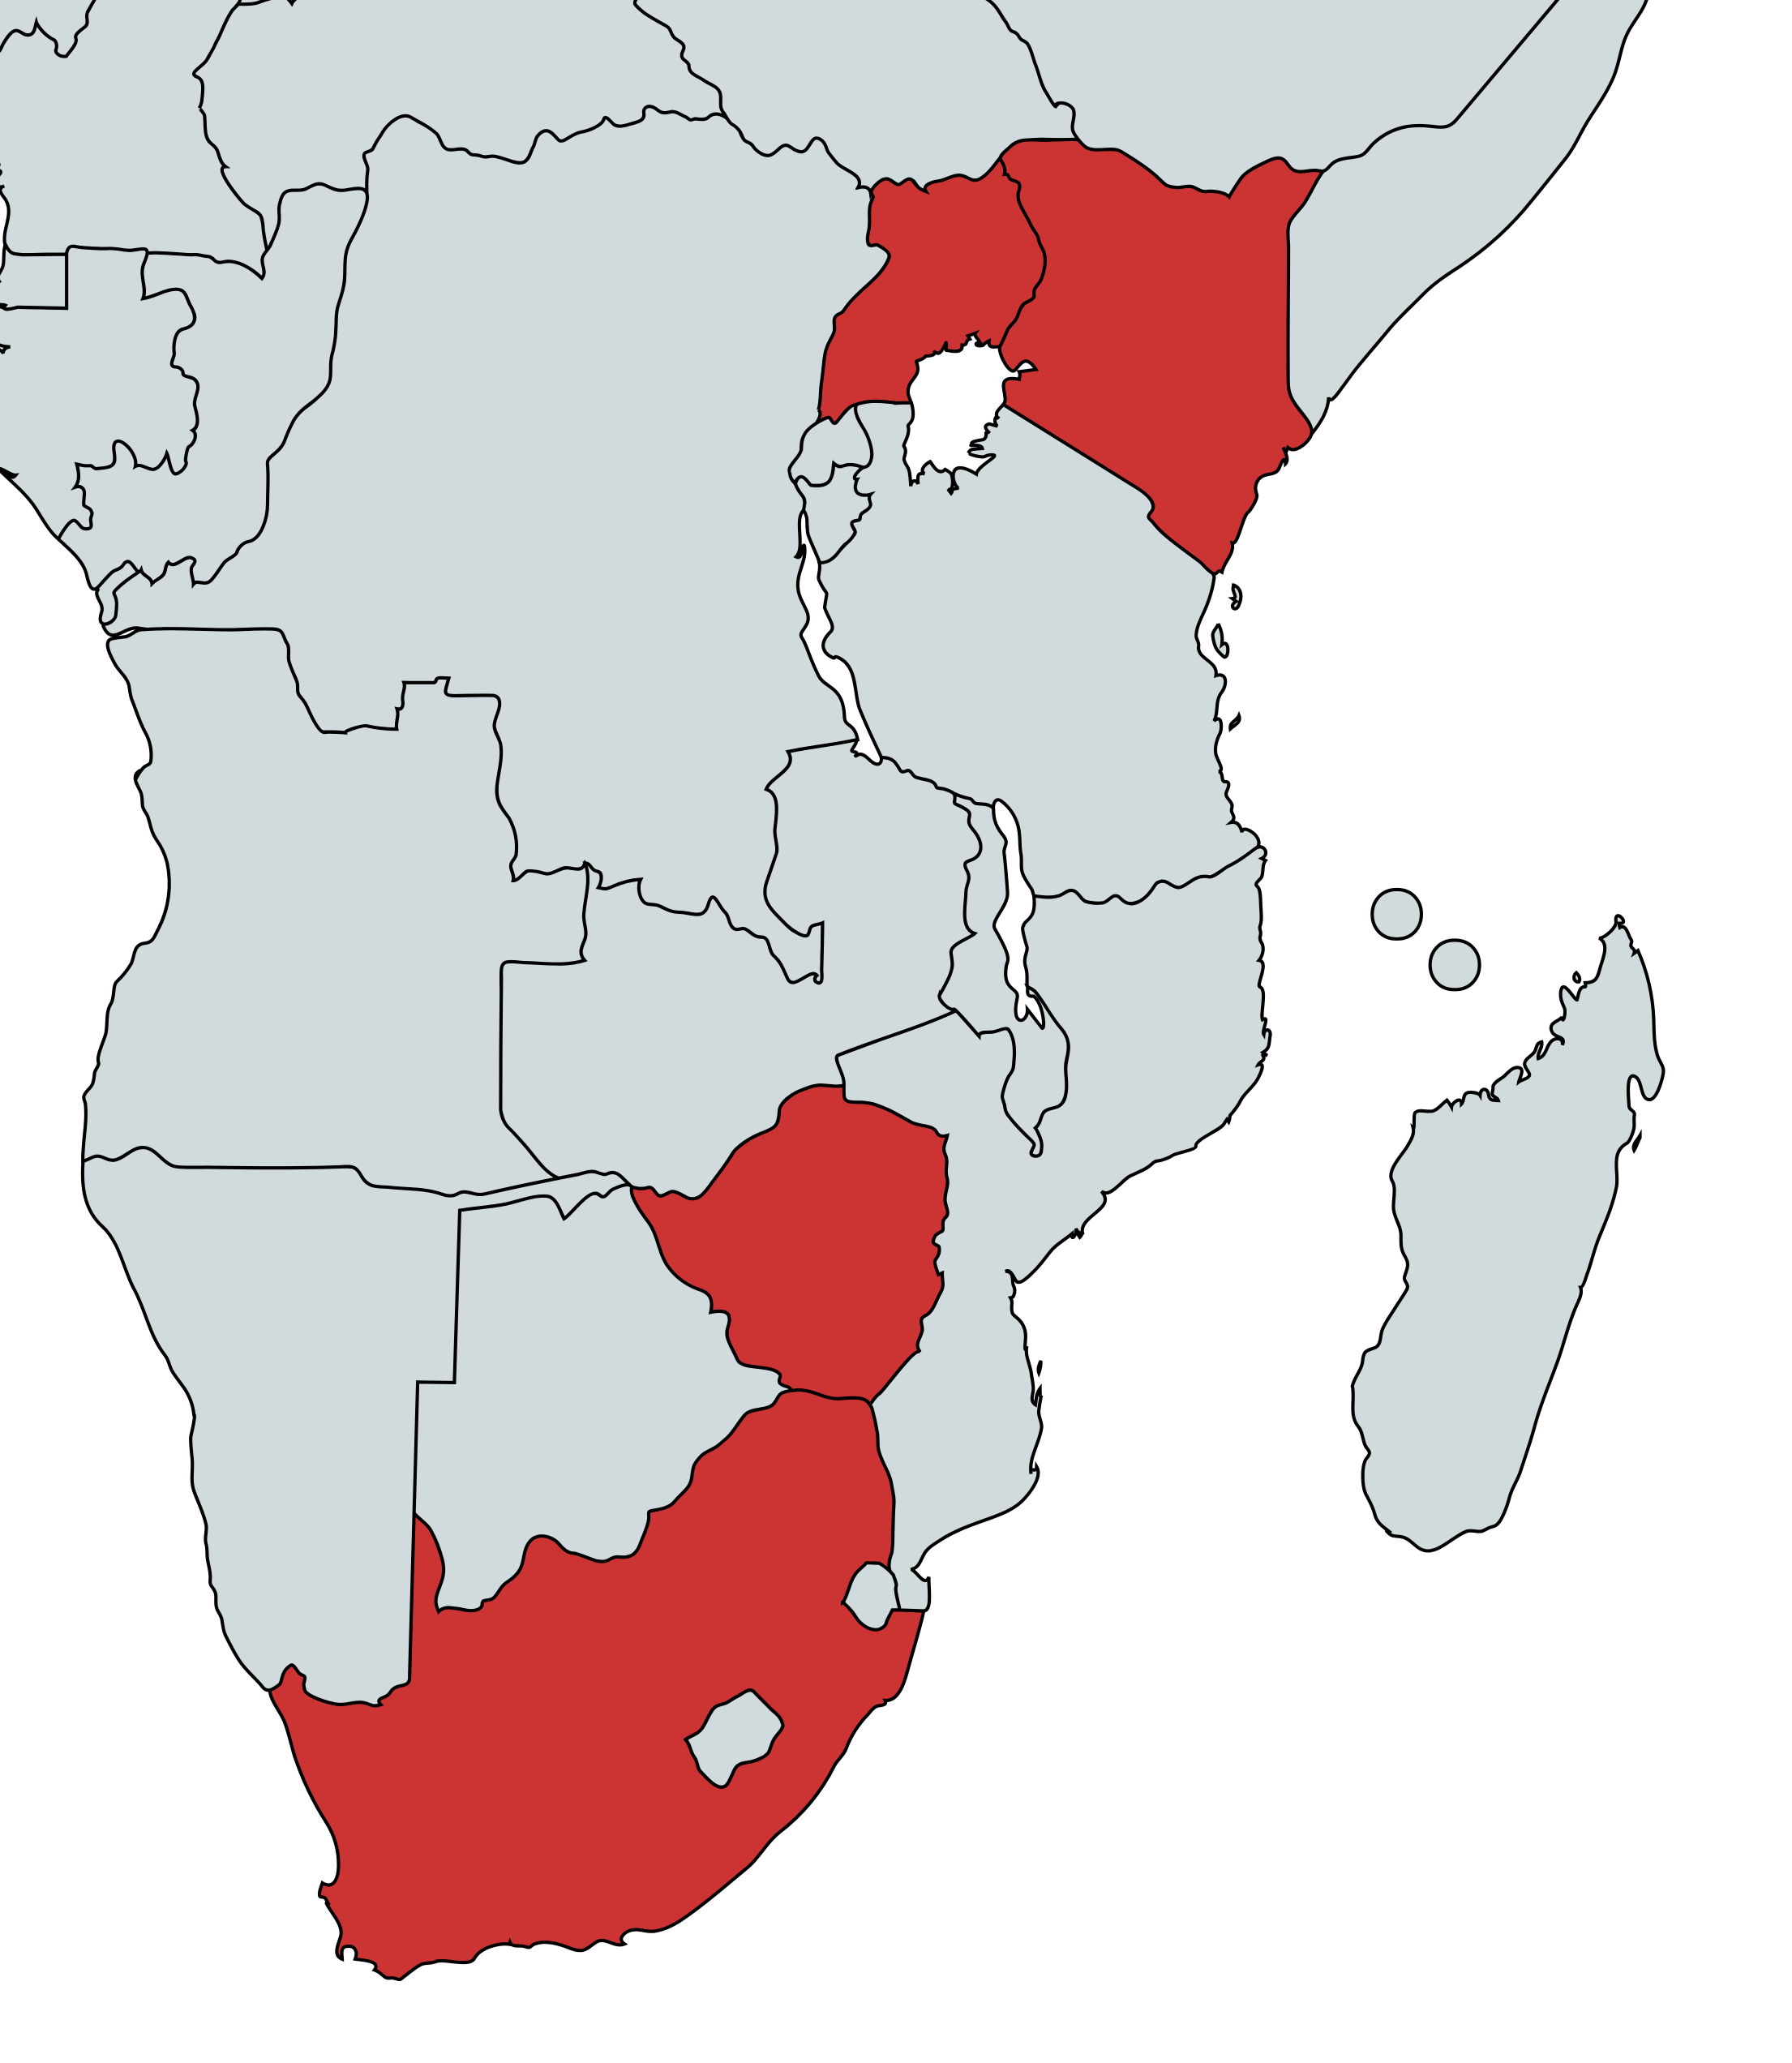
Baseline characteristics
Uganda
212 (45%)
470 participants were randomised at 5 sites across 4 countries in sub-Saharan Africa
At baseline, participants were:
56% assigned female at birth
97% acquired HIV through vertical transmission
Median 16.5 years of age (IQR: 14.6-18.1)
Median 11.8 years on ART (IQR: 8.6-14.1)
Median 2.5 years on DTG (IQR: 2.1-3.2)
Kenya
84 (18%)
Zimbabwe
142 (30%)
South Africa
32 (7%)
Slide 4

Slide 6
Primary efficacy endpoint: testing non-inferiority using the SAFE frontier
23 (10%) SCT vs 11 (5%) CT participants had confirmed viral rebound*
5% risk in CT → NI margin of 8% and a 99% CI (SAFE)
We cannot conclude SCT is non-inferior to CT
NI margin
Primary analysis: 99% CI
5.1% (CI:-0.8, 11.5)
Favours SCT ← 0 → Favours CT
4
6
8
10
Risk difference (SCT-CT, % with confirmed viral rebound*)
*2 consecutive plasma HIV-RNA ≥50 copies/mL
Slide 5

Slide 7
Primary efficacy endpoint: inferiority
NI margin
Primary analysis: 99% CI
5.1% (CI:-0.8, 11.5)
Primary analysis: 95% CI
5.1% (CI:0.5, 9.9)
Favours SCT ← 0 → Favours CT
4
6
8
10
Risk difference (SCT-CT, % with confirmed viral rebound)
SCT is significantly worse (inferior) than CT; p-value 0.034
*2 consecutive plasma HIV-RNA ≥50 copies/mL
Slide 6

Slide 8
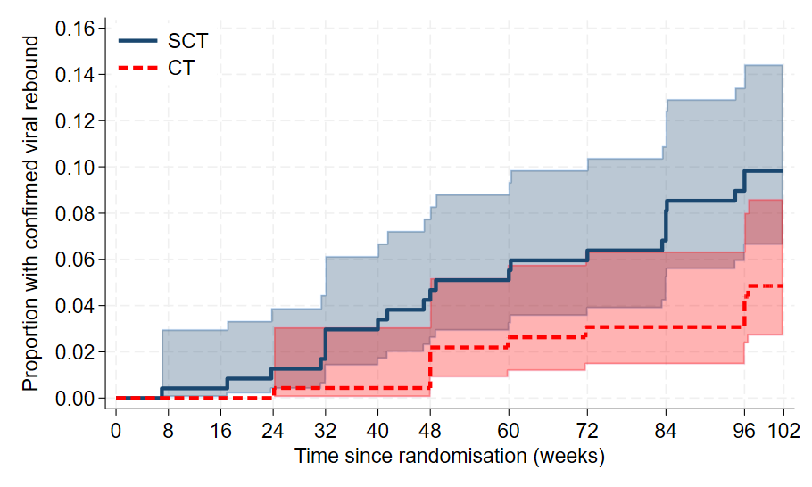
Primary efficacy endpoint: Kaplan-Meier estimates for confirmed viral rebound
HR 2.1 (95% CI 1.0-4.4)
No heterogeneity in treatment effect by site or baseline age
*
Figure Kaplan–Meier estimates for confirmed viral rebound rate, stratified by treatment arm with 95% confidence intervals
*98% of participants met the primary endpoint or had ≥96 weeks follow-up
Slide 7

Slide 9
ART / strategy changes
ART changes
3 participants (1 SCT, 2 CT) changed ART regimen by week 96 for AEs
There were no ART regimen changes for raised viral loads
Strategy changes
97% of SCT follow-up to week 96 was spent on SCT strategy
20 SCT participants were on CT at their week 96 viral load (all remained on TLD)
  6 confirmed viral rebound, 13 pregnancy/wanting to conceive/not using highly effective contraception, 1 participant choice
Slide 8

Slide 10
Re-suppression following confirmed viral rebound*
All 9 SCT participants who switched to CT for confirmed viral rebound resuppressed
10/14 of the remaining SCT participants who did not switch back to CT resuppressed
8/11 CT participants resuppressed
*2 consecutive plasma HIV-RNA ≥50 copies/mL
median follow-up was 117 weeks
Slide 9

Slide 11
Secondary efficacy endpoint: cross-sectional VL<50
ITT comparison of the proportion of participants with cross-sectional VL<50 at week 96*
215 (93%) SCT vs. 211 (93%) CT participants had VL<50 at week 96
*Considers single VL closest to week 96; ignores confirmatory VL testing or changes to ART regimen/strategy
Recall: 20 SCT participants were on CT at week 96 VL
Slide 10

Slide 12
Resistance mutations in those with confirmed viral rebound
Resistance results received for 12/23* SCT and 6/11* CT participants with confirmed viral rebound** by week 96
#1 participant on CT with INSTI and NRTI resistance
Stanford: high-level 3TC resistance and potential low-level DTG resistance
Major IAS mutations: INSTI - G140R, NRTI - M184I
Gene | SCT major mutations | CT major mutations
INSTI | 0 / 12 | 1# / 6
NRTI | 0 / 12 | 1# / 6
NNRTI | 3 / 12 | 2 / 6
PI | 0 / 12 | 0 / 6
*6 SCT participants had all VLs below threshold required for resistance testing; remaining results (5 SCT, 5 CT) awaiting final testing
**2 consecutive plasma HIV-RNA ≥50 copies/mL
Slide 11

Slide 13
Safety
There were no safety concerns with SCT
There were 16 SAEs in 15 SCT participants, and 22 SAEs in 16 CT participants
Slide 12

Slide 14
Adherence
SCT
At 96% visits, participants self-reported that all tablets (required per strategy) were taken in the last 7 days
Adherence was also measured in a MEMS cap sub-study (n=210, over weeks 8-32 or 48-72)
92% SCT vs 92% CT tablets were taken Monday-Thursday
1
CT
.8
.6
Proportion of days with a tablet taken
.4
.2
0
Monday
Tuesday
Wednesday
Thursday
Friday
Saturday
Sunday
Figure MEMS cap sub-study: tablets taken by day of the week
Slide 13

Slide 15


Our research in context
Current literature on trials of 2nd generation INSTIs:
TRIAL | ART | Participants | Population | VLs | Efficacy [Endpoint]
BREATHER Plus | TLD | 239 SCT [5/7]; 231 CT | 12-19yrs, SS Africa | 6-12m | [Confirmed VL≥50 by w48/96] 5.1% SCT, 2.2% CT by w48 9.9% SCT, 4.8% CT by w96
QUATUOR¹ (DTG sub-group) | DTG-based triple ART | 73 SCT [4/7]; 76 CT | Adults, France | 12w | [Confirmed VL≥50 by w48/96] 0% SCT, 1.3% CT by w48 0% by w96 (of 73 on SCT)
DUETTO² | DTG/3TC or DTG/RPV | 217 SCT [4/7]; 213 CT | Adults, France | 8-12w | [Confirmed VL≥50* by w48] 3.7% SCT; 0% CT
BICFOTO Pilot Study³ | B/F/TAF | 30 SCT [5/7]; 30 CT | Adults, Taiwan | 12-24w | [VL<50 at w52/w100] 100% SCT; 96.7% CT at w52 100% at w100 (of 29 on SCT)
BETAF-RED⁴ | B/F/TAF | 10 each 3W#, 2W#, 1W# and CT | Adults, Spain | 12w | [FDA VL≥50 at w48, ITT] 0% in all groups
*Based on FDA snapshot definition considering 2 consecutive VL≥50 by week 48 as ‘VL≥50’ at week 48
#3W=[3/7], 2W=[2/7], 1W=[1/7]
¹Landman et al., 2022; ²Landman et al., 2023; ³Sun et al., 2025; ⁴Chivite et al., 2025

Slide 16
Conclusions
Despite similar adherence between arms, SCT was inferior to CT
Adverse events were similar between arms
The majority of participants with confirmed viral rebound had resuppressed by end of follow-up and none required switch to 2nd line ART
Resistance at confirmed viral rebound was rare
SCT cannot be recommended as a strategy in adolescents on TLD with standard-of-care 6-12 monthly VLs in Africa
Slide 14

Slide 17













Acknowledgements
We would like to thank all participants and their families, the BREATHER Plus Youth Trial Board and consortium, the TSC and IDMC, all ethics bodies & regulatory committees involved in the BREATHER Plus trial and the EDCTP
​
This project (RIA2017MC-2005-BREATHER Plus) is part of the EDCTP2 programme, funded by the European Union and with funding from the Swedish International Development Cooperation Agency (Sida) and the UK Medical Research Council​
Slide 15

Slide 18
Additional slides

Slide 19
Our research in context
Current literature on trials of 2nd generation INSTIs:
TRIAL | ART | Participants | Population | VLs | Efficacy [Endpoint]
BREATHER Plus | TLD | 239 SCT [5/7]; 231 CT | 12-19yrs, SS Africa | 6-12m | [Confirmed VL≥50 by w48/96] 5.1% SCT, 2.2% CT by w48 9.9% SCT, 4.8% CT by w96
QUATUOR¹ (DTG sub-group) | DTG-based triple ART | 73 SCT [4/7]; 76 CT | Adults, France | 12w | [Confirmed VL≥50 by w48/96] 0% SCT, 1.3% CT by w48 0% by w96 (of 73 on SCT)
DUETTO² | DTG/3TC or DTG/RPV | 217 SCT [4/7]; 213 CT | Adults, France | 8-12w | [Confirmed VL≥50* by w48] 3.7% SCT; 0% CT
BICFOTO Pilot Study³ | B/F/TAF | 30 SCT [5/7]; 30 CT | Adults, Taiwan | 12-24w | [VL<50 at w52/w100] 100% SCT; 96.7% CT at w52 100% at w100 (of 29 on SCT)
BETAF-RED⁴ | B/F/TAF | 10 each 3W#, 2W#, 1W# and CT | Adults, Spain | 12w | [FDA VL≥50 at w48, ITT] 0% in all groups
*Based on FDA snapshot definition considering 2 consecutive VL≥50 by week 48 as ‘VL≥50’ at week 48
#3W=[3/7], 2W=[2/7], 1W=[1/7]
¹Landman et al., 2022; ²Landman et al., 2023; ³Sun et al., 2025; ⁴Chivite et al., 2025

Slide 20
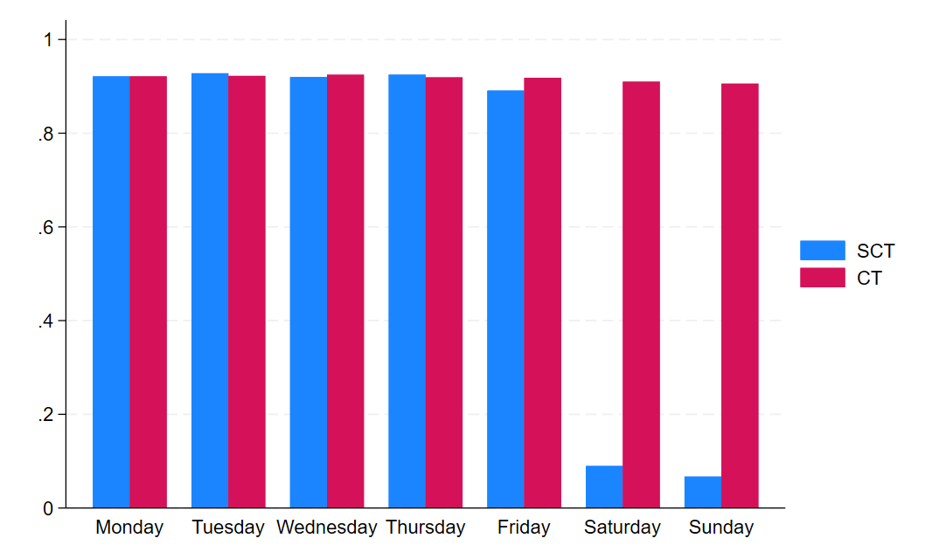
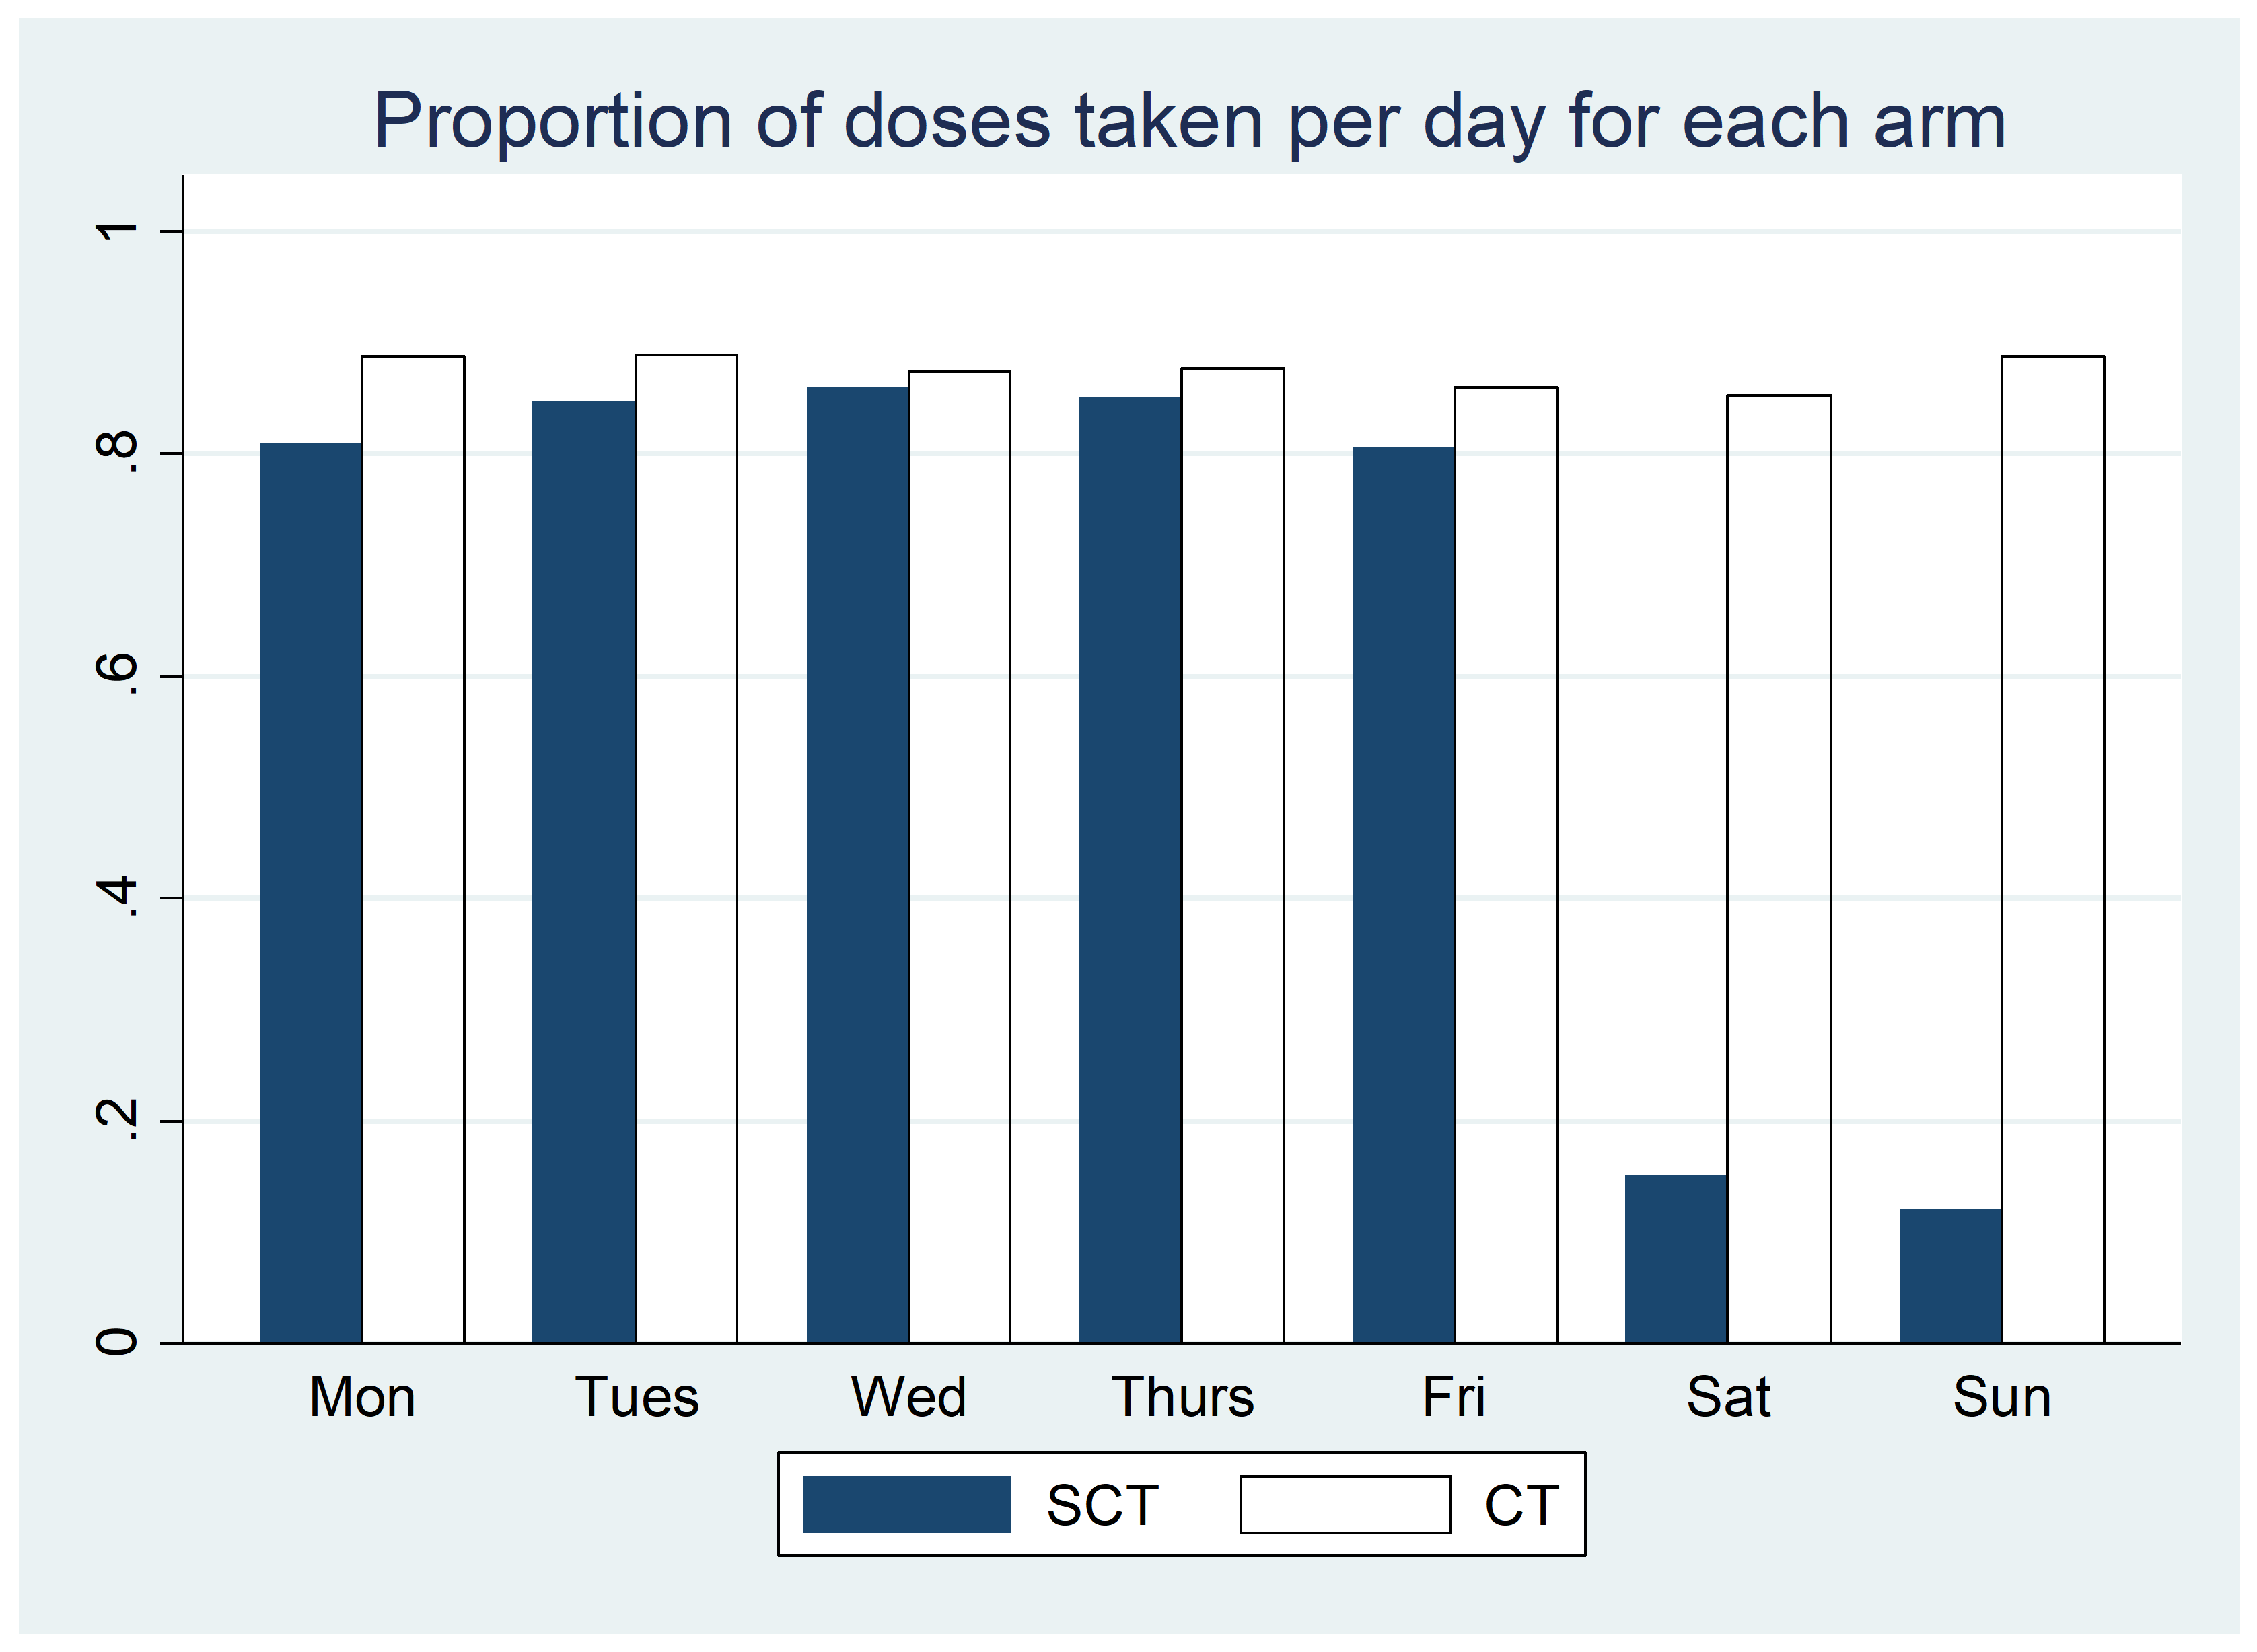
MEMS Cap sub-studies
BREATHER Plus:
BREATHER:
92% SCT vs 92% CT tablets Mon-Thurs
CT conf’d viral rebound = 4.8% by week 96
84% SCT vs 89% CT tablets Mon-Thurs
CT conf’d viral rebound = 11.2% by week 96

