Slide 1
Long-acting cabotegravir and rilpivirine in adults with suboptimal HIV control in sub-Saharan Africa: the IMPALA trial 48-week results
Co-Chairs’ choice, OAS01
Fiona Cresswell
on behalf of Eugene Ruzagira, Loice Achieng Ombajo, Nigel Garret, Noela Owarwo, Eva Laker Odongpiny, Henry Mugerwa, Ibrahim Yawe, Sheetal Kassim, Sharana Mahomed, Awhonukeh Idahosa, Ingrid Eshun-Wisonova and the IMPALA trial team
MRC/UVRI and LSHTM Uganda Research Unit, Uganda
Brighton and Sussex Medical School, UK
London School of Hygiene and Tropical Medicine, UK
CoI: I have recevied grant funding to institution from Wellcome, Johnson & Johnson, ViiV

Slide 2
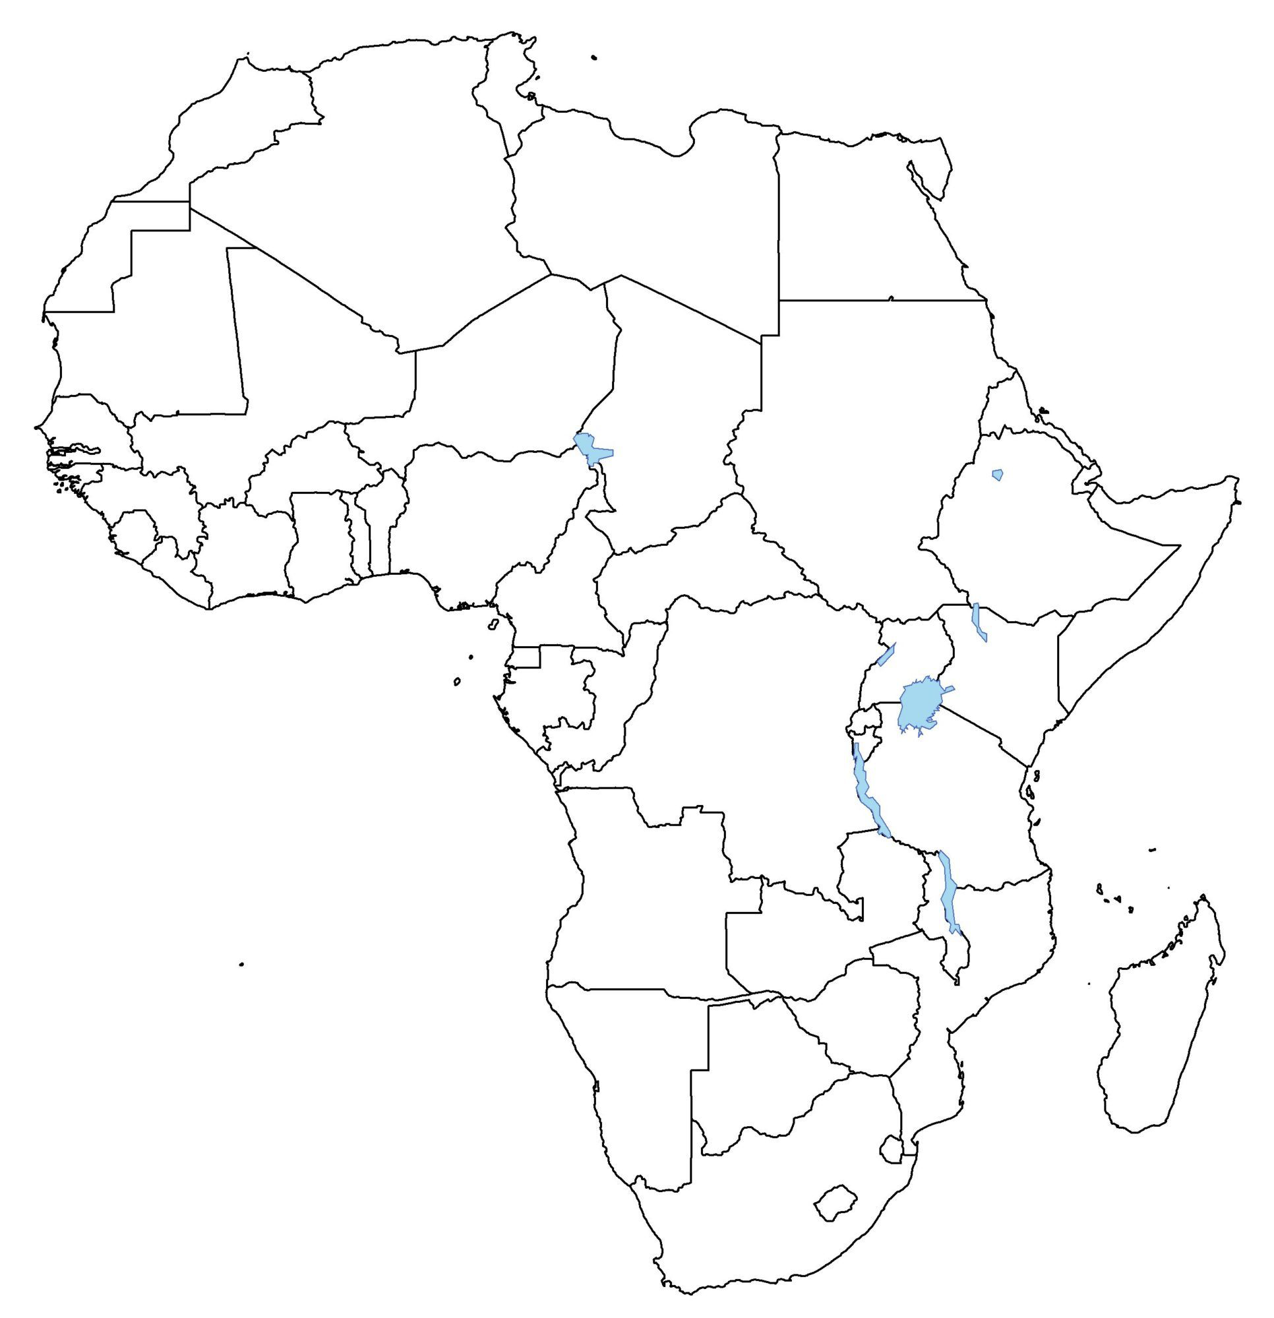

IMPALA trial partners
Coordinating partners
Eugene Ruzagira
Fiona Cresswell
Daniel Grint (Statistician)
MRC/UVRI-LSHTM Uganda Research Unit, Uganda
LSHTM, UK
Partners with a centre
Eugene Ruzagira, MRC/UVRI-LSHTM, Uganda
Eva Laker, Noela Owarwo, Infectious Diseases Institute, Uganda
Ibrahim Yawe, Henry Mugerwa, JCRC, Uganda
Loice Achieng Ombajo, University of Nairobi, Kenya
Nigel Garrett, Sharana Mahomed, CAPRISA, South Africa
Sheetal Kassim, Desmond Tutu Health Foundation, South Africa
Partners with investigational product
Johnson & Johnson, Belgium
ViiV, UK
Funder and collaborative study partner
Johnson & Johnson, Belgium
Health economics:
Ruanne Barnabas, Massachusetts General Hospital, Harvard, USA
Notes:
On behalf of my collaborators, I’m delighted to share the 48-week results of the IMPALA trial.

Slide 3

Background
Stigma¹
Pill fatigue²
In East and Southern Africa, ~1 million people on oral ART remain unsuppressed¹
Inconsistent ART adherence contributes to the 630,000 HIV-related deaths and increasingly contributes to the 1.3 million transmission events per year globally^{1,2,3}
Long-actings (LA): reduced dosing frequency, greater privacy, may mitigate drug holidays
LA cabotegravir (CAB) + rilpivirine (RPV) is now recommended by WHO as a suppressed switch option
Meta-analysis 6 RCTs: LA CAB + RPV has demonstrated equivalent efficacy to oral ART (91.5% versus 91.4% with VL<50 c/ml at 48 weeks)⁴
Evidence on CAB + RPV LA from the African public health approach
Population: Adults with stable viral suppression Results: Non-inferior efficacy (96% vs 97%)⁵
Population:
Adults with inconsistent
ART adherence
UNAIDS. 2024. 2) Moolla H. AIDS, 2024 3) Johnson LF. J Aquir Immune Def Sydr. 2022. 4) Manalu SBPS, JAC. 2025. 5) Kityo C, Lancet ID. 2024
Notes:
In East and Southern African, alone there are still 1 million people on oral ART who remain unsuppressed
Inconsistent adherence to oral ART contributes to the 630,000 HIV-related deaths per year and increasingly to the 1.3 million transmission events.
Long-acting (or LA) therapies represent a transformative advancement, offering reduced dosing frequency, greater privacy and potentially mitigating drug holidays.
Meta-analysis of 6 randomised trials of LA cabotegravir and rilpivirine demonstrated equivalent efficacy to oral ART, but greater of risk integrase resistance in the event of virological failure.
Last year the CARES trial demonstrated that 2-montly cabotegravir / rilpivirine is effective in in the African public health approach in a population with stable viral suppression. IMPALA builds upon the foundation of the CARES trial by examining this regimen in adults with inconsistent adherence.

Slide 4
Study rationale and design
Evidence gaps: sub-optimal HIV control in public health approach, prior HBV exposure (cAb+), women
Phase 3b, open-label, non-inferiority trial
7 sites: Uganda, Kenya, S. Africa (NCT05546242)
Optional 1 month oral lead in
CAB LA + RPV LA
600 mg / 900mg
IM Q8W
4 years post-study access
Population, n=540
>18 y.o. with suboptimal HIV-1 control
SCREENING
PHASE
HIV-1 VL <200 c/ml for >3 months at the end of screening
2NRTI + DTG
HIV-1 VL >1000 c/ml in prior 2 yrs despite being on ART
History of loss to follow up (>4 wks)
Unlinked to HIV care >3 months since HIV diagnosis
2NRTI + DTG
Transition to Standard of Care
Key exclusions:
Second-line ART
Pregnant or breastfeeding
Positive hepatitis B virus surface antigen
1:1
DTG = dolutegravir, CAB = cabotegravir, RPV = rilpivirine,
IM = intramuscular, Q8W = 8-weekly dosing
Day 1 12 months 24 months
Participants on the LA arm recevied their first injection at month 1
HIV1-VL is tested 4 times in year 1 and 2 times in year 2
Notes:
In addition to generating evidence from adults with sub-optimal HIV control in the public health, the IMPALA trial sought to generate more evidence for people with prior hepatitis B virus exposure and for women.
It is a 3b, open-label, non-inferiority trial with 7 sites in Uganda, Kenya and South Africa.
The participants had documented HIV VL >1000 despite being ART-experienced
OR had been disengaged from care for > 4 weeks.
Those who were on second-line ART, pregnant or breastfeeding or had chronic hepatitis B were excluded.
After at least 3 months of viral suppression on tenofovir/lamivudine/dolutegravir (TLD), participants were randomised 1:1 to either receive 2-monthly cabotegravir / rilpivirine with an optional 1 month oral lead in, or to continue oral therapy.
They needed to be on DTG for minimum one month, but could have been on an NNRTI before this. Some DTHF participants switched from NNRTI to DTG during the screening period

Slide 5
Endpoints
Primary analysis based on intention to treat exposed population (ITTe) population at Week 48
Primary endpoint - aligns with UNAIDS 95-95-95 target
Proportion of participants with HIV-1 VL <50 c/mL (FDA snapshot algorithm). 10% NI margin.
Key secondary endpoints
Proportion of participants with virologic non-response HIV-1 VL ≥50 c/mL (FDA snapshot). 4% NI margin.
Proportion of participants with confirmed virologic failure (CVF) HIV-1 VL ≥200 c/mL on 2 consecutive occasions ~4 weeks apart. 4% NI margin.
Proportion of participants experiencing adverse events
Participant-reported outcomes: quality of life (MOS-HIV, EQ-5D-5L), treatment satisfaction (HIVTSQ) & preference
Pre-specified virological failure sensitivity analysis
Proportion of participants with CVF at 200 c/ml OR one HIV-1 VL >1000 c/ml*. 4% NI margin.
ITTe = receiving at least one dose of long-acting investigational drug in the CAB LA + RPV LA arm. or one dose of oral ART in the control arm.
*In press Lancet HIV, The CONSENSUS-LAI Study: Establishing Shared Definitions of Virological Failure and Discontinuation for Long-Acting Injectable Cabotegravir and Rilpivirine Therapy using an international survey and Delphi process Orkin et al.
Notes:
The primary analysis is based on the intention to treat exposed population at w 48.
Primary endpoint is the proportion with HIV VL <50 using the FDA snapshot algorithm and a 10% non-inferiority margin. This endpoint aligns with the UNAIDS targets.
Secondary endpoints included:
The proportion with VL >50
The proportion with confirmed virological failure, using a threshold of 200 copies on two consecutive occasions, and a 4% non-ineriority margin.
Adverse events
And participant reported outcomes.
A pre-specified virological failure sensitivity analysis including participants with CVF at 200 copies OR a single VL >1000 was performed.
This aligns with the global consensus defintion for viral failure on LA cabotegravir/rilpivirine that was presented at BHIVA in April this year and will be published in Lancet HIV this month.

Slide 6
Baseline characteristics
VL >1000 c/ml n=261
LTFU n=282
Unlinked n=11
Ugandan n= 240
Kenyan n= 160
S. African n= 140
 | Total
Age, median years (IQR) | 40 (33-48)
Cis-female, n (%) | 324 (60%)
Black African, n (%) | 538 (99.6%)
Hepatitis B core antibody positive | 168 (31.1%)
Formal employment, n (%) | 96 (17.8%)
BMI > 30, N (%) | 120 (22.2%)
CD4, median cells/µl (IQR) | 629 (453-873)
ART duration, median yrs (IQR) | 7.5 (4.6-10.8)
Prior AIDS-defining illness, n (%) | 142 (26.3%)
Prior exposure to NNRTI, n (%) | 411 (78.3%)
Next generation sequencing for archived baseline resistance and sub-type is ongoing. This is performed on proviral DNA extracted from baseline PBMCs and will be included in the manuscript. All variables were well balanced between randomization arms
Randomised
N=540
CAB + RPV LA
N= 271
Oral ART
N= 269
All particpants had VL<200 prior to randomisation
4 withdrawals from study (2 LA, 2 oral)
1 participant choice after randomisation to oral arm
2 participant choice due to visit schedule (1 oral, 1 LA)
1 moved out of area, LA arm
Notes:
540 participants were randomised.
60% were female, a third were HepBcAb-postitive, 22% had BMI > 30, a quarter had a prior AIDS-defining illness, and 80% had prior NNRTI exposure.
Next generation sequencing for archived baseline resistance is ongoing

Slide 7
Primary outcome at Week 48
99.0% retention. 98% of 2159 injections given within window
HIV-1 VL <50 c/mL
demonstrating
non-inferiority
demonstrating
non-inferiority
Notes:
At week 48 the study had a 99% retention, and 98% of injections were given within window.
91% of the participants on the LA arm and 89% in the oral arm remained virally suppressed, demonstrating non-inferiority.
In the per protocol population, 94% of participants on LA and 90% on orals remained virally suppressed, demonstrating non-inferiority.
Efficacy was not compromised in those with BMI > 30

Slide 8
Secondary endpoints at Week 48
ITTe population
demonstrating
non-inferiority
demonstrating
non-inferiority
demonstrating
superiority
Notes:
For the secondary endpoints,
6.3% in the LA arm and 7.8% in the oral arm had a VL > 50 copies, demonstrating non-inferiority.
5, or 1.9%, of people in the LA arm experienced confirmed virological failure compared to zero in the oral arm, demonstrating non-inferiority.
In the pre-specified viral failure sensitivity analysis which aligns with the global consensus definition for viral failure on LA, 2.6% of people experienced viral failure on the LA arm compared to 6.7% of people on the oral arm, demonstrating pre-specified superiority.

Slide 9
Confirmed virological failure
Number | 1 | 2 | 3 | 4 | 5
Visit | Month 6 | Month 8 | Month 12 | Month 12 | Month 12
Sub-type | C | unknown | A1 | C | A1
Baseline resistance$ | Testing ongoing | Testing ongoing | NNRTI: K103S INSTI: none | NNRTI: L100I, K103N INSTI: L74I High level RPV | Testing ongoing
HIV VL at failure c/ml | 3336 | 6303 | 36670 | 475 | 5232
Repeat HIV VL c/ml | 1809 | 1888 | 96120 | 282 | 231
NNRTI RAMs at failure | Insufficient volume | E138K, Y188L | K103S, E138K, Y181C | K103N, V108I | E138K, Y181C
Resistance prediction | N/A | Low: ETR High: EFV, NVP, RPV | Intermediate: ETR High: RPV, EFV, NVP | Sensitive: RPV High: EFV, NVP | Intermediate: EFV, ETR High: RPV, NVP
INSTI RAMs at failure | Insufficient volume | E138K, Q148R | E138K, Q148R | Q148R | Q148R
Resistance prediction& | N/A | Intermediate: DTG, BIC High: CAB, RAL, EVG | Intermediate: DTG, BIC High: CAB, RAL, EVG | Low: DTG, BIC High: CAB, RAL, EVG | Low: DTG, BIC High: CAB, RAL, EVG
Identifiable risk factors or DDI | Herbal medicine | BMI 38.3 kg/m² | Nil | RPV RAMs (L100I/K103N) | Nil
Current regimen | TLD | TLD | TLD | TDF/FTC + LPV/r | TLD
Most recent HIV VL* | <50 c/ml | <50 c/ml | <50 c/ml | <50 c/ml | <50 c/ml
$ archived resistance on HIV DNA from PBMC using NGS &prediction using Stanford algorithm. *Median duration of follow-up following switch to oral ART is 35 weeks. TLD = tenofovir, lamivudine, dolutegravir. LPV/r = lopinavir/ritonavir. EFV = efavirenz. NVP = nevirapine, RPV = rilpivirine. ETR = etravirine. CAB = cabotegravir. RAL = raltegravir. EVG = elvitegravir. BIC = bictegravir. TDF = tenofovir df. FTC = emtricitabine. DDI = drug-drug interaction.
Notes:
Diving into the 5 treatment failures a little deeper:
3 experienced treatment failure at month 12
2 had subtype A1 and 2 subtype C.
Baseline resistance is currently available for 2, one of which had high level RPV resistance as well as the L74I integrase polymorphism
All those whose resistance test successfully amplified were found to have dual class resistance, including high level resistance to cabotegravir and low or intermediate resistance to dolutegravir.
4 of the 5 participants were switched to TLD and remain virally suppressed with a median F/U duration of 9 months.

Slide 10


Safety
Participants with >1 AE n (%) | CAB+RPV LA (N=271) | Oral ART (N=269) | aRD (95% CI)
Any (grade 1-4) | 242 (89.3%) | 206 (76.6%) | 12.7% (7.0% to 18.5%)
- Excluding ISRs | 228 (84.1%) | 206 (76.6%) | 7.6% (3.1% to 13.7%)
- Lab abnormalities | 143 (52.8%) | (55.0%)
- Related*, excluding ISRs | 49 (18.1%) | 36 (13.4%)
- Discontinuations due to AEs& | 7 (2.6%) | 3 (1.1%)
- Drug-related discontinuations$ | 2 (0.7%) | 2 (0.7%)
Grade 3 and above: | 33 (12.2%) | 21 (7.8%) | 4.4% (-0.5% to 9.3%)
- Related, excluding ISRs^ | 1 (0.4%) | 0
Serious AEs | 11 (4.1%) | 7 (2.6%) | 1.5% (-1.5% to 4.5%)
*Considered to be drug-related if classified as possibly, probably or definitely drug-related & Discontinuations due to AEs were: 2 TB (may resume LA after completion of anti-TBs), 1 acute hepatitis B, 1 multifactorial hepatitis, 1 back pain, 1 neurodegenerative condition, 1 rheumatoid arthritis. $ Drug-related discontinuations: 1) back pain on OLI; 2) multifactorial hepatitis (both possibly related) ^ grade >3, drug-related: malaise post injection, hospitalised, full recovery, continued LA, prob related
Pregnancies at week 48:
 | CAB + RPV LA | Oral ART
Total | 6 | 4
Elective termination | 4 | 2
Live births | 2 | 2
Infant HIV status | 2x negative (HIV DNA) | 2x negative (1xDNA, 1xRNA)
Injection site reactions: no ISR-related discontinuations
161 events from 100 (37%) participants, all grade 1 & 2
Notes:
The safety analysis shows that adverse events were more frequent in the LA arm than the oral arm.
The LA arm had 6 visit per year, compared to 4 in the oral arm, which likely impacts AE reporting.
LA was discontinued in 7 participants, 3 of which were during the oral lead in.
2 were drug-related discontinuations. There were also 2 were drug-related discontinuations in the oral arm.
One grade 3 event (malaise) was deemed to be drug-related in the LA arm.
Injection site reactions were mild and did not lead to any discontinuations.
There were 6 pregnancies on the LA arm including two live births, both infants were HIV DNA negative.
3 of these only received OLI

Slide 11
Participant-reported outcomes
 | CAB+RPV LA Mean (SD) | Oral ART Mean (SD) | Site-adjusted mean difference (95% CI) | P-value
Baseline (HIVTSQs) | 66.1 (7.8) | 64.5 (10.0)
Change at week 48 (HIVTSQc) | 35.1 (1.8) | 32.3 (7.5) | +2.9 (2.1 – 3.7) | <0.0001
Treatment preference:
249/266 (94%) participants who switched to CAB + RPV LA preferred it to oral therapy
In-depth interviews revealed privacy and stigma reduction as reasons for satisfaction with LA.
Please see e-Poster for qualitative analysis: EP0539
Notes:
Treatment satisfaction increased in both arms, but more so on LA.
94% of participants preferred long-actings to oral therapy, citing reasons of privacy and stigma reduction. See poster 539 for details of the qualitative work.

Slide 12
Conclusion
High efficacy: CAB+RPV LA 2-monthly was non-inferior to dolutegravir-based therapy in an African population with prior sub-optimal HIV control
  Achieved without baseline resistance testing
Five virological failure events on CAB+RPV LA
  Frequency <2%
  High consequence resistance-associated mutations at the time of VF
  All resuppressed on oral ART, 4/4 on once daily TLD
Fewer total episodes of viraemia on CAB+RPV LA, relevant for transmission
Well tolerated, safe, preferred by 94%
Long-acting treatment has an important role as a management option in people who struggle with daily pill-taking in Africa
Notes:
In conclusion, 2-monthly cabotegravir and rilpvirine was non-inferior to oral DTG-based ART in an African population with prior suboptimal HIV control
This was achieved without any baseline resistance testing
However, there were 5 VF events whilst on LA with a frequency of <2%, comparable to other trials
There were emergent high consequence dual class drug resistance mutations. Nonetheless, all resuppressed on oral therapy, including 4/4 on once daily TLD.
There were fewer episodes of viraemia on LA cabotegravir / rilpvirine, which is a consideration for transmission events
The LA regimen was well tolerated, safe and preferred by the vast majority
Long-acting treatment has an important role to play in the management of people who struggle with daily pill taking
Access to LA agents for prevention and treatment on this continent is a public health priority

Slide 13










Merci beaucoup, Asante sana, Webale nyo, Ngiyabonga, Enkosi
Acknowledgements
Participants
Study teams and collaborators
Community Advisory Boards
Regulatory authorities
Independent Data and Safety Monitoring Committee
Trial Steering Committee
Notes:
Thank you for listening. Summary

Slide 14
Summary
What is your main question?
Is switch to CAB+RPV LA effective and safe in African adults with a history of non-adherence to oral ART when used in programmatic care settings?
What did you find?
CAB+RPV LA has non-inferior efficacy to oral DTG-based ART
1.9% experienced CVF. Dual class resistance was present in those with drug resistance test results.
Re-suppression with once-daily oral dolutegravir-based ART was achieved in 4/4 participants.
96% preferred CAB+RPV LA to oral therapy
Why is it important?
Oral ART alone has not been effective in ending HIV-deaths and transmissions. Novel treatment approaches are needed in Africa. Injectable CAB +RPV was safe and effective.
Long-acting cabotegravir and rilpivirine in adults with suboptimal HIV control in sub-Saharan Africa: the IMPALA trial 48-week results

