Slide 1

Safety and Pharmacokinetics of MK-8527 Oral Once-monthly: a Phase 2 Study in Adults at Low Risk of HIV-1 Exposure
Oral presentation OAS0106LB
Kenneth Mayer^{1,2}, Philip Kotze³, Johannes Lombaard⁴, Yoseph Caraco⁵, Avivit Peer⁶, Nicole Poovan⁷, Satkirin Khalsa⁸, Shishir Khetan⁹, Adrienne E. Shapiro¹⁰, Mohammed Rassool¹¹, Antonio Gonzalez¹², Yashna Singh¹³, Gary Sinclair¹⁴, Sharon Riddler¹⁵, Susan Buchbinder¹⁶, Michelle Vesay¹⁷, Brenda Homony¹⁷, Barbara Evans¹⁷, Anjana Grandhi¹⁷, Chenguang Zhang¹⁷, Maja Skataric¹⁷, Michael N. Robertson¹⁷, Yash Kapoor¹⁷, Randolph P. Matthews¹⁷, Rebeca M. Plank¹⁷
¹Fenway Health and Department of Medicine, Beth Israel Deaconess Medical Center, Boston, MA, USA; ²Harvard Medical School, Boston, MA, USA; ³Qhakaza Mbokodo Research Clinic, Ladysmith, South Africa; ⁴Josha Research, Bloemfontein, South Africa; ⁵Hadassah-Hebrew University Medical Center, Jerusalem, Israel; ⁶Rambam Health Care Campus, Haifa, Israel; ⁷Wits RHI, University of the Witwatersrand, Johannesburg, South Africa; ⁸Albuquerque Clinical Trials, Inc., Albuquerque, NM, USA; ⁹Velocity Clinical Research, Rockville, MD, USA; ¹⁰University of Washington & Fred Hutchinson Cancer Center - Seattle HIV Vaccine Trials Unit, Seattle, WA, USA; ¹¹Helen Joseph Hospital-Clinical HIV Research Unit, Johannesburg, South Africa; ¹²Advanced Research for Health Improvement, Immokalee, FL, USA; ¹³Desmond Tutu HIV Centre, Institute of Infectious Diseases and Molecular Medicine, University of Cape Town, South Africa; ¹⁴Prism Health North Texas, Oak Cliff Health Center, Dallas, TX, USA; ¹⁵University of Pittsburgh, Pittsburgh, PA, USA; ¹⁶Bridge HIV- San Francisco Department of Public Health, San Francisco, CA, USA; ¹⁷Merck & Co., Inc., Rahway, NJ, USA.
13 – 17 July • Kigali, Rwanda

Slide 2
Conflicts of Interest Disclosures
The presenting author (Dr. Kenneth Mayer) declares the following potential conflicts of interest:
  Research grants from Merck & Co., Inc., Rahway, NJ, USA, Viiv Healthcare, and Gilead Sciences
  Scientific advisory boards for Merck & Co., Inc., Rahway, NJ, USA, Viiv Healthcare, and Gilead Sciences
Funding for this research was provided by Merck Sharp & Dohme LLC, a subsidiary of Merck & Co., Inc., Rahway, NJ, USA. Employees of the study sponsor were involved in trial design, data analysis, and co-authoring this presentation.

Slide 3
Summary
What was the study’s main question?
  To evaluate the safety and pharmacokinetics of MK-8527 (3 mg, 6 mg, and 12 mg) oral once monthly, for 6 months, in adults with a low likelihood of HIV-1 exposure
What did this study find?
  Six consecutive monthly doses of MK-8527 (3 mg, 6 mg, and 12 mg) were well tolerated with safety profiles similar to that of placebo
  The pharmacokinetics of MK-8527 were dose-proportional
Why is this study important?
  The results of this study support the continued clinical development of MK-8527 oral QM for the prevention of HIV in Phase 3 studies

Slide 4
Background
Despite the approval of several agents for pre-exposure prophylaxis (PrEP), approximately 1.3 million [1.0–1.7 million] people acquired HIV in 2023¹
The efficacy of FTC/TDF and FTC/TAF for PrEP is strongly correlated with adherence to daily oral therapy², which can be a challenge for some people who could benefit from PrEP³
  Long-acting oral options for HIV-1 PrEP, with less frequent dosing, are needed
Once monthly oral PrEP was the preferred modality among respondents in a recent online survey⁴
MK-8527 is a novel, oral, nucleoside reverse transcriptase translocation inhibitor (NRTTI) with pharmacokinetic properties supporting once monthly (QM) dosing⁵
We studied the safety, tolerability, and pharmacokinetics of MK-8527 oral QM in adults with low likelihood of HIV-1 exposure in a randomized, double-blind, placebo-controlled phase 2 clinical study (MK-8527-007, NCT06045507)
https://www.who.int/teams/global-hiv-hepatitis-and-stis-programmes/hiv/strategic-information/hiv-data-and-statistics
O Murchu E, et al. BMJ Open. 2022;12:e048478
Hojilla JC, et al. JAMA Network Open. 2021;4(8):e2122692
Gravett RM, et al. J Acquir Immune Defic Syndr. 2025;99:128-137.
Gillespie G, et al. Safety and Pharmacokinetics of MK-8527, a Novel NRTTI, in Adults without HIV. Presented at 31st CROI, March 3-6, 2024, Denver CO.

Slide 5
MK-8527-007 Study Design
Key Inclusion Criteria
  18-65 years old without HIV
  Low likelihood of HIV exposure
  Not pregnant or breastfeeding
  No prior use of islatravir or MK-8527
Participants randomized (2:2:2:1) to receive oral monthly doses of MK-8527 (3, 6, or 12 mg) or placebo for up to 6 consecutive months (1 dose every 4 weeks) from Day 1 to Week 20
Randomization was stratified by sex (female, male) and region (Africa, non-Africa)
The study was conducted in Israel, South Africa, and the United States
Phase 2 randomized
double-blind, dose-ranging study
8-week Follow-Up
(Blinded)
Group 1 (n~100)
MK-8527 (3 mg) QM
Group 2 (n~100)
Total
N~350
MK-8527 (6 mg) QM
Group 3 (n~100)
MK-8527 (12 mg) QM
Group 4 (n~50)
Placebo QM
45-day Screening
Period
Screen
W4/Dose 2
W8/Dose 3
FU/W8
Day 1/Dose 1
W12/Dose 4
W20/Dose 6
W16/Dose 5
FU/W4
Notes:
Sites per country: Israel 3, South Africa 5, and United States 10.

Slide 6
Assessments
Safety & Tolerability
Review of adverse events and lab tests performed at each study visit through 8 weeks after last dose
Study intervention was discontinued for on-treatment decreases (confirmed at 2 consecutive visits) in total lymphocyte count and/or CD4 count, specified as <1.0 x 10⁹/L and <500 cells/mm³, respectively, with a ≥30% decline from baseline
HIV testing was performed at screening, day 1, and every 4 weeks thereafter
Pharmacokinetics
MK-8527 in plasma measured in all participants: days 1 and 2, week 20 (or last dose) and follow-up day 1
MK-8527-triphosphate (TP), the intracellular active metabolite, was measured in PBMCs from ~20 participants/MK-8527 group at each study visit
Pharmacokinetic exposures for MK-8527 and MK-8527-TP were based on analysis of the sparse data collected in the study

Slide 7
Baseline Characteristics
 | MK-8527 3 mg N=101 | MK-8527 6 mg N=101 | MK-8527 12 mg N=99 | Placebo N=49
Sex at birth: Male | 43 (42.6) | 42 (41.6) | 41 (41.4) | 20 (40.8)
Female | 58 (57.4) | 59 (58.4) | 58 (58.6) | 29 (59.2)
Age (years), median (IQR) | 27.0 (23, 33) | 28.0 (24, 34) | 28.0 (23, 34) | 28.0 (24, 34)
Race: White | 49 (48.5) | 54 (53.5) | 51 (51.5) | 26 (53.1)
Black | 44 (43.6) | 40 (39.6) | 40 (40.4) | 21 (42.9)
Asian | 3 (3.0) | 2 (2.0) | 3 (3.0) | 0 (0.0)
Other | 5 (5.0) | 5 (5.0) | 5 (5.1) | 2 (4.1)
Ethnicity: Hispanic/Latino | 18 (17.8) | 13 (12.9) | 14 (14.1) | 11 (22.4)
Country: United States | 42 (41.6) | 48 (47.5) | 45 (45.5) | 21 (42.9)
South Africa | 35 (34.7) | 34 (33.7) | 34 (34.3) | 16 (32.7)
Israel | 24 (23.8) | 19 (18.8) | 20 (20.2) | 12 (24.5)
Notes:
350 participants were enrolled and received at least one dose of study intervention; 328 (93.7%) received all 6 doses.
The study population was 58.3% female; 51.4% White, 41.4% Black/African American, and 2.3% Asian.
Median age was 28 years (IQR 23 to 34).
Enrollment targets: ≥30% women, ≥30% men; ≥80% age ≤35 years; ≥30% enrolled in Africa.
Sites per country: Israel 3, South Africa 5, and United States 10.

Slide 8
Incidence of AEs was Similar Across MK-8527 and Placebo Groups
Number (%) of participants | MK-8527 3 mg N=101 | MK-8527 6 mg N=101 | MK-8527 12 mg N=99 | Placebo N=49
with one or more adverse event (AE) | 62 (61.4) | 69 (68.3) | 66 (66.7) | 31 (63.3)
with drug-related† AE | 15 (14.9) | 16 (15.8) | 20 (20.2) | 9 (18.4)
with toxicity grade 3-4 AE | 5 (5.0) | 2 (2.0) | 4 (4.0) | 4 (8.2)
with serious AE (SAE) | 2 (2.0) | 0 (0.0) | 1 (1.0) | 1 (2.0)
with drug-related SAE | 1 (1.0) | 0 (0.0) | 0 (0.0) | 1 (2.0)
discontinued due to an AE | 0 (0.0) | 2 (2.0) | 1 (1.0) | 2 (4.1)
discontinued due to a drug-related AE | 0 (0.0) | 1 (1.0) | 1 (1.0) | 0 (0.0)
† Relationship to study drug was determined by the investigator. One participant in the 12-mg group died of a gunshot wound (not related to study drug).
One SAE (spontaneous abortion at ~6 weeks gestation) was considered related to MK-8527 (3 mg)
Two participants discontinued MK-8527 due to drug-related AE: grade 1 CD4/lymphocyte count decreased (6 mg); grade 2 hypoaesthesia (12 mg)
No HIV-1 seroconversions were observed during the study
Notes:
One participant in the 3 mg MK-8527 group reported a Grade 3 SAE of abortion spontaneous on Day 138 at approximately 6 weeks gestation (1 month, 18 days after the participant’s fourth [final] qm dose). The event resolved and was considered to be drug related by the investigator.
Two participants discontinued due to a drug-related AE:
- In the 6-mg MK-8527 group, 1 participant discontinued due to decreases in TLC and CD4 counts (Grade ≤1, drug related, nonserious, and resolved); see more information in slide 9 (this is the confirmed case of lymphocyte and CD4 count decline).
- In the 12-mg MK-8527 group, 1 participant discontinued due to hypoesthesia (PI reported term: numbness of cheeks) (Grade 2, drug related, nonserious, and resolved in 11 days).

Slide 9
Drug-Related† AEs were Similar Across MK-8527 and Placebo Groups
Number (%) of participants | MK-8527 3 mg N=101 | MK-8527 6 mg N=101 | MK-8527 12 mg N=99 | Placebo N=49
with one or more drug-related† AE | 15 (14.9) | 16 (15.8) | 20 (20.2) | 9 (18.4)
with toxicity grade 3-4 drug-related† AE | 1 (1.0) | 0 (0.0) | 1 (1.0) | 1 (2.0)
Most common drug-related† AEs (>2% in any MK-8527 group)
Headache | 4 (4.0) | 5 (5.0) | 2 (2.0) | 1 (2.0)
Nausea | 3 (3.0) | 4 (4.0) | 2 (2.0) | 1 (2.0)
CD4 lymphocytes decreased | 2 (2.0) | 1 (1.0) | 3 (3.0) | 1 (2.0)
Lymphocyte count decreased | 0 (0.0) | 1 (1.0) | 4 (4.0) | 1 (2.0)
Fatigue | 0 (0.0) | 3 (3.0) | 2 (2.0) | 1 (2.0)
† Relationship to study drug was determined by the investigator.
Most drug-related AEs were DAIDS toxicity Grade 1 or 2 and were reported as resolved during the study
Two participants had confirmed CD4 and/or lymphocyte count declines that met protocol-specified discontinuation criteria, which resolved within 11 weeks
  MK-8527 6 mg: lymphocyte nadir 0.80 x 10⁹/L (36.5% ↓), CD4 nadir 313 cells/mm³ (grade 1; 51.4% ↓)
  MK-8527 12 mg: lymphocyte nadir 0.61 x 10⁹/L (grade 1; 54.1% ↓)
Notes:
Drug-related AEs with toxicity Grade 3-4 were reported for 3 participants.
MK-8527 3 mg: grade 3, drug-related SAE of spontaneous abortion.
MK-8527 12 mg: grade 4, drug‑related AE of lipase increased on Day 162 (21 days since last dose); resolved within approximately 8 days. No concurrent AEs were reported for this participant.
Placebo: grade 3, drug-related SAE of osteoarthritis.
Two participants met the protocol-defined discontinuation criteria for confirmed decreases in total lymphocyte and/or CD4 counts.
One participant in the 6 mg MK-8527 group discontinued study intervention after 3 doses due to confirmed declines in total lymphocyte count (-36.5% from baseline; nadir 0.80x10⁹/L) and CD4 count (-51.4% from baseline; nadir 313 cells/mm³) at the Week 12 visit. These declines resolved (2 consecutive values >=1.0 x10⁹/L lymphocytes and >=500 cells/mm³ CD4 cell count) within 60 days.
One participant in the 12 mg MK-8527 group had declines in total lymphocyte count (-54.1% from baseline; nadir 0.61x10⁹/L) and CD4 count (-43.7% from baseline; nadir 452 cells/mm³) at Follow-up Day 1 (1 day after the 6th/final QM dose. At the Follow-up Week 4 visit, the decrease in lymphocytes was confirmed (-32.3% from baseline; value: 0.90x10⁹/L). At the Follow-up Week 4 visit, the CD4 count had improved (533 cells/mm³) and so was not confirmed. The decline in lymphocytes resolved (2 consecutive values >=1.0 x10⁹/L lymphocytes) in 49 days.
Drug-Related Decrease in CD4 Count: 3 mg: G0(1),G1(1); 6 mg: G1(1); 12 mg: G0(1),G2(2); Placebo: G0(1).
Drug-Related Decrease in Lymphocyte Count: 3 mg: 0, 6 mg: G0(1), 12 mg: G0(2),G1(1),G2(1), Placebo: G0(1).

Slide 10
No Meaningful Change in Total Lymphocyte Count or CD4 Count for MK-8527 Doses up to 12 mg oral QM
Mean % change at Week 24 (4 weeks after last dose)
3 mg: +2.90% 12 mg: +4.52%
6 mg: -0.32% Placebo: -0.04%
Mean % change at Week 24 (4 weeks after last dose)
3 mg: +6.1% 12 mg: +5.7%
6 mg: +1.6% Placebo: +2.3%
Notes:
Study drug was administered at weeks 0, 4, 8, 12, 16, and 20.

Slide 11
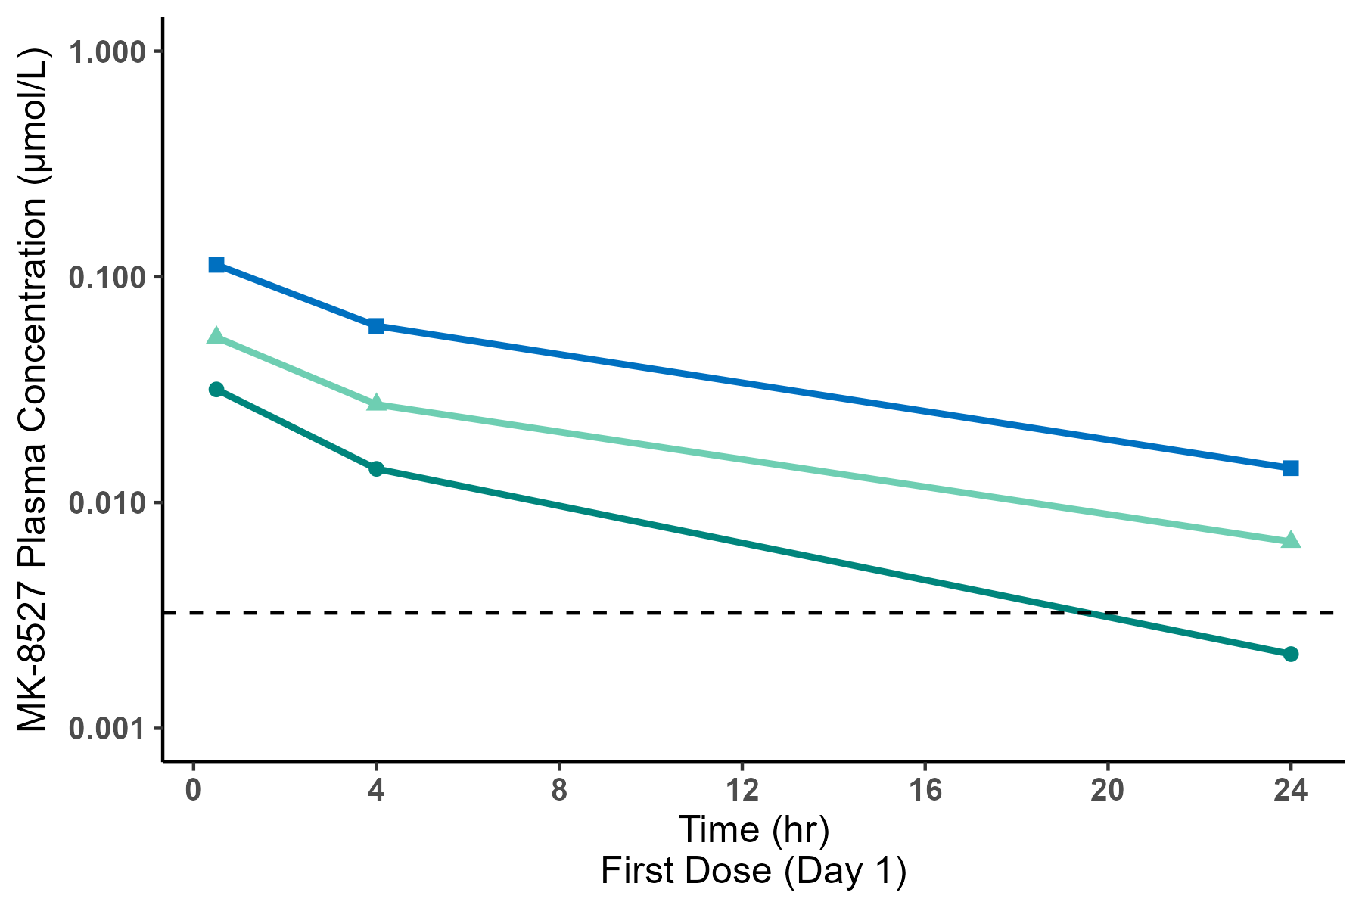
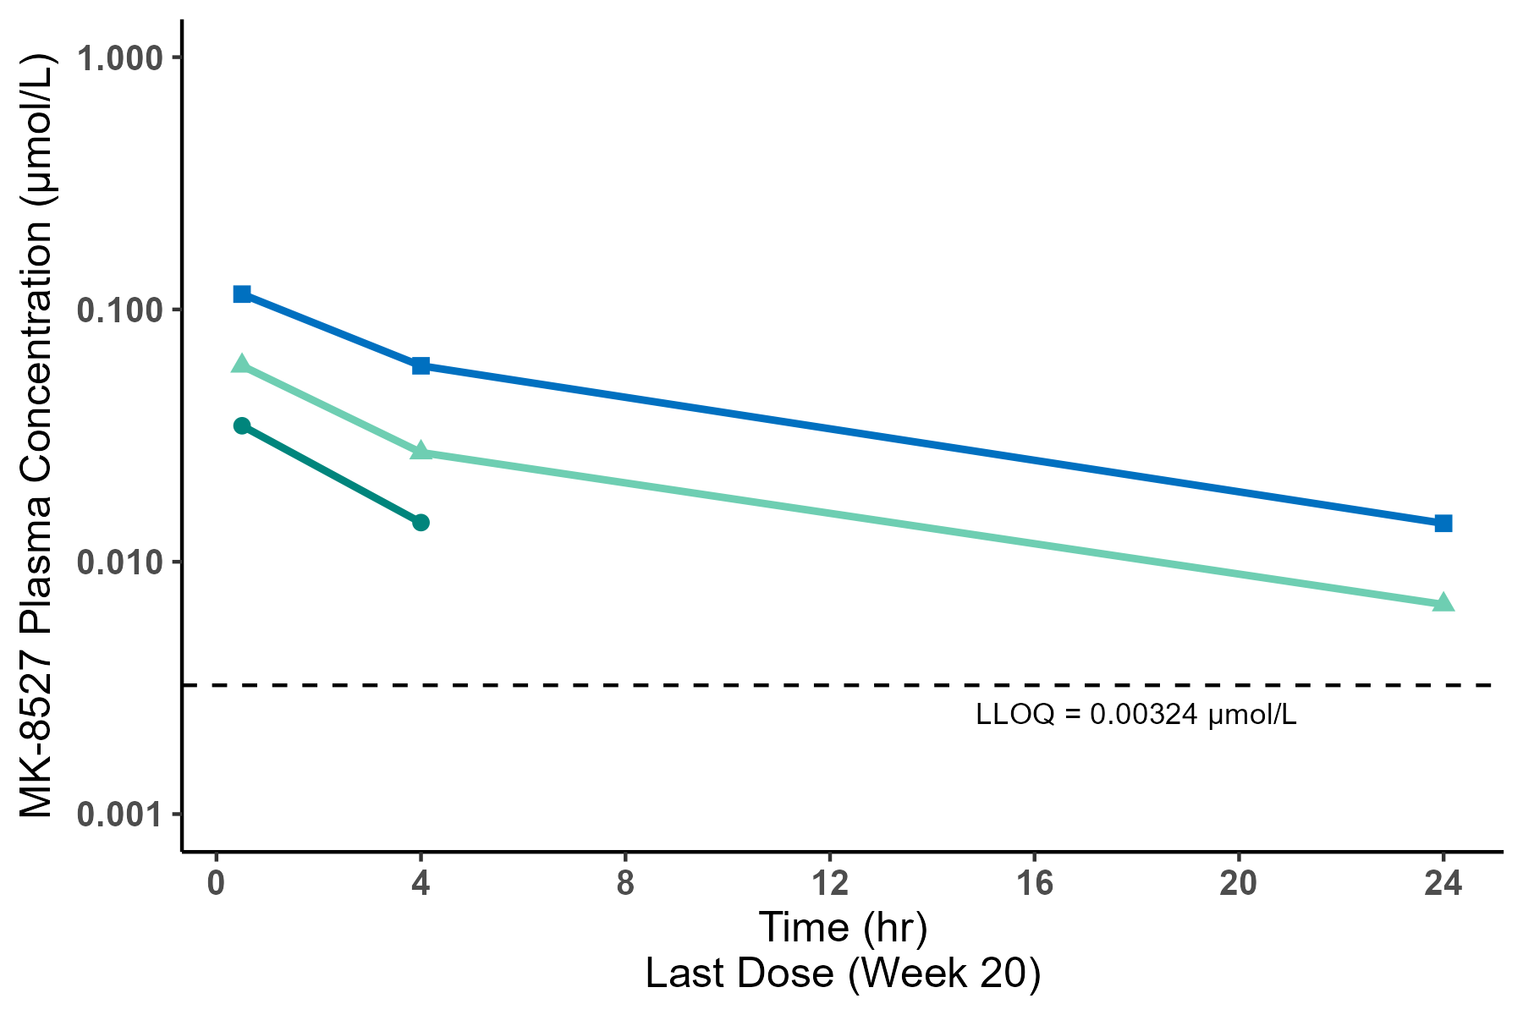
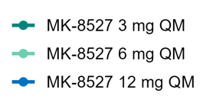
MK-8527 in Plasma
Concentration vs Time Profiles (semi-log scale)
Dose (mg) | Parameter | First Dose (Day 1) |  | Last Dose (Wk 20)
 |  | N | GM (GCV%) | N | GM (GCV%)
12 | AUC_{0-last} | 97 | 0.861 (34.1) | 95 | 0.836 (55.0)
 | C_{max} | 97 | 0.113 (64.5) | 95 | 0.108 (72.5)
6 | AUC_{0-last} | 96 | 0.397 (36.1) | 92 | 0.404 (37.3)
 | C_{max} | 96 | 0.0490 (75.6) | 92 | 0.0538 (73.5)
3 | AUC_{0-last} | 95 | 0.132 (84.8) | 78 | 0.129 (81.5)
 | C_{max} | 95 | 0.0289 (69.0) | 78 | 0.0320 (67.5)
AUC, area under the curve (hr*µmol/L). C_{max}, maximum concentration in plasma (µmol/L). GM, geometric mean. GCV%, geometric coefficient of variation.
PK parameters for MK-8527 are dose-proportional
No apparent accumulation of MK-8527 in plasma with monthly dosing

Slide 12
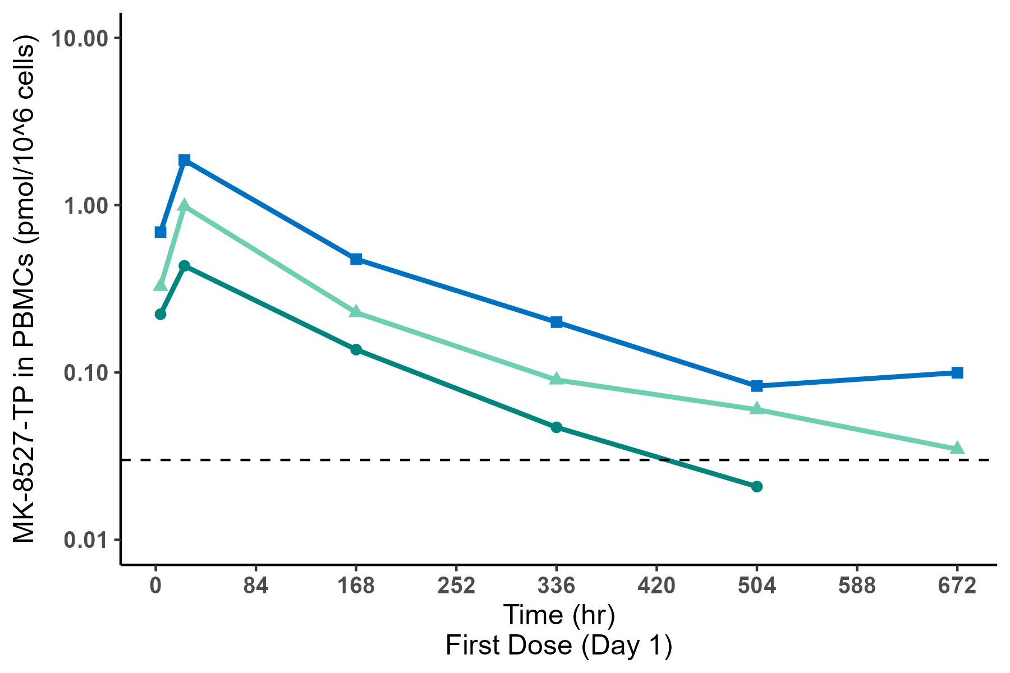
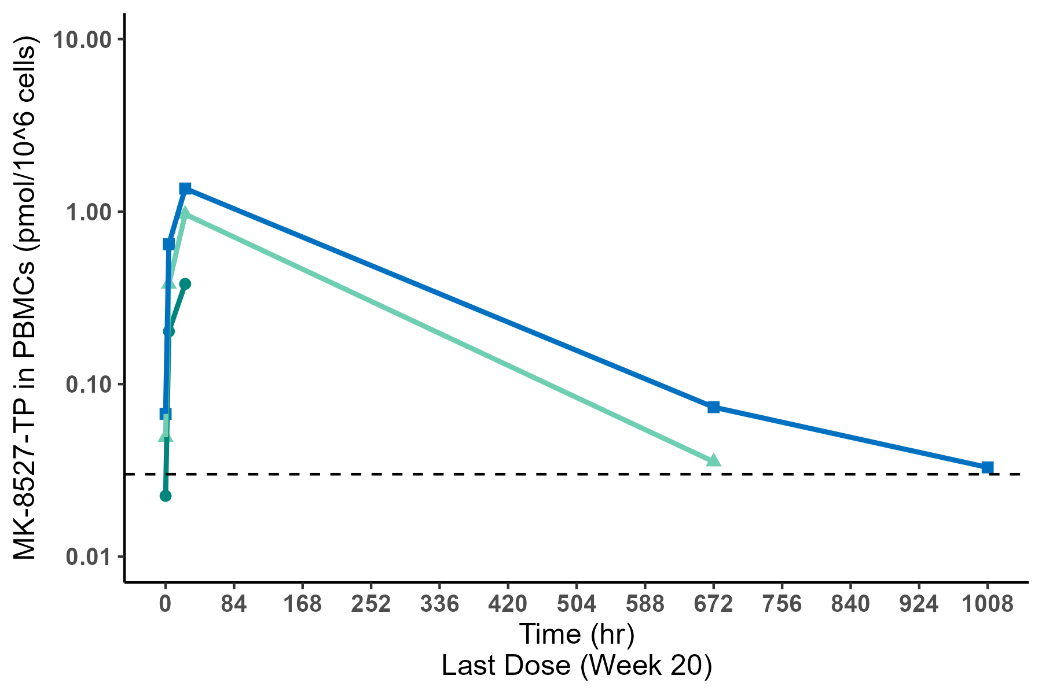
MK-8527-TP in PBMCs
Concentration vs Time Profiles (semi-log scale)
Dose (mg) | Parameter | First Dose (Day 1) |  | Last Dose (Wk 20)
 |  | N | GM (GCV%) | N | GM (GCV%)
12 | AUC_{0-last} | 22 | 204 (71.3) | 19 | 287 (55.9)
 | C_{max} | 22 | 1.48 (79.7) | 19 | 1.23 (63.9)
6 | AUC_{0-last} | 26 | 108 (56.3) | 23 | 128 (178.6)
 | C_{max} | 26 | 0.707 (89.7) | 23 | 0.782 (72.2)
3 | AUC_{0-last} | 21 | 52.9 (67.7) | 20 | 20.7 (255.5)
 | C_{max} | 21 | 0.394 (89.4) | 20 | 0.325 (78.7)
AUC, area under the curve (hr*pmol/10⁶ cells). C_{max}, maximum concentration in PBMC (pmol/10⁶ cells). GM, geometric mean. GCV%, geometric coefficient of variation.
PK Efficacy Threshold = 0.03 pmol/10^6 cells
PK parameters for MK-8527-TP are dose-proportional
Minimal accumulation of MK-8527-TP in PBMCs with monthly dosing
Kapoor Y, et al. MK-8527 PK/PD Threshold and Phase 2 Dose Selection for Monthly Oral HIV-1 Preexposure Prophylaxis. Presented at 32nd CROI, March 9–12, 2025, San Francisco, CA.
Notes:
MK-8527 oral QM dose of ≥6 mg is expected to meet the therapeutic preventive threshold for PreP.
Dose selection for phase 3 was based on multiple factors that will be the subject of a future presentation.

Slide 13
Conclusions
In this large, randomized, double-blind, placebo-controlled, Phase 2 study in adults with low likelihood of HIV-1 exposure:
6 consecutive monthly doses of MK-8527 (3 mg, 6 mg, and 12 mg) were generally well tolerated and demonstrated a safety profile similar to placebo
Pharmacokinetics of MK-8527 and MK-8527-TP were dose-proportional and well-correlated
These results support the continued clinical development of MK-8527 oral QM for PrEP
Phase 3 studies of MK-8527 oral QM, EXPrESSIVE-10 and EXPrESSIVE-11, are expected to begin later this year

Slide 14

MK-8527 Phase 3 Program for PrEP
EXPrESSIVE-10
Adolescent girls and young women at greater likelihood of HIV-1 exposure
N ~ 4580
Kenya, South Africa,
Uganda
EXPrESSIVE-11
People at greater likelihood
of HIV-1 exposure
N ~ 4390
Argentina, Brazil, Chile, Colombia, Dominican Republic, France, Guatemala, Kenya, Malaysia,
Peru, Philippines, South Africa, Switzerland, Thailand,
USA, Vietnam
NCT 07044297

Slide 15
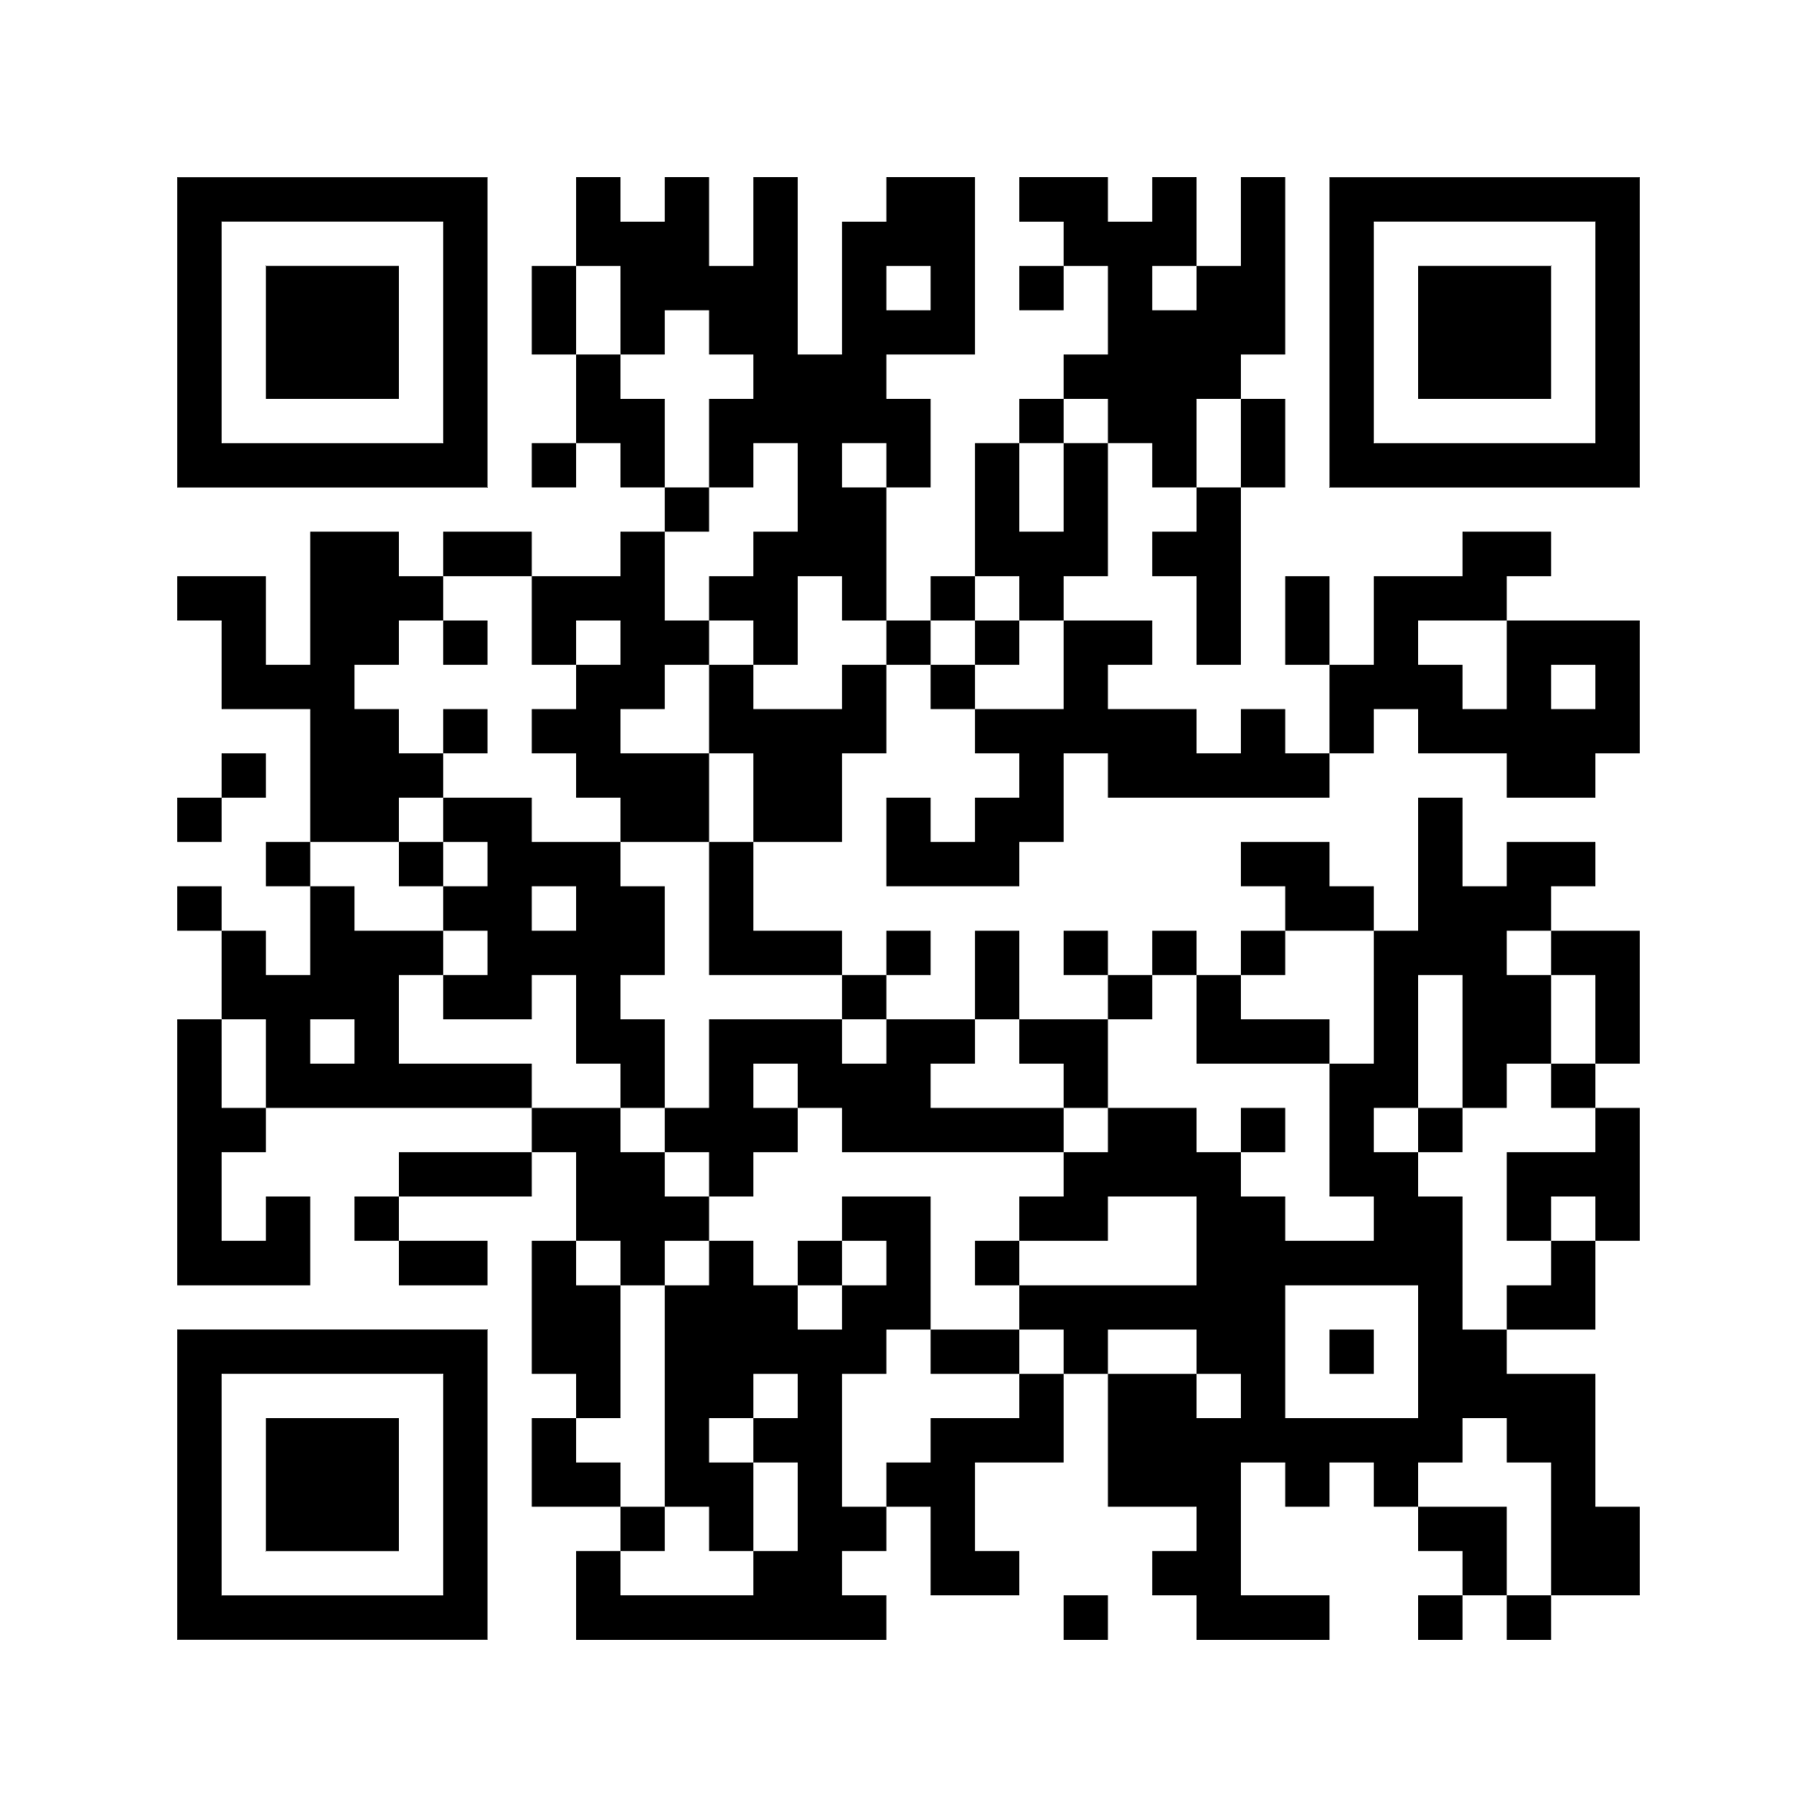
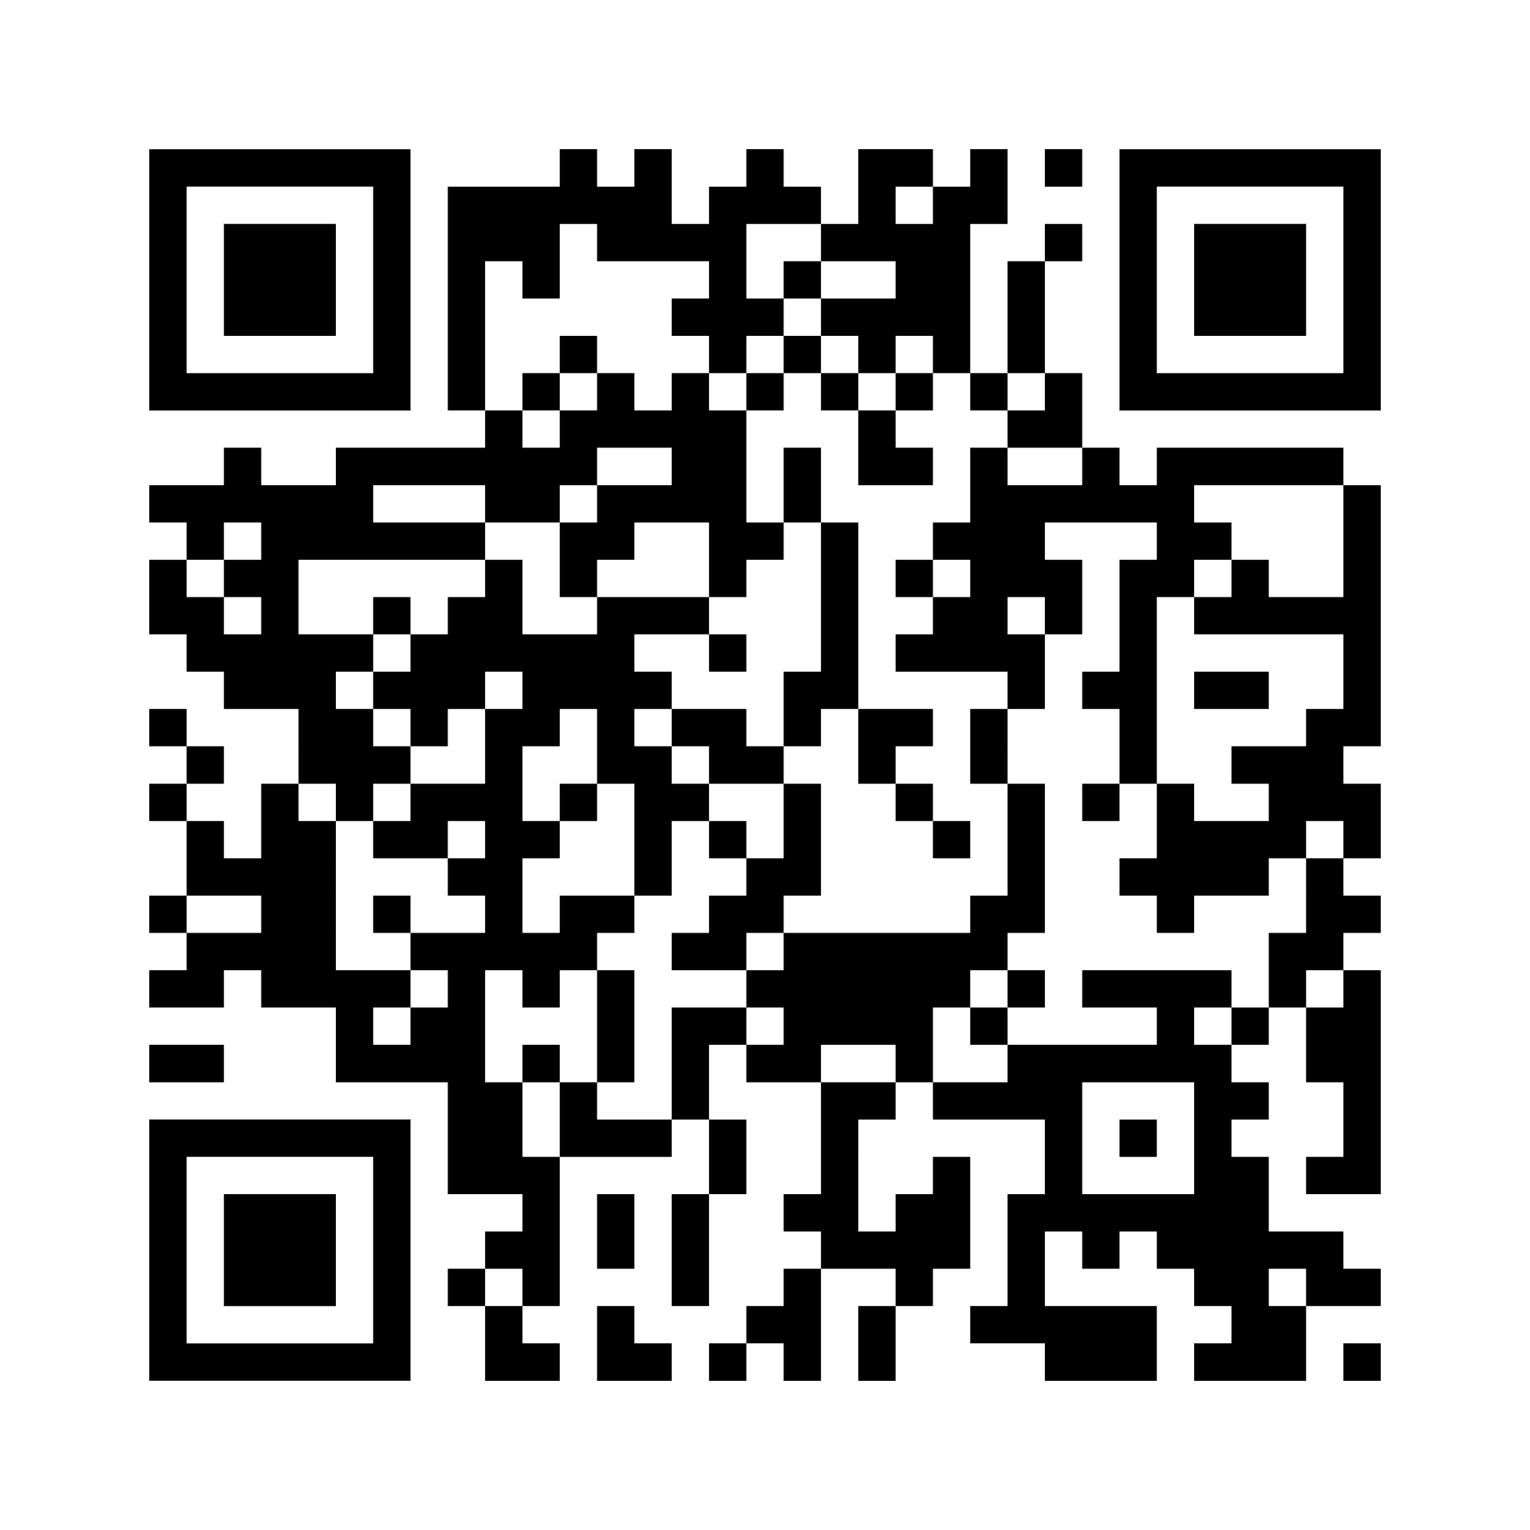
Acknowledgments
We thank the participants and their families
and the investigators and site personnel from 18 study sites
Funding for this research was provided by Merck Sharp & Dohme LLC, a subsidiary of Merck & Co., Inc., Rahway, NJ, USA. Medical writing assistance was provided by Kim Strohmaier, MPH, and editorial assistance by Carol Zecca, BS, both of Merck Sharp & Dohme LLC, a subsidiary of Merck & Co., Inc., Rahway, NJ, USA.
Contact: Dr. Kenneth Mayer at KMayer@fenwayhealth.org for questions or comments
To download today’s presentation
To download a plain language summary
or visit:
https://bit.ly/4jMCVwJ
or visit:
https://bit.ly/43SGlrY

