Slide 1
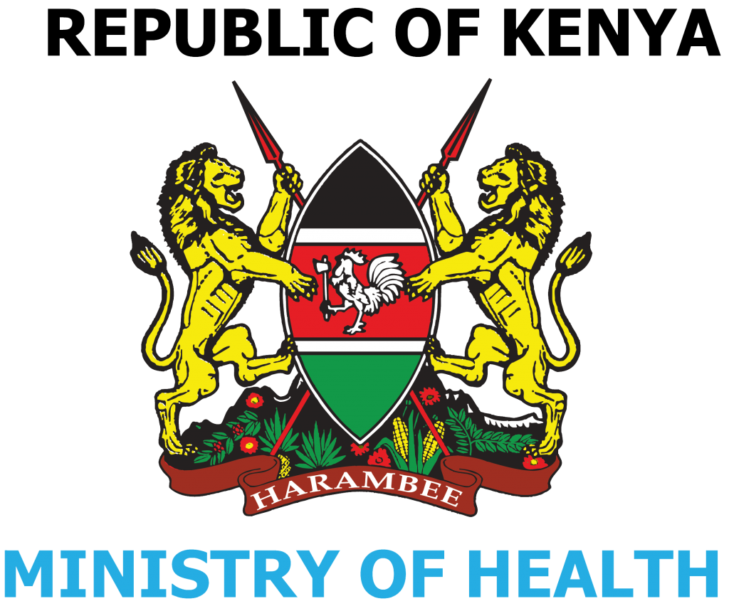
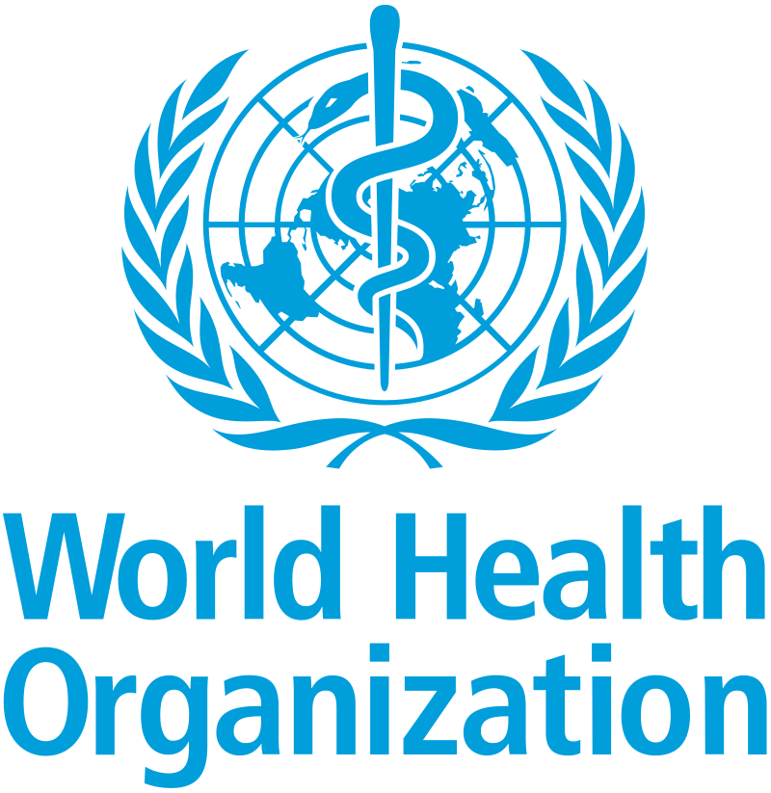

Evaluating the Impact of HIV Self-Test Distribution on HIV Diagnosis and Treatment Initiation Across Health Facilities in Kenya
Kasturi Bhamidipati, Elvis Kirui, Alexandra de Nooy,
Hae-Young Kim, Brooke E Nichols, Aliza Monroe-Wise, Cheryl C Johnson, Christine Kisia, Barbara Mambo, Jonah O Magare, Anna Bershetyn

Slide 2
Significance
HIV self-testing (HIVST) has emerged as an innovative strategy to reduce barriers to HIV diagnosis.
  It allows individuals to test themselves in private; enhances confidentiality, reduces stigma, and potentially increases testing uptake.
Kenya began the distribution of HIVST kits since 2017, with over 1.5M kits distributed nationally.
However, most evidence of the impact of HIVST distribution comes from controlled trial settings.
The real-world impact of HIVST on key programmatic outcomes - such as HIV-positive diagnoses and ART initiation - at national scale remains unknown.

Slide 3
Objective
Our study aims to evaluate the impact of HIV self-test distribution on HIV diagnosis and ART treatment initiation across health facilities in Kenya using routine programmatic data

Slide 4
Data and Methods
Data Sources
Facility-level HIV self-test data: HCMP (no demographic data available)
Facility-level HIV+ diagnoses, facility-based HIV tests, and ART initiations by age/sex: KHIS
County-level prevalence of HIV: PHIA 2018 survey
Statistical Method
Multivariable linear regression models adjusting for facility-based HIV tests and county-level HIV prevalence
Exposure: HIVST distribution
Outcomes: HIV+ diagnoses and ART initiation
Abbreviations:
HCMP: Health Commodities Management Platform
KHIS: Kenya Health Information System

Slide 5
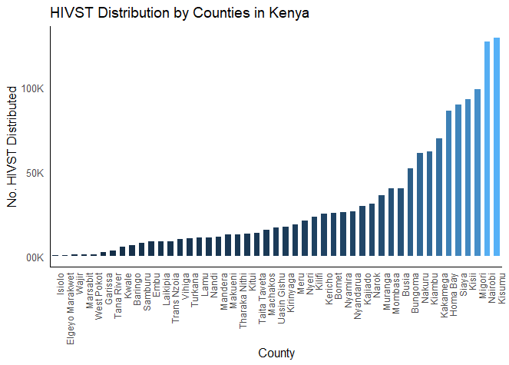
Results: Data Summary
HIVST Distributed across Counties in Kenya 2019-2023
Across 7126 health facilities
Year | HIVST | HIV Tests | ART Initiations | HIV+
2019 | 242,027 | 8.4M | 162,714 | 169,921
2020 | 317,567 | 4.8M | 131,620 | 135,827
2021 | 281,794 | 3.9M | 113,951 | 117,140
2022 | 252,977 | 3.4M | 88,641 | 89,949
2023 | 329,339 | 5.6M | 92,645 | 101,469
Total | 1.4M | 26.2M | 589,571 | 614,306

Slide 6
HIVST distribution was associated with increased HIV+ diagnoses and ART initiations
 | HIV+ Diagnoses Estimate (95% CI) | ART Initiation Estimate (95% CI)
Overall | 6.0 (5.5, 6.5)* | 6.7 (6.0, 7.3)*
Men | 2.6 (2.4, 2.8)* | 2.9 (2.7, 3.1)*
Women | 4.6 (4.2, 5.0)* | 5.3 (4.8, 5.7)*
Every 100 self tests distributed in Kenya was associated with 6 additional HIV+ diagnoses and 7 ART initiations per facility, after adjusting for facility-based HIV tests and county-level HIV prevalence.
This association was higher in women compared to men.
Note: our exposure is number of HIVST tests distributed in general. We do not know the demographics of who used the HIVST, only of who tested in facilities.​
*p-value < 0.001

Slide 7
Subgroup analysis revealed larger impacts in adults 25+
 | HIV+ Diagnoses Estimate (95% CI) | ART Initiation Estimate (95% CI)
Men, ≤19 (yrs) | 0.2 (0.2, 0.3)* | 0.4 (0.4, 0.4)*
Men, 20-24 (yrs) | 0.2 (0.2, 0.2)* | 0.3 (0.3, 0.3)*
Men, 25+ (yrs) | 2.1 (2.0, 2.3)* | 2.1 (2.0, 2.3)*
Women, ≤19 (yrs) | 0.6 (0.6, 0.7)* | 0.7 (0.6, 0.7)*
Women, 20-24 (yrs) | 0.8 (0.8, 0.9)* | 1.2 (1.1, 1.2)*
Women, 25+ (yrs) | 3.6 (3.2, 3.9)* | 4.1 (3.8, 4.5)*
The largest impact was among women aged 25+, in whom every 100 self-tests distributed was associated with 4 additional HIV+ diagnoses and 4 ART initiations per facility, after adjusting for facility-based tests and county-level prevalence of HIV.
Note: our exposure is number of HIVST tests distributed in general. We do not know the demographics of who used the HIVST, only of who tested in facilities.​
*p-value < 0.001

Slide 8
Conclusions
HIVST had a significant impact on both additional HIV+ diagnoses and ART initiations in Kenya
  Every 100 HIVST kits distributed was associated with an additional 6 HIV+ diagnoses and 7 ART initiations.
  Stronger effects in women.
Larger impacts in older adults (25+)
  The largest impact was among women 25+, with every 100 self-tests associated with ~4 additional HIV+ diagnoses and ART initiations.
  Significantly smaller impact among individuals <25 years.
Limitations: Demographic information for HIVST uptake such as age and sex is unknown. Our current models assume the same number of HIVST uptake across all subgroups.

Slide 9
Supplementary Slides

Slide 10
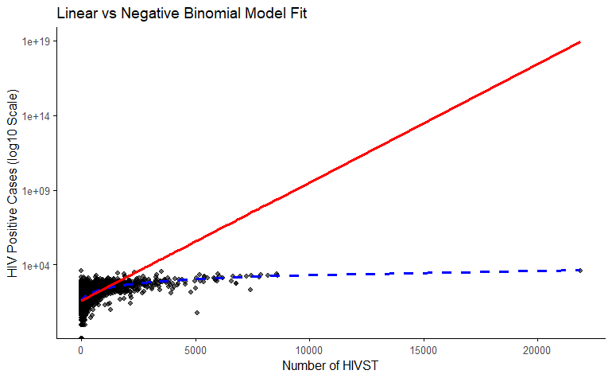
Comparison of Models Supports Choosing Linear Regression
Model Fit Assessment: To evaluate model robustness and ensure appropriate specification, we compared linear regression and negative binomial models using both statistical and visual diagnostics.
Linear Regression Model:
  R-squared = 0.4958
  Explains approximately 50% of the variance in the outcome variable
  Indicates a reasonably strong linear association between predictors and outcome
Negative Binomial Model:
  Pearson Chi-square = 17,151.91, df = 7,124, p < 0.001
  Significant overdispersion and poor fit; predicted counts diverge substantially from observed values
Negative Binomial Model
Linear Model
Model Selection: Based on both goodness-of-fit statistics and visual diagnostics, the linear model demonstrated superior performance and was selected for the analysis.

Slide 11
Outcome: HIV+ per 100 Self-Tests Distributed
 | Unadjusted Model Estimate (95% CI)
 | 2019 | 2020 | 2021 | 2022 | 2023
Overall | 11.2 (10.6, 11.9)* | 13.6 (12.7, 14.4)* | 14.6 (14.0, 15.2)* | 12.4 (12.0, 13.0)* | 14.9 (14.5, 15.4)*
Men | 4.5 (4.3, 4.8)* | 5.0 (4.7, 5.2)* | 5.9 (5.7, 6.1)* | 4.7 (4.5, 4.9)* | 5.5 (5.3, 5.7)*
Women | 6.7 (6.3, 7.1)* | 8.6 (7.9, 9.3)* | 8.7 (8.3, 9.0)* | 7.7 (7.4, 8.1)* | 9.4 (9.1, 9.7)*
 | Adjusting for facility-based HIV tests and prevalence Estimate (95% CI)
 | 2019 | 2020 | 2021 | 2022 | 2023
Overall | 3.0 (2.5, 3.4)* | 6.0 (5.2, 6.9)* | 5.2 (4.7, 5.7)* | 3.3 (2.9, 3.8)* | 5.0 (4.6, 5.4)*
Men | 1.5 (1.3, 1.7)* | 1.8 (1.6, 2.0)* | 2.3 (2.1, 2.5)* | 2.3 (2.1, 2.5)* | 2.7 (2.6, 2.9)*
Women | 1.8 (1.6, 1.7)* | 4.8 (4.0, 5.6)* | 3.9 (3.6, 4.3)* | 2.5 (2.2, 2.8)* | 3.8 (3.5, 4.0)*
*p-value < 0.001

Slide 12
Outcome: ART Initiations per 100 Self Tests Distributed
 | Unadjusted Model Estimate (95% CI)
 | 2019 | 2020 | 2021 | 2022 | 2023
Overall | 13.4 (12.6, 14.2)* | 13.8 (13.1, 14.5)* | 15.8 (15.2, 16.5)* | 13.1 (12.5, 13.7)* | 16.1 (15.7, 16.6)*
Men | 5.0 (4.7, 5.3)* | 4.6 (4.4, 4.9)* | 5.5 (5.3, 5.8)* | 4.6 (4.4, 4.8)* | 5.7 (5.6, 5.9)*
Women | 8.4 (7.9, 8.9)* | 9.2 (8.7, 10.0)* | 10.3 (9.9, 10.7)* | 8.5 (8.1, 8.9)* | 10.4 (10.1, 10.7)*
 | Adjusting for facility-based HIV tests and prevalence Estimate (95% CI)
 | 2019 | 2020 | 2021 | 2022 | 2023
Overall | 4.7 (4.0, 5.4)* | 5.4 (4.9, 6.1)* | 6.7 (6.0, 7.3)* | 3.6 (3.0, 4.2)* | 6.1 (5.7, 6.6)*
Men | 2.3 (2.0, 2.6)* | 1.7 (1.5, 1.9)* | 2.4 (2.2, 2.6)* | 2.3 (2.0, 2.5)* | 3.0 (2.8, 3.2)*
Women | 2.8 (2.3, 3.3)* | 4.6 (4.2, 5.0)* | 5.4 (5.0, 5.8)* | 2.9 (2.5, 3.3)* | 4.7 (4.4, 5.0)*
*p-value < 0.001

Slide 13
Outcome: HIV+ per 100 Self-Tests Distributed
 | Unadjusted Model Estimate (95% CI) |  |  |  |  | Adjusting for facility-based HIV tests & prevalence Estimate (95% CI)
 | 2019 | 2020 | 2021 | 2022 | 2023 | 2019 | 2020 | 2021 | 2022 | 2023
Men, ≤19 (yrs) | 0.2 (0.2, 0.2)* | 0.2 (0.2, 0.3)* | 0.3 (0.3, 0.3)* | 0.2 (0.2, 0.3)* | 0.3 (0.3, 0.3)* | 0.1 (0.1, 0.1)* | 0.1 (0.1, 0.2)* | 0.2 (0.2, 0.2)* | 0.2 (0.1, 0.2)* | 0.2 (0.2, 0.2)*
Men, 20-24 (yrs) | 0.3 (0.3, 0.3)* | 0.3 (0.3, 0.4)* | 0.3 (0.3, 0.3)* | 0.2 (0.2, 0.3)* | 0.3 (0.3, 0.4)* | 0.1 ((0.1, 0.1)* | 0.2 (0.2, 0.2)* | 0.1 (0.1, 0.2)* | 0.2 (0.1, 0.2)* | 0.2 (0.2, 0.2)*
Men, 25+ (yrs) | 4.1 (3.8, 4.3)* | 4.4 (4.2, 4.6)* | 5.3 (5.1, 5.5)* | 4.2 (4.0, 4.4)* | 4.8 (4.7, 5.0)* | 1.0 (0.9, 1.2)* | 1.5 (1.4, 1.7)* | 2.0 (1.8, 2.2)* | 1.7 (1.6, 1.9)* | 2.5 (2.4, 2.7)*
Women, ≤19 (yrs) | 0.6 (0.6, 0.7)* | 0.7 (0.6, 0.7)* | 0.7 (0.7, 0.8)* | 0.6 (0.6, 0.7)* | 0.9 (0.8, 0.9)* | 0.3 (0.3, 0.4)* | 0.5 (0.4, 0.5)* | 0.5 (0.5, 0.5)* | 0.4 (0.4, 0.4)* | 0.5 (0.4, 0.5)*
Women, 20-24 (yrs) | 1.0 (1.0, 1.1)* | 1.2 (1.1, 1.2)* | 1.3 (1.2, 1.4)* | 1.2 (1.1, 1.2)* | 1.5 (1.5, 1.6)* | 0.3 (0.3, 0.4)* | 0.8 (0.7, 0.8)* | 0.8 (0.7, 0.8)* | 0.6 (0.5, 0.6)* | 0.7 (0.7, 0.8)*
Women, 25+ (yrs) | 5.0 (4.7, 5.4)* | 6.7 (6.0, 7.4)* | 6.7 (6.4, 7.0)* | 5.9 (5.7, 6.2)* | 7.0 (6.8, 7.2)* | 1.3 (1.0, 1.5)* | 3.7 (3.0, 4.5)* | 2.8 (2.5, 3.0)* | 1.5 (1.3, 1.8)* | 2.9 (2.7, 3.1)*
*p-value < 0.001

Slide 14
Outcome: ART Initiations per 100 Self Tests Distributed
 | Unadjusted Model Estimate (95% CI) |  |  |  |  | Adjusting for facility-based HIV tests & prevalence Estimate (95% CI)
 | 2019 | 2020 | 2021 | 2022 | 2023 | 2019 | 2020 | 2021 | 2022 | 2023
Men, ≤19 (yrs) | 0.3 (0.3, 0.3)* | 0.3 (0.3, 0.4)* | 0.4 (0.4, 0.4)* | 0.4 (0.3, 0.4)* | 0.4 (0.4, 0.4)* | 0.2 (0.2, 0.3)* | 0.2 (0.2, 0.3)* | 0.2 (0.2, 0.2)* | 0.3 (0.3, 0.3)* | 0.3 (0.2, 0.3)*
Men, 20-24 (yrs) | 0.4 (0.4, 0.4)* | 0.3 (0.3, 0.3)* | 0.3 (0.3, 0.3)* | 0.2 (0.2, 0.3)* | 0.3 (0.3, 0.3)* | 0.3 (0.3, 0.3)* | 0.2 (0.1, 0.2)* | 0.2 (0.1, 0.2)* | 0.2 (0.2, 0.2)* | 0.2 (0.2, 0.2)*
Men, 25+ (yrs) | 4.3 (4.0, 4.5)* | 4.0 (3.8, 4.2)* | 4.9 (4.7, 5.1)* | 4.0 (3.8, 4.2)* | 5.0 (4.9, 5.2)* | 1.5 (1.3, 1.7)* | 1.3 (1.1, 1.5)* | 2.0 (1.8, 2.2)* | 1.6 (1.4, 1.8)* | 2.7 (2.6, 2.9)*
Women, ≤19 (yrs) | 0.6 (0.5, 0.6)* | 0.6 (0.6, 0.7)* | 0.7 (0.7, 0.7)* | 0.6 (0.6, 0.6)* | 0.8 (0.7, 0.8)* | 0.3 (0.3, 0.4)* | 0.5 (0.4, 0.5)* | 0.5 (0.5, 0.6)* | 0.4 (0.4, 0.5)* | 0.5 (0.5, 0.5)*
Women, 20-24 (yrs) | 1.3 (1.2, 1.4)* | 1.6 (1.5, 1.6)* | 1.7 (1.6, 1.8)* | 1.4 (1.3, 1.4)* | 1.7 (1.7, 1.8)* | 0.5 (0.5, 0.6)* | 1.1 (1.0, 1.1)* | 1.2 (1.1, 1.2)* | 0.7 (0.7, 0.9)* | 0.9 (0.9, 1.0)*
Women, 25+ (yrs) | 6.5 (6.1, 6.9)* | 7.0 (6.6, 7.4)* | 7.9 (7.6, 8.3)* | 6.5 (6.2, 6.8)* | 7.9 (7.7, 8.1)* | 2.0 (2.0, 2.5)* | 3.4 (3.1, 3.7)* | 4.0 (3.7, 4.4)* | 1.8 (1.5, 2.1)* | 3.6 (3.3, 3.8)*
*p-value < 0.001

