Slide 1
Closing the gap: the impact of HIV self-testing distribution on new HIV positive results in South Africa
Alexandra de Nooy, Amsterdam Institute for Global Health and Development
From distribution to linkage: Strategies to improve HIV self testing, diagnosis and care across diverse settings

Slide 2
Summary
Main question
Are we able to quantify the impact of HIVST distribution on the HIV programme in South Africa using routinely collected data?
Findings
HIVST distribution resulted in approximately 2.9 additional HIV positive results returned per 100 HIVST distributed, with 5.6% of positive results being attributable to HIVST during the study period.
Why is it important?
HIVST distribution significantly impacted the number of HIV positive diagnoses made. Hence HIVST could play an important role in ensuring access to HIV testing services and in identifying people living with HIV who may otherwise have remained unaware.

Slide 3
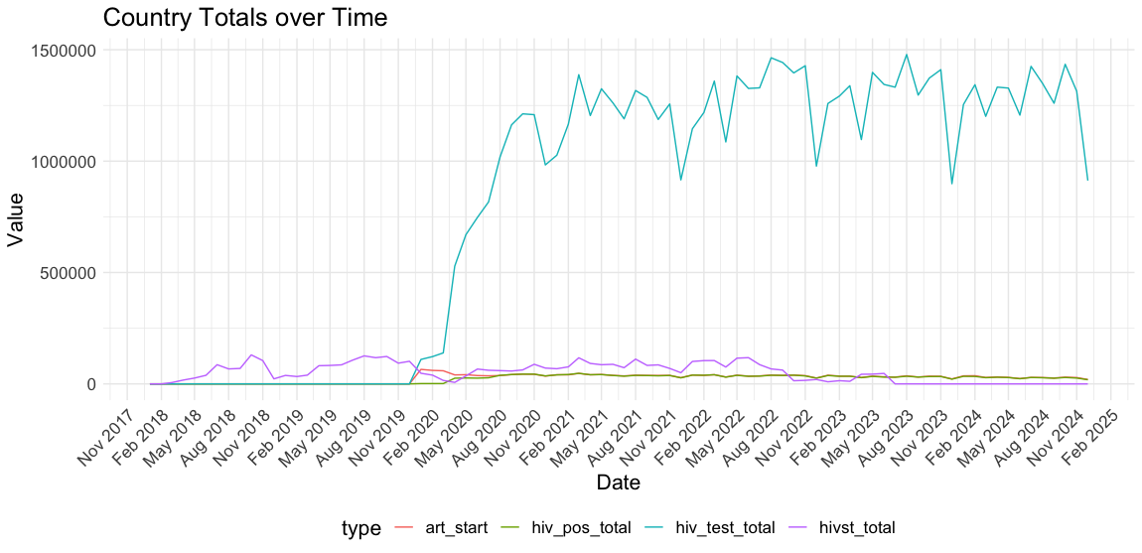
HIVST and Routine Data
HIVST Data:
Monthly, district level data
Disaggregated by sex and distribution type
Routine Data:
Monthly, facility level data (aggregated to district and quarterly)
Facility HIV tests, HIV positive results and ART initiations by age group.
Naomi estimates:
Prevalence
Proportion untreated
Temporal changes
Select period of overlapping data: October 2020 – June 2023
  Allowed for by new data not available at initial submission

Slide 4
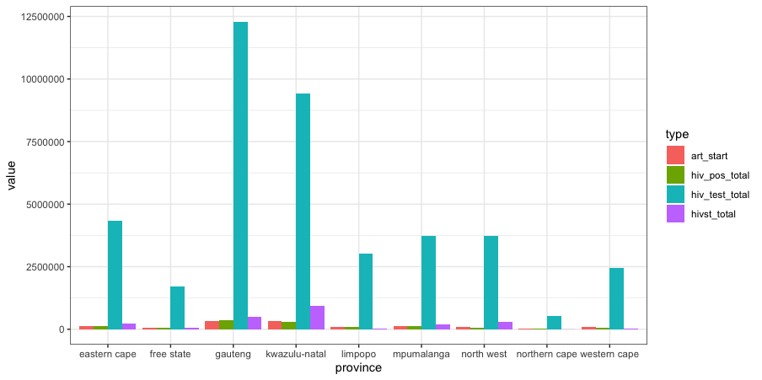
Data Summary:
October 2020 – June 2023
Type | Total
HIV Facility Tests* | 41,212,496
HIVST | 2,275,359
HIV positive tests* | 1,219,248
ART Start | 1,233,242
*Excluding ANC and Infant PCR
Regional differences in testing (facility and self-testing), yield and ART initiations
HIVST represents only a small percentage (<6%) of the testing performed in-country

Slide 5
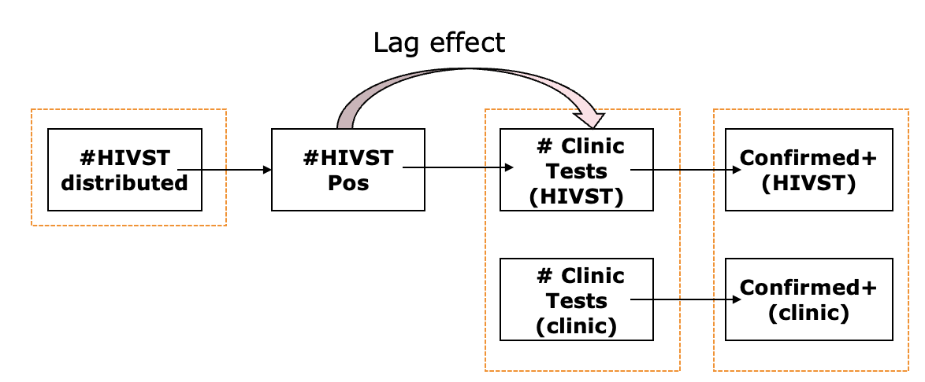
HIVST in the testing system
Lag effect
#HIVST distributed
#HIVST Pos
# Clinic Tests (HIVST)
Confirmed+ (HIVST)
Data available
# Clinic Tests (clinic)
Confirmed+ (clinic)

Slide 6
Approach to estimating impact of HIVST distribution
Multivariable Linear Regression: Although limitations, most easily interpretable approach to quantifying effect of HIVST (additive effects)
Aim: Predict the number of HIV positive results returned per district and quarter
Data Considered: HIVST, Facility tests, regional and temporal differences
Additional Exploration: HIVST distribution potentially has lagged effect on programme (median 85 days¹ between distribution and linkage to additional services)
  Consider effect on current quarter diagnoses may be as a result of HIVST distributed up to two quarters prior
Best model and included factors: Stepwise comparison with final model adjusted to include all considered quarters of HIVST
  HIVST distributed, Facility tests, proportion untreated, province, year, quarter number
¹Zhang Y, Goh SM, Tapa J, et al. Linkage to care and prevention after HIV self‐testing: a systematic review and meta‐analysis. J Int AIDS Soc 2024; 27: e26388.

Slide 7
Key Regression Results
Variable | Estimate | Error | P-value
HIVST (current quarter) * | 1.2 | 0.5 | 0.0108
HIVST (prior quarter) | 0.6 | 0.5 | 0.2405
HIVST (two quarters prior) * | 1.1 | 0.5 | 0.0304
Facility Tests * | 3.1 | 0.07 | <0.00002
*Per 100 Tests
Adjusted R²=0.922
HIV facility-based tests have largest impact on new diagnoses in a quarter: 3.1 positive results per 100 tests conducted
HIVST are however positively and significantly associated with new positive results
Total net impact of HIVST: Minimum of 2.9 additional diagnoses per 100 HIVST distributed

Slide 8
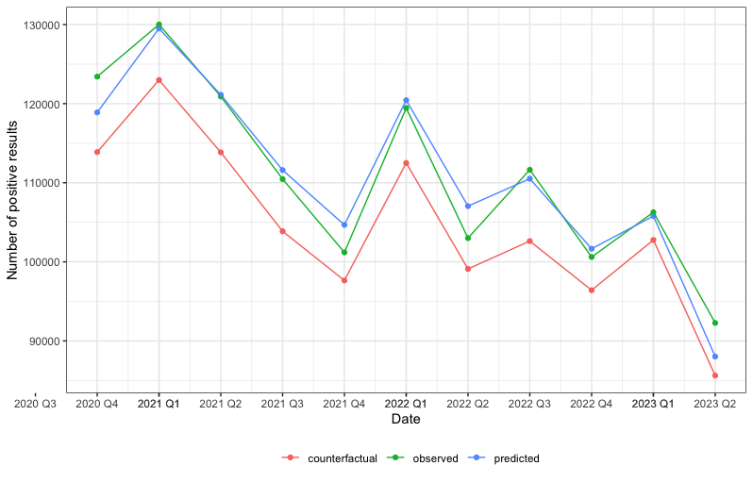
Additional diagnoses through HIVST
Observed, predicted and counterfactual results over time
Model prediction and observed values for HIV positive results returned closely matched over time
5.6% of HIV positive results returned (n=68,005) are estimated to be attributable to HIVST between Q4 2020-Q2 2023.
Counterfactual assumes 0 HIVST distributed

Slide 9
Differences in HIVST distribution - Sex
Original Distribution
Additional HIV positive results (total) per 100 HIVST distributed by sex for different allocations of HIVST with unknown sex. Presented in table as regression coefficient (error)
 | Estimate (Error) | Distribution of unknown HIVST (male %/ female %)
Variable | Original | Unknown (50%, 50%) | Unknown (25%, 75%)
HIVST Males | 22.5 (2.8)* | 14.2 (2.4)* | 16.8 (2.3) *
HIVST Females | -11.3 (1.9)* | -7.2(1.8)* | -6.8 (1.3)*
HIVST Unknown | 0.7 (0.72)
* Significant effect at p <0.05 level
Analysis reviews impact of HIVST distribution by sex on the number of HIV positive results (lag excluded)
Different allocations of HIVST with unknown sex notably impacts magnitude of results
In all considered scenarios, HIVST distributed to men have positive, significant effect on HIV positive results in the quarter (always larger than for women)
  Suggests HIVST distribution to men could be filling a gap in HTS

Slide 10
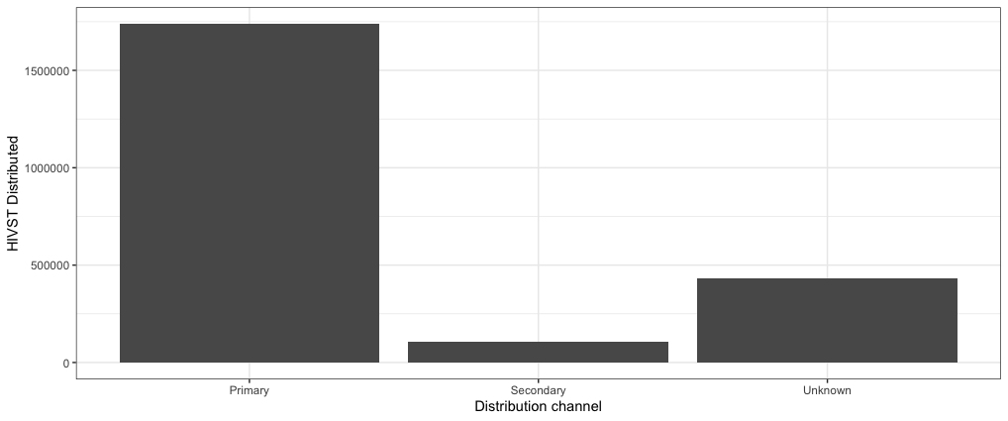
Differences in HIVST distribution - Type
Additional HIV positive results (total) per 100 HIVST by distribution type (primary/secondary) for different allocations of HIVST with unknown type. Presented in table as regression coefficient (error)
 | Estimate (Error) | Distribution of unknown HIVST (primary %/ secondary %)
Variable | Original | Unknown (95%, 5%) | Unknown (75%, 25%) | Unknown (50%, 50%)
HIVST Primary | 2.6 (0.52) * | 1.84 (0.45)* | 2.19 (0.5)* | 2.51 (0.56)*
HIVST Secondary | 3.52 (2.13) | 2.86 (2.13) | 0.17 (1.7) | -0.05 (1.07)
HIVST Unknown | 0.7 (0.6)
* Significant effect at p <0.05 level
Distribution predominantly primary – significant association of between 1.84 – 2.6 additional HIV positive results per 100 primary HIVST distributed (depending on allocation)
Non-significant association for secondary distribution between -0.05 to 3.52 additional diagnoses per 100 secondary HIVST

Slide 11
Limitations and Future Work
Limitations
Linear regression while most intuitive and easily interpretable, may not be best statistical approach
Cases where linear regression can predict negative number of HIV positive results (not possible)
Other and future work
Exploring other regression types (e.g binomial regression) as well as potential mechanistic approaches
Expanding analyses to other countries

Slide 12
Conclusions
Significant impact of HIVST: 2.9 additional diagnoses per 100 HIVST distributed
HIVST impact is immediate and lagged - significant effect seen for HIVST distributed two quarters prior
Primary distribution and distribution to men had strong positive association which could be used to reduce tetsing gaps
Additional work needed in pursuing other approaches to quantifying HIVST impact

Slide 13








Acknowledgements
Ezintsha
Mohammed Majam
Angela Tembo
Francois Venter
New York University Grossman School of Medicine
Kasturi Bhamidipati
Hae-young Kim
Anna Bershteyn
Boston University, Wits Diagnostic Innovation Hub
Brooke Nichols
WHO
Thato Chidarikire
Cheryl Johnson
Boston University and Health Economics and epidemiology research office
Sydney Rosen
SA National Department of Health
Alarice Marsh
Thank you also to Romy Fritz for assistance with additional data access

