Slide 1
The words we use matter in the response to HIV
This slide is a note to the author – please read, then delete
Do… | Don't...
use: people or person living with HIV; person or people with TB; person or people living with HIV and TB; healthcare seekers or clients. | label people as: HIV-infected; infected; co-infected; cases; carriers; victims; patients; sufferers.
spell out the names of key populations: gay men and other men who have sex with men sex workers and their clients trans people people who inject drugs people in prisons and other closed settings | use acronyms for key and vulnerable populations.
talk of the response to HIV and ending the HIV pandemic as a public health threat. | use war talk for HIV (the war on HIV; the fight against HIV).

Slide 2







Overcoming stigma: Enhancing linkage to care after HIV self-testing among key populations in Uganda
From distribution to linkage: Strategies to improve HIV self-testing, diagnosis, and care across diverse settings
Justine Tumusiime | Research Scientist | PATH

Slide 3
Summary
What is your main question?
We aimed to understand if peer-driven HIV self-testing (HIVST) distribution models and follow-up strategies would improve linkages to confirmatory testing and care among key populations.
What did you find?
Our results highlighted that peer-led outreach and follow-up did improve linkage to care following HIVST among key population communities in Uganda.
Why is it important?
Scaling tailored peer-based interventions is critical for addressing persistent gaps in HIV care access and continuity among key populations.

Slide 4
Setting the scene: Access to care among key populations in Uganda
1.4 million people living with HIV in Uganda; 5.1% HIV prevalence rate among adults aged 15 and 49.
HIV prevalence among key population communities estimated at 2-5x higher than the general population
men who have sex with men (12.7%)
female sex workers (31.3%)
Disproportionate impact on specific communities due to structural barriers → recent punitive laws, social exclusion, and increased stigma led to decreases in key populations seeking health services at traditional/standard-of-care entry points.
Critical need for more confidential, convenient, and safe service delivery models that align with how, when, and where key populations would prefer to access services → HIVST offers a more accessible and private HIV testing modality, but strategies needed to facilitate follow-on linkage to care.
Source: 2022 Uganda mode of transmission study
Notes:
Uganda’s KP communities face a higher burden of HIV, with prevalence rates two to five times higher than the general population. Stigma, social exclusion, harsh cultural and political environments limit access to HIV testing and care. Despite the increased accessibility of and privacy offered by HIVST, KP communities still encounter social and self-imposed stigma that hinders linkage to care.

Slide 5




Aligning HIVST services with key population preferences
PATH leveraged human-centered design to ensure HIVST delivery models were responsive to key population needs.
Through Unitaid-funded STAR III initiative, PATH and the Uganda Ministry of Health applied peer-driven HIVST distribution and follow-up strategies across three urban districts (Wakiso, Kampala, and Mukono) to improve linkage to testing and care following HIV self-testing among key population communities.
Price
Price differentiation by willingness-to-pay → partially subsidized or fully subsidized (free).
Person
Diverse needs based on population type.
Individual enablers and barriers.
Individual abilities and motivation.
Product
Blood or oral fluid self-test kits.
Co-packaged with other healthcare products.
Notes:
Uganda’s KP communities face a higher burden of HIV, with prevalence rates two to five times higher than the general population. Stigma, social exclusion, harsh cultural and political environments limit access to HIV testing and care. Despite the increased accessibility of and privacy offered by HIVST, KP communities still encounter social and self-imposed stigma that hinders linkage to care.

Slide 6




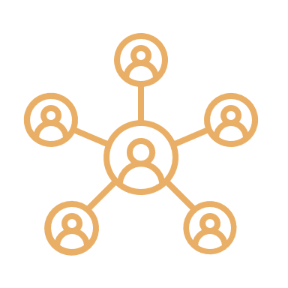








Diversified HIVST distribution models
Tertiary educational institutes
Targeted community outreach
Hotspots
Sex worker clinics
Community
Social network-based testing
Door-to-door distribution
Key populations
Private sector
Antiretroviral treatment (ART) clinics
Outpatient departments
Workplaces
Pharmacies
Public sector
Maternal and child health departments
Nurse and midwife-led clinics
Index testing
Notes:
Designed and introduced four distribution models – describe models used for key populations including linkage flow from HIVST distribution to confirmatory diagnosis and treatment/care for those with reactive self-test results
“Peer supporters distributed HIVST kits at popular congregation points, and through door-to-door and community outreach.”

Slide 7
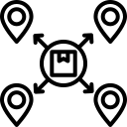
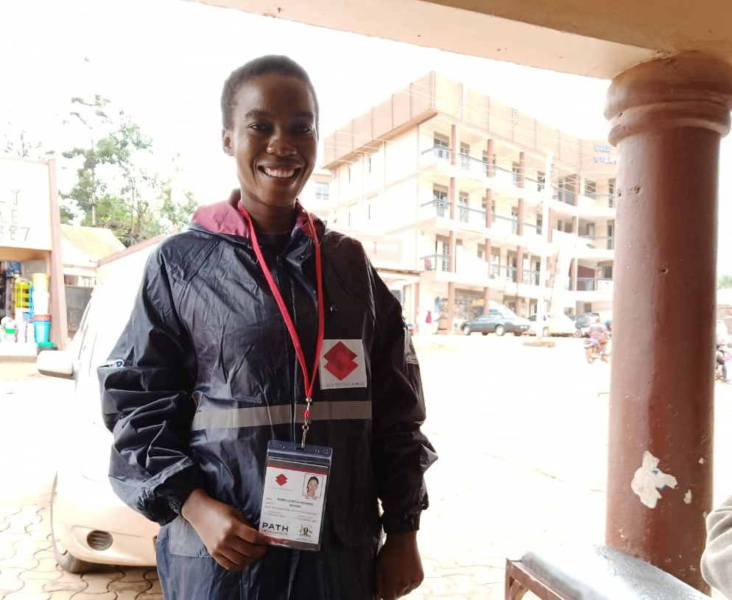



Tailored services for key population communities
Peer-driven services: Trusted peer supporters recommended by key population communities were trained to lead outreach, HIVST distribution, follow-up, and escorted linkages to linked facilities for clients with reactive HIVST results.
Guided referrals at linked health facilities: Supervisors (health care providers; focal points at linkage health facilities) provided guided referrals through facility service flows for confirmatory diagnosis and care.
HIV stigma reduction: Peer supporters and their supervisors were trained on stigma reduction strategies like use of targeted SBC messages and counseling, privacy and confidentiality utilization of unconventional testing points like KP hot spots, homes, Sex workers clinics and DICs, use of socail media like facebook and whatsApp to convey HIVST messages, follow up and linkages and escorted referrals of reactive clients.
Online/mobile outreach for greater privacy: Leveraged key population networks on social media platforms to share informational materials and videos on HIVST; offered variety of options for remote/virtual post HIVST counseling, results return, and linkage to follow-up testing/care (phone call; WhatsApp; toll-free line).
STAR HIVST distributor in Uganda wearing project-branded material. Photo: PATH/Edson Twesigye

Slide 8
HIVST distribution to treatment cascade
203,377 people received HIVST kits→51.5% distributed to key population communities.
Higher HIVST reactivity, linkage to diagnosis and care, positivity, ART linkage, and ART initiation rates among key populations versus all individuals:
Reactivity: 0.95% (overall) versus 33% (key populations)
Linkage to diagnosis and care: 84% of key populations successfully linked to diagnosis and care – higher than national average (79%)
Testing positivity: 0.8% versus 33% (key populations)
ART linkage: 95% versus 99% for KP
ART initiation: 81% versus 99% (key populations)
Figure 1. HIVST cascade, overall and among key populations, November 2020-November 2022.
203,337 people received HIVST kits
1,939 (0.95%) people with reactive HIVST results
1,625 (83.8%) people confirmed HIV positive*
1,543 (95%) people linked to ART
1,303 (81%) people initiated on ART
104,739 (51.5%)key populations received HIVST kits
640 (33%) KP with reactive HIVST results
578 (90%) KP confirmed HIV positive*
572(99%) KP linked to ART
546(99%) initiated on ART
*includes people who received invalid HIVST results and were tested for HIV.

Slide 9
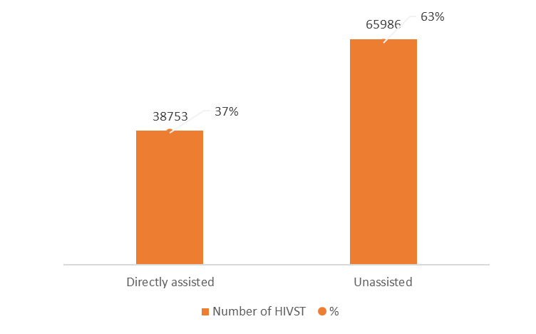
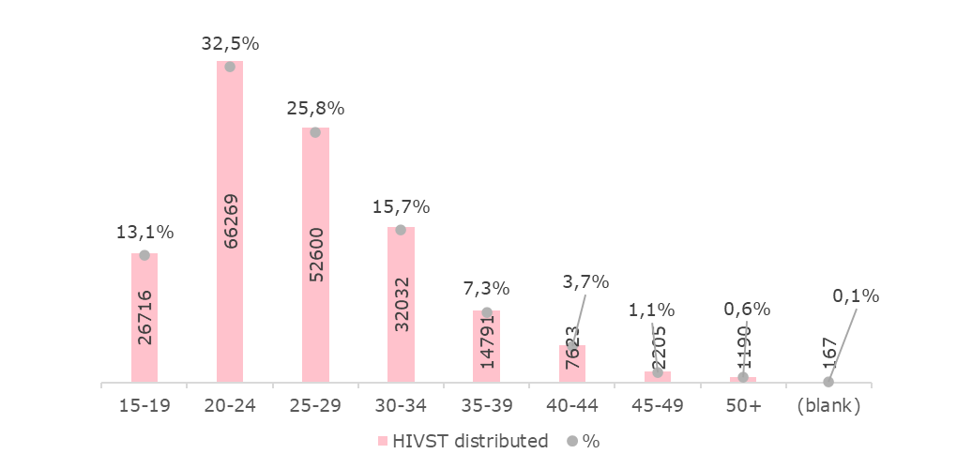
Preference for unassisted HIVST; half of KP reached were infrequent or first-time testers
About 51% of the kits were distributed to Key Population.
63% of AGYW preferred unassisted self-testing.
29,611 (50%) of AGYW who received an HIVST had not tested in the past 12 months; 111 (0.2%) had never tested for HIV before.
Figure 2. HIVST distribution by age range, November 2020-September 2022.
Figure 3. HIVST distribution by self-test type, November 2020-September 2022.
Notes:
Of the AGYW who received HIVST kits, 69% were between the ages of 20 and 24 years.
AGYW demonstrated a preference for directly unassisted HIVST (66%).
More than 75% of AGYW had not tested in the last 12 months.
Preference for OF (79%) over BB (20.95%) STs

Slide 10
Majority of HIVST kits were distributed to KP through peer-based modalities
Figure 4. HIVST distribution among KP by model,
Model | HIVST distributed | %
Community Based | 2619 | 3%
Key Population | 99502 | 95%
Private Sector | 1880 | 1.8%
Public Sector Facility | 738 | 0.2%
Grand Total | 104739 | 100%
Notes:
Among the four distribution models, 60% of AGYW utilized community distribution, mainly through targeted communities and hotspot modalities.
22% of AGYW accessed HIVST through public-sector facilities such as outpatient services, and 18% of AGYW accessed HIVST through the public sector, mainly through nurse/midwife-led clinics.

Slide 11
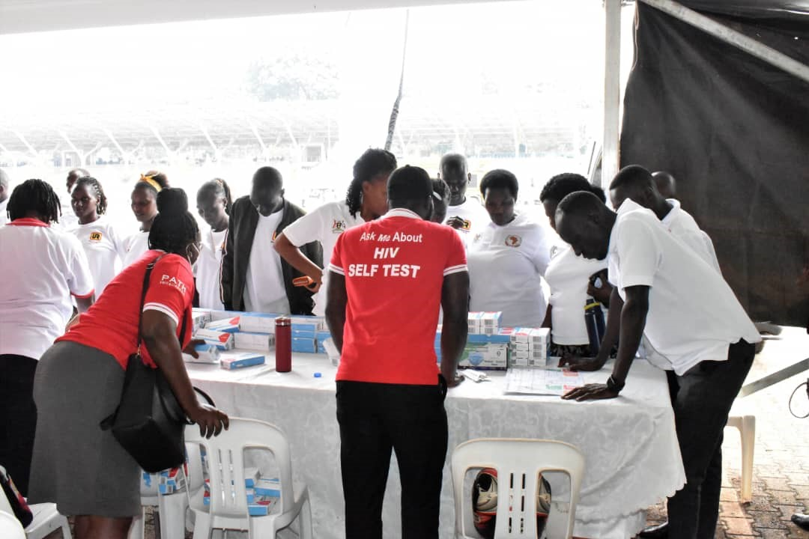
Conclusion
  Engaging peer supporters and facility-based supervisors who are trusted within key population (KP) communities—and equipping them with training in HIV stigma reduction counseling—was essential in building a foundation of trust that enabled effective follow-up and linkage to care.
  Additionally, leveraging technology and social media for counseling and follow-up provided enhanced privacy, which contributed to improved follow-up and linkage outcomes.
Peer supporters distributing HIVST. Photo credit: Justine Tumusiime/PATH

Slide 12
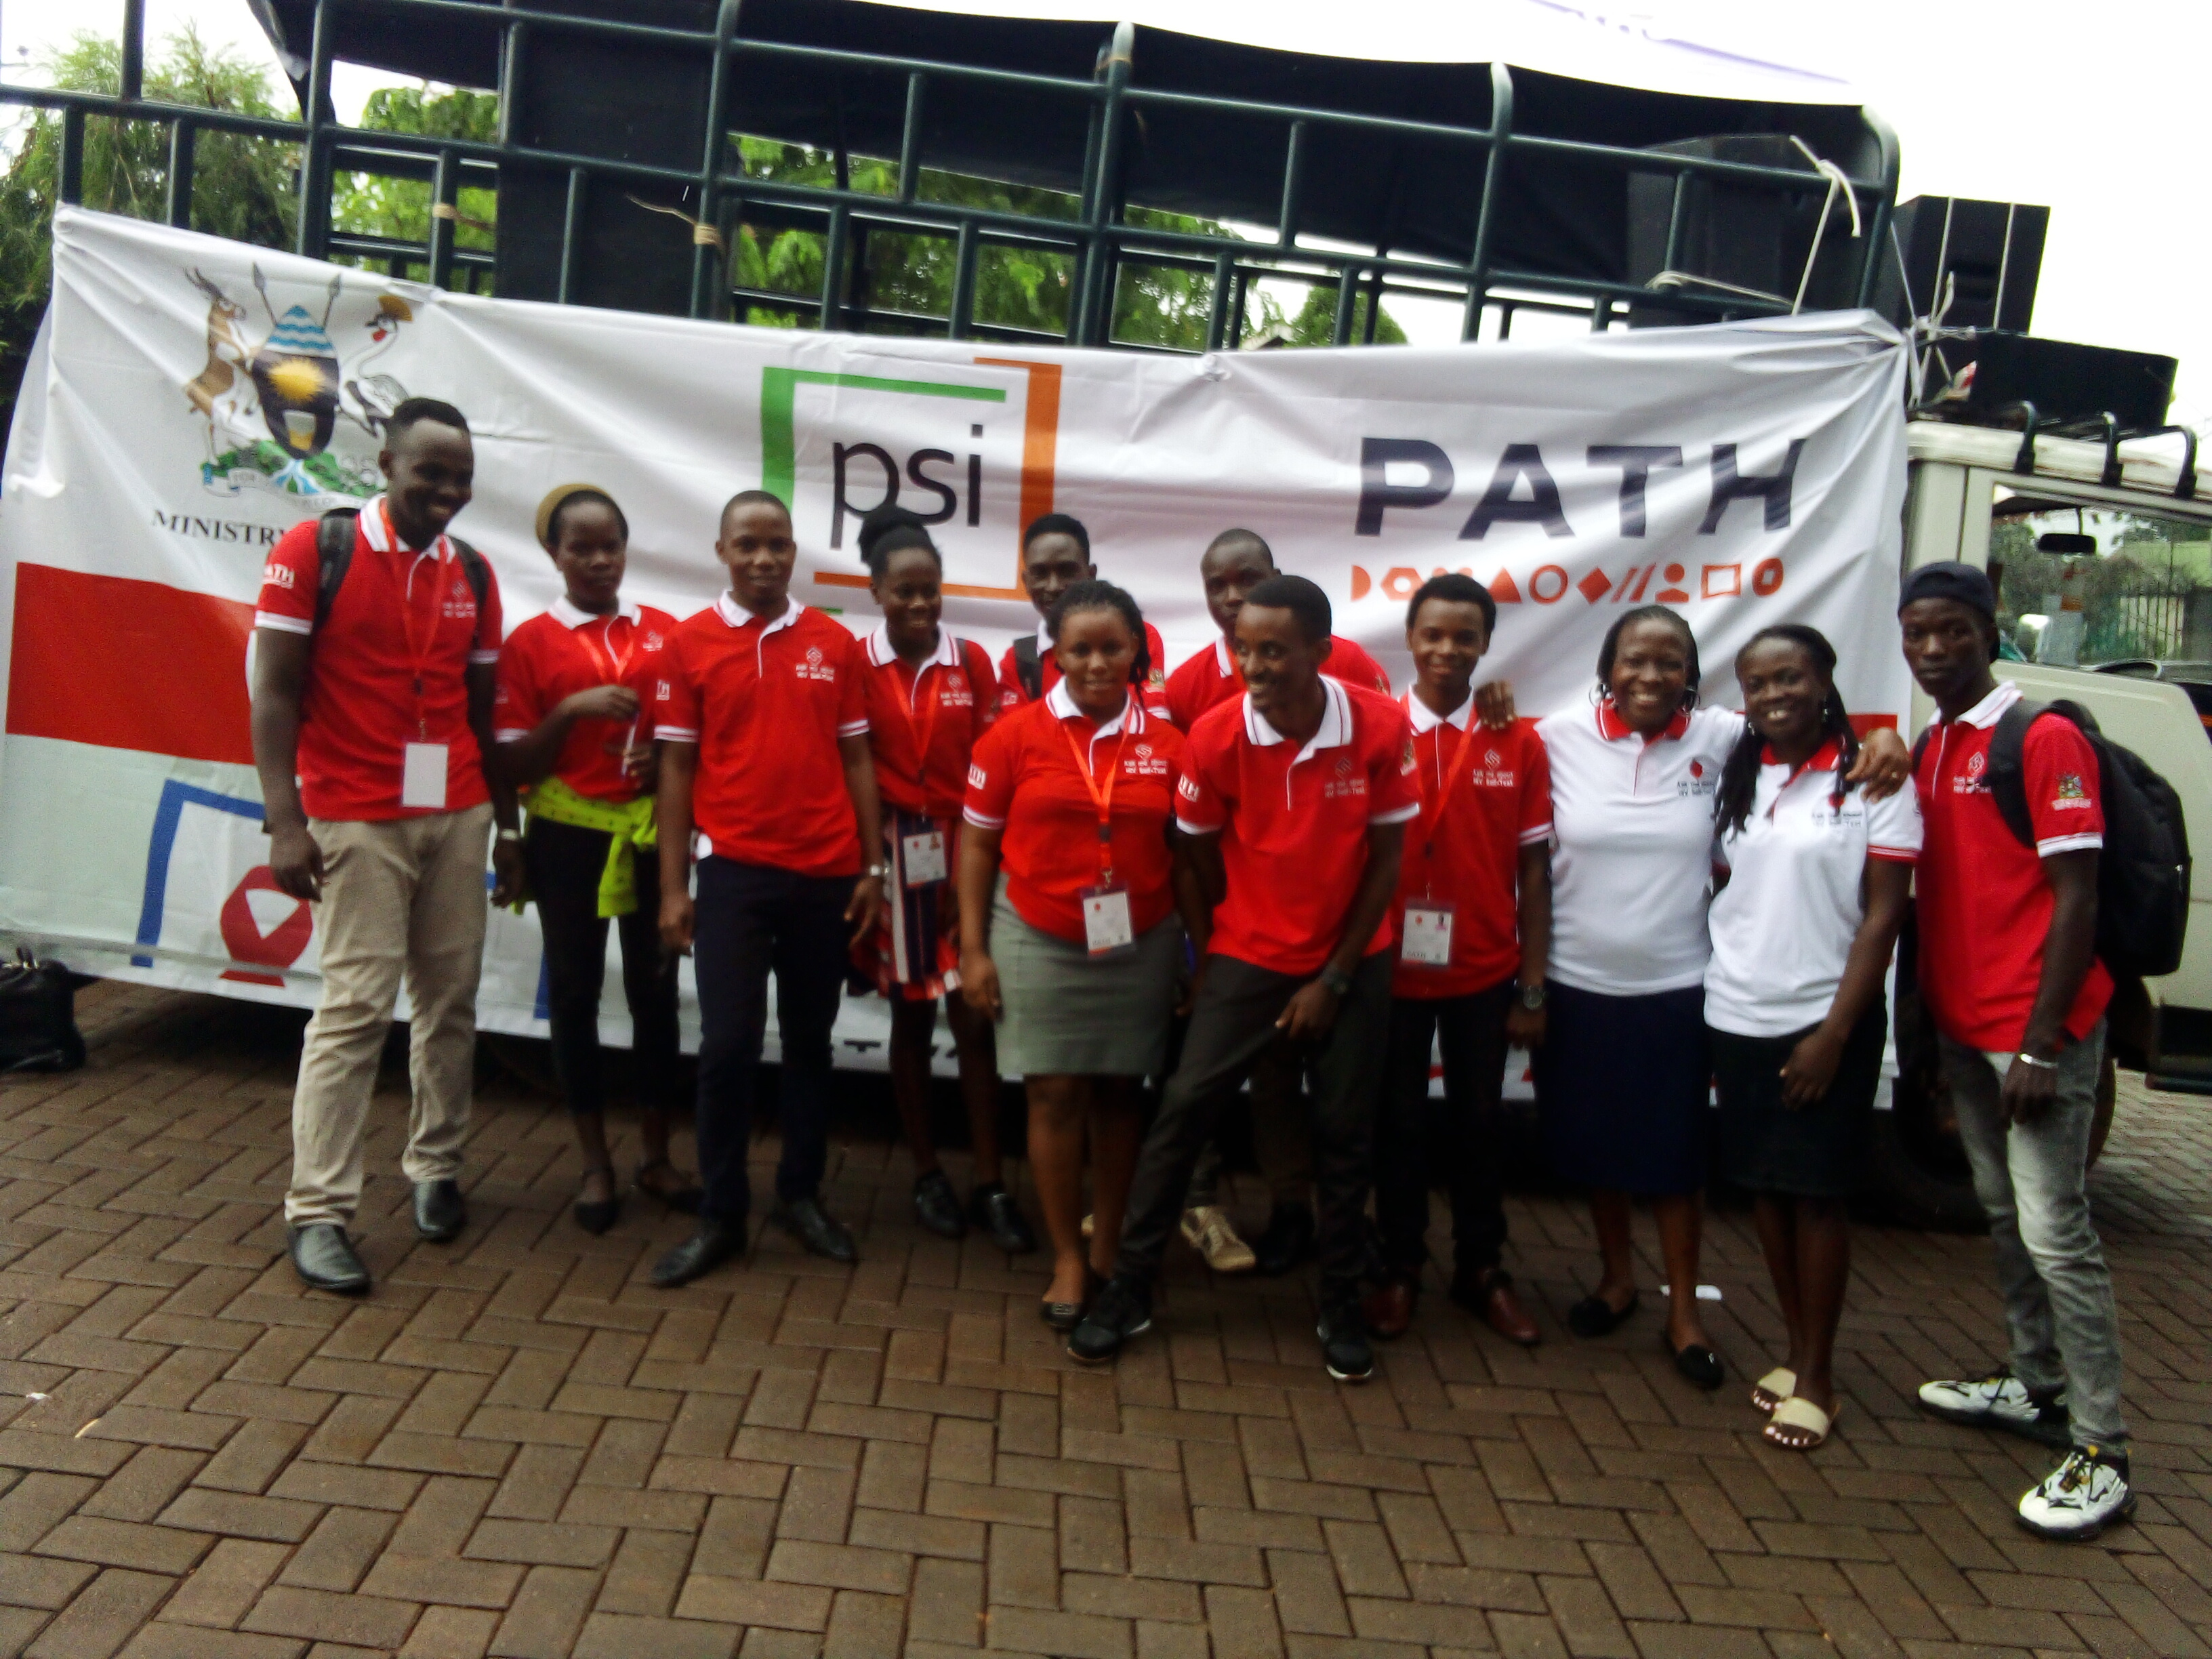
Recommendations
Strengthen Community-Based Support Systems.
Prioritize Trust-Building Interventions
Integrate Technology and Social Media into HIV Services
Enhance Privacy and Confidentiality Measures
Peer supporters distributing HIVST. Photo credit: Justine Tumusiime/PATH

Slide 13
Acknowledgements
Uganda Ministry of Health
Unitaid
Population Services International
STAR-III project partners and PATH staff
Key population peer distributors
Most At Risk Population (MARPI)

