Slide 1
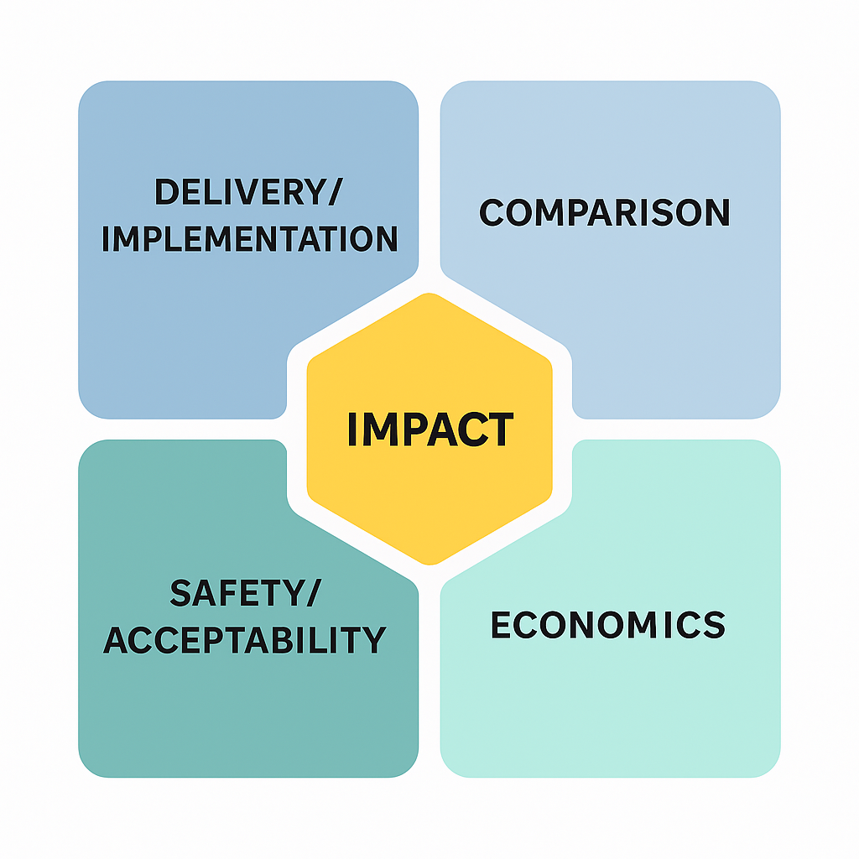

Lekey Khandu, PhD Candidate
School of Population Health, Curtin University, Western Australia
HIV Self-testing for Index Testing to Reach Sexual and Drug Injecting Partners in Low to Upper-Middle-Income Countries: Mixed Method Systematic Review
This study is part of my PhD research, conducted under the supervision of A/Professor. Jonathan Hallett, A/Professor Gemma Crawford, A/Professor Justine Leavy of Curtin University & Dr Daniel Vujcich from WAAC-Western Australia.
Notes:
First, I would like to express my sincere gratitude to the International AIDS Society for granting me this invaluable opportunity to attend the 13th IAS Conference on HIV Science 2025 in Kigali, Rwanda. My name is Lekey Khandu, and I am currently pursuing a PhD at Curtin University in Western Australia under the HDR Scholarship. I am originally from Bhutan.
My presentation focuses on a systematic review examining the acceptability and feasibility of HIV self-testing (HIVST) for partner notification among sexual and drug-injecting partners of people living with HIV in low- and middle-income countries. This forms one of the key components of my ongoing doctoral research and reflects my commitment towards community-centred, equitable and sustainable HIV responses.

Slide 2
Summary
What is your main question?
Is HIVST and aPN acceptable and feasible for index testing and partner notification in LMICs?
What did you find?
HIVST and aPN are acceptable and feasible but need stronger policy/system support.
aPN yields higher positivity and linkage despite low partner elicitation.
The aPN model is cost-effective, but no cost-effectiveness study on the index HIVST.
Key gaps: unmarried/undiagnosed KPs & under-researched regions (South & East Asia).
Why is it important?
Improves case finding and supports efforts to close the case detection gap in ending HIV by 2030.
Notes:
Let me provide you with the key summary of the SLR; our main aim is to see the feasibility and acceptability of HIVST for index testing and partner notification to research the sexual and drug injecting partners of the diagnosed people living with HIV.

Slide 3
Rationale
HIV testing is key to timely diagnosis and linkage to care, but stigma and structural barriers limit access.
HIVST improves access for key populations (e.g., MSM, FSW, transgender people, PWID).
As HIV incidence decreases, partner notification (PN) is essential to identify undiagnosed cases.
Integrating HIVST into PN is a promising but underexplored strategy to enhance testing and improve linkage to care.

Slide 4
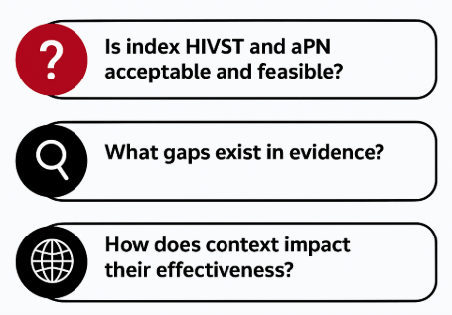
Key Review Questions
Visual assets sourced from Canva Pro (Canva.com)
Notes:
What is the level of uptake of HIVST for PN compared to facility-based testing?
What is the effectiveness of aPN and other partner notification strategies with and without HIVST, among index cases and undiagnosed key populations?
What are the barriers and facilitators for HIVST indexing to PNS among index cases, and undiagnosed key population?

Slide 5
Design and framework
Mixed-method systematic review (JBI methodology)
Aligned with PRISMA guidelines
PROSPERO Registered
Scope and Timeframe
Included studies from LMICs
Jan 2016- Dec 2023
Focus: HIV index clients & key population (MSM, TG, FSW, PWID)
Data Screening and Review
Screening by the first Author
Reviewed by co-authors
A total of 76 studies were included.
Analysis
A convergent, segregated approach is used for synthesis
Quantitative: narrative synthesis (no meta-analysis)
Qualitative: meta-aggregation
METHODS
Notes:
This is a mixed-methods systematic review conducted from October 2023 to March 2024 focusing on HIV index clients & key populations (MSM, TG, FSW, PWID). We included 76 quantitative and qualitative studies for analysis. A convergent, segregated approach is used for synthesis, where quantitative data were analysed narratively without meta-analysis and qualitative data using meta-aggregations.

Slide 6
Results: Effectiveness of HIVST for Partner Notification
Quantitative
Higher HIVST uptake vs. facility-based testing reported in 8 studies, with increases ranging from 49% to 70%.
Qualitative
High acceptability and feasibility (Offorjebe et al., 2020)
Improves partner communication (Agot et al., 2020).
Effective HIVST partner notification relies on supportive policies (Selvaraj et al., 2017).
Hindered by mistrust of HIVST results, stigma, gender norms, and safety concerns (Rahmalia et al., 2022, Choko et al., 2021; Dovel et al., 2023, Xiao et al., 2020).
Notes:
Several RCT studies that we reviewed showed that higher uptake of HIVST when compared with facility-based testing, with the rates ranging from 49% to 70% whereas for facility-based testing, PN stands between 6% to 25%. This shows that HIVST does enhance case reaching sexual and drug-injecting partners of diagnosed PLHIV, indicating its feasibility for index testing and partner notification services.
The qualitative findings from several studies also showed high acceptability and feasibility to use at the individual level, but some concerns about distribution to their partners.
Participants highlighted that HIVST significant role in improving partner communication because they perceived that HIVST often served as a practical entry point to start conversations about HIV, testing, and sexual health, topics that are usually hard to bring up in traditional settings. This shows that if HIVST is used strategically, it can improve relationships and trust, which was found to be a key in HIVST distribution for partner testing.
Although HIVSTs are highly acceptable and feasible for PNS but evidence also shows that their implementation is often challenged by unclear policy to integrate HIVST within the existing aPN services in the health centers, and inconsistent index testing guidelines or no guidelines at all thus making it difficult for the providers to implement the HIVST index testing efficiently.

Slide 7
Result: Effectiveness of aPN for Partner Notification (Without HIVST)
Quantitative
21 studies reported on the effectiveness of aPN in increasing partner testing uptake, new diagnosis and linkages to care.
Qualitative
Low partner elicitation was linked to:
Fear of HIV status disclosure and relationship conflict.
Experiences or threats of sexual and verbal violence (Liu et al., 2022)
Gender power imbalances limiting ability to share information (Offorjebe et al., 2020)
Healthcare provider skill gaps (Tembo et al., 2019)
Example of RCT studies showing the effectiveness of aPN for index testing
Country/Author | Partner testing uptake (%) | Index partner ratio | Positivity (%) | Linkage to care (%)
Nigeria (Onovo et al., 2021) | 84.1 | 2.9 | 49.7 | 93
Kenya (Sharma et al., 2021) | 77 | 2.1 | 44 | 93
Uganda (Buhikire et al., 2018) | 58 | 1.4 | 32 | n/a
China (Fu et al., 2016) | 1.5 | 10 | 10 | n/a
Notes:
We have also reviewed several studies to see the effectiveness of traditional aPNS without HIVST and found that the approach was effective in reaching the sexual and drug-injecting partners of diagnosed PLHIV. Owing to time constraints, I would like to show you examples of three RCT studies out of 21 studies showing similar patterns.
For instance, if we look at Nigeria, the index partner ratio is 2.9, meaning one index client had notified about 2.9 sexual and drug injecting partners. The overall testing uptake of the notified partners was about 84% resulting in a 49.7% positivity rate and 93% linkage to treatment.
Similarly, the Kenyan RCT showed that the index partner ratio of 2.1, with 77% testing uptake, resulting in a 44% positivity rate and 93% linkages to treatment. These examples show that traditional index testing using aPN is indeed effective for testing the sexual and drug-injecting partners. Integrating HIVST to aPN not only improves testing uptake among the index partners but also provides alternative options for testing.

Slide 8
Result: Effectiveness of aPN with HIVST vs Passive PN
Six RCTs showed that HIVST with aPN achieved 35–71% partner testing when compared with passive partner referral.
PPR is linked to IPV, self-harm, and emotional breakdowns; many participants have suggested aPN over PPR 9 (Quinn et al., 2018, Thirumurthy et al., 2021; Ye et al., 2023).
Note: aRR for Malawi (Dovel et al., 2023) = 2.77 (95% CI: 2.56–3.00); Hu et al. also found 49% of disclosed partners tested vs. 28% in passive PN.
Notes:
As I have highlighted before, this slide depicts the effectiveness of integrating HIVST within aPNS. When we looked at the effectiveness of aPN with HIVST compared to Passive PN, we found that six RCTs reported that aPN with HIVST achieved high partner testing uptake, ranging from 35% to 71%, while Passive Partner Referral showed lower uptake, ranging from 17% to 52%.
The main reason for low uptake of partner testing via PPR is that PPR is linked to IPV, self-harm, and emotional breakdown; thus, many participants suggested aPN over PPR.

Slide 9
Cost-effectiveness of aPN
aPN is cost-effective in Kenya and Mozambique, especially under task-shifting models (Sharma et al., 2018 & Wamuti et al., 2021).
  In Kenya: $823–$1619 per DALY averted; total cost stayed below per capita GDP ($2,000–$2,200).
  In Mozambique: $1813 per infection averted, $65.32 per HIV diagnosis.
  Main cost drivers:
    Kenya: Human resources (49%), transport (13%).
      Mozambique: human resources (52%), test kits (28%).
Notes:
Based on my experience, what I have observed is that index testing in many national programs is not being prioritised, with the belief that it is a complex, time-consuming and costly intervention. However, evidence from Kenya and Mozambique has clearly shown that aPN is a cost-effective intervention; for instance, in Kenya, implementing aPN costs between $823 and $1,619 per DALY averted, which falls well below the country's per capita GDP. That means every dollar spent is buying a meaningful health benefit.
Similarly, in Mozambique cost to diagnose one person with HIV through aPN was about $65. That includes the cost of testing kits, staff time, and outreach. However, when considering the bigger picture from prevention to testing and treatment, averting one new HIV infection was around $1,800. Although diagnosis is quite affordable, preventing further spread takes more resources, but it’s still considered cost-effective when compared to long-term treatment costs and the health impact of undiagnosed HIV.
The evidence shows that the main cost drivers for aPN are human resources, transport and test kits.

Slide 10
Conclusion
HIVST is highly acceptable and feasible for index testing and partner notification.
It promotes open communication, mutual disclosure, and informed partner testing.
Assisted and choice-based referrals are safer and more effective than passive methods.
Success depends on supportive policies, but relational and structural barriers still exist.
Traditional aPN is cost-effective, but there is no cost-effectiveness data yet for index HIVST.
Evidence gaps remain for unmarried and undiagnosed key populations, and in South/East Asia.

Slide 11
Thank you for your attention
Any question PLEASE???
Let’s Take the Right Path to End AIDS

