Slide 1
How have policies influenced PrEP uptake?
An analysis of PrEP data in 139 countries
Janki Tailor, Independent Consultant
Big money and the big picture: Funding and HIV epidemiology
Notes:
Thank you all for attending! My name is Janki Tailor and I am an independent consultant with AVAC a global HIV prevention advocacy nonprofit.
Today I will discuss the importance of specific policies in enabling PrEP uptake at both a global and Africa-continental level.

Slide 2
Summary
What is your main question?
What global policies related to HIV testing and prevention, structural changes, and health systems enable PrEP uptake and the expansion of options?
What did you find?
Policies on non-criminalization of same-sex sex and HIV exposure, task shifting, self-testing, prohibition of compulsory testing, and lifting age restrictions on testing and treatment associated with high PrEP uptake.
Both individual policies and policies that act in concert by overlapping or reinforcing one another enable PrEP access & uptake.
Context matters: policies that significantly enable PrEP uptake differ by region.
Policies that make PrEP access easier associated with higher uptake.
Why is it important?
Oral PrEP is at varying stages of scale-up globally, while longer-acting PrEP products and multi-purpose prevention technologies (MPTs) are slowly rolling out in limited supplies. This analysis sheds light on how to leverage policies to efficiently drive access and maximize public health impact.
Notes:
The main question of this analysis was: What global policies related to HIV testing and prevention, structural changes, and health systems enable PrEP uptake and the expansion of options?
We found that there are specific policies that significantly enable PrEP uptake, as I will cover later.
While individual policies show significant associations with PrEP uptake when analyzed in isolation, their effects are not entirely independent. Instead, the policies tend to act in concert, overlapping or reinforcing one another, which makes it difficult to isolate the effect of any one policy. This suggests that the overall policy environment, rather than any single measure, plays a critical role in enabling PrEP uptake.
The policies that make PrEP access easier are those associated with higher PrEP uptake.
All of these findings are important because not only is oral PrEP at varying stages of scale-up globally, but longer-acting PrEP products and multi-purpose prevention technologies (MPTs) are also slowly starting to enter the market. How we leverage our policies and the policy environments we create will significantly affect who has access to PrEP, how many people have access, and the direction the global HIV pandemic takes.

Slide 3
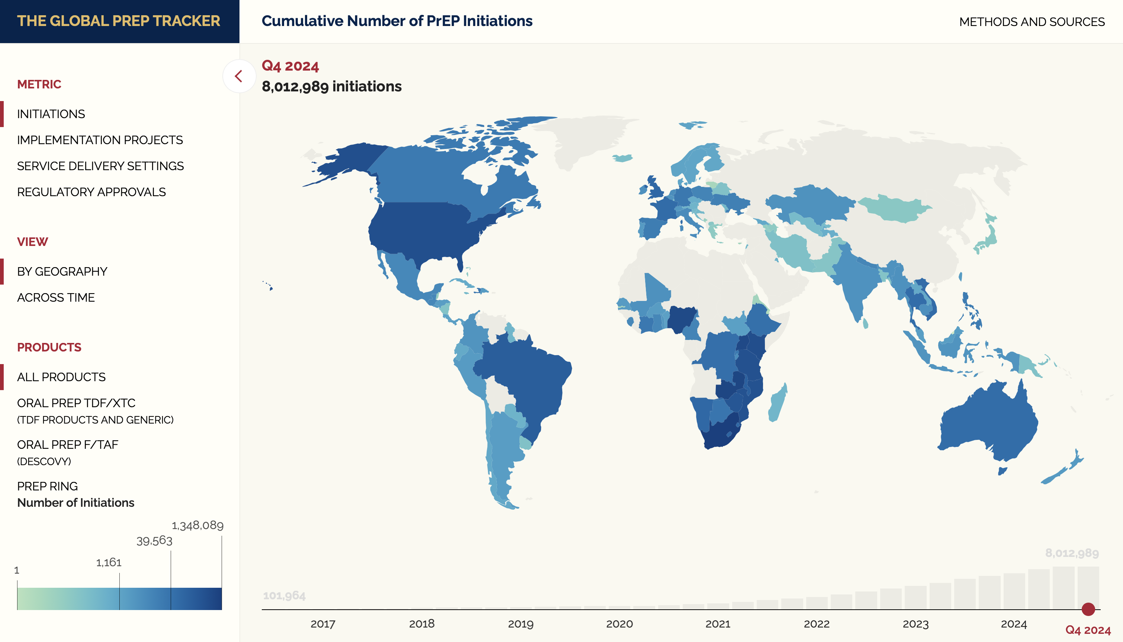
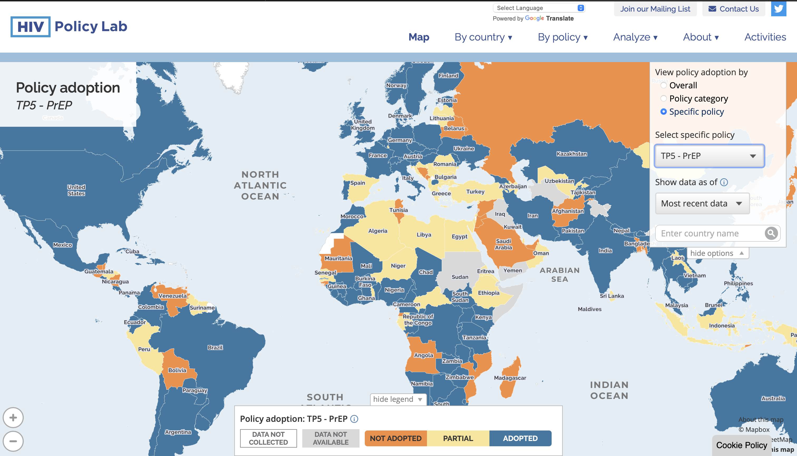
Methodology
Data Collection
  Data on cumulative PrEP initiations for 139 countries, as of Sept. 2024, used from AVAC’s Global PrEP Tracker
  Data on the status of 54 policies related to HIV testing & prevention, structural changes, and health systems across 139 countries, as of Jul. 2024, collected from HIV Policy Lab
Analyses
  Multiple and individual regressions, using RStudio, assessed significance of policies altogether and individually (p=0.05)
  Separate analysis done for 33 African countries
  Correlations, using the Pearson coefficient, and variance inflation factors (VIFs) of independent variables calculated to assess which policies are multicollinear (working together)
  Ridge regression analysis assessed if multicollinear variables should be eliminated from the model to remove confounding in multiple regressions.
Global PrEP Tracker
HIV Policy Lab
Notes:
We started by using data on PrEP uptake for 139 countries as of September 2024 from AVAC's Global PrEP Tracker.
Next, we collected data on the country statuses of 54 policies related to HIV testing & prevention, structural changes, and health systems across all 139 countries, as of July 2024, from Georgetown University's HIV Policy Lab.
Then, we conducted both individual and multiple regressions on our dataset using RStudio where the significance threshold was p=0.05. A separate set of regressions was done for 33 African countries. Regressions were conducted to assess the individual effects of each policy on PrEP uptake, as well as to determine whether those effects persist when analyzing the collective influence of all 54 policies together.
After that, given differences in results from the multiple and individual regressions, we conducted correlations using the Pearson coefficient and variance inflation factors. These basically helped us see which policies are multicollinear, meaning which policies are associated with high PrEP uptake because they work together.
Since several policies were multicollinear, we conducted ridge regression analyses to figure out if any of the multicollinear policies should be eliminated from the model to remove potential confounding in the multiple regressions.

Slide 4
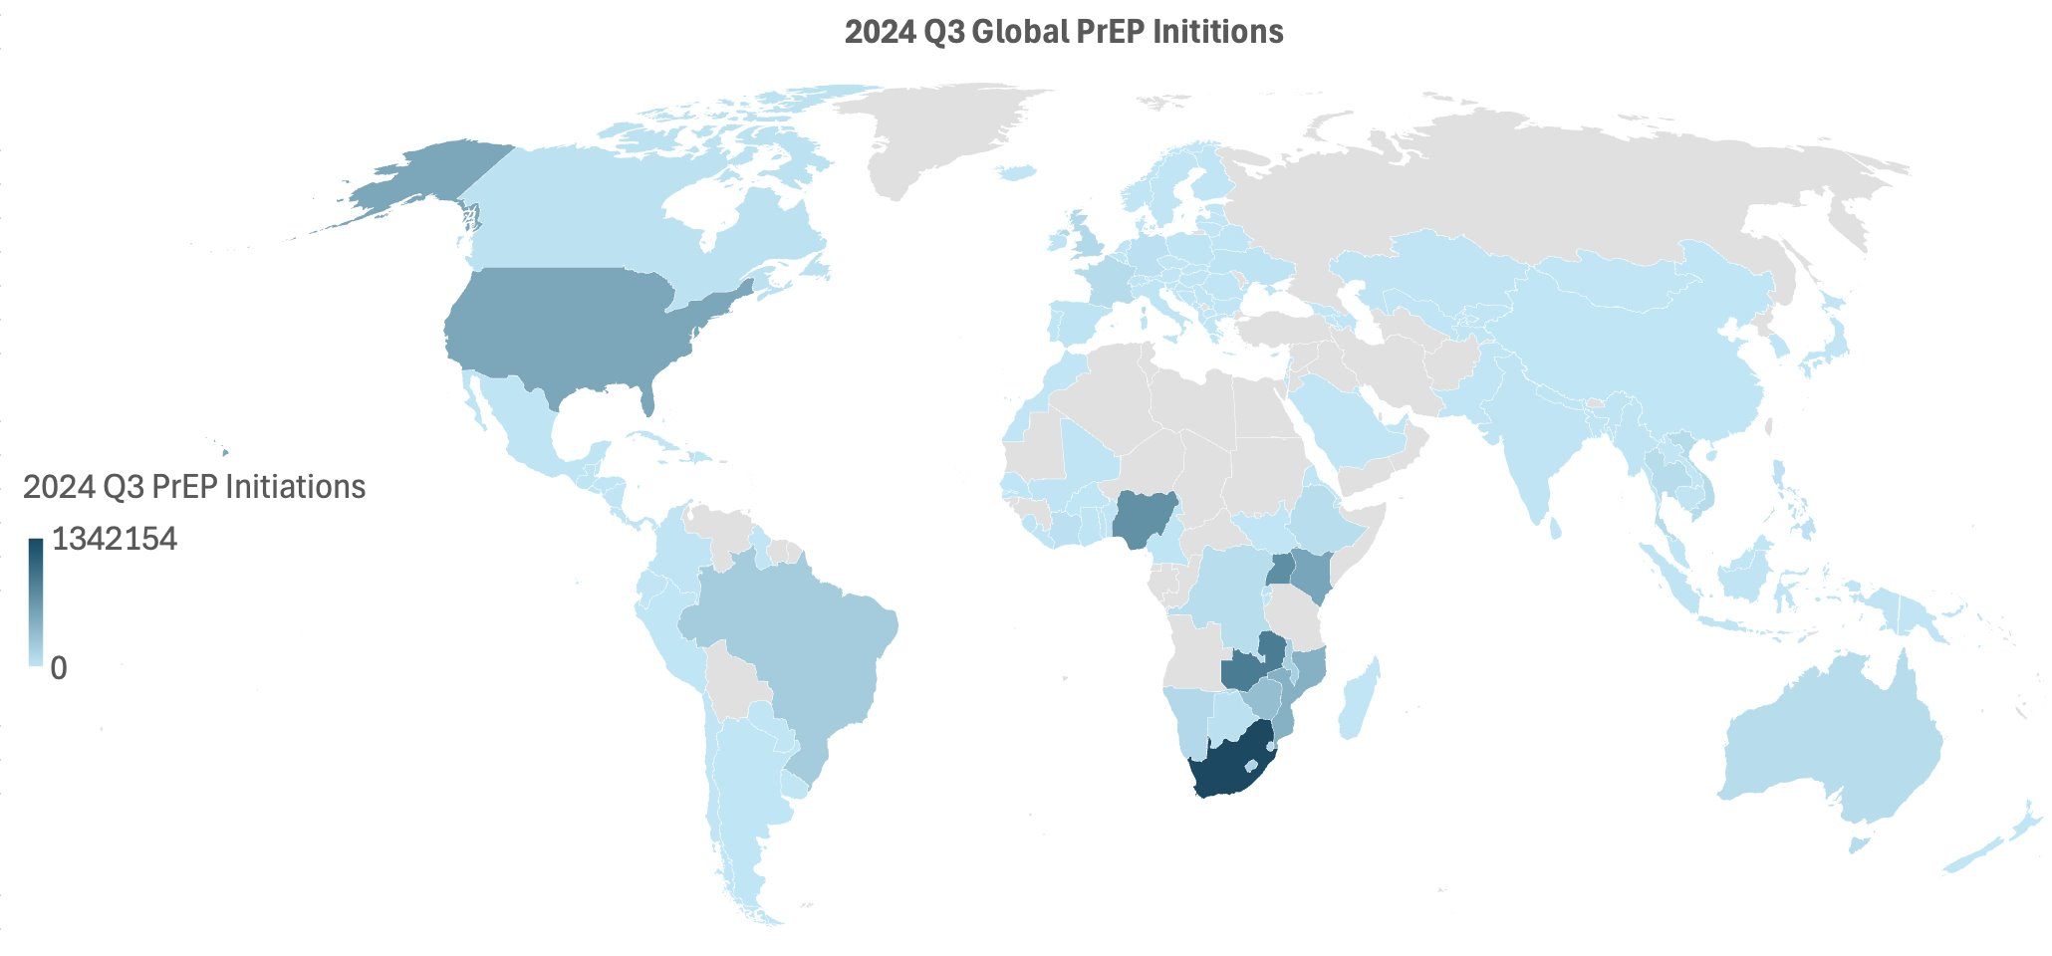
Countries Analyzed
The Africa region was separately analyzed due to its unique context and high HIV burden.
Notes:
All of the highlighted countries were included in this analysis. The darker the color the higher the PrEP uptake.
We did a separate analysis on just the 33 African countries because of their unique context and high HIV burden.

Slide 5
Results Overview
 | Global | Africa
Individual Regressions | 8 policies significantly associated with PrEP uptake | 4 policies significantly associated with PrEP uptake
Multiple Regressions | 1 of 54 policies significantly associated with PrEP uptake | 0 of 54 policies significantly associated with PrEP uptake
Analyses confirmed 8 policies globally and 4 in the Africa region have similar enough effects on PrEP uptake that the statistical model could not differentiate their individual contributions to the multiple regression results.
  What this means: Related policies, such as those governing the arrest versus the prosecution of those engaging in same-sex sex, each affected PrEP uptake on their own, but when considered together, their effects on PrEP uptake were so similar that the model could not separate them.
Ridge regression analyses showed that these policies were very strongly contributing to the predictive power of the multiple regression model and cannot be eliminated.
  What this means: Individual policies are important for PrEP uptake, but policies work together in systems which drive PrEP uptake as well.
Notes:
The key finding was that individual policies affect PrEP uptake, but policies also work together as a system to influence PrEP uptake.
Like I said, we started with individual and multiple regression analyses. The difference between both is that individual regressions looked at how much each separate policy influenced PrEP uptake, whereas multiple regressions looked at how much the collective 54 policies affected PrEP uptake.
The global analyses showed that 8 policies were individually significantly associated with PrEP uptake but only 1 within the context of 54 was significantly associated with PrEP uptake.
The Africa-continental analyses showed that 4 policies were individually significantly associated with PrEP uptake but 0 within the context of 54.
What this means is that related policies, such as those governing the arrest versus the prosecution of those engaging in same-sex sex, each affected PrEP uptake on their own, but when considered together, their effects on PrEP uptake were so similar that the model could not separate them.
So the next logical question was why this difference in findings between individual and multiple regressions?
Normally, this difference happens if your model of independent variables, which in our case are the policies, has several multicollinear variables.
Correlation and variance inflation factor analyses confirmed that 8 policies were multicollinear with each other, confounding the multiple regression results. This means that these policies tend to act in concert, which made it difficult for the multiple regression model to isolate the effect of any one policy.
So the next question we asked was: is it possible to get more accurate results from the multiple regression analysis if we eliminated the multicollinear policies?
To find out, we used ridge regression analyses. Results showed that while these policies are highly correlated with each other, they are very strongly associated with PrEP uptake in the multiple regression model and cannot be eliminated.
So the key takeaway here is that individual policies matter. They absolutely influence PrEP uptake. But policies work together as well. And they collectively influence PrEP uptake, which means a generally favorable policy environment as a whole is crucial.

Slide 6



Policies Analyzed (Global)
Health Systems | Structural | Testing & Prevention
Task Shifting | Same-sex sex non-criminalization | Self-testing
Health Financing | Sex work non-criminalization | Partner notification/index testing
Universal Health Coverage | Drug use non-criminalization | Compulsory Testing
User Fees | HIV exposure non-criminalization | Age restrictions on testing and treatment
Access to Medicines (TRIPS) | Non-discrimination protections | PrEP
Unique identifiers w/ data protections | National human rights institutions | Harm Reduction
Data sharing | Constitutional right to health | Comprehensive sexuality education
 | Girls Education | Prisoner's Prevention
 | Gender based violence
 | Civil Society
Notes:
Like I said earlier, the 54 policies that we assessed were all split amongst three different policy types as shown here. Many of these have their own subpolicies as well, which are part of the 54 we assessed.
---
For global level results, 6 structural policies and subpolicies, 1 health systems policy , and 1 testing and prevention policy were individually significant to enable PrEP uptake. While only the health systems policy on task shifting was significant to enable PrEP uptake through multiple regressions.

Slide 7
Significant Policies Defined (Global)
Task Shifting – nurses or other non-physicians are allowed to initiate HIV treatment under national policy
Same-sex sex non-criminalization – national law/policy refrains from criminalizing and prosecuting people for consensual same-sex sexual acts
  Laws – national law refrains from criminalizing consensual same-sex sexual acts
  Arrests – law-enforcement policy avoids prosecution for consensual same-sex acts in recent years
HIV exposure non-criminalization - national law refrains from criminalizing and prosecuting people for non-intentional HIV exposure/ transmission.
  Laws - national law refrain from criminalizing non-intentional HIV exposure/transmission
  Arrests - law-enforcement policy avoided arrests/prosecution for non-intentional HIV transmission/exposure in recent years.
Self-testing – self-testing is approved in national policy.
Notes:
These policies are defined as follows.
Task shifting – nurses or other non-physicians can initiate HIV treatment
Same-sex sex non-criminalization - non criminalisation of consensual same-sex sexual acts
HIV exposure non-criminalization – non criminalization of non-intentional HIV exposure/transmission
Self-testing – self-testing is approved

Slide 8
Policies Analyzed (Africa)
Health Systems | Structural | Testing & Prevention
Task Shifting | Same-sex sex non-criminalization | Self-testing
Health Financing | Sex work non-criminalization | Partner notification/index testing
Universal Health Coverage | Drug use non-criminalization | Compulsory Testing
User Fees | HIV exposure non-criminalization | Age restrictions on testing and treatment
Access to Medicines (TRIPS) | Non-discrimination protections | PrEP
Unique identifiers w/ data protections | National human rights institutions | Harm Reduction
Data sharing | Constitutional right to health | Comprehensive sexuality education
 | Girls Education | Prisoner's Prevention
 | Gender based violence
 | Civil Society
Notes:
For Africa level results, we analyzed the same 54 policies.
---
Here, 2 structural policies on HIV exposure non-criminalization and 2 testing and prevention policies were individually significant to enable PrEP uptake. While no policies were significant to enable PrEP uptake through multiple regressions.

Slide 9
Significant Policies Defined
HIV exposure non-criminalization - national law refrains from criminalizing and prosecuting people for non-intentional HIV exposure/ transmission.
  Arrests - law-enforcement policy avoided arrests/prosecution for non-intentional HIV transmission/exposure in recent years.
Compulsory Testing - compulsory HIV testing is prohibited under national law
Age restrictions on testing & treatment - adolescents (≥12 yo) can access HIV testing and treatment without parental consent under national policy.
Notes:
I already defined the HIV Exposure policies.
Compulsory Testing – compulsion of HIV testing is prohibited
Age restrictions on testing and treatment – kids 12 yo and older can get HIV testing and treatment without parental consent.

Slide 10
Conclusions
Policy recommendations: task shift, decriminalize consensual same-sex sex, decriminalize non-intentional HIV exposure/transmission, approve self-testing, prohibit compulsory testing, loosen age restrictions.
Policies found to significantly enable PrEP uptake make access easier, reduce discrimination, and align with user preferences.
While individual policies show significant associations with PrEP uptake when analyzed in isolation, they tend to act in concert, overlapping or reinforcing one another, making it difficult to isolate the effect of any one policy. This suggests that both individual policies and overall policy environments, rather than any single measure, plays a critical role in enabling PrEP uptake.
Differences in policies that significantly enable PrEP uptake at global and regional levels imply that context affects which policies should be implemented.
Regional analyses are necessary to understand systemic policy gaps that hinder PrEP access and uptake.
Future analyses and policies should be adapted to incorporate long-acting PrEP and MPT products.
Notes:
Based on these results, we recommend policy changes that support task shifting, decriminalization of consensual same-sex sex, decriminalization of non-intentional HIV exposure/transmission, Approval of self-testing, prohibition of compulsory testing, and loosening age restrictions.
Individual policies have significant associations with PrEP uptake, but collections of policies tend to act together suggesting that both individual policies and the overall policy environment are critical in enabling PrEP uptake.
Context affects which policies should be implemented.
Future analyses and policies should be adapted to incorporate long-acting PrEP and MPT products.
The limits of this analysis include the fact that we did not consider more systemic level policies that effect health indirectly, such as transit, gender, education and others.
We also did not triangulate data from the HIV policy lab with any other policy databases.

Slide 11
Acknowledgements
Thank you to Catherine Verde Hashim, Kate Segal, Mitchell Warren, and Wawira Nyagah of AVAC for co-authoring and supporting this research. ​

