Slide 1


Viral load suppression at first viral load after shifting from six to three months post-ART initiation:
A retrospective analysis of early outcomes in the South African public sector HIV program
K. Rees^{1,2}, B. Mugisa³, N. Davies¹, C. O’Connor¹, L.S Wilkinson^{4,5}
1. Anova Health Institute, Johannesburg, South Africa 2. University of the Witwatersrand, Department of Community Health, School of Public Health, Johannesburg, South Africa 3. USAID, Pretoria, South Africa 4. International AIDS Society, Johannesburg, South Africa 5. University of Cape Town, Centre for Infectious Epidemiology and Research, Cape Town, South Africa
Notes:
This slide should include Title, Presenter name(s), and date

Slide 2
Background
South African guidelines pre-April 2023: First viral load (VL) at 6 months on ART
High visit frequency in 1st year on ART: Minimum 9 visits
  Burden on clients – direct and opportunity costs
  Burden on health system – untargeted frequent visits for all
High treatment interruptions and disengagements in first year on ART (Euvrard 2024; Maskew 2024)
Targeted support for adherence challenges only possible after first VL result review from 7 months on ART
DSD model access reducing burden on stable ART clients and health system only possible from 7 months on ART
Important changes to consider in guideline update:
WHO 2021 guidelines – review first VL result by 6 months on ART
Expansion of DTG as first line with faster suppression profile
1. Maskew M, Benade M, Huber A et al. Patterns of engagement in care during clients’ first 12 months after HIV treatment initiation in South Africa: A retrospective cohort analysis using routinely collected data. PLOS Glob Public Health. 2024 Feb 28;4(2):e0002956.
2. Euvrard J, Timmerman V, Keene CM, Phelanyane F, Heekes A, Rice BD, et al. The cyclical cascade of HIV care: Temporal care engagement trends
within a population-wide cohort. PLOS Med. 2024 May 10;21(5):e1004407.

Slide 3
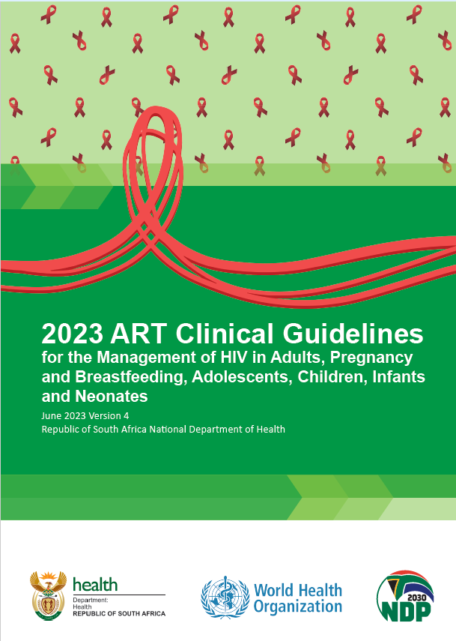
South African guidelines post-April 2023: First VL at 3 months on ART
Month
0
Month
3
Initiation visit
Month
1
Month
4
VL draw
Follow-up visit
DSD eligibility
Notes:
Decreased early visit burden & early evidence of adherence challenges / success

Slide 4
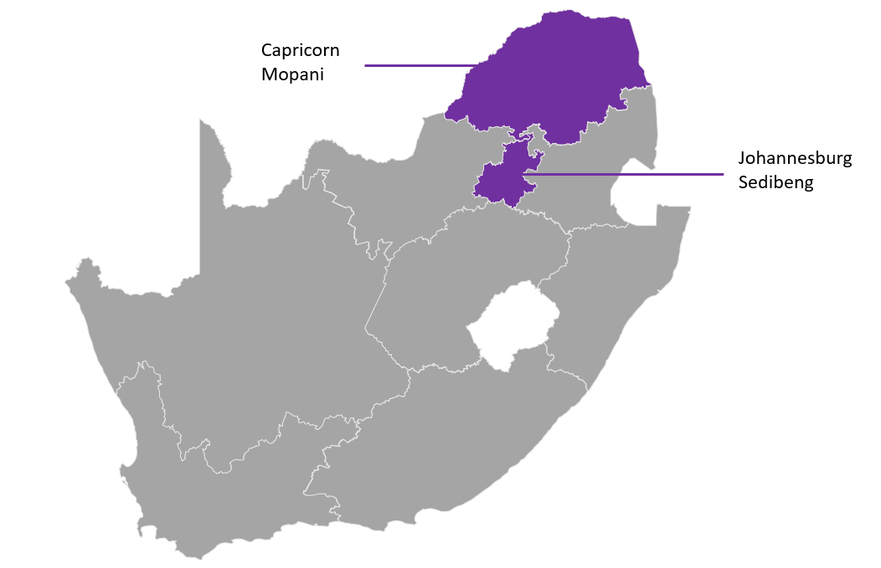
Shift in first viral load timing supported these further guideline changes:
Guidelines | Pre-April 2023 First VL at 6 months on ART | Post-April 2023 First VL at 3 months on ART
Number of clinic visits in 1st year on ART for clinical review (including ART start visit) | 8 (M0,M1,M2,M3,M4,M5,M6,M7) | 5 (M0,M1,M3,M4,M10)
Number of DSD model visits in 1st year on ART | 1 (Month 10) | 1 (Month 7)
Minimum total visits in 1st year | 9 | 6
Earliest targeted adherence support | Month 7 | Month 4
Timing of 2nd VL if unsuppressed | Month 9 | Month 6
Timing of 2nd VL if suppressed | Month 12 | Month 10
Earliest DSD enrolment timing | Month 7 | Month 4
We evaluated the impact of this guideline change on VL suppression (<50 and <200 copies/mL) rates, and DSD enrolment and timing in four South African districts in 2023

Slide 5
Methods
Routine programme data – TIER.Net national HIV/TB database
Analysed ART initiations from 2017-2023, focusing post-implementation period May to December 2023
City of Johannesburg & Sedibeng (Gauteng Province); Capricorn & Mopani (Limpopo Province)
A follow-up period of 180 (6 months) applied following guideline-mandated first VL timing:
  Pre April 2023: 360 days (1st VL timing: 180 days + follow-up period: 180 days)
  Post April 2023: 270 days (1st VL timing: 90 days + follow-up period: 180 days)
Excluded recorded:
  Deceased; transferred out; baseline VL (suggesting prior treatment/ potential re-engagement)
Did not exclude clients who may have disengaged during follow-up period
VL<200 copies/ml, VL suppression (<50 copies/mL), and DSD enrolment were analyzed using logistic regression.
A Cox proportional hazards model evaluated time to DSD enrolment adjusting for age, gender, district and time to first VL.

Slide 6
Table 1: VL suppression & DSD enrolment in 26,091 people initiating ART May-Dec 2023
Category | Early (29-77 days) | 3 months (78-112 days) | Between (113 to 161 days) | 6 months (162 to 196 days) | Late (>196 days)
VL < 200 copies /ml (%) | 1671 (80.1%) | 11813 (87.8%) | 3814 (83.3%) | 3194 (86.2%) | 1723 (80.4%)
Adjusted OR (p-value; 95% CI) | 0.57 (<0.01; 0.51-0.64) | Ref | 0.73 (<0.01; 0.67-0.80) | 0.92 (0.18; 0.83-1.03) | 0.62 (<0.01; 0.56-0.71)
VL < 50 copies /ml (%) (suppressed) | 1191 (57.1%) | 8758 (65.1%) | 2946 (64.4%) | 2476 (66.9%) | 1371 (64.0%)
Adjusted OR (p-value; 95% CI) | 0.71 (<0.01; 0.64-0.78) | Ref | 1.00 (0.93; 0.93- 1.07) | 1.13 (<0.01; 1.05-1.23) | 1.02 (0.76; 0.92-1.12)
Suppressed enrolled in DSD (%) | 473 (39.7%) | 4322 (49.4%) | 1109 (37.6%) | 895 (36.2%) | 383 (27.9%)
Adjusted OR (p-value; 95% CI) | 0.68 (<0.01; 0.60; 0.77) | Ref | 0.63 (<0.01; 0.58- 0.69) | 0.59 (<0.01; 0.53-0.64) | 0.41 (<0.01; 0.36-0.47)
Suppressed median time to DSD enrolment (days) | 143 | 162 | 196 | 252 | 295
Adjusted HR (p-value; 95%CI) | 1.12 (0.02; 1.02-1.24) | Ref | 0.65 (<0.01; 0.61-0.70) | 0.44 (<0.01; 0.41-0.47) | 0.37 (<0.01; 0.33-0.41)

Slide 7
Viral suppression in 26,091 people initiating ART May-Dec 2023
AOR: 0.93 (0.83-1.03)
VL suppression is similar when 1st VL is taken at 3 or 6 months
  At VL<50 copies/mL, there is a 13% greater odds of suppression at 6 months compared to 3 months
  At VL<200 copies/mL, there is a 7% greater odds of suppression at 3 months compared with 6 months
AOR: 1.13 (1.05-1.22)
Approx 20% of ART initiators’ first VL result is 50-199 copies/mL irrespective of timing
Notes:
We don’t show this over the years….would be of value to add this from paper.

Slide 8
Trends in first VL result, ART initiations 2017-2023
 | 2017 | 2018 | 2019 | 2020 | 2021 | 2022 | 2023
VL done in study period | 65 414 | 54 875 | 61 025 | 46 146 | 40 773 | 39 151 | 40 878
First VL result: <50 copies/mL (%) | 35 758 (54.7%) | 30 366 (55.3%) | 35 160 (57.6%) | 28 969 (62.8%) | 26 592 (65.2%) | 25 109 (64.1%) | 26 544 (64.9%)
50-199 copies/mL (%) | 14 432 (22.1%) | 12 606 (23.0%) | 12 481 (20.5%) | 8 642 (18.7%) | 7 465 (18.3%) | 7 967 (20.3%) | 8 509 (20.8%)
200-399 copies/mL(%) | 4 403 (6.7%) | 3 291 (6.0%) | 3 588 (5.9%) | 2 188 (4.7%) | 1 730 (4.2%) | 1 692 (4.3%) | 1 674 (4.1%)
400-999 copies/mL(%) | 3 433 (5.2%) | 2 229 (4.1%) | 2 516 (4.1%) | 1 719 (3.7%) | 1 368 (3.4%) | 1 071 (2.6%) | 1 036 (2.5%)
>1000 copies/mL(%) | 7 388 (11.3%) | 6 383 (11.6%) | 7 280 (11.9%) | 4 628 (10.0%) | 3 618 (8.9%) | 3 312 (8.5%) | 3 114 (7.6%)
3. Amongst all ART initiators 2017-2023 VL 50-199 copies/ml approximately 20%

Slide 9
Table 1: VL suppression & DSD enrolment in 26,091 people initiating ART May-Dec 2023
Category | Early (29-77 days) | 3 months (78-112 days) | Between (113 to 161 days) | 6 months (162 to 196 days) | Late (>196 days)
VL < 200 copies /ml (%) | 1671 (80.1%) | 11813 (87.8%) | 3814 (83.3%) | 3194 (86.2%) | 1723 (80.4%)
Adjusted OR (p-value; 95% CI) | 0.57 (<0.01; 0.51-0.64) | Ref | 0.73 (<0.01; 0.67-0.80) | 0.92 (0.18; 0.83-1.03) | 0.62 (<0.01; 0.56-0.71)
VL < 50 copies /ml (%) (suppressed) | 1191 (57.1%) | 8758 (65.1%) | 2946 (64.4%) | 2476 (66.9%) | 1371 (64.0%)
Adjusted OR (p-value; 95% CI) | 0.71 (<0.01; 0.64-0.78) | Ref | 1.00 (0.93; 0.93- 1.07) | 1.13 (<0.01; 1.05-1.23) | 1.02 (0.76; 0.92-1.12)
Suppressed enrolled in DSD (%) | 473 (39.7%) | 4322 (49.4%) | 1109 (37.6%) | 895 (36.2%) | 383 (27.9%)
Adjusted OR (p-value; 95% CI) | 0.68 (<0.01; 0.60; 0.77) | Ref | 0.63 (<0.01; 0.58- 0.69) | 0.59 (<0.01; 0.53-0.64) | 0.41 (<0.01; 0.36-0.47)
Suppressed median time to DSD enrolment (days) | 143 | 162 | 196 | 252 | 295
Adjusted HR (p-value; 95%CI) | 1.12 (0.02; 1.02-1.24) | Ref | 0.65 (<0.01; 0.61-0.70) | 0.44 (<0.01; 0.41-0.47) | 0.37 (<0.01; 0.33-0.41)
49% of those with a VL<50 copies/mL at 3 months enrolled in a DSD model by the end of follow-up period compared to 36% of those with a VL<50 copies/mL at 6 months.
Median time to DSD enrolment reduced by 90 days (3 months) for those with their first VL taken at 3 months compared with those with their first taken at 6 months after ART start.

Slide 10
Discussion
VL suppression rates (<50 and <200 copies/mL) remained stable across ART initiation years (2017–2023) - and following guideline VL timing shift- regardless of whether VL was taken at 3 or 6 months
  Performing an individual’s first VL at 3 months compared with those who continued to have it taken at 6 months post guideline change, increased DSD enrolment and reduced time to DSD by 3 months.
High prevalence of low-level viraemia (VL 50–199 copies/mL)
  Observed consistently across years and timing; confirming concerns about test reliability at VL<200 copies/mL (Hans 2023)
  Increases in clinic visits, adherence counselling, and repeat VL testing
  Results in ~20% fewer clients eligible for DSD enrolment
  Increases possibly unnecessary client burden, health system workload, and costs
Small shift in suppression thresholds when first VL taken at 3 compared with 6 months on ART post-guideline VL timing change: ~2% decrease in VL <50 copes/mL rates and ~2% increase in VL < 200 copies/mL rates. Significance unclear due to possible unreliability of VL testing at low levels
Hans L, Cassim N, Sarang S, Hardie D, Ndlovu S, Venter WDF, Da Silva, P.; Stevens, W. HIV Viral Load Testing in the South African Public Health Setting
in the Context of Evolving ART Guidelines and Advances in Technology, 2013–2022. Diagnostics. 2023 13, 2731.
Notes:
Accepting that lower DSD enrolment at 6 months might be as a result of slower adopters still doing 6 month VLs.

Slide 11
Recommendations & way forward
Way forward:
To capitalise on earlier VL timing:
  Improve on time first VL completion at mandated time.
  Enrol clients immediately into less-intensive DSD models when suppressed.
  Target immediate adherence interventions for clients not suppressed.
Future research:
  Continue DSD enrolment evaluation beyond first 8 months of implementation.
  Obtain a better understanding of contributory factors to consistently high rates of VL 50-199 copies/mL: Impact of time to VL test (collection/transport/lab delays), VL testing platform and sub-optimal adherence.
Recommendations:
Consider shifting guideline recommended:
  Timing of first VL to 3 months on ART.
  DSD eligibility immediately thereafter if suppressed.
Continue to monitor VL completion, VL suppression (at <50, <200 and <1000 copies/mL) and DSD enrolment rates.

Slide 12
Acknowledgements
Contact:
rees@anovahealth.co.za

