Slide 1

PrEP experiences and challenges among transgender women in the United States and Puerto Rico in the era of PrEP choice: findings from the ENCORE cohort
Erin Cooney, Johns Hopkins Bloomberg School of Public Health
OAD0507: "I will not lower my voice": Experiences from trans and gender-diverse communities
Presented on behalf of co-authors: Tonia Poteat, Asa Radix, Chris Beyrer, Jason Schneider, Marissa Miller, Vani Vannappagari, Leigh Ragone, Adrienne Guignard, Annemiek de Ruiter, Sari Reisner, Andrea Wirtz, and the ENCORE Study Group
Disclosure: This analysis is supported by a grant from ViiV Healthcare to Johns Hopkins University. Vani Vannappagari, Leigh Ragone, Adrienne Guignard, and Annemiek de Ruiter are employed by ViiV Healthcare.
Notes:
Thank you to the organizers for convening this important session and to the audience and the other presenters for being a part of this dialogue
On behalf of my co-authors, I will be sharing findings on PrEP experiences, challenges and motivations for PrEP choice among trans women in the US and PR

Slide 2
Thank you to the trans women who have generously shared their time, experiences, and bodies for the purposes of this research, and the advancement of science.
And to the many trans and gender diverse colleagues, collaborators, advocates, and community members who continue to put themselves forward, despite the risks, to continue this critical work.
Notes:
I want to take a moment to note that we owe so much to the trans and gender diverse individuals and communities who have consistently contributed to the advancement of HIV treatment and prevention science over the last several decades, including the research in this presentation

Slide 3
Summary
What is your main question?
What are the experiences of trans women who use PrEP in the United States and Puerto Rico?
What are the reasons for choosing one PrEP method over another? Do these challenges and reasons differ by race, ethnicity, and/or age?
What did you find?
18% of our sample had used PrEP (last 6 months), 95% of whom only had experience with daily, oral PrEP
Respondents rated their experience using PrEP positively, which was consistent across PrEP methods and sociodemographic characteristics
Black and Latina trans women, and women ages 18-29 were more likely to report stigma related to their PrEP use
Reasons for PrEP method choice also differed by race, ethnicity, and age
Why is it important?
Transgender women generally reported positive PrEP experiences, but motivations and challenges differed by sociodemographics.
Shared decision-making tools and interventions that address individual experiences and motivations may support effective PrEP use among populations most burdened by the HIV epidemic.
Notes:
Here is the plain language summary of the presentation, which I am going to skip for time

Slide 4
Background
HIV prevalence and incidence among trans women are high¹⁻⁴
Highest prevalence of all priority populations in the US epidemic (19-44%)
HIV incidence has increased in recent years and is disproportionately concentrated among Black, Latina, and young trans women
PrEP engagement has been sub-optimal^{5,6}
Prior to June 2025, there were two FDA-approved PrEP options for trans women in the US: oral TDF/TAF PrEP and long-acting cabotegravir
20% of trans women who may benefit are using PrEP effectively
Low PrEP initiation rates (6.5 initiations/100-person-years among PrEP eligible trans women) and high discontinuation rates (37.5 discontinuations/100 person-years among trans women using PrEP)
With expanding PrEP options, more data are needed on PrEP experiences, challenges, and motivations for PrEP choice
Notes:
As many of you may be aware, trans women experience a disproportionate burden of HIV globally. HIV incidence among trans women in the US and PR has been increasing in recent years, and is disproportionately concentrated among young, Black, and Latina trans women.
Yet despite the high PrEP need among trans women, engagement has been suboptimal for a variety of reasons, and more data are needed to inform the HIV response and to address inequities, particularly as new PrEP options are made available

Slide 5

Enhanced Cohort methods for HIV Research and Epidemiology (R01AI172092, mPI: Wirtz, Reisner)
Nationwide, community co-led, observational cohort study
Primary study aim: evaluate HIV incidence, risk factors, and syndemic conditions among transgender women in the US
N=2,506 transgender women not living with HIV in all 50 US states, the District of Columbia, and Puerto Rico enrolled from April 2023 to December 2024
Hybrid, hub-supported digital cohort model
  Biannual study visits (survey and HIV test) can be completed remotely or with in-person support available in 10 Ending the HIV Epidemic (EHE) priority jurisdictions
  Survey including more than 10 domains completed from any web-enabled device
  Self-collected sample (either DBS or oral fluid) for HIV testing at central lab
All study materials and procedures available in English and Spanish
Recruitment via community partners, dating apps, and machine-learning based ad services
Notes:
So, with that in mind, we undertook this analysis using baseline data from the ENCORE cohort, which is an observational cohort of over 2,500 trans women throughout the US and Puerto Rico who are not living with HIV. Study participation involves biannual sociobehavioral surveys and laboratory-based HIV testing. This study is led by Drs. Andrea Wirtz and Sari Reisner and was previously supported by the NIH up until March 2025 when it was illegally terminated.

Slide 6
Statistical Analysis
All analyses restricted to participants who self-reported taking PrEP in prior 6 months
Descriptive statistics to characterize:
  Self-rated PrEP experience
    “On a scale of 0-100, zero being negative to 100 being positive, how would you rate your experience overall using [oral/long-acting injectable*] PrEP?”
  Challenges taking PrEP
    “What challenges, if any, have you experienced taking [oral/long-acting injectable] PrEP? Select all that apply”
  Reasons for PrEP method selection
    “Why have you decided to use [oral PrEP (pills)/long-acting injectable PrEP] instead of [injectable PrEP/oral PrEP]? Select all that apply”
Challenges and reasons were tailored for each method as appropriate (e.g., remembering to take daily pill was only included as a challenge for oral PrEP users)
Participants who had used both methods (prior 6 mo) were asked to rate experiences and report challenges for both methods
We assessed for differences by PrEP method, race, ethnicity, and age (using Chi-square, Fisher’s exact, Kruskal–Wallis, and t-tests as appropriate)
*Note: “Injectable PrEP” refers to long-acting cabotegravir
Notes:
As the focus of our analysis was on experiences using PrEP, we restricted our sample to those who had self-reported any PrEP use in the 6 months prior to completion of the baseline survey.
We performed descriptive statistics to characterize self-rated PrEP experience, PrEP challenges, and reasons for PrEP method choice and assessed for differences by sociodemographic characteristics using the appropriate statistical tests.

Slide 7
Results: Sample Characteristics
Factor | n (%)
N | 441
Age, median (IQR) | 33 (27, 42)
Race/ethnicity
Non-Hispanic White | 249 (56.5%)
Non-Hispanic Black | 48 (10.9%)
Hispanic White | 26 (5.9%)
Hispanic Black | 9 (2.0%)
Non-Hispanic and more than one race or another race | 52 (11.8%)
Hispanic and more than one race or another race | 54 (12.2%)
Unknown | 3 (0.7%)
Health insurance
Uninsured | 38 (8.6%)
Public insurance | 186 (42.2%)
Private insurance | 209 (47.4%)
Unknown | 8 (1.8%)
Census region
West | 122 (27.8%)
Midwest | 98 (22.3%)
Northeast | 79 (18.0%)
South | 140 (31.9%)
Ever PrEP use
24% (591/2506)
Analytic sample: Prior 6-month PrEP use
18% (441/2,506)
PrEP methods prior 6 months*
94% oral PrEP only (415/441)
3% long-acting injectable PrEP only (15/441)
2% both methods (9/441)
*data on PrEP method was not reported for 2 participants
Notes:
441 people or 18% of the ENCORE cohort had reported using PrEP within 6 months of their baseline visit, which constitute the analytic sample for this analysis.
Of those, 94% only had experience with oral PrEP. Just 24 individuals or 5% had used long-acting cabotegravir.
Our sample was largely representative of the general population of US adults in terms of the distribution of age, race, ethnicity, and geography.

Slide 8
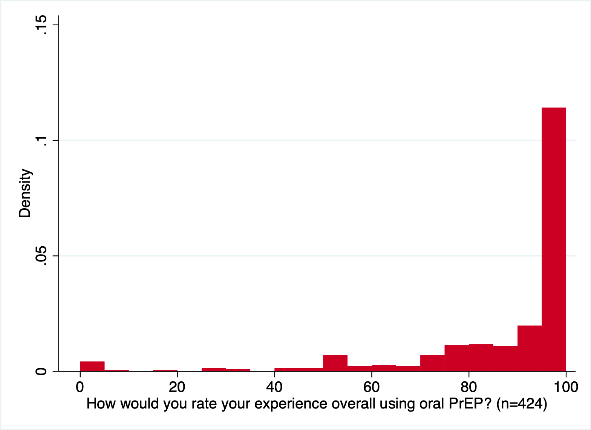
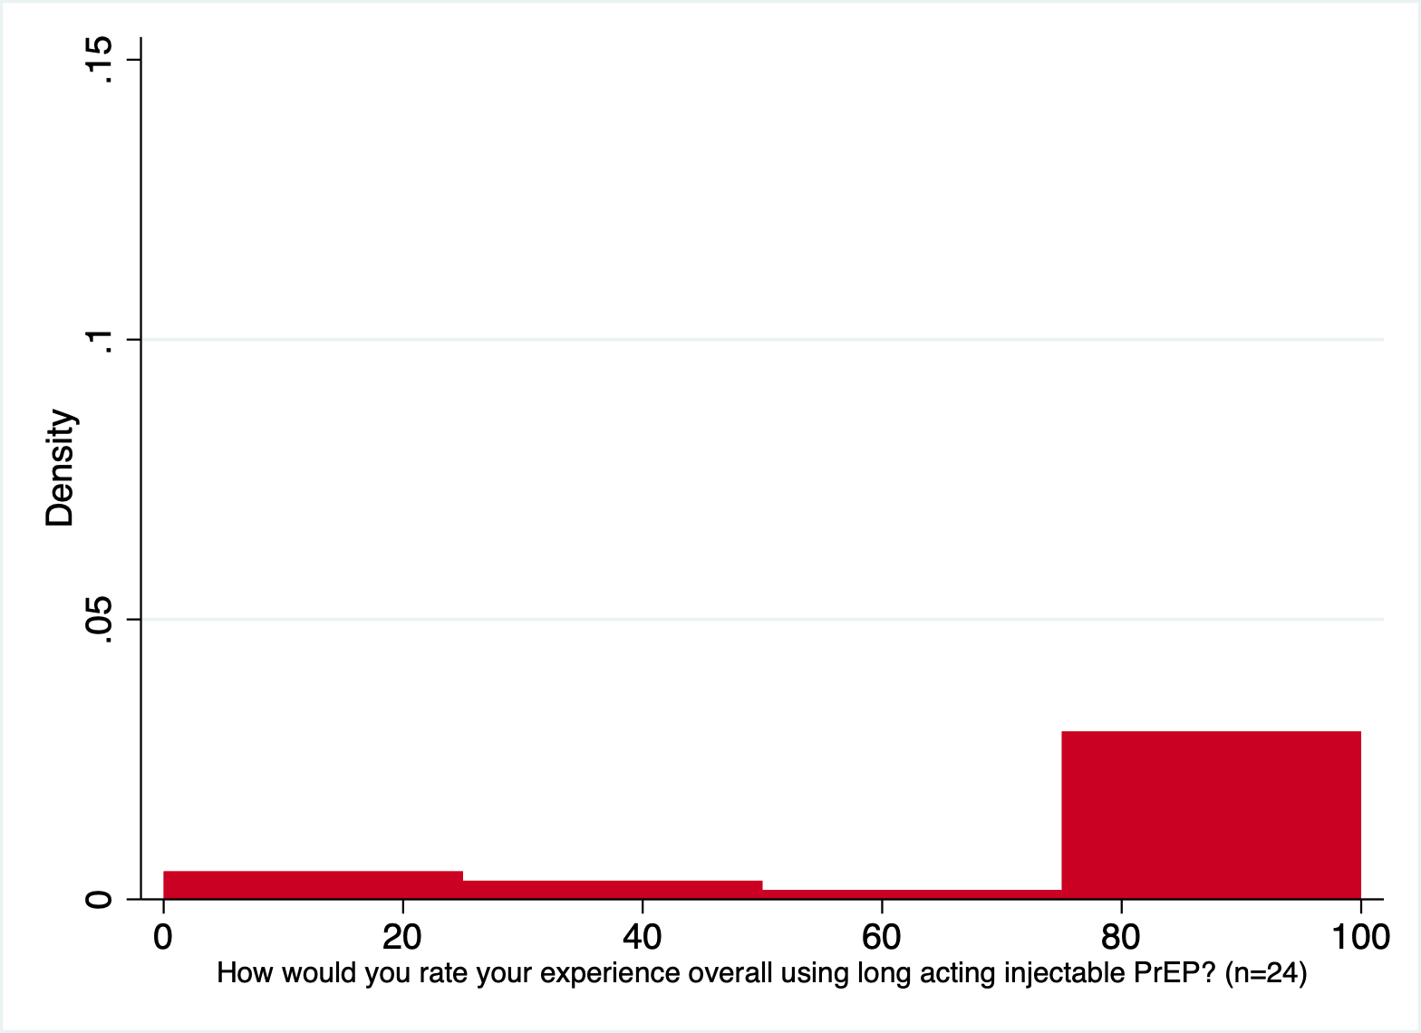


PrEP Experiences
Self-rated PrEP experiences (0-100 scale):
Daily Oral (n=424)
Mean (sd): 88 (21)
Median (IQR): 100 (82-100)
93% rated their experience >50
LAI (n=24)
Mean (sd): 78 (35)
Median (IQR): 100 (70-100)
79% rated their experience >50
No significant differences by age, race, ethnicity, education, insurance, or region
Notes:
We first asked “On a scale of 0-100, with 0 being completely negative and 100 being completely positive, how would you rate your experience using PrEP?”
As you can see, we found the vast majority of PrEP users rated their experience positively, and this was true for daily oral PrEP users as well as LAI users.
And we did not find any differences by race, ethnicity, age, education, insurance, or region.
Meaning that, by and large, participants that had recent experience using PrEP had positive experiences overall.

Slide 9
Challenges by PrEP Method
“What challenges, if any, have you experienced taking [oral/long-acting injectable] PrEP? Select all that apply”
Daily oral (n=424)
28% Difficult to remember to take pills daily
25% Side effects
22% People think you have a lot of sex partners
22% No challenges
21% Don't like the clinical visits/testing required
21% Does not protect against STI
20% People think you have HIV
19% Worry about interactions with hormones
19% Dislike taking pills regularly
17% Sex partner(s) don't want to use condoms because of PrEP use
13% Cost of the pills or associated clinical visits
10% Feels excessive for level of HIV risk
4% Partner(s) did not want you to use it or did not like you using it
Long-acting injection (n=24)
38% Side effects and/or pain at injection site
33% Don't like the clinical visits/testing required
29% No challenges
21% People think you have a lot of sex partners
17% Cost of injections or clinical visits
13% People think you have HIV
8% Worry about interactions with hormones
8% Sex partner(s) don't want to use condoms because of PrEP use
8% Feels excessive for level of HIV risk
8% Does not protect against STI
8% Dislike injections
8% Pausing/stopping injections is too complicated
0% Partner(s) did not want you to use it or did not like you using it
0% Complications with gluteal implants/augmentation
0% the oral lead-in was too complicated
Notes:
We next asked participants: ““What challenges, if any, have you experienced taking [oral/long-acting injectable] PrEP? Select all that apply” and here is the final ranking of potential challenges by method, with more commonly reported experiences at the top and less commonly reported experiences at the bottom, which I will walk through in detail.

Slide 10
Challenges by PrEP Method
Daily oral (n=424)
28% Difficult to remember to take pills daily
25% Side effects
22% People think you have a lot of sex partners
22% No challenges
21% Don't like the clinical visits/testing required
21% Does not protect against STI
20% People think you have HIV
19% Worry about interactions with hormones
19% Dislike taking pills regularly
17% Sex partner(s) don't want to use condoms because of PrEP use
13% Cost of the pills or associated clinical visits
10% Feels excessive for level of HIV risk
4% Partner(s) did not want you to use it or did not like you using it
Long-acting injection (n=24)
38% Side effects and/or pain at injection site
33% Don't like the clinical visits/testing required
29% No challenges
21% People think you have a lot of sex partners
17% Cost of injections or clinical visits
13% People think you have HIV
8% Worry about interactions with hormones
8% Sex partner(s) don't want to use condoms because of PrEP use
8% Feels excessive for level of HIV risk
8% Does not protect against STI
8% Dislike injections
8% Pausing/stopping injections is too complicated
0% Partner(s) did not want you to use it or did not like you using it
0% Complications with gluteal implants/augmentation
0% the oral lead-in was too complicated
Roughly a quarter of users reported no challenges with PrEP use
Notes:
The first point is that 22% of oral PrEP users and 29% for LAI users reported no challenges, despite being prompted with a long list of potential challenges

Slide 11
Challenges by PrEP Method
Daily oral (n=424)
28% Difficult to remember to take pills daily
25% Side effects
22% People think you have a lot of sex partners
22% No challenges
21% Don't like the clinical visits/testing required
21% Does not protect against STI
20% People think you have HIV
19% Worry about interactions with hormones
19% Dislike taking pills regularly
17% Sex partner(s) don't want to use condoms because of PrEP use
13% Cost of the pills or associated clinical visits
10% Feels excessive for level of HIV risk
4% Partner(s) did not want you to use it or did not like you using it
Long-acting injection (n=24)
38% Side effects and/or pain at injection site
33% Don't like the clinical visits/testing required
29% No challenges
21% People think you have a lot of sex partners
17% Cost of injections or clinical visits
13% People think you have HIV
8% Worry about interactions with hormones
8% Sex partner(s) don't want to use condoms because of PrEP use
8% Feels excessive for level of HIV risk
8% Does not protect against STI
8% Dislike injections
8% Pausing/stopping injections is too complicated
0% Partner(s) did not want you to use it or did not like you using it
0% Complications with gluteal implants/augmentation
0% the oral lead-in was too complicated
Top 3 most commonly reported challenges were similar across methods
Notes:
The next point is that the Top 3 challenges for each method were similar. Perhaps unsurprisingly, the most common challenge reported with daily oral PrEP was Difficulty remembering to take a daily pill. The most common challenge for LAI was side effects, including injection site pain, followed by a dislike for the clinical visits and testing required. These two challenges were commonly reported in both groups but were reported somewhat more frequently among the LAI group, which makes sense given the bimonthly injection schedule and frequency of injection site pain previously reported for LAI CAB

Slide 12
Challenges by PrEP Method
Stigma and partnership challenges were reported somewhat less frequently among LAI users
Daily oral (n=424)
28% Difficult to remember to take pills daily
25% Side effects
22% People think you have a lot of sex partners
22% No challenges
21% Don't like the clinical visits/testing required
21% Does not protect against STI
20% People think you have HIV
19% Worry about interactions with hormones
19% Dislike taking pills regularly
17% Sex partner(s) don't want to use condoms because of PrEP use
13% Cost of the pills or associated clinical visits
10% Feels excessive for level of HIV risk
4% Partner(s) did not want you to use it or did not like you using it
Long-acting injection (n=24)
38% Side effects and/or pain at injection site
33% Don't like the clinical visits/testing required
29% No challenges
21% People think you have a lot of sex partners
17% Cost of injections or clinical visits
13% People think you have HIV
8% Worry about interactions with hormones
8% Sex partner(s) don't want to use condoms because of PrEP use
8% Feels excessive for level of HIV risk
8% Does not protect against STI
8% Dislike injections
8% Pausing/stopping injections is too complicated
0% Partner(s) did not want you to use it or did not like you using it
0% Complications with gluteal implants/augmentation
0% the oral lead-in was too complicated
Notes:
Some of the challenges related to stigma and partners’ perceptions about PrEP, which may be reduced with a more discreet option such as LAI, tended to be less commonly reported in the LAI group, with the caveat again about sample size

Slide 13
Challenges by PrEP Method
Long-acting injection (n=24)
38% Side effects and/or pain at injection site
33% Don't like the clinical visits/testing required
29% No challenges
21% People think you have a lot of sex partners
17% Cost of injections or clinical visits
13% People think you have HIV
8% Worry about interactions with hormones
8% Sex partner(s) don't want to use condoms because of PrEP use
8% Feels excessive for level of HIV risk
8% Does not protect against STI
8% Dislike injections
8% Pausing/stopping injections is too complicated
0% Partner(s) did not want you to use it or did not like you using it
0% Complications with gluteal implants/augmentation
0% the oral lead-in was too complicated
Daily oral (n=424)
28% Difficult to remember to take pills daily
25% Side effects
22% People think you have a lot of sex partners
22% No challenges
21% Don't like the clinical visits/testing required
21% Does not protect against STI
20% People think you have HIV
19% Worry about interactions with hormones
19% Dislike taking pills regularly
17% Sex partner(s) don't want to use condoms because of PrEP use
13% Cost of the pills or associated clinical visits
10% Feels excessive for level of HIV risk
4% Partner(s) did not want you to use it or did not like you using it
Other LAI-specific challenges were not reported or were infrequent
Notes:
In terms of challenges specific to LAI CAB, no participants reported challenges related to gluteal implants or an oral lead-in, and just two out of 24 mentioned that the complexity of pausing/stopping injections was a challenge

Slide 14
Challenges by PrEP Method
Daily oral (n=424)
28% Difficult to remember to take pills daily
25% Side effects
22% People think you have a lot of sex partners
22% No challenges
21% Don't like the clinical visits/testing required
21% Does not protect against STI
20% People think you have HIV
19% Worry about interactions with hormones
19% Dislike taking pills regularly
17% Sex partner(s) don't want to use condoms because of PrEP use
13% Cost of the pills or associated clinical visits
10% Feels excessive for level of HIV risk
4% Partner(s) did not want you to use it or did not like you using it
Long-acting injection (n=24)
38% Side effects and/or pain at injection site
33% Don't like the clinical visits/testing required
29% No challenges
21% People think you have a lot of sex partners
17% Cost of injections or clinical visits
13% People think you have HIV
8% Worry about interactions with hormones
8% Sex partner(s) don't want to use condoms because of PrEP use
8% Feels excessive for level of HIV risk
8% Does not protect against STI
8% Dislike injections
8% Pausing/stopping injections is too complicated
0% Partner(s) did not want you to use it or did not like you using it
0% Complications with gluteal implants/augmentation
0% the oral lead-in was too complicated
Other challenges
Notes:
There are a few other challenges worth mentioning: First, the lack of dual protection against other STIs remains a challenge. And, despite evidence that interactions with hormones are not clinically significant, participants continue to report concerns about those potential interaction with hormones as a challenge. And finally, cost remains an important challenge

Slide 15
Sociodemographic differences in PrEP challenges
Black trans women were significantly more likely to report:
Other people think they have HIV due to PrEP use (28% vs 18%; p=0.041)
Less likely to report:
  PrEP method feels excessive for level of HIV risk (3% vs 12%; p=0.018)
  Don’t like clinical visits/testing required to stay on PrEP (9% vs 24%; p=0.005)
Latina trans women were significantly more likely to report:
  At least one PrEP challenge (85% vs 75%; p=0.037)
  Other people think they have a lot of sex partners due to PrEP use (38% vs 18%; p<0.001)
  Other people think they have HIV due to PrEP use (27% vs 17%; p=0.038)
  Partner(s) did not want them to use PrEP or did not like that they were using it (8% vs 3%; p=0.046)
Notes:
We next assessed for differences in reporting frequency of each potential challenge by race and ethnicity. We found that compared to women of other races, Black trans women were more likely to report that other people assumed they were living with HIV due to their PrEP use and less likely to report that their PrEP method felt excessive for level of HIV risk.
Compared to women of other ethnicities, Latina trans women were more likely to experience at least one challenge with their PrEP use, and to report that other people assumed they had a lot of partners and/or were living with HIV due to their PrEP use. They also more commonly reported that their partners did not want them to use PrEP.

Slide 16
Sociodemographic differences in PrEP challenges
Trans women ages 18-29 were significantly more likely to report:
  Sex partner(s) do(es) not want to use condoms because of PrEP (22% vs 14%; p=0.05)
  For those on oral PrEP, difficulty remembering to take pills daily (37% vs 23%; p=0.002)
  For those using LAI PrEP, other people think they have a lot of different sex partners (57% vs 6%; p=0.014) and other people think they have HIV (43% vs 0%; p=0.017)
Notes:
We also assessed for differences by age. Compared to women ages 30+, young trans women more commonly reported that their sex partners did not want to use condoms because of their PrEP use. For those using oral PrEP, they were also more likely to have difficulty remembering to take the daily pill. And finally, young trans women using LAI PrEP were more likely to report stigmatizing experiences.

Slide 17
Reasons for PrEP method choice
“Why have you decided to use [oral PrEP (pills)/long-acting injectable PrEP] instead of [injectable PrEP/oral PrEP]? Select all that apply”
Daily oral (N=415)
35% Using pills before LAI FDA-approval
32% Healthcare provider recommendation
31% Unaware of long-acting injection option
24% Oral PrEP seems to be simpler to start and continue to use than injectable PrEP
17% Dislike injections
12% Oral PrEP seemed more appropriate for level of risk
7% Feel more confident that pills will protect against HIV
5% Worry that effectiveness of the injection decreases over time
2% Concerned about injections in a location with gluteal (butt) implants or other augmentation
Long-acting injection (N=24)
79% Prefer frequency of injections every 2 months over daily pills
38% Dislike pills
21% Healthcare provider recommendation
17% Feel more confident that injections will protect against HIV
13% Injectable PrEP seemed more appropriate for level of risk
Notes:
Next, now that we are entering the era of PrEP choice, we asked about motivations for using one form of PrEP over the other in a select all that apply format.
The results are again ordered from most commonly reported to least commonly reported for each PrEP method.

Slide 18
Reasons for PrEP method choice
Daily oral (N=415)
35% Using pills before LAI FDA-approval
32% Healthcare provider recommendation
31% Unaware of long-acting injection option
24% Oral PrEP seems to be simpler to start and continue to use than injectable PrEP
17% Dislike injections
12% Oral PrEP seemed more appropriate for level of risk
7% Feel more confident that pills will protect against HIV
5% Worry that effectiveness of the injection decreases over time
2% Concerned about injections in a location with gluteal (butt) implants or other augmentation
Long-acting injection (N=24)
79% Prefer frequency of injections every 2 months over daily pills
38% Dislike pills
21% Healthcare provider recommendation
17% Feel more confident that injections will protect against HIV
13% Injectable PrEP seemed more appropriate for level of risk
Notes:
For those who chose oral PrEP, the top reasons indicate that oral PrEP was sort of a default option rather than an active choice. For example, nearly a third of oral PrEP users were not aware that LAI PrEP was an option. And for LAI PrEP users, a majority simply said that they preferred the dosing frequency. We also saw that 21% of LAI users and 32% of oral users cited healthcare provider recommendation as a reason for their choice.

Slide 19
Reasons for PrEP method choice
Daily oral (N=415)
35% Using pills before LAI FDA-approval
32% Healthcare provider recommendation
31% Unaware of long-acting injection option
24% Oral PrEP seems simpler to start and continue than injectable PrEP
17% Dislike injections
12% Oral PrEP seems more appropriate for level of HIV risk
7% Feel more confident that pills will protect against HIV
5% Worry that effectiveness of the injection decreases over time
2% Concerned about injections in a location with gluteal implants or other augmentation
Long-acting injection (N=24)
79% Prefer frequency of injections every 2 months over daily pills
38% Dislike pills
21% Healthcare provider recommendation
17% Feel more confident that injections will protect against HIV
13% Injectable PrEP seemed more appropriate for level of HIV risk
Notes:
Some of the other reasons are potentially indicative of more active decision-making comparing specific features or perceptions about one method versus the other.
For example, a quarter of oral PrEP users indicated that oral PrEP seemed simpler to start and continue than LAI PrEP.
Some also reported more confidence in the protection provided by one method over the other, and that some methods felt more appropriate for level of risk.

Slide 20
Sociodemographic differences in PrEP Method Choice
Black trans women who chose oral PrEP:
More commonly cited concern that effectiveness of LAI PrEP would decrease over time (10% compared to 4%; p=0.044)
Less commonly reported healthcare provider recommendation (19% compared to 35%; p=0.011)
Black trans women who chose LAI PrEP more commonly reported:
Feeling more confident that injections will protect against HIV (50% compared to 6%; p=0.011)
LAI PrEP seemed more appropriate for level of risk (50% compared to 0%; p=0.010)
Latina trans women who chose oral PrEP:
More commonly reported feeling more confidence that pills will protect against HIV (18% compared to 4%; p<0.001)
Trans women ages 18-29 who chose oral PrEP more commonly cited the following reasons for their choice:
Oral PrEP seems simpler to start and continue to use (31% compared to 19%; p=0.007)
Dislike injections (24% compared to 14%; p=0.007)
Feel more confident that pills will protect against HIV (11% compared to 5%; p=0.036)
Notes:
Next we assessed for differences by race, ethnicity, and age. Compared to women of other races, Black trans women more commonly cited concern about the effectiveness of LAI PrEP over time, and less commonly cited healthcare provider recommendation as a reason for choosing oral PrEP. For Black trans women who chose LAI PrEP, they more commonly cited confidence in the protection provided and appropriateness for risk level.
Compared to trans women of other ethnicities, Latina Trans women who chose oral PrEP more commonly cited confidence in the protection provided. And finally younger trans women more commonly cited the simplicity of starting and using oral PrEP, disliking injections, and feeling more confident in the protection provided as reasons for choosing oral PrEP.

Slide 21
Conclusions
Decision support tools and interventions that address individual experiences and motivations may support effective PrEP use among populations most burdened by the HIV epidemic
Trans women rated their PrEP experiences positively
Challenges and motivations for PrEP method selection differed by sociodemographics
  Black and Latina trans women, and trans women ages 18-29 were more likely to report stigma related to their PrEP use
  Reasons for PrEP method selection also differed by race, ethnicity, and age
Notes:
So, to summarize, trans women overwhelmingly reported positive experiences using PrEP, which was consistent across PrEP methods and sociodemographic characteristics.
However, there were important sociodemographic differences in the types of challenges experienced and in the rationale for selecting one PrEP method over the other. For example, stigmatizing experiences were noted as a challenge much more commonly among Black and Latina trans women and those age 29 and under.
Taken together, these data point to the need for individually tailored interventions. Trans women are not a monolith; therefore, in the era of PrEP choice, individual experiences and motivations for using PrEP must be assessed in order to support informed choice regarding PrEP method selection and efficacious use of the chosen methods

Slide 22


Acknowledgements
ENCORE Participants
Community Advisory Board
Principal Investigators (Drs. Andrea Wirtz and Sari Reisner)
Co-Investigators and study staff (Keri Althoff, Annick Borquez, Carter Brown, James Case, Sonya Haw, Arianna Lint, Sabriya Linton, Marissa Miller, Ceza Pontes, Tonia Poteat, Asa Radix, Allan Rodriguez, Jason Schneider, Meg Stevenson, Andrew Wawrzyniak, Camille White)
Centers for AIDS Research at JHU, Duke, Emory, and U Miami
Funders:
NIAID/NICHD (R01AI172092, Joanna Roe and Robin Huebner)
ViiV Healthcare (Vani Vannappagari, Leigh Ragone, Adrienne Guignard)
Photo Credit: LITE Atlanta Community Photo Shoot
Notes:
I want to thank the many many colleagues, collaborators, and research participants for their contributions to this work, especially Principal Investigators Drs. Andrea Wirtz and Sari Reisner, and our incredible colleagues at ViiV who supported this analysis and our program officers at NIH for their support of the ENCORE cohort. And I also want to specifically thank the many trans and gender diverse colleagues, collaborators, and research participants who continue to push this work forward despite the risks, especially at this moment.

Slide 23
References
Wirtz AL, Humes E, Althoff KN, et al. HIV incidence and mortality in transgender women in the eastern and southern USA: a multisite cohort study. Lancet HIV 2023; 10(5): e308-e19.
Centers for Disease Control and Prevention. HIV Infection, Risk, Prevention, and Testing Behaviors Among Transgender Women—National HIV Behavioral Surveillance, 7 U.S. Cities, 2019–2020. HIV Surveillance Special Report 27. April 2021
Baral SD, Poteat T, Stromdahl S, Wirtz AL, Guadamuz TE, Beyrer C. Worldwide burden of HIV in transgender women: a systematic review and meta-analysis. Lancet Infect Dis 2013; 13(3): 214-22.
Becasen JS, Denard CL, Mullins MM, Higa DH, Sipe TA. Estimating the Prevalence of HIV and Sexual Behaviors Among the US Transgender Population: A Systematic Review and Meta-Analysis, 2006-2017. Am J Public Health 2019; 109(1): e1-e8.
Cooney EE, Saleem HT, Stevenson M, et al. PrEP initiation and discontinuation among transgender women in the United States: a longitudinal, mixed methods cohort study. Journal of the International AIDS Society. 2023 Dec;26(12):e26199.
Cooney EE, Poteat TC, Stevenson M, et al. Oral Presentation. The persistent chasm between PrEP awareness and uptake: characterizing the biomedical HIV prevention continuum in a nationwide cohort of transgender women in the United States. HIV Research for Prevention. 2024 October 6-10. Lima, Peru. International AIDS Society.

