Slide 1


Slide 2

Meeting protocols
Stay on mute unless you are presenting, or a moderator calls on you
Use the chat to ask questions and share your thoughts on the points raised by the presenters
If you would like to ask a question or provide a verbal comment during the discussion, raise your hand and wait to be called on

Slide 3
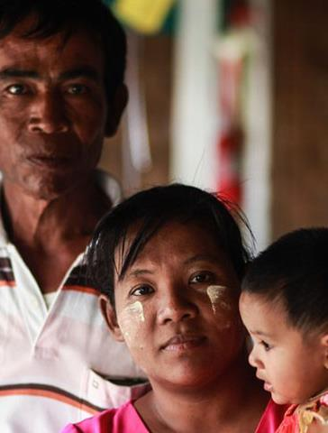
IAS Person-Centred Care (PCC) programme
Prioritizes integrated, inclusive and responsive healthcare services
Focuses on changing needs, priorities and preferences of each person living with or affected by HIV
Empowers clients and is shaped by the many aspects of people’s intersectional identities
Notes:
This event has been organized by the IAS Person-Centred Care programme which is advocating for integrated, inclusive and responsive healthcare services that focus on the changing needs, priorities and preferences of individuals and empowers them to demand services that respect their identities.

Slide 4

What is the PCC Research Collaborative?
Access PCC programme resources
Mission: To work collectively and efficiently to fill evidence gaps around person-centred care for people living with HIV or vulnerable to HIV acquisition
Participants: Researchers, clients and providers who are championing evidence generation related to client-provider relationships, participatory approaches that value experts by experience as well as specific research and policy gaps related to person-centred care within the HIV response
Objective for 2024-2026: Develop a research agenda for scaling up PCC approaches for people living with HIV or vulnerable to HIV acquisition
Notes:
The PCC research collaborative has the mission of working collectively and efficiently at a global level to fill evidence gaps around person-centred care for people living with HIV or vulnerable to HIV acquisition. This collaborative meets around three times a year to convene researchers, clients and providers who are championing evidence generation related to client-provider relationships, participatory approaches that value experts by experience as well as specific research and policy gaps related to person-centred care within the HIV response

Slide 5
Today’s objective
The objectives of this meeting are to identify the evidence-based strategies and future research gaps with regards to person-centred care prevention for people vulnerable to HIV acquisition, with a focus on recent evidence from the JIAS supplement.

Slide 6
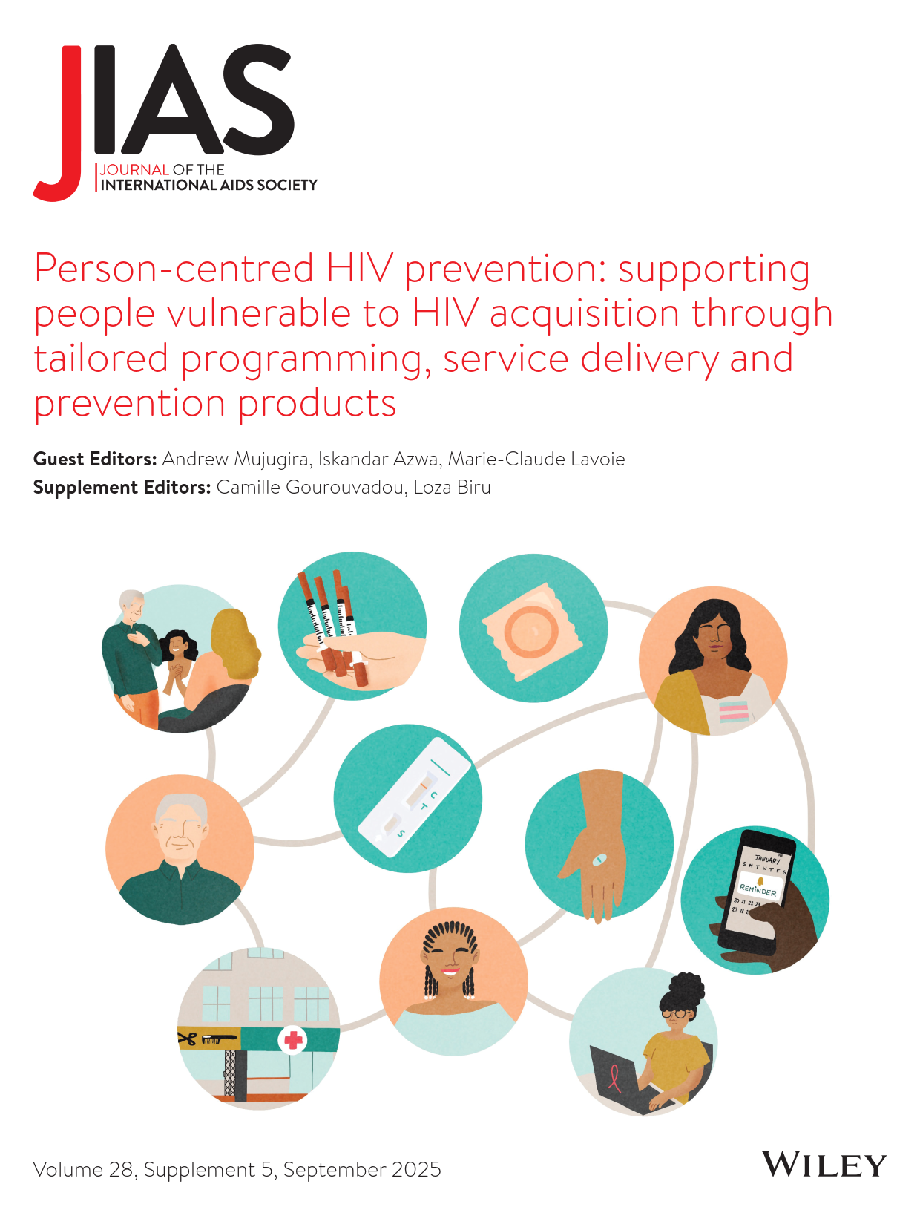
JIAS supplement Sep 2025
Guest editors:
Andrew Mujugira, Makerere University, Uganda
Iskandar Azwa, University of Malaya, Malaysia
Mare-Claude Lavoie, University of Maryland, United States
Notes:
This supplement will feature x research, x viewpoint, x etc
Thank fellow GEs

Slide 7
Supplement objectives
Disseminate new evidence to scale up person-centred HIV prevention interventions, services and products.
Scope included the integration of HIV prevention services with those for hepatitis and tuberculosis, as well as sexual and reproductive health.
Selection prioritized contributions that evaluate novel strategies, including within de-medicalized settings, to overcome or circumvent structural and legal barriers to improve access to prevention services and ensure effective linkage to care among marginalized groups.
Notes:
Document and disseminate evidence on the impact of interventions designed to enhance access to and advance the scale up of effective, person-centred HIV prevention interventions, services and products.
Scope includes the integration of HIV prevention services with those for hepatitis and tuberculosis, as well as sexual and reproductive health.
Selection prioritizes contributions that evaluate novel strategies, including within de-medicalized settings, to overcome or circumvent structural and legal barriers to improve access to prevention services and ensure effective linkage to care among marginalized groups

Slide 8
Key themes of new evidence on person-centred HIV prevention
Acceptability
Accessibility
Choice
Cost-effectiveness
Digital health tools
Self-care
Sustainability
Youth-friendliness
Informed, effective choice is highly valued by clients
Oral PrEP adherence is often sub-optimal but digital tools can support adherence
Diverse demand for long-acting PrEP formulations exists
Safer supply of opioids can reduce HIV and HCV acquisition within broad, trauma-informed care
Status-neutral, appropriately integrated and inclusive primary healthcare and harm reduction services are key
Gender-affirming care can be an effective entry point for HIV prevention services

Slide 9
Programme (part 1) – today
Topic | Speaker
Opening remarks, objectives of session and overview of supplement and editorial themes | Marie-Claude Lavoie, University of Maryland School of Medicine, United States
Harnessing digital health data for person-centred HIV prevention monitoring: a survey of national health information systems | Shona Dalal, World Health Organization, Switzerland
Oral pre-exposure prophylaxis initiation, continuation and adherence among pregnant and postpartum women receiving antenatal and postnatal care: a systematic review | Anke Rotsaert, Institute of Tropical Medicine, Belgium
Person-centred HIV care and prevention for youth in rural South Africa: preliminary implementation findings from Thetha Nami ngithethe nawe stepped-wedge trial of peer-navigator mobilization into mobile sexual health services | Maryam Shahmanesh, Africa Health Research Institute, South Africa
“From an HCV and HIV point of view, it’s been remarkable”: A qualitative study about using prescribed safer supply to support people who use drugs along the HIV and HCV prevention and treatment cascades in Ontario, Canada | Adrian Guta, University of Windsor, Canada
Panel discussion to propose and prioritize research gaps on themes | Moderator + speakers
Q&A and open discussion with participants | All participants
Closing remarks | Marie-Claude Lavoie, University of Maryland School of Medicine, United States

Slide 10
Harnessing digital health data for person-centred HIV prevention monitoring: a survey of national health information systems
Shona Dalal, World Health Organization, Switzerland

Slide 11






Pre-exposure prophylaxis initiation, continuation, and adherence among pregnant and postpartum women attending antenatal and postnatal care: a systematic review
Anke Rotsaert, Zaynab Essack, Shannon Bosman, Dvora Joseph Davey, Bernadette Hensen

Slide 12
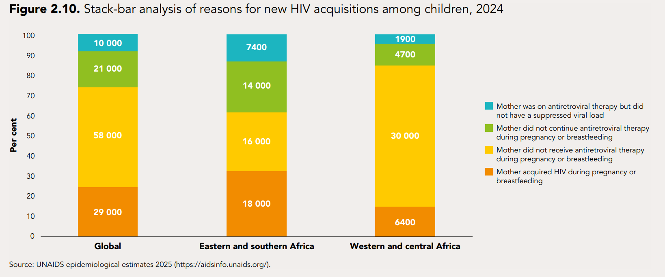
One in four child HIV infections globally result from maternal HIV acquisition during pregnancy or breastfeeding
Source: AIDS, crisis and the power to transform, UNAIDS global AIDS update 2025
BACKGROUND

Slide 13
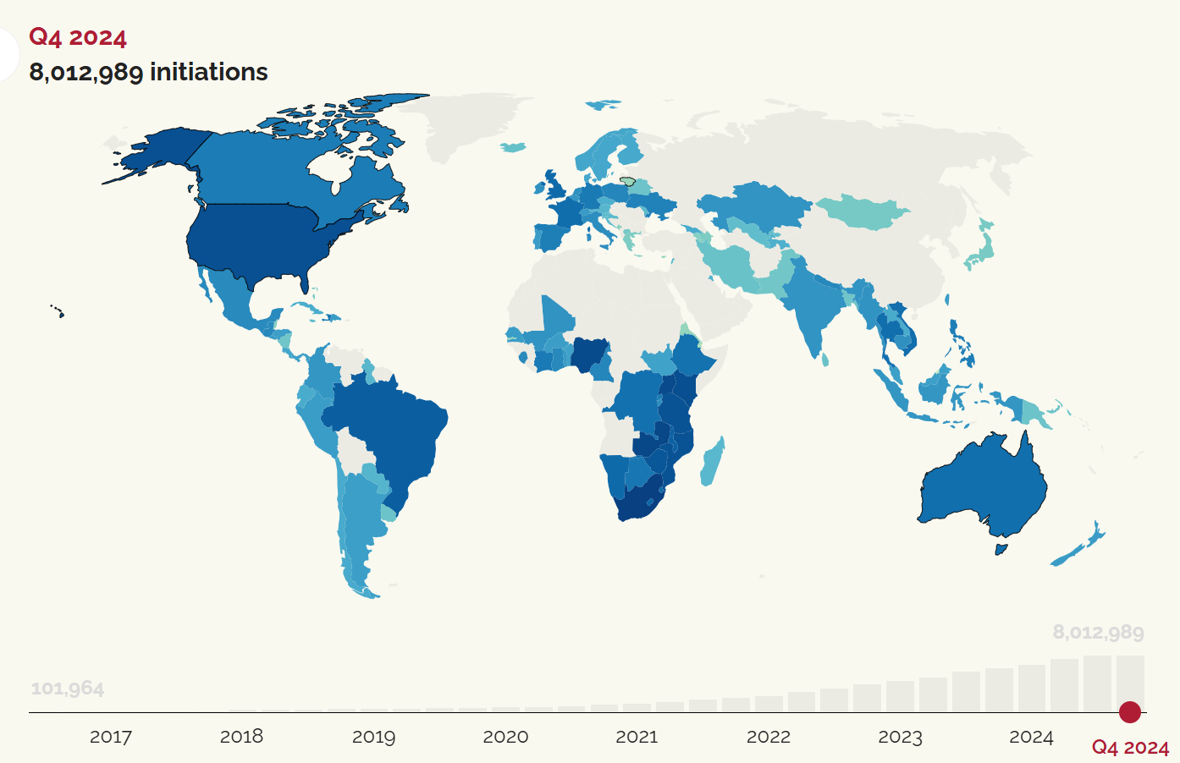
Oral PrEP is safe,
but underused among pregnant and postpartum women
Source: global PrEP tracker, PrEPWatch
BACKGROUND

Slide 14
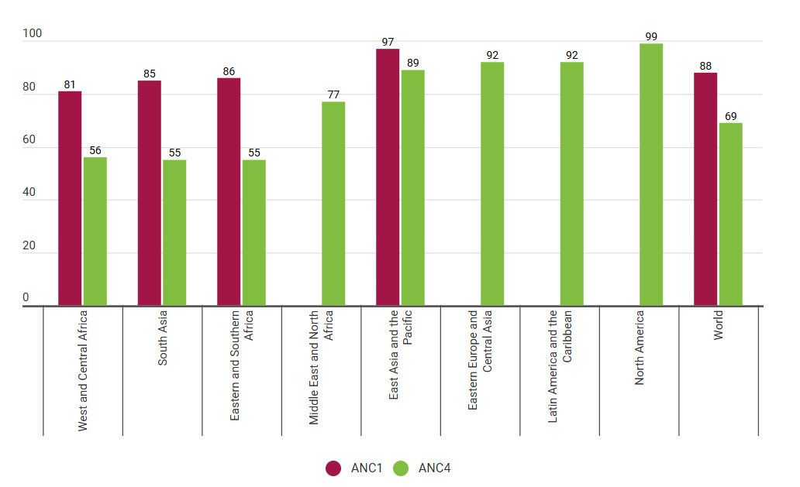
How to reach pregnant and postpartum women?
High coverage of antenatal and postnatal care (ANC/PNC)
Integration of PrEP into ANC/PNC promising person-centred approach
OBJECTIVE: to summarise oral PrEP initiation, continuation, and adherence among pregnant and postpartum women receiving ANC/PNC
Source: Unicef
Notes:
88% of women globally attended ≥ 1 ANC visit
71% attended routine PNC visit <2 days after birth
Integration PrEP into ANC/PNC promising approach
Limited evidence on operationalisation

Slide 15
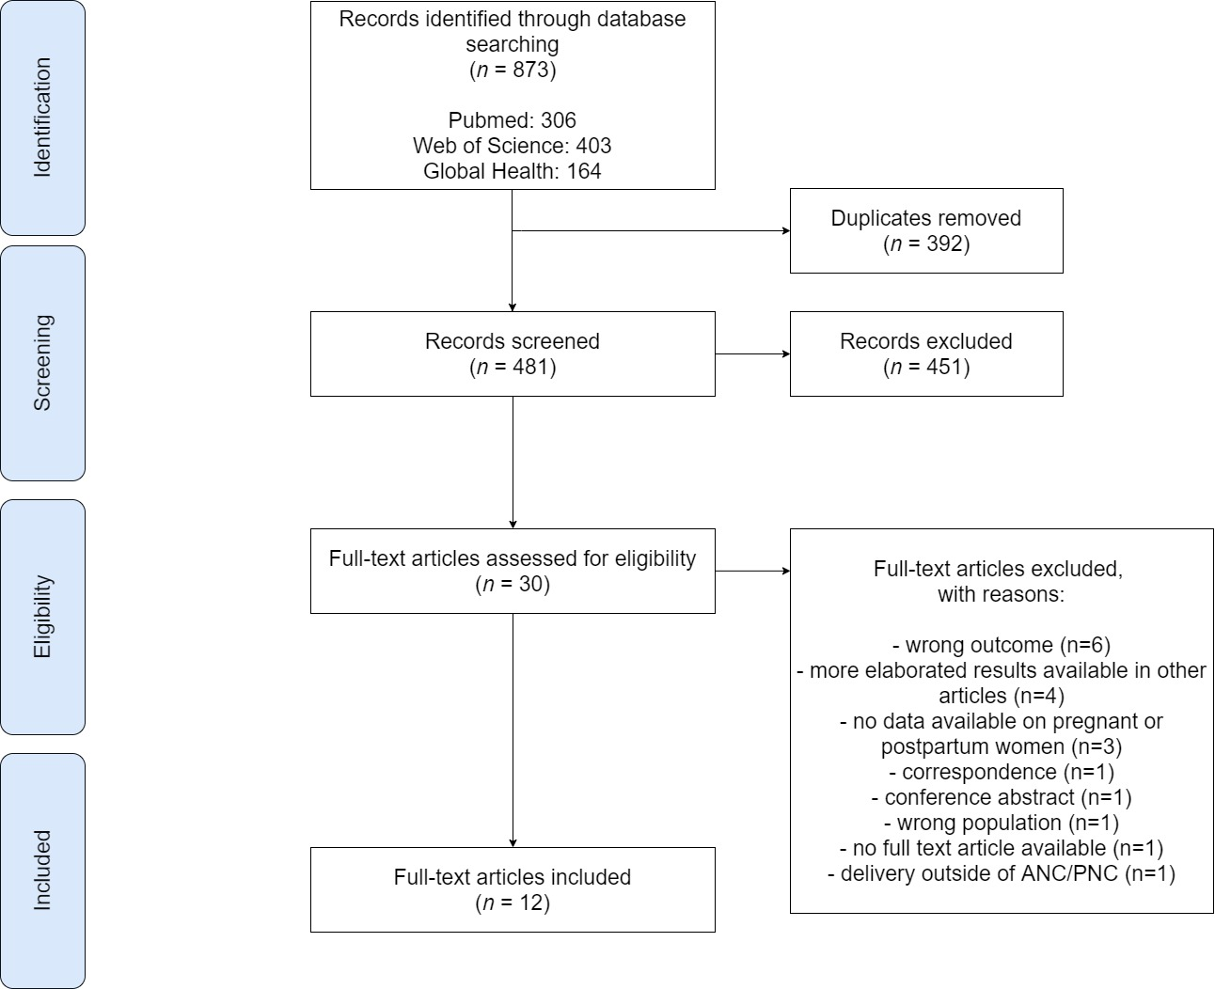
Systematic review: methods
English-language quantitative studies
January 2015 – March 2024
No geographical restrictions
PrEP delivery through ANC/PNC
Reported on outcome on oral PrEP:
  Initiation
  Continuation
  Adherence

Slide 16
Characteristics of articles eligible for inclusion (N=12)
Study, first author, publication year | Country and study period | Study design
Chi, 2024 | Malawi, Jun 2020-Nov 2020 | Randomised pilot trial
Masenyetse, 2023 | Lesotho, Jan 2019-May 2022 | Retrospective chart review
PrEP in Pregnant and Postpartum women (PrEP-PP) in South Africa
Joseph Davey, 2022 | Aug 2019- Oct 2021 | Prospective cohort
Joseph Davey, 2021 | Aug 2020-Apr 2021 | Randomised controlled pilot trial
Joseph Davey, 2022 | Aug 2019- Oct 2021 | Prospective cohort
Khadka, 2023 | Aug 2019- Oct 2021 | Prospective cohort
Sexually Transmitted Infections and PrEP in Pregnancy Study (STIPPS)
De Voux, 2023 | South Africa, Nov 2021-May 2022 | Randomised controlled trial
PrEP Implementation for Mothers in Antenatal care (PrIMA) in Kenya
Kinuthia, 2023 | Jan 2018-Jul 2021 | Cluster randomised trial
Pintye, 2023 | Jan 2018-Jul 2021 | Prospective cohort
PrEP Implementation for Young women and Adolescents (PriYA) in Kenya
Kinuthia, 2020 | Nov 2017-Dec 2018 | Prospective cohort
Pintye, 2020 | Nov 2017-Dec 2018 | Prospective cohort
Pintye, 2020 | Feb 2018-Oct 2018 | Pre-/post-evaluation

Slide 17
Study characteristics
Median gestational age: 20-26 weeks
Follow-up period: 1 month post-enrolment – 12 months postpartum
* Outcome: Total exceeds 12 due to studies reporting on multiple outcomes

Slide 18
Initiation (n=7)
Defined as:
Accepting initial prescription or
self-reported use at follow-up visit
14% - 84%
Higher uptake among women with increased exposure to HIV
Partner living with HIV
Diagnosed with an STI

Slide 19
Study reference | Continuation post-enrolment
 | 1 month | 3 months | 6 months
 | % (n/N) | % (n/N) | % (n/N)
South Africa
Joseph Davey et al. | 66% (629/953) | 58% (493/844) | NR
Khadka et al. | 63% (253/403) | 54% (212/395) | 39% (149/380)
Davey et al. | I: 91% (48/53) C: 98% (52/53) | NR | NR
De Voux et al. | I: 79% (70/133) C: 80% (67/135) | NR | NR
Kenya
Pintye et al. | NR | NR | 58% (212/363) 9 months postpartum
Kinuthia et al. | 39% (786/2030) | 22% (441/2030) | 12% (189/1618)
Kinuthia et al. | NR | NR | I: Median: 8.6 (IQR 3.2-11.4) months in FU C: Median: 9.0 (IQR 3.8-11.9) months in FU
Pintye et al., Kenya, 2020[31] | I: 43% (81/190) C: 22% (37/166) | NR | NR
Masenyetse et al., Lesotho | 40% (156/389) no FU visit; 20% (76/389) has one FU visit; 40% (157/389) had ≥2 FU visits | NR | NR
Chi et al., Malawi | I: 94% (94/100) C: 92% (92/100) | I: 90% (90/100) C: 89% (89/100) | I: 88% (88/100) C: 83% (83/100)
Continuation
Definition:
Receiving a prescription for PrEP
Self-reported PrEP use at follow-up visit, or
Participant presenting for study visit
Challenges: Varying definitions & measurement of continuation
C: control arm
I: intervention arm
NR: not reported
Notes:
Definition: Receiving PrEP prescription, self-reported PrEP use at follow-up visit, or participant presenting for study visit

Slide 20
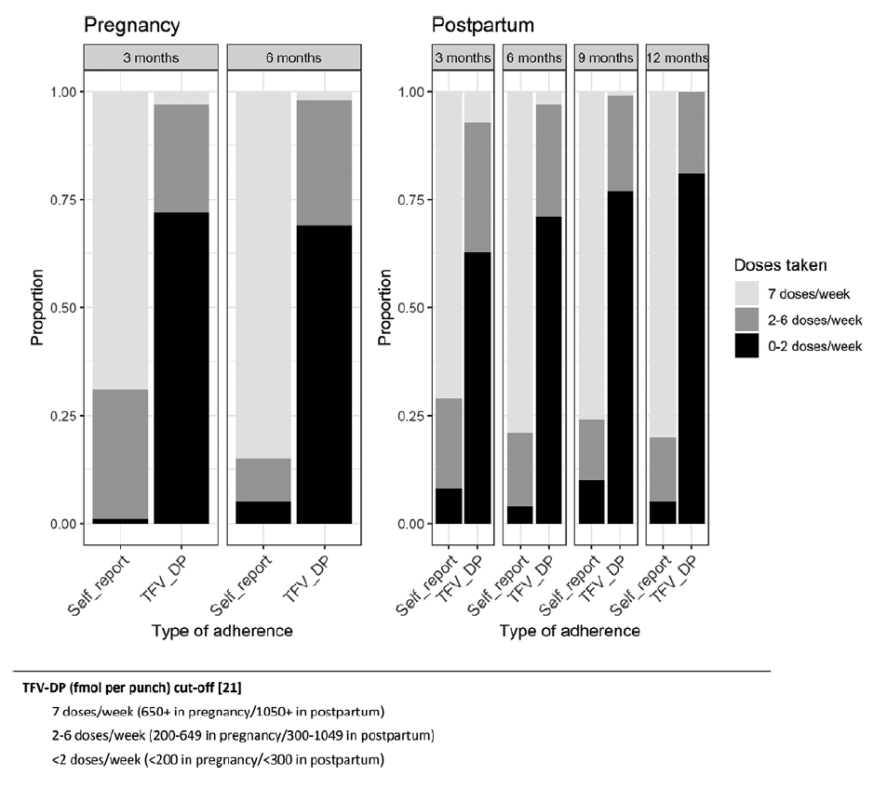
Adherence (n=10)
  Self-reported adherence: generally high
  Objectively measured adherence: inadequate levels to effectively prevent HIV acquisition
  Suboptimal adherence throughout pregnancy and postpartum period
Figure. Estimated number of doses taken in the prior 7 days by study visit, pregnancy status, self-report and TFV-DP level in dried blood spots.
Source: Joseph Davey et al., 2022

Slide 21
Limitations
Focus on oral PrEP
Varying definitions for PrEP use outcomes
Limited geographical scope
Lack of long-term follow-up
Notes:
In limitations could also review that most countries are not collecting ANC or PNC data until recently which limits understanding of prep use in public facilities more generally

Slide 22
Conclusion
Promising initiation, but substantial challenges in continuation and adherence
Need for more person-centred, supportive interventions
Expanding access to long-acting PrEP options
Investigating differentiated models of delivery postpartum
Essential insights into PrEP use

Slide 23
PrEP For Two: Advancing HIV prevention: understanding and enhancing PrEP use in pregnant and postpartum women in Zambia (ITM, Zambart, FWO)
Do-PrEP: Evaluation of differentiated, client-centred PrEP delivery models (community-based and alternative access points) among adolescent girls and women of reproductive age, including pregnant and postpartum women. (MGH, HSRC, WHC)
EXPRESSIVE 10 (MK-8527, WHC site): Phase 3 evaluation of once-monthly oral PrEP with continued participation of women who become pregnant during the study.
SCOPE-PP: Evaluation of stepped care for pregnant and postpartum women on oral PrEP, including evaluation of client-centered choice in PrEP and HIV testing delivery in South Africa (UCLA, UCT)
PrEPared to Choose: Evaluation of PrEP choice (oral, injectable CAB and DVR) among AGYW, including PPW, and their partners in South Africa (DTHF), with extension for LEN in 2026

Slide 24
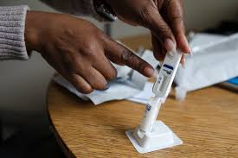
Person-centred PrEP delivery: Examples from South Africa
Person-centred delivery strategies that address fluctuating risk, mobility, and care engagement may improve effective PrEP use among PPW
RCT evaluated differentiated delivery of PrEP in postpartum women who had discontinued PrEP in peripartum including choice of home delivery, clinic rapid pick up and community delivery with HIV self-testing or clinic testing (n=266 women)
Results:
  Rapid clinic pick-up with HIV self-testing the most frequently selected option
  Half of postpartum women switched their method of collection
  Half selected HIVST for HIV testing methods
  Offering dynamic choice in PrEP delivery increased PrEP adherence &
  continuation (aOR=1.73, 95% CI=1.05-2.87) vs. enhanced counseling in clinic
Joseph Davey, et al. “RCT of Dynamic Choice to Provide Oral PrEP to Postpartum South African Women”, CROI, 2026; Under review JIAS

Slide 25
Research gaps to be addressed related to person-centred prevention service delivery
Implementation of long-acting PrEP (incl. LEN) in ANC/PNC
Understanding how long-acting PrEP can be safely, feasibly and acceptably integrated into routine ANC/PNC, incl. monitoring, counselling and pharmacovigilance requirements.
Sustained postpartum continuation strategies
Identifying differentiated service delivery approaches that prevent the sharp decline in PrEP continuation observed during the postpartum and breastfeeding periods.
Digital and AI-enabled risk identification, choice support and adherence
Evaluating how digital and AI-supported tools can enhance risk assessment, informed product choice, provider training, and adherence support as prevention options expand.
Sustainable, equitable models in resource-constrained settings
Generating implementation and cost-effectiveness evidence to ensure long-acting and differentiated PrEP delivery models are scalable and accessible to women both within and beyond formal ANC platforms.
Integration of STI testing services

Slide 26


Acknowledgements
Dr. Bernadette Hensen (ITM)
Dr. Dvora Joseph Davey (UCLA, UCT)
Dr. Zaynab Essack (HSRC)
Dr. Shannon Bosman (SYNAPSE, WHC)

Slide 27

Person-centered HIV prevention for youth in rural South Africa: Early implementation findings from Thetha Nami ngithethe nawe cRCT of peer-navigator mobilization into mobile sexual health services
Prof. Maryam Shahmanesh FRCP PhD
NIHR Global Health Professor
4th of March 2026
IAS

Slide 28
Conflict of interest
I have received drug donations (cabotegravir) for LAPIS from ViiV

Slide 29
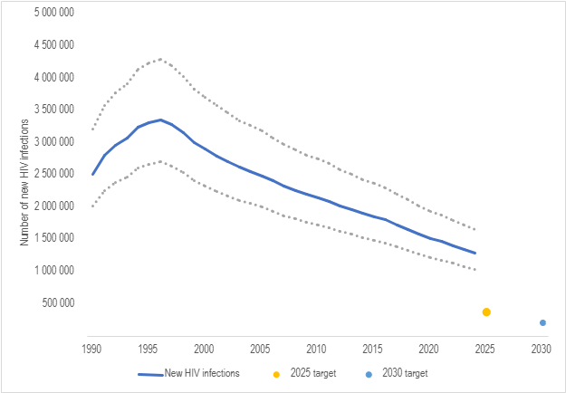
Background
SA recorded 178,000 new HIV infections in 2023/4,
Despite free access to biomedical tools to prevent HIV transmission (ART) or acquisition (PrEP and PEP)
Notes:
We all know that despite effective, cheap and safe biomedical tools – namely point of care lateral flow tests and a pill a day that can prevent HIV transmission (antiretroviral therapy) and a pill a day that prevents HIV acquisition HIV pre and post exposure prophylaxis – we have failed to eliminate HIV

Slide 30
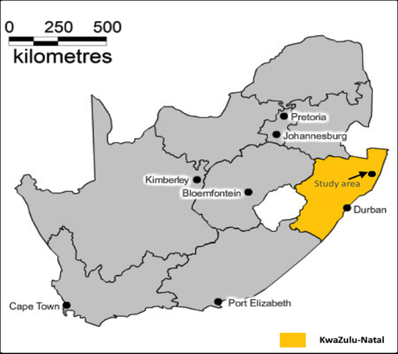
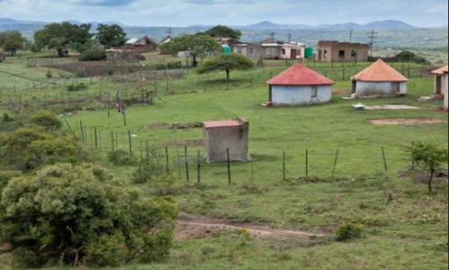
The Africa Health Research Institute
Rural and poor
High HIV burden
>85% youth unemployment
Notes:
I work in rural KwaZulu-Natal South Africa. The study site is a health and demographic site located in KwaZulu-Natal South Africa, and it is about 200 km north from Durban. The area is rural and poor with high unemployment and a high burden of HIV.

Slide 31
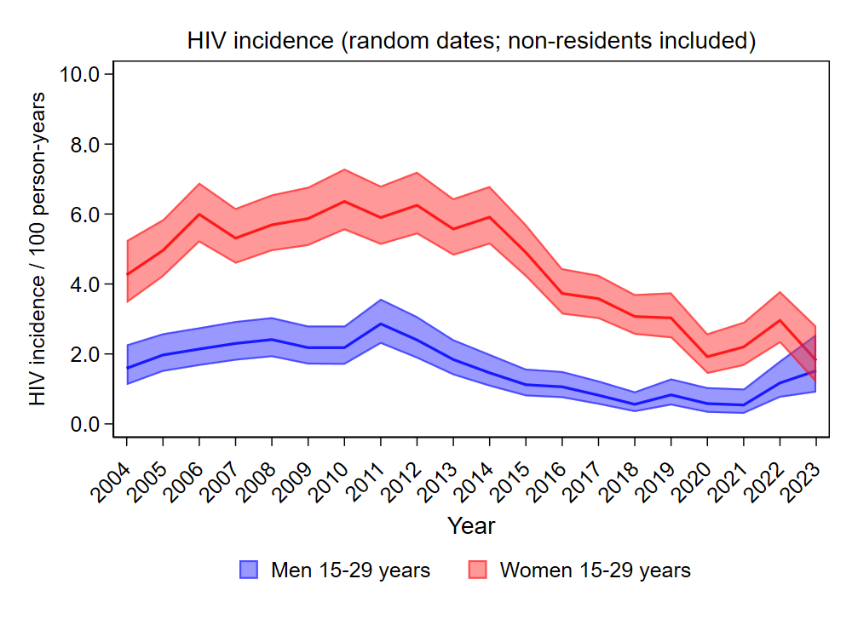
Problem:
HIV incidence declines driven by antiretroviral therapy and VMMC has slowed – even before the recent cuts in HIV prevention funding
Notes:
Despite declines in HIV incidence, we have not reached less than than 0.01% - and there are suggestions that it may be increasing

Slide 32

Test the population impact of implementing community-based models of person-centered care

Slide 33
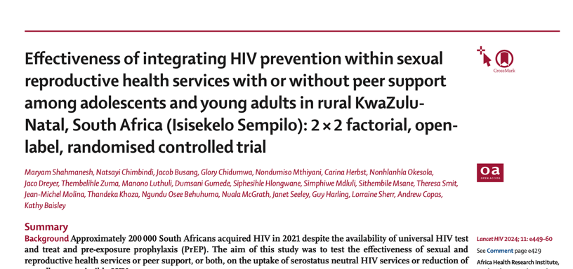
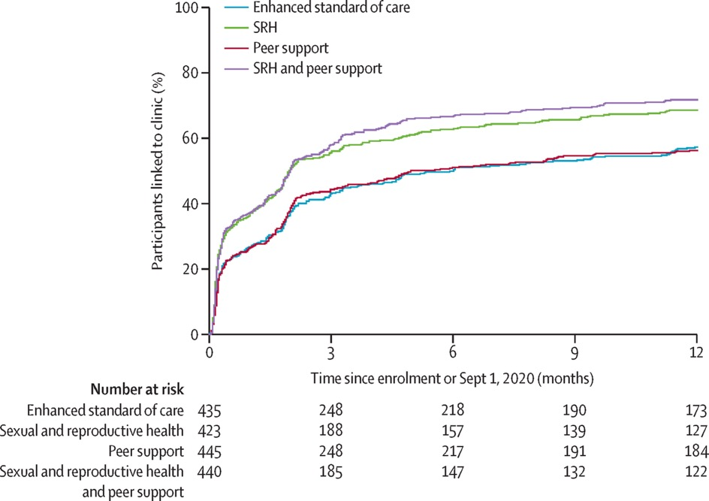
Why mobile sexual health services?
First RCT to show Sexually Transmitted Infection testing and sexual health increases demand for HIV prevention by 60%
Population-weighted prevalence estimates for any STI and each individual STI, by sex and age group (with 95% CI).¹
Notes:
Our social science teams found that policy makers, young people and their families were concerned with the sexual and reproductive health of youth, fertility and poor birth outcomes. They are right - we consistently find high prevalence of curable sexually transmitted infection, mainly asymptomatic. In the first RCT globally we showed home-based STI self-sampling and testing and sexual health increases demand for risk-differentiated HIV prevention, including PrEP amongst adolescents and youth by 60%.

Slide 34

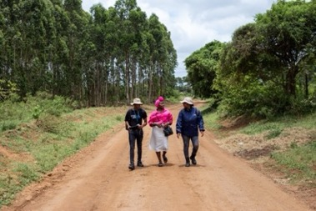

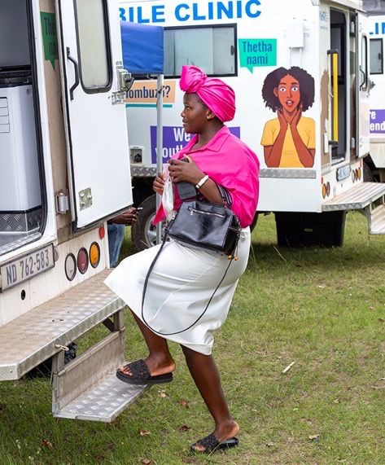
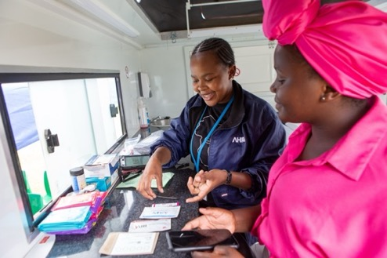
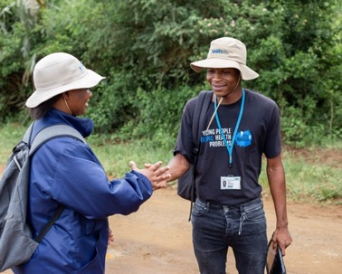
Peer-led community-based person-centred SRH and PrEP
Mobile sexual health services
Peer-led tailored
Assessment
Electronic Clinical management tool
HIV & STI testing, SRH, HIV treatment or PrEP
Peer mentorship
Notes:
Thetha Nami ngththe nawe was co-created to leverage lived experience and support community-based HIV testing, treatment and HIV PrEP. Area-based Peer Navigators map resources in their communities, mobilise PrEP demand, promote PrEP literacy and during a health promotion conversation identify the nature and urgency of the need that is shared through an Electronic Clinical Management System with the clinical and social services – they refer those who would benefit from sexual health services, HIV testing, PrEP or ART to the mobile sexual health services that visit the area monthly Peer navigator digital tools allow real-time integration of differentiated care between the peers and the clinical and social services.

Slide 35
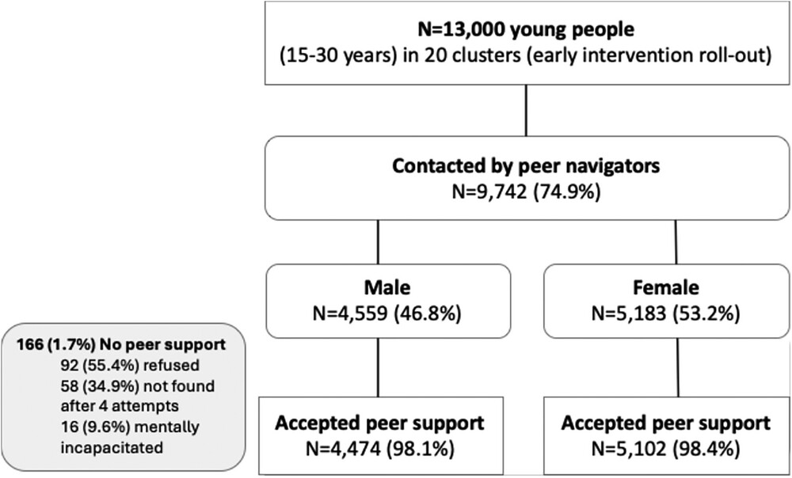

Peers reach the majority of 15-30-year-olds with tailored care
Journal of the International AIDS Society, Volume: 28, Issue: S5, First published: 08 October 2025, DOI: (10.1002/jia2.70032)
Notes:
By knowing our denominator we know that In the first year of the step-wedge trial peer navigators, reached three quarters of all young people, nearly half young men.

Slide 36
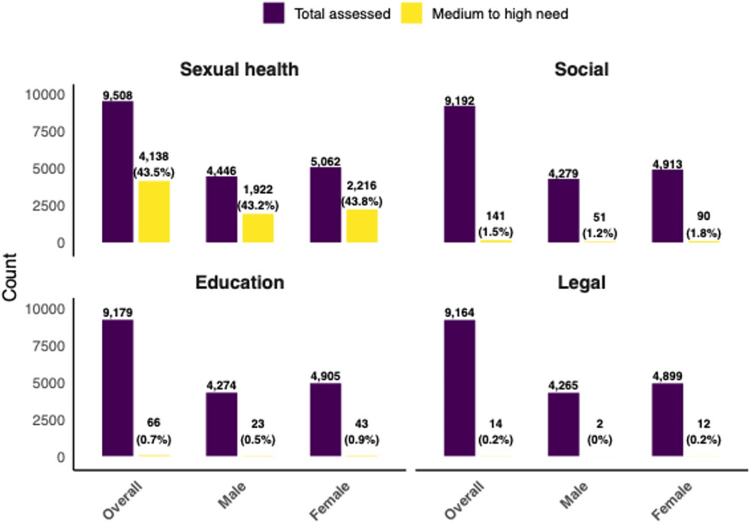
Electronic Clinical management tool
Journal of the International AIDS Society, Volume: 28, Issue: S5, First published: 08 October 2025, DOI: (10.1002/jia2.70032)
Notes:
Among the young people assessed, sexual health needs were the most frequently reported. Of the 9508 (99.2%) assessed, of whom 4138 (43.5%) were identified as having medium to high needs and were referred for mobile adolescent and youth-friendly clinical services. In contrast, assessments for social support, education and legal needs revealed much lower proportions of medium or high need: The patterns of needs were similar across sexes.

Slide 37
Peers refer a high HIV need population of AYA
55% referred by peers attended mobile services
93% tested for HIV
47% need ART or PrEP
  212 (10%) living with HIV (15% amongst women)
  HIV incidence 2.53 per 100 person-years (95% CI: 1.13–5.62).
PrEP uptake was higher among high-risk* than low-risk AYA - adjusted OR 5.4, 95%CI=3.6-8.0, p<0.001
*High risk defines as Transactional sex, condomless sex with 2 or more partners, unknown HIV status, alcohol and drug misuse, and GBV
Notes:
Among the 4138 individuals identified with medium or high sexual health needs and referred for clinical services, 2269 (55%) successfully linked to care. Linkage rates were higher among females, 59% compared to 50% mong males. A total of 2103 (93%) of clinic attendees underwent HIV testing, with a similar uptake rate of HIV testing between males. Nearly half needed HIV treatment or PrEP – PrEP uptake (85%) was five times higher amongst high risk AYA compared to lower risk AYA. 212 (10.1%) were living with HIV; this was higher in females (15.1%) than males (3.3%) and HIV incidence was 2.5%.

Slide 38
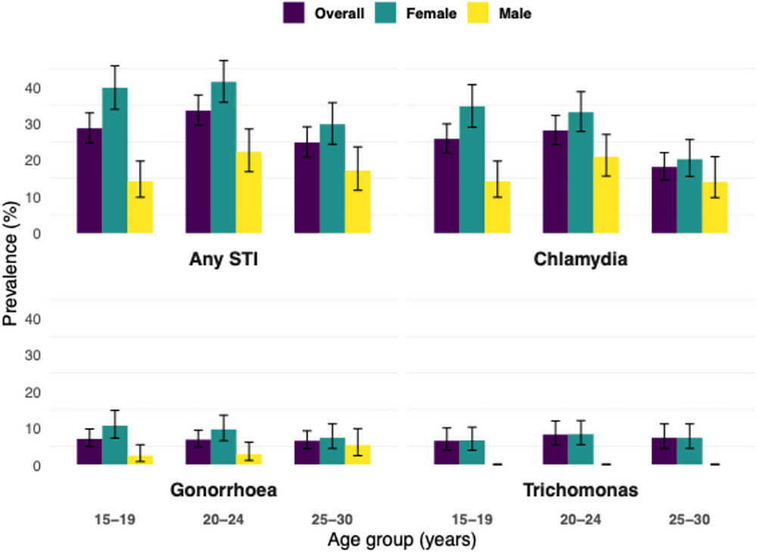
Peers refer a high SRH need population
1433 (63%) tested for STIs
  29% any STI
  ~40% amongst women aged 15-24
  92% were treated
65% newly received contraception
71% of those aged 15-19
Journal of the International AIDS Society, Volume: 28, Issue: S5, First published: 08 October 2025, DOI: (10.1002/jia2.70032)
Notes:
A total of 1433 (63.2%) clinic attendees were tested for common and curable STIs (chlamydia, gonorrhoea and trichomonas) with similar proportions for males (62.0%) and females (64.0%). Overall, 418 (29.2%) tested positive for any STI, with a higher prevalence among females (37.2%, 95% CI: 34.4%–40.1%) than males (17.9%, 95% CI: 15.4%–20.8%). Among those who tested positive, 385 (92.1%) received STI treatment. Treatment uptake did not differ significantly by sex (p = 0.67).
Across all age groups, the prevalence of any STI was consistently higher among females compared to males, and it was highest in females aged 15–24 reaching a shocking 40% Overall, 65.0% (558/1310) of contraception users received contraception through the study, with higher uptake rates among those in the 15–19 age group (71%).

Slide 39

Conclusion
Peer-led person-centered care reaches the majority of adolescents and young adults with differentiated biosocial care
Nearly half of AYA referred into mobile services need HIV care or PrEP
One third of AYA referred to mobile services had a curable STI and two thirds of women needed contraception

Slide 40

Way forward for adolescent and youth centered care
Effective HIV prevention reduce new HIV infections and time to HIV treatment
Gain efficiencies by
  Layering HIV and SRH and social care
  Task shift to peers with lived experience
ACCEL will scale-up reaching priority populations at highest risk of HIV acquisition through
  Peers with lived experience,
  Sexual health
  Choice of venue and product
Notes:
Effective HIV prevention, not only reduces HIV incidence, it also reduces time to HIV treatment. Peer-led delivery of HIV with SRH and social care, efficiently provides differentiated care to AYA – In Unitaid funded ACCEL we will evaluate the scale up to reach priority and key populations through peers with lived experience – choice or venue and choice of oral PrEP or LEN -

Slide 41



Social Scientists: Thembelihle Zuma, Sinakekelwe Nkwanyana, Siphesihle Hlongwane, Manono Luthuli, Sibonfiseni Xulu, Janet Seeley.
Implementation Scientists and clinical trialists: Maryam Shahmanesh, Natsayi Chimbindi, Thandeka Khoza, Limakatso Lebina, Anne Derache, Nkosinathi Ngcobo, Ngundu Behuhuma, Willem Hanekom,
Statistics, Data Management and population scientists: Nondumiso Mthiyane, Jacob Busang, Faith Magut Kathy Baisley, Andrew Copas, Kobus Herbst, Jaco Dreyer
Project Management (clinical and social work): Nonhlanhla Okesola, Carina Herbst, Ashley Jalazi,, Simphiwe Mdlili, Sithembile Msane, Samke Ngubane, Thandeka Danisa, Lucky Mtolo, Theresa Smit
di,

Slide 42
“From an HCV and HIV point of view, it’s been remarkable”
A qualitative study about using prescribed safer supply to support people who use drugs along the HIV and HCV prevention and treatment cascades in Ontario, Canada
Guta, A., Rudzinski, K., Gagnon, M., Schmidt, R., Kolla, G., German, D., Kryszajtys, D., Perri, M., Sereda, A., Sterling-Murphy, C., Strike, C.
Contact: aguta@uwindsor.ca

Slide 43
Land Acknowledgment
Indigenous peoples in Canada experience a disproportionate burden of HIV and drug-related harms—outcomes tied to colonial policies and systemic inequities. I also want to recognize the leadership of Indigenous scholars, clinicians, and community organizations, whose work in harm reduction and culturally grounded care has been foundational to advancing person-centred approaches.

Slide 44
Canadian Context
There were an estimated 65,270 people living with HIV (PLHIV)
in Canada at the end of 2022. (PHAC, 2024 PROGRESS REPORT)
  13% were people who have ever injected drugs (PWID)
  89% diagnosed / 85% on ART / 95% suppressed [Considerable regional variation] (PHAC, 2024)
  18.2% of new diagnoses attributed to injection drug use in 2023 (PHAC surveillance report, 2025)
Drug Toxicity Crises
  There was a total of 53,308 apparent opioid toxicity deaths reported between January 2016
  and June 2025 (Substance-related Overdose and Mortality Surveillance Task Group)
  83% involved opioids that were non-pharmaceutical (fentanyl and fentanyl analogues,
  non-medical benzodiazepines, and other sedatives and tranquillizers) – all associated with increased HIV risk – increased nitazenes, which are also being seen across Europe

Slide 45
Safe(r) Supply
Safer supply services provide prescribed medications to people who use drugs, overseen by a health care practitioner, with the goal of preventing overdoses and saving lives.
They are provided in a less clinical and more flexible way compared to other care options for substance use, such as opioid agonist treatment (OAT).
Made it easier to access relevant medications, including issuing exemptions from the Controlled Drugs and Substances Act (Health Canada)

Slide 46
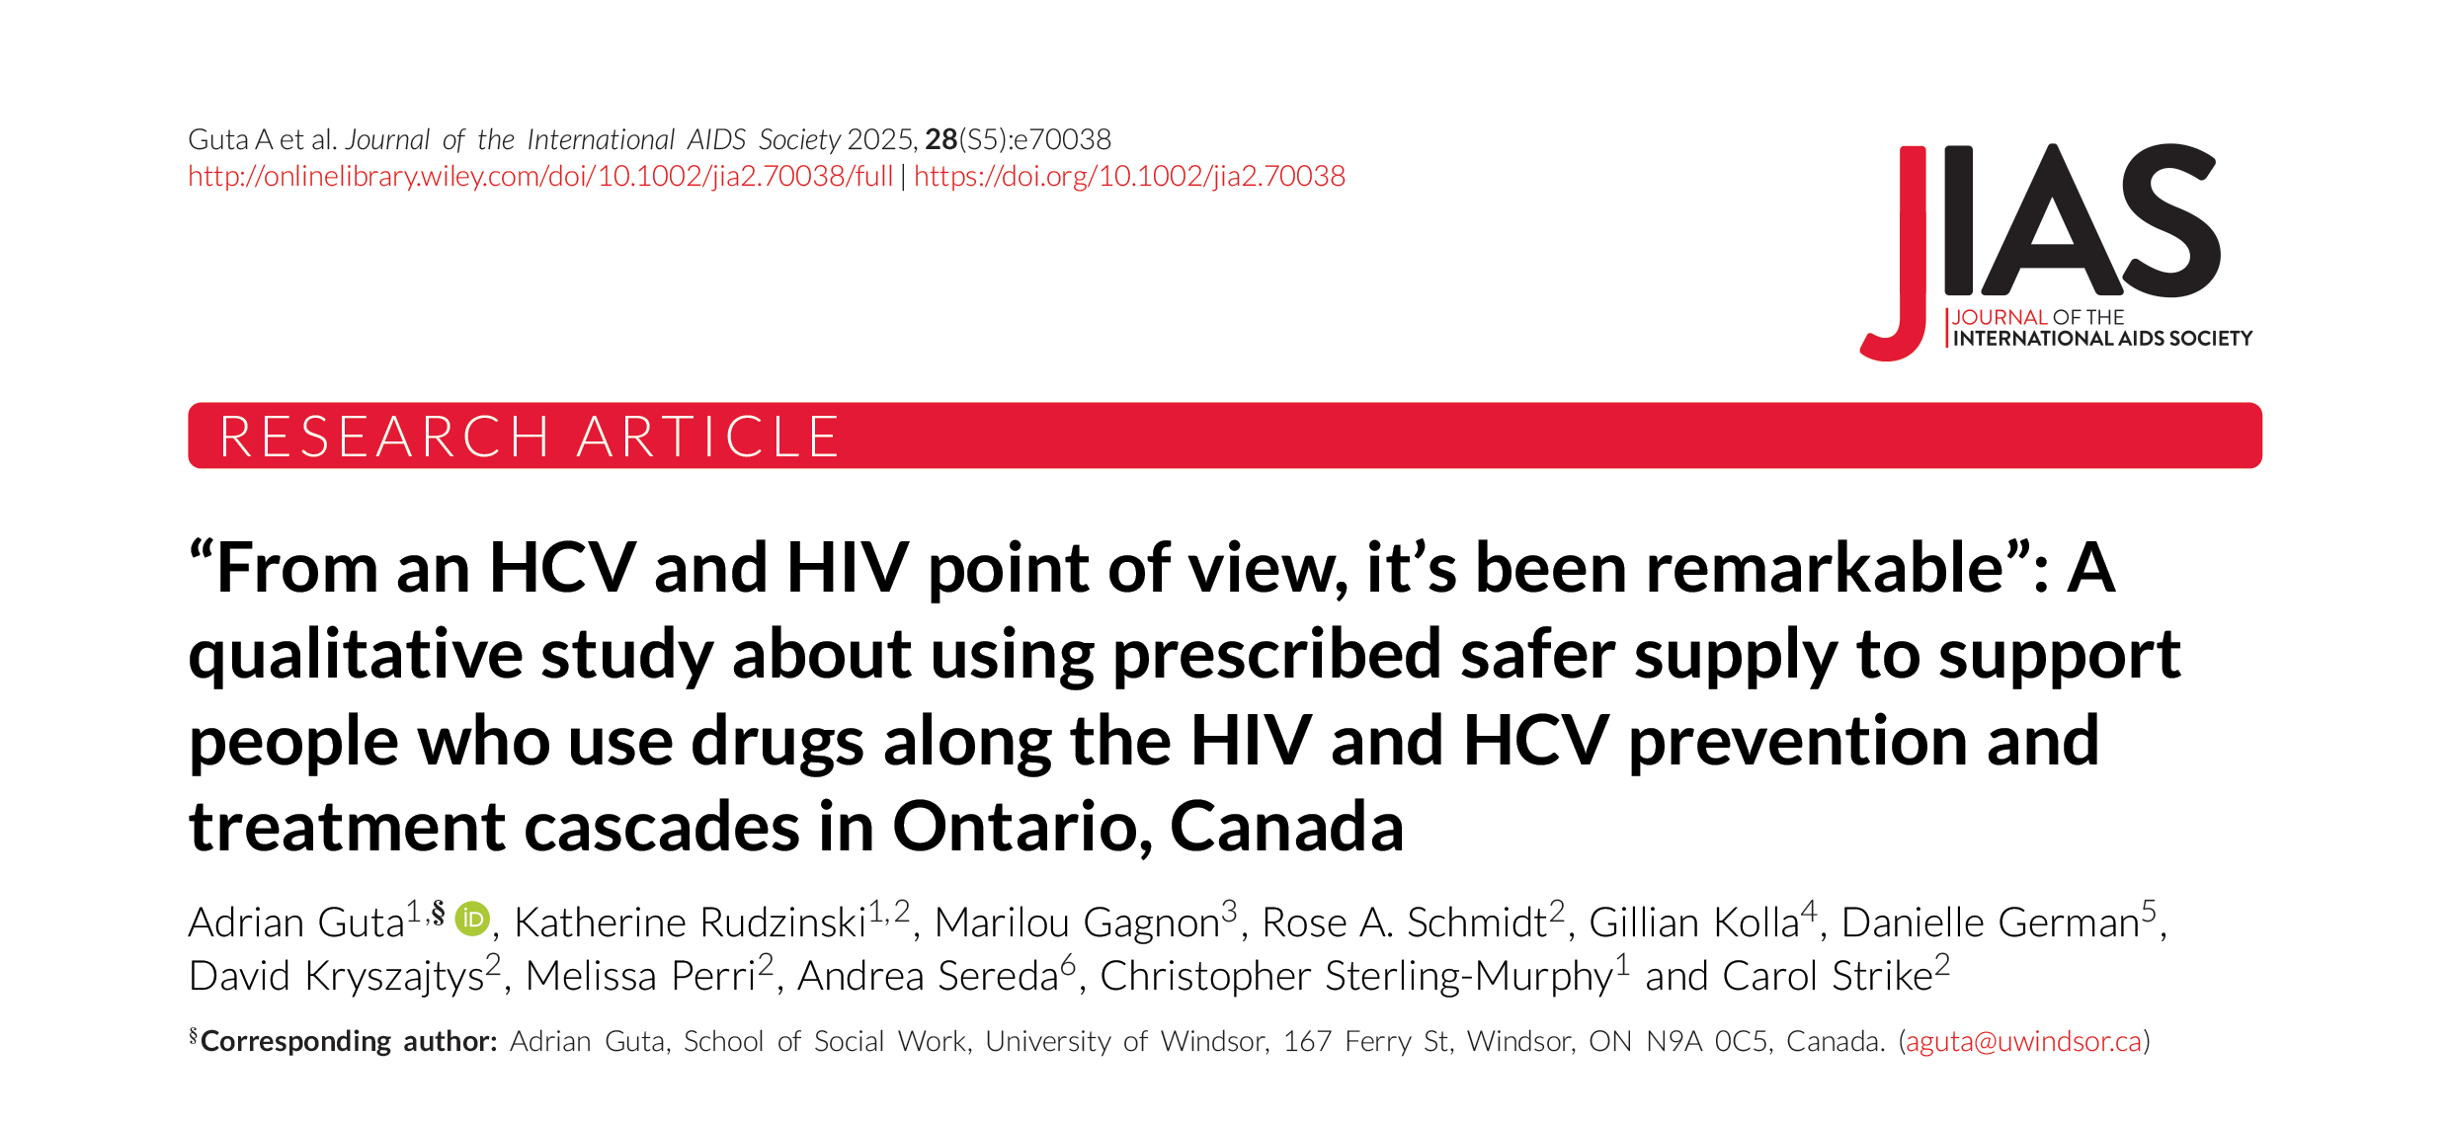
JIAS Paper

Slide 47
SOS programs included in the project
Tablet Hydromorphone prescribing within wrap-around primary care with system navigation.
  Intercommunity Health- London
  Parkdale Queen West Community Health Centre (both sites)- Toronto
  South Riverdale Community Health Centre- Toronto
  Street Health- Toronto
In 2020, the Substance Use and Addiction Program at Health Canada provided temporary funding to these SOS programs.
  All were prescribing SOS medication before receiving the funding.

Slide 48
Methods
Data collection methods | Semi-structured interviews Demographic survey Program characteristic survey (completed 1/site)
Participants | People enrolled in SSP (n= 52) Prescribers, allied health, pharmacists (n=21)
Sampling | People enrolled - purposive – varied gender and race/ethnicity Physicians/allied health – census Pharmacists – purposive
Recruitment | Staff assisted, snowball February to October, 2021 (no face-to-face research: allowed 03/20 to 09/21)
Data collection | In person, zoom and telephone, audio recorded interviews Interviewers - research coordinators/assistants and two PIs (COVID restrictions)
Data analysis | Thematic analysis – team based Advisory group/team provided feedback on coding structure/themes

Slide 49
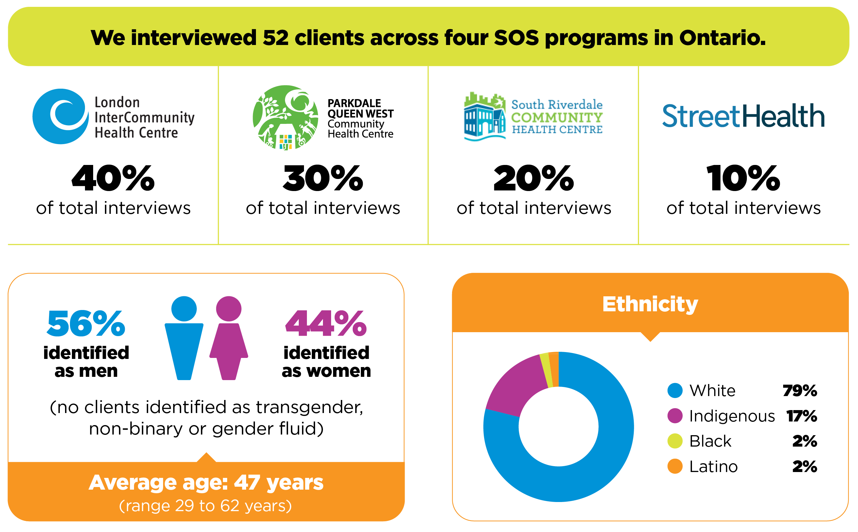
Participants
7 HIV positive
  All currently on medication
  All undetectable viral loads
77% of
clients had
ever received
a hepatitis C positive diagnosis

Slide 50
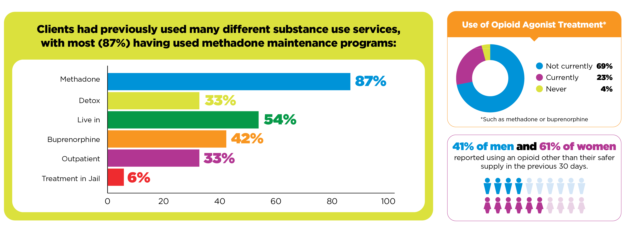
Participant’s Opioid and Treatment Use

Slide 51
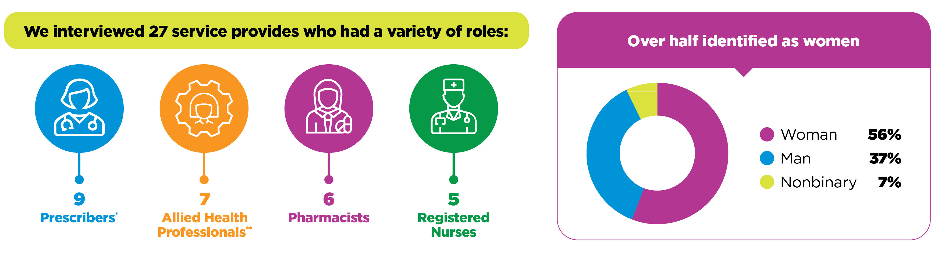
Service Providers
58% had 6-10 years of experience working with people who use drugs, and another 16% had more than 10 years of experience.

Slide 52
Engagement First
Safer supply functioned as a pre-cascade engagement platform for medically and socially complex patients; addressing drug use needs first was associated with re-engagement in healthcare (and eventually HIV/HCV care).
Relationship-building preceded viral load metrics.
“When I say ‘engagement tool’, what I mean by that is we’re giving patients something that’s actually useful and wanted in their life… and that brings them back into health care in other ways.” (PHYSICIAN)

Slide 53
Aligning HIV Care with Patient Realities
Integrated, non-punitive substance use healthcare created the conditions for treatment initiation and/or stabilized adherence among previously disengaged patients.
Daily pharmacy dispensing enabled bundling of ART/HCV medications with opioid medications.
“From a HepC and HIV point of view, it’s been remarkable… being able to twin the medications alongside their long-acting [opioid] that they’re going to the pharmacy for every day has made providing HIV primary care so much easier.” (PHYSICIAN)
“I wasn’t even takin’ my meds before I started the program and now, I’m undetectable… So it’s good.” (Patient)

Slide 54
Cascade Stabilization in Medically Complex Patients
Person-centred design translated into both patient experience and cascade gains (viral suppression, HCV treatment uptake).
“It’s way more humane… it’s judgment-free, you lay all your problems on
the table.” (PATIENT)
“Out of all patients who came to safer supply with a palliative designation, a hundred per cent of them are still alive and no longer palliative. The patients who came to us with untreated HIV, that had actually progressed to AIDS, ninety-six per cent were virally suppressed, and on continuous HIV treatment. Out of all patients who came to us with Hepatitis C diagnoses, 92%… had either received Hepatitis C treatment or were in the process of receiving Hepatitis C treatment.” (NURSE PRACTITIONER)

Slide 55
Conclusion & Future Directions
In a population characterized by high medical and social complexity, the convergence of strong engagement and favourable cascade indicators suggests a promising pathway for person-centred HIV/HCV care delivery within diverse drug policy contexts.
  The field currently relies on qualitative findings and some population-level administrative data. Next steps include cascade-aligned intervention studies examining comparative effectiveness across safer supply modalities (e.g., oral vs. smokable opioids; opioid vs. stimulant models) and their differential impact on HIV/HCV outcomes
  In the context of program defunding and harm reduction scale-back, next steps include assessing cascade disruption: treatment interruption, loss of viral suppression, reduced testing uptake, and increased transmission risk. Parallel epidemiologic analyses are needed to evaluate changes in HIV/HCV incidence associated with diminished access to safer supply and needle–syringe exchange.

Slide 56
References
Public Health Agency of Canada. (2024). Canada’s progress towards ending the HIV epidemic, 2022. Government of Canada. https://www.canada.ca/en/public-health/services/publications/diseases-conditions/canada-progress-towards-ending-hiv-epidemic.html
Public Health Agency of Canada. (2025). HIV in Canada: Surveillance report to December 31, 2023. Government of Canada. https://www.canada.ca/en/public-health/services/publications/diseases-conditions/hiv-canada-surveillance-report-december-31-2023.html
Public Health Agency of Canada. (2025). Opioid- and stimulant-related harms in Canada. Government of Canada. https://health-infobase.canada.ca/substance-related-harms/opioids-stimulants/

Slide 57

Study Team
Investigators
Research Assistants
Adrian Guta
Ahmed Bayoumi
Anita Benoit
Carol Strike (NPI)
Emmet O'Reilly
Gillian Kolla
Jessica Hales
Katherine Rudzinski
Kathleen Kenny
Laurel Challacombe
Malika Sharma
Marilou Gagnon
Nanky Rai
David Kryszajtys
Melissa Perri
Natalie Kaminski
Rose Schmidt (Coordinator)

Slide 58
Acknowledgements
Participants for sharing their stories, personal hopes
and challenges and candor.
Sites for their help and patience with the study.
FUNDER:
FUNDER:
Breaking New Ground Grant, Ontario HIV Treatment Network.

Slide 59
Programme (part 2) – 5 March
Topic | Speaker
Opening remarks, objectives of session and overview of supplement and editorial themes | Iskandar Azwa, University of Malaya, Malaysia
Sustaining HIV prevention success in Australia through person-centred approaches | Benjamin Bavinton, Kirby Institute, Australia
Enhancing PrEP adherence through person-centred mobile app interventions: a real-world data and machine learning approach using UPrEPU among gay, bisexual and other men who have sex with men in Taiwan | Carol Strong, National Chenk Kung University, Taiwan
Empowering at-risk Thai adolescents and young adults: an observational study of “Stand By You” – a person-centred online service model for HIV self-screening, text-based counselling and linkage to care | Kantarida Sripanidkulchai, Mahidol University, Thailand
Laser hair removal to antiretrovirals: findings from a person-centred care model for transgender people in India | Simran Shaikh, The Johns Hopkins University School of Medicine, New Delhi, India
Rapporteur report back from part 1 meeting focused on evidence from Africa and North America | Andrew Mujugira, The Infectious Diseases Institute Limited, Uganda
Panel discussion to propose and prioritize research gaps on themes | Moderator + speakers
Q&A and open discussion with participants | All participants
Closing remarks | Iskandar Azwa, University of Malaya, Malaysia

Slide 60


Acknowledgements
The Person-Centred Care programme of IAS – the International AIDS Society – is implemented with financial support from, and in collaboration with, Gilead Sciences.
Gilead Sciences has nominated Megan Dunbar, Executive Director, Gilead Sciences to participate in the PCC research collaborative.
The IAS has full control over all the activities and decisions relating to, and forming part of, the Person-Centred Care programme.

