Slide 1








Welcome! This webinar will start soon.
Sustaining HIV prevention in a period of transition
Join the online conversation around this webinar by using #Rethink. Rebuild. Rise
@iasociety
/iasociety
@iasociety
@iasociety.bsky.social

Slide 2
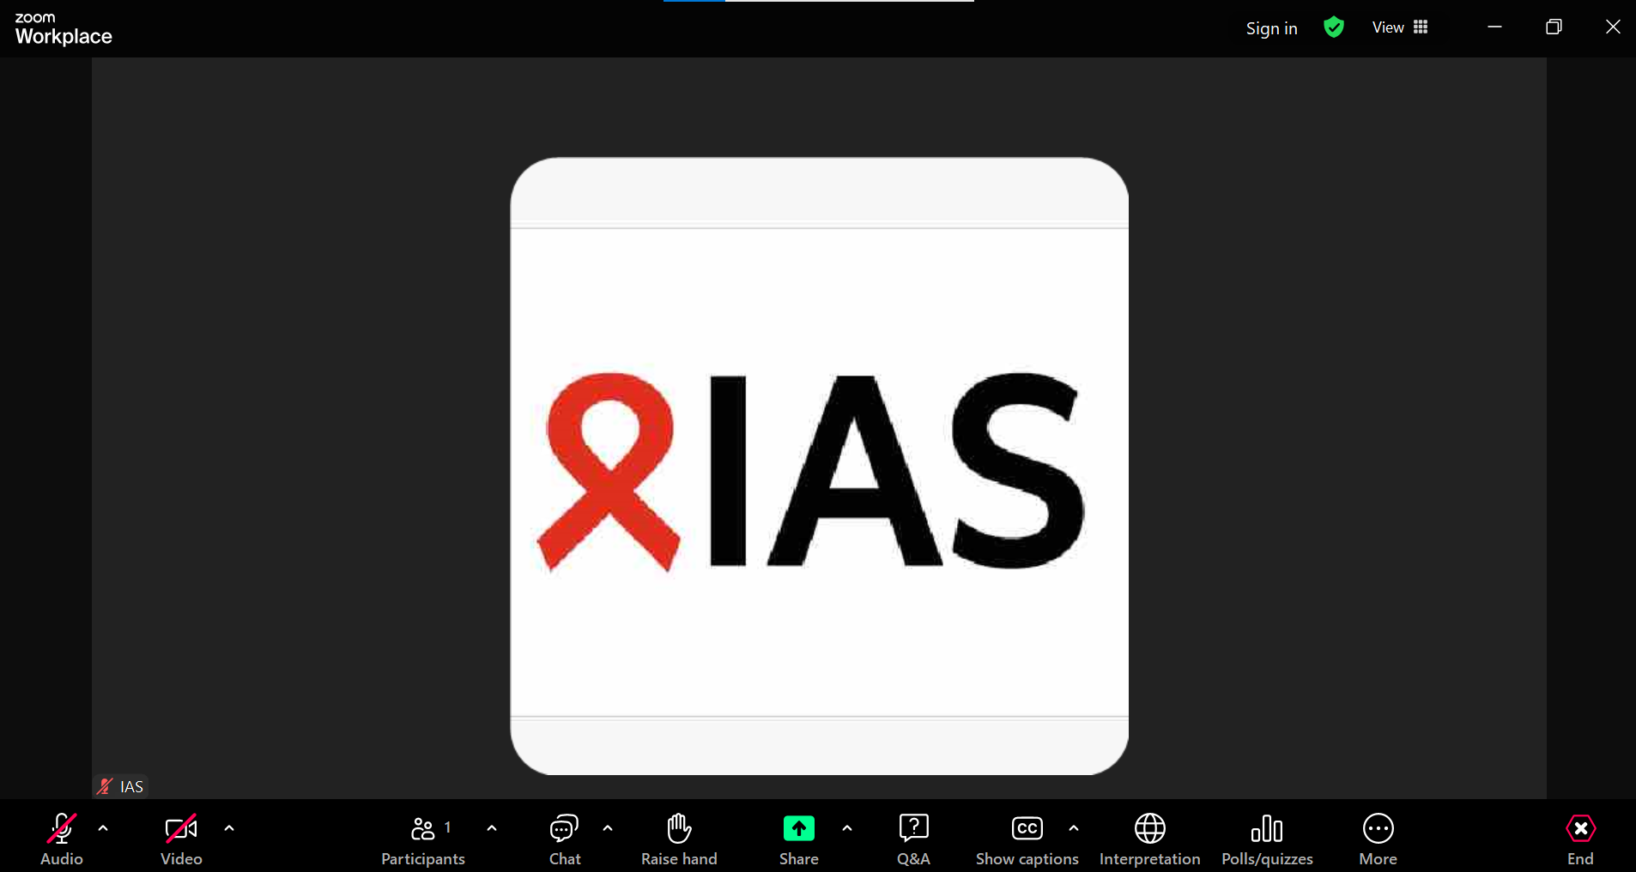
Housekeeping
To introduce yourself and for Zoom-related questions or comments, please use the “Chat” function
For questions to the speakers, please use the “Q&A” function
Enable captions in any language (AI generated)
Choose your preferred language (English, French, or Portuguese) in the Interpretation function
The recording will be available on the IAS+ platform and shared with all registrants

Slide 3

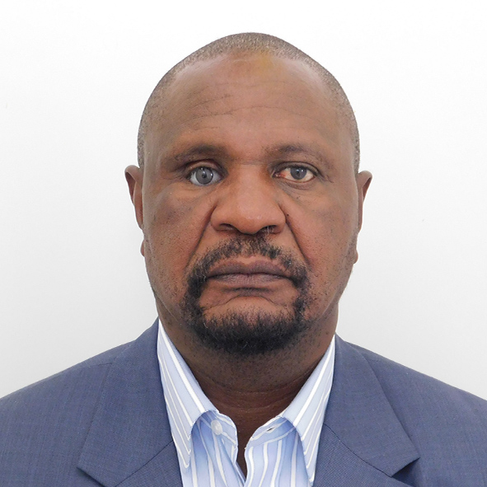



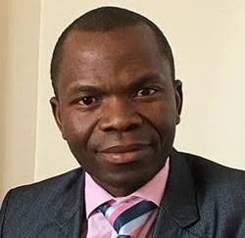

Sustaining HIV prevention in a period of transition
Raymond Yekeye
Operations Director,
Zimbabwe National AIDS
Commission
Vu Thi Hoang Lan
Head, Department of
Epidemiology, Hanoi
University of Public Health,
Vietnam
Beatrice Matanje
CEO, Malawi National
AIDS Commission
Gallican Rwibasira
HIV, STI, Viral Hepatitis and
Other Viral Diseases Control
Manager, Rwanda Biomedical
Institute
Lloyd Mulenga
Director of Infectious Diseases, Zambia Ministry of Health
Nondumiso BQ Ncube
NERCHA National Executive Director, Eswatini
Landry Tsague
Director, Primary Healthcare
Africa CDC

Slide 4
How Zimbabwe's AIDS Levy demonstrates the promise and limits of domestic health financing
Raymond Yekeye​
Operations Director
Zimbabwe National AIDS ​Commission

Slide 5
Situation
Zimbabwe's 1999 AIDS Levy was a direct legislative response to 26% HIV prevalence and volatile donor cycles
With adult HIV prevalence peaking at 26% in the late 1990s and donor flows proving volatile, Zimbabwe took matters into its own hands.
A 3% income tax surcharge; legislated under the Finance Act (Chapter 23:04) funds HIV services directly through a ring-fenced National AIDS Trust Fund, managed by the NAC.
Now in its 25th year, it is one of the most durable domestic HIV financing mechanisms on the continent.
26%
Adult HIV prevalence at peak (late 1990s)
One of the highest rates globally
1999
Year the levy was legislated
Finance Act, Chapter 23:04
3%
Income tax surcharge — individuals, companies & trusts
Rate unchanged since inception
80%
Decline in new infections since 2010 — #1 in Africa
UNAIDS 2024; HIV Epidemic Update 2025
Source: NAC Zimbabwe; Finance Act Chapter 23:04; UNAIDS 2024 estimates; HIV Epidemic Update Sept 2025

Slide 6
Complication
Levy revenues grew 7x since dollarisation reaching US$90M est. in 2026; but contracted in 2023, exposing economic sensitivity
$100M
$90M
$75M
$70M
$50M
2023: economic contraction reduced formal sector tax base
$38.6M
$35M
$32M
$30M
$25M
$22M
$12M
$0M
2009
2012
2014
2016
2019
2023
2025
2026e
25+ years of uninterrupted domestic financing — through hyperinflation, dollarisation and donor shifts
Source: NAC Zimbabwe Annual Reports; NAC.org.zw; PMC / NIH case study (Bhat et al. 2016); PMC12162903

Slide 7
Complication
The levy secures a treatment floor, national autonomy, and funding for the gaps donors systematically neglect
1
Commodity security—50% ring-fenced for ARVs by law
A statutory floor kept ART running through every funding disruption—enabling Zimbabwe to achieve 97/98/96 on the adult cascade ahead of schedule by 2022.
2
A bridge during shocks—and a prerequisite for grants
The levy buffers funding gaps and satisfies Global Fund co-financing requirements, unlocking larger international grants.
3
National autonomy—priorities set by local data, not donors
Government sets its own priorities and coordinates partners from a position of ownership, not dependency.
4
Comprehensive care—funds the gaps donors ignore
Local advocacy, stigma reduction and youth programmes; areas routinely excluded from donor portfolios are covered through this channel.
Source: NAC Zimbabwe; Zimbabwe 95-95-95 Achievement Report (Yekeye); HIV Epidemic Update Sept 2025

Slide 8
Complication
Domestic funds cover only 11–15% of Zimbabwe's HIV budget — external partners still provide the majority
Share of total national HIV budget
Why the gap persists
Scale dependency
The Global Fund and PEPFAR fund over 60% of treatment. The levy is growing — but cannot replicate this volume.
62%
External partners
(Global Fund, PEPFAR)
Economic sensitivity
Collections track the formal job market. A fiscal shock cuts revenue precisely when need rises.
25%
Other / gap
The 50% mandate constrains flexibility
Half of revenue is locked to ARVs. Prevention and emerging needs — including the children's cascade gap — compete for the rest.
Prevention still off track
New infections estimated at 14,600 in 2025 — nearly double the 7,600 target. Children's status knowledge sits at 63% vs the 95% goal.
Source: UNAIDS 2024 estimates; HIV Epidemic Update Sept 2025; PMC12162903; PEPFAR/Global Fund allocation reports

Slide 9
Resolution
The path forward is co-investment: domestic financing anchors the response while partnerships provide the scale
Three shifts define equitable partnership in practice:
01
Co-financing as a catalyst, not a burden
The levy already satisfies Global Fund co-financing requirements. Reframe it as leverage—ownership that unlocks international co-investment.
02
Technical synergy: partners improve the efficiency of domestic spending
Partners contribute data systems and evaluation capacity that stretch the value of every domestically-raised dollar without substituting for ownership.
03
From aid to co-investment; a transition, not a cliff
As revenues grow, external support should shift from direct service funding to specialised technical assistance — preserving sustainability without abrupt withdrawal.
Source: Global Fund co-financing requirements; Lancet HIV & Lancet Global Health Joint Series on Sustainable HIV Prevention in Africa

Slide 10
Conclusion
Domestic financing drove Zimbabwe to #1 in Africa for HIV decline but the last mile requires both anchor and engine
Domestic financing is possible even on a low-income tax base
25+ years and US$30–90M annually prove that political will can create durable, homegrown health financing.
Ring-fenced, legislated funding outperforms project-based aid for stability
The levy cannot be suspended or redirected at year-end. That predictability is structurally more valuable than its headline amount.
11–15% domestic coverage still delivers outsized policy leverage
A minority domestic funder still sets the agenda; convening partners, satisfying co-financing requirements, and defining national priorities.
ZNASP V sets the target: raise domestic financing from 11–15% to 30% by 2030
Zimbabwe's next five-year plan explicitly names domestic resource mobilisation as a priority; the levy's evolution is already planned.
Call to action: Treat domestic financing as the anchor, then build equitable partnerships that transition from direct service funding to technical co-investment.

Slide 11
Thank you
Zimbabwe's AIDS Levy proves that domestic financing for HIV is possible — and that national ownership is the only foundation a resilient response can be built upon.
Raymond Yekeye · Director of Operations, National AIDS Council Zimbabwe · nac.org.zw
#RethinkRebuildRise · #AIDS2026 · #RoadToRio
IAS Road to Rio · Webinar 1: Sustaining HIV Prevention in a Period of Transition · 7 April 2026

Slide 12
Financing for HIV/AIDS in Vietnam:
Integrating HIV into the social health insurance system
Vu Thi Hoang Lan
Head, Department of ​Epidemiology
Hanoi ​University of Public Health,
Vietnam

Slide 13
Presentation outline
To assess key achievements and remaining challenges in transitioning HIV financing into social health insurance
To evaluate the implications of this transition for coverage and financial protection
To draw policy lessons for sustaining HIV responses in transitioning low- and middle-income countries

Slide 14
Why Financing Transition Matters
Vietnam’s HIV response at a turning point
HIV treatment scale-up has relied heavily on international funding
  PEPFAR
  Global Fund
In the past decade:
  Vietnam transitioned to lower-middle income status
  Global funding for HIV/AIDS has declined significantly
Risk:
  Unsustainable reliance on external funding
  Potential disruption of lifelong ART treatment
Transitioning HIV financing into the Social Health Insurance system was essential to sustain treatment, protect patients, and secure national ownership of the HIV response

Slide 15
Policy Response
Decision 2188 (2016): Enabling the transition
Issued by the Prime Minister to:
Transition ART financing from donor programs → SHI (BHYT)
Established key mechanisms:
Centralized national procurement of ARVs
Direct contracting between Vietnam Social Security (VSS) and suppliers
Mandate for provinces to ensure 100% BHYT coverage for PLHIV
Financial support for co-payments through local and social funds
Accompanied by:
MOH circulars (2017–2020)
National implementation guidance

Slide 16
Operationalizing SHI-financed HIV treatment
National level
MOH: policy guidance and procurement framework
VSS: contracting, payment, and reimbursement
Provincial level
Fund Health insurance cards for PLHIV
Support co-payments (poor, vulnerable groups)
Health facilities
Deliver ART services under SHI
Manage dual drug sources during transition
System features
Centralized procurement + decentralized service delivery
Strong coordination across 63 provinces (34 provinces since 12/06/2025)
Implementation relied on strong coordination between central agencies, local governments, and service providers

Slide 17
Coverage Achievements: Rapid expansion of insurance coverage
BHYT coverage among ART patients:
  50% (2016) → 96% (2023)
  Nearly doubled within 7 years
By 2023:
  No province below 90% coverage
  Coverage among PLHIV exceeds general population
Key enabling factors:
  Clear national guidance
  Strong provincial commitment
  Active enrollment support at treatment sites
Vietnam achieved near-universal insurance coverage for PLHIV, a critical foundation for sustainable HIV financing

Slide 18
ART Financing Transition: From donor-funded to SHI-financed ART
March 2019:
  First ARV drugs financed by BHYT delivered nationwide
By mid-2023:
  171,000+ people on ART
  ~88% receiving SHI-financed ARVs
Remaining patients:
  children, special groups, uninsured
  still partially supported by Global Fund
Expansion of ARV package:
  2 drugs (2019) → up to 5–6 drugs (2020–2023)
  aligned with updated national treatment guidelines
Annual SHI spending on ARVs increased sharply:
2019 → 54.9 billion VND
2023 → 378.1 billion VND

Slide 19
Enablers and Barriers to SHI Coverage among People Living with HIV
🏛 Clear policy framework
→ National guidance (Circular 27/2018)
→ Simplified enrollment process
🤝 Strong coordination
→ HIV programs + Social Security
→ Efficient enrollment system
📢 Active enrollment support
→ Counseling at treatment sites
→ Provincial political commitment
👥 Patient engagement
→ Awareness of SHI benefits
→ Household insurance incentives
🚫 Stigma & avoidance
→ ~10% avoid SHI services
→ Fear of disclosure
🪪 Administrative barriers
→ Lack of ID documents
→ Difficult enrollment
⏳ Funding delays
→ Late budget allocation from provincial level
→ Delayed SHI coverage
🔄 Interrupted coverage
→ Job loss / informal work
→ Difficulty maintaining SHI

Slide 20
Catastrophic payment (Over 40% of total expenditure): 2 rounds of national OOPE

Slide 21
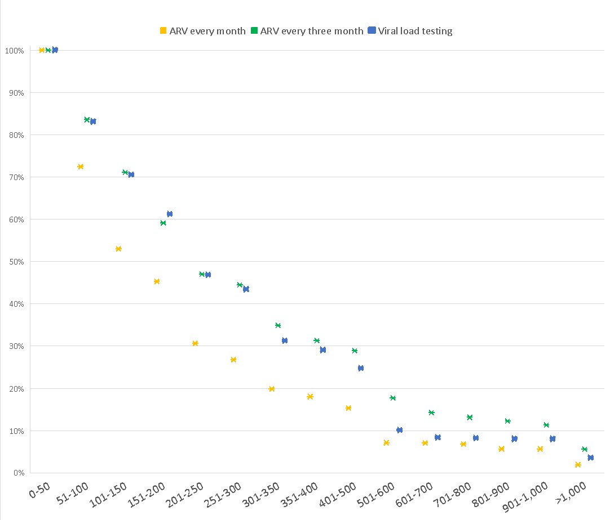
Willingness to pay
80.53% preferred MMD
79.88% willing to co-pay for getting ARV every month
88.27% willing to co-pay for getting ARVs every three month
87.90% willing to co-pay for viral load test every year
Cumulative percentage of respondents willing to pay for ARV-related services (among non-zero WTP responses)

Slide 22
Co-payment Support for ARV: What Works and What Challenges
💰 Local budget commitment
→ Provinces allocate annual funding for co-payment support
📋 Clear payment procedures
→ Standardized guidelines and forms
→ Easier aggregation and reimbursement
🌍 International support
→ Technical + financial support from donors
→ Helped address early implementation gaps
🤝 Strong coordination
→ MOH + Social Security + provinces
→ Improved payment and reporting systems
💻 System adaptation
→ Insurance software updated
→ Enables tracking of co-payment costs
⚙️ Initial system limitations
→ Lack of cost management systems at facilities
→ Difficulty separating co-payment costs
⏳ Delayed reimbursement
→ Slow verification of claims
→ Mismatch with fiscal year deadlines
📊 Complex payment processes
→ Multiple drug sources (central procurement vs negotiated drugs)
→ Different co-payment mechanisms
📉 Declining donor support
→ Increasing burden on patients

Slide 23
Policy Recommendations for Sustaining HIV Financing
⚙️ Reform procurement and payment mechanisms
→ Move away from centralized payment model
→ Allow health facilities to contract and pay suppliers directly
📦 Increase flexibility in ARV procurement
→ Reduce delays and supply disruptions
→ Improve responsiveness to real-world demand
Maintain universal SHI coverage for PLHIV
→ Continue policy requiring provinces to fund BHYT cards
→ Ensure 100% coverage
💰 Expand co-payment support
→ Cover both:
centrally procured ARVs
price-negotiated ARVs
→ Maintain financial protection for vulnerable groups

Slide 24
Panel discussion
Raymond Yekeye
Operations Director,
Zimbabwe National AIDS
Commission
Vu Thi Hoang Lan
Head, Department of
Epidemiology, Hanoi
University of Public Health,
Vietnam
Beatrice Matanje
CEO, Malawi National
AIDS Commission
Gallican Rwibasira
HIV, STI, Viral Hepatitis and
Other Viral Diseases Control
Manager, Rwanda Biomedical
Institute
Nondumiso BQ Ncube
NERCHA National Executive Director, Eswatini
Landry Tsague
Director, Primary Healthcare
Africa CDC
Lloyd Mulenga
Director of Infectious Diseases, Zambia Ministry of Health

Slide 25
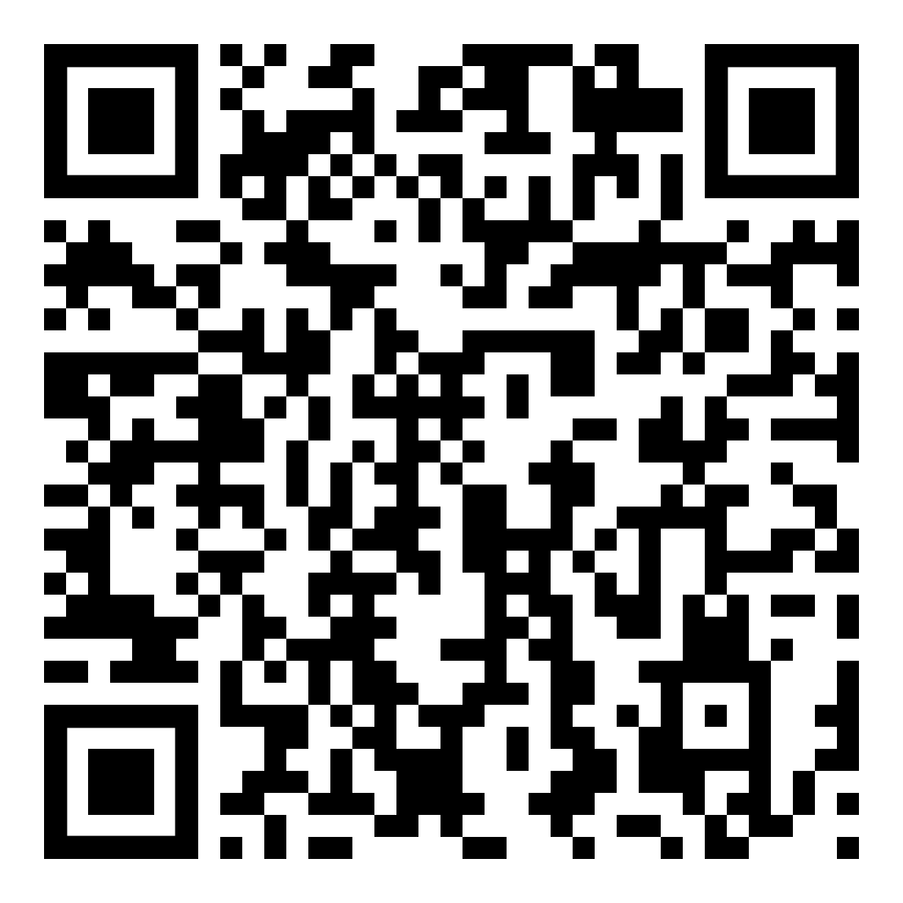
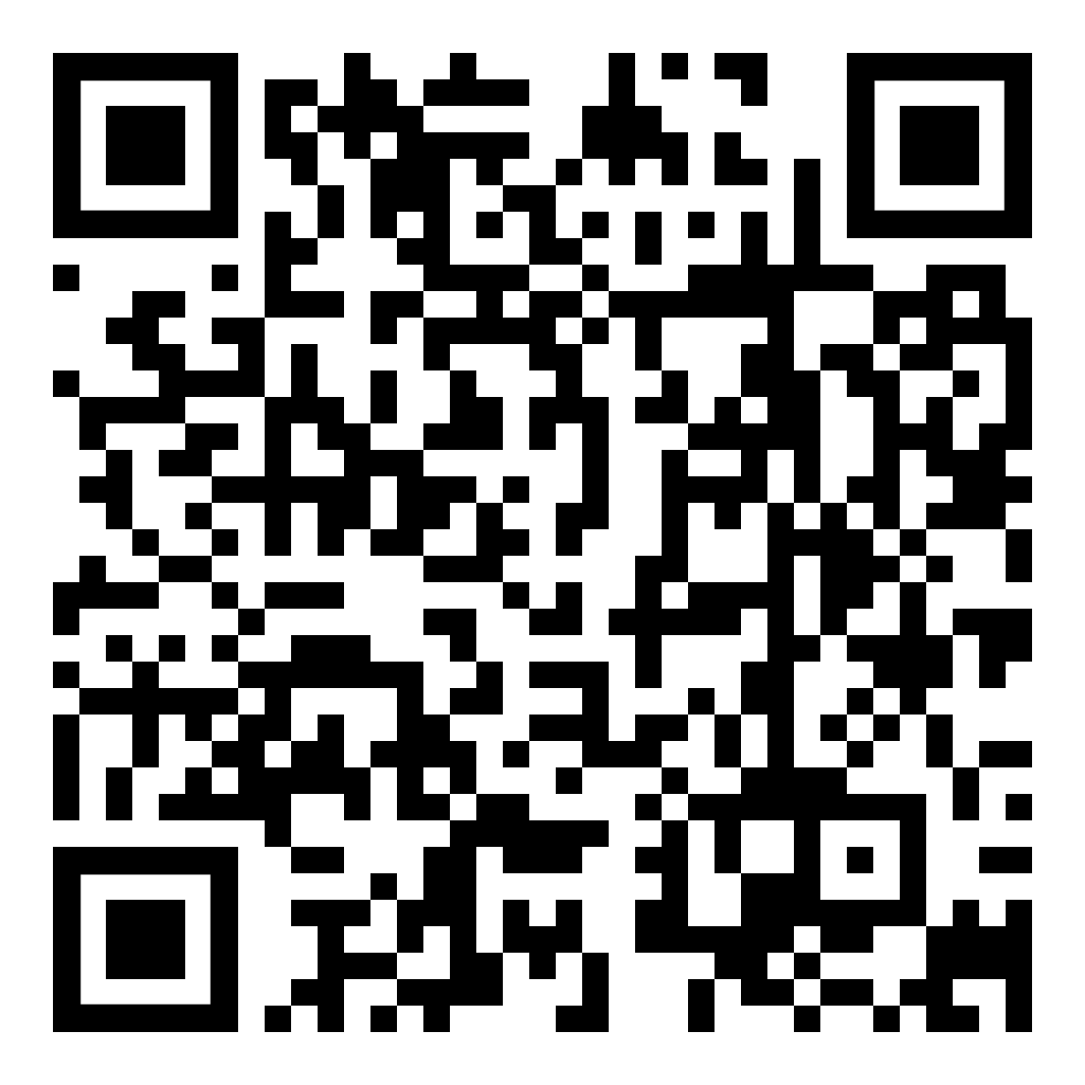
Upcoming webinars
Beyond the hype: What AI really means for the HIV response – Tuesday 14 April (17:00 – 18:30 CEST)
Using digital tools to launch and scale new HIV prevention products – Wednesday 6 May (15:00 – 16:30 Central African Time)

