Slide 1








Welcome! This webinar will start soon.
Leveraging digital tools to support effective introduction and scale-up of HIV prevention products
Join the online conversation around this webinar by using #Rethink. Rebuild. Rise
@iasociety
/iasociety
@iasociety
@iasociety.bsky.social

Slide 2
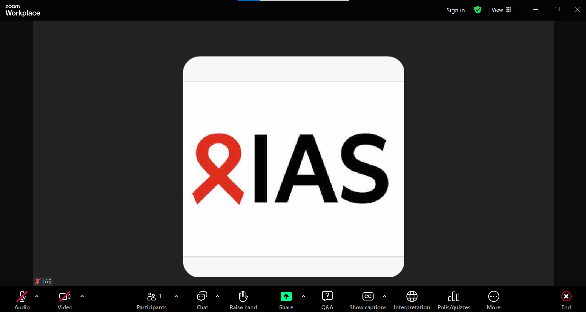
Housekeeping
To introduce yourself and for Zoom-related questions or comments, please use the “Chat” function
For questions to the speakers, please use the “Q&A” function
Enable captions in any language (AI generated)
Choose your preferred language (English, French, or Portuguese) in the Interpretation function
The recording will be available on the IAS+ platform and shared with all registrants

Slide 3




Sustainable HIV Prevention in Africa Lancet HIV and Lancet Global Health Joint Series
Paper 1: Global HIV prevention is not on track: how a health systems approach can promote sustainable progress in African countries
Paper 2: Advancing functional and systemic integration of HIV prevention into public health systems
Paper 3: The role of digital health and artificial intelligence in improving the reach and effectiveness of HIV prevention in Africa
Paper 4: Enhancing HIV prevention through systematic community engagement, learning, and response
Paper 5: Strengthening nationally led approaches to new product introduction for HIV prevention
Paper 6: Future directions: ending HIV in Africa—a call to action for sustainable and nationally led prevention
→
→
To learn more about The Lancet Global Health and The Lancet HIV Joint Series on Sustainable HIV Prevention in Africa
To learn more about the Sustainable HIV Prevention Initiative

Slide 4









Leveraging digital tools for effective introduction and scale-up of HIV prevention products
Charles Holmes
Georgetown University Center for Innovation in Global Health, USA
Hidayat Yahaya
Community Prevention and Care Services, National Agency for the Control of AIDS, Nigeria
Long Tran Khanh
MEL Team Lead,
PATH Vietnam
Lloyd Mulenga
Director of Infectious Diseases, Ministry of Health Zambia
Beatriz Grinsztejn
Director, HIV/AIDS Clinical Research Laboratory, Fiocruz, Brazil and IAS President
Betha Igbinosun
Georgetown University Center for Innovation in Global Health, USA
Jirair Ratevosian
Duke Global Health Institute
USA
Solomon Simba
Digital Development Lead, Health Systems Information Programme, Ministry of Health, Kenya
Hasina Subedar
Senior Technical Advisor Prevention, National Department of Health, South Africa

Slide 5
A case study of Nigeria’s HIV data ecosystem and Youthful Alive and Healthy (YAaHNAIJA) initiative
Hidayat Yahaya​
Community Prevention and Care Services, National Agency for the Control of AIDS
Nigeria

Slide 6



LEVERAGING DIGITAL TOOLS
TO SUPPORT EFFECTIVE INTRODUCTION AND SCALE-UP OF NEW HIV PRODUCTS
A CASE STUDY OF NIGERIA HIV AND AIDS DATA ECOSYSTEM AND YOUTHFUL ALIVE AND HEALTHY (YAaHNAIJA) INITIATIVE

Slide 7


INTRODUCTION - HIV/AIDS DATA ECOSYSTEM
Nigeria’s HIV/AIDS data ecosystem is a coordinated, multi-level architecture led by the National Agency for the Control of AIDS (NACA). It integrates routine service data, community-generated data, commodity and supply chain information, surveillance and digital reporting platforms to support evidence-based decision-making across the national response.
The ecosystem enables program monitoring, strategic planning, resource optimization and real-time feedback for adaptive implementation while also providing a critical platform for introducing and scaling new HIV prevention technologies through improved readiness assessment, uptake monitoring and data-driven decisions.

Slide 8
FUNCTIONS OF THE DATA ECOSYSTEM
HIV/AIDS Data Ecosystem
Participating Entities
Data Configuration
Data Exchange
User Access Management
Entities that participate in health data exchange
Profile various entities across the business line on a periodic basis
1-way or 2-way transfer of health information between systems
Secure and efficient access management
Rule Engine
Alert Generation
Dashboard & Advanced Analytics
Rule creation for important events that need to be monitored
Generate alerts on important events across multiple dashboards
Publish dashboards and reports for monitoring & evaluation. ML models for forecasting and prediction

Slide 9
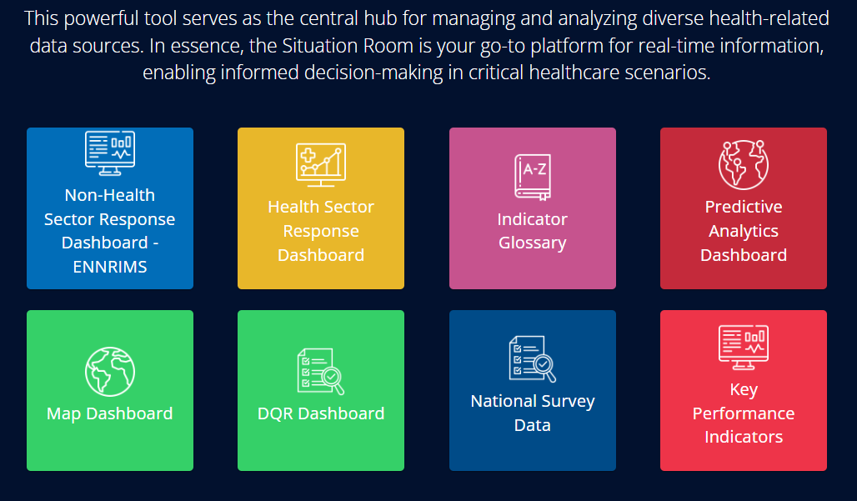
DATA ECOSYSTEM DASHBOARD
Ensure smooth data exchange between diverse health systems using HAPI FHIR for standardization and compatibility.
Serve as a central hub for managing data exchange protocols, supporting real-time, online, and batch data transfer.
Enable simple setup and configuration of data exchange protocols with customizable mapping between source systems and FHIR standards.
Ensure the secure transmission of health information, complying with strict data privacy and security standards.

Slide 10
ACHIEVEMENTS
LESSONS LEARNED
Enhanced availability and clarity of evidence to support informed decision making
Data Collection Alone Is Not Enough; Use of Data in decision making Matters
Digital Innovation Strengthens Demand-Side Intelligence
Strengthened Coordination and Governance
Enhanced program targeting and differentiated service delivery
Integrated Data Ecosystems Work Better than Siloed Systems
Enhanced Commodity and Service Monitoring
Data Improves Product Introduction Readiness
Increased Community and Youth Voice in Data Use
Data Quality and Interoperability Remain Ongoing Priorities
Amplified community and youth engagement in data use
Data system linked with NDR, eNNRIMS, NHMIS. Linkage of NDARS, NHLMIS, GBV dashboard is ongoing.
Governance and Coordination Are as Important as Technology
Situation rooms set up in 6 states
Community Data Is Critical

Slide 11



YOUTHFUL ALIVE AND HEALTHY (YAaH) NAIJA
Launched in 2022 , formerly referred to as ‘U Test’ is an innovative HIV prevention intervention for Adolescents and Young People (AYP) aged 15 – 24 years.
The intervention aims to create awareness and scale up the uptake of two (2) high-impact HIV prevention tools – HIVST and PrEP amongst AYP in Nigeria.
The intervention is a flagship national AYP HIV intervention owned and driven by the government and AYP, supported by partners.
It has been integrated into existing service provision structures/programs that are already providing HIV prevention services for AYP or have the potential to do so.

Slide 12
PROCESSES AND DESIGN
Stage 1
Stage 2
Stage 3
Co-creation workshop (Stakeholders workshop) obtain additional refinement for key components and information gaps required to develop a final draft of a program design. This session birthed the thematic areas of the YAaHNaija intervention;
Consultative/Initial brainstorming workshop to identify additional stakeholders to engage with, obtain information and identify intervention areas that require further deep dives and refining.
Stakeholders meeting to obtain specific deep dives required for further refinement of specific components as the interventions were being implemented.
  Coordination,
  Communication,
  Community Service Provision,
  Digitization,
  Meaningful Youth Engagement (MAYE) and
  Monitoring, Evaluation, and Strategic Knowledge Management.

Slide 13
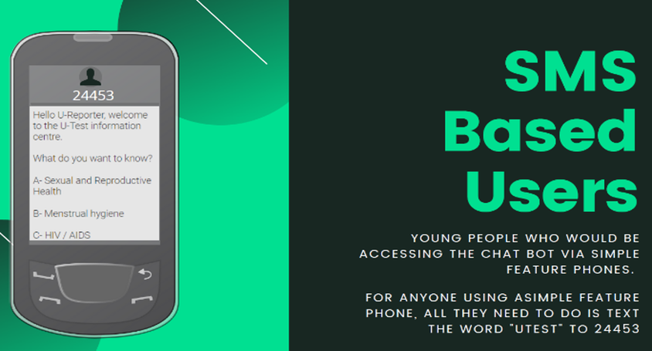
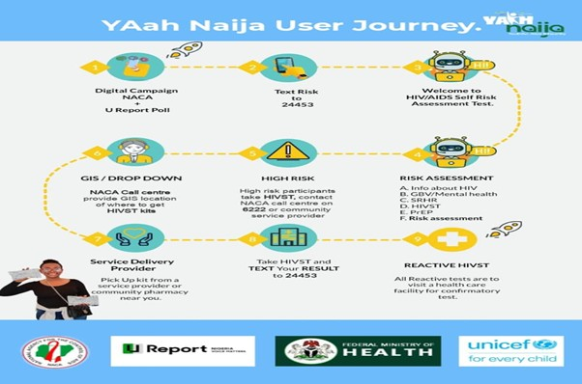

The YAaHNaija ‘User Journey’ has been designed to use these digital tools to access services.
AYPs start the journey when they come in contact with a message on the social media platforms, the U Report platform. When AYPs join U Report by sending ‘join’ to the U Report number ‘24453’, they engage a chat bot which has been designed to provide information on – HIV, GBV/mental health, SRH, HIVST and PrEP.

Slide 14

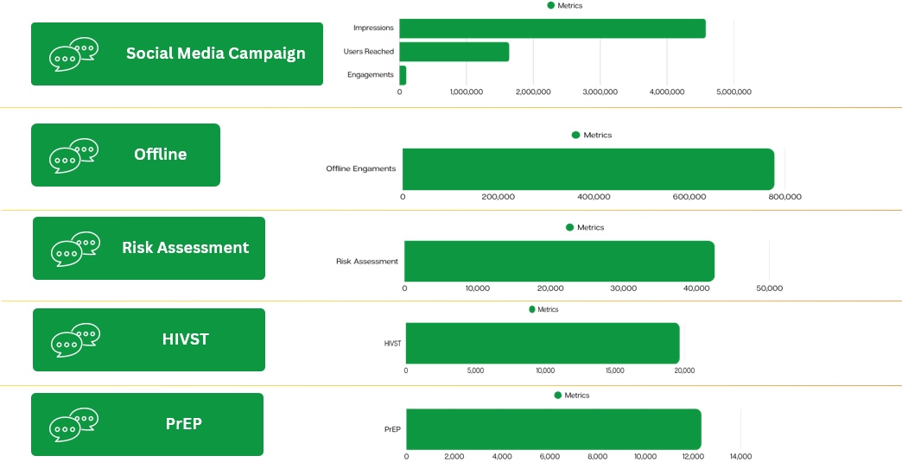
SERVICE COVERAGE/ACHIEVEMENTS
HIV Self-Testing and Pre-Exposure Prophylaxis (PrEP) with integration of HPV and other SRH Services
Anambra, Lagos, and Rivers were selected as pilot states in which UNICEF supported the State Agency for Control of AIDS (SACA)
Scale-up in FCT, Cross River, Ogun, Bauchi, Enugu, Kaduna, Kano and Osun states with SRH services integration
YAaHNaija Webinar
Community Outreach
Capacity strengthening
Commodities and Supplies

Slide 15
LESSONS LEARNED
Leveraging Geographic Information System (GIS) mapping enhances the planning and delivery of facility and community based services
Leveraging Geographic Information System (GIS) mapping enhances the planning and delivery of facility and community based services
Conducting a risk assessment poll enables early identification of vulnerabilities and supports targeted and differentiated interventions of young people
Monitoring, evaluation and strategic knowledge management
YAaHNaija social media campaign-this helped expand reach and engagement with young people

Slide 16
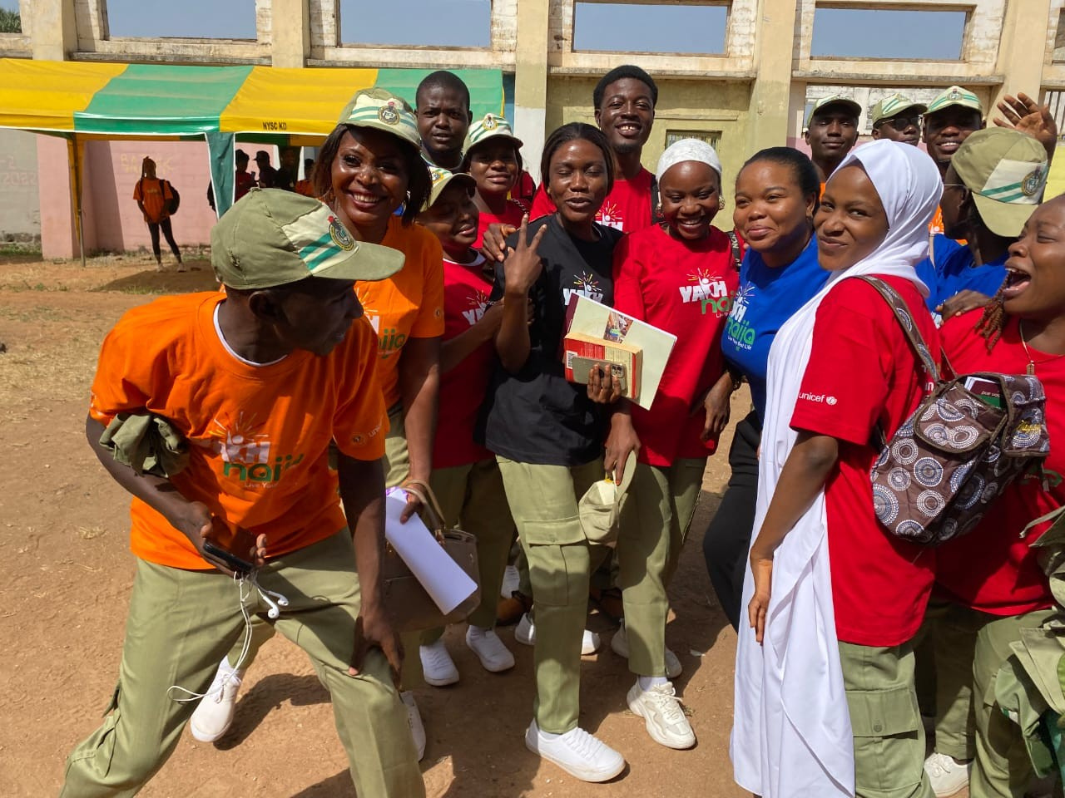
THANK YOU

Slide 17

CONTACT US
Hidayat Yahaya
Community Prevention and Care Services, NACA-Nigeria
byahaya@naca.gov.ng
www.naca.gov.ng
www.naca.gov.ng/yaahnaija/

Slide 18
Leveraging digital tools to expand access to PrEP services in Vietnam
Long Tran Khanh
MEL Team Lead
PATH Vietnam

Slide 19

PATH/Gabe Bienczycki
May 6, 2026
Leveraging digital tools to expand PrEP services in Vietnam
Tham Tran and Long Tran, PATH

Slide 20
A Digital-First Approach Accelerated the Evolution of Vietnam’s PrEP Program
MOH approved PrEP pilots
National PrEP launched
First PrEP guidelines
approved
PrEP services are now available across all 34 provinces nationwide.
National PrEP plan approved
HMED-PrEP launching
12/2016
6/2017
12/2017
11/2018
2016
2017
2018
2019
2020
2021 - 2026
3/2016
9/2016
3/2017
10/ 2017
5/2018
Expanded PrEP coverage in 28 provinces in Vietnam
TelePrEP integrated into HMED-PrEP in 2022
PrEP study tour to BKK (MOH, CBOs, private clinics)
PrEP first distributed in HCMC (PATH/HM)
PrEP study (n=200) in HCMC (VinaPrEP, UNAIDS)
PrEP available in 11 provinces
National Technical Workshop on PrEP and dialogue with CBOs
Digital solutions drive awareness, expand reach to key populations, and connect clients to PrEP services

Slide 21
Digital as a Strategic Enabler for Scaling Up PrEP Services
Low community awareness about PrEP and related PrEP services
Over 89% of MSM own a smartphone
Difficulty reaching key populations due to stigma and discrimination
98% use social media (80% on Facebook)
Weak data systems for monitoring, decision-making, and advocacy
98% use social media (80% on Facebook)
Limited availability and access to HIV/PrEP services for key populations
74% said they sought their sex partners online
Strong need for a national digital data system to enhance monitoring and program management

Slide 22

















Expanding Reach Through Diverse Digital Communication Channels
Approximately 50% of PrEP clients at private community clinics are reached through online channels
Public & Private clinics
Increase Use
Raise Awareness
CBOs
Social channels
HIV, PrEP, nPEP, STI, ART, HCV, TB testing
OCAs & peer influencers
App for LGBTQI+
Create Trust
Other social platforms
Chatbot
Events

Slide 23
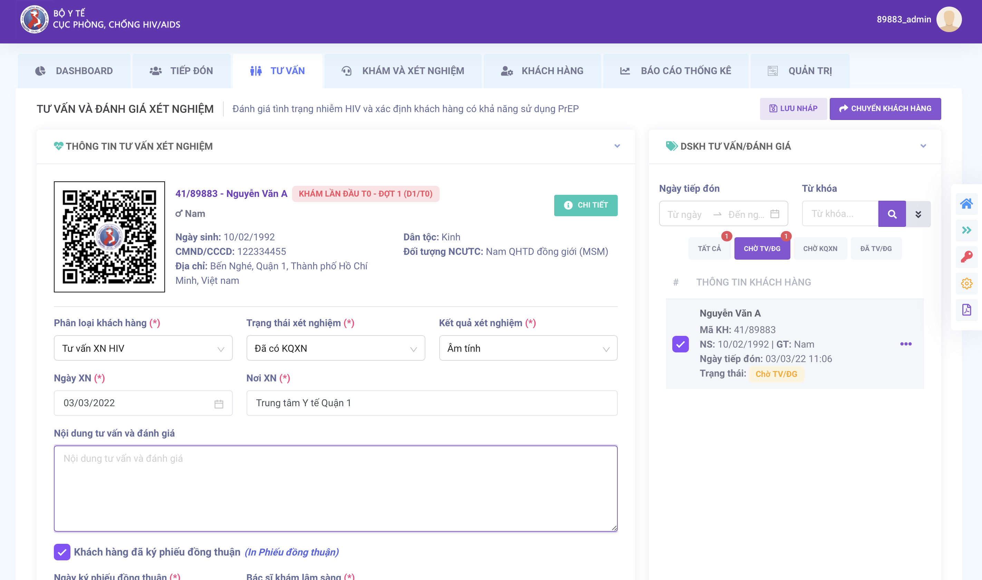
HMED-PrEP: A National System for PrEP Program Management
A secure, centralized EMR system serving as the backbone of Vietnam’s national PrEP program
Captures and manages real-time clinical and demographic data from HIV testing to PrEP initiation, adherence, and follow-up
Strengthens client management through referrals, appointment reminders, and tools to support retention and continuity of care
HMED-PrEP is adopted and managed by the Vietnam Ministry of Health and implemented across all public and private PrEP clinics, currently supporting over 71,000 clients nationwide.
Supports national program management with drug forecasting, inventory tracking, and comprehensive reporting for monitoring and decision-making

Slide 24

Current Structure of Vietnam’s HIV/AIDS Health Information System
HMED
01
ARV management
02
PrEP Management
Latent TB
management
Hepatitis management
04
03

Slide 25
Key Lessons Learned
Strong Ministry of Health leadership and ownership are fundamental to sustainability and national scale.
Embedding digital solutions within national systems accelerates institutionalization and long-term impact.
Digital platforms are critical enablers to overcome barriers across the HIV cascade—from testing to retention.
Strengthening community capacity to leverage digital channels—combined with community-led and peer-driven approaches—is critical to generate demand, build trust, and sustain service uptake at scale.

Slide 26
Zambia’s accelerated regulatory approval and health system readiness for CAB - LA and LEN introduction
Lloyd Mulenga
Director of Infectious Diseases
Ministry of Health, Zambia

Slide 27

Accelerated Regulatory Approval
& Health System Readiness for CAB-LA and LEN Introduction
Prof Lloyd Mulenga

Slide 28
BACKGROUND & CONTEXT
Estimated Annual New HIV Infections vs 2026 & 2030 Targets
While Zambia has achieved the 95-95-95 targets overall, children and adolescents continue to fall short of these milestones.
Progress required to reach the national 2026 & 2030 (<10% of 2010 estimated infections) target
30,000 new infections outpace 16,000 AIDS related deaths annually. Incidence-to-mortality ratio: 1.87 (epidemic not controlled)
Why Long-Acting Injectables (LAIs) for HIV Prevention?
Daily oral PrEP adherence remains a barrier — LAIs offer dosing every 2–6 months
CAB-LA (Cabotegravir) and LEN (Lenacapavir) show >99% efficacy in Phase III trials
Zambia prioritizes key populations: AGYW, sex workers, MSM, serodiscordant couples
WHO prequalification and accelerated national pathways now enable rapid introduction
Sources: UNAIDS, AIDSinfo, Link & Zambia 2022-2026 National Health Strategic Plan
Notes:
Zambia needs prevention options that people can stick with. If long-acting dosing is a key driver of the higher persistence seen with CAB-LA, then LEN’s 6-monthly schedule could further reduce visit burden, especially for mobile AGYW and KP

Slide 29
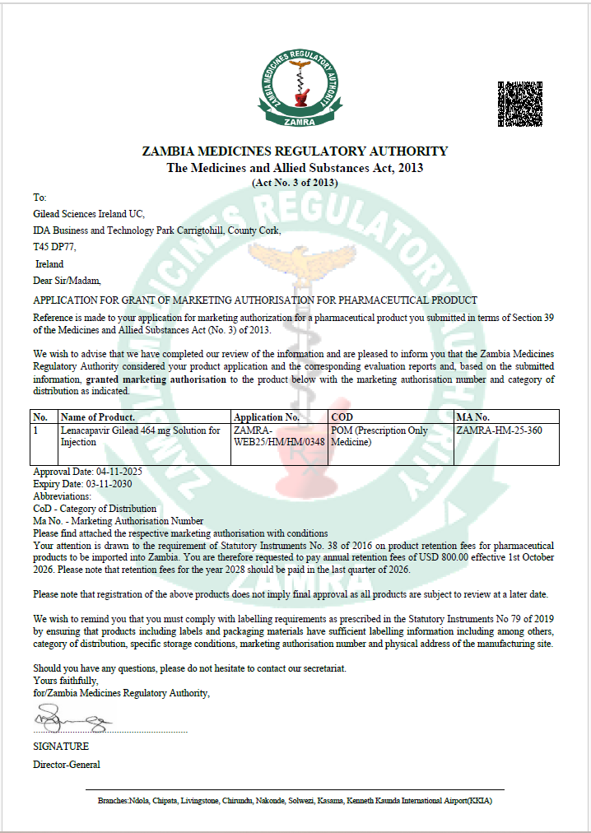
ZAMBIA REGULATORY PATHWAY — ZAMRA ACCELERATED APPROVAL
Step 1
Step 2
Step 3
Step 4
Step 5
WHO Prequalification
Reliance
SRA Recognition
(FDA/EMA)
ZAMRA Technical
Review
Ministerial
Approval
Market
Authorization
ZAMRA leverages WHO PQ dossier under the Collaborative Registration Procedure (CRP)
Data from Stringent Regulatory Authority used to fast-track national dossier review
National review focuses on local relevance: safety, cold chain, local trial data
MoH approval aligned with National HIV Strategic Plan and public health urgency
Product registered on national formulary; procurement and tender initiated
Zambia Approval Milestones
2021
CAB-LA Phase III results published (HPTN 083/084)
2022
WHO Strategic Advisory Group endorses CAB-LA for PrEP
2023
Zambia MoH CAB-LA Working Group established; pilot sites identified
2024
ZAMRA grants accelerated registration for CAB-LA; national formulary listing
2025
LEN dossier submitted to ZAMRA; WHO PQ review ongoing
2026
Target: LEN market authorization & national rollout commencement
Notes:
Zambia needs prevention options that people can stick with. If long-acting dosing is a key driver of the higher persistence seen with CAB-LA, then LEN’s 6-monthly schedule could further reduce visit burden, especially for mobile AGYW and KP

Slide 30



HEALTH SYSTEM READINESS
SUPPLY CHAIN MANAGEMENT
DELIVERY PLATFORMS
Cold chain mapping across 57 sites completed
ZAMMSA central warehouse readiness verified
Quantification: 40,000 client-years Y1 target
Waste management protocols in place
57 pilot sites across 4 provinces (Lusaka, CB, Southern, Eastern)
Integration into HIV testing & PrEP clinics
Mobile outreach for AGYW & key pops
Dedicated injection-trained nurses
MONITORING, EVALUATION, & LEARNING
CAPACITY BUILDING
800+ HCWs trained in LAI administration
Competency-based training modules
Supervision & mentorship systems
Community health worker linkage protocols
SmartCare EMR integration for LAI tracking
Quarterly client follow-up dashboards
Pharmacovigilance reporting to ZAMRA
Real-time stock visibility via eLMIS

Slide 31
DEMAND CREATION & COMMUNITY ENGAGEMENT
Demand Creation Strategies
Priority Populations for LAIs
Community dialogues via CBOs & faith-based organizations
AGYW peer navigator model — 1,200 navigators trained
SMS/WhatsApp client recall systems for 2-month/6-month doses
Male partner engagement & couples counseling integration
Social media campaign targeting 15–24 age group
Adolescent Girls & Young Women (AGYW)
38%
Female Sex Workers (FSW)
24%
Serodiscordant Couples
18%
Men Who Have Sex with Men (MSM)
12%
People Who Inject Drugs (PWID)
Known Barriers & Mitigations
8%
Stigma: Confidential injection services & community champions
Access: Mobile outreach & extended hours in urban clinics

Slide 32
FINANCING, PROCUREMENT & PRICE LANDSCAPE
Funding Architecture
Global Negotiated Price Points (Per Patient/Year)
PEPFAR / USAID
Product
List Price
LMIC Tier
Zambia Target
52%
Global Fund
CAB-LA
~$22,200
~$270
$120–180
28%
LEN (Gilead)
~$42,250
~$400
TBD 2025
Government of Zambia
12%
LEN (Generic)
N/A
~$40–100
<$100
UNITAID / Others
Key Procurement Actions
8%
Pooled procurement via PEPFAR SCMS and Global Fund PSM
Voluntary licensing agreements with generic manufacturers (Viatris, Cipla)
ZAMMSA strategic stockpile: 6-month buffer target established
Annual quantification & forecasting with CHAI & GHSC-PSM

Slide 33
CHALLENGES & RISK MITIGATION
Risk
Level
Mitigation Strategy
Supply chain disruption
6-month strategic reserve; dual-supplier contracts; ZAMMSA integration
High
Cold chain failure in rural areas
Solar refrigeration at 40 rural sites; real-time temperature monitoring
High
Low demand due to stigma
Community champion model; confidential service delivery at 100% of sites
Medium
HCW turnover / skill gap
Task-sharing to nurses; refresher training integrated into CPD system
Medium
Funding gap post-PEPFAR transition
GRZ cost-sharing MOU; Global Fund co-financing negotiation underway
Medium
LEN regulatory delay
Parallel WHO PQ and ZAMRA dossier submission; SRA reliance pathway
Low

Slide 34
Early experiences of LEN implementation in Brazil
Beatriz Grinsztejn
Director, HIV/AIDS Clinical Research Laboratory Fiocruz, Brazil
IAS President

Slide 35
Leveraging digital tools to support effective introduction and scale-up of new HIV prevention products | 2026
LEN implementation
in Brazil:
Early experiences of the ImPrEP LEN study
Beatriz Grinsztejn, MD, PhD
Instituto Nacional de Infectologia Evandro Chagas
Fundação Oswaldo Cruz - FIOCRUZ

Slide 36
ImPrEP LEN Brasil
Expanding PrEP options among young MSM, transgender and non-binary persons in Brazil: incorporating twice-yearly lenacapavir for HIV prevention
GOAL
To evaluate the feasibility of implementing LEN for HIV prevention in real-world settings within the Brazilian Public Health System to generate critical evidence to inform national policies and program implementers.
PRIMARY OBJECTIVE
Assess LEN persistence among study participants in a context where they exercise choice of their PrEP methods.

Slide 37
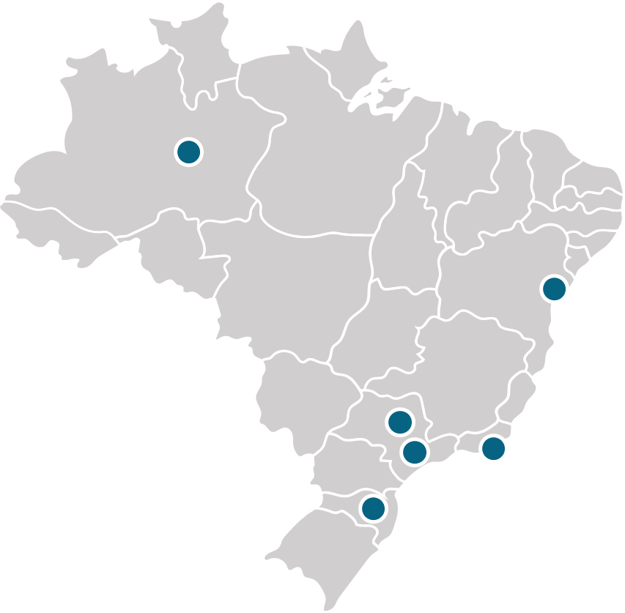

ImPrEP LEN Brasil: Study population & Location
Study Population
Cisgender MSM, non-binary assigned as male at birth, or transgender persons with a negative HIV test result
Aged 16-30 years
PrEP naïve or PrEP-experienced remaining under vulnerability
Seeking PrEP or HIV testing spontaneously or through peer invitation
Location
9 Public PrEP services in 7 Brazilian cities
(Campinas, Florianopolis, Manaus, Salvador, São Paulo, Nova Iguaçu and Rio de Janeiro)

Slide 38
Engagement strategy evaluation
Pre-period 1: Current service model
Period 1: Invitation-based engagement
(prior to LEN inclusion)
Oral PrEP
Oral PrEP
Open-door
Network-based approach
X
Open-door
Post-period 2: Invitation-based engagement
(after enrollment in LEN)
Period 2: Invitation-based engagement
(during LEN enrollment)
Oral PrEP
Oral PrEP and injectable LEN
Network-based approach
X
Open-door
Network-based approach
X
Open-door

Slide 39
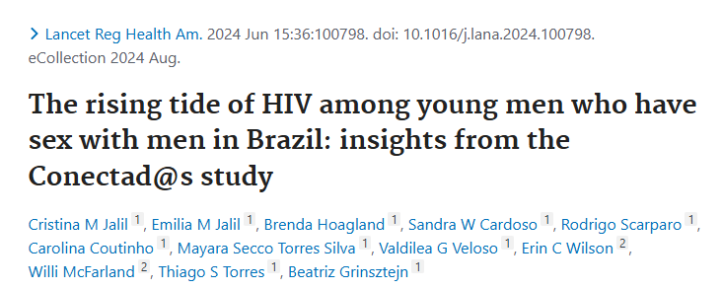
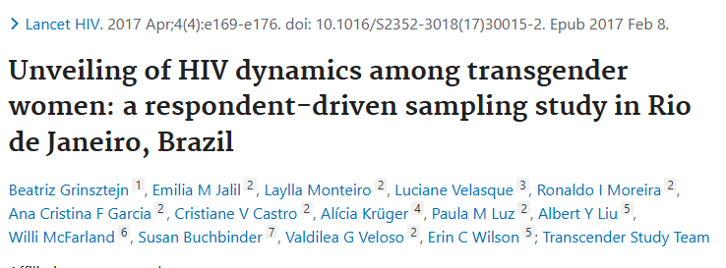
Engagement strategy evaluation
Methods for reaching hidden and/or hard-to-reach populations
Time-location sampling (TLS)
Respondent-driven samplig (RDS)
Startfish sampling
Black
70%
Black
75%
Adapting strategies for the real-life context:
Implementation in Public Health (SUS)

Slide 40









Engagement strategy

Slide 41


Engagement strategy
Approach and data collection from all individuals who seek the service
Information from 100% of individuals who present to the service:
Age
Gender identity
Race/Color
Education
Reason for visit
How they arrived at the site (e.g., did they receive an invitation?)
SUS
Individuals with a selected profile (with approval/oversight from the Coordination team) will receive invitations to distribute among peers

Slide 42
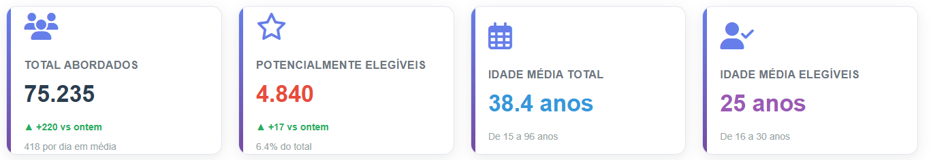
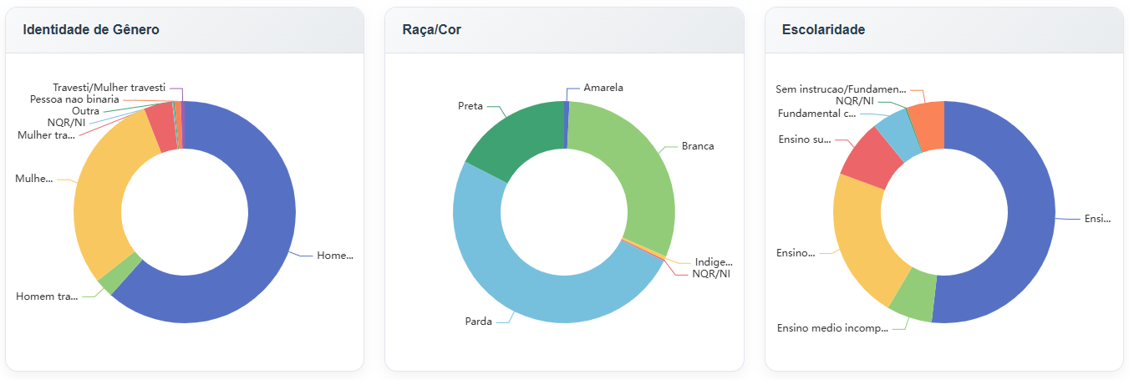
Engagement strategy monitoring
Dashboard for monitoring user flow at the service, including individuals presenting to the site through invitations, those potentially eligible, enrolments, and PrEP modality choice

Slide 43
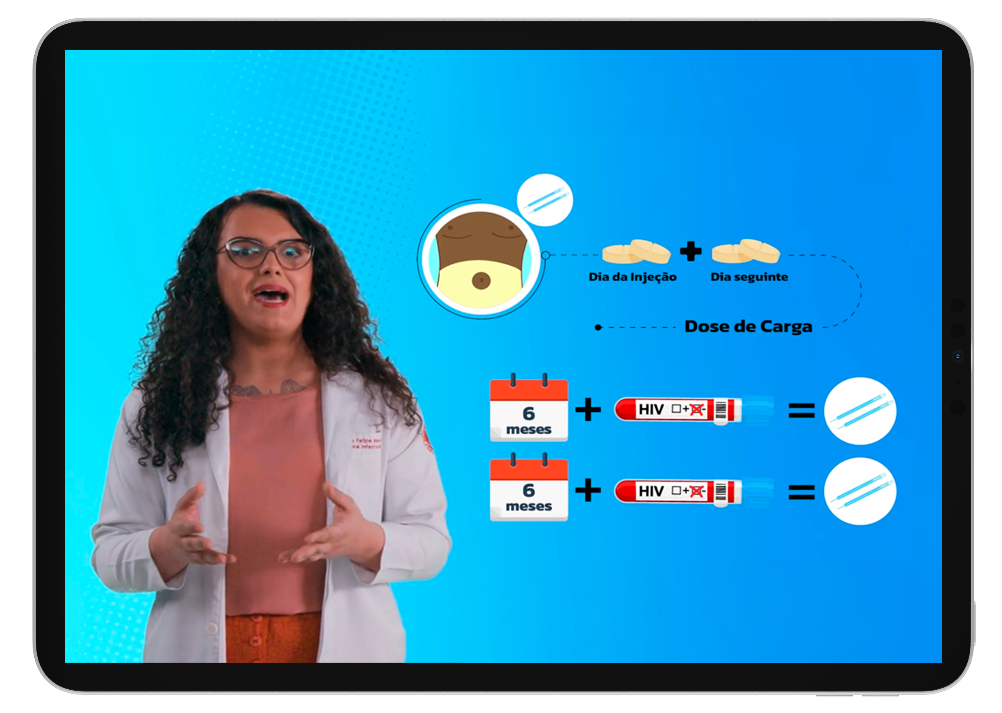


The mHealth intervention
Developed collaboratively for ImPrEP CAB Brasil, with input from young MSM, transgender individuals, and health professionals
Comprised five short videos with 17 minutes of content in total.
Videos covered: oral and injectable PrEP, and other HIV and STI prevention strategies
People (including physicians) featured in the videos were SGM individuals
Used at enrollment, when participants independently accessed the content on a tablet before choosing their PrEP option
Adapted and used in ImPrEP LEN for PrEP choice and support

Slide 44








Intervention package
Pharmacists generate reports to support outreach to ppts with delayed injections
Study team contacts participants to reschedule
LEN injections dispensed
Brazilian ARV Logistic System that records every ARV dispensation nationwide
Schedule feature integrated into the system to calculate the ideal window for the next injections
The system will automatically generate and send WhatsApp reminders
Last registered injections

Slide 45





Intervention package
Loading dose
Report of drug leakage
Ppts with the indication of loading dose of oral LEN 600mg (enrollment and reloads)
Ppts with the indication of loading dose of oral LEN*
(enrollment and reloads)
Ppts with the indication of loading dose of oral LEN 600mg (enrollment and reloads)
Assessment of ppt reporting drug leakage
Short survey to assess intake of the second oral loading dose
WhatsApp reminders
Short survey to assess intake of the second oral dose and eventual side events
WhatsApp reminders
Short survey to assess intake of the second oral dose and eventual side events
Short survey to assess drug leakage
Study team contact ppt to investigate what happened
WhatsApp reminders
*Loading dose of oral LEN:
First dose (same day as initial injections): 2 tablets of 300 mg each
Second dose (24 hours later): 2 tablets of 300 mg each

Slide 46
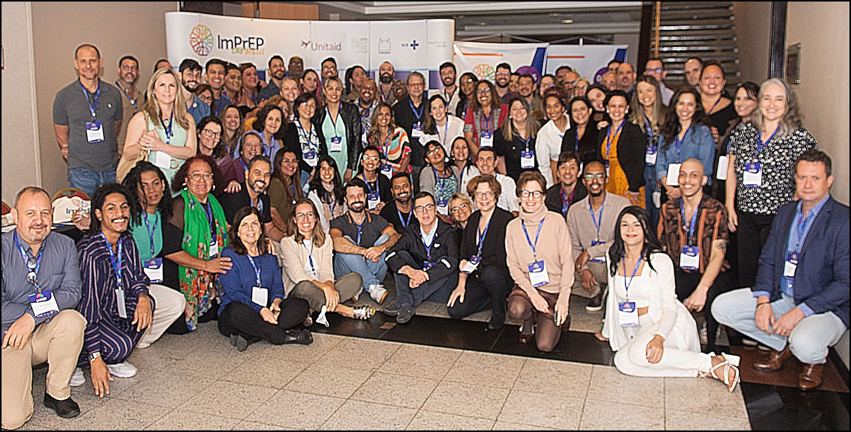
Acnowledgements
Coordinating Site
Support from:
UNITAID
Brazilian Ministry of Health
Gilead Sciences
Beatriz Grinsztejn
Valdiléa Veloso
Brenda Hoagland
Carolina Coutinho
Debora Castanheira
Elvin Geng
Emilia M. Jalil
Júlio Moreira
Keila Simpson
luri Leite
Luana Monteiro Spindola Marins
Monica Derrico
Luciana Kamel
Marcos R. Benedetti
M. Cristina Pimenta
Roberta Trefiglio
Ronaldo Ismério Moreira
Sandro C. Nazer
Thiago S. Torres
Study Sites
Alessandro Farias (Salvador)
Maria Paula G. Mourão (Manaus)
José Valdez Madruga (São Paulo)
Maria Cristina Abbate (São Paulo)
Josué N. de Lima (Campinas)
Ronaldo Zonta (Florianópolis)
Beatriz Grinsztejn (Rio de Janeiro)
José Henrique Pilotto (Nova Iguaçu)
ImPrEP LEN Brasil Study Group

Slide 47

Obrigada!
Beatriz Grinsztejn gbeatriz@ini.fiocruz.br
www.fiocruz.br

Slide 48
Panel discussion
Charles Holmes
Georgetown University Center for Innovation in Global Health, USA
Hidayat Yahaya
Community Prevention and Care Services, National Agency for the Control of AIDS, Nigeria
Long Tran Khanh
MEL Team Lead,
PATH Vietnam
Lloyd Mulenga
Director of Infectious Diseases, Ministry of Health Zambia
Beatriz Grinsztejn
Director, HIV/AIDS Clinical Research Laboratory, Fiocruz, Brazil and IAS President
Betha Igbinosun
Georgetown University Center for Innovation in Global Health, USA
Jirair Ratevosian
Duke Global Health Institute
USA
Solomon Simba
Digital Development Lead, Health Systems Information Programme, Ministry of Health, Kenya
Hasina Subedar
Senior Technical Advisor Prevention, National Department of Health, South Africa

Slide 49

Upcoming webinars
Integrating HIV prevention into public health system while protecting equitable access
Thursday 4 June (15:00 – 16:15 CEST)

