Slide 1

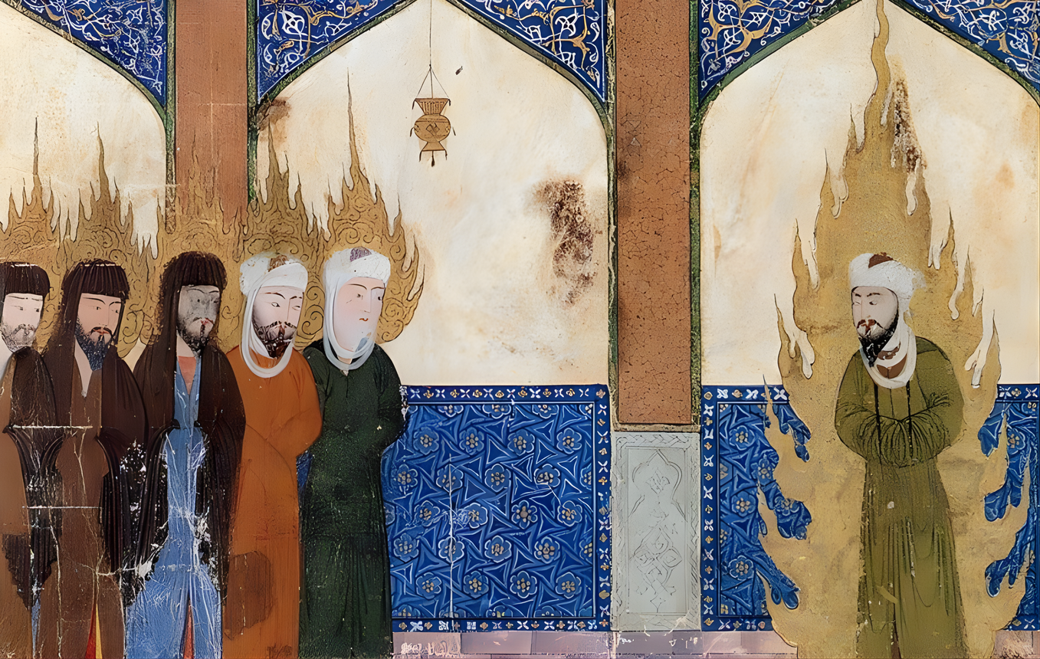

Islam & Drug Policy
Human Rights Implications of Capital Punishment for Drug Offences

Slide 2

Understanding The Legal Frameworks
01
02
03
Qur'anic Principles
Divine revelation and foundational texts
Juristic Interpretation (Fiqh)
Scholarly analysis and contextual application of the Shariah (Quran + Sunnah)
State Legislation
Codified penal laws in Muslim majority states
  Islamic Law varies by country, is influenced by local customs, and evolves overtime.
  The death penalty for drug offences is often justified as "Shariah" in policy debates.
  However, almost all Muslim-majority states operate through codified penal laws, not direct Qur'anic application.
  Islamic law involves interpretation (fiqh), which varies across contexts and schools
The reality is that Islamic principles or Islamic laws can accommodate many things, so there’s actually very little that Islamic law requires or dictates
Intisar Rabb, a professor of Islamic law, Harvard University
This framing allows for legal engagement without entering theological debate.

Slide 3


Qur'anic Standard for the Death Penalty
The Qur'an Strictly Limits Capital Punishment
The Qur'an mentions the death penalty for only two cases:
  Intentional killing (qisas)
  Fasad fil arz (grave harm to society)
It is not mandatory in either case. The principle of sanctity of life restricts arbitrary or expanded use of capital punishment.
Surah Al-Ma'idah (5:32):
...whoever kills a soul—unless for a soul or for corruption [done] in the land—it is as if he had slain mankind entirely. And whoever saves one—it is as if he had saved mankind entirely.
Islamic law establishes a narrow and exceptional scope for the death penalty, providing avenues for clemency and allowing restitution .

Slide 4
Drug Offences as Ta'zir
Discretionary Punishment Framework
Hudud
Fixed punishments prescribed in Qur'an
Qisas
Retaliatory punishment for harm
Ta'zir
Discretionary, context-specific penalties
→
Drug offences are not mentioned in the Qur'an
they fall under ta'zir. Ta'zir punishments are discretionary,
context-specific, and historically non-capital in nature.
The hand of the thief is not cut who steals a bundle of dates or in a year of famine.
Umar ibn al-Khattab (Muṣannaf Abd al-Razzāq 18371)
Scholarly research shows ta'zir should not exceed hudud punishments. The use of the death penalty for drug offences is not grounded in Islamic legal doctrine.

Slide 5
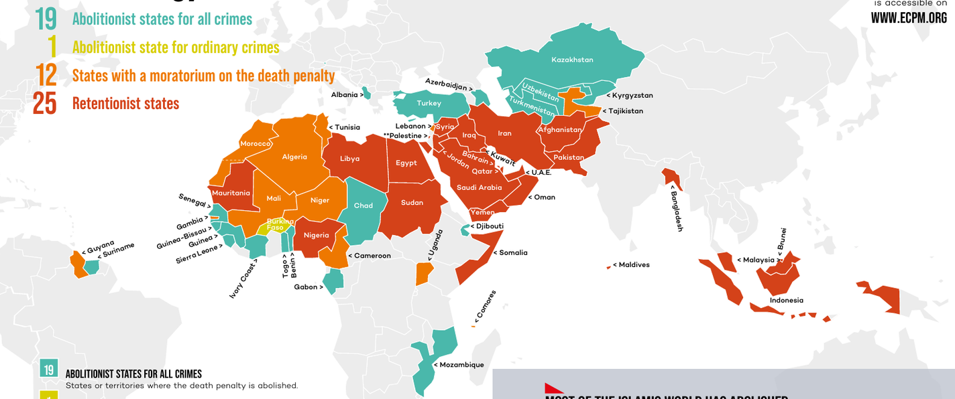
Source: Ensemble Control La Peine de Mort (ECPM)

Slide 6
Complementary Safeguards in Islamic Law
Mercy and Clemency
High Evidentiary Threshold
Forgiveness and avoidance of punishment where possible are central principles in Islamic jurisprudence
Punishment is avoided in cases of doubt (shubha), limiting wrongful conviction
Prohibition of Intoxicants
Repentance Accepted
The Prophet (P.B.U.H) said: "Whoever drinks wine and gets drunk, his prayer will not be accepted for forty days... but if he repents, Allah will accept his repentance." Repentance is accepted before punishment is imposed
The Qur'an prohibits intoxicants (Qur'an 5:90) but does not prescribe capital punishment
Hadith-based punishments for alcohol consumption were non-capital (flogging) and varied in application. Even discretionary (ta'zir)
punishments are debated as needing to remain below or within the bounds of hudud penalties. Classical frameworks emphasised deterrence with restraint, not escalation.

Slide 7
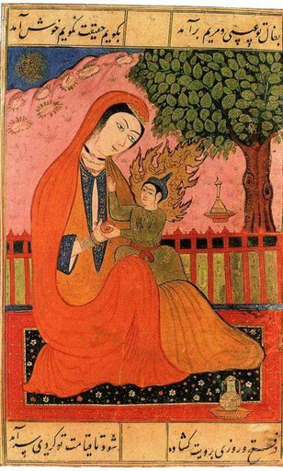
International Standards on the Death Penalty
The "Most Serious Crimes" Threshold
International Law Restrictions
  Death penalty restricted to crimes of intentional killing
  Drug offences do not meet this threshold
  States must prevent arbitrary deprivation of life
  States must move toward abolition
01
02
03
Human Dignity
Core principle of all human rights frameworks
Health-Based Approaches
Emphasised over punitive measures
Clear Consensus
Against capital punishment for drug offences

Slide 8
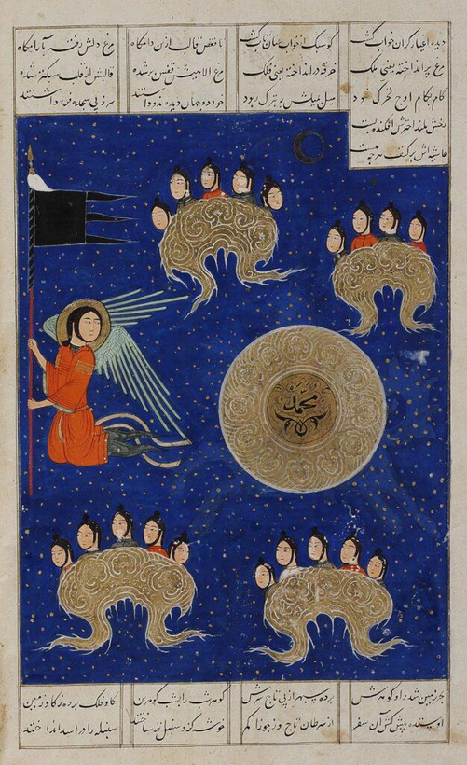

Convergence Between Islamic Law and IHRL
Islamic Law Framework
  Limits scope to specific crimes
  Never mandatory
  Encourages mercy, pardon, and restraint
International Law
  Limits to "most serious crimes"
  Requires strict safeguards
  Prevents arbitrary deprivation
Shared Principles
  High evidentiary standards
  Protection against arbitrariness
  Justice grounded in dignity and fairness
The two systems are aligned in limiting—not expanding—capital punishment.

Slide 9

Strategic Framing for Engagement
Building a Coherent Approach for Muslim Contexts
Consistent Baseline Position
Engagement with Muslim-majority states requires a consistent baseline position grounded in both legal frameworks
Internal Legitimacy
Arguments framed only in international law may be resisted as external. Islamic legal principles provide internal legitimacy for reform
Focus on Codified Laws
Focus on codified laws and safeguards, not abstract theology—e.g., translation of international guidelines on drug policy with Islamic principles
Shared Principles
Use shared principles to avoid polarised debates and build common ground
Fragmented advocacy risks contradiction and weakens reform efforts. A unified approach grounded in both Islamic law and IHRL strengthens policy engagement and reform outcomes.

