Slide 1
From Advocacy to Impact :
HIV Advocacy in Zambia
Best Practices in Healthcare Worker and Stakeholder-Led HIV Prevention and Treatment for People with Substance Use Disorders
Linah Kampilimba Mwango, RN, Bsc Nrs, MPH
ADVANCE Project Director | Technical Director Ciheb Zambia
Wednesday , 8 July 2026 | IAS Educational Fund Webinar

Slide 2
Presentation Outline
Zambia’s HIV Context
Introduction: Advocacy in HIV care
From practice to impact
Zambia’s evolving HIV response
Advocacy and impact Example: Substance Use Disorders
Best practices in community-based HIV advocacy
What is the impact of advocacy?
Zambia progress in HIV response
Conclusion from Practice to Impact

Slide 3
Introduction: Advocacy in HIV Care
Advocacy has evolved beyond awareness raising and policy influence to become a key driver of improved health outcomes.
Promotes person-centered, equitable, and high-quality HIV services for people living with HIV.
Helps reduce health inequalities by improving access to health services

Slide 4
Practice to Impact
Practice: Engage communities, empower clients, generate evidence, and influence policies to improve HIV services
1
Action: Advocate for person-centered, equitable, and stigma-free HIV prevention, treatment, and care.
2
Impact: Increase access to quality services, strengthen retention in care, and improve viral suppression.
4
Outcome: Transform advocacy into measurable improvements in health outcomes, and equity.
3

Slide 5
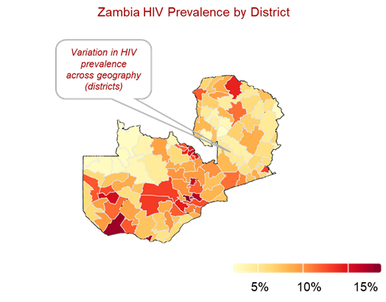
Zambia’s Evolving HIV Response
Why we must advocate
Epidemic Disparities
Population: 22 million (66% <25 yrs) – Large youth population
Socio-economic: LMIC
Gender Gaps: Women are dispropotionalty affected ( 13.9% vs 8% among men)
Vulnerable Groups: Key populations and adolescents face acute gaps in testing, treatment and retention.
Health System: Decentralized service delivery, with a strong network of Primary Health Care facilities
Why we must advocate
Reaching the Last Mile: Shifting strategies to satisfy the UNAIDS 95-95-95 targets equitably
Dismantling Barriers: Targeting clinical stigmas, and legal blockades
Dignified Care: Championing empathy over clinical volume

Slide 6
Advocacy Example: Substance Use Disorders
HIV prevalence among PWID
100
BBS demonstrated high HIV prevelance among PWIDs
HIV was identified as a major public health problem among PWIDs
Advocacy for comprehensive opiod agonistic therapy, HIV treatement & prevention followed
  Influenced stakeholders’ involvement
  Undertook south to south learning networks (virtual consultations and in-person study tours)
Zambia biobehavioral surveys (BBS) 2021-2022

Slide 7
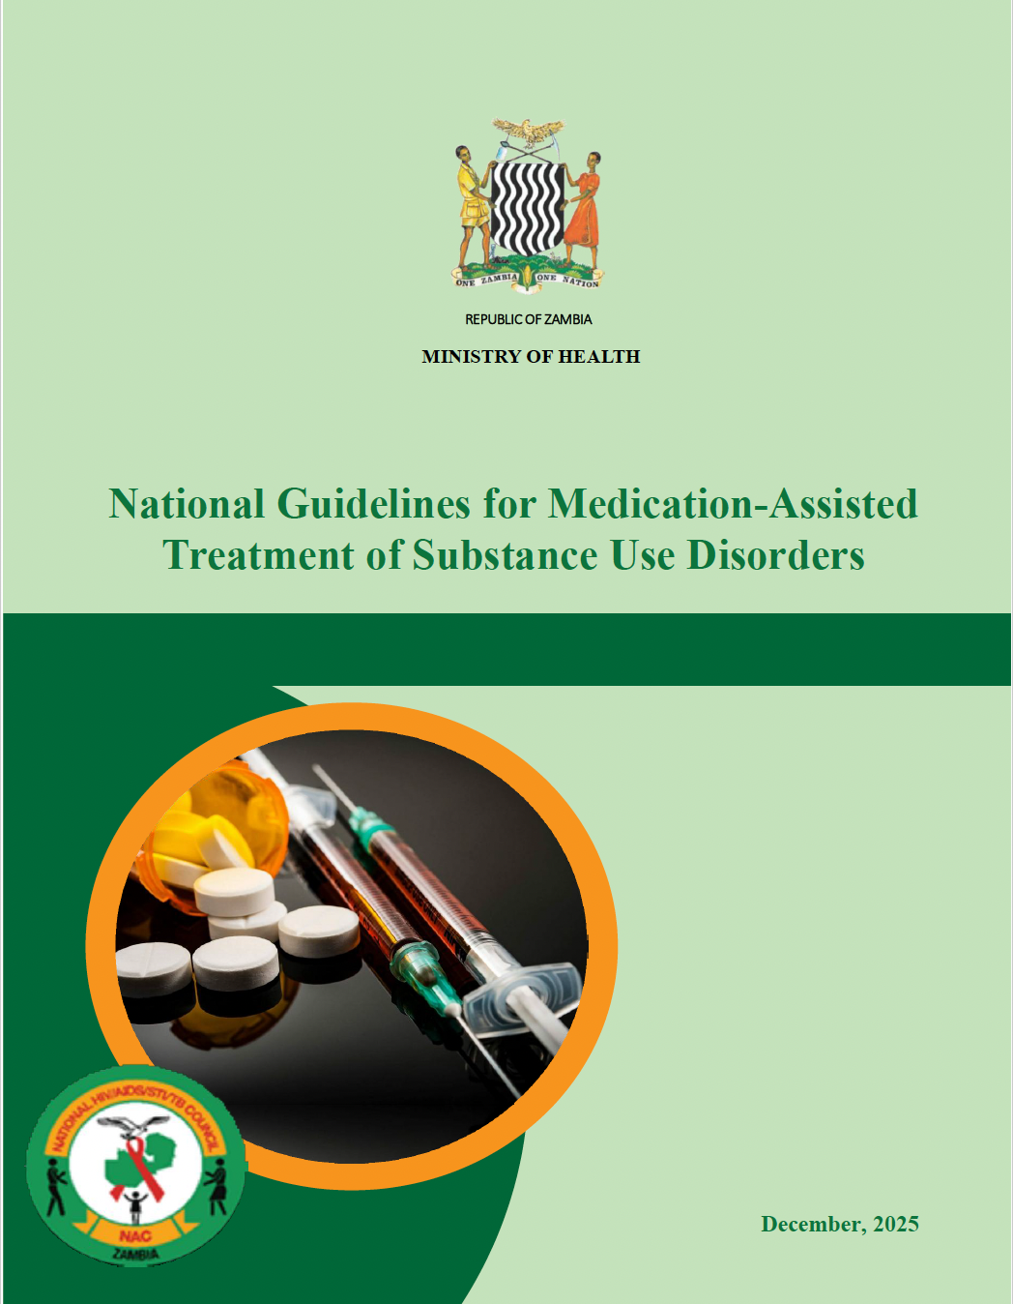
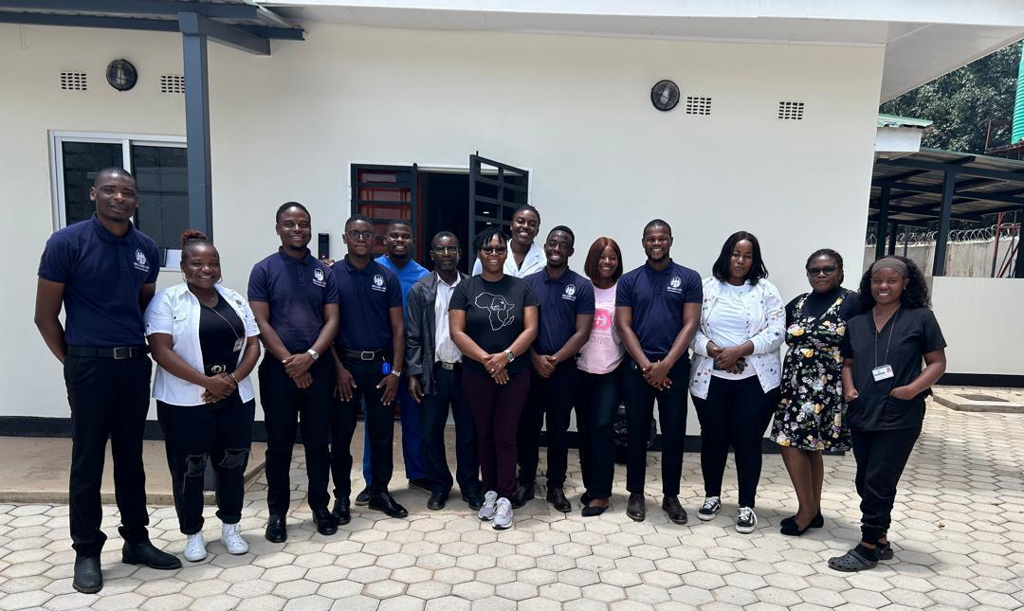
Impact of the Advocacy
Strengthening Services for People Who Inject Drugs
Advocacy has increased recognition of substance use disorder as a public health issue
Policy and Guidelines formulated
Establishment of infrastructure for Medication-Assisted Therapy (MAT) services and integrated HIV prevention and treatment
Delivery of services via Person Centered Care
Services include opiod agnosistic therapy, HIV testing, hepatitis screening, psychosocial support, and peer outreach
UTH MAT Clinic Staff at Newly Constructed MAT Outpatient Unit

Slide 8
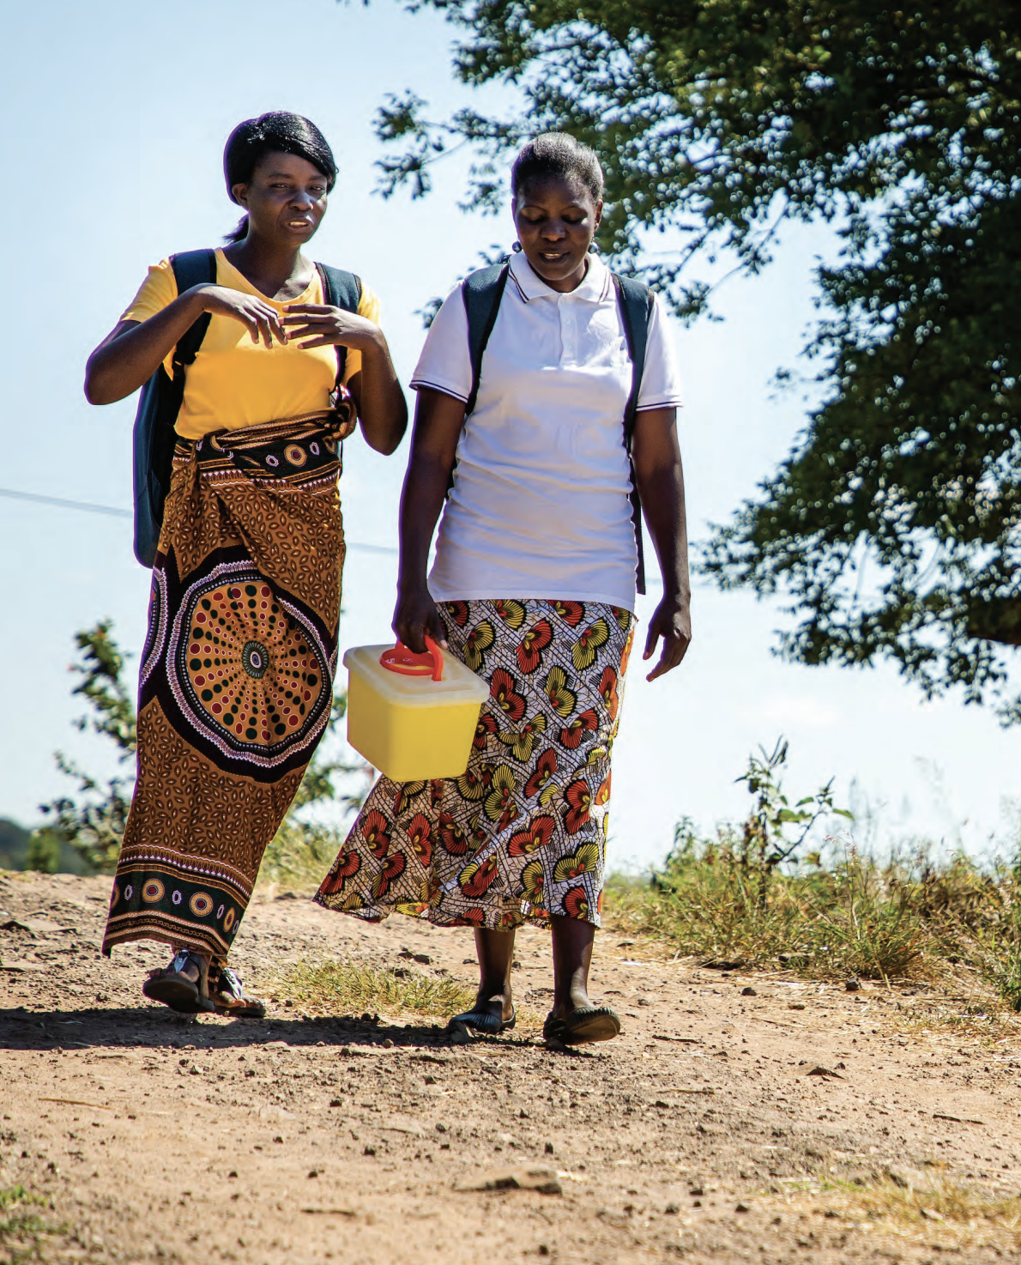
Community Based HIV Advocacy
Community-Led HIV Service Delivery
  Integrated community health workers, peer educators into HIV service delivery.
Best Practice
  Community-based organizations conduct:
    HIV testing
    ART linkage
    Treatment support
    Adherence counseling
    Index testing support
    Viral load follow-up
    Treatment retention follow ups

Slide 9
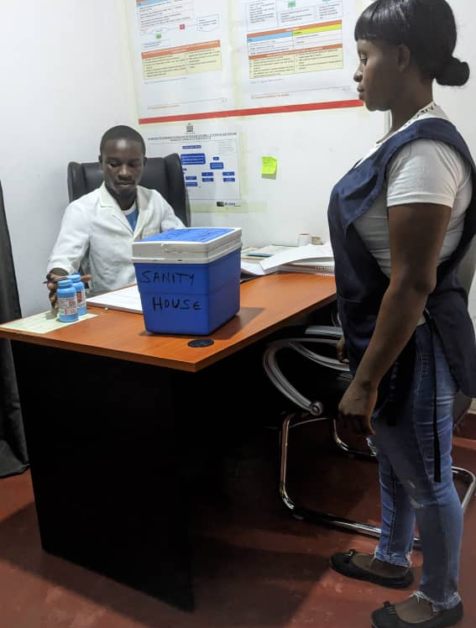
Best Practices in HIV Advocacy
Peer navigators
  Powerful advocates
  Understand the lived experiences
Peers assist fellow clients by:
  Providing psychosocial support
  Facilitating disclosure
  Supporting adherence
  Tracing missed appointments
  Addressing stigma
Evidence consistently shows that peer-led interventions improve linkage to care and long-term retention

Slide 10
What is the Impact of Advocacy?
Care is Coordinated
Care is
enabling
Care is personalized
A coordinated approach in health and social services where care is tailored to the individual’s needs, preferences, values, and context.
  Aligns with an individual’s unique needs, values and circumstances
  Coordinates services across sectors so that care is seamless
  Ensures interventions are relevant, culturally sensitive, feasible and supportive

Slide 11
Zambia Progress in HIV Response
Treatment Cascade Progress
(2024)
Children
(0 to 14)
82%
88%
95%
98%
98%
97%
of CLHIV know their status
who know their status on ART
on ART have suppressed viral loads
on ART have suppressed viral loads
AGYW
(15 to 24)
92%
of PLHIV know their status
who know their status on ART
95%
95%
of PLHIV know their status
who know their status on ART
on ART have suppressed viral loads
65% decrease in new HIV infections between 2010 and 2023
Zambia has achieved its UNAIDS targets
65% decrease of new HIV infections
Community based services & PCC have been the pillar in HIV services
Sources: Zambia September 2025 Estimates_UNAIDS AIDSInfo Database,. Link
Notes:
And like many other Sub Saharan Africa countries, Zambia has made great progress over the past decade, in reducing new HIV infections, but to drive these down even further a more prioritized and differentiated approach in our HIV program would be needed.

Slide 12
Conclusion from Practice to Impact
Advocacy transforms policies into improved HIV outcomes.
Partnerships strengthen and expand access to quality HIV services.
Invest in community leadership, evidence, and human rights to sustain epidemic control.
Keep advocacy at the center of Zambia's HIV response to achieve equitable, person-centered, high-quality care for all.

Slide 13
Thank you for your dedication to achieving equitable, person-centered HIV care in Zambia and beyond
lkmwango@cihebzambia.org

