Slide 1
Culturally-responsive advocacy strategies
Lessons from Southeast Asia
Rayner Kay Jin Tan, BSocSci, PhD
Incoming Governing Council Member (Asia and the Pacific) 2026-2030, International AIDS Society
Assistant Professor, Saw Swee Hock School of Public Health, National University of Singapore, Singapore
Assistant Professor, Centre for Behavioural and Implementation Science Interventions, NUS Medicine, Singapore
Board Member, Project X Singapore

Slide 2

HIV and AIDS Activism
A brief historical take on how HIV and AIDS activism has shaped the global response

Slide 3
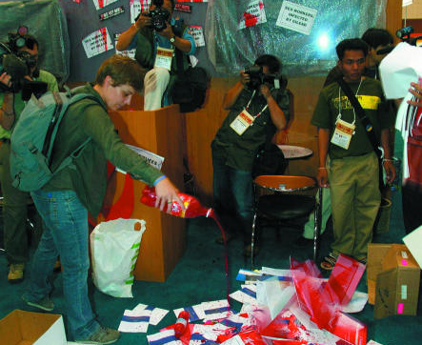
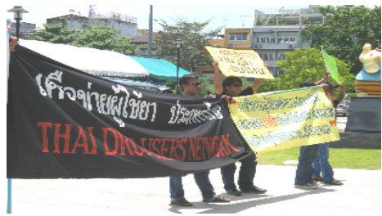
HIV Advocacy in Southeast Asia
Cambodia: In August 2004, HIV pre-exposure prophylaxis trials for sex workers halted by Cambodian government following protests by communities.
Thailand: In 2005, Thai Drug Users Network protested against the design of a study of tenofovir pre-exposure prophylaxis over lack of community involvement and unethical practices
Mills EJ, Singh S, Singh JA, Orbinski JJ, Warren M, Upshur RE. Designing research in vulnerable populations: lessons from HIV prevention trials that stopped early. BMJ. 2005 Dec 10;331(7529):1403-6. doi: 10.1136/bmj.331.7529.1403. PMID: 16339256; PMCID: PMC1309660.

Slide 4
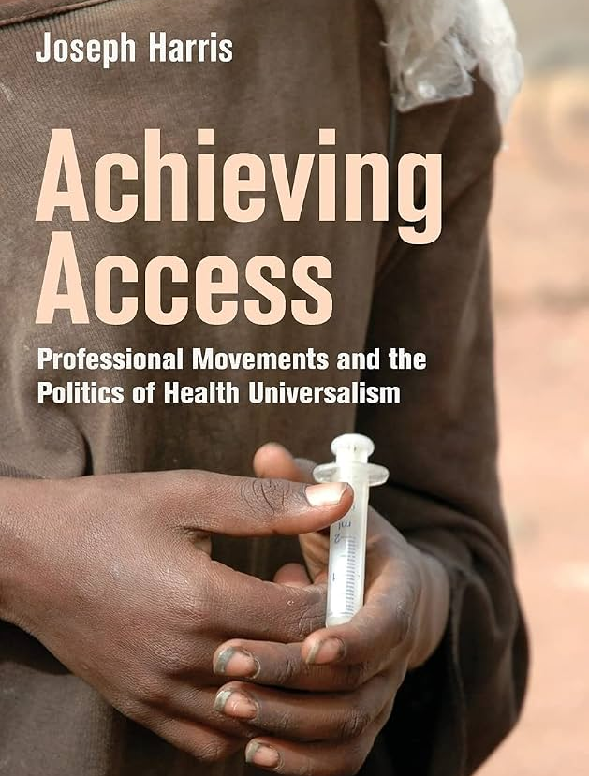
Professional Movements and Activist Scholars
Navigating dual positionalities, professional movements, and building institutional support inside-out

Slide 5
Professional Movements as Advocacy
Epistemic Communities and Professional Movements
The expansion of expensive health commitments: universal healthcare and AIDS treatment, in resource-constrained democracies is driven not by mass movements, disease burden, or wealth
”Professional movements": networks of elite, well-placed professionals, chiefly doctors and lawyers, who embed themselves within the state and mobilise their technical and legal expertise to push through reforms on behalf of communities, often against the resistance of their own professions and entrenched interests.
Joseph Harris; “Professional Movements” and the Expansion of Access to Healthcare in the Industrializing World. Sociology of Development 1 September 2017; 3 (3): 252–272. doi: https://doi.org/10.1525/sod.2017.3.3.252

Slide 6
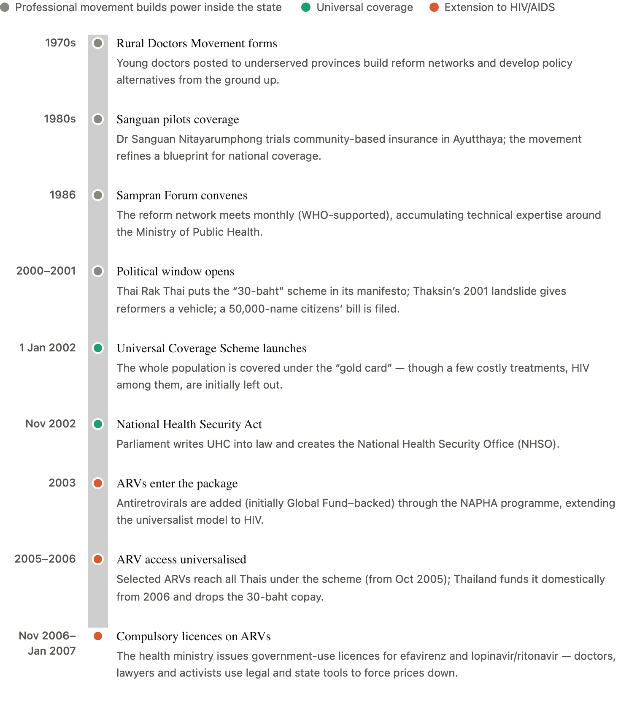
Professional Movements (Thailand)
Timeline of Universal Health Coverage and ART Access Reform
Harris argues Thailand's universal healthcare and HIV treatment commitments came from a professional movement of reformist doctor-bureaucrats who captured party politics under democratisation.
Selway counters that Harris overstates the movement, crediting the 1997 electoral reforms and party incentives; both concede it's necessary but not sufficient.
These accounts under-credits grassroots HIV activists, and some drug-access wins came during post-coup military rule.
Harris, Joseph, and Joel Sawat Selway. 2020. "Exchange: Explaining the Passage of Universal Healthcare in Thailand." Journal of East Asian Studies 20(1): 99–119. — this is the single best cite, since it's the direct head-to-head where each concedes ground.

Slide 7
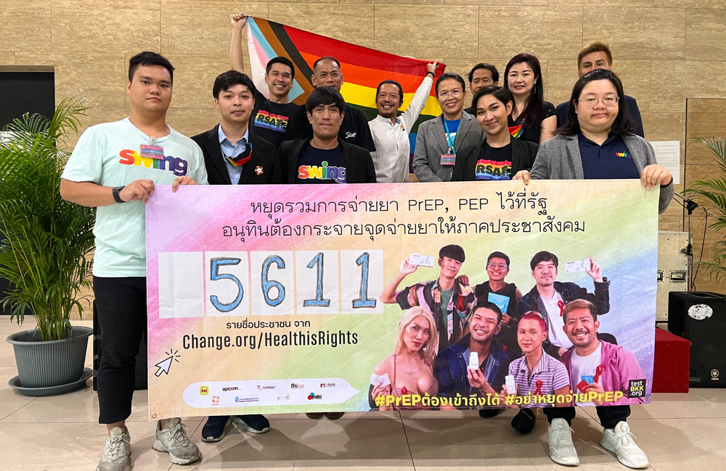
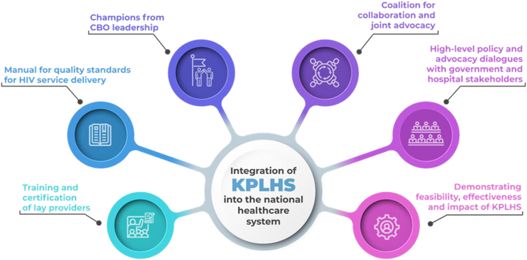
Key Population-Led Health Services (Thailand)
Brokerage and legitimation: Embedded physician-scientists used clinical standing to vouch for peer-delivered services, securing a 2019 MOPH decree that certified lay providers to test, counsel and dispense PrEP.
Evidence production: Demonstration projects and published research converted peer delivery into evidence-based, guideline-endorsed practice; making community innovation policy-legible.
Financing and platform: KPLHS was grafted onto the UHC system; yet direct NHSO reimbursement remains unfinished, leaving it exposed as 2025 donor funding retreats.
Community activists protesting the changes at the Thai parliament, 16 January 2023. Image from APCOM.

Slide 8
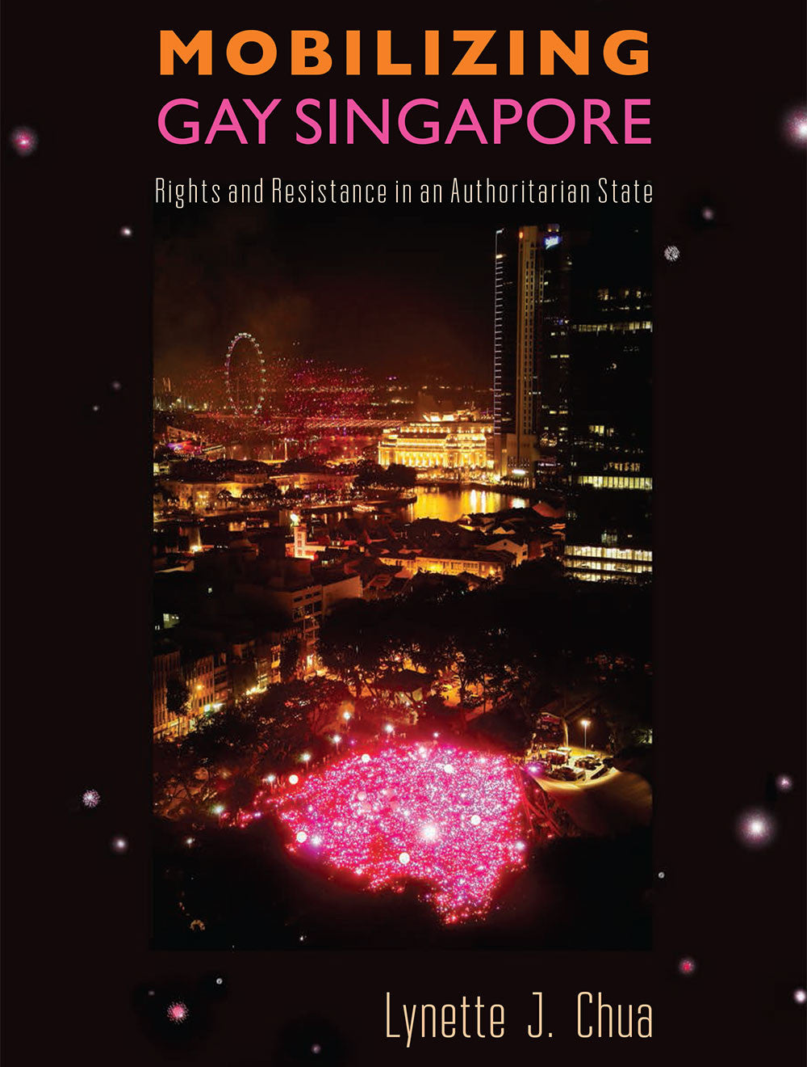
Pragmatic Resistance
Prioritising incremental progress, adaptability, and survival over direct ideological confrontation
Chua, L.J. (2012), Pragmatic Resistance. Law & Soc'y Rev, 46: 713-748.
https://doi.org/10.1111/j.1540-5893.2012.00515.x

Slide 9
Political Economies And Advocacy
Dimension | China | Singapore
Legal context | Homosexuality decriminalised (1997) and depathologised (2001), but independent NGOs are hard to register; many operate informally or as businesses. | Sex between men criminalised under Section 377A (in force at the time of the study; repealed 2022); groups register under the Societies Act, which restricts overtly political bodies.
Political space / norms | Authoritarian; civil society tolerated mainly in depoliticised, “safe” areas. Explicit rights claims carry real risk. | Soft-authoritarian “out-of-bounds” markers; public-health work is acceptable, gay-rights framing politically sensitive.
HIV/AIDS funding | The HIV/AIDS crisis brought political as well as economic opportunity; money flowed through state-controlled “filter-model” channels, then was withdrawn as the state’s need diminished — boom, then bust. | A high-income country largely outside international HIV donor flows; HIV work (e.g. Action for AIDS) was mainly domestically or self-funded — no comparable donor-driven surge.
Government response | State actively partnered with gay/MSM groups for HIV outreach — it needed their access to hidden populations — while curbing explicit rights activity. | Tolerated HIV services under a health frame; warier of gay-rights mobilisation, though rights-adjacent events (Pink Dot, from 2009) later emerged within legal limits.
Effect on activism | HIV opened opportunity but bred donor-dependent, self-limiting organisations. Responses ranged from state partners that dropped rights advocacy (“de-pinked”) to a rare few that challenged the state: leaving many exposed when funding ended. | The health frame offered cover, but with little donor money the health-to-rights pipeline was a weaker driver; HIV service organisations and gay-rights groups grew more as separate strands under 377A’s shadow.

Slide 10
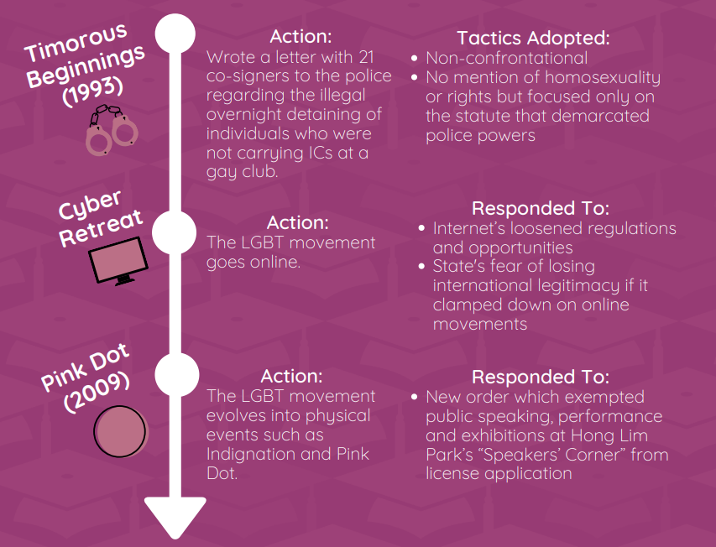
Pragmatic Resistance in Singapore

Slide 11
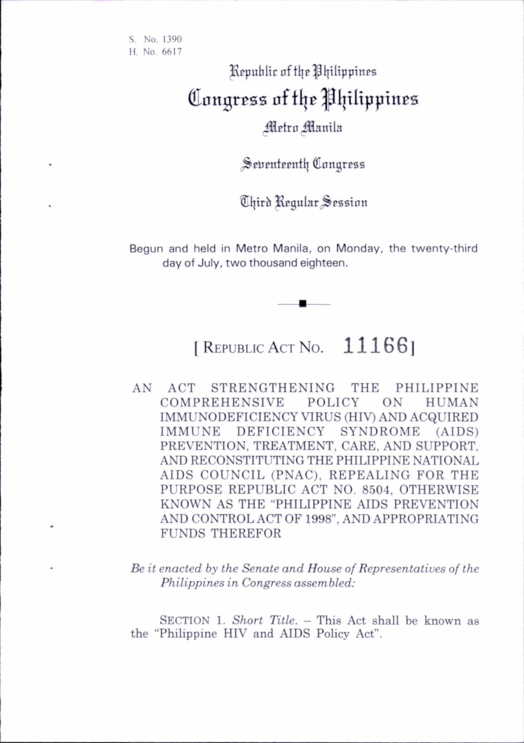
Bringing it together through RA 11166
Community leadership, professional and legislative support, and a policy window
Chua, L.J. (2012), Pragmatic Resistance. Law & Soc'y Rev, 46: 713-748.
https://doi.org/10.1111/j.1540-5893.2012.00515.x

Slide 12
RA 11166 (The Philippines): December 2018
Lowered Age of HIV Testing Consent to 15 years and older
Anti-Discrimination: The law makes it unlawful to fire an employee, refuse admission or expel a student, or deny medical services due to actual or perceived HIV status.
Penalties for violating confidentiality or performing discriminatory acts
Reconstitution of the PNAC: Strengthens the Philippine National AIDS Council to coordinate the government's response.
Prohibition of Compulsory Testing with some legal expections.
Strict Confidentiality: All medical information regarding an individual’s HIV status is strictly confidential with some exceptions.

Slide 13
RA 11166 (The Philippines)
Problems: Fastest-growing, youth-focused HIV epidemic in the region
Policies: Civil society, UNAIDS having draft solutions
Politics: Political support from legislators like Senator Risa Hontiveros
Macro: Kingdon's Three Streams
Passage was driven not by pluralistic mass movement but by an embedded network of clinicians, PLHIV organisations (PAFPI, ACHIEVE)
Meso: Professional Movements
Micro: Rights and Pragmatism as Tactical Strategy
Technocrats mobilising expertise inside the state, then locked into governance via a reconstituted PNAC.
Opposition pre-empted through positioning on epidemiological urgency and focus away from condom promotion
Rights-based language on health and non-discrimination aligned with constitutional philosophy (unlike Singapore)
Human Rights Watch. (2018, May 22). Philippine AIDS bill silent on condom promotion. https://www.hrw.org/news/2018/05/22/philippine-aids-bill-silent-condom-promotion
Kingdon, J. W. (2011). Agendas, alternatives, and public policies (Updated 2nd ed.). Longman. (Original work published 1984)
Philippine HIV and AIDS Policy Act of 2018, Republic Act No. 11166 (2018). https://lawphil.net/statutes/repacts/ra2018/ra_11166_2018.html
World Health Organization. (2019, January 11). New law important boost to HIV response in the Philippines. https://www.who.int/philippines/news/detail/11-01-2019-new-law-important-boost-to-hiv-response-in-the-philippines

Slide 14
Takeaway Message
Many innovations start from, and are sustained through community voice and action
Embedded professionals, legislators, and other partners are essential in advocacy
Policy windows, or opportunities to impact legislation or policies matter for sustained change
Policy advocacy is not the work of only a single partner
Prevailing culture, constitutional norms, healthcare policies all determine advocacy strategies and policy windows
Progress is precarious, and regression is always imminent. Sustained advocacy, solidarity, and partnerships remain key.

