Slide 1
HIV Advocacy:
A Role for Everyone
Tristan J Barber MA MD FRCP
Consultant in HIV Medicine, Royal Free London NHS Foundation Trust, London UK
Honorary Associate Professor, Institute for Global Health, University College London
Chair, British HIV Association (BHIVA)

Slide 2
Disclosures
None with regard to this talk

Slide 3
What is Advocacy?
Advocacy is the act of publicly supporting, representing, or speaking up for a cause, an idea, or an individual's rights. It involves taking action to help ensure that a person’s voice is heard or that specific social, legal, or systemic changes are made

Slide 4
What is Advocacy?
Advocacy is the act of publicly supporting, representing, or speaking up for a cause, an idea, or an individual's rights. It involves taking action to help ensure that a person’s voice is heard or that specific social, legal, or systemic changes are made
The concept spans several distinct areas, which can be broken down by how and where they are used:

Slide 5
1. Individual Advocacy
This type focuses on supporting a single person. An advocate helps someone articulate their needs, understand their options, and secure their rights when dealing with authorities, healthcare systems, or social services.
Key traits: Advocates do not make decisions for the person; rather, they stand by their side to ensure their wishes are respected.
Self-Advocacy: The ability to speak up and represent one's own interests and needs.

Slide 6
2. Systemic & Cause Advocacy
This involves large-scale efforts to influence decisions within political, economic, or social institutions to bring about change
Grassroots & Campaigns: Organizing public support, protests, or awareness campaigns to change public opinion.
Lobbying: Engaging directly with lawmakers and policymakers to change laws or budget allocations.

Slide 7
3. Legal Advocacy
In a legal context, advocacy refers to the work a lawyer (such as a barrister) does to represent a client's case and defend their interests in a court of law. This can include written submissions or oral arguments.

Slide 8
Health Advocacy
Health advocacy involves influencing decisions within political, economic and social systems to improve health outcomes.
  It goes beyond individual client support by addressing the broader structures and policies that shape people’s health and access to services.
Health advocacy includes speaking up for the needs and rights of individuals and communities to ensure they have fair access to quality healthcare.
  It focuses on reducing inequities and addressing the systemic barriers that prevent people from receiving the care they need.
Advocacy usually focuses on dialogue, negotiation and engagement with policymakers to influence decisions from within systems.
  Activism, on the other hand, often involves public actions to bring attention to an issue and push for change from the outside.
  Both approaches can be powerful and complementary in advancing health and social goals.

Slide 9
In The HIV Sector
Individual
Community
Insitutional

Slide 10
Before 1996
1996 - 2005
2005 - 2015
After 2015

Slide 11


Slide 12


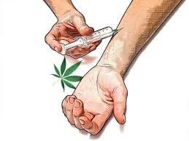




Notes:
Groups ‘especially’ needing advocacy – include straight talk, white stigma, etc

Slide 13
In The HIV Sector
Individual

Slide 14
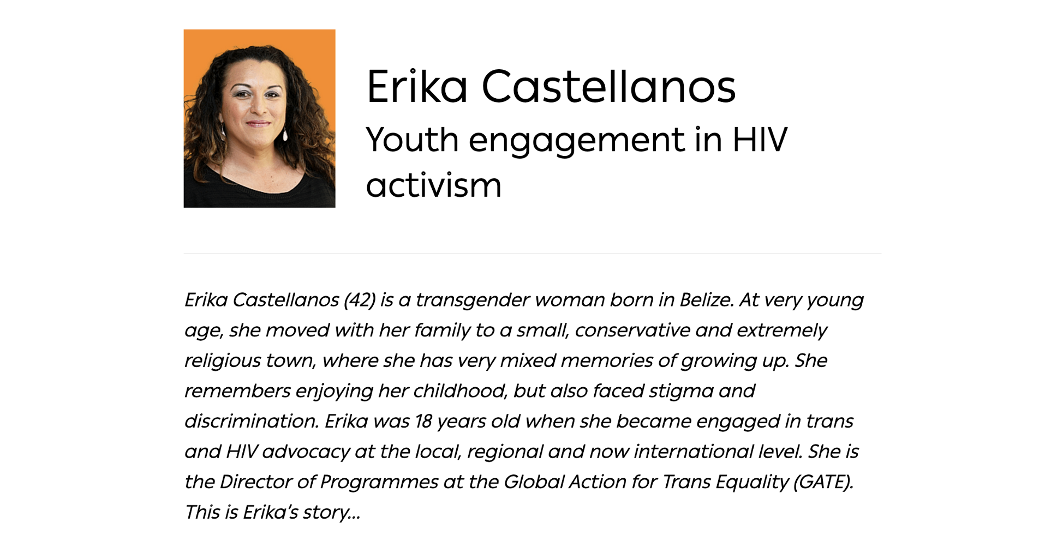

Slide 15
In The HIV Sector
Community

Slide 16


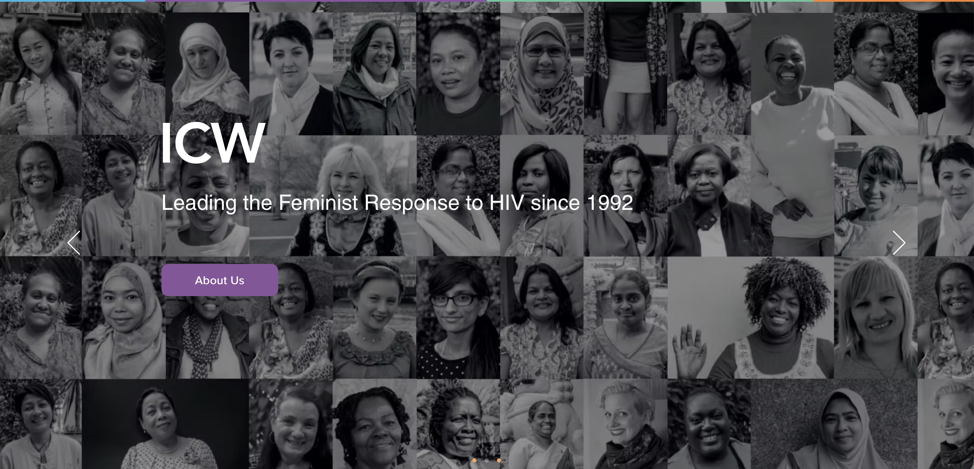

Slide 17
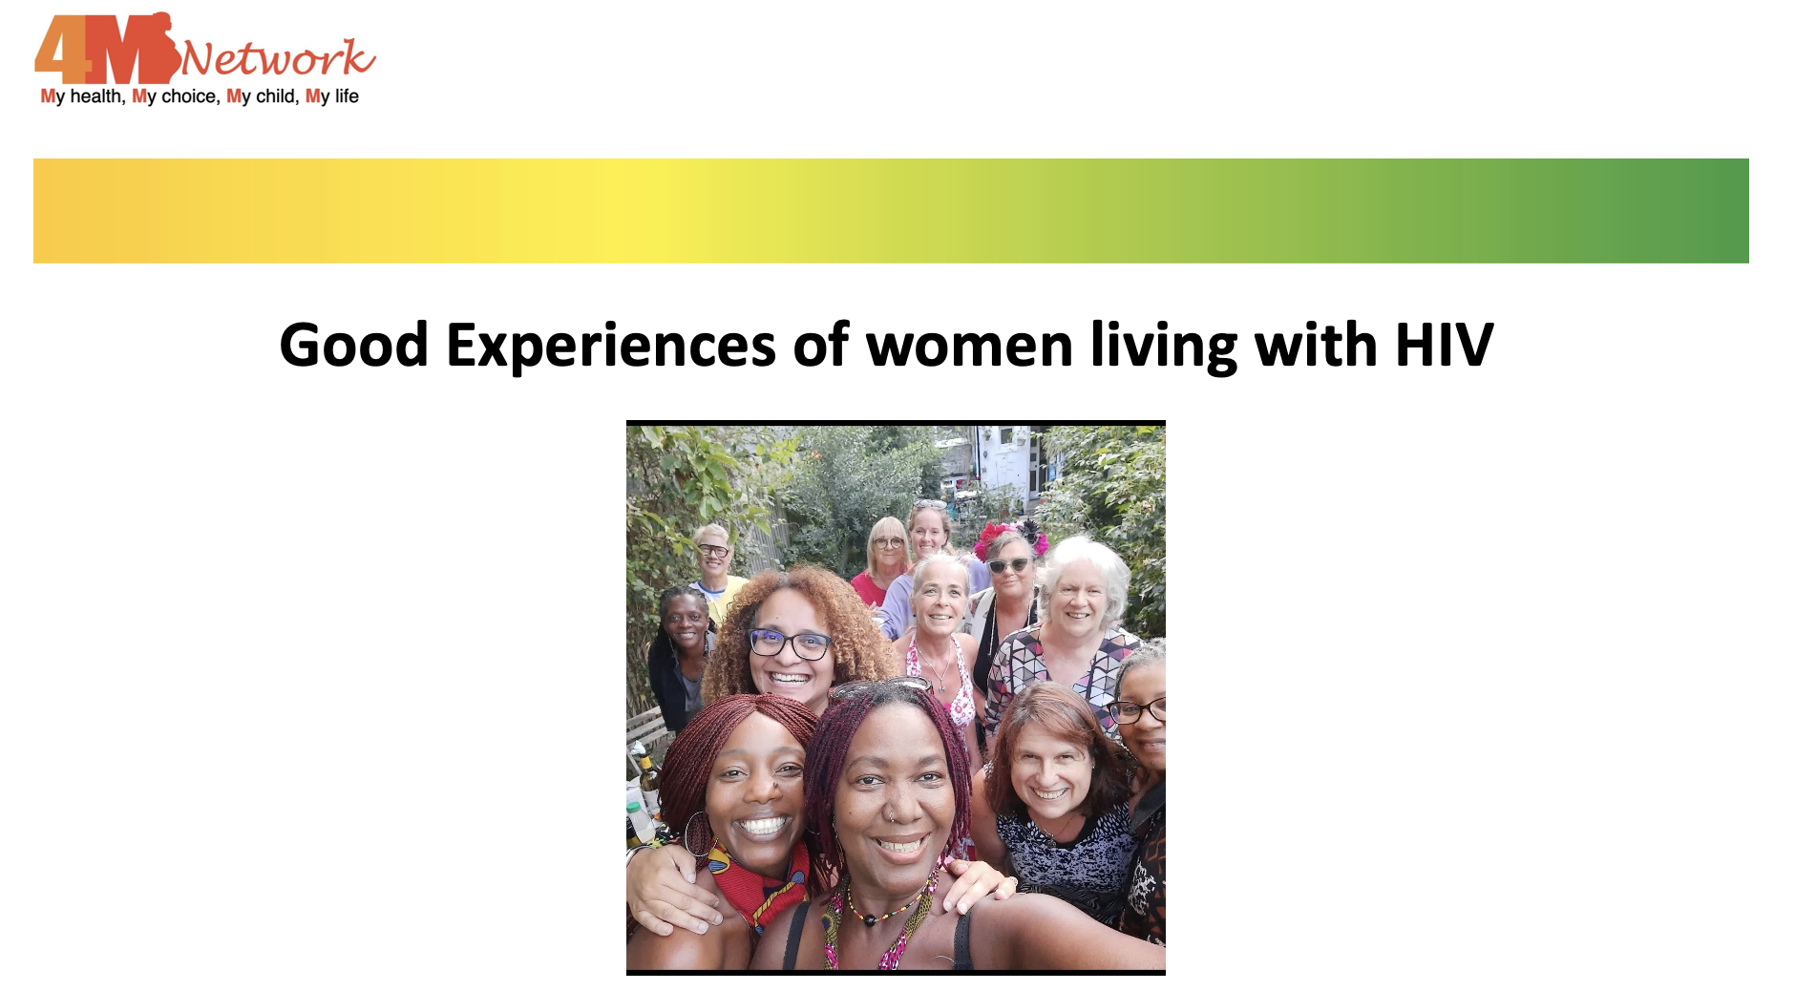

Slide 18



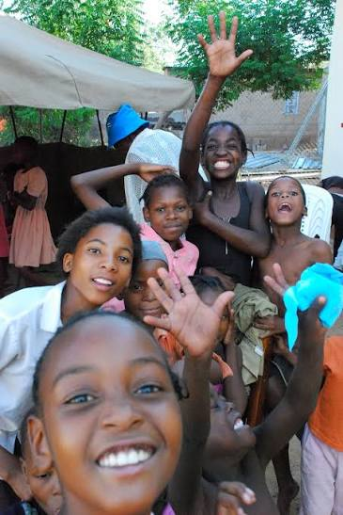




Slide 19
In The HIV Sector
Insitutional

Slide 20









Slide 21
Importantly
Getting to zero new HIV infections, zero stigma and discrimination, and zero AIDS-related deaths depends on meeting people where they are, with empathy, understanding and support

Slide 22
Importantly
Getting to zero new HIV infections, zero stigma and discrimination, and zero AIDS-related deaths depends on meeting people where they are, with empathy, understanding and support
Advocacy (and peer support) are not optional. They are ESSENTlAL.

Slide 23
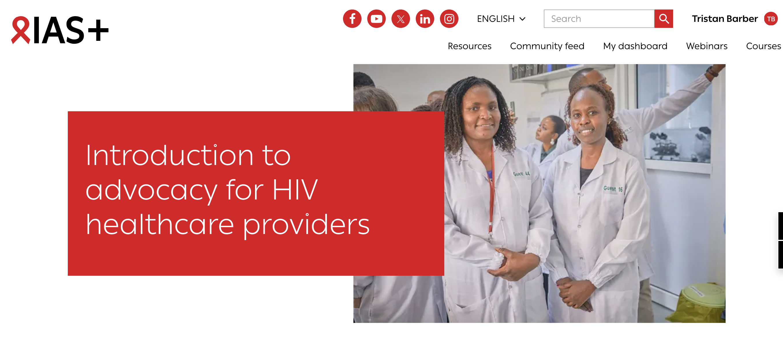
https://plus.iasociety.org/all-courses/introduction-advocacy-hiv-healthcare-providers

Slide 24



Slide 25



Thank You!
t.barber@nhs.net
@tristanjbarber.bsky.social
https://www.linkedin.com/in/tristan-barber-0ab54317/

