Slide 1
Healthcare professionals as intermediaries in HIV advocacy and disease care integration:
Best practices from Nigeria
8th July 2026
Bonaventure Ukoaka
IAS Mark Wainberg Fellow
Excellence Community Education Welfare Scheme (ECEWS), Nigeria
Desmond Tutu Health Foundation, South Africa

Slide 2
Disclaimer:
Some content in this presentation relating to the foundational concepts of healthcare worker-led advocacy has been adapted from the IAS’ “Introduction to Advocacy for HIV Healthcare Providers” course. Full attribution is given to the IAS’ Mark Wainberg Fellowship Programme
The course is freely accessible on IAS+

Slide 3
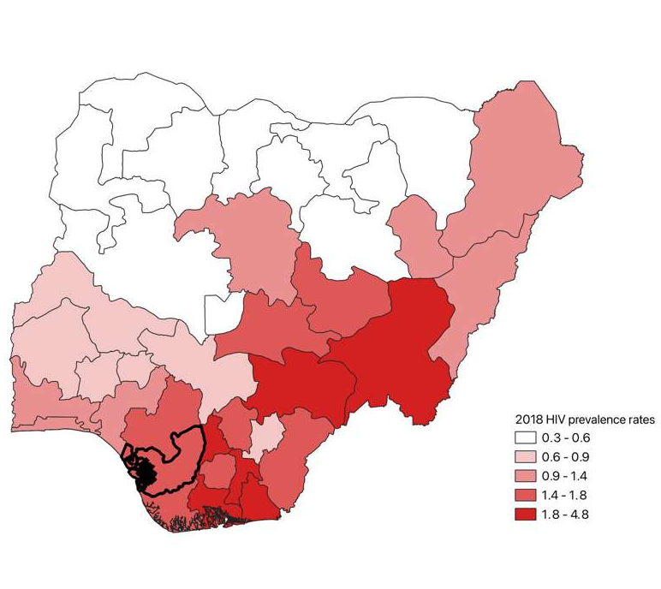
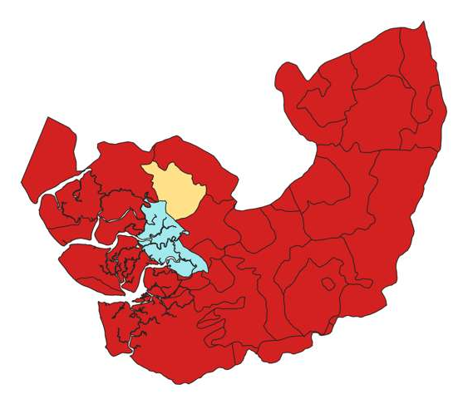
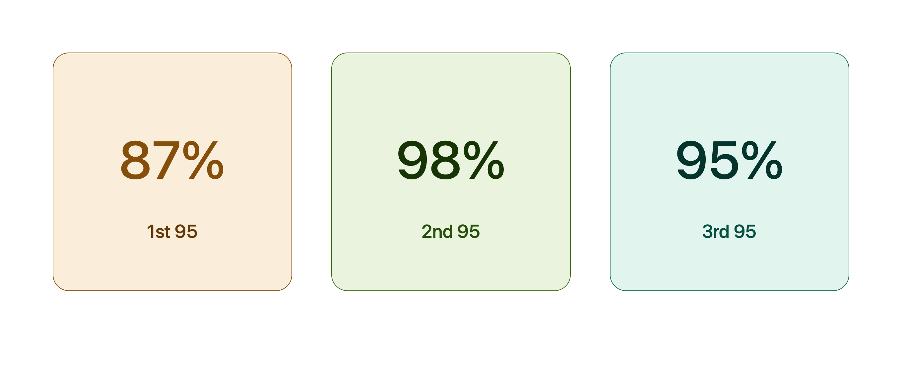
The Nigerian HIV landscape
1.3%
National HIV prevalence
3rd
largest HIV burden globally
People living with HIV
1.9m
Nigeria has met two of the three global HIV targets set for 2030
(NACA 2025)
4th
People living
with HIV
People living
with HIV
4th 95:??

Slide 4
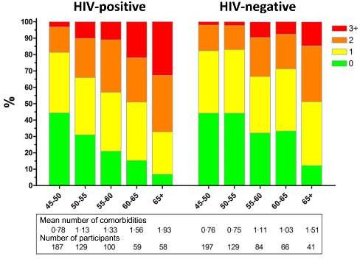
Why the case for HIV and disease integration?
PLWH Non-PLWH
Hypertension – 45.4% vs 30.5%
Myocardial infarction – 3.9% vs 1.5%
Peripheral artery disease – 2.6% vs 0.6%
Impaired renal function – 4.3% vs 2.1%
Judith Schouten et al. Clin Infect Dis. 2014;59:1787-1797

Slide 5
The person-centred care project and how advocacy was embedded in its core
Improve the care experiences of clients who received care at the clinics
Healthcare workers were trained on person-centred care practices and how integrating this into care delivery could redefine service provision and reception
Introduced NCD screening – hypertension, diabetes, and mental health disorders (evidence was informed by a previous pilot)
Leveraged international health days such as the World Hypertension Day (May 2025) to conduct healthcare rallies and increase advocacy/awareness (conducted in partnership with SMoH)
Routinely, same screening services were conducted across rural and difficult-to-reach settings
Extensive stakeholder partnership from start to completion – Health facility leadership, NEPWHAN, LACA, SACA/SASCP, SMoH, IP, Funders

Slide 6
Integrated care as a form of advocacy
Delivering HIV treatment + NCD screening (hypertension, diabetes, MHD, cervical cancer) in a single visit/setting strengthens retention in care & overall HRQoL.
Deliver care
Share with government, funders, media, etc
Document results
Policy &
Funding change
Case study: ECEWS’ NCD programs across 5 states
ECEWS implements a fully integrated HIV-NCD programme in two states (Akwa Ibom and Cross River)
Pilot programmes in Delta, Ekiti, and Osun states
Advocacy outcome: Data from the pilot programmes have been used to support programme funding requests (CDC) and the IAS’ PCC project in Delta
Notes:
1. When a patient presents to the clinic for ART and is offered additional services, whether, BP screening, BS checks, MH screening and counselling, cervical cancer, or just counselling an adolescent on sexual reproductive health, we are advocating for a more inclusive and an-all involving healthcare
2. The result is that treatment numbers are improved, because the patient knows that when they come to the clinic for their meds, there will be a MH specialist or psychologist to listen to them, to concerns that may not even be related to HIV care. This will translate to suppressed viremia and overall better QoL

Slide 7
How clinicians and HCPs can advocate for systems change
HCPs are well-positioned to be advocates:
  Community trust
  Clinical and scientific credibility
  Intermediary role
  Access to decision-making
            ~ IAS+
Map and Plan:
Know your facility’s data
Audit missed NCD screens, ART pickups, stockouts, missed appointments and opportunities
Basic Excel analysis can surface compelling patterns for management.
Use basic visuals such as RUNS chart to display quarterly progress and targets
Quality Improvement Cycles:
Use existing hospital governance structures e.g. infection control, QI, pharmacy & therapeutics, to institutionalise advocacy as part of normal operations.
Partnership and Collaborations:
Inter-clinic/inter-facility collaborations
Partnership with research institutions/centres and PLHIV networks give clinicians a collective platform to engage with relevant ministries.
State HIV programme reviews (quarterly and annual) are the primary decision-making forum.
Write, Disseminate and Publish
Write a one-page policy brief or “best practices” showIng a working solution from your site
Submit good and compelling evidence for conference presentations and journal publications (including case reports)
Notes:
State-level networks can amplify demands and provide community evidence that complements clinical data.
These are actions clinicians can take without leaving clinical practice — embedded advocacy, not additional burden.

Slide 8
Other advocacy strategies advancing HIV care in Nigeria
Client feedback mechanisms via client satisfaction (clinic exit) surveys as a tool to gain insights into client experience and areas for improvement
Routine hands-on capacity-building, leveraging existing meetings and gatherings to improve the quality of service delivery.
For example:
To support PrEP optimisation and integration with STI, GBV and SRH services, WHO, in collaboration with FMOH-NASCP, recently conducted a national training-of-trainers across states for healthcare workers traditionally outside the PrEP space

Slide 9
Advocacy strategies for diverse stakeholders
Health systems leadership
Administrators
Funders
Most health systems need solutions that affect the ROC directly
Effective, timely, and continuous communication
National Technical Working Groups (TWGs) and other strategic platforms. E.g. the Nigerian National HIV Prevention TWG includes HCWs, advocates and academicians.
Capacity building and training of peers, community members, and other HCWs
Co-advocacy with communities as PLHIV networks (NEPWHAN) presents a unified demand.
Partnerships with national and local agencies/coalitions amplify clinician voices at federal and state budget cycles.
Engage, but safely, with the media – news outlets, professional SM platforms like LinkedIn
Document and publish every facility-level innovation. Pilots at UCH Ibadan and LUTH have been presented at FMOH TWGs for national adoption.
Funders respond to data-driven interventions and outcomes
SMART project objectives
Think like a marketer! – the elevator pitch strategy
Invest in transparency
Build trust with funder country offices (CDC Nigeria). Invest in long-term relationships
Regular programme updates, site visits and co-authored reports matter.

Slide 10
2. Time poverty in overstretched facilities
Fear of institutional pushback
Frame advocacy as QI and patient safety — language clinicians already use and administrators support.
Embed data collection into routine consultations
Duty delegation for proper documentation
Challenges
3. Low health literacy among patients limiting community pressure
5. Disease-integration specific challenges
PLHIV peer educators (NEPWHAN model) translate clinical advocacy into community voice
Patient awareness
Lack of skills among HCPs
Short staffing
Lack of basic screening commodities – blood pressure machines, blood sugar strips, etc
Staff willpower and willingness
Stakeholders buyin
Willingness to invest
4. Mistrust between clinicians and administrators
Co-design solutions
Good communication and continuous stakeholder engagement
Notes:
Acknowledge real barriers — don't pretend advocacy is easy in a resource-constrained system. These examples show it's possible.

Slide 11
Conclusion
Advocacy remains a key strategy for driving systemic health changes for HIV care
The Clinician/HCP advocate plays a key intermediary role between the care recipients and stakeholders
Clinical data is your most powerful advocacy tool; collect it, analyse it, present it
Funders respond to demonstrated outcomes; build your evidence base with implementation science rigour
Integrated disease care is not just better medicine; it is a visible argument for equitable systems.
The clinic that integrates, documents, and shares its outcomes is already advocating

Slide 12
THANK YOU
bonaventureukoaka@gmail.com
bukoaka@ecews.org

