Slide 1







AIDS 2026 · 26TH INTERNATIONAL AIDS CONFERENCE · PLENARY
New realities, new responses
Migration and HIV in Latin America & the Caribbean
General populations, migrants & refugees, youth, and gender diversities
Prof. Báltica Cabieses bcabieses@udd.cl
Rethink.
Rebuild.
Rise.
Professor of social epidemiology at the Centre for Global Intercultural Health (CeSGI), Faculties of Medicine and Psychology at UDD, Chile
Senior visiting scholar, Department of Health Sciences, University of York, England
Honorary Professor, Department of Family Medicine and Primary Care, LKS Faculty of Medicine, University of Hong Kong, China
Director WHO/PAHO Collaborating Center on Capacity Building for Training and Research in the Health of Migrants and Refugees
Board Lancet Migration Latin American Hub Latin American Hub – Lancet Migration
Board Red Chilena de Investigación en Salud y Migración (RECHISAM) https://saludinmigrantes.cl
Board INRICH INRICH – International Network for Research on Inequities in Child Health
Let´s connect: Baltica Cabieses | LinkedIn
ORCID http://orcid.org/0000-0003-0756-1954
Google Scholar: https://scholar.google.cl/citations?user=yQQSbZ0AAAAJ&hl=es
Notes:
OPENING — approx. 1 min.
Thank the chairs and the community delegates in the room. Keep the bio to one line: social epidemiologist, WHO/PAHO Collaborating Centre on migrant and refugee health, based in Chile.
Frame the moment in two sentences: migration has remade this region in a single decade, and Latin America is one of the few places on earth where new HIV infections are still rising — at the exact moment the largest external funding source is contracting.
Signpost the structure: the regional picture, migrants and refugees against the general population, youth and gender diversities, our own evidence, and what is already working.

Slide 2

MIGRATION IN LAC · THE TREND
Migration in Latin America
& the Caribbean
The decade that remade the region
Cartagena de Indias, Colombia · Photo: Martin St-Amant (S23678), CC BY-SA 3.0 — Wikimedia Commons
02
https://commons.wikimedia.org/wiki/File:68_-_Carthag%C3%A8ne_-_D%C3%A9cembre_2008.jpg
Notes:
SECTION DIVIDER — migration. About 10 seconds; do not read the slide.
Transition line: "Before a single HIV figure, we need the scale of movement behind it."
Cartagena — a reminder that these are the ordinary cities absorbing extraordinary flows.

Slide 3
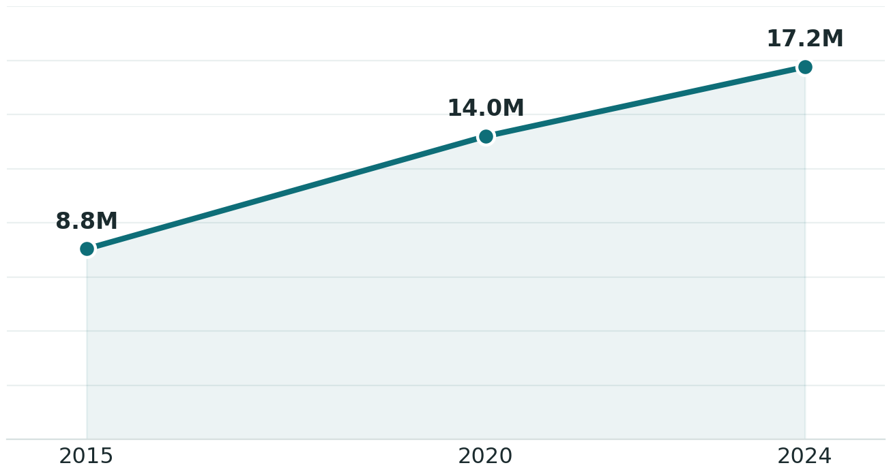
MIGRATION IN LAC · THE TREND
Migration has remade Latin America & the Caribbean
Estimated International migrants in LAC (millions), 2015–2024
17.2 M
international migrants in LAC in 2024 — nearly double the 8.8 M of a decade earlier
≈ 7.7 M
are Venezuelan refugees & migrants — the single largest driver of the rise
≈ 80%
of these moves are within the region — overwhelmingly South–South
Sources: UN DESA, International Migrant Stock 2024 — un.org/development/desa/pd; Venezuelan figures from R4V / IOM–UNHCR 2024–2025 — r4v.info.
AIDS 2026 · Rio de Janeiro | B. Cabieses · CeSGI–UDD
03
Notes:
THE SCALE — approx. 1.5 min.
Three numbers, in order:
• 17.2 million international migrants in LAC in 2024 — nearly double the 8.8 million of a decade earlier.
• About 7.7 million are Venezuelan refugees and migrants — the single largest driver.
• Roughly 80% of these moves stay inside the region — this is South–South mobility, not a story about people leaving for the global North.
The point to land: this is the largest displacement in the modern Americas, and it is the structural backdrop to everything that follows. Middle-income health systems, not high-income ones, are carrying it.

Slide 4



VENEZUELAN EXODUS
Where people settled — and why it reshapes the HIV response
Top host countries — Venezuelans (millions)
Concentrated receiving systems
Five countries — Colombia, Peru, Brazil, Chile, Ecuador — absorbed most arrivals, and with them an unmet HIV burden their systems had not planned for.
Dangerous, mixed transit
Flows now mix nationalities and cross hazardous routes (the Darién, the Andes, the Caribbean Sea), fracturing prevention and treatment along the way.
Policy is the lever
Regularisation, insurance and intercultural services decide whether mobility becomes exclusion — or continuity of HIV care.
Sources: R4V Population figures, host-country data 2024–2025 (r4v.info); Mixed Migration Centre, Migrants in South America snapshot, 2025.
AIDS 2026 · Rio de Janeiro | B. Cabieses · CeSGI–UDD
04
Notes:
WHERE PEOPLE SETTLED — approx. 1.5 min.
Geography is destiny here: where people settled decides which health systems carry the load. Five countries absorbed most arrivals — Colombia (2.8M), Peru (1.7M), Brazil, Chile and Ecuador — and with them an HIV burden their systems had not planned or budgeted for.
Two additional points:
• Flows are now mixed in nationality and cross genuinely dangerous routes — the Darién, the Andes, the Caribbean Sea. Prevention and treatment fracture along the way.
• Policy is the lever. Regularisation, insurance and intercultural services decide whether mobility becomes exclusion, or continuity of care.
Bridge: "So what does the HIV epidemic look like in the region receiving them?"

Slide 5
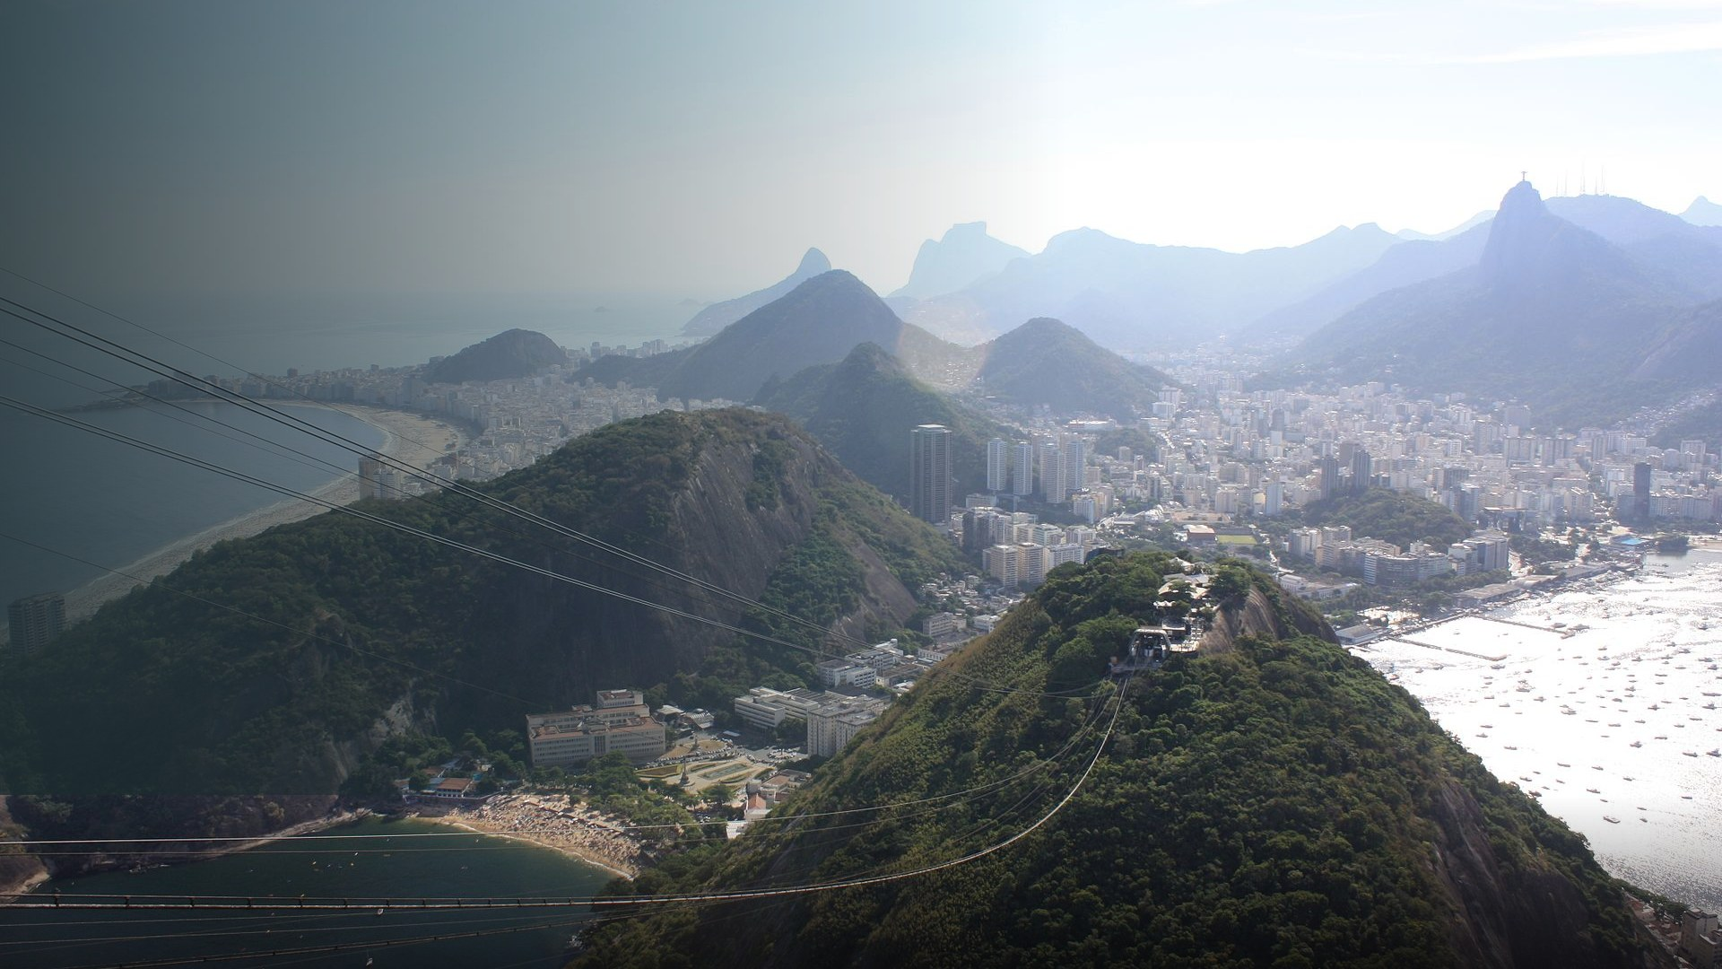
HIV/AIDS IN LAC · THE TREND
HIV in Latin America
& the Caribbean
Reading the trend
Rio de Janeiro, Brazil · Photo: Arian Zwegers from Brussels, Belgium, CC BY 2.0 — Wikimedia Commons
05
https://commons.wikimedia.org/wiki/File:Rio_de_Janeiro,_Copacabana_Beach,_Morro_da_Urca,_and_Cristo_Redentor_from_P%C3%A3o_de_A%C3%A7%C3%BAcar_(15929750801).jpg
Notes:
SECTION DIVIDER — HIV in LAC. About 10 seconds.
Transition: "Now the epidemic itself — and it is not one story, it is two."
Rio: acknowledge the host city and the Brazilian response we will return to later.

Slide 6

HIV/AIDS IN LAC
The regional reality
~2.6 M
1 of 3
88-89-95
people living with HIV across
Latin America & the Caribbean 2025
world regions where new infections
have RISEN since 2010
global 95-95-95 cascade end-2025
— but uneven, lagging in LAC
+13%
−30%
Jan 2025
New people acquiring HIV in LATIN AMERICA, 2010–2024 — one of the few world regions still rising
New people acquiring in the CARIBBEAN, 2010–2025 — hard-won, fragile progress
US foreign-aid pause & PEPFAR stop-work — prevention services hit hardest across LAC
The single regional story has split in two. Treatment science works — undetectable means untransmittable — yet prevention is not reaching those most at risk, and the populations furthest from services are the ones now driving the curve. This talk reads the divide across the migrant lenses.
Sources: UNAIDS Global AIDS Update 2025 — Latin America (unaids.org/sites/default/files/2025-07/2025-global-aids-update-latam.pdf); UNAIDS, Impact of US funding cuts on HIV in LAC (unaids.org/impact-US-funding-cuts).
AIDS 2026 · Rio de Janeiro | B. Cabieses · CeSGI–UDD
06
Notes:
THE REGIONAL REALITY — approx. 2 min. One of the two most important slides.
• ~2.6 million people living with HIV across LAC.
• Latin America is one of only three world regions where new infections have RISEN since 2010 — up about 13%.
• The Caribbean has gone the other way: down about 30%. Hard-won and fragile.
• Since January 2025, the US foreign-aid pause and PEPFAR stop-work orders have hit prevention services hardest.
The argument: the single regional story has split in two, and the funding shock lands on the side of the ledger already losing ground. Treatment science works — undetectable equals untransmittable. Prevention is not reaching the people most at risk.
Stress that the rise is concentrated, not diffuse. That concentration is what the rest of the talk unpacks.

Slide 7
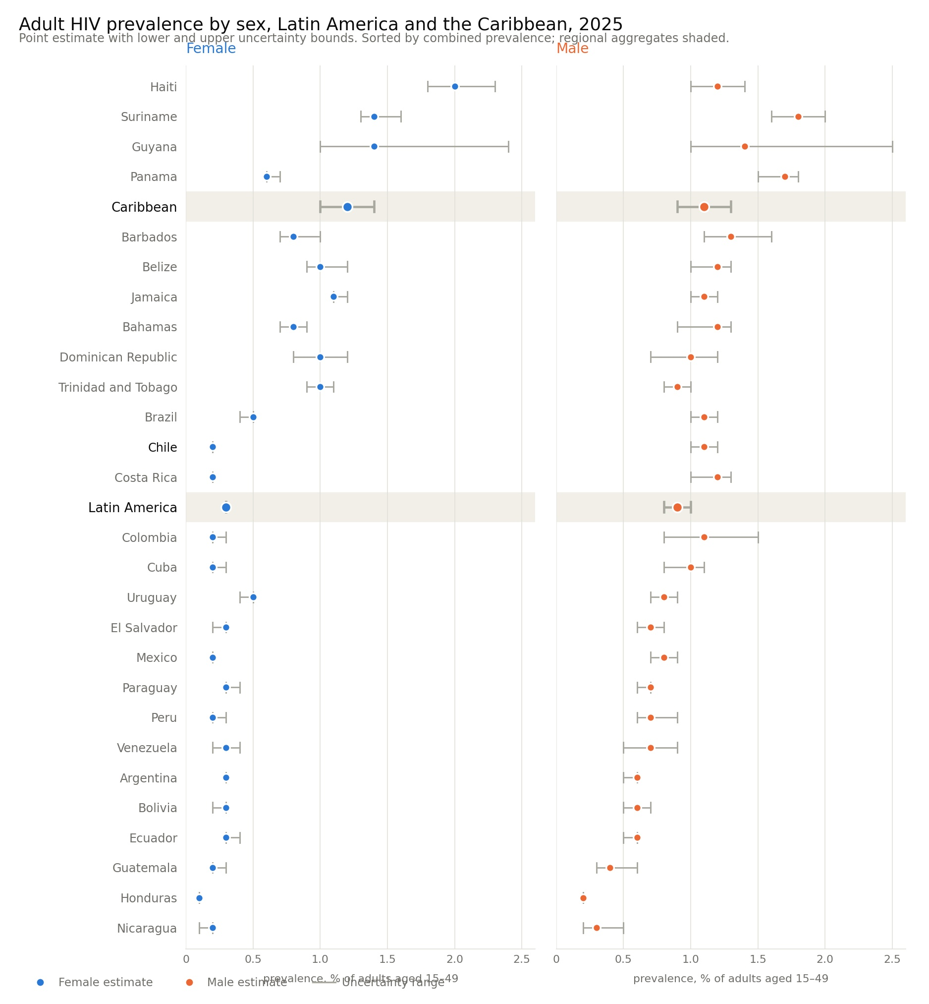
HIV/AIDS IN LAC
The regional reality
UNAIDS 2025 data
No available data for migrants versus locals
AIDS 2026 · Rio de Janeiro | B. Cabieses · CeSGI–UDD
06

Slide 8



GENERAL POPULATIONS
Prevention is not reaching the people most at risk
The PrEP gap, Latin America
Concentrated, not general
A growing share of new people acquiring HIV is among key populations — gay men & other MSM, trans women, sex workers — and their partners.
Global north/South divide: Tools exist; reach does not
PrEP, PEP and HIV self-testing are available but scale-up is too slow and too urban.
Stigma gates the door
Criminalisation and discrimination keep the most exposed away from testing and prevention.
PrEP users in 2024 versus the 2025 regional target (millions) — coverage far below target.
Source: UNAIDS Global AIDS Update 2025 — Latin America; PrEP coverage 2024 (unaids.org/sites/default/files/2025-07/2025-global-aids-update-latam.pdf).
AIDS 2026 · Rio de Janeiro | B. Cabieses · CeSGI–UDD
07
Notes:
THE PREVENTION GAP — approx. 1.5 min.
This is the engine of the regional rise.
• The epidemic is concentrated, not general: a growing share of new infections is among gay men and other MSM, trans women, sex workers, and their partners.
• PrEP reached roughly 250,000 people in 2024 against a 2025 regional target of 2 million — well under a quarter, and heavily urban.
• Criminalisation and discrimination gate the door to testing and prevention.
The line to land: the tools are not the problem. Delivery, reach and stigma are. Everything that follows is about who the delivery system fails first.

Slide 9

MIGRANTS VERSUS LOCALS – HIV/AIDS
Migrants & refugees
vs the general population
Commonalities and divergences
Lima, Peru · Photo: magicmonkey, CC BY 2.0 — Wikimedia Commons
08
https://commons.wikimedia.org/wiki/File:Lima_Peru_coast.jpg
Notes:
SECTION DIVIDER — migrants and refugees. About 10 seconds.
Transition: "Which brings us to the group most often talked about and least often measured."
Set expectations honestly: this section is about commonalities as much as divergences.

Slide 10
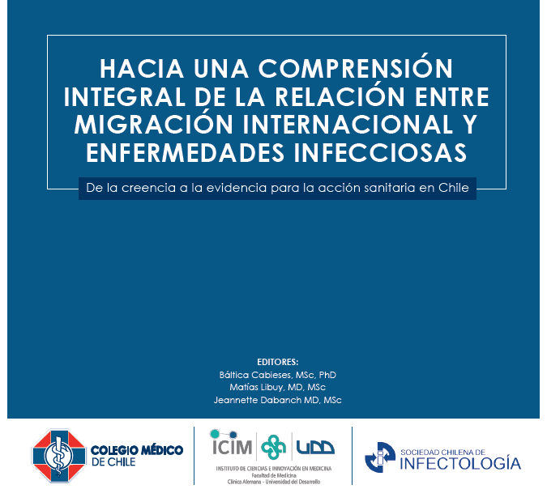

MIGRANTS & REFUGEES
Migrants and refugees: a measurable excess risk
Risk is structural, not inherent
SEMINAL META-ANALYSIS
HIV prevalence ratio — migrants vs native-born
Excess prevalence does not mean migrants bring HIV. Acquisition can occur in origin, transit, or destination — and the highest ratios fall on those with the least legal protection.
Any foreign-born migrant
1.7×
Refugees
2.4×
Undocumented people
4.0×
Asylum seekers
54.8×
Santoso et al., EClinicalMedicine 2022 — 38 studies, 7.1 M migrants pooled.
@2019
Sources: Santoso et al., EClinicalMedicine 2022 — doi:10.1016/j.eclinm.2022.101661; R4V / IOM 2024 (r4v.info); UNAIDS Global AIDS Update 2025.
AIDS 2026 · Rio de Janeiro | B. Cabieses · CeSGI–UDD
09
Notes:
EXCESS RISK — approx. 2 min. Handle with precision.
Santoso et al., EClinicalMedicine 2022 — 38 studies, 7.1 million migrants pooled. HIV prevalence ratios versus native-born populations:
• any foreign-born migrant 1.7×
• refugees 2.4×
• undocumented people 4.0×
• asylum seekers 54.8×
Reframe immediately and explicitly: excess prevalence does NOT mean migrants bring HIV. Acquisition can occur at origin, in transit, or at destination. Read the gradient — the ratio rises exactly as legal protection falls. That is a statement about exclusion, not origin.
Be careful with the asylum-seeker figure: it reflects extreme marginalisation, exposure and sampling in screened populations. Say so out loud rather than letting it be quoted without context.

Slide 11

MIGRANTS VS GENERAL POPULATION
Migrants & refugees vs the general population
Shared risks, divergent structures. Most risk factors are common, but mobility and legal status add a structural layer that standard programmes miss.
Commonalities
Divergences (migrant-specific)
No “whole of route” approach: Mobility breaks the cascade — ART interrupted across borders; care rarely re-anchored.
Legal status gates everything: no insurance, fear of deportation, rights misapplied by providers. IRREGULAR MIGRATION STATUS AS A HEALTH RISK FACTOR.
Intercultural & language barriers; near-total data invisibility in surveillance.
In both regions (LA and Caribbean), a large share of new HIV acquisitions occurs among people from key populations — gay men and other men who have sex with men, transgender women, sex workers — and their sex partners.
Stigma, late diagnosis and limited prevention coverage — including low uptake of pre-exposure prophylaxis (PrEP) — sustain transmission in both territories.
Services in both regions remain heteronormative and poorly adapted to young people.
Implication: Reaching migrants needs the general-population toolkit PLUS portable records, legal inclusion and intercultural delivery.
Sources: Wirtz et al., Lancet HIV 2023 — doi:10.1016/S2352-3018(23)00085-1; Cabieses, Sepúlveda & Obach, Andes Pediatr (Rev Chil Pediatr) 2020 — doi:10.32641/andespediatr.v91i5.1784.
Sources: Santoso et al., EClinicalMedicine 2022 — doi:10.1016/j.eclinm.2022.101661; Wirtz et al., Lancet HIV 2023 — doi:10.1016/S2352-3018(23)00085-1; UNAIDS Global AIDS Update 2025 (LAC).
AIDS 2026 · Rio de Janeiro | B. Cabieses · CeSGI–UDD
11
Notes:
COMMONALITIES AND DIVERGENCES — approx. 2 min.
Lead with what is SHARED, deliberately, so we do not "other" migrants:
• the same key populations drive the epidemic in both groups
• U=U works for both; suppression is high once people are reached and retained
• stigma, late diagnosis and thin PrEP reach drive transmission in both
• both are under-served by heteronormative, non-youth-friendly services.
Then the structural divergences: measurable excess prevalence; mobility breaking the cascade; legal status gating everything; intercultural and language barriers; near-total invisibility in surveillance data.
The implication line is the design principle for the solutions section — say it slowly: the biology is the same, the structures differ. Reaching migrants needs the general-population toolkit PLUS portable records, legal inclusion and intercultural delivery.

Slide 12

SPECIFIC POPULATIONS IN LAC – HIV/AIDS
Specific populations
Youth, gender diversities & intersections
Valparaíso, Chile · Photo: Kinosmosis, CC BY-SA 4.0 — Wikimedia Commons
12
https://commons.wikimedia.org/wiki/File:Comet_G3_ATLAS_above_Valpara%C3%ADso.jpg
Notes:
SECTION DIVIDER — specific populations. About 10 seconds.
Transition: "Two groups where the regional pattern departs sharply from the global script — young people and gender-diverse people."
Valparaíso.

Slide 13
SUBGROUP: GENERAL YOUTH
General Young people: the epidemic's growing edge in LAC
26%
77%
of all people newly acquiring HIV in Latin America are among young people aged 15–24
of people newly acquiring HIV are young men, concentrated among young gay men and other men who have sex with men, and young transgender women.
Implication. HIV prevention for young people in Latin America needs programming designed for and by young gay men and other men who have sex with men, and young transgender women: comprehensive sexuality education, pre-exposure prophylaxis (PrEP) and HIV self-testing delivered through channels that reach them despite criminalisation, stigma and discrimination in health-care settings.
Source: UNAIDS Global AIDS Update 2025 — Latin America, new infections by age & sex (unaids.org/sites/default/files/2025-07/2025-global-aids-update-latam.pdf).
AIDS 2026 · Rio de Janeiro | B. Cabieses · CeSGI–UDD
13
Notes:
YOUNG PEOPLE — approx. 1.5 min.
Two figures, paired:
• 26% of all new HIV infections in Latin America are among people aged 15–24.
• 77% of those youth infections are among young MEN.
This reframes youth programming. The default global script — adolescent girls and young women — misreads Latin America. Here the youth epidemic is concentrated among young gay and bisexual men and young trans people.
Implication: comprehensive sexuality education, PrEP and self-testing designed for young MSM and young trans people, reaching them where stigma is highest — not generic campaigns. Say plainly that generic campaigns are why the curve keeps climbing.

Slide 14

SUBGROUP: MIGRANT YOUTH
Migrant youth: invisible at the intersection in LAC
Triple marginalisation
Reductionist, heteronormative services
Age — adolescence treated as a ‘healthy’, low-need stage
Obach, Blukacz, Sadler, Carreño-Calderón, Cabieses & Díaz (BMC Public Health 2024):
Sexual and reproductive health and rights services for young migrants and displaced people in northern Chile narrow to pregnancy, sexually transmitted infections and HIV, framed through a heteronormative lens — reinforced by provider narratives of "risk" and "lack of self-care".
Migration — status, language, discrimination
Sexual orientation and gender identity — heteronormative service design
Inequalities & access barriers
Carreño-Calderón, Obach, Cabieses et al. (Int J Equity Health 2025):
Mixed-methods evidence on adolescent migrants in Chile — low coverage of youth health programmes among the most vulnerable.
Data gap: adolescent migrants are under-counted across LAC — invisibility in data becomes invisibility in policy action.
Sources: Obach et al., BMC Public Health 2024 — doi:10.1186/s12889-024-17884-5; Carreño-Calderón et al., Int J Equity Health 2025 — doi:10.1186/s12939-025-02615-y.
AIDS 2026 · Rio de Janeiro | B. Cabieses · CeSGI–UDD
14
Notes:
MIGRANT YOUTH — approx. 1.5 min. This is where our field evidence is sharpest.
Triple marginalisation: age (adolescence treated as a "healthy", low-need stage), migration (status, language, discrimination), and sexuality/gender (heteronormative service design).
• Obach, Blukacz, Sadler, Carreño-Calderón, Cabieses & Díaz, BMC Public Health 2024: SRH services for young migrants in Tarapacá narrow to pregnancy, STI and HIV "risk" through a heteronormative lens — reinforced by narratives of risk and "lack of self-care".
• Carreño-Calderón, Obach, Cabieses et al., Int J Equity Health 2025: low coverage of youth health programmes among the most vulnerable adolescent migrants in Chile.
The recurring finding: services designed for an imagined low-risk adolescent fail the young person who is none of those defaults. And adolescent migrants are under-counted across LAC — invisibility in data becomes invisibility in policy.

Slide 15
SUBGROUP
General Transgender people: the population most affected in LAC
25.9%
66×
SEMINAL REVIEWS
Baral, Poteat et al. Lancet Infect Dis 2013 — pooled 19.1%, OR 48.8 worldwide.
Pooled HIV prevalence among transgender women in Latin America (95% CI 20.0–31.8)
Higher odds of living with HIV for transgender women vs other adults — a global, structural disparity
Stutterheim et al. PLOS One 2021 — updated; LAC 25.9%; transgender people ~7×.
Where transgender women are sampled separately from gay men and other men who have sex with men, HIV prevalence in Latin American countries ranges from 18% to 38% (Silva-Santisteban et al., J Int AIDS Soc 2016). This reflects exclusion: transphobia, criminalisation of gender identity and of sex work, exclusion from formal employment and education, and health systems that deny gender-affirming care. Also, persistent gaps in prevention coverage for transgender women across the region.
Sources: Baral & Poteat et al., Lancet Infect Dis 2013 — doi:10.1016/S1473-3099(12)70315-8; Stutterheim et al., PLoS One 2021 — doi:10.1371/journal.pone.0260063; Silva-Santisteban et al., J Int AIDS Soc 2016 — doi:10.7448/IAS.19.3.20799.
AIDS 2026 · Rio de Janeiro | B. Cabieses · CeSGI–UDD
15
Notes:
TRANS WOMEN — approx. 1.5 min. State it plainly.
Trans women are the single most affected population in this region.
• Pooled HIV prevalence among trans women in Latin America: 25.9% (95% CI 20.0–31.8) — Stutterheim et al., PLoS One 2021.
• 66× higher odds of living with HIV than other adults. Baral, Poteat et al., Lancet Infect Dis 2013 put the worldwide pooled figure at 19.1%, OR 48.8.
• Where measured separately from MSM, prevalence runs 18–38% across LAC countries. Trans men are also affected — roughly 7×.
The driver is not behaviour. It is transphobia, criminalisation, survival sex, and health systems that deny gender-affirming care. Silva-Santisteban et al. document the persistent prevention gaps.
Say it directly: 66× is a measure of structural violence, not of anything inherent to being trans.

Slide 16


SUBGROUP
At the sharpest intersection: gender-diverse people on the move
When transphobia, xenophobia, HIV stigma and criminalisation compound in one person, every barrier on every previous slide stacks at once.
Layered stigma and racism
Legal invisibility
Transphobia + xenophobia + HIV stigma + criminalisation — barriers multiply rather than add.
Irregular status and unrecognised gender identity block insurance, ID-based care and PrEP access.
Survival on the route
An evidence gap
Exclusion from formal work pushes many into transactional sex with little prevention reach.
Transgender migrants are largely absent from surveillance — a priority for new research.
Anchors: Stutterheim et al., PLoS One 2021 — doi:10.1371/journal.pone.0260063; Baral et al., Lancet Infect Dis 2013 — doi:10.1016/S1473-3099(12)70315-8; with trans-migrant-health reviews.
AIDS 2026 · Rio de Janeiro | B. Cabieses · CeSGI–UDD
16
Notes:
THE SHARPEST INTERSECTION — approx. 1.5 min. Conceptual peak of the talk.
When transphobia, xenophobia, HIV stigma and criminalisation land on one person, every barrier from every previous slide stacks at once — they multiply rather than add.
• Legal invisibility: irregular status and unrecognised gender identity block insurance, ID-based care and PrEP.
• Survival on the route: exclusion from formal work pushes many into transactional sex with almost no prevention reach.
• Evidence gap: trans migrants are largely absent from surveillance.
Naming that gap is itself a call to action — most systems in this room cannot currently see this group at all.
Design principle to state slowly: responses must be gender-affirming AND migration-aware at the same time. Neither lens alone reaches these communities.

Slide 17
Figgou L, Bozatzis N, Kadianaki I. ‘Guilty as charged’: Intersectionality and accountability in lay talk on discrimination and violence. Br J Soc Psychol. 2023.
Llácer A, Zunzunegui MV, Del Amo J, Mazarrasa L, Bolůmar F. The contribution of a gender perspective to the understanding of migrants’ health. J Epidemiol Community Health. 2007;61(Suppl 2):ii4-ii10.
Crenshaw K. Demarginalizing the intersection of race and sex: A black feminist critique of antidiscrimination doctrine, feminist theory and antiracist politics. U Chi Legal F. 1989:139.
Viveros Vigoya M. La interseccionalidad: una aproximación situada a la dominación. Debate Feminista. 2016;52:1-17.
INTERSECTIONAL, drawing on its development within feminist theory, invites us to analyse processes of production and reproduction of asymmetrical power relations that lead to social and health inequities, conflict and violence, poverty, exclusion and marginalisation, among other harmful effects on population health.
STRUCTURAL, rooted in the belief that skin colour determines a person's place in a hierarchy. These discriminatory practices have permeated society as structural racism, including in the field of health. Structural racism has led to health disparities in Afro-descendant and Latino communities. This influences current and historical policies on discrimination.
Homan P et al. Structural Intersectionality as a New Direction for Health Disparities Research. 2021 Sep;62(3):350-370. doi: 10.1177/00221465211032947.
Allen et al. Exploring Race, Racism, and Structural Racism in Medicine. 2023 Apr;41(2):345-350. doi: 10.1016/j.det.2022.08.005.
Martínez-Hernández et al. Structural competency in epidemiological research: What’s feasible, what’s tricky, and the benefits of a ‘structural turn’. 2023 Jan 7;1-14. doi: 10.1080/17441692.2023.2164903.
HISTORICAL AND PERSISTENT, through beliefs, prejudices and even misleading scientific theories and studies used to promote the concept of the inferiority of people based on race and to support and maintain the institution of slavery.
Viruell-Fuentes EA, Miranda PY, Abdulrahim S. More than culture: structural racism, intersectionality theory, and immigrant health. Soc Sci Med. 2012;75(12):2099-106.
Castañeda H, Carrion IV, Kline N, Tyson DM. False hope: effects of social class and health policy on oral health inequalities for migrant farmworker families. Soc Sci Med. 2010 Dec;71(11):2028-37. PMID: 20943298.
Informality, Social Citizenship, and Wellbeing among Migrant Workers in Costa Rica in the Context of COVID-19. Int J Environ Res Public Health. 2022;19(10):6224. PMID: 35627759.
RACISM
in LAC
COLONIAL AND POSTCOLONIAL, recognising that during colonial occupation the colonising groups held political, economic and social privileges denied to the colonised, and the hierarchy was typically sustained by claims that colonized communities were racially inferior. The historian Partha Chatterjee refers to this as “the rule of colonial difference”. Within it, the colonised, by virtue of their biology, were represented “as incorrigibly inferior” (1993, pp. 19).
Wendel ML, Jones G Jr, Nation M, Howard T, Jackson T, Brown AA, Kerr J, Williams M, Ford N, Combs R. ‘Their heels is not helping’: Policing as a Tool of Structural Violence against Black Communities. Psychol Violence. 2022 Jul;12(4):231-240. PMID: 37187805.
Cordova D, Parra-Cardona JR, Blow A, Johnson DJ, Prado G, Fitzgerald HE. ‘They don’t look at what affects us’: the role of ecodevelopmental factors on alcohol and drug use among Latinos with physical disabilities. Ethn Health. 2015;20(1):66-86. PMID: 24571535.
SYSTEMIC, INTERGENERATIONAL, GLOBAL, drawing on the role of intergenerational mechanisms (including epigenetic ones) in transmitting the impact of stress and ancestral trauma, poor nutrition and exposure to toxic substances across generations, and the factors that can mitigate the effects of these experiences. In addressing ancestral trauma, real change and healing will require acknowledgement of the harms done and broader change at the level of systemic policy.
Kaufman J, Khan M, Shepard Payne J, Mancini J, Summers White Y. Transgenerational Inheritance and Systemic Racism in America. Psychiatr Res Clin Pract. 2023;5(2):60-73. PMID: 37293142.
Matoba N, Collins JW, Dizon M. Fetal origins of health disparities: transgenerational consequences of racism. Dev Neurosci. 2023 Jun 8. PMID: 37290414.
Edwards T, McManarnna N, King B. The absence of language: A critical race discourse analysis of Ontario’s child welfare legislation and the impacts on Black families. Child Abuse Negl. 2023;143:106249. PMID: 37290205.
14

Slide 18

FROM OUR OWN RESEARCH IN CHILE AND LAC
From our own research
Chile & LAC · CeSGI–UDD
Torres del Paine, Chile · Photo: Pedro Szekely from Los Angeles, USA, CC BY-SA 2.0 — Wikimedia Commons
17
https://commons.wikimedia.org/wiki/File:Cuernos_del_Paine_in_Torres_del_Paine_National_Park.jpg
Notes:
SECTION DIVIDER — our own research. About 10 seconds.
Transition: "Let me show you how these mechanisms look when you trace them in the field, in Chile and across the region."
Torres del Paine.

Slide 19
EVIDENCE FROM CESGI–UDD · 1 OF 2
From exclusion to HIV acquisition — migrant and forcibly displaced women and young people
STRUCTURAL DRIVER
MECHANISM / PATHWAY
HIV OUTCOME
Pregnant migrant women
Irregular status, language & cultural distance
→
Late or missed antenatal HIV screening
→
Vertical (mother-to-child) transmission
Cabieses, Sepúlveda & Obach, Rev Chil Pediatr 2020
Young migrants’ SRH
Heteronormative, pregnancy-only services
→
‘Risk / lack of self-care’ narratives → disengagement
→
Unmet testing, PrEP & prevention
Obach et al., BMC Public Health 2024
Adolescent migrants
‘Healthy adolescent’ assumption; low coverage
→
Data & service invisibility — no entry point
→
Prevention window missed
Carreño-Calderón et al., Int J Equity Health 2025
18
AIDS 2026 · Rio de Janeiro | B. Cabieses · CeSGI–UDD
Notes:
CESGI EVIDENCE, 1 OF 2 — approx. 2 min.
Read the columns once — structural driver, mechanism, outcome — then walk ONE pathway end to end. Pregnancy is the clearest: irregular status, language and cultural distance → late or missed antenatal HIV screening → vertical transmission (Cabieses, Sepúlveda & Obach 2020).
Then gesture across the other two rows rather than reading them: heteronormative, pregnancy-only services → "risk / lack of self-care" narratives → unmet testing and prevention (Obach et al. 2024); the "healthy adolescent" assumption → data and service invisibility → prevention window missed (Carreño-Calderón et al. 2025).
Point at the MECHANISM column and say: this is where our interventions sit. Every pathway is interruptible — intercultural, youth-, migrant- and gender-responsive care inserted at the mechanism stage breaks the chain before the outcome. Full citations on the references slide.

Slide 20
EVIDENCE FROM CESGI–UDD · 2 OF 2
From exclusion to HIV acquisition — gender norms, migration status and stigma
STRUCTURAL DRIVER
MECHANISM / PATHWAY
HIV OUTCOME
Border liminality & closures
Restrictive border / pandemic measures
→
Precariousness; interrupted care; rights violations
→
ART discontinuity along the route
Rocha-Jiménez et al., BMC Public Health 2023 & Lancet Reg Health Am 2025
Stigma & discrimination narratives
Stigmatising ‘threat / disease’ narratives
→
Mistrust, fear & avoidance of services
→
Delayed testing; disengagement from care
Cabieses et al., Lancet Reg Health Am 2024
Where to act. Every pathway can be interrupted. Intercultural, person-centred services designed for and by young people — gender-transformative, and inclusive of migrants and forcibly displaced people — placed at the mechanism stage prevent the outcome rather than treating it.
19
AIDS 2026 · Rio de Janeiro | B. Cabieses · CeSGI–UDD
Notes:
CESGI EVIDENCE, 2 OF 2 — approx. 2 min. Same structure; move faster, the audience now reads the grid.
• Masculine-identity norms → condom and testing avoidance, delayed care-seeking → late diagnosis and onward transmission (Ferrer, Cianelli, Bernales et al., J Nurs Scholarsh 2016).
• Restrictive border and pandemic measures → precariousness, interrupted care, rights violations → ART discontinuity along the route (Rocha-Jiménez et al., BMC Public Health 2023; Lancet Reg Health Am 2025). Our participants' words: border closure only increased precariousness.
• Stigmatising "threat / disease" narratives → mistrust and avoidance of services → delayed testing and disengagement (Cabieses et al., Lancet Reg Health Am 2024).
The policy point worth pausing on: closing a border does not stop movement, it only removes the care from it.
Repeat the intervention line — the mechanism column is the place to act.

Slide 21




SYNTHESIS: PROPOSED MECHANISMS
Why these inequities persist: a syndemic (interacting health conditions tied to social inequality)
Social determination
Colonial, intersectional stigma
Structural & legal exclusion
Service design failure
Data invisibility
Historical and interacting: poverty, housing, work, education and migration status shape vulnerability — the conditions attached to migration, not movement itself, determine health.
Colonial roots: racism and xenophobia.
Stigma related to HIV, gender, sexual orientation, migration status and race intersects and compounds — it does not merely add.
Irregular status, exclusion from health coverage and criminalisation block or condition access — and fear of deportation keeps people away from services that are nominally open..
Services are not migrant inclusive, not differentiated for young people, and not intercultural — so people who do reach them often do not come back.
Where surveillance is not disaggregated — by gender identity, migration status and age — the most affected populations disappear from the data, and from the response.
Framework synthesis: social-determinants & syndemics scholarship; Cabieses, Bernales & Van der Laat, Lancet Psychiatry 2016 — doi:10.1016/S2215-0366(16)30006-2.
AIDS 2026 · Rio de Janeiro | B. Cabieses · CeSGI–UDD
20
Notes:
SYNTHESIS — approx. 1.5 min. If the audience remembers one slide for the mechanism question, this is it.
Five structural engines recur across every population:
1. Social determinants — poverty, housing, work, education. Migration is itself a determinant of health.
2. Intersecting stigmas — HIV, gender, sexuality, migration and race stigmas multiply, not merely add.
3. Structural and legal exclusion — irregular status, no insurance, criminalisation, fear of deportation.
4. Service design failure — heteronormative, reductionist, non-intercultural care turns people away at the door.
5. Data invisibility — un-disaggregated surveillance hides the most affected; invisibility becomes inaction.
Syndemic logic: these cluster and interact, so single-disease or single-identity programmes underperform by design. Effective responses act on the structures, not only on the virus.
Bridge: "So what is already working?"

Slide 22

INTEGRATING THE EVIDENCE –
MECHANISMS/PATHWAYS
Integrating the evidence into solutions
Mechanisms & pathways
Iguazú Falls, Argentina/Brazil · Photo: Sky shark 0, CC BY-SA 4.0 — Wikimedia Commons
21
https://commons.wikimedia.org/wiki/File:Iguazu_Falls_Brazilian_Side.jpg
Notes:
SECTION DIVIDER — solutions. About 10 seconds.
Transition: "This is the constructive half. None of what follows is hypothetical — all of it is running somewhere in this region right now."
Iguazú.

Slide 23



WHAT IS WORKING · I
Impactful responses I — biomedical tools & resilient systems
Migrant regularization as a public health matter
Universal-access systems
Colombia's Estatuto Temporal de Protección para Migrantes Venezolanos (ETPV, 2021) granted ten-year permits that opened a pathway to health system affiliation — and with it, HIV testing, treatment and care — for Venezuelans who registered. Legal status as an enabling condition for prevention.
Scale & decentralise biomedical tools
PrEP, HIV self-testing and long-acting injectables — delivered through differentiated service delivery in community-led and primary care settings rather than tertiary hospitals, removing the referral, registration and documentation steps that stop people reaching services at all.
Continuity of care across borders
AIDS 2026 · Rio de Janeiro | B. Cabieses · CeSGI–UDD
22
Notes:
WHAT IS WORKING, I — approx. 2 min. Move from problem to proof.
• Brazil's SUS guarantees free ART, PrEP and testing — domestically financed, and it absorbed the funding shock. This is the strongest available argument for sustainability over donor dependence.
• Colombia's 10-year Temporary Protection Statute (ETPV, 2021) opened insurance and the full HIV cascade to displaced Venezuelans. Policy as prevention — a legal instrument doing epidemiological work.
• Scale and decentralise the biomedical tools: PrEP, self-testing and long-acting injectables out of tertiary hospitals and into community and primary care, where reach actually is.
• Continuity across borders: the PAHO/UNAIDS models for uninterrupted ART — portable records, cross-border referral, navigation support.
Two exemplars, two different levers — universal financing and legal inclusion. Both are replicable, and both were domestic decisions.

Slide 24



WHAT IS WORKING · II
Impactful responses II — community-led, intercultural, rights-based
Community-led organisations
Intercultural navigation
The backbone of reach to key populations. Protect and sustainably finance them — social-contracting mechanisms can keep services running beyond donor cycles.
Welcome programmes and peer navigators (the CeSGI model) translate entitlements into access — across language, culture and migration status.
Gender-affirming & youth-friendly
Peer support along the route
Differentiated service delivery designed with transgender communities and young people — affirmation is itself an HIV-prevention intervention.
Migrant-led peer networks sustain testing, adherence and re-linkage at each step of the journey, where formal systems hand off.
Sources: Guillén et al., J Int AIDS Soc 2026 — doi:10.1002/jia2.70081; UNAIDS LAC community-response analyses 2025; CeSGI–UDD programme (cesgi.udd.cl).
AIDS 2026 · Rio de Janeiro | B. Cabieses · CeSGI–UDD
23
Notes:
WHAT IS WORKING, II — approx. 2 min.
• Community-led organisations are the backbone of reach to key populations. Protect and finance them sustainably — social contracting can keep services running beyond donor cycles.
• Intercultural navigation: welcome programmes and peer navigators — the CeSGI model — translate entitlements into actual access across language, culture and legal status.
• Gender-affirming and youth-friendly differentiated service delivery, designed WITH trans communities and young people. Affirmation is itself an HIV-prevention intervention.
• Migrant-led peer networks sustain testing, adherence and re-linkage at each step of the journey, exactly where formal systems hand off.
The central point: biomedical tools fail without community delivery — and the funding shock hit precisely this layer (Guillén et al., J Int AIDS Soc 2026). Protecting and financing it is now the central policy question for this region.

Slide 25
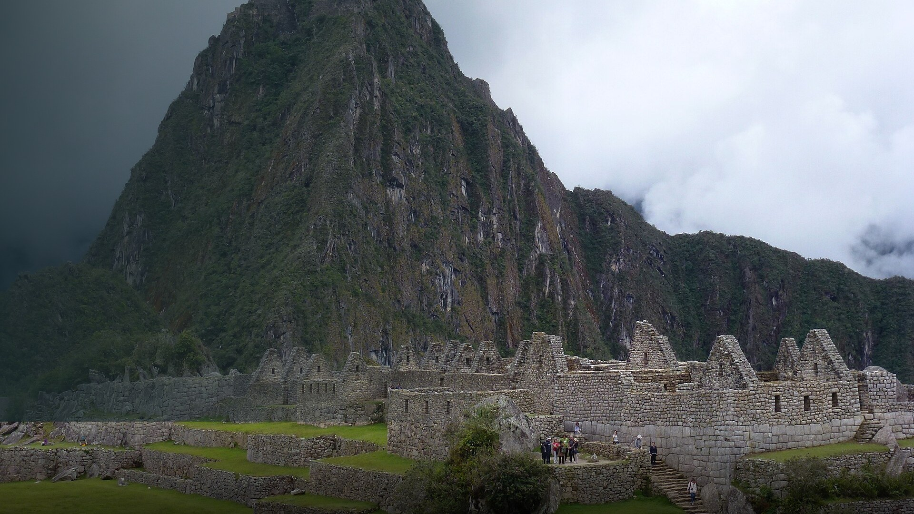
CLOSING REMARKS
Closing remarks
Rethink. Rebuild. Rise.
Machu Picchu, Peru · Photo: PIERRE ANDRE LECLERCQ, CC BY-SA 4.0 — Wikimedia Commons
24
https://commons.wikimedia.org/wiki/File:Haunya_Picchu_(Machu_Picchu)_P%C3%A9rou_(2).jpg
Notes:
SECTION DIVIDER — closing. About 10 seconds.
Pause here. Slow the pace down deliberately before the final slide.

Slide 26
IN CLOSING
Rethink. Rebuild. Rise.
New HIV acquisitions are rising in Latin America while falling in the Caribbean — and the funding contraction lands on the populations already furthest from services.
Migrants and displaced people, young people, gay men and other men who have sex with men, and transgender women are not separate populations but one intersecting pattern of structural and colonial exclusion.
The science works. The gap is delivery, stigma and the legal environment — addressable through intercultural, community-led, cost-effective responses, most of which already exist.
The people furthest from services must be closest to the response — and must help lead it. That includes people who have crossed borders.
Selected sources: UNAIDS Global AIDS Update 2025 · Santoso et al. 2022 · Wirtz et al. 2023 · Baral & Poteat et al. 2013 · Stutterheim et al. 2021 · Silva-Santisteban et al. 2016 · Obach et al. 2024 · Carreño-Calderón et al. 2025 · Cabieses, Sepúlveda & Obach 2020 · Guillén et al. 2026. Full list overleaf.
bcabieses@udd.cl · cesgi.udd.cl
25
Notes:
CLOSING — approx. 1.5 min. Four sentences, delivered slowly, then stop.
• Latin America's epidemic is rising while the Caribbean's falls — and the funding shock lands on the populations already furthest from care.
• Migrants, young people and gender-diverse people are not three separate problems. They are one intersecting story of structural exclusion.
• The science works. The gap is delivery, stigma and rights — solvable with intercultural, community-led, domestically financed responses.
• Final line, land it and hold the silence: the people furthest from services must become the closest to the response. That often includes people on the move.
Then thank the room and open the floor. Anticipated questions: the asylum-seeker prevalence ratio; whether regional data can be disaggregated by migration status; what replaces PEPFAR funding.

Slide 27
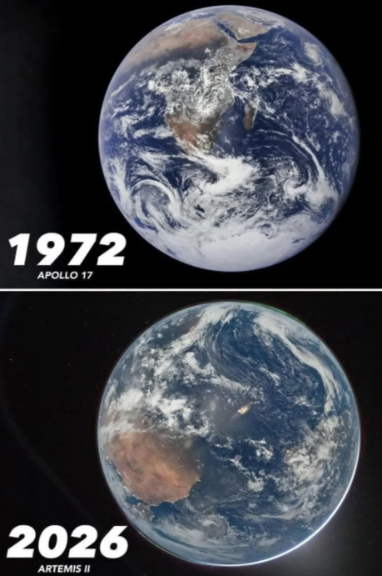
Design principle:
Responses — including pre-exposure prophylaxis (PrEP) coverage — must be simultaneously gender-affirming and inclusive of migrants and forcibly displaced people. Neither lens alone reaches young transgender women who are also migrants or displaced.
HIV protocols, policies and programmes should name migrants, refugees, people seeking asylum and stateless people explicitly in their eligibility criteria, and remove documentation and residency requirements that exclude them in practice.

Slide 28
Stop blaming migrants and displaced people.
Start removing the documentation, insurance and residency barriers that keep them out of prevention and care in countries of origin, during transit and at the countries of destination.

Slide 29
IN CLOSING
Keep an eye on…
2022 World report on the health of refugees and migrants: https://www.who.int/publications/i/item/9789240054462
2026 Second report on the health of refugees and migrants: https://www.who.int/publications/i/item/9789240117747
2021 Who Refugee and migrant health: Global Competency Standards for health workers: https://www.who.int/publications/i/item/9789240030626
PAHO Dashboard evidence Americas health of migrants: https://www.paho.org/en/migration-and-health-americas/health-and-migration-americas-information-platform#LiteraturaCientifica
WHO global repository good practices: https://www.who.int/tools/dashboard-on-global-experiences-in-promoting-refugee-and-migrant-health
bcabieses@udd.cl · cesgi.udd.cl
26
Notes:
RESOURCES — approx. 30 seconds. Do not read the list; tell people it will be shared.
Flag two in particular: the WHO 2026 Second report on the health of refugees and migrants, and the PAHO Americas migration-and-health dashboard, which is the practical starting point for anyone wanting country-level evidence.
Also worth naming: the WHO global competency standards for health workers, and the WHO repository of good practices — useful for delegates who want to act on the service-design point rather than the policy one.

Slide 30
REFERENCES
Key umbrella & systematic reviews, regional estimates, and CeSGI–UDD studies cited in this plenary.
01
R4V / IOM–UNHCR. Regional Refugee & Migrant Response Plan (RMRP) 2025–2026 and regional population figures (7.74 M displaced globally; 6.59 M in LAC, end-2024). r4v.info · crisisresponse.iom.int
11
Carreño-Calderón A, Obach A, Cabieses B, Oyarte M, Arias Schreiber A. Addressing health inequalities and barriers to access among adolescent migrants in Chile: a mixed methods study. Int J Equity Health. 2025;24:234. doi:10.1186/s12939-025-02615-y
02
UNAIDS. Global AIDS Update 2025 — Latin America & the Caribbean. Geneva: UNAIDS; 2025. unaids.org/sites/default/files/2025-07/2025-global-aids-update-latam.pdf
12
Cabieses B, Sepúlveda C, Obach A. Prevención de la transmisión vertical de VIH en mujeres migrantes internacionales. Andes Pediatr (formerly Rev Chil Pediatr). 2020;91(5). doi:10.32641/andespediatr.v91i5.1784
03
UNAIDS. Impact of US funding cuts on the HIV response in Latin America & the Caribbean. Feature stories, Feb–Mar 2025. unaids.org/impact-US-funding-cuts
13
Ferrer L, Cianelli R, Villegas N, Reed R, Bernales M, Repetto P, et al. Exploring the masculine identity in the context of HIV prevention in Chile. J Nurs Scholarsh. 2016;48(2):128–138. doi:10.1111/jnu.12190
04
Santoso D, Asfia SKBM, Mello MB, et al. HIV prevalence ratio of international migrants vs native-born counterparts: a systematic review and meta-analysis. EClinicalMedicine. 2022;53:101661. doi:10.1016/j.eclinm.2022.101661
14
Cabieses B, Bernales M, Van der Laat C. Health for all migrants in Latin America and the Caribbean. Lancet Psychiatry. 2016;3(5):402. doi:10.1016/S2215-0366(16)30006-2
05
Wirtz AL, Guillén JR, Stevenson M, et al. HIV infection and engagement in the care continuum among migrants & refugees from Venezuela in Colombia: a biobehavioural survey. Lancet HIV. 2023;10(7):e461–e471. doi:10.1016/S2352-3018(23)00085-1
15
Rocha-Jiménez T, Olivari C, Martínez A, Knipper M, Cabieses B. “Border closure only increased precariousness”: restrictive COVID-19 measures and Venezuelans’ health & human rights in South America. BMC Public Health. 2023;23. doi:10.1186/s12889-023-16726-0
06
Baral SD, Poteat T, Strömdahl S, Wirtz AL, Guadamuz TE, Beyrer C. Worldwide burden of HIV in transgender women: a systematic review and meta-analysis. Lancet Infect Dis. 2013;13(3):214–222. doi:10.1016/S1473-3099(12)70315-8
16
Obach A, Sadler M, Cabieses B, et al. Strengths and challenges of a school-based SRH programme for adolescents in Chile. PLoS One. 2022;17(3):e0265309. doi:10.1371/journal.pone.0265309
07
Stutterheim SE, et al. The worldwide burden of HIV in transgender individuals: an updated systematic review and meta-analysis. PLoS One. 2021;16(12):e0260063. doi:10.1371/journal.pone.0260063
17
Obach A, Sadler M, Robledo C, Wright C, Cabieses B. Unmet needs in young women’s SRH and rights: a qualitative study in Chile’s Metropolitan Region. Sex Reprod Health Matters. 2025. doi:10.1080/26410397.2025.2558272
08
Silva-Santisteban A, Eng S, de la Iglesia G, Falistocco C, Mazin R. HIV prevention among transgender women in Latin America: implementation, gaps and challenges. J Int AIDS Soc. 2016;19(3 Suppl 2):20799. doi:10.7448/IAS.19.3.20799
18
Obach A, Hasen F, Cabieses B, D’Angelo C, Santander S. Conocimiento, acceso y uso del sistema de salud en adolescentes migrantes en Chile. Rev Panam Salud Publica. 2020;44:e175. doi:10.26633/RPSP.2020.175
09
Guillén JR, Stevenson M, Barriga Talero MÁ, Torres MA, Wirtz AL. Consequences of US funding suspensions on community-led HIV services in LAC: a rapid service provider survey. J Int AIDS Soc. 2026;29:e70081. doi:10.1002/jia2.70081
19
Obach A, Sadler M, Jofré N. Sexual and reproductive health of adolescents in Chile: the role of sexual education. Rev Salud Pública (Bogotá). 2017;19(6):848–854. doi:10.15446/rsap.v19n6.70023
10
Obach A, Blukacz A, Sadler M, Carreño-Calderón A, Cabieses B, Díaz C. Barriers and facilitators to access SRH services among young migrants in Tarapacá, Chile: a qualitative study. BMC Public Health. 2024;24:386. doi:10.1186/s12889-024-17884-5
20
Rocha-Jiménez T, Torres I, Cabieses B, López-Cevallos DF, Mercado-Órdenes M. Intersectionality, racism and mental health of migrants at borders in Latin America (Ecuador & Chile). Lancet Reg Health Am. 2025;44:101040. doi:10.1016/j.lana.2025.101040
21
Cabieses B, Belo K, Carreño Calderón A, Rada I, Rojas K, Araoz C, Knipper M. The impact of stigma and discrimination-based narratives in the health of migrants in LAC: a scoping review. Lancet Reg Health Am. 2024;40:100660. doi:10.1016/j.lana.2023.100660
Prepared for AIDS 2026 · Rio de Janeiro. DOIs resolve at doi.org. Correspondence: bcabieses@udd.cl · cesgi.udd.cl
AIDS 2026 · Rio de Janeiro | B. Cabieses · CeSGI–UDD
27
Notes:
REFERENCES — hold briefly; no narration needed.
If asked: 21 sources — umbrella and systematic reviews, regional estimates from UNAIDS and R4V/IOM, and CeSGI–UDD studies. All carry DOIs or institutional URLs, verified via Crossref.
Migration figures come from R4V/IOM (ref 1); regional epidemiology from UNAIDS 2025 (refs 2–3); the prevalence-ratio meta-analysis is ref 4; the trans-population reviews are refs 6–8.
Slides and reference list available on request at bcabieses@udd.cl.

Slide 31

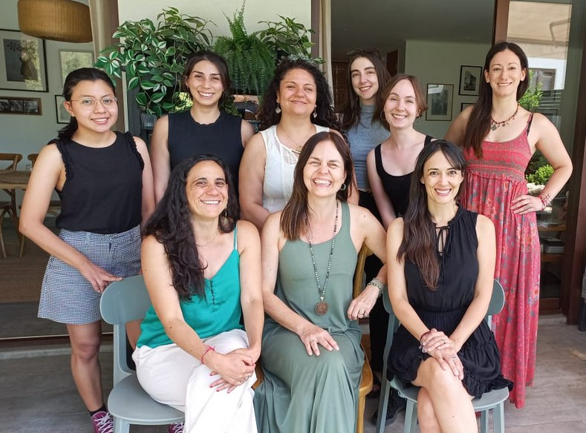
Thank you
The CeSGI–UDD team — with gratitude to partner communities, people living with HIV, and Lancet Migration LAC.
Centro de Salud Global Intercultural · Universidad del Desarrollo · cesgi.udd.cl · @cesgi_udd
28
Notes:
THANK YOU — approx. 30 seconds.
Thank the CeSGI–UDD team by name if time allows, and acknowledge the partner communities, the people living with HIV who took part in this research, and Lancet Migration's Latin American Hub.
Invite people to connect: cesgi.udd.cl, @cesgi_udd, and bcabieses@udd.cl.
Leave this slide up for the discussion.

