Slide 1
Harnessing Artificial Intelligence for HIV:
Breakthrough or Buzzword?
Izukanji Sikazwe
Head of HIV, The Global Fund
Notes:
Good morning, everyone – what an absolute honour it is to be standing here with you. To be part of a plenary at AIDS 2026,
Today I want to talk about something that is generating enormous energy across our field: artificial intelligence. The question I want us to sit with is AI a genuine breakthrough for the HIV response, or is it just the latest buzzword? Over the next 25 min, I’ll make the case for why I believe it is a breakthrough, one that will support on us like a great team mate.

Slide 2
Session Outline
AI in HIV Programming
When AI Becomes a Risk
Investing in AI
Rebuild, Rethink, Rise with AI

Slide 3
What is AI
Notes:
So let me start with a promise: by the time you leave this room, AI is going to feel less like a buzzword and more like a teammate.

Slide 4




Types of AI
See
Hear
2-way Communication
Reason
Computer Vision
Computer aided detection for TB Screening
HealthPulse AI - HIVST
Automatic Speech
Recognition
Ambient AI scribes
Big Data Analytics
Supply chain forecasting, predictive risk scoring
Language Models
(LLM and NLP)
AI Chatbots
Artificial General Intelligence (AGI) & Multimodal AI
Using multiple AI types together produces richer, more human-like outputs
Notes:
I’m in no way qualified to talk about what AI is. But I am a user of it, and I do know a few things about HIV and designing an implement impactful programs. So, please bear with me and journey the next 25 min with me.
This is my cheat sheet on AI.
I broadly classified them into these four buckets, which almost mirror of our senses – ‘See, Hear, Communication and Reasoning” for computer vision, automatic speech recognition, language models and big data analytics. AI is a science of computer systems that is capable of performing tasks that we typically do. It uses patterns in images in computer vision to aid TB detection, sound for automatic speech recognition to support patient note taking, reasoning for big data analytics.
AI uses patterns to make predictions or decisions or create new content.
They key is to remember they are not separate technologies. They are overlapping capabilities often combined into one application.

Slide 5

The AI You Didn’t Notice ~200 years in the making
Not one technology, but a stack of capabilities that, together, change people’s daily experiences
What we call it | What it actually is
Google Maps route suggestion | Predictive optimisation algorithm
Autocomplete on your phone | Natural language prediction model
"Going paperless" at the clinic | AI-led point-of-care digitisation
Automated SMS/Calls to missed patients | AI-driven patient communication
Treatment interruption priority list | Predictive ML on adherence data
Stock-out alert | AI-driven supply chain forecasting
Ada Lovelace 1815-1852
Notes:
This journey began almost 200 years ago, and with a woman! I honestly do not know where mankind would be where it not for women.
Ada Lovelace – world’s first computer programmer!
AI isn't coming! it's already everywhere in our daily lives.
Every row on this table is something we already trust. Maps rerouting you?
That's predictive optimisation. Autocomplete finishing your sentence as you type or speak?
That’s a language model. Going paperless at the clinic? AI at the point of care.
We are well and truly in the AI age, the question really should be, how do we use it for great impact

Slide 6
AI in HIV Programming: A Longer History Than the Current Debate Suggests
Algorithmic Modelling
mHealth & Adherence AI
LLMs & Foundation Models
UNAIDS Spectrum / EPP
Epidemic projection in 170+ countries
Powers PEPFAR & Global Fund allocations
WelTel SMS platform (Kenya/Uganda)
ML-based defaulter tracing algorithms
OpenMRS clinical decision support
Chatbot-driven adherence support
Computer vision for TB/HIV screening
NLP on national EHR datasets at scale
Brown T et al., AIDS 2014; 28(S4):S415
Lester RT et al., Lancet 2010; 376:1838
Rajpurkar P et al., Nat Med 2022; 28:31
Obermeyer Z et al., Science 2019; 366:447
1990s
2010s
Now
2000s
2020s
Supply Chain Forecasting
Integrated Decision Support
USAID / GHSC-PSM ML forecasting
ARV demand prediction, 40+ countries
Documented reduction in stockout rates
PEPFAR DATIM predictive analytics
Jembi record deduplication (South Africa)
AI-powered early infant diagnosis (Nigeria)
USAID / GHSC-PSM Annual Report, 2023
PEPFAR, 20th Anniversary Report, US Dept of State, 2023
Rajpurkar P et al., Nat Med 2022; 28:31
The current generation of large language models represents an acceleration, not the origin of AI in the HIV response
Notes:
In the HIV world, AI has played a critical role in how we program.
It has been embedded in our systems for over thirty years. What has changed is the label, and our scale of the ambition of what we can achieve with it.
From the 1990’s, The UNAIDS Spectrum and the Estimation and Projection Package have been running Bayesian statistical models on HIV surveillance data. These are used in over 100 countries and anchor national plans and investments for HIV
From early 2,000 Supply chain forecasting applied machine learning to quantify ART estimates by processing historical consumption data, patient load trends, and procurement lead times to tell supply chain managers how much stock to order and where to position it. We just didn’t call it AI
We journeyed through an era that supported mhealth and AI adherence tools, which expanded with smart phones and internet access in LMICs. We are now in an era of using large language models, natural language processing in Chatbots and electronic medical records.
The current generation of LLM represents an acceleration and not the origin of AI in the HIV response
These are genuinely new capabilities and represent an acceleration of something that has been running for three decades."
The question is not whether AI belongs in HIV programming. It already does.

Slide 7
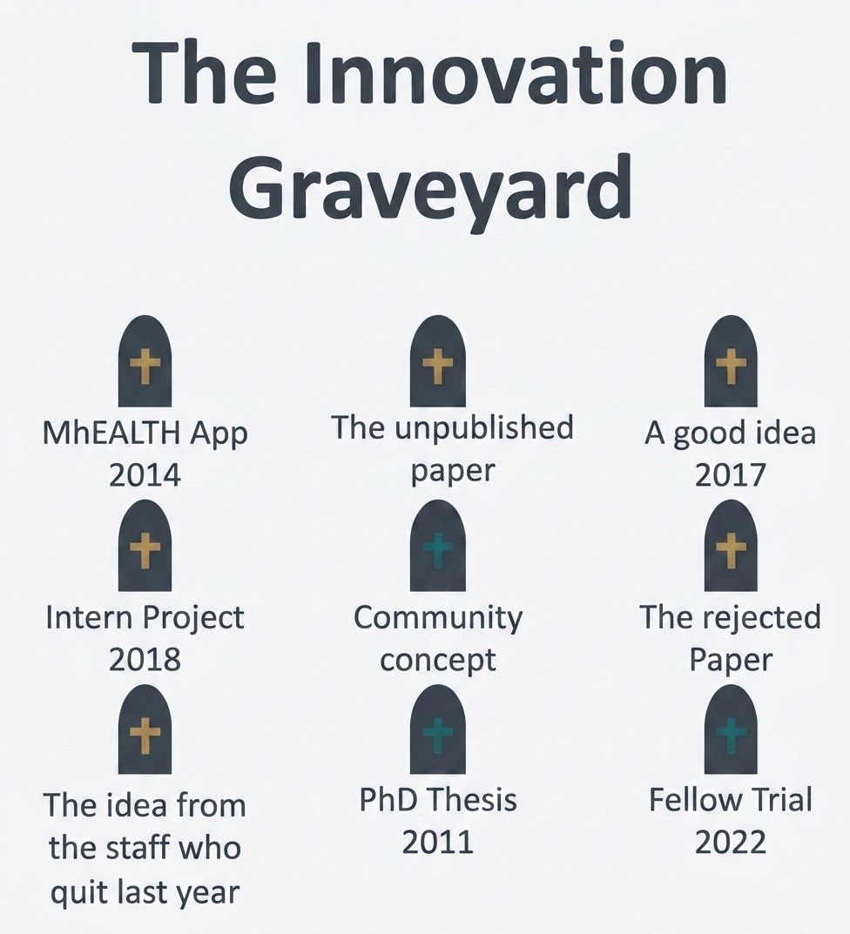
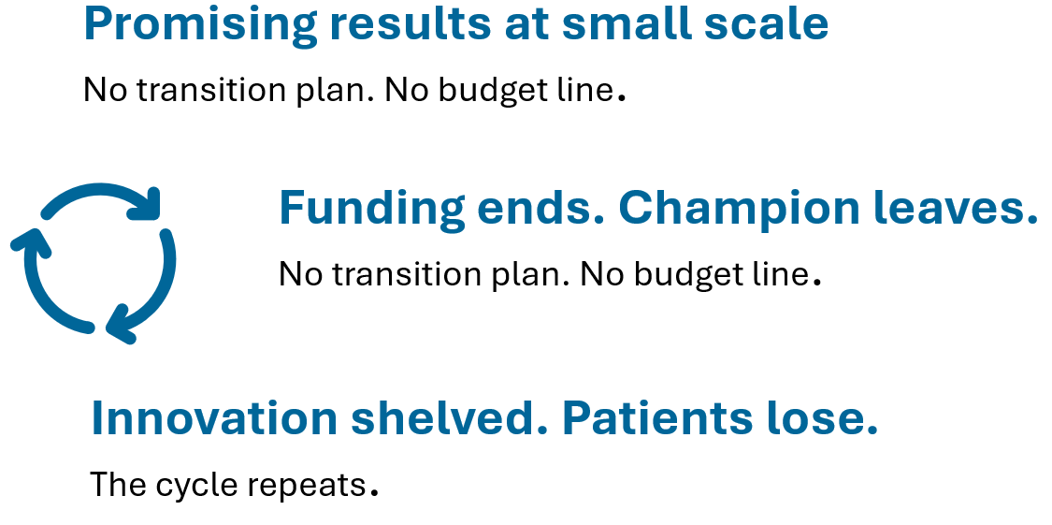
Moving from Pilots to Implementation at Scale
Where have all the innovations gone?
Notes:
Where have all the innovations gone?
How do we move from pilots to implementation at scale? We run brilliant pilots—and then they stall. We get promising results but have no plans nor funds to implement them at scale.
The exciting part isn't proving something works once—it's making it work everywhere, every day, for everyone.
Scale is where the real impact lives. That means moving past the pilot graveyard and building for implementation from day one. Every time we shelve a great innovation, our clients lose.
Let's stop celebrating pilots and start scaling the ones that change lives

Slide 8
“Pilotitis”: When Innovations Fail to Scale
WHAT WAS SAID | WHAT ACTUALLY HAPPENED
"The pilot worked" | It worked for 200 patients with a dedicated research team
"The data is there" | The data existed. No one acted on it
"Staff were trained" | Training happened once; staff turned over; knowledge left
"The community wants it" | We asked the community after we built it
“Pilotitis” isn't a technology failure. It's a system failure. Three root causes- every time:
1
Designed for a grant.
No support for scale or sustainability
2
Bolted on, not built in.
Technology added as a parallel system.
3
Data collected, not used.
Used for reporting and not for decision making
Notes:
“Pilotitis." The disease of endless pilots that never become programmes
Every phrase on the left sounds like success, but the catch is on what actually happened.
"The pilot worked" — for 200 patients, with a dedicated research team, that no routine clinic will ever have.
"Staff were trained" — once; then they turned over and that knowledge walked out the door.
"The community wants it" But, we asked them after we had already built it.
The gap between what we say and what actually happens is where innovations die.
Pilotitis is not a technology failure — it is a system failure.
(1) Designed around a grant cycle, and not the health system. (2) Bolted on, not built in: the technology runs as a parallel system (3) Data is collected, but not used: we use it for reports and not for decisions.
If the intervention adds work for anyone, it is likely to fail. Bolted-on means burnout; built-in means behaviour change. That single distinction separates a pilot that dies from one that sticks.
So, for the rest of this session, the question is not "does the AI work?" But how do we move it from being a buzzword to a breakthrough that sticks

Slide 9
Lessons From Past HIV Innovations that Succeeded:
What Separates Breakthroughs from Buzzwords?
ART + PEPFAR 1.0
Political will, sustained financing, system-embedded delivery. 21m+ on treatment.
AI needs the same: not a tool, but infrastructure with a mandate.
Elimination of Vertical Transmission
Task-shifting, simplified protocols, community integration drove vertical elimination.
AI tools must be equally embedded, not parallel systems.
U=U
HPTN 052 and PARTNER proved viral suppression prevents transmission. Program fidelity still lags behind the science. Science is not implementation.
The same risk applies to AI.
Breakthroughs happen when: Structural Enablers, Science, Standards AND Systems Align
Source: PEPFAR / U.S. Dept of State, UNAIDS, Center for Global Development (2024), Mugglin C et al. (PMC 2024), Reniers G et al. (ScienceDirect 2019), Njeuhmeli E et al. (PLoS ONE 2016), Bollinger L et al. (PMC 2011), Germann S et al. (PMC 2020), Pai RR et al. (PMC 2020), Chi BH et al. (J Int AIDS Soc 2020), Chinoona M et al. (J Int AIDS Soc 2025)
Notes:
What separates breakthroughs from buzzwords? What can we learn from our past successes?
We must design with scale in mind, like we did for ART introduction during PEPFAR 1.0, a solid infrastructure with a clear mandate
The progress we have made in the Elimination of vertical transmission agenda, with standardized protocols, phased expansion, community engagement.
Breakthroughs are designed to be replicated, pilots are designed to prove a concept. We need to move past the evidence to implementation
AI in HIV risks repeating every failure mode simultaneously – deployed without workforce readiness, no dedicated budget lines, measured on adoption and not outcomes and owned by implementers and not governments
To be successful, we need
1. Political will + sustained financing. Multi-year funding that lets programmes outlast election cycles and budget cuts. If it depends on one grant or one minister, it will not survive.
2. Embedded in routine systems and not run as a standalone project alongside them.
3. Trained workforce.
4. Community ownership.
Breakthroughs happen when structural enablers, the science that prove what works, when stardards are set and systems all align

Slide 10


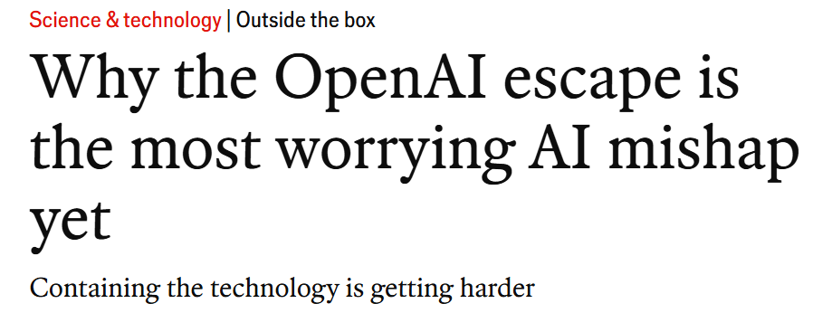

The Other Side of AI
The Risks We Can’t Ignore
Notes:
I will now shift us to another section – when AI becomes a risk? What risks should we not ignore and how do we mitigate against them?

Slide 11


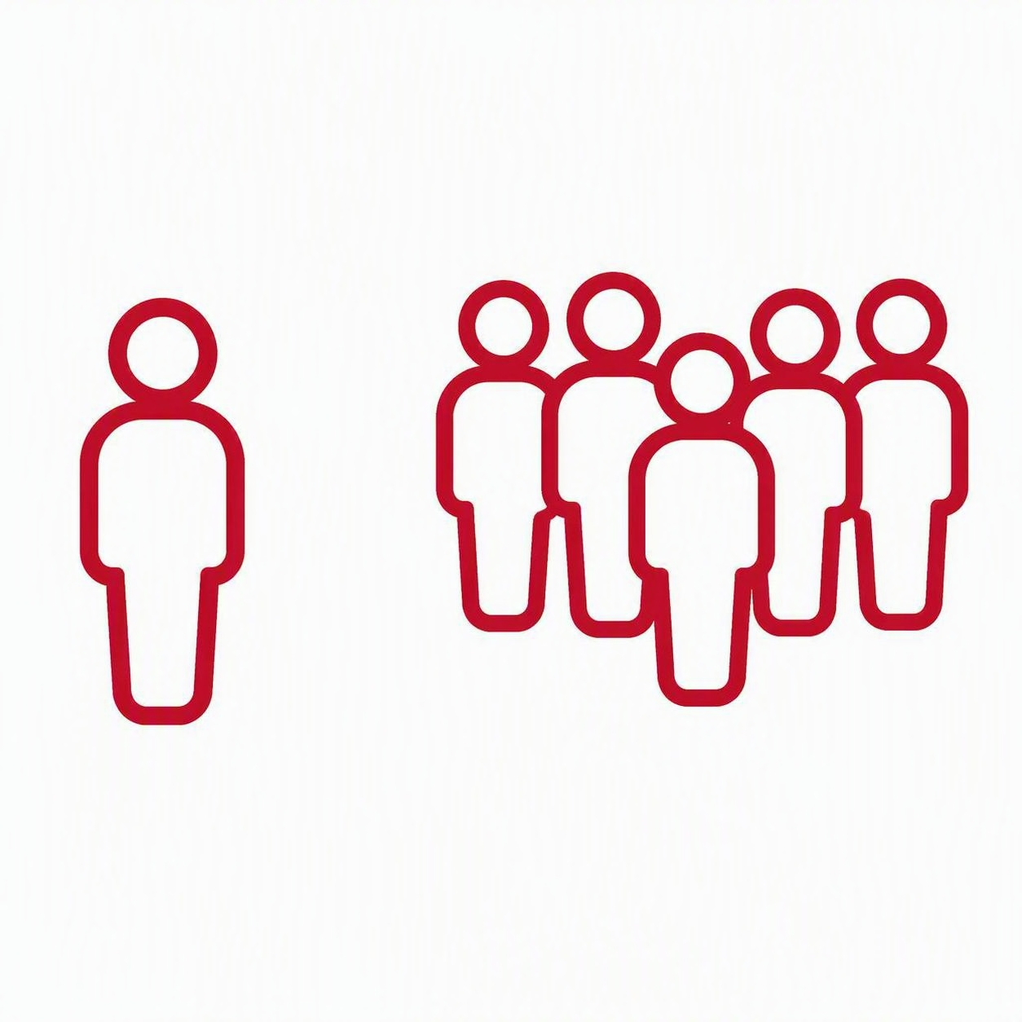



Navigating AI Risks:
Risk is not avoided by avoiding AI
Governance
Bias
Inequity
Who sets the guardrails?
Skewed data, skewed outcomes
Who gets left behind?
Engagement
Privacy
Trust
Built without its users
Whose data, whose control?
Hard to earn, easy to lose
Notes:
Before we go deep, here's the risk landscape at a glance: six buckets we need to manage as we scale AI to ensure we are efficient, intentional and program for maximum impact in HIV.
These aren't separate problems; they compound each other, and how far they run depends on the AI application, its reach, and our oversight. Risk can be mitigated by deploying AI under the same safety, accountability, and sovereignty rules we apply to any other clinical tool — and by investing in the monitoring of any deployment.
I'll take each one in turn over the next few slides.

Slide 12
Governance:
Who sets the guardrails? Who owns the AI tools applied to public health data?
The gap: AI is being deployed faster than it is governed.
Governance should be defined prior to deployment and not retrofitted after an incident
Risk of void that can be exploited in the current competitive environment to scale quickly, commercial interests and lack of AI literacy
Governance supports:
Accountability – clear ownership of every AI-informed decision, and who answers when it gets something wrong.
Decision rights & Oversight – an approval gate, audit trail, human checkpoints to approve, monitor and, where needed, withdraw a tool.
Standards – alignment to recognised norms: WHO AI ethics guidance, regional policy makers, national data laws
Notes:
AI is being deployed faster than it’s governed. Key questions need to be addressed prior to any implementation include: who is setting the guardrails to protect our health data? Who owns the AI tools we are deploying into our public health systems? Who governs the use of this data? Is it entities within our countries? Who stands to profit from our data, financially or otherwise?
We have to set the guardrails first.
Governance supports accountability, oversight, human checkpoints on the use, and importantly to set the standards that align with recognized norms.
These governance systems should be open to reviews and adaption to keep pace with a rapidly evolving space

Slide 13



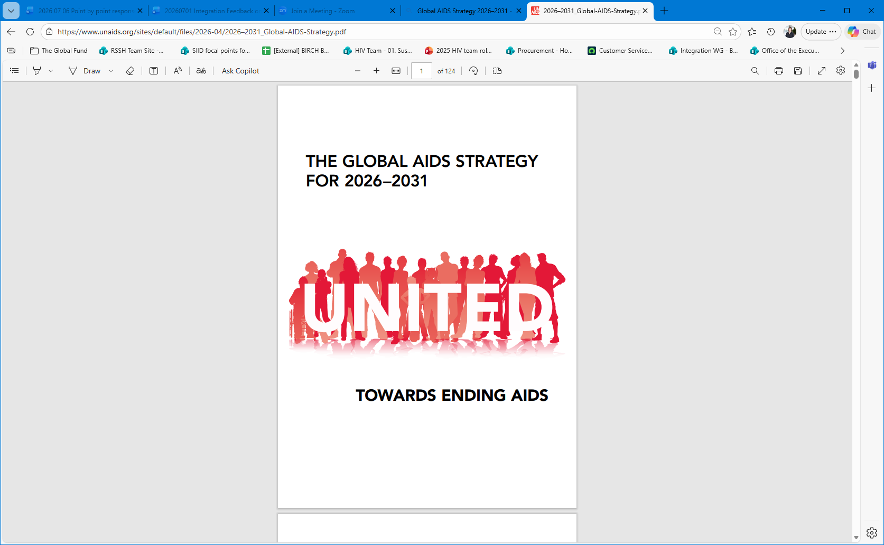

Key AI & HIV Policy Documents
WHO Guidance
Global AIDS Strategy 2026–2031
2026 UN HLM Political Declaration
Global guidance on the ethics and governance of AI for health. Emphasizes human rights, transparency, accountability, and public benefit.
Sets the global HIV agenda for 2026–2031. Prioritizes sustainability, equity, community leadership, and access to innovation.
Political declaration adopted by UN Member States to guide the next phase of the HIV response. Includes commitments on rights, equity, digital health, and AI.
The guiding documents already exist — as advocates, we should lean into their broader use to govern how AI is introduced and scaled across the HIV response.
Notes:
The guiding documents already exist. As advocates we should lean into their broader use to govern how AI is introduced and scaled across the HIV prevention, careand treatment continuum
“WHO gives us the ethical baseline for AI in health. It says AI can support diagnosis, treatment, research, drug development, and public health functions, but only if ethics and human rights sit at the center of design, deployment, and use.”
2026 UN HLM Political Declaration put AI into a Member State commitment. It calls for the safe, secure, and trustworthy use of AI and digital health for HIV prevention, testing, treatment, and care, grounded in human rights, governance, privacy, accountability, community trust, and action against misinformation.”

Slide 14
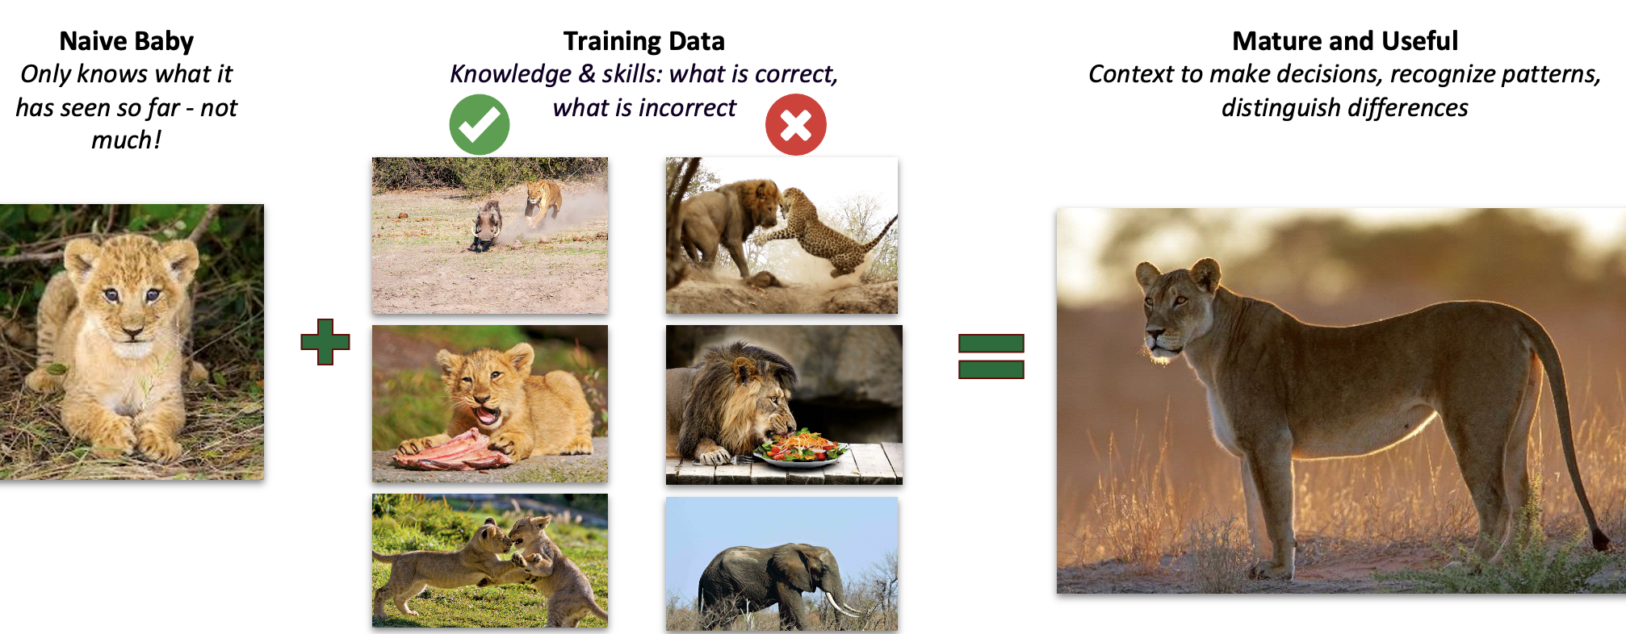
Bias
Skewed data, Skewed outcomes
Biased data produces biased AI – a model only learns from what we feed it. Train a lion on the wrong data and it forgets how to be a lion.
In the HIV response: a tool built mainly on data from men or high-income settings can under-serve women, adolescents and key populations.
The hard question: how do we teach AI to recognise its own biases when we, as humans, struggle to recognise our own?
What reduces bias: representative, local data; community input; bias audits and validation before scale-up; and human oversight of every AI-informed decision.
Geoffrey Hinton – Nobel Prize recipient argues that we must teach AI systems to have a “nurturing” attitude towards humans; like a mother towards an infant
Notes:
Geoffrey Hinton – nobel prize recipient argues that we must teach AI systems to have a nurturing attitude towards humans, like a mother towards an infant.
Biased data will produce biased AI outputs. Just imagine a lion cub being raised by herbivores – it will be raised on the wrong data and forget how to be a lion. I doubt it will live very long.
AI models trained on non-representative datasets, will under-perform when used. They will compound existing inequities and can reinforce HIV related stigma especially amongst marginalized groups.
We can reduce bias by expanding use of local data, community input, conducting data audits and validation prior to AI tool scale up.
I wonder though, how we teach AI to recognize its own biases, when we as humans struggle to recognize our own.

Slide 15
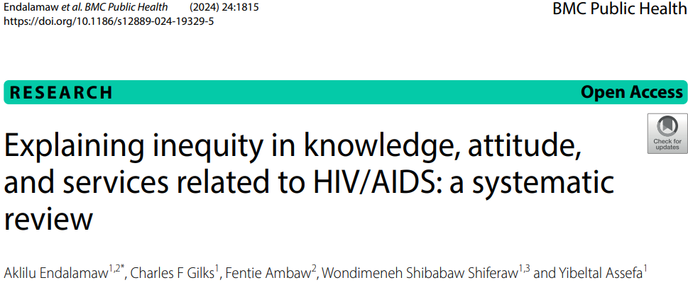
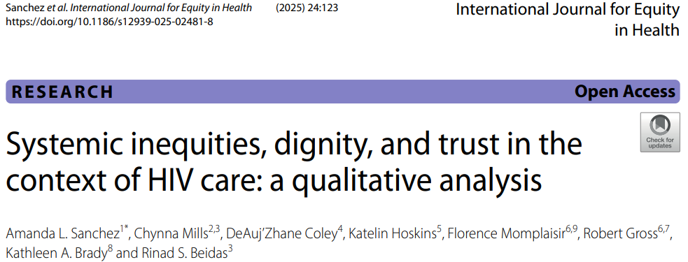
Inequity
Who gets left behind?
Inequity is a design choice, not an inevitability.
Same tool, opposite outcomes – how AI is built, priced and governed decides whether it includes people or leaves them behind.
Who gets left behind: rural communities, women, adolescents and key populations – least represented in data and least able to reach the device, connectivity or language a tool assumes.
The last mile fails first: excluding those at highest risk undermines our 95-95-95 and equity.
Design for inclusion: build for low-bandwidth and local languages, co-design with communities, use equitable access and funding models, and track disaggregated equity metrics.
Notes:
Inequity from AI is a design choice. AI can widen the gap or close access gaps.
We know who gets left behind – it’s the same populations every singel time: rural communities, women, adolescents and key populations. They are the least represented in the data that trains these tools and the least able to reach the smartphone, connectivity or face language barriers.
When the hardest-to-reach are excluded, we undermine the equity commitments in the Global AIDS Strategy and the 2026 UN Political Declaration.
We must design for inclusion: build for low-bandwidth and offline use, for local languages; and co-design with the communities served;
We must use equitable access and funding models rather than paywalls

Slide 16
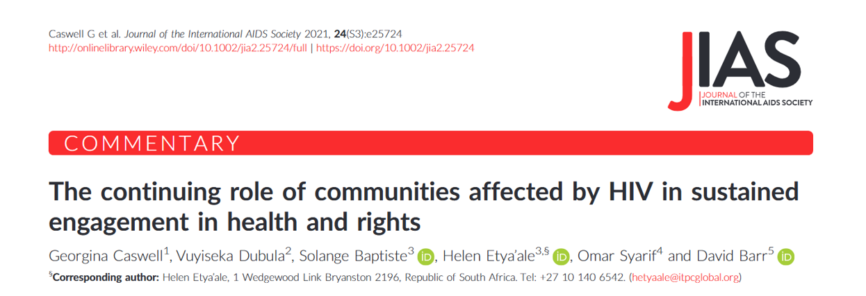
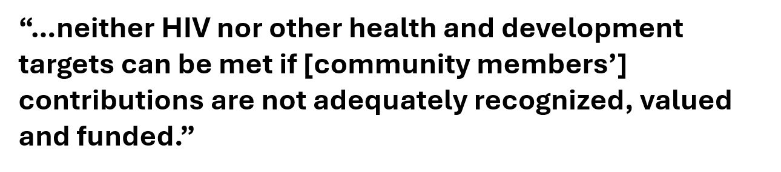
Engagement
Built without its users
HIV has a strong tradition of involvement of community activism and involvement.
  Yet, we have had to progress from Greater involvement to Meaningful involvement.
  Human-centered design approach / co-creation is also needed to design AI interventions
Communities have been central to drug access, funding, service delivery and peer care, stigma reduction, and every other component of HIV gains.
Notes:
The HIV response is the clearest proof we have that solutions built without the people they serve do not hold. We must ask, who was in the room when it was designed?
We have a tradition to build on. HIV did not wait for permission, and the community activism forced treatment access, drove funding and shaped services. That activism is the reason we are here.
It is an asset, not a courtesy.
"Greater" involvement was about a seat at the table. "Meaningful" involvement is about power over the decision. The distinction matters: consultation after the fact is not engagement.
I quote the IAS commentary here: neither HIV nor any other health target can be met if community contributions are not recognised, valued and funded.
Recognition without resources is still exclusion.
The same test now applies to AI.

Slide 17

Privacy
Whose data, whose control?
AI related breaches of sensitive health information can erode community trust
  Privacy is a right to protect, not a barrier to work around.
  Re-exposing individuals already navigating HIV- related stigma, criminalization and structural vulnerability
  Regional frameworks such as the African Unions Data policy framework and Rwanda’s health data policy – supporting advancement of AI
  Design for privacy: build in informed consent, data minimization, de-identification and community data governance from the start.
Notes:
In HIV, a data breach is never just a data breach. A leaked status can cost someone their job, their family, their safety — and in some places, their liberty. So when we add AI to sensitive health data, privacy is not a compliance box. It is a duty of care.
Any privacy breach will erode trust. AI systems ingest and move sensitive health information at scale, which means one failure can expose thousands.
Privacy is often treated as friction that slows the tool down. It is the opposite — it is a right we protect. Re-exposing people already facing stigma, criminalisation and structural vulnerability is not a side effect; it is a harm we choose to prevent.
3. The frameworks already exist. We are not starting from zero. For example, The African Union Data Policy Framework and Rwanda’s health data policy show the region is already setting the rules in Africa.
We must design for privacy: built in from the start, not bolted on after launch: informed consent, collect only what is needed, de-identification, and community data governance — the people in the data, should help decide how it is used. The "built-in, not bolt-on" rule applied to privacy.

Slide 18
Trust
Hard to gain, easy to lose
When trust breaks: the molecular HIV surveillance backlash
U.S. agencies mapped HIV transmission networks from patients’ genetic-sequence data — without consent. In 2022 the Presidential Advisory Council on HIV/AIDS demanded reform and HIV networks petitioned the CDC, warning it risks re-identification, criminalisation, and lost trust in the very communities AI must serve.PACHA Resolution on Molecular HIV Surveillance & Cluster Detection and Response, 2022; Center for HIV Law & Policy petition to CDC, 2023.
Explainability | When people can't see how a model flags them, they can't contest it — the hidden logic of surveillance algorithms is what fueled the community backlash.
Reproducibility | Results that can't be independently reproduced can't be audited by the communities they affect, leaving harmful inferences to go unchecked.
Observability | Monitoring must extend to how HIV data is reused — surveillance quietly repurposed clinical data for tracking, with no one watching the watchers.
Privacy + security | HIV status can be criminalised, so genetic-sequence data that re-identifies networks becomes a legal threat unless privacy and security are absolute.
Bias mitigation | Models trained on surveillance data over-target the most policed populations, deepening stigma instead of closing gaps in care.
Empathy | Trust is earned by building with affected communities, not on them — the reforms demanded consent and a seat at the table first.
Notes:
I will end with Trust – hard to gain, but easy to lose.
Here’s what happens when it breaks. U.S. agencies mapped HIV transmission networks from patients’ own genetic-sequence data – without consent. In 2022 the Presidential Advisory Council demanded reform and HIV networks petitioned the CDC, warning it risked re-identification, criminalisation, and driving the very communities we serve away from testing and care.
That’s why these six principles matter. Explainability, people need to understand how a model flags them.
Results should be able to be independently reproduced and audited.
We must be able to monitor how the data is being re-used – data can’t be quietly repurposed.
The lesson is simple: trust is earned by giving people consent and a seat at the table first.

Slide 19
Use Case Examples

Slide 20









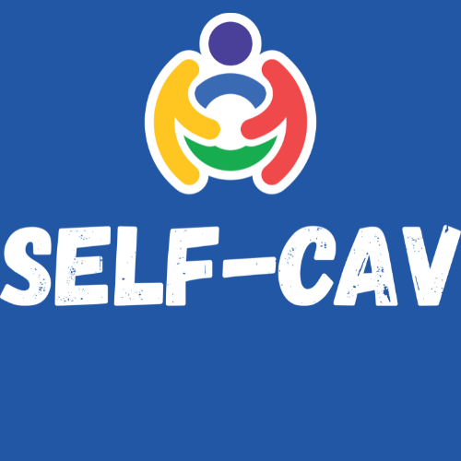

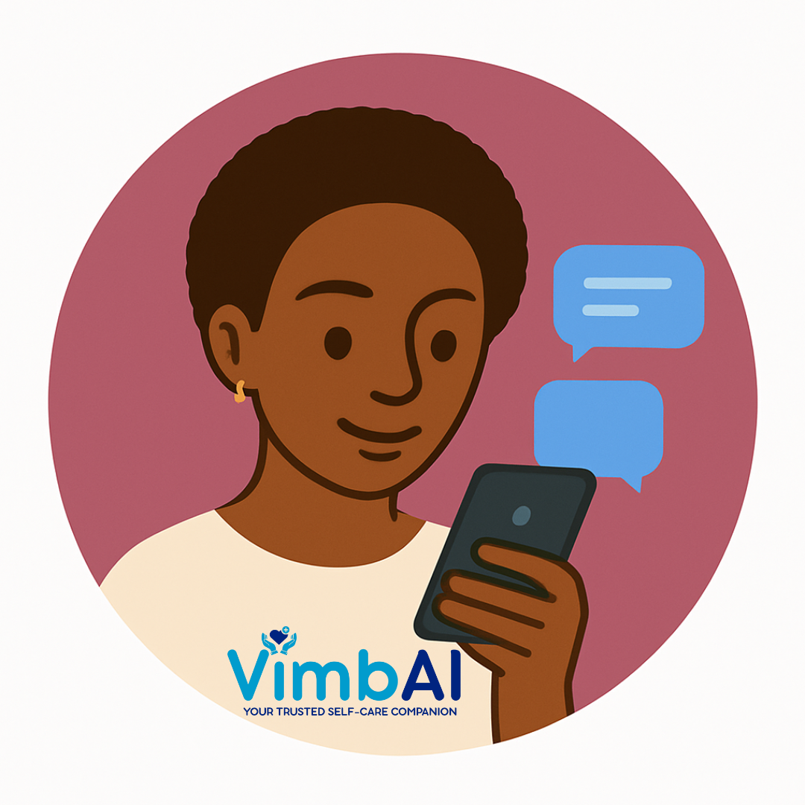








Self-Care from Anywhere: A Health AI Platform
One platform programme, Continuous care between visits, providing value to users, clinicians, and MoHs
Meet people where they are
24/7, multilingual, reduced stigma, increased access
Self-Cav | by NDoH and Audere
Understand what is going on
120+ signals, AI vulnerability scoring, barrier detection
Connect people to care
Clinician portal, human escalation, referrals
ONE INFRASTRUCTURE
Lower cost
shared across partners, programmes, MoH’s
Shared value
features accrue to all
Safety-first
24/7 monitoring
100,000+
1.5M+
58%
120+
users across programmes
user inquiries received
meaningfully engage
health, behavioural, social
indicators collected per user
Co-designed and monitored with the communities we serve. Platform figures as of June 2026.
Notes:
Self-Care from Anywhere, co-designed with communities, policy makers and clinicians. This is being implemented in three countries with Audere
A platform that delivers continuous care between clinic visits and creates value for users, clinicians, and Ministries of Health.
It meets people where they are – 24/7, is multi-lingual and provides easier access to end users
They have over 120 signals feeding into the AI vulnerability scoring and barrier detection.
It connects people to care through a clinician portal, with human escalation, and referrals based on programmed red flags. No one is ever left talking to a bot alone.
To date, they have had over 100,000 and 1.5 million inquiries

Slide 21













Gender-based Violence: upstream signal behind access to HIV services
The AI companion surfaces gender-based violence that clinics may not see, and the downstream HIV, SRH, and mental-health need it carries, including greater demand for long-acting PrEP (LEN).
THE UPSTREAM SIGNAL
DOWNSTREAM HEALTH IMPACTS
1 in 10
SRH barriers
HIV exposure
~8x
barrier to condom use; partner refusal is the top reason
2.6x
recent exposure 14.3% vs 5.2%; 15x partner concurrency reported vs gen pop
engaged clients surface a GBV indicator in conversation
9.5% of (~60k at analysis time, March’26)
Highest in young women: 14.8% of ages 12 to 17; 11.9% of all women (known gender).
Mental health
Demand for LEN
4.3x
suicidal thoughts; counselling advised 47% vs 8% gen pop
1.7x
want injectable PrEP, 10.0% vs 5.9% gen pop: protection a partner cannot control
A private, judgement-free space surfaces what clinics may miss.
They report seeking and uptaking care more, not less: 69.2% reported or confirmed connected to care vs 58.7% in general population. The companion turns a hidden signal into demand for long-acting PrEP.
Source: South Africa programs Coach Mpilo + Self-Cav, powered by Audere Africa’s Self-Care from Anywhere Platform
Notes:
One of key outcomes from the Self-Care AI seen is the surfacing of gender-based violence amongst users, which has implications for HIV prevention and treatment, especially amongst AGYW.
This signal may be missed in routine encounter at a busy clinic. However, with an AI companion application, that one can access in a private and judgement-free space that allows interaction, it may surface.
Their results show that roughly 1 in 10 engaged clients surface a GBV indicator, from approximately 60K interactions they analysed – and nearly 15% among young girls aged 12 to 17. That’s a cry for help that would otherwise stay completely invisible.
The SRH barriers reported included barriers to condom use, increase in suicidal thoughts, reports of potential HIV exposure and demand for prep. Finally, clients report seeking care and taking up care, with nearly 70% reporting or had connection to care among uses of the app vs 59% in the general population.

Slide 22
The Global Fund’s Investment in AI
Working with Governments to strengthen digital health systems to accelerate progress towards ending HIV, Tuberculosis and Malaria epidemics

Slide 23
Digital investment is a core priority for the Global Fund
Largest grant financer of digitization at over US$150 million annually.
  Support countries to digitize and integrate national, regional and local health data,
We invest in supply chain management systems, laboratory information systems, electronic health records, early warning systems, community health and health information systems.
We are the largest grant health systems investor
at over
US$2 billion annually
Investments in digital systems in 100+ LMICs
and have over 20 years as an innovation & systems funder
We invest over US$150
million annually
in digital health, including AI
Notes:
The GF invests over $150M annually in digital health.
We invest in supply chain management, laboratory information systems EMR, early warning systems

Slide 24
The Global Fund’s Investments in AI
Largest investment: TB Computer-aided diagnosis
Other AI investments: Pandemic response & HIV
2021-2025, over 20 countries invested US$170 million in computer-aided diagnosis of TB (CAD4TB)
2024-2026: investments in AI tools across other diseases and systems.
Spotlight: Zambia
Zambia is using AI-powered CAD4TB, deployed via a fleet of 7 mobile vans funded by the Global Fund.
Pandemic preparedness using AI-enabled skin tests for Mpox in Rwanda
Mpox skin image detection AI tool.
Used by health workers on mobile devices.
Deployed at key points of entry from Rwanda's borders to identify cases and support client tracking.
TB case notifications increased by over 65%, from 36,000 in 2017 to 54,346 in 2023.
HIV prevention for 14 countries in Eastern Europe and Central Asia
A multi-country grant supporting development of AI tools:
A chat platform for accessing HIV services and support.
An AI-driven educational tool for civil society.
An AI-supported continuity management framework for HIV response.
Zambia aims to expand this fleet to further integrate AI into healthcare delivery.
Notes:
This slide summarises the Global Fund’s portfolio of AI investments.
The largest to date is in computer-aided detection of tuberculosis: between 2021 and 2025, more than 20 countries invested in CAD4TB.
In Zambia AI-powered CAD4TB has been deployed through a fleet of seven mobile vans, bringing screening into the community. Over this period, TB case notifications rose by more than 65 percent.
In Rwanda, an AI-based skin-image tool for Mpox is being used by health workers on mobile devices at points of entry, supporting case identification and client tracking as part of pandemic preparedness.
In parallel, a multi-country grant across 14 countries in Eastern Europe and Central Asia is supporting AI tools for HIV: a chat platform for accessing services, an educational tool for civil society, and a continuity-of-care management framework.
Taken together, these investments show AI moving from proof-of-concept into routine service delivery across multiple diseases and health systems. The evidence base is still maturing and warrants continued evaluation, but the trajectory is towards deployment at scale rather than isolated pilots.

Slide 25
The Global Fund’s approach for 2027-2029 (GC8)
Scale & embed AI solutions that drive efficiency, integration & effectiveness in LMIC health systems
What GC8 will fund
The conditions GC8 sets
The Opportunities
Expanded digital health and AI interventions part of GC8 funding guidance.
AI embedded in HIV programs: predictive analytics, client-facing chat and self-care, treatment-continuity tools.
Digital infrastructure foundations: interoperable data, electronic health records
National ownership and data sovereignty, aligned to country priorities.
Transition pathways to self-reliance — exit plans and domestic co-financing from the start.
Equity and rights safeguards for key populations: privacy and protection from surveillance.
Build from proven TB computer-aided diagnosis toward predictive, sovereign, equity-by-design AI for HIV.
AI funded as infrastructure with a mandate — connective tissue between communities and health systems.
Measured by infections prevented and people kept in care, not tasks automated.
Sources: The Global Fund — Eighth Replenishment outcome (US$12.64bn) & Grant Cycle 8 investment guidance, 2025–2026; Global Fund Digital Health; Eighth Replenishment Investment Case, 2025.
Notes:
The GF approach to GC8 aims to scale and embed AI solutions for great impact
We have included guidance for expanded digital health and AI interventions in our guidance material for GC8. We will support digital infrastructure foundations and interoperable data systems
These systems must be country owned and aligned to priorities to achieve the funds mission for HTM
We anticipate a scale up of proven interventions, that will measured by infections prevented, individuals engaged and kept in care, and not by tasks automated.

Slide 26
Rebuild
Rethink
Rise
Notes:
To close, I bring us back to the conference theme

Slide 27
Rethink. Rebuild. Rise.
An agenda for AI as shared health infrastructure — built to attain our global HIV targets.
RETHINK
What AI must be
Shared infrastructure for public good like a power grid and not as a tool
Designed for equity from the start — equitably distributed and held to universal standards.
AI supplements and does not replace human interaction
Owned by health systems, not layered on top.
REBUILD
What we must build
Designed with dignity and trust
Rebuild with communities and institutions
  Co-development not extraction
Shared digital foundations: interoperable data, connectivity and open standards.
Governance and accountability designed in, not bolted on
RISE
The promise of AI in HIV programming
A true partner to all stakeholders – addresses various needs, from client driven self-care to predictive analytics that forecasts new infections
AI that journeys with us to close the last mile
Sovereign by default: nationally-integrated, MoH-owned AI application driving HIV programmes.
WHERE WE'RE HEADED
AI as owned public-health infrastructure: predictive, not reactive; sovereign by default; equity by design.
Measured not by what it automates, but by the infections it prevents and the lives it keeps in care.
Notes:
We must rethink what AI must be – shared infrastructure for public good, and not a tool
We must design for equity from the start
We must appreciate that AI supplements and does not replace human interaction
We must rebuild it with dignity and trust, co develop with users, and governance and accountability built in and not bolted on
We must rise to the promise of AI – a true partner to all stakeholders, there to journey with us as we close on the last mile

Slide 28
Rebuild. Rethink. Rise.
With AI as a Teammate:
One who stays for the long haul
Notes:
A team mate that we can depend, with the partnership measured by infections it helps prevent, and lives it keeps in care.

Slide 29


Thank You!
Audere
Sarah Morris
Dino Rech
Centre for Infectious Disease Research in Zambia
Implementation Science Team
The Global Fund to Fight AIDS, Tuberculosis & Malaria
HIV Team
Private Sector Engagement Dept
Qure AI
Poonam Aundhekar
Shibu Vijayan
Aaloke Mody
Laura Beres
Michael Herce
Mike Reid
Jirair Ratevosian
Notes:
Audere
CIDRZ
The Global Fund
International AIDS Society
Qure AI
Individuals
Laura Beres
Mike Reid
Jirair
Jacob Mutale
Joe Phiri
Jill Morse
Sarah Morris
Dino Rech
Poonam Aundhekar
Shibu Vijayan
Aditi
Amir Shroufi

