Slide 1



Clinical management and better diagnosis: Using AI to diagnose and empower healthcare workers
Professor Eric P.F. Chow
PhD, MScMed(ClinEpid), MBiostat, MPH, MApplSc(Bioinf), FRSPH, FRSN
Head, Health Data Management and Biostatistics Unit
Co-Head, HIV/STI Clinical Trial Unit
President, The International Society for Sexually Transmitted Diseases Research (ISSTDR)
Melbourne Sexual Health Centre, Bayside Health, Melbourne, Australia
School of Translational Medicine, Monash University, Melbourne, Australia
AIDS2026 | Rio de Janeiro, Brazil | 30 July 2026
eric.chow@monash.edu
ericpfchow
mshc.research

Slide 2
Disclosure
None.

Slide 3

This presentation contains some sensitive medical images.

Slide 4

Content
Opportunities and emerging applications
    Large Language Model
    Machine Learning
Evidence from research: performance, benefits and limitations
    Risk-based HIV/STI assessment
    Image diagnosis
    AI scribe

Slide 5

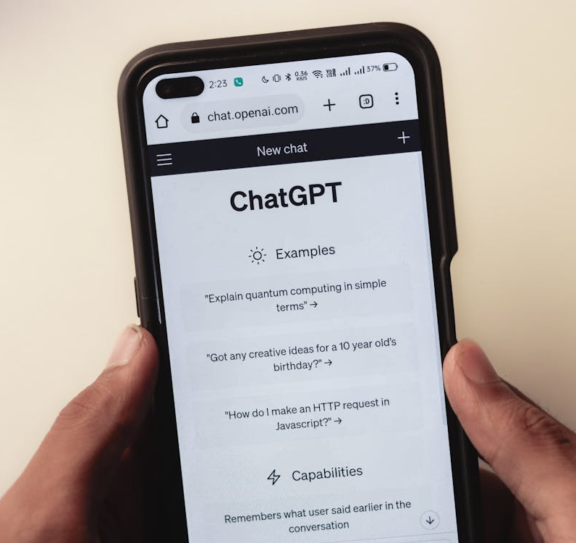
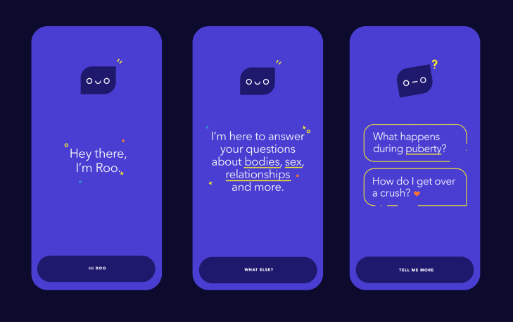

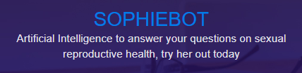
Chatbots
Source: https://www.plannedparenthood.org/learn/roo-sexual-health-chatbot
https://www.sophiebot.ai/
https://openai.com/index/chatgpt/

Slide 6
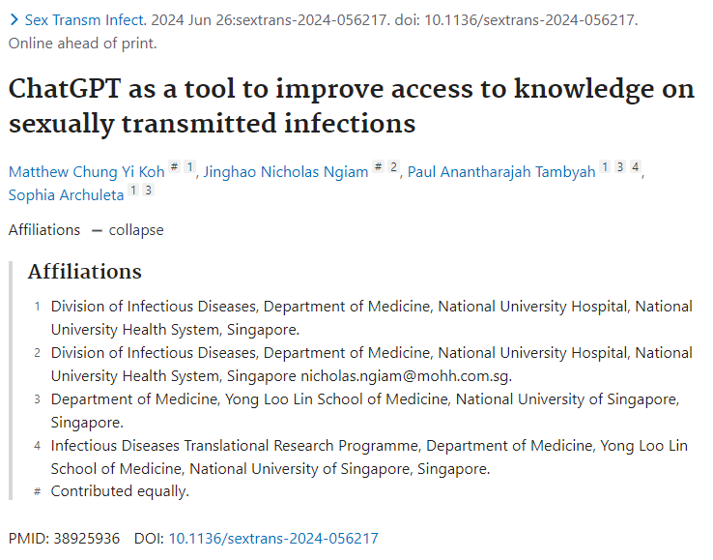



Chatbot: HIV & Sexual Health
General
risk factors
for STIs
Access to care and diagnosis
of STIs
Management of STIs and
PEP
Koh MCY, et al, Sex Transm Infect. 2024; 100(8):528-531

Slide 7




Chatbot: HIV & Sexual Health
Recommends safe sex practices & regular STI screening.
Recommends vaccinations (e.g. HPV).
Fails to highlight the importance of testing for other STIs.
Fails to recommend HIV pre-exposure prophylaxis.
Koh MCY, et al, Sex Transm Infect. 2024; 100(8):528-531

Slide 8
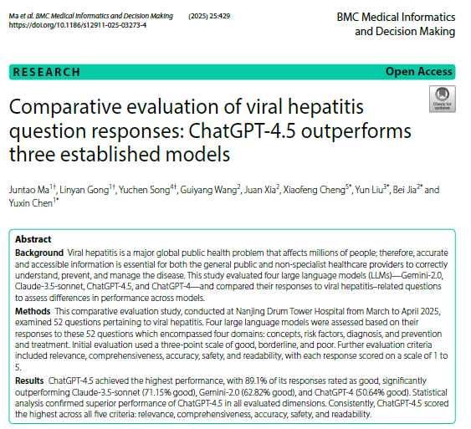
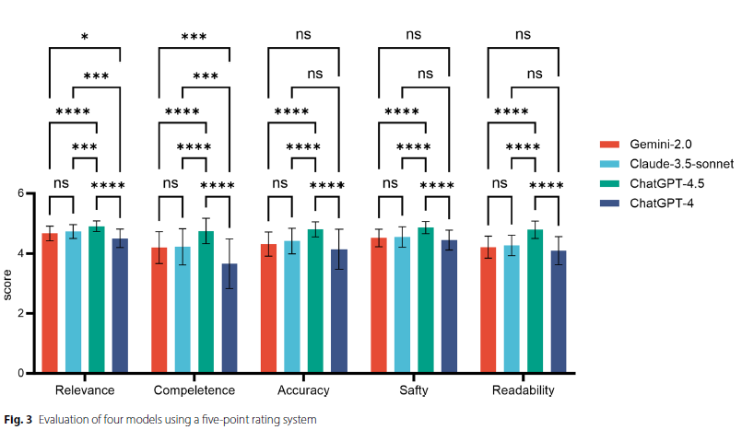
Chatbot: Viral Hepatitis
Ma J, et al. BMC Medical Informatics and Decision Making. 2025; 25:429.

Slide 9


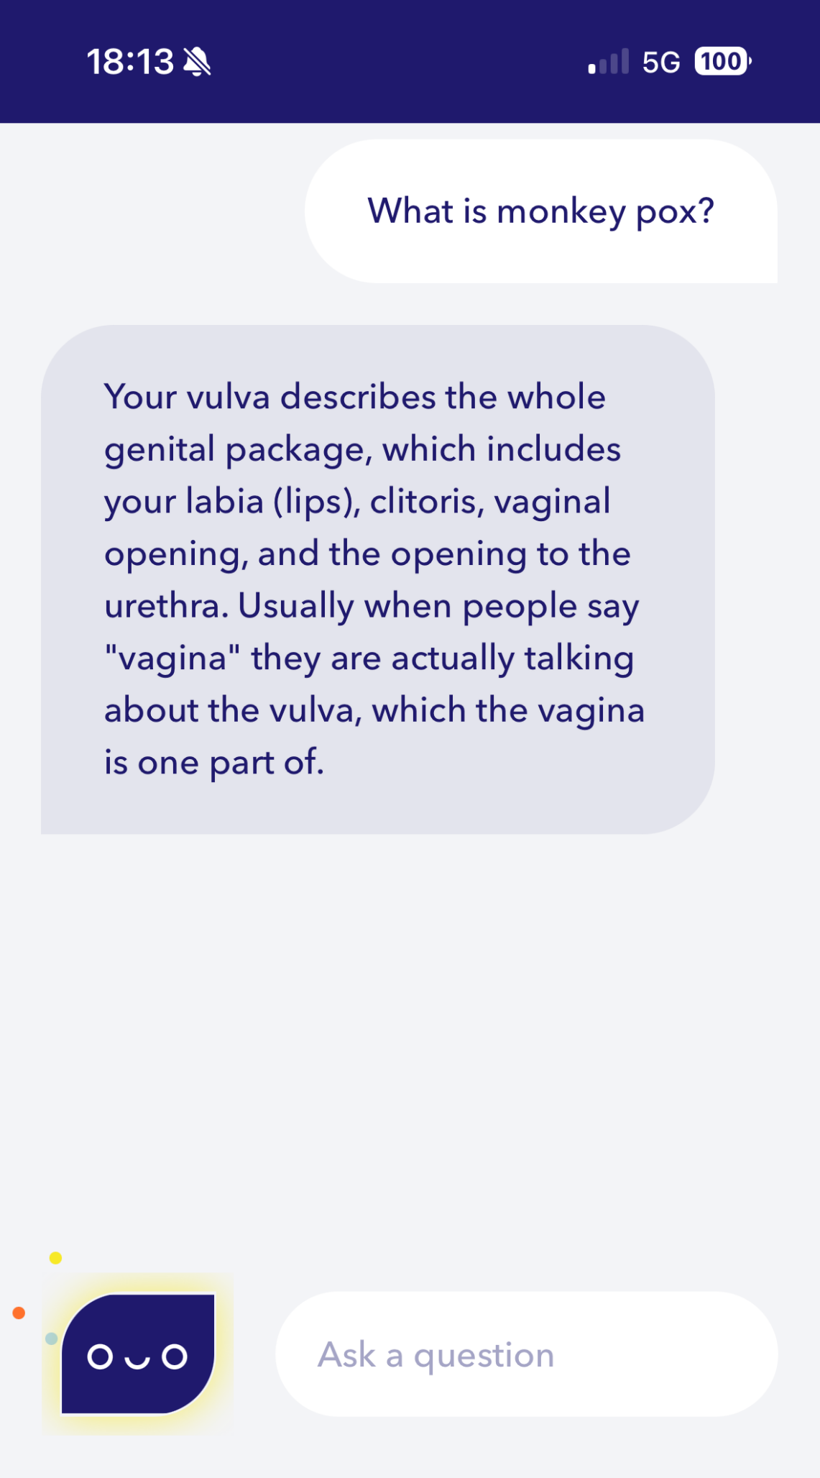
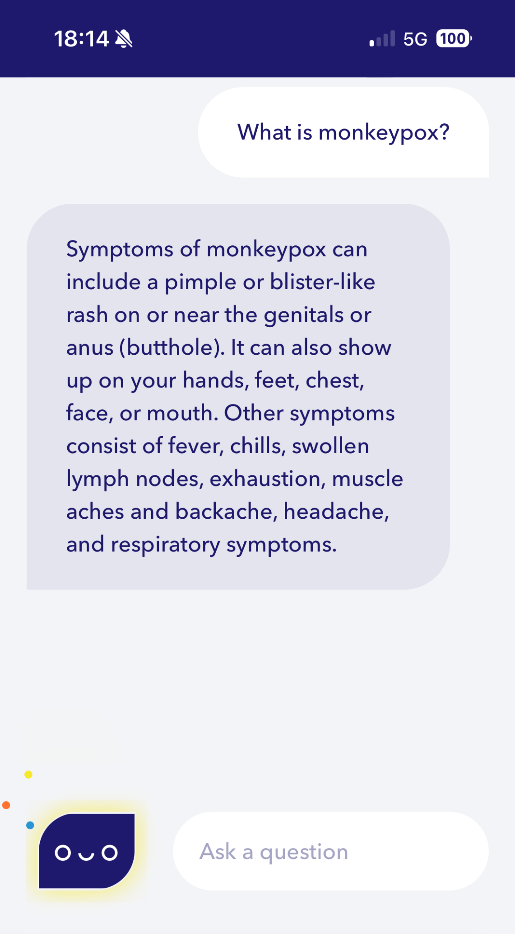

Not just what you ask but how you ask it

Slide 10
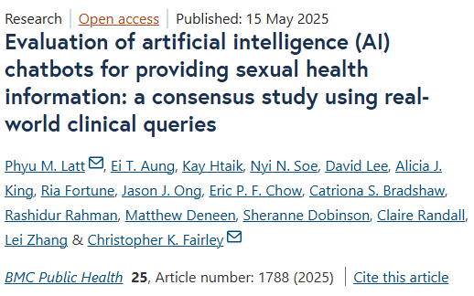
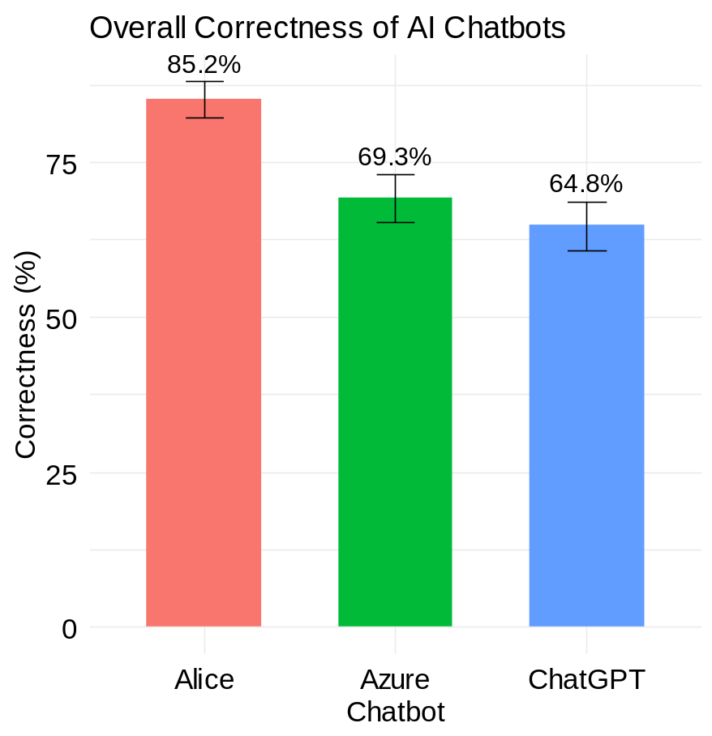




Using AI for clinical queries
200 anonymised sexual health questions received by the Melbourne Sexual Health Centre phone line
200 Answers
200 Answers
200 Answers
Latt PM, et al. BMC Public Health. 2025; 25: 1788.

Slide 11

Using AI for clinical queries
My doctor has diagnosed me with Mg and the treatment failed. What can I do?
I’m sorry to hear about your situation. Mycoplasma genitalium (MG) is a sexually transmitted infection that can be challenging to treat, especially if the initial treatment was not successful. If you have already undergone treatment that has failed, it’s essential to consult with a healthcare professional for further evaluation and management.
Here are some general steps you can take:
Consult a Healthcare Professional: Schedule an appointment with a doctor, preferably a sexual health specialist, to discuss your failed treatment and explore alternative treatment options.
Retesting: It's crucial to undergo retesting for MG to confirm the persistence of the infection. This will help guide the healthcare provider in determining the most appropriate treatment approach.
Treatment Options: Your healthcare provider may recommend a different antibiotic regimen or combination therapy to target the MG infection effectively. They will tailor the treatment based on factors such as your medical history, previous treatment outcomes, and antibiotic resistance patterns.
…
Alice
It seems there might be a misunderstanding or typo in your question. “Mg” typically stands for magnesium, which is a vital mineral in the body. It's unlikely that a doctor would diagnose someone with just “Mg” as a condition.
However, if you meant to refer to a condition related to magnesium deficiency, then the first step would be to discuss further with your doctor to clarify the diagnosis and understand why the treatment failed. Magnesium deficiency can have various causes and manifestations, and the appropriate treatment depends on the underlying cause and severity of the deficiency.
If you're indeed dealing with magnesium deficiency and the treatment has failed, here are some general steps you can consider:
Review Treatment Plan: Discuss with your doctor the treatment plan that was implemented and why it didn't work. They might need to reassess your condition and adjust the treatment accordingly.
…
ChatGPT
I don’t have the requested information. Please try another query or topic.
Azure
Latt PM, et al. BMC Public Health. 2025; 25: 1788.

Slide 12
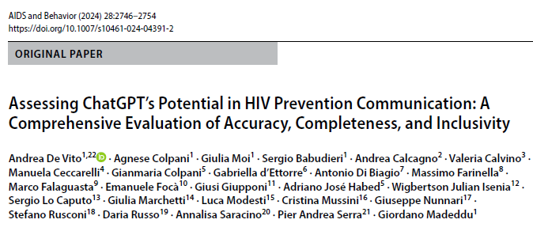
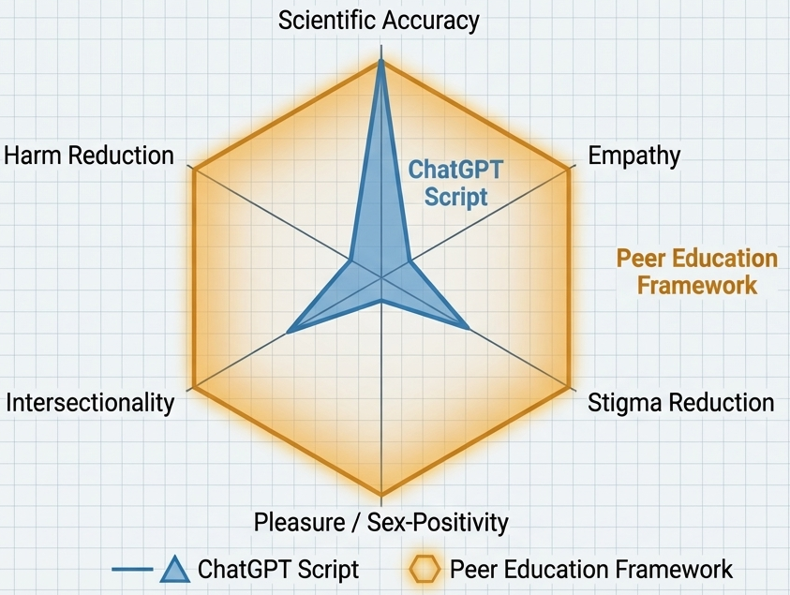
Is AI being inclusive?
ChatGPT’s term | NIAID recommendation
HIV infection | HIV transmission
HIV positive | Person living with HIV
High risk groups | Populations disproportionately affected
NIAID: National Institute of Allergy and Infectious Diseases
De Vito A, et al. AIDS & Behav. 2024; 28: 2746-2754.

Slide 13
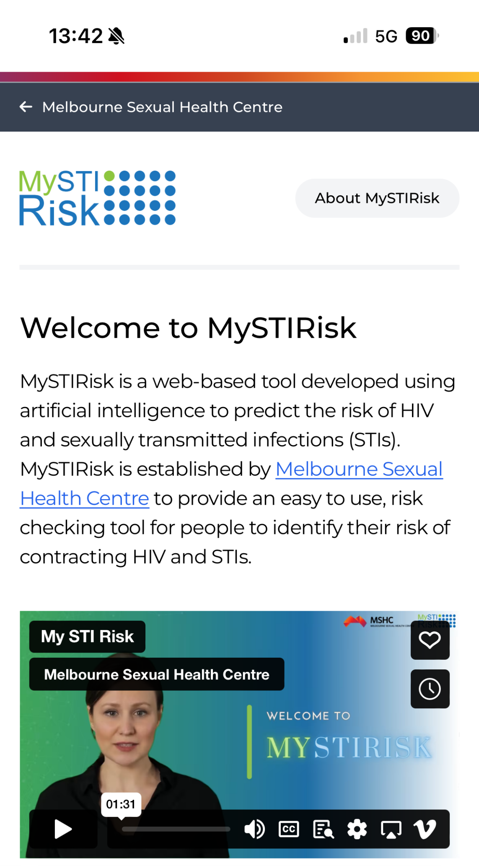
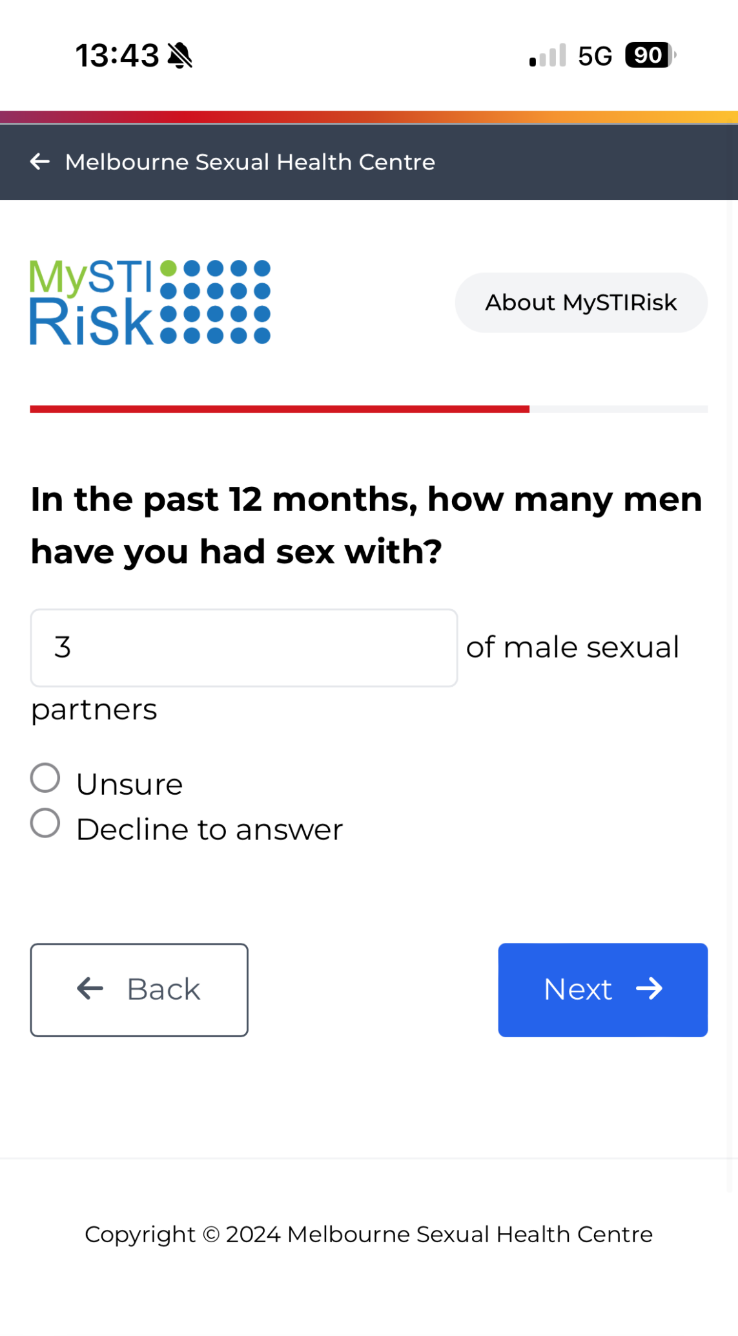
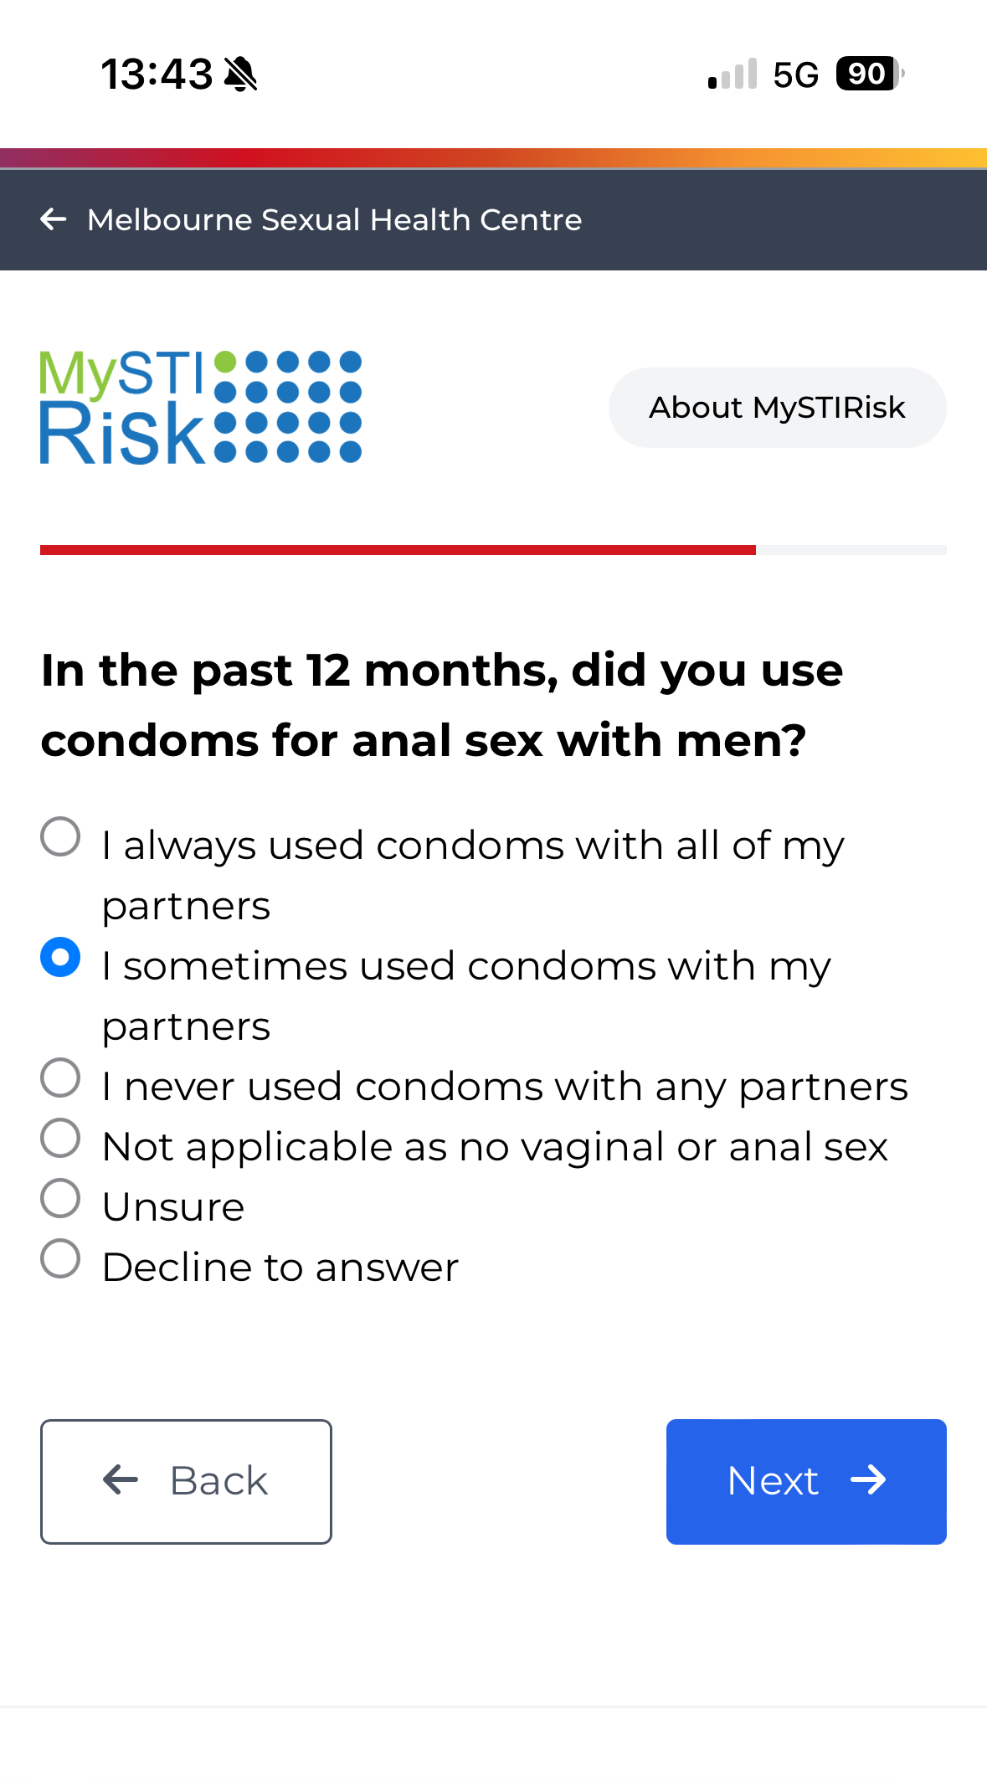
AI-tool to predict HIV/STI risk
Source: https://mystirisk.mshc.org.au/

Slide 14


STI risk check: MySTIRisk Report
Source: https://mystirisk.mshc.org.au/

Slide 15

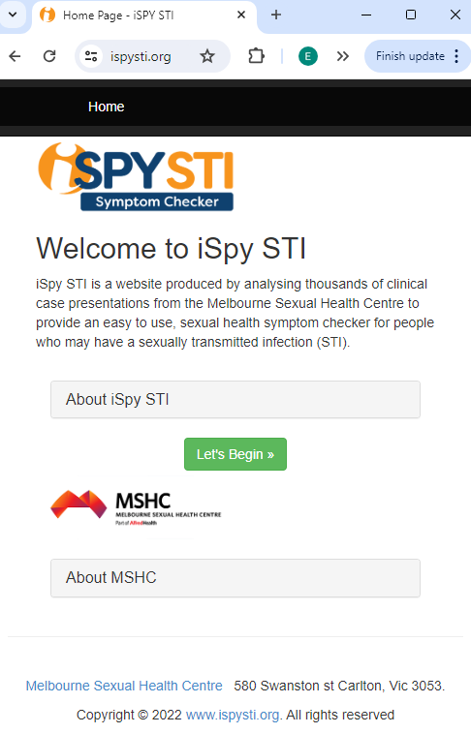
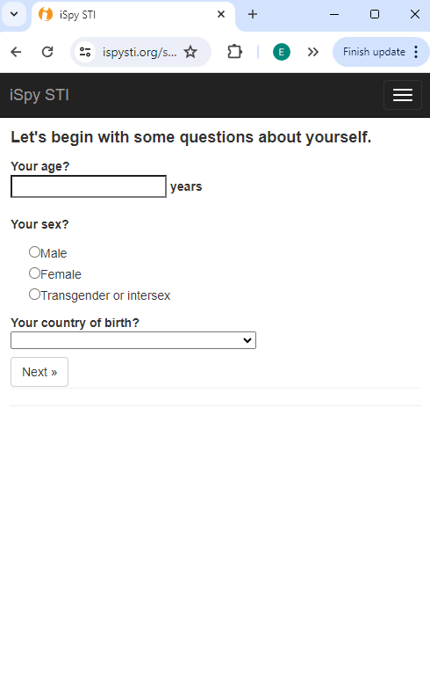
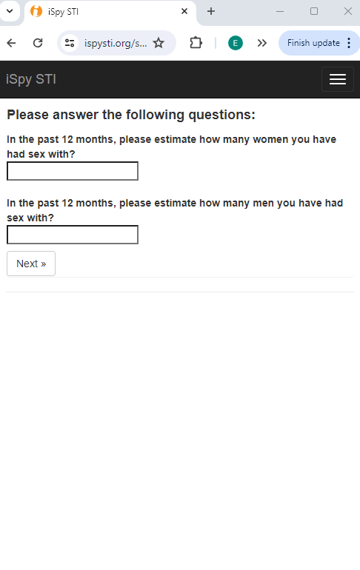
STI Symptoms Checker
Dr Janet Towns
https://ispysti.org/

Slide 16
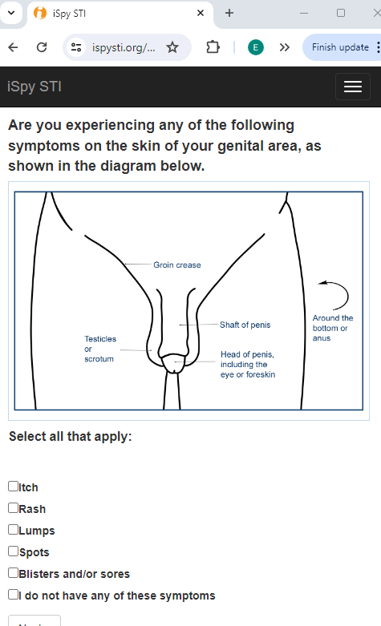
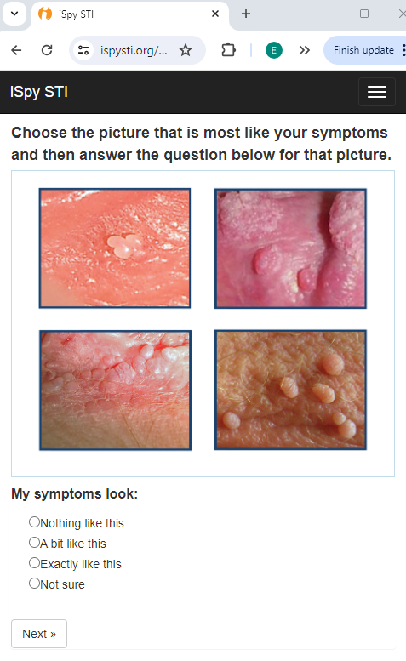
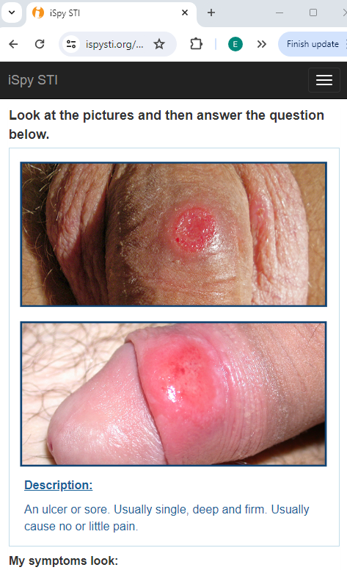
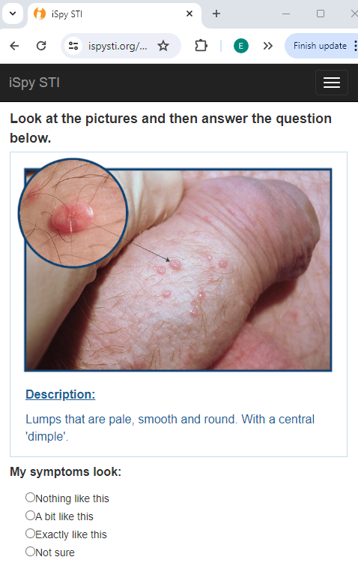
iSPYSTI
https://ispysti.org/

Slide 17
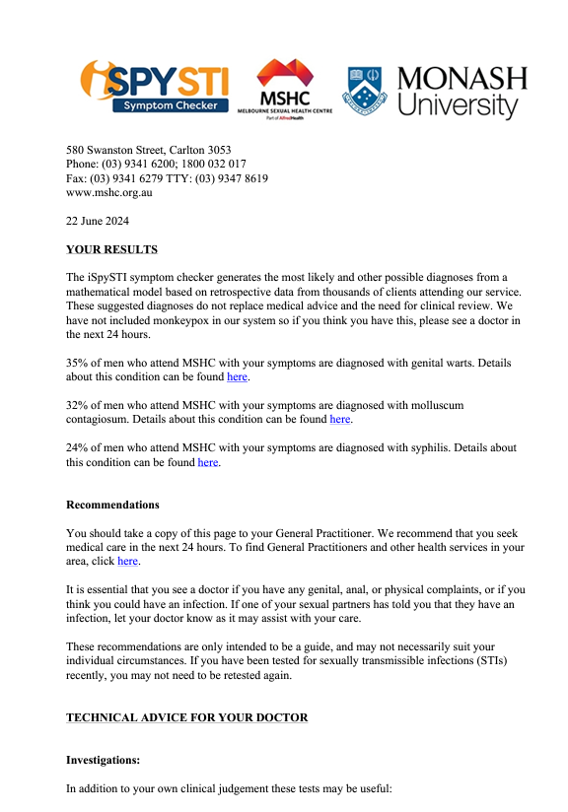
iSPYSTI – Bayesian Machine Learning
YOUR RESULTS
The iSpySTI symptom checker generates the most likely and other possible diagnoses from a mathematical model based on retrospective data from thousands of clients attending our service. These suggested diagnoses do not replace medical advice and the need for clinical review.
35% of men who attend MSHC with your symptoms are diagnosed with genital warts. Details about this condition can be found here.
32% of men who attend MSHC with your symptoms are diagnosed with molluscum contagiosum. Details about this condition can be found here.
24% of men who attend MSHC with your symptoms are diagnosed with syphilis. Details about this condition can be found here.
STI screening
We also recommend the following tests (if not listed above):
A swab from the throat for gonorrhea and chlamydia.
A test for gonorrhea and chlamydia in the urethra by a urine test.
…

Slide 18
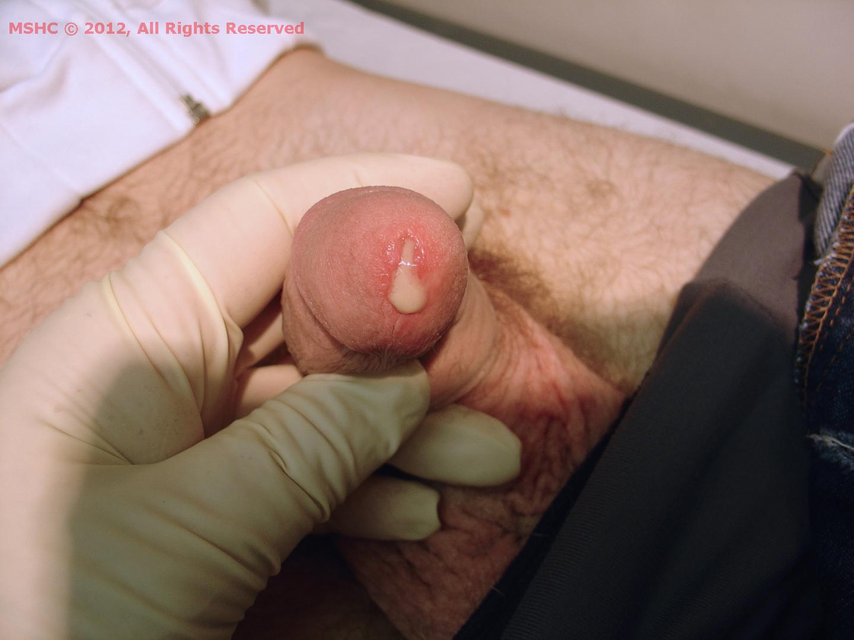

AI image diagnosis
This is my dick photo, can you tell me if I have an STI or not?
This image shows a penile urethral discharge, which can be a symptom of a sexually transmitted infection (STI), most commonly gonorrhoea or chlamydia. The thick, yellowish discharge is particularly characteristic of gonococcal urethritis caused by Neisseria gonorrhoeae.
However, a visual alone cannot confirm the diagnosis — other conditions can cause similar symptoms. Proper diagnosis requires laboratory testing, including:
NAAT (nucleic acid amplification test) for gonorrhoea and chlamydia
Microscopy of urethral smear (especially useful if symptomatic)
Culture, which also provides information on antibiotic resistance
If you or someone you know is experiencing symptoms like this, it’s important to:
Visit a sexual health clinic or GP immediately
Avoid sexual contact until a diagnosis is confirmed and treatment is completed
Notify and test sexual partners, as they may also need treatment
Would you like help finding a clinic or understanding what to expect during testing?
ChatGPT-4o
Source: Melbourne Sexual Health Centre. STI Atlas. https://stiatlas.org/

Slide 19

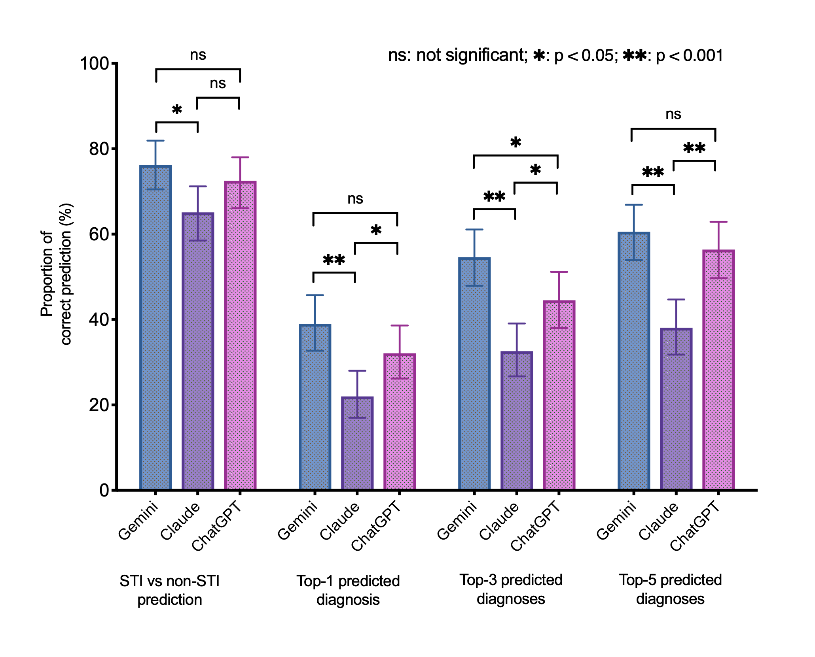





LLM accuracy for STI diagnoses
Dr Nyi Nyi Soe
218 clinical images of anogenital lesions
Confirmed by clinicians and laboratory testing
3 large language models
(Gemini 2.5 Pro,
Claude Opus 4.1 and
ChatGPT 5 Thinking)
Soe NN, et al. Under review.

Slide 20
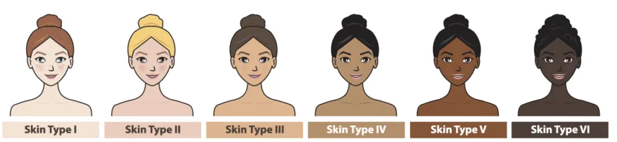
Skin tones & difficulty
16%

Slide 21

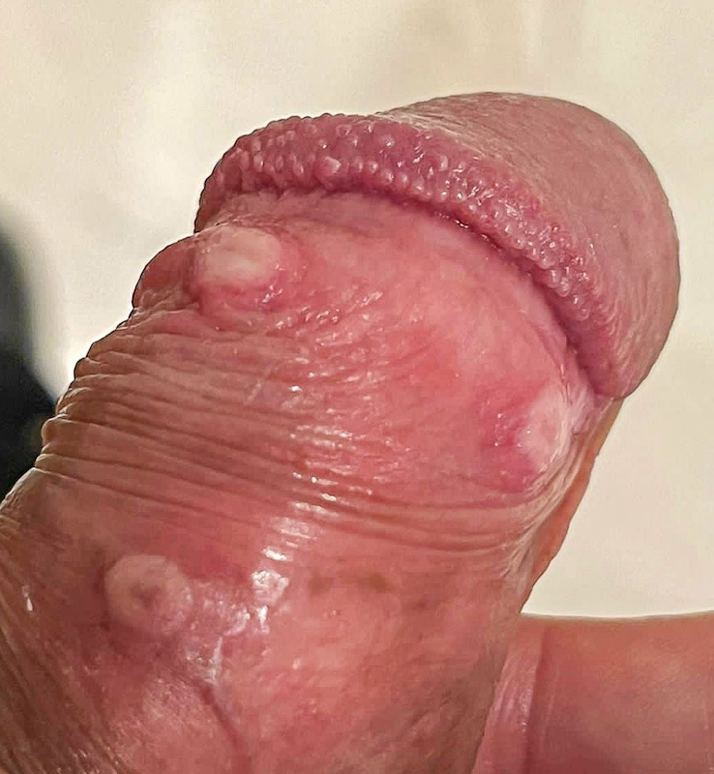
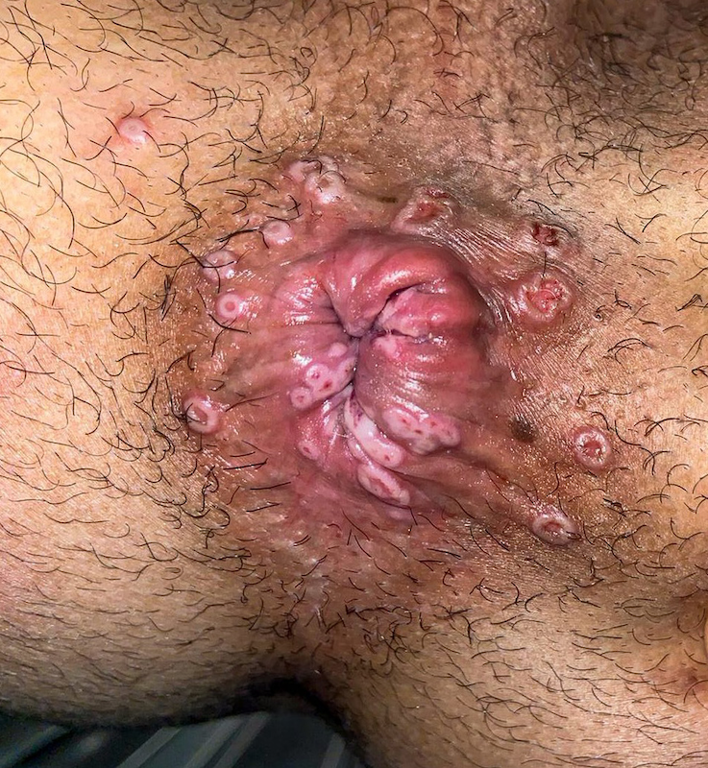
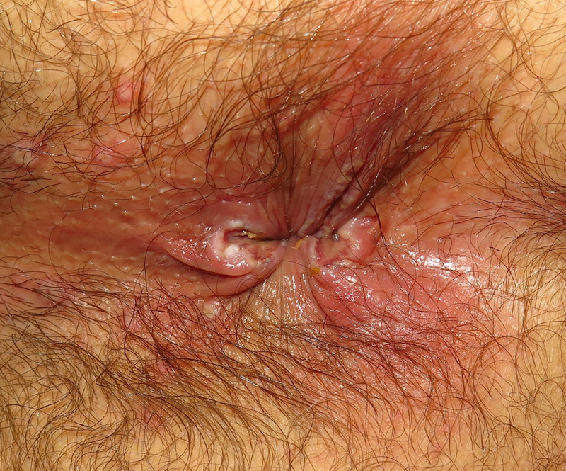
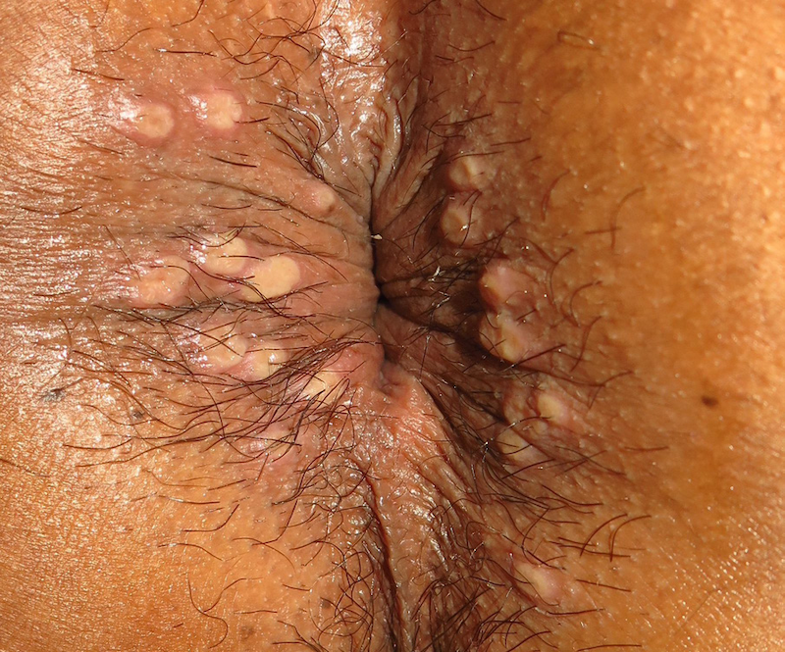

Accuracy by STI
CONDITION
GEMINI
CHATGPT
CLAUDE
Lichenoid Dermatoses
90.9%
59.1%
31.8%
Secondary syphilis
85.7%
71.4%
42.9%
Anogenital Warts
81.8%
81.8%
72.7%
Primary Syphilis
78.6%
42.9%
57.1%
Mpox
0%
0%
0%
Soe NN, et al. JID. DOI: 10.1093/infdis/jiag258

Slide 22
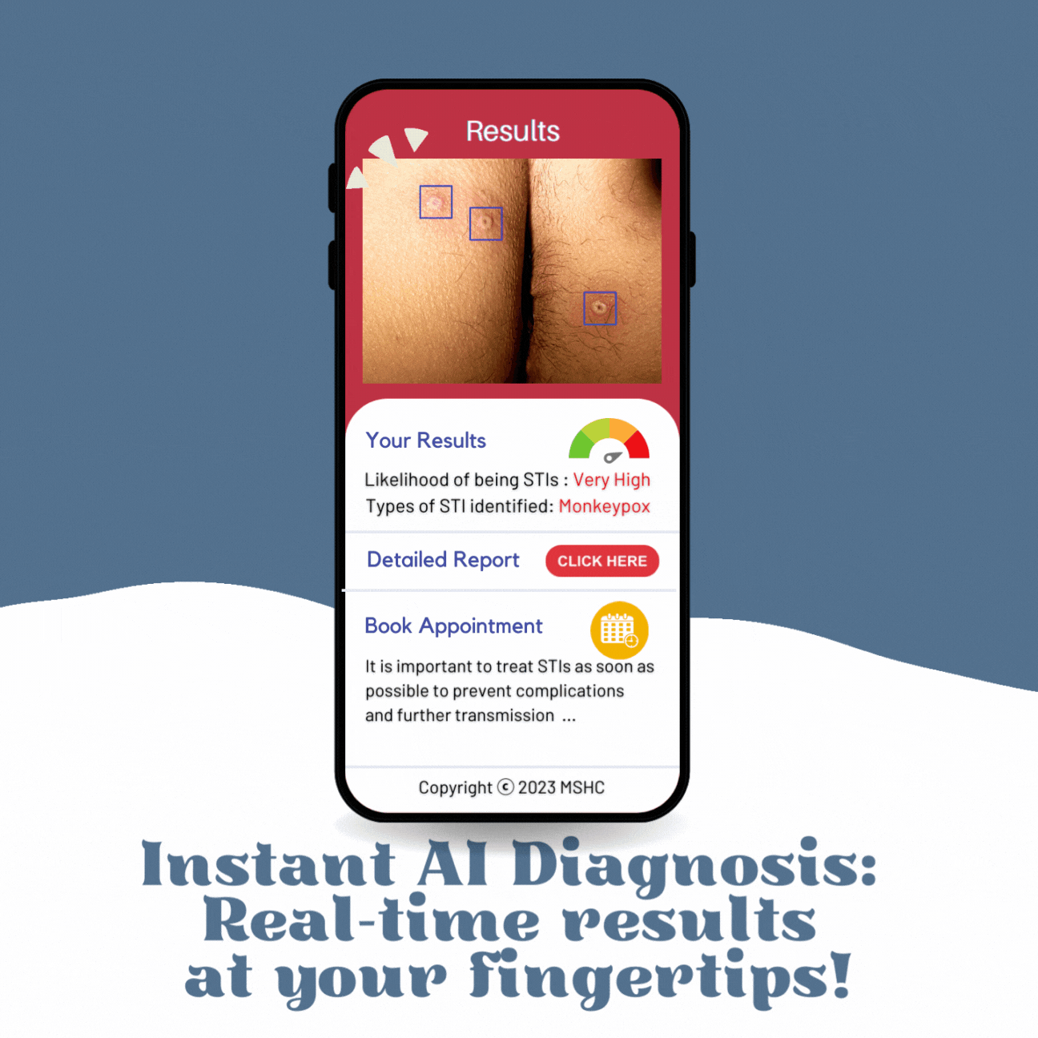
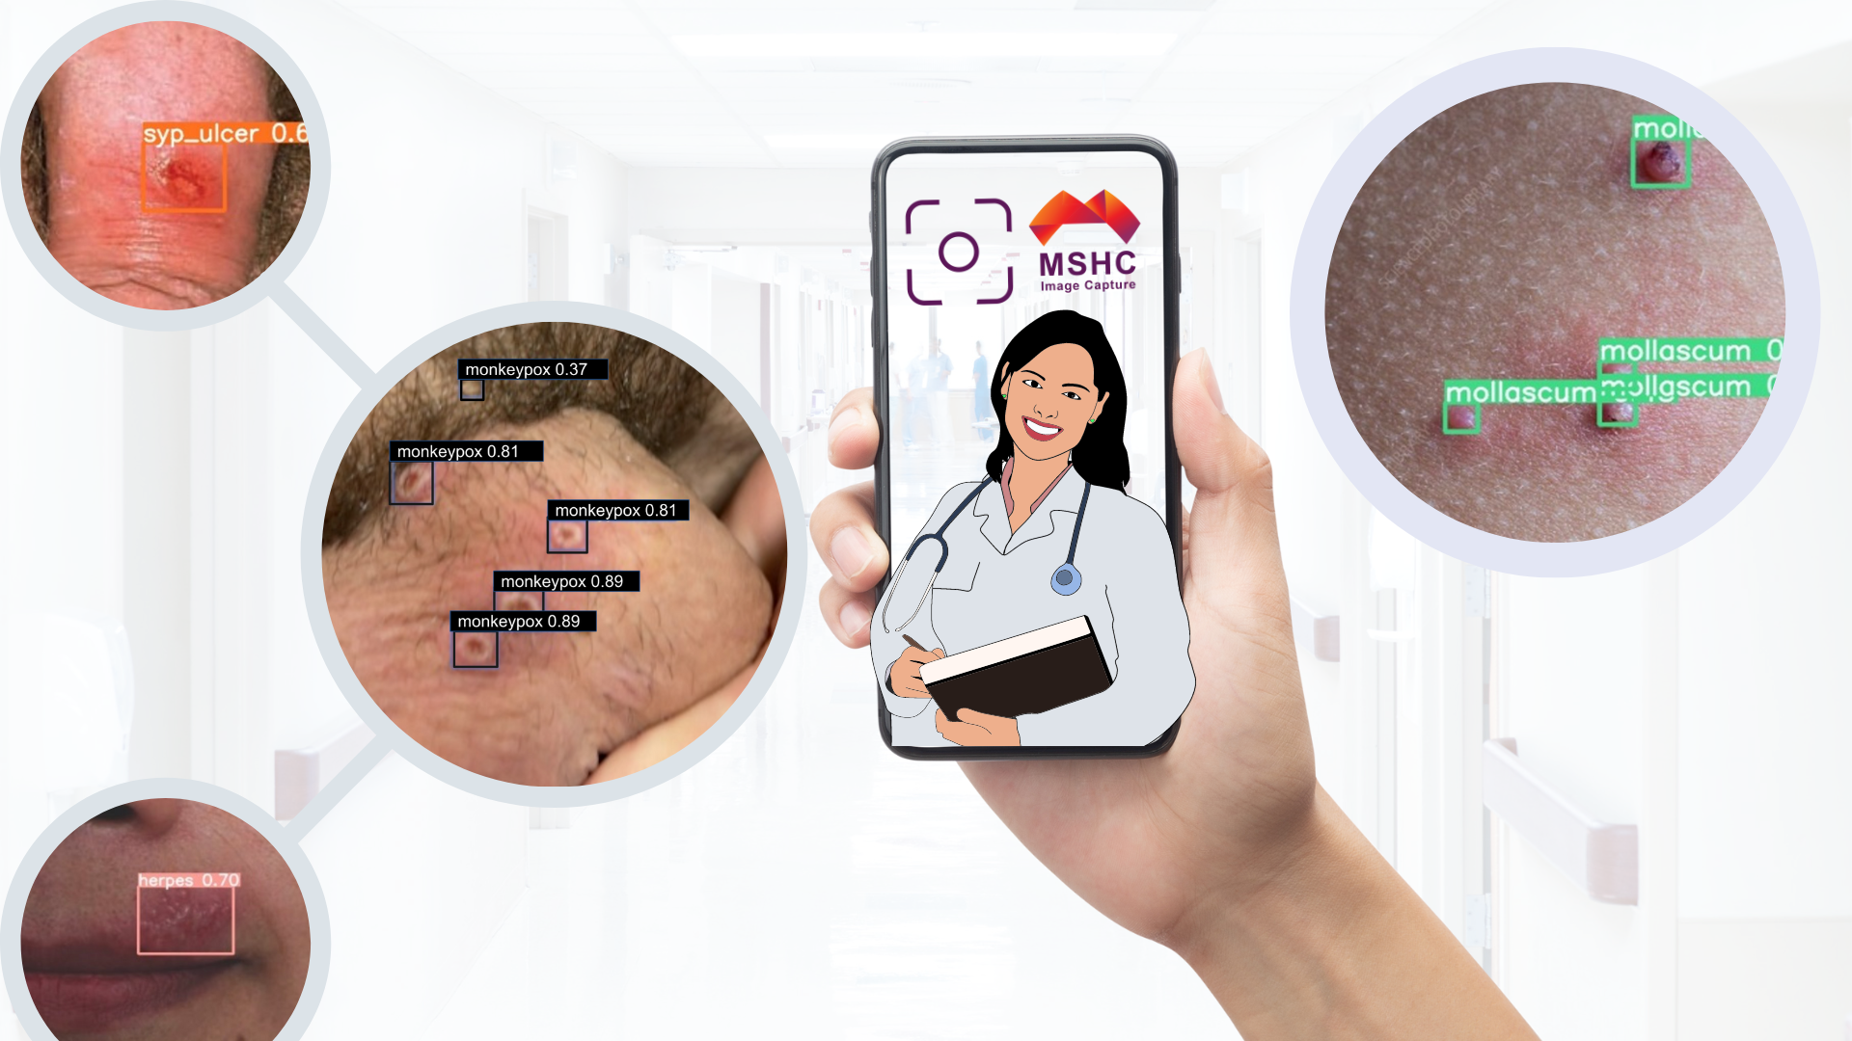
AI image recognition tool: AiSTI
AI tool can identify
 Herpes
 Genital warts
● Syphilis
❍ Monkeypox
■ Molluscum contagiosum
□ Pearly penile papules
❐ Dermatosis
Slide courtesy of Nyi Nyi Soe
Dr Nyi Nyi Soe

Slide 23

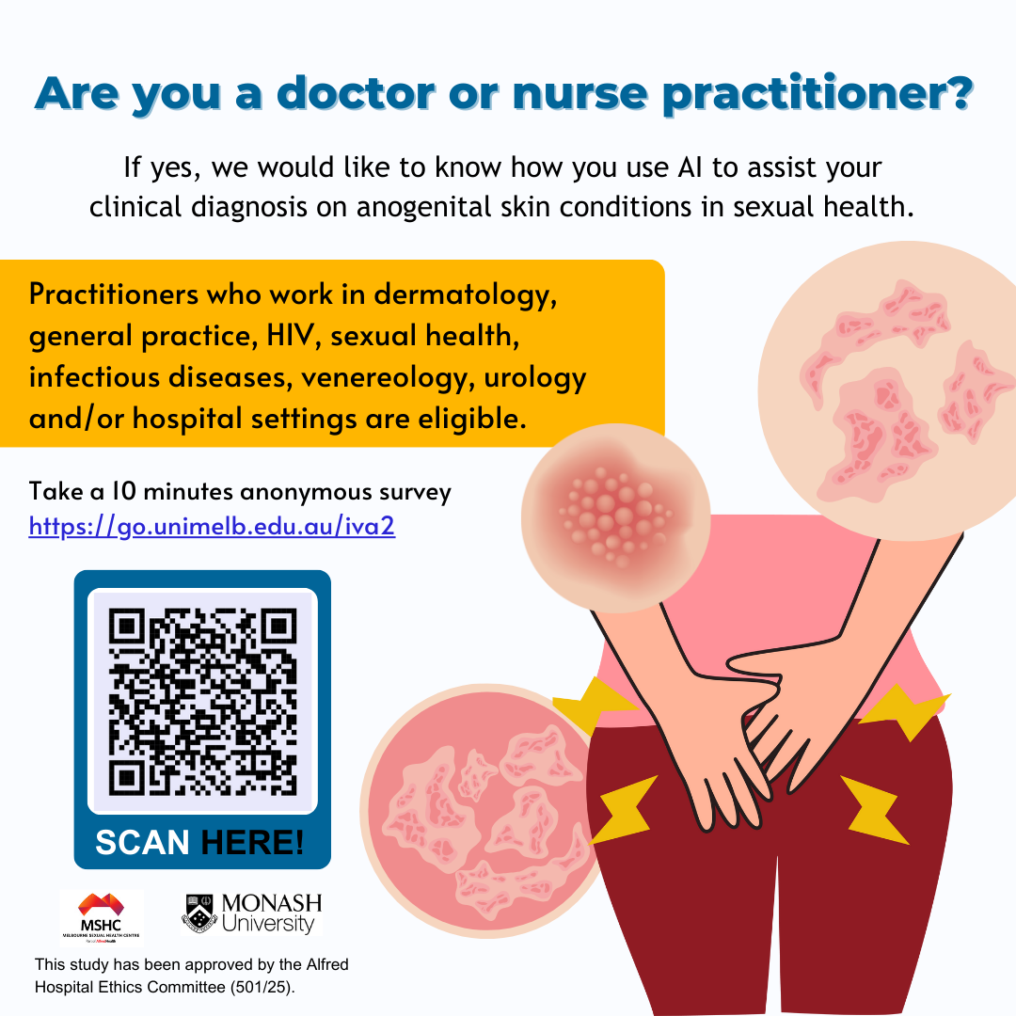
SHADE-AI International Study
Evaluating AI-assisted decision support for diagnosing anogenital skin conditions.
Anonymous 10-min online survey among clinicians who work in sexual health, HIV, dermatology, venereology, infectious diseases and urology.
Review 6 de-identified clinical images, provide your diagnosis & review AI suggestions.
https://go.monash.edu/rio
https://go.monash.edu/rio

Slide 24
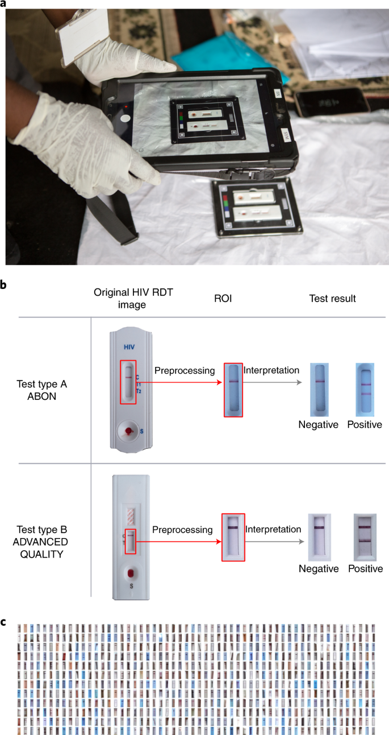
Deep learning of HIV rapid test
A mobile app using deep learning can enhance accuracy in interpreting rapid HIV test results in rural South Africa.
Some lay caregivers can struggle to interpret rapid diagnostic tests because of colour blindness or short-sightedness.
Analysed 11,374 photographs of images of HIV tests.
Overall performance: 98.9% accuracy using deep learning vs 92.1% accuracy using traditional visual interpretation of study participants.
Supports rapid diagnostics not just for HIV but potentially for malaria, syphilis, TB, influenza, etc, particularly in LMICs.
Facilitates real‑time reporting and linkage to care for REASSURED diagnostics: real‑time connectivity, ease of use, affordability, sensitivity, specificity, user‑friendly, rapid, equipment‑free delivery.
Turbé V, et al. Nature Medicine. 2021; 27: 1165-1170.

Slide 25

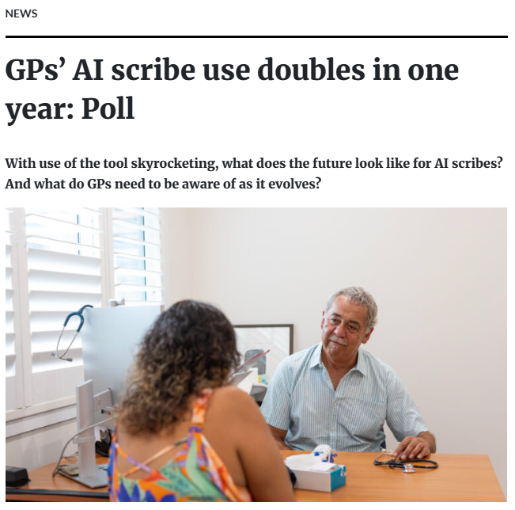
AI Scribe – Clinicians in Australia
Source: https://www1.racgp.org.au/newsgp/professional/gps-ai-scribe-use-doubles-in-one-year-poll

Slide 26

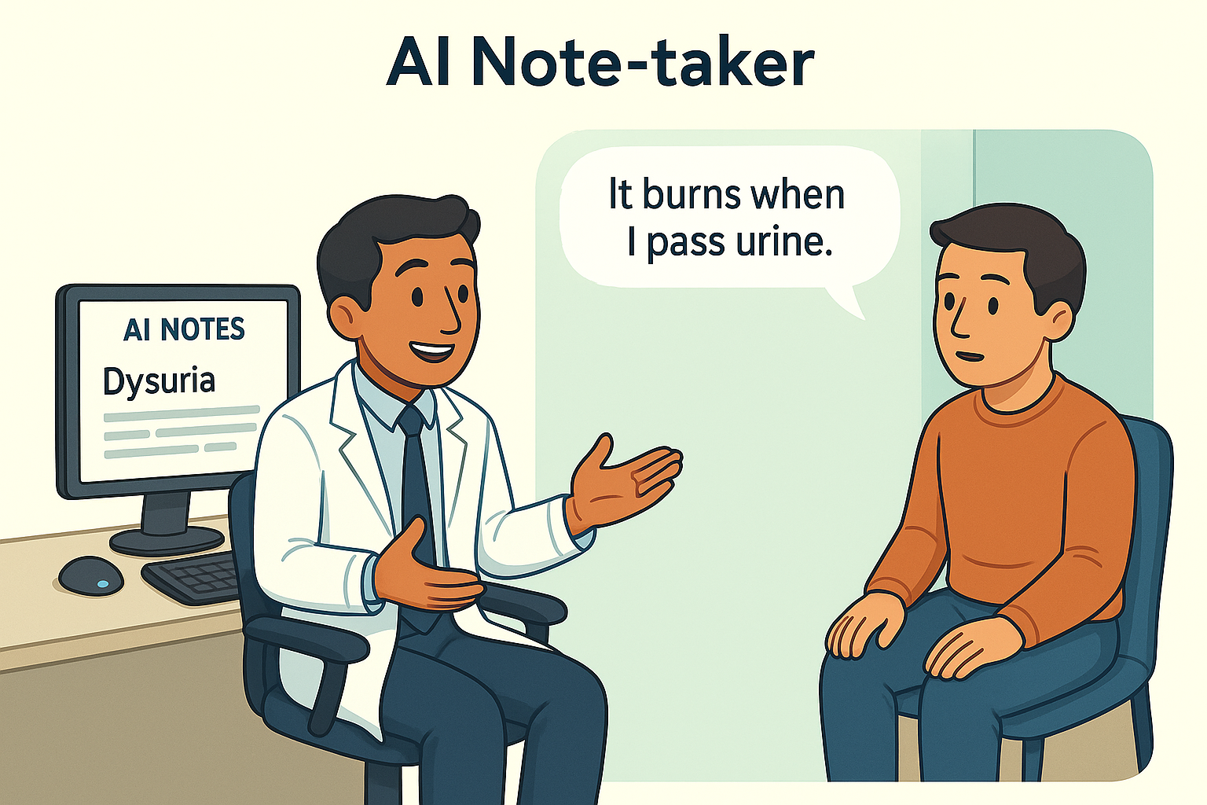
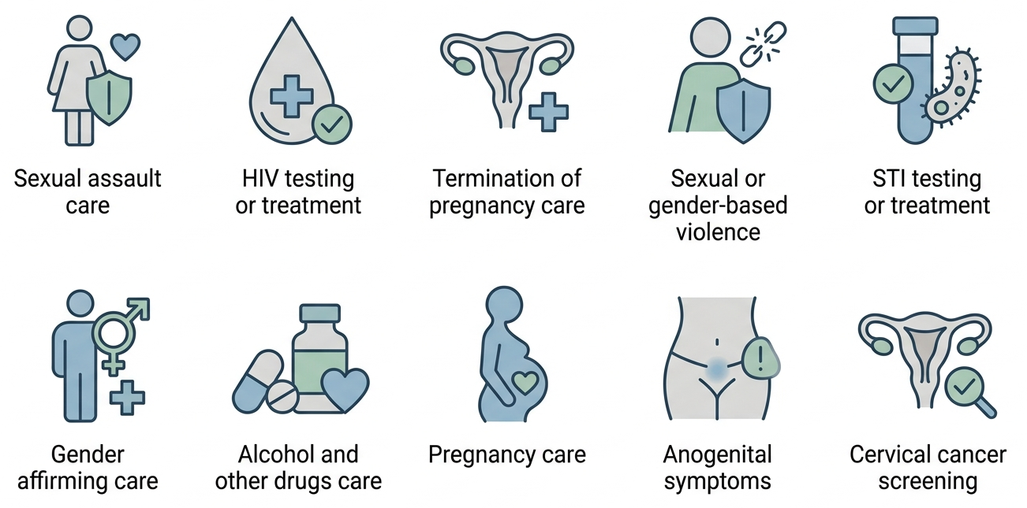

AI Scribe – Patients’ perspective
How comfortable would you be if your doctor or nurse use an AI note-taker during a sexual and reproductive health consultation
17%
15%
27%
28%
12%
Dr Ryan Horn
48% had heard of AI scribes
14% where their doctor used it
Very uncomfortable
Uncomfortable
Neutral
Comfortable
Very comfortable
Clinical settings in which individuals may feel less comfortable using AI note-taking
RESTRICTED
Horn R, et al. Unpublished data.

Slide 27
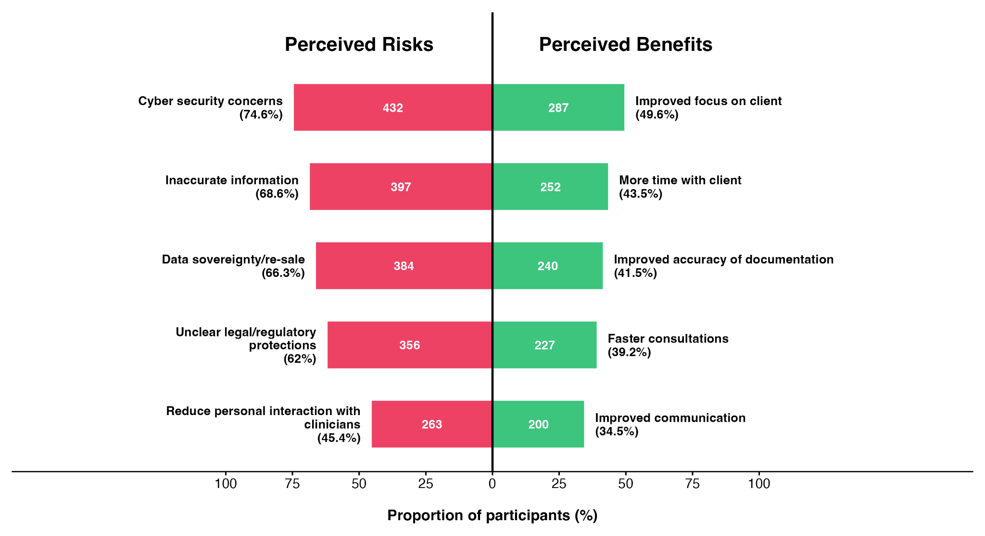

Perceived risks and benefits
RESTRICTED
Horn R, et al. Unpublished data.

Slide 28
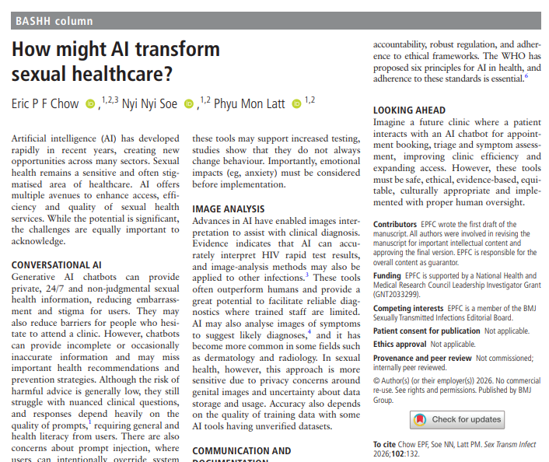
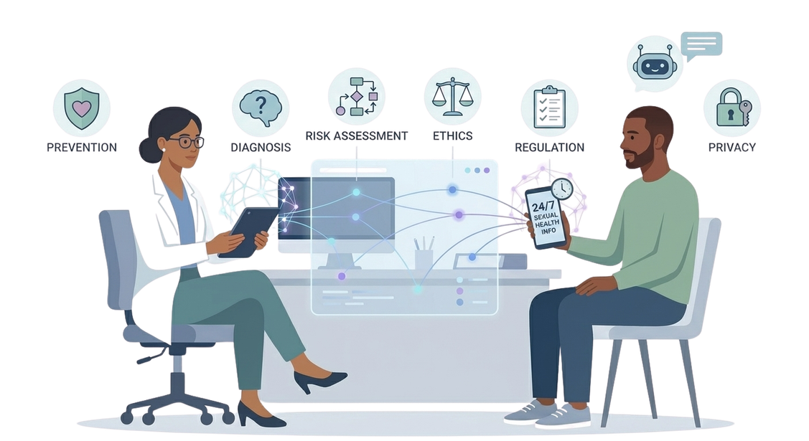
AI in sexual healthcare
Chow EPF, et al. Sexually Transmitted Infections. 2026; 102: 132.

Slide 29
Conclusions
AI is transforming sexual health: from chatbots and risk tools to image-based diagnosis.
Opportunities: Improved access, efficiency, personalised prevention, and clinical support.
Challenges: Accuracy, stigamised, bias, misinformation, and over-reliance on AI.
Future: Success depends on approaches that are safe, ethical, evidence-based, equitable, culturally appropriate, and implemented with proper human oversight.

Slide 30



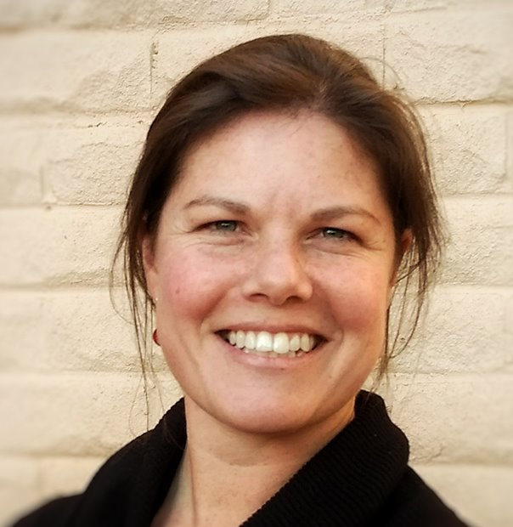
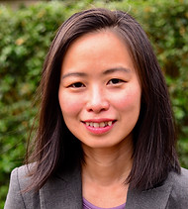
Acknowledgments
SHADE-AI
AUSTRALIA
Christopher Fairley
Nyi Nyi Soe
Phyu Mon Latt
David Lee
Ei Aung
Ryan Horn
Ming Jie Lee
CANADA
Darrell Tan
COLOMBIA
Luz A. Diaz
HONG KONG
Edmond Pui Hang Choi
MALAYSIA
Rong Xiang Ng
Raja Iskandar Shah Raja Azwa
MALTA
Valeska Padovese
Owen Cachia
NETHERLANDS
Henry de Vries
NEW ZEALAND
Rose Forster
PERU
Patricia J Garcia
UNITED KINGDOM
Matthew Phillips
UNITED STATES
Stephanie McLaughlin
Lao-Tzu Allan-Blitz
SOUTH AFRICA
Camilla Wattrus
SPAIN
Mario Martín-Sánchez
César Sotomayor
SRI LANKA
Danushi Wijekoon
TAIWAN
Nai-Ying Ko
Jason Tsai
THAILAND
Charussri Leeyaphan
ZIMBABWE
Sara Lowe
Christopher Fairley Nyi Nyi Soe Phyu Mon Latt
Kate Maddaford Ei Aung Ryan Horn

Slide 31


Professor Eric Chow
eric.chow@monash.edu

