Slide 1
Uptake, persistence and preference for long-acting injectable versus oral PrEP among mobile men in Uganda and South Africa
Eugene Ruzagira, MRC/UVRI and LSHTM Uganda Research Unit
Mobile Men Trial

Slide 2
Summary
What is your main question?
How do persistence and choice compare between CAB-LA and oral PrEP among heterosexual men who travel for work in Uganda and South Africa?
What did you find?
In a randomised trial, men initiating PrEP were assigned to either CAB-LA or oral TDF/FTC (Daily or event-driven). After 9 months, they were offered choice of PrEP:
CAB-LA persistence was significantly higher than oral PrEP (28% vs 16%; OR 2.53, p=0.002).
When given the choice, more men selected CAB-LA than oral PrEP (58% vs 42%, p=0.01)
An important minority of men chose an oral option, especially event-driven PrEP
Why is it important?
Among the first evidence of LA-PrEP delivery for heterosexual mobile men in Africa, a high-risk, underserved population.
Shows long-acting injectable PrEP’s advantage in persistence and preference, alongside real demand for choice among men without prior CAB-LA experience

Slide 3
Background
Men who travel for work in sub-Saharan Africa have a high HIV prevalence (26–54%) but limited access to PrEP
Adherence to daily pills is particularly challenging during extended travel
Event-driven oral PrEP reduces pill burden; long-acting injectable PrEP eliminates daily pills
Despite high efficacy, neither have been evaluated in men who are mobile for work in Africa
Evidence on uptake, persistence, choice, and cost is needed to guide PrEP delivery in this population
The Mobile Men study (NCT06133686) was designed to address this

Slide 4
Primary objectives
To compare persistence patterns across oral & injectable PrEP
  CAB-LA: receipt of all scheduled injections within ±7-day visit window
  Oral PrEP: visit attendance within ±7-day visit window with continuous drug supply (& detectable TFV-DP in Dry Blood Spots)
To compare adoption (uptake & choice preference) across oral & injectable PrEP
  Choice preference: proportion who chose & initiated a PrEP modality

Slide 5
Study design
Randomised phase
Same-day screening, randomisation & PrEP initiation
Group A: oral PrEP
(n=200)
Group B: CAB-LA
(n=200)
Uptake and persistence of PrEP modality (Month 0-9)
Participants offered choice of a further 9m of CAB-LA or oral PrEP
Choice phase
PrEP choice and persistence (Month 9–18)

Slide 6
Study participants
Enrolment: Aug-Nov 2024
We included
Adult (≥18 years) individuals assigned male at birth
Tested HIV-negative
Willing to provide informed consent
Willing to use PrEP
Had a history of work-related travel in the past 6 months, including ≥1 night away from home
Masaka, Uganda: Men in Lake Victoria fishing communities (referral to research clinic)
KwaZulu-Natal, South Africa: Truck/taxi drivers, farm workers, & other labourers (mobile clinics)
Eastern Cape, South Africa: Truck/taxi drivers, construction, migrant workers & other labourers (mobile clinics)

Slide 7
Randomised phase (0-9 months) results

Slide 8
Baseline socio-demographics
Characteristic | oral PrEP (N=198) | CAB-LA (N=202)❋
 | n (%) | n (%)
Eastern Cape, South Africa | 74 (37.4) | 76 (37.6)
KwaZulu-Natal, South Africa | 62 (31.3) | 64 (31.7)
Masaka, Uganda | 62 (31.3) | 62 (30.7)
Median age (IQR) | 32 (26-40) | 31 (24-38)
Married | 44 (22) | 42 (21)
Nights outside of community in past 6 months (IQR) | 4 (2-14) | 3 (2-14)
Heard of PrEP | 122 (62) | 125 (62)
Tested positive for hepatitis B surface antigen | 8 (4) | 10 (5)‡
Positive for Chlamydia trachomatis or Neisseria gonorrhoeae | 22 (11.1) | 33 (16.3)
Condomless sex in past 2 months | 150 (76) | 151 (75)
≥2 sexual partners in past 3 months | 131 (66.2) | 138 (68.3)
❋One participant in the CAB-LA group declined injection; ‡Ten participants who tested HBsAg+ were switched to oral PrEP

Slide 9
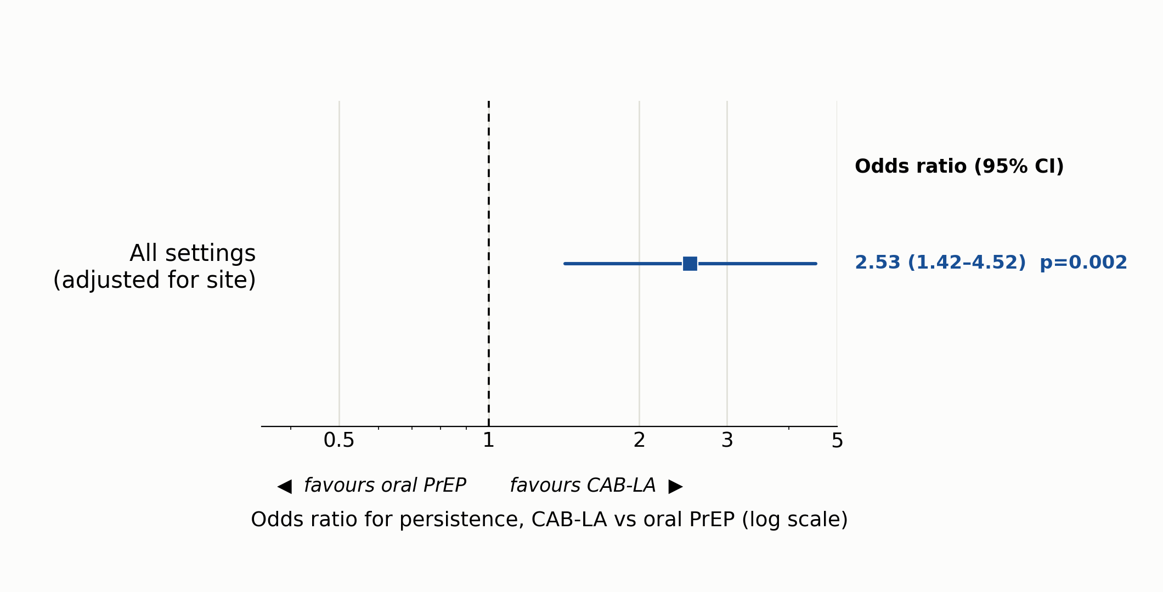
CAB-LA users had approx. 2.5× higher odds of persisting compared with oral PrEP users

Slide 10
Persistence was low overall and varied by site

Slide 11
At month 9, most men chose CAB-LA, including many that were randomised to oral PrEP
Overall, 58% chose CAB-LA vs 42% oral PrEP (p=0.01)

Slide 12
Among oral PrEP users, event-driven dosing was more commonly used than daily-only dosing
Event-driven dosing predominated in South Africa compared to Uganda
n=number of visits

Slide 13
Conclusions
Same-day HIV testing & CAB-LA initiation is feasible for mobile men in Uganda & South Africa
CAB-LA persistence was significantly higher than oral PrEP, though overall persistence was low
CAB-LA was preferred overall, but fewer individuals switched to it than observed in other populations
Among oral PrEP users, event-driven dosing was preferred overall, though this varied by setting

Slide 14
Next steps
Incorporation of drug-level dry blood spot data into the oral PrEP persistence estimates
Complete modelling, cost-effectiveness, and qualitative (see poster TUPED297) analyses to inform delivery of injectable PrEP alongside oral options at scale

Slide 15





Acknowledgements
European Union, through the Horizon/EDCTP Global Health call for vulnerable adults (Project 101103140)
Injectable CAB-LA supplied by ViiV Healthcare
Oral PrEP drugs supplied by the Ministries of Health, South Africa and Uganda
HIV test kits supplied by the World Health Organization
With thanks to the Mobile Men study participants and communities in Masaka (Uganda), KwaZulu-Natal and Buffalo City Metro (South Africa), and the study team

Slide 16










Mobile Men study team
KCL, UK: Julie Fox
MRC/UVRI & LSHTM Uganda Research Unit, Uganda: Eugene Ruzagira, Sylvia Kusemererwa, Berna Kalanzi, Paddy Kafeero, Ayoub Kakande, Shamim Nabukenya
UCL, UK: Andrew Phillips, Loveleen Bansi-Matharu
ARHI, South Africa: Maryam Shahmanesh, Limakatso Lebina, Dumsani Gumede, Thabang Manyaapelo, Anita Edwards
DTHF, South Africa: Linda Gail-Bekker, Nigel Garrett, Riaan Beukes, Philip Smith, Andrew Marino, Blessings Gausi, Tracey Swinerd, Annelize Louw, Sammy Nena, Pippa Macdonald, Cathlene Els
APHP, France: Jean Michel Molina
LSHTM, UK: Janet Seeley, Emily Webb
WITS, South Africa: Gesine Meyer-Rath
Trial Oversight: TSC, IDMC

Slide 17
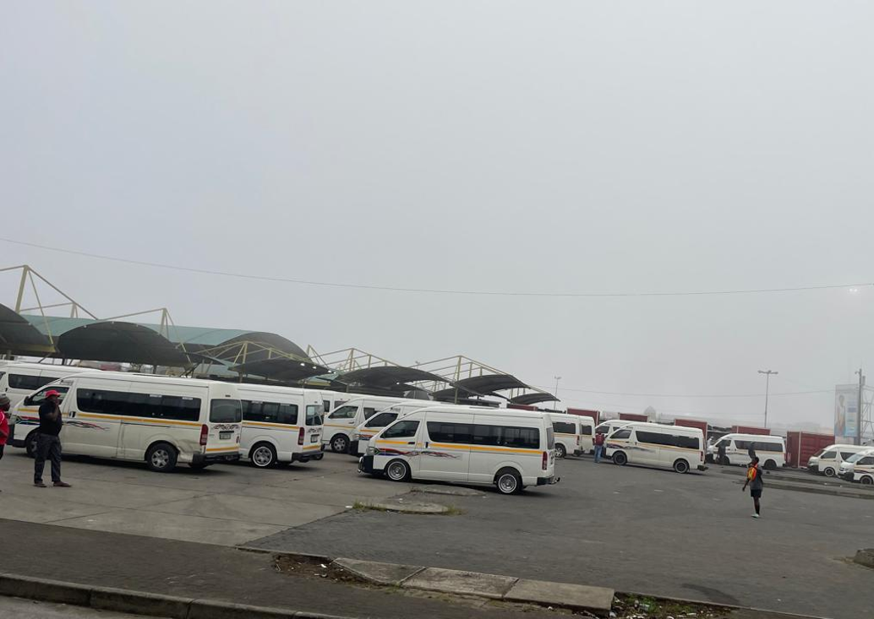
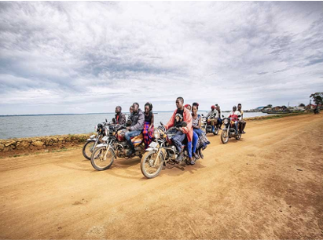
Thank you

