Slide 1
Measuring PEPFAR Disruptions at Scale: Results from a 46-Country Implementing Partner Survey
Elise Lankiewicz, amfAR
AIDS 2026: Co-Chairs' Choice
No conflicts of interest to declare.

Slide 2
Summary
What is your main question?
What happened to PEPFAR's implementing partners after the 2025 funding and policy disruptions? No independent systematic accounting exists.
What did you find?
Damage across the entire PEPFAR system, unevenly distributed. Disruption was near universal, even among partners whose services were nominally protected, with the deepest losses in prevention, key population, and community services and among local organizations.
Why is it important?
What goes uncounted often goes unaddressed. To know where we go from here, we first have to know what's left.

Slide 3
Background
Over the last 18 months, rapid and immense changes have been implemented at PEPFAR
Partial pictures of the state of PEPFAR have emerged through expenditure and monitoring data
What’s missing is an accounting of implementing partners; the backbone of the PEPFAR program

Slide 4
Methods
Electronic survey distributed to frame of 708 PEPFAR country-level implementing partners
  Manual outreach through organizational email addresses
  3 outreach attempts per organization
Conducted November 2025 – April 2026
Survey assessed the impact of the 2025 funding and policy changes on their awards, their staffing, and their services
Primarily descriptive with tests of association by partner type and region

Slide 5
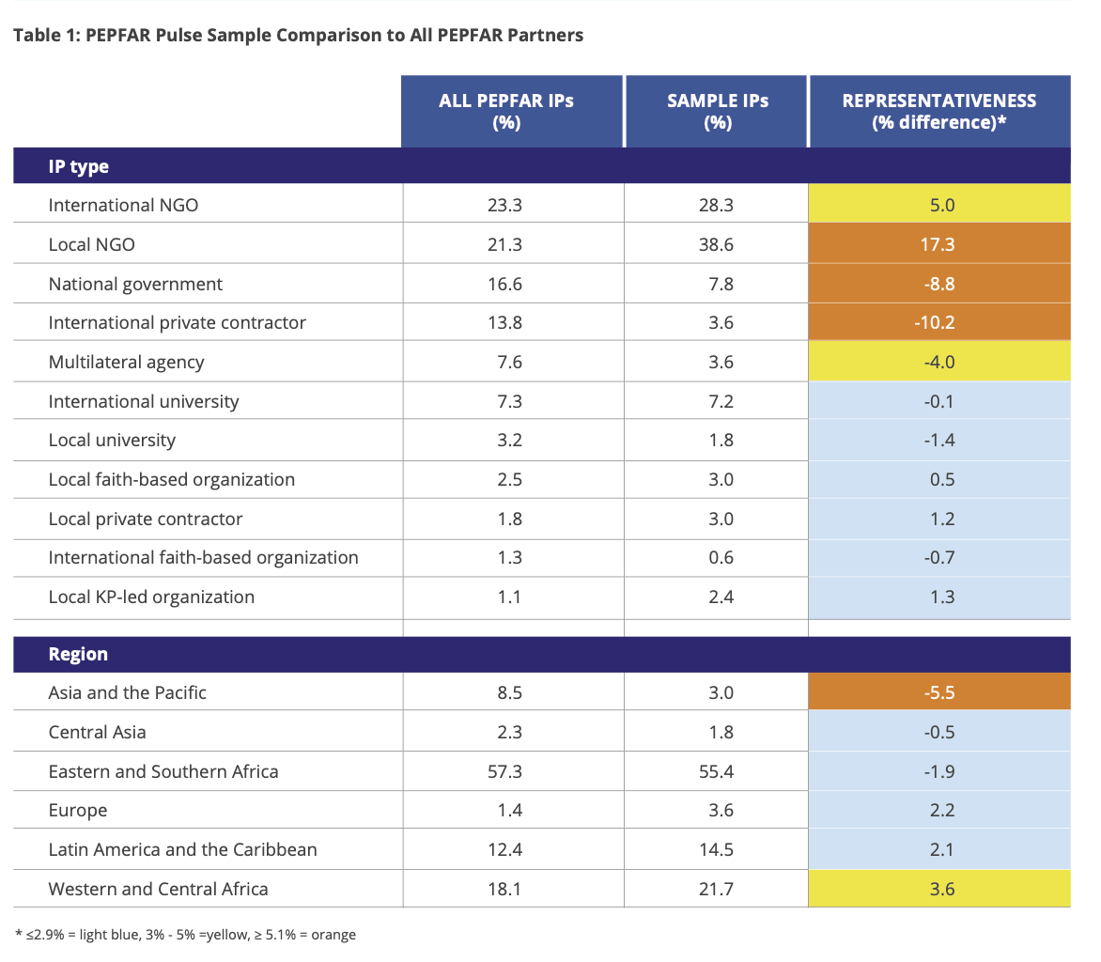
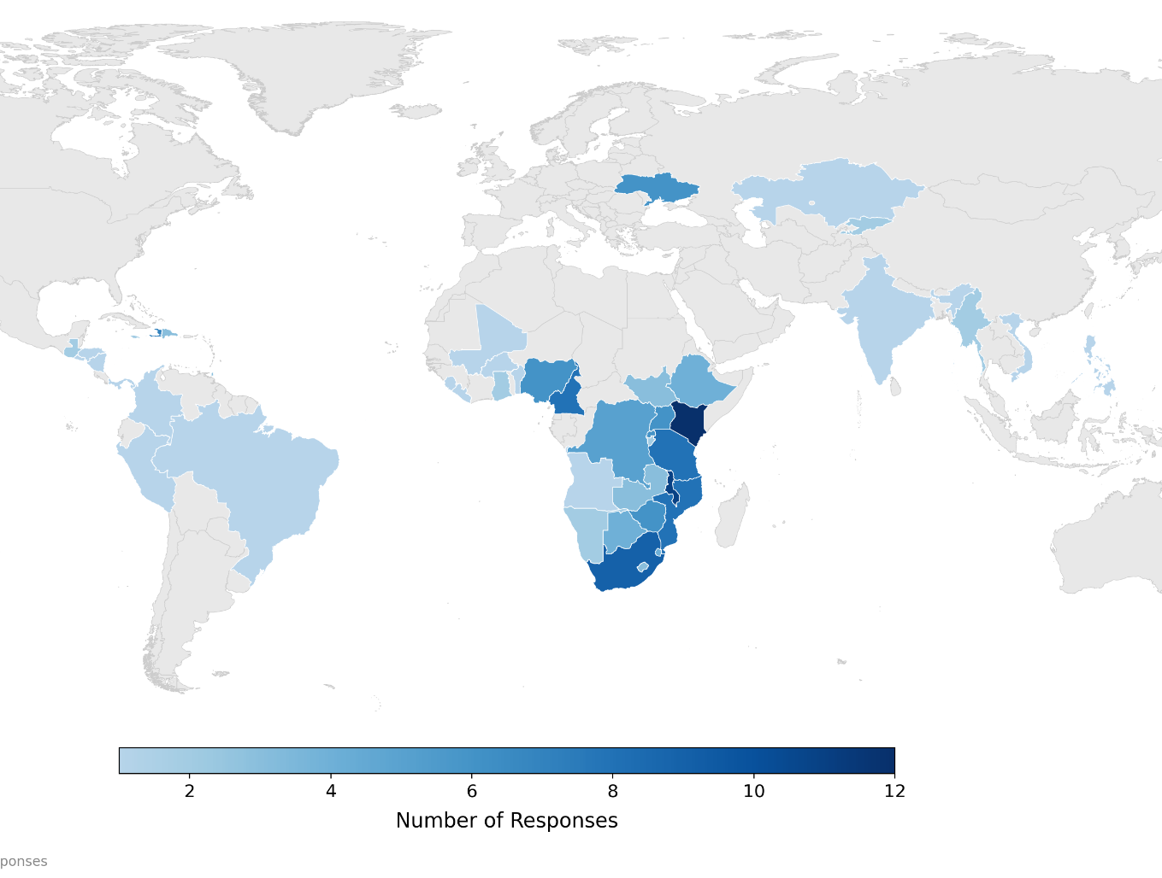
Respondents
166 respondents from 46 countries
~23% of the PEPFAR IP universe

Slide 6
Damage across the system
Services stopped among IPs previously providing that service
77% of respondents reported a delayed or terminated award
  Half of respondents (51.9%) reported at least one cancelled award
  Half (51.3%) reported at least one delayed award

Slide 7
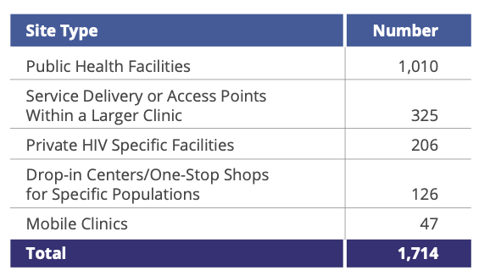
Damage across the system
5 IPs fully closed
Importance of lost DICs:
  100% (n=126) of closed DICs were located in countries that criminalize drug use,
  86.5% (n=109) were in countries that criminalize sex work, and
  41.3%(n=52) were in countries that criminalize same-sex relations.
Service delivery point closures by type

Slide 8
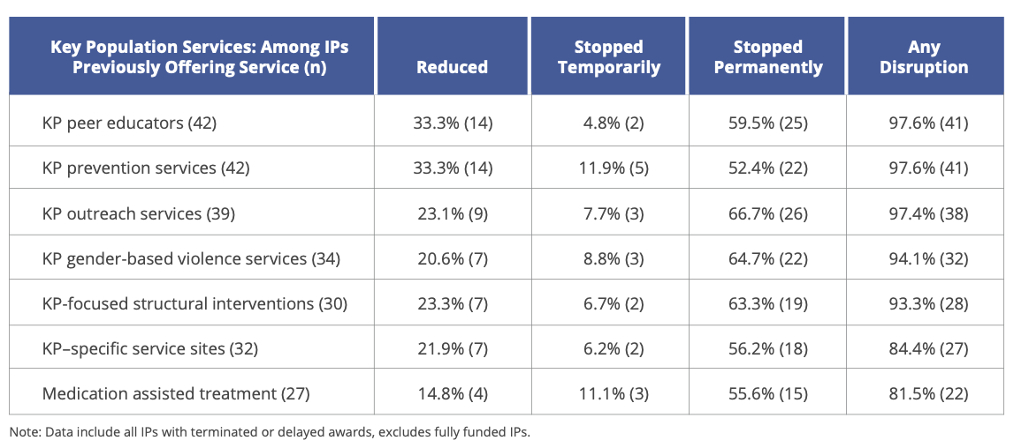
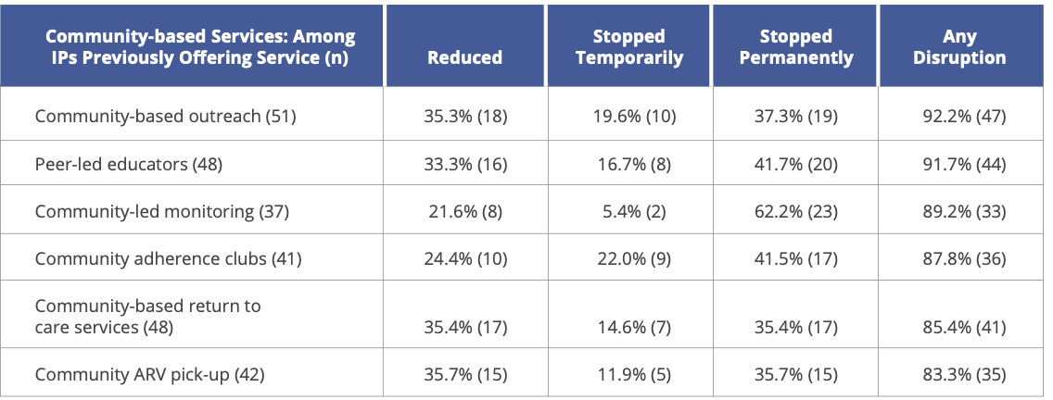
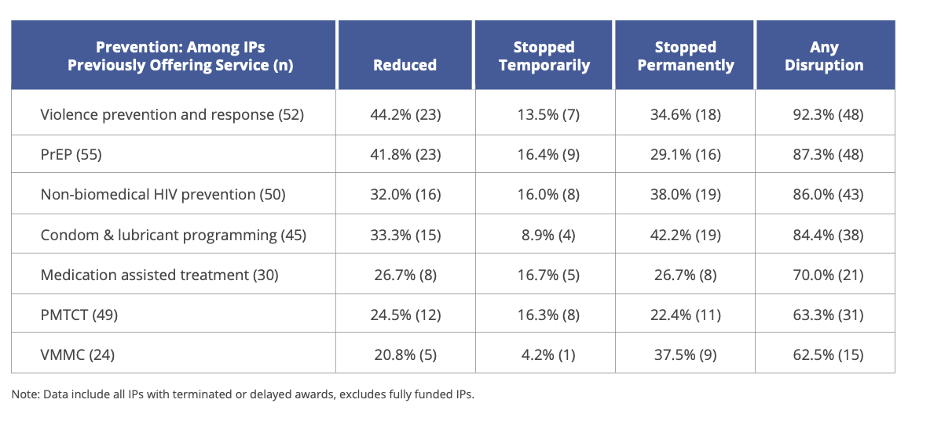
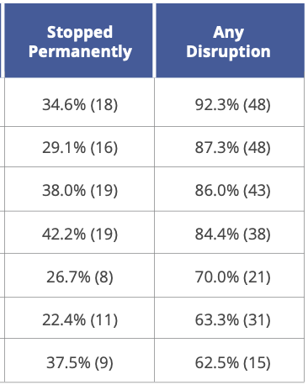
Areas of deepest disruption
Key population services
Prevention
Community-based services
72.6% of IPs who previously provided KP services permanently stopped at least one
46.1% of IPs who previously provided community-based services permanently stopped at least one
43.0% of IPs who previously provided prevention services permanently stopped at least one

Slide 9
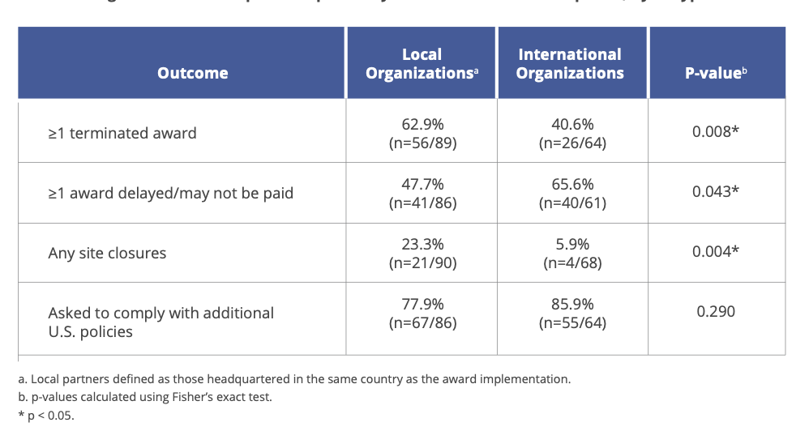
Organizations destabilized
For the majority (57.8%) of IPs, PEPFAR funding made up more than half of their budget
Only two IPs reported identifying sufficient new funding to fill lost awards
87.2% reported staffing reductions as a result of PEPFAR disruptions (a loss of 16,452 FTE)
Local IPs were more likely to have terminated awards and report any site closures

Slide 10
Beyond award cancellations
Policy conditions shaped what IPs could do
77% of IPs were asked to comply with new U.S. policy restrictions as a condition of continued PEPFAR funding
Fully funded partners still altered programming
78% of IPs with no terminated or delayed award changed how they worked to comply
Of those, 61% stopped a service outright
Damage rippled through PEPFAR partners
55% of open direct service providers had a partner they rely on for service delivery lose funding
Sub-granting collapsed
64% of IPs cut off a sub-grantee entirely
20% of primes had a sub-grantee close

Slide 11
Conclusions
Many of the programs that bring people into care and keep them there have been stopped. Treatment continuity now rests on a system that has lost many of its entry points.
Alterations go beyond funding loss, with shifts away from programs for the most vulnerable populations. Restoring funding alone would not restore the program that existed.
Without dedicated support outside government systems, key population services are unlikely to return.

Slide 12





With immense gratitude to our study team, and the PEPFAR implementors who gave us their time.
Thank you!
Read the full report here:

