Slide 1
CAPRISA 012C Phase 2 Trial:
Assessing the safety & efficacy of CAP256V2LS & VRC07-523LS for HIV prevention
Co-Chairs' Choice session
Dr Sharana Mahomed on behalf of the CAPRISA 012C Team Centre for the AIDS Programme of Research in South Africa (CAPRISA)
CAPRISA 012C Team: Sharana Mahomed, Farzana Osman, Ishana Harkoo, Disebo Potloane, Izukanji T. Sikazwe, Ethel Kamuti, Nono Mkhize, Kevin Carlton, Nicole Doria-Rose, Lara Lewis, Derseree Archary, Tanuja N. Gengiah, Natasha Samsunder, Leila Mansoor, Nikita Devnarain, John Mascola, Richard A. Koup, Mike Castro, Sandeep Narpala, Leonid Serebryannyy, Bruno Pozzetto, Stephane Paul, Catherine Hankins, Melissa-Rose Abrahams, Lynn Morris, Carolyn Williamson, Penny Moore, Quarraisha Abdool Karim* & Salim S. Abdool Karim*
Notes:
Good morning. On behalf of the study team, I will be presenting results from the CAPRISA 012C trial that set out to assess the safety & efficacy of two broadly neutralising antibodies for HIV prevention.

Slide 2
Summary for Community
What is your main question?
Is the combination of VRC07 & CAP256 - two broadly neutralising antibodies (bnAbs) - safe, and can it prevent HIV infection in women?
What did you find?
The antibodies were safe and well tolerated. Overall, this bnAb combination did not reduce HIV infection compared to placebo. However, in a pre-specified analysis based on whether the viruses were sensitive to each of the antibodies, there was an indication that the antibodies helped protect against infection.
Why is it important?
While the study does not lead to a new prevention product, it advances our understanding of antibody combinations that may protect against prevailing HIV strains.
Notes:
We conducted this study to determine if two broadly neutralising antibodies were safe and able to prevent HIV infection in women at risk. The combination of antibodies was safe and well tolerated. Overall, it did not reduce HIV infection. However, in a pre-specified analysis based on whether the viruses were sensitive to one or both of the antibodies, there was an indication that the antibodies helped protect against infection. This is important as it advances our understanding of antibody combinations that may protect against a wide range of HIV strains.

Slide 3
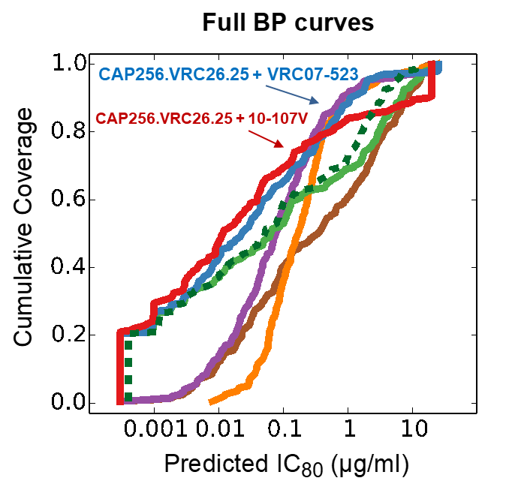
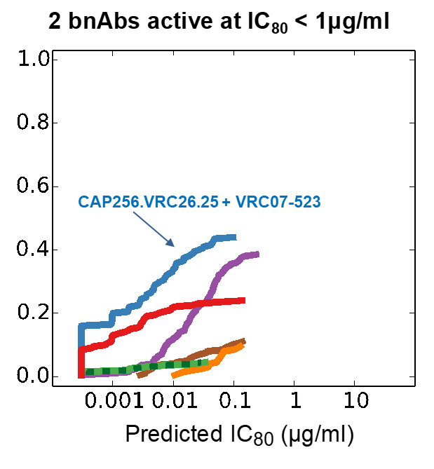
Rationale
Young women in Africa still have high HIV incidence rates, despite daily oral PrEP – highlighting the need for long-acting PrEP formulations
The AMP trial of VRC01, a single broadly neutralising antibody (bnAb), indicated initial promise for this approach for HIV prevention
A lab analysis of a panel of 208 diverse viruses showed that a combination of a CD4 binding site (VRC07) and V2 loop (CAP256) antibodies provided a good combination of breadth and potency against HIV infection
Source: Wagh et al., PLoS Pathogens 2016
Notes:
Young women in Africa still have high HIV incidence rates, highlighting the need for long-acting PrEP formulations. The use of broadly neutralising antibodies commonly referred to as bNAbs, have emerged as a promising strategy. The AMP trial of VRC01, a single bNAb, provided proof of concept for this approach. Based on these findings we decided to improve coverage by using 2 different antibodies that target different epitopes: CAP256V2LS (a V2 loop antibody) and VRC07-523LS (a CD4 binding site antibody). This combination provided good predictive coverage across subtype C viruses.

Slide 4
CAPRISA 012C study schema
Purpose | To evaluate the safety, PK and efficacy of CAP256V2LS + VRC07-523LS SC in women at risk
Study design | Phase II expanded safety and efficacy study of 6-monthly fixed doses of: 1.2 g loading dose followed by 600mg CAP256V2LS and 1.2 g VRC07-523LS, administered as subcutaneous (SC) infusions
Study participants | Eligible women without HIV (N=1023) women aged 18 to 35 years
Study sites | South Africa: CAPRISA eThekwini urban clinic & Vulindlela rural clinic Zambia: Centre for Infectious Disease Research in Zambia (CIDRZ)
Methods | 1º endpoint: Safety – systemic AEs & local reactogenicity (MedDRA) 2º endpoint: HIV acquisition – 3 monthly HIV rapid tests & PCR confirmation bnAb resistance – based on AMP trial approach (Cutoffs on IC80) Statistics – Kaplan-Meier & Aalen-Johansen (competing risks) for cumulative incidence & Cochran-Armitage test for trend
Notes:
CAPRISA 012C was a Phase II study to assess extended safety, PK, and a signal of efficacy - of subcutaneously administered CAP256V2LS in combination with VRC07- 523LS in women without HIV. 1023 women received both bNAbs at a 1.2 g loading dose subcutaneously, followed by 600mg of CAP256V2LS and 1.2g VRC07-523LS at 6-month dosing intervals. The study was conducted at the CAPRISA eThekwini clinic & Vulindlela clinic in South Africa, and the Centre for Infectious Disease Research (CIDRZ) in Zambia. The primary endpoint was safety, and the secondary endpoints included HIV acquisition and bNAb resistance, which was pre-set at IC80 concentrations of 1ug/ml for VRC07-523LS and 0.1ug/ml for CAP256V2LS

Slide 5
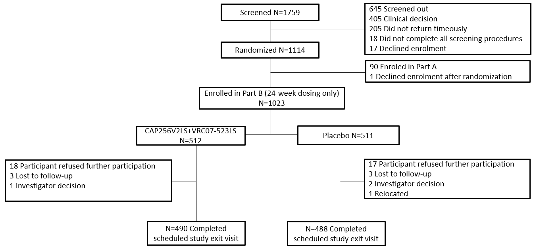
Enrolment, randomization & follow-up
Notes:
A total of 1,759 women were screened. 1,114 were randomized and 1,023 were enrolled. 512 participants entered the active arm and 511 entered the placebo arm. Just over 95% of the participants in both groups completed follow-up in the study.

Slide 6
Characteristics at baseline & follow-up
 | CAP256V2LS + VRC07-523LS (N=512) | Placebo (N=511)
Age (years)* | 23.0 (20.0 - 25.0) | 23.0 (20.0 - 25.0)
Never used condoms$ | 33.8% (173) | 32.9% (168)
STDs in 30 days before enrolment | 1.0% (5) | 2.0% (10)
STDs (CT/TV/NG) during the trial | 2.5% (13) | 2.2% (11)
PrEP use at enrolment | 1.2% (6) | 1.0% (5)
Prep Uptake during the trial | 37.7% (193) | 38.9% (199)
Contraceptive use at enrolment | 85.5% (438) | 83.4% (426)
Pregnancies during the trial | 2.5% (13) | 1.8% (9)
*Median (IQR) $ % (number)
Notes:
Baseline demographic and behavioural characteristics were well balanced between the active and placebo groups. PrEP uptake and the number of STI events during trial follow up were similar in both arms.

Slide 7
Safety: Adverse events & local reactions
 | CAP256V2LS + VRC07-523LS | Placebo
Number of adverse events | 1057 (355)* | 930 (346)*
Serious adverse events (No deaths) | 11 (7) | 13 (11)
Grade 3 adverse events | 26 (23) | 25 (20)
Grade 4 adverse events | 5 (5) | 4 (4)
Solicited systemic reactions (fever, headache, fatigue, myalgia, nausea, chills) | 856 (333/512)$ | 259 (146/511)$
Solicited local reaction - CAP256V2LS (pain, tenderness, erythema, swelling, induration) | 302 (225/512) | 78 (71/511)
Solicited local reaction - VRC07-523LS (pain, tenderness, erythema, swelling, induration) | 429 (300/512) | 84 (75/511)
* Number of events (number of women with events)
$Number of events (number of women with events / number of women) – after first dose
Notes:
Overall, both bnAbs were safe. Adverse events recorded were similar between active and placebo recipients. Serious adverse events were similar in both groups and were all graded as unrelated to study product. There were no deaths. As expected, reactogenicity was higher in bnAb recipients than placebo recipients. Local reactions were more common at the VRC07-523LS injection site. This is most likely in keeping with the higher dose of VRC07 administered compared to CAP256.

Slide 8
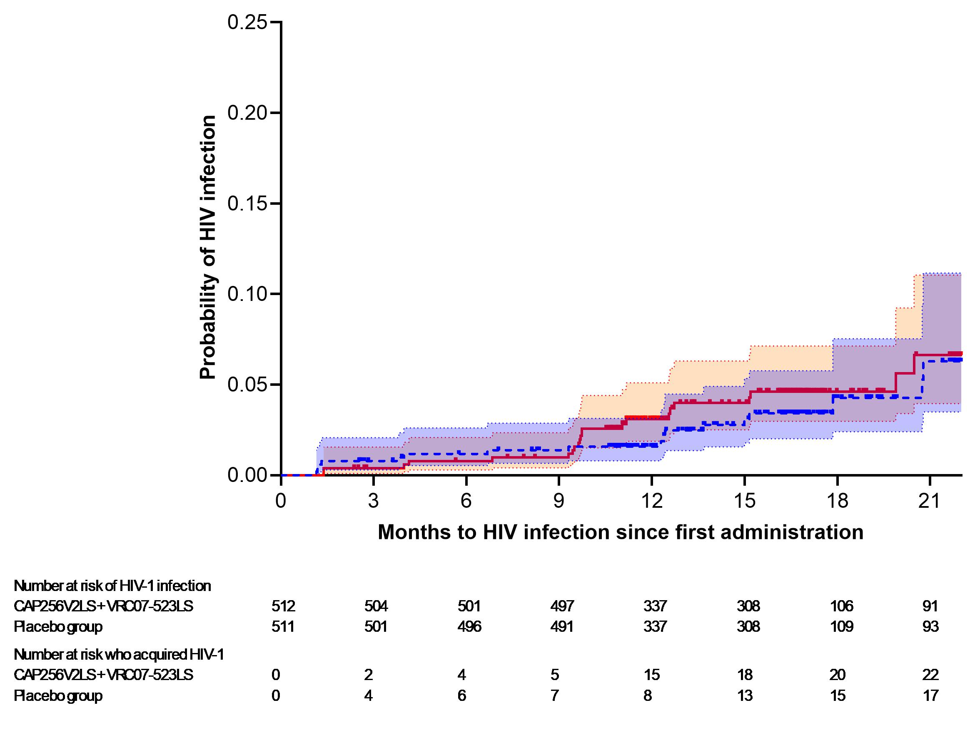
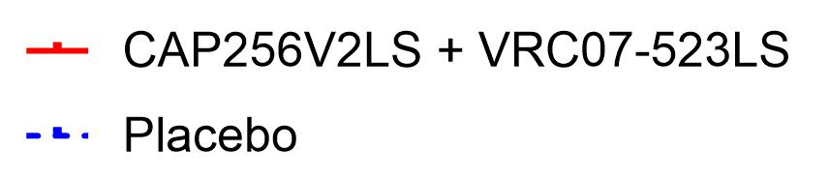
Cumulative probability of HIV in bnAb & placebo recipients
 | N | Women with HIV | Incidence per 100wy (95% CI)
Placebo | 511 | 17 | 2.61 (1.52-4.19)
bnAbs | 512 | 22 | 3.38 (2.12-5.12)
Overall | 1023 | 39 | 2.99 (2.13-4.09)
IRR (95% CI): 1.29 (0.69–2.43)
Notes:
Overall, there was no evidence of HIV prevention efficacy. During the on-product follow-up period, there were 22 HIV acquisitions among the participants who received the bNAbs and 17 HIV acquisitions among placebo recipients. The Kaplan–Meier curves for both study arms overlap substantially. The incidence rate ratio was 1.29 and was not statistically significant. Overall, a total of 39 infections occurred in 1023 women with an incidence of 2.99 per 100 women years.

Slide 9

HIV incidence by viral neutralization
Subgroup
Breakthrough infections
bnAb vs placebo (counts)
Incidence rate ratio (IRR)
(bnAb vs placebo)
IRR (95% CI)
1. VRC07-523LS sensitivity
IC₈₀ < 1 µg/mL
4 vs 7
0.57 (0.17–1.95)
IC₈₀ ≥ 1 µg/mL
18 vs 10
1.80 (0.83–3.89)
Threshold based on VRC07-523LS IC₈₀ analysis
2. CAP256V2LS sensitivity
IC₈₀ < 0.1 µg/mL
0 vs 5
0.00 (0.00–1.09)
IC₈₀ ≥ 0.1 µg/mL
22 vs 12
1.83 (0.91–3.70)
Threshold based on CAP256V2LS IC₈₀ analysis
3. Combined antibody sensitivity
Sensitive to both
0 vs 2
0.00 (0.00–5.32)
Sensitive to one
4 vs 8
0.50 (0.15–1.66)
Resistant to both
18 vs 7
2.57 (1.07–6.15)
Cochran–Armitage test for trend: p=0.023
100
0.01
0.1
1
10
Incidence rate ratio (log scale)
Favors antibodies
Favors placebo
Combined sensitivity categories were defined using CAP256V2LS IC₈₀ threshold 0.1 µg/mL and VRC07-523LS IC₈₀ threshold 1 µg/mL. ◄ = 0 infections in bnAb arm (IRR = 0, below plotting range).
26–31 July • Rio de Janeiro, Brazil
aids2026.org
Notes:
We then looked at HIV incidence rates based on resistance to one or both of the antibodies. IC80 concentrations were assessed twice independently – 38 of the 39 samples were concordant. Participants with viruses resistant to both CAP256V2LS and VRC07-523LS (shown in red) had a higher number of HIV seroconversions, whereas those with viruses sensitive to one antibody (shown in orange) had a lower infection rate. When viruses were sensitive to both antibodies (shown in green), there were no infections. The Cochrane Armitage test for trend was statistically significant. It is important to note that that this analysis is based on very small numbers and must be interpreted with caution.

Slide 10
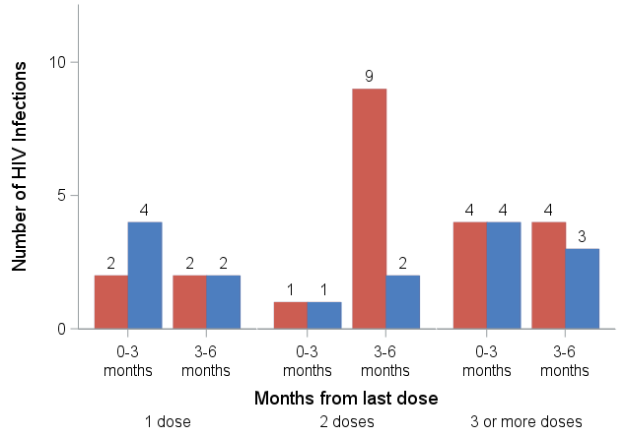

HIV infection by dose received & time since last dose
No evidence of early post-dose protection, when bnAb levels higher & CAP256 has neutralisation
Antibody-dependent enhancement unlikely – only one interval has the additional HIV infections in the bnAb group
Note: mean concentrations of each bnAb were similar in seroconvertors & HIV-ve
IRR: 4.3
(0.9-20.1)
Months since
last dose
1st dose 2nd dose 3rd & 4th doses
Notes:
When comparing HIV seroconversions in the 2 groups, there is no evidence of early post-dose protection-when bnAb levels are higher & CAP256 is able to neutralise viruses, as its neutralisation wanes after a few weeks. While the bnAb concentration data have not been shown here, it should be noted that mean concentrations of each bnAb were similar in seroconvertors & women who remained uninfected suggesting that seroconversions are unlikely to have occurred due to suboptimal antibody concentrations. Also, antibody-dependent enhancement is unlikely as the additional HIV infections occur in only one interval in the bnAb group.

Slide 11
Conclusions
Subcutaneous administration of fixed dose CAP256V2LS & VRC07-523LS was safe & well tolerated
Overall, HIV incidence rates were not significantly different in bnAb & placebo recipients demonstrating no overall protection
A pre-specified analysis indicated a trend towards higher HIV protection when viruses were sensitive to both bnAbs and to at least one bnAb when compared to viruses resistant to both bnAbs (note: analysis involved small numbers of bnAb-sensitive viruses)
bnAb sensitivity profiles of contemporary circulating viruses need to be factored into planning future trials of bnAbs for HIV prevention
Notes:
The study demonstrated that subcutaneous administration of fixed dose CAP256V2LS & VRC07-523LS was safe & well tolerated. HIV incidence rates were not significantly different in bnAb & placebo recipients demonstrating no overall protection. However, there was a trend towards higher HIV protection in those with viruses sensitive to both bnAbs and to at least one bnAb, when compared to viruses resistant to both bnAbs. Sensitivity to bnAbs in contemporary circulating viruses will need to be factored into planning future trials of bnAbs.

Slide 12

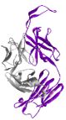

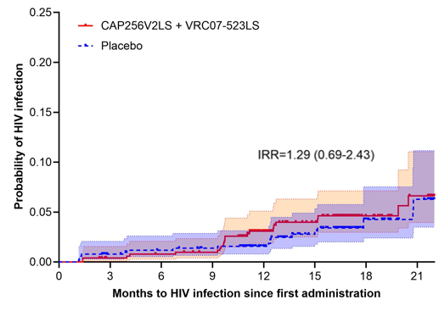
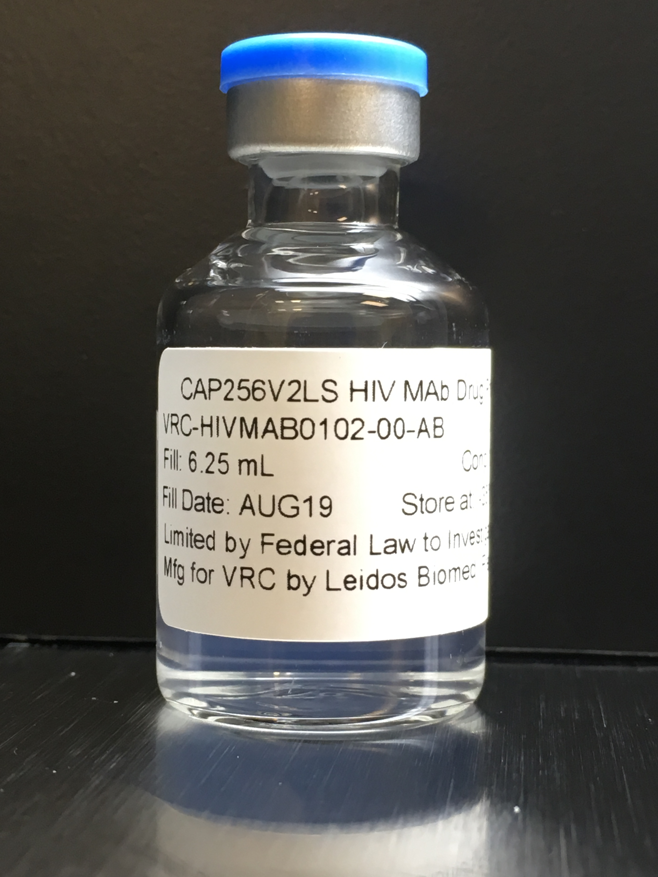
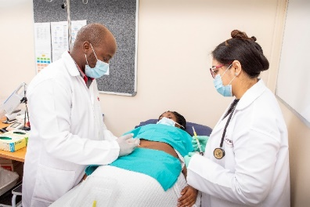
From Clinic to Lab to Clinic:
The 22-year story of CAP256
Potent bnAbs isolated from CAP256
Phase 2 trial began
Caprisa 256 enrolled
Participant
initiated on ART
Monkey efficacy studies
Cohort enrolled
CAPRISA 012 trial CAP256 + VRC07
1st batch CAP256
Results
CAP256
tested HIV+
Identification of bNAbs
Isolation of CAP256’s variants
2004 |  | 2006 |  | 2008 |  | 2010 |  | 2012 |  | 2014 |  | 2016 |  | 2018 |  | 2020 |  | 2022 |  | 2024 |  | 2026
Clinic
Laboratory
Clinic
Notes:
In 2011, a potent bnAb was identified in the blood of a young woman who was the 256th participant to enrol in a CAPRISA acute infection study in 1994. This discovery initiated the Africa-led development of CAP256 involving a large collaboration of partners within Africa and across the globe. Importantly, it was a collaboration with the women and the communities involved in this study. The 22-year story of CAP256 - from clinical studies to laboratory research to develop CAP256 as a product which is then tested in the same community where participant CAP256 still lives, is a testament to the power of science, collaboration and community. What began with a single volunteer grew into a cross-continental collaboration, united by one shared goal—to end HIV.

Slide 13

Acknowledgments
CAPRISA:
Salim S Abdool Karim, Quarraisha Abdool Karim, Farzana Osman, Lara Lewis, Lynn Morris, Carolyn Williamson, Penny Moore, Nono Mkhize and Melissa-Rose Abrahams
NIH – Vaccine Research Center
John Mascola, Kevin Carlton, Nicole Doria-Rose, Julie Ledgerwood, Rick Koup, Jason Sands & Lucio Gama
Amsterdam Institute for Global Health and Development:
Catherine Hankins, Frank Cobelens & Arnold Willemsen
Centre for Infectious Disease Research in Zambia (CIDRZ):
Izukanji Sikazwe, Roma Chilenge, Ethel Kamuti & Hope Chinganya
Jean Monnet University, St Etienne:
Bruno Pozzetto & Stephane Paul
Notes:
I would like to acknowledge the study participants, the study team, Profs Quarraisha and Salim Abdool Karim, as well as our many partners and collaborators. This 22 year journey was made possible by our funders - the European Union contributed about 1/3 of the funds, the US government’s National Institutes for Health contributed about 1/3 of the funds, and the South African government through the National Research Foundation and Medical Research Council contributed about 1/3 of the funds. Thank you to the IAS organizing committee for enabling us to present our findings. I thank you for your attention.

