Slide 1

Every-8-weeks injectable cabotegravir and rilpivirine is superior to daily oral tenofovir disoproxil fumarate/ lamivudine/ dolutegravir in adolescents living with HIV in sub-Saharan Africa: LATA 96-week results
Session: Co-chairs’ Choice
Abstract code: OAX1105LB
Mutsa Bwakura-Dangarembizi*, Elizabeth Chappell, Adeodata R. Kekitiinwa, Cissy Kityo, Abraham Siika, Mo Archary, Lungile Jafta, Hilda A Mujuru, Louis Diana Anena, Shamim Nakabuye, Cecilia Kiilu, Rosie Mngqibisa, George Akabwai, Henry Mugerwa, Simon Walker, Janet Seeley, David Burger, Anas Omar, Alasdair Bamford, Annabelle South, Hanh Nguyen, Carlo Giaquinto, Ben Spittle, Deborah Ford, Sarah Pett, on behalf of the LATA trial team
*University of Zimbabwe Clinical Research Centre, Harare, Zimbabwe

Slide 2
Conflicts of interest:
None

Slide 3
Summary
What is your main question?
Is long-acting injectable (LAI) CAB/RPV non-inferior to oral TLD for preventing confirmed viral rebound (2 consecutive HIV-1 RNA ≥50 copies/mL) any time through week 96, in adolescents living with HIV in sub-Saharan Africa?
What did you find?
LAI was superior compared to TLD for maintaining viral suppression, with no new safety concerns observed, and was preferred by adolescents.
Why is it important?
LAI offer an effective strategy to improve treatment outcomes for adolescents.
CAB: cabotegravir; RPV: rilpivirine
TLD: tenofovir disoproxil fumarate/ lamivudine/ dolutegravir

Slide 4
Background
Adolescents living with HIV have poorer treatment outcomes than adults
LAI CAB/RPV has demonstrated non-inferior efficacy and safety, and high acceptability in trials in virologically suppressed adults¹⁻⁵
The only previous treatment trial of LAI CAB/RPV in adolescents was single arm⁶
1 Margolis et al, Lancet, 2017; 2 Orkin et al, Lancet HIV, 2021; 3 Kityo et al, Nat Med, 2026
4 Ramgopal et al, Lancet HIV, 2023; 5 Swindells, NEJM, 2020; 6 Gaur et al, Lancet HIV, 2026

Slide 5
Study design
Study design: open-label non-inferiority (NI) RCT comparing Q8W LAI CAB/RPV (LAI) vs. daily oral TLD (control)
Inclusion criteria: Adolescents aged 12-19 years living with HIV-1, on ART ≥1 year, ≥35kg, HBsAg negative, no history of treatment failure, virologically suppressed (<50 copies/mL) for 12 months
Follow-up: Until last participant reached 96 weeks, VL testing 24-weekly
Primary endpoint: Confirmed viral rebound (2 consecutive HIV-1 RNA ≥50 copies/mL), any time through week 96
  NI margin and significance level depended on the event rate in the control arm¹
1 ‘Smooth away from expected’ (SAFE) non-inferiority margin, Quartagno et al, Trials, 2023

Slide 6
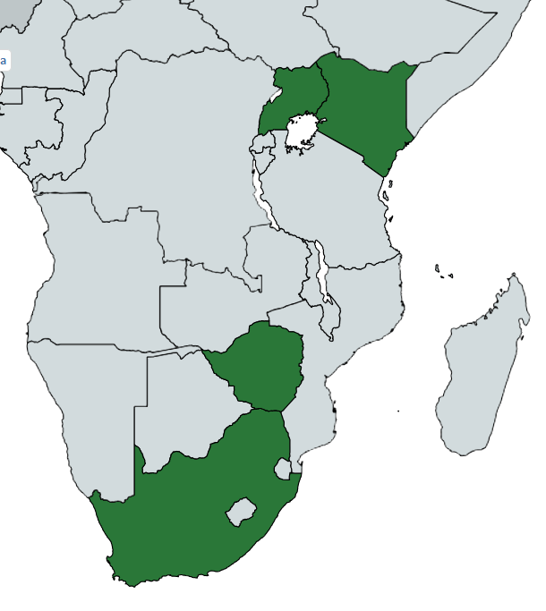
Baseline characteristics
476 participants enrolled: 235 LAI, 241 control
Uganda
200 (42%)
At baseline, % or median (range):
  Age: 16.5 years (12.0, 19.99)
  Sex: 54% female
  Mode of HIV acquisition: 98% vertical
  BMI: 19.6 kg/m² (14.2, 39.9)
  Years on ART: 11.7 years (1.4, 18.9)
  Previous ART: 99.6% DTG, 83% NNRTI
  40% chose optional CAB/RPV Oral Lead In (LAI arm only)
  All characteristics were well balanced across arms
Kenya
77 (16%)
Zimbabwe
128 (27%)
South Africa
71 (15%)

Slide 7
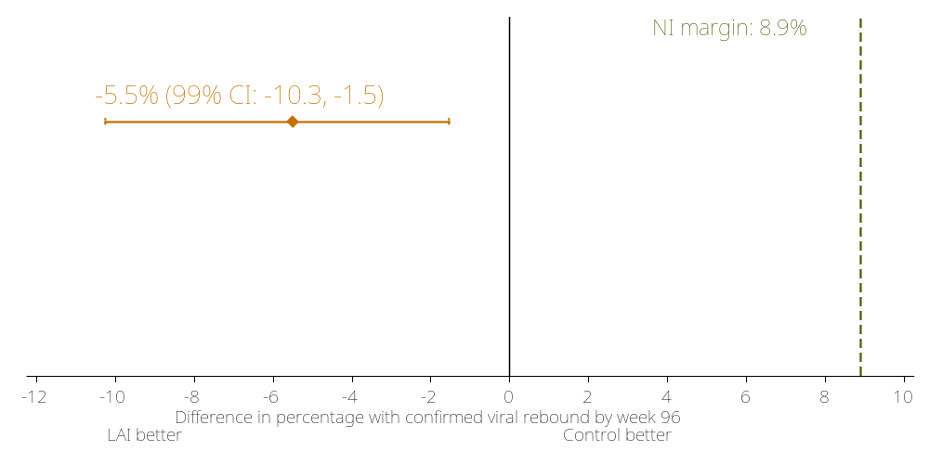
Primary outcome: ITT results
2 (0.9%) LAI vs. 15 (6.4%) control had confirmed viral rebound
Testing for NI:
LAI non-inferior to control

Slide 8
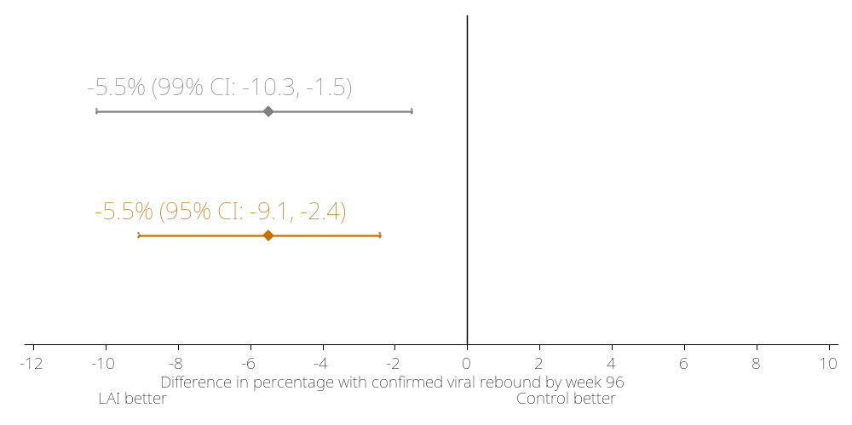
Primary outcome: ITT results
2 (0.9%) LAI vs. 15 (6.4%) control had confirmed viral rebound
Testing for NI:
LAI superior to control (p=0.001)
Testing for superiority:

Slide 9
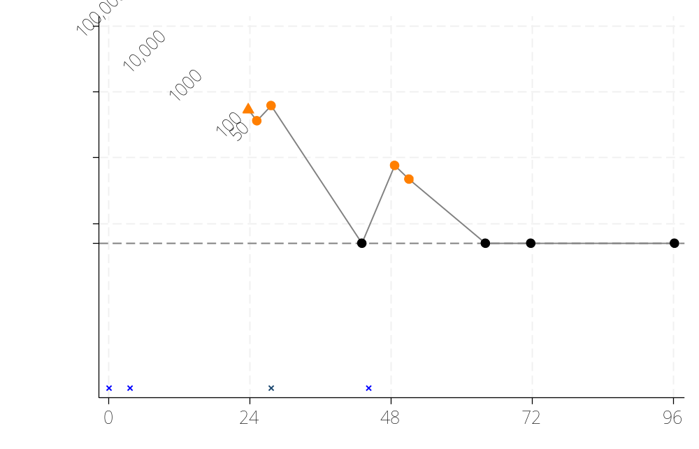
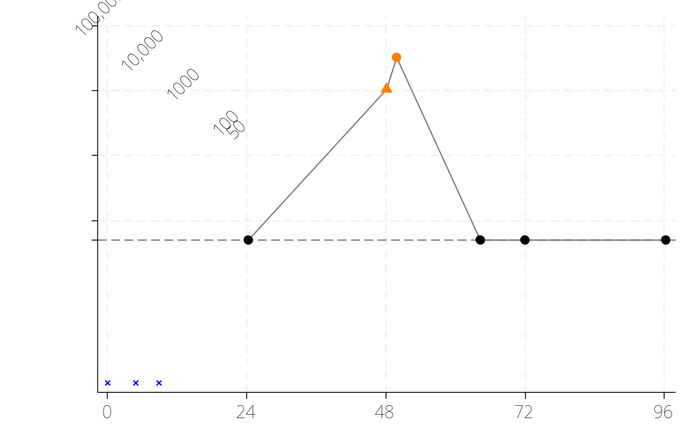
Confirmed viral rebound- LAI arm
#1
ART history: EFV-based regimen, TLD.
Confirmed HIV-1 RNA ≥200 copies/mL on LAI at week 24, returned to TLD. Resistance at time of viral rebound:
INSTI mutations: G140GA, Q148R.
  High-level: CAB, EVG, RAL; Intermediate: DTG, BIC
NNRTI mutations: K101E, Y181C.
  High-level: NVP, RPV; Intermediate: EFV, ETR
PI mutations: None
Switched to DRVr/TDF/3TC at week 44
#2
Participant only received LAI at week 4, and stopped due to an AE.
Confirmed viral rebound 40 weeks later, on TLD.
No major resistance at time of viral rebound

Slide 10
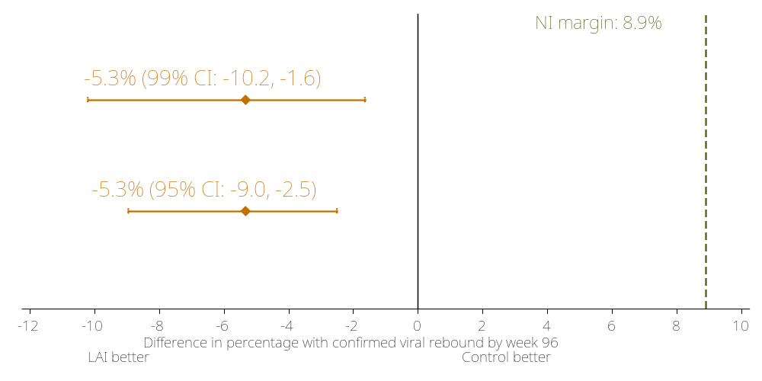
Primary outcome: Per protocol
1 (0.5%) LAI vs. 13 (5.8%) control had confirmed viral rebound
Testing for NI:
LAI superior to control
(p=0.001)
Testing for superiority:
Excludes anyone found to be ineligible or randomised in incorrect strata [0 LAI, 3 Control], and censors participants at use of incorrect ART or interruption to ART (including late injection) [38 LAI, 9 Control]

Slide 11
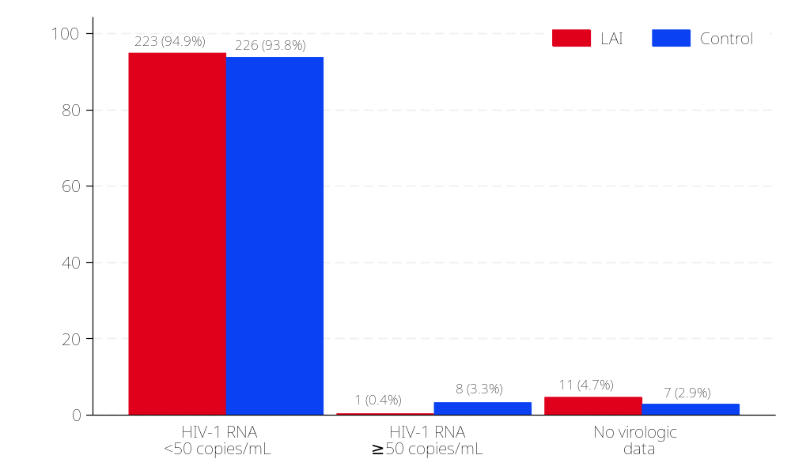
FDA snapshot at week 96
Adjusted difference in proportion HIV-1 RNA ≥50 copies/mL
(LAI-control):
-2.8% (95% CI: -5.2%, -0.5%), p=0.018
Presenting results from a modified FDA snapshot, where participants with change in treatment for AE or death were classified according to last on-treatment VL.
Proportions compared between groups using a Cochran-Mantel-Haenszel test (with adjustment for East vs Southern Africa due to insufficient event numbers to adjust by site)

Slide 12
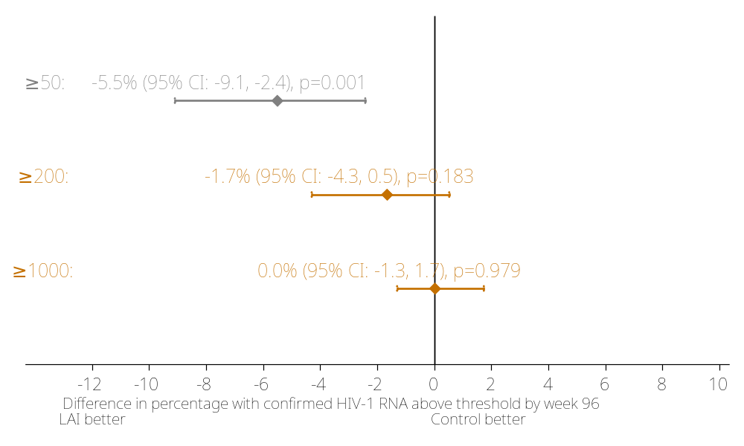
Confirmed HIV-1 RNA ≥200/1000 copies/mL
2 (0.9%) | 15 (6.4%)
2 (0.9%) | 6 (2.5%)
2 (0.9%) | 2 (0.8%)
LAI | Control

Slide 13
Major resistance mutations at confirmed viral rebound
 | LAI (N=2) | Control (N=8)
INSTI | 1 | 0
NRTI | 0 | 1
NNRTI | 1 | 2
PI | 0 | 0
Resistance results not available for 7 participants in the control arm: 4 had HIV-1 RNA below required threshold (<200/<1000 by site), 3 samples failed to amplify. Drug resistance mutations were classified according to the International Antiviral Society–USA (IAS-USA). Major resistance mutations identified in the control arm: Participant 1) NNRTI: K103N, E138K. Participant 2) NNRTI: V106M, Y181C; NRTI: M184V.

Slide 14
Safety
 | LAI | Control | aHR (LAI vs. Control)
WHO 3/4 or death | 3 [3] | 2 [2] | 1.50 (0.25, 8.98), p=0.658
SAE | 14 [14] | 18 [12] | 1.16 (0.54, 2.51), p=0.706
Grade ≥3 AE | 31 [27] | 34 [26] | 1.06 (0.62, 1.82), p=0.820
ART modifying event* | 5 [5] | 1 [1] | 5.16 (0.60, 44.22), p=0.134
ART-related AE (excluding ISR)** | 4 [3] | 1 [1]
Permanent discontinuation of allocated ART*** | 7 | 0
Due to ART-related AE | 2 | 0
Events [participants]. Data to end of follow-up.
*LAI arm: 1 hypersensitivity reaction possibly related to LAI, 1 drug eruption probably related to LAI, 1 malaria initially considered to be RPV-related anaemia, and 1 pulmonary TB and 1 lymph node TB both considered unrelated to ART.
**LAI arm: 1 drug eruption, 1 hypersensitivity, 1 participant with abdominal & back pain.
***LAI arm (no return to LAI by end of follow-up): 1 confirmed VL≥200c/mL, 2 planning pregnancy, 1 drug eruption, 1 hypersensitivity, 1 TB, 1 participant choice
Injection site reactions (ISR)
91% on LAI ever reported an ISR. Only 4 grade 3 events, none grade 4. Most common: pain (82%). No ISR led to discontinuation. Incidence decreased over time.

Slide 15
Pregnancies
 | LAI |  |  | Control (N=17)
 | Opted to stay on LAI (N=12) | Opted to return to oral ART (N=2) | Previously returned to oral ART (N=4)
Live birth* | 4 | 2 | 2 | 4
Miscarriage | 4 |  | 2 | 4
Induced abortion | 1 |  |  | 4
Ongoing | 3 |  |  | 5
*Negative HIV tests reported for all live-born infants

Slide 16
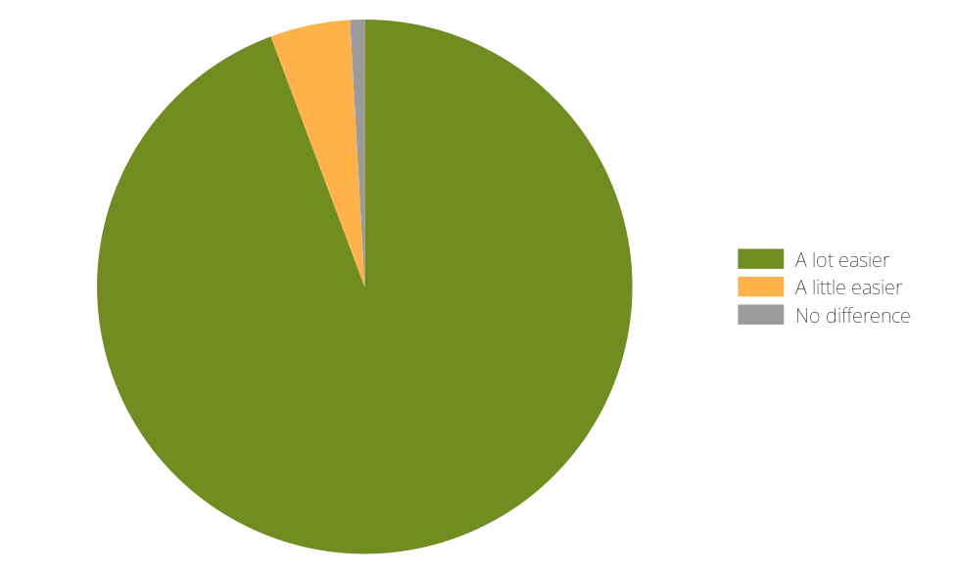
Acceptability
99% of participants (in both LAI and control) reported that taking HIV medication had not been a burden and had not made it difficult to live a normal life
1%
No difference
5%
A little easier
Those on LAI were asked:
“How does receiving injections of HIV medication make things for you compared to taking your medicines every day?”
94%
A lot easier

Slide 17
Conclusions
LATA is the first randomised trial to compare the efficacy and safety of LAI to oral ART in adolescents.
Q8W LAI CAB/RPV was superior to TLD over 96 weeks, using the primary outcome of confirmed HIV-1 RNA ≥50 copies/mL and FDA snapshot HIV-1 RNA ≥50 copies/mL.
LAI CAB/RPV was well tolerated, with no new safety concerns identified, and was strongly preferred by adolescents.
LATA results support WHO guidelines recommending LAI CAB/RPV as an alternative option for virally suppressed adolescents to reduce burden of daily oral ART.
Access to LAI CAB/RPV remains limited in regions where the need is greatest.

Slide 18















Acknowledgements
We would like to thank all participants and their families, the LATA Youth Trial Board and consortium, the TSC and IDMC, all ethics bodies & regulatory committees involved in the LATA trial, and our funders.
The trial is supported by grant funding from the European Developing Countries Clinical Trials Partnership (EDCTP) (grant number RIA2017MC-2005) and funding from Janssen Pharmaceutica NV. The LATA team at the UCL Innovative Clinical Trials Unit (previously the MRC Clinical Trials Unit at UCL) was supported by funding from the UK Medical Research Council (grant MC_UU_00004/03 and MC_UU_00004/04) until 31-March-2026. Janssen and ViiV Healthcare Ltd provided study drugs.

Slide 19
Back up slides

Slide 20
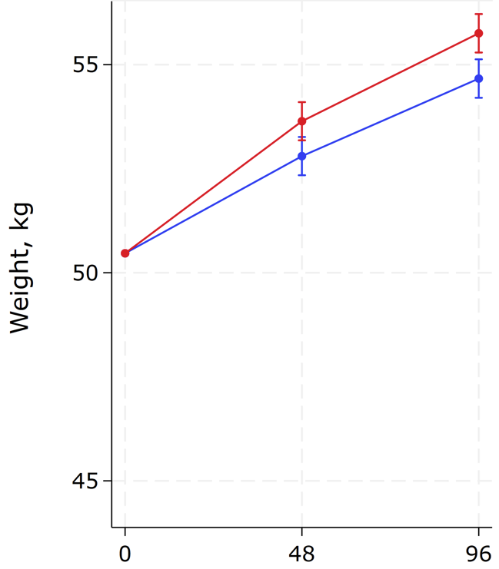
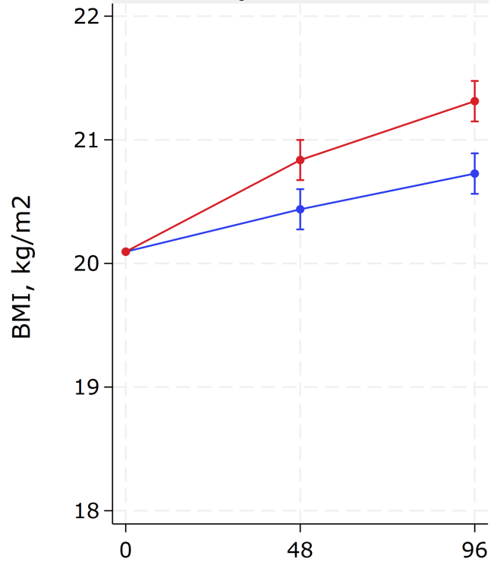

Anthropometrics
Adjusted difference (LAI -control) in mean change to W96:
1.09 (95% CI 0.43, 1.74), p=0.001
Adjusted difference (LAI - control) in mean change to W96:
0.59 (95% CI 0.35, 0.82), p<0.001
Notes:
remove

