Slide 1
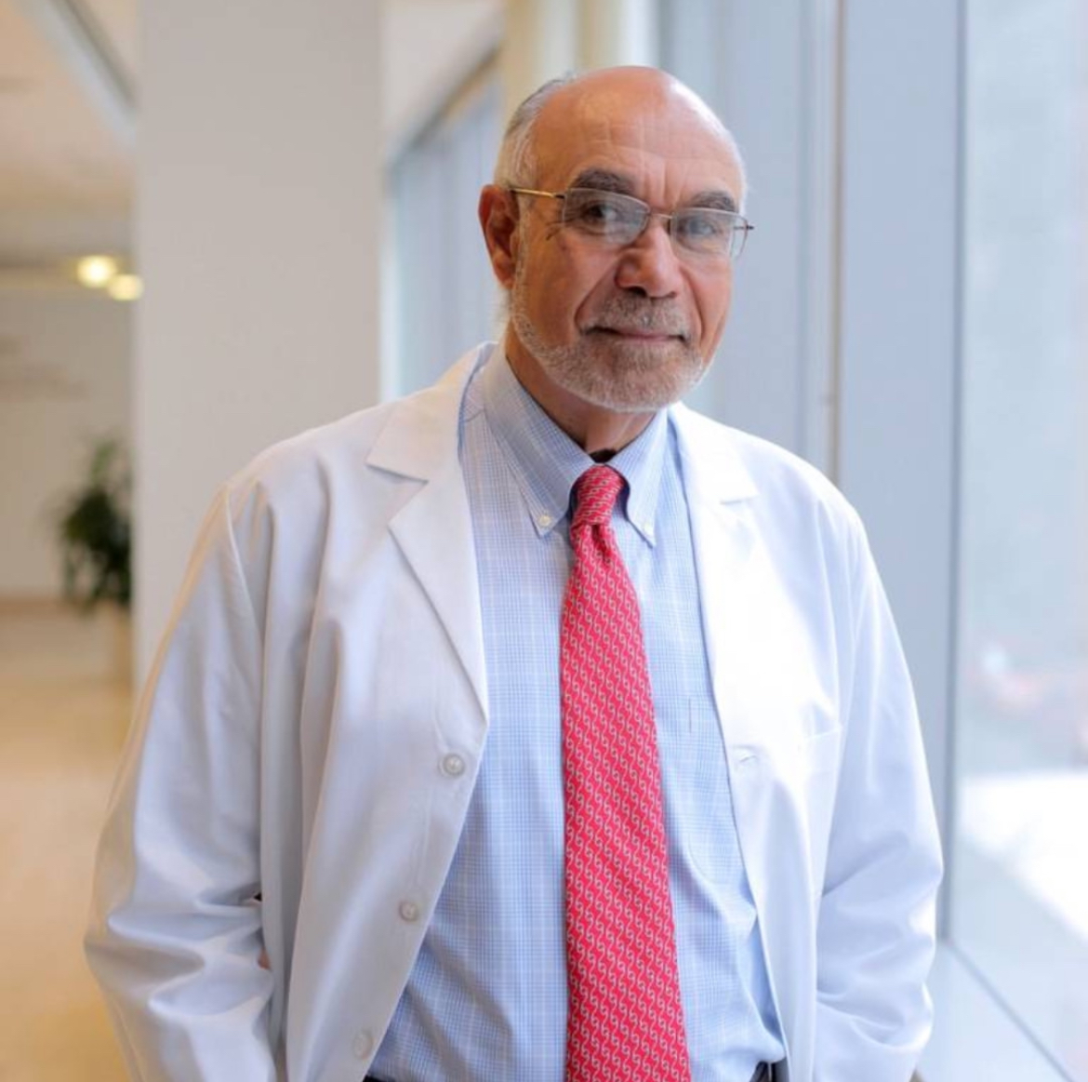
IAS President’s Award
Jean William “Bill” Pape
Founder and Executive Director
GHESKIO, Haiti
Notes:
So it is my honour to present the 2026 CIPHER Research Grants to
Helena Lamptey from Ghana, for the project titled, ”Perspectives on HIV Cure-Related Research among Ghanaian Children and Adolescents Living with HIV, their Caregivers and Key Stakeholders”
[no grantees on stage. After applause move to the next slide]

