Slide 1
Barriers and facilitators of person-centred care for key and vulnerable populations

Slide 2


Organizers

Slide 3
Organizer disclosures
The Person-Centred Care programme of IAS – the International AIDS Society – is implemented with financial support from, and in collaboration with, Gilead Sciences.
The IAS has full control over all the activities and decisions relating to, and forming part of, the Person-Centred Care programme.
Gilead Sciences had no influence on, nor provided input into, the content, development or delivery of any of the presentations in this satellite.

Slide 4

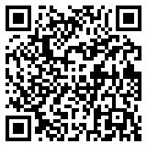
Translation for this session
Scan the QR code located at the entrance and around the session room
Select your preferred language, and
Click “Join”
Please use own headphones for the audio or read captions if you do not have headphones

Slide 5
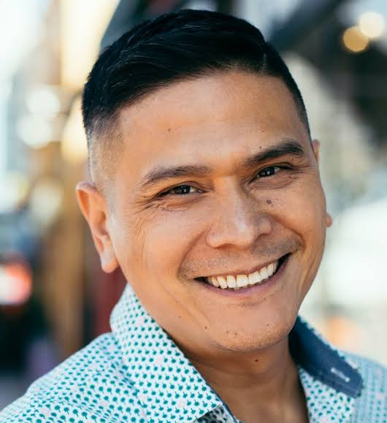

Moderators
Andrew Spieldenner
MPact Global Action, United States
Clarice Nheleti Pinto Samo Gudo
World Health Organization, Switzerland

Slide 6




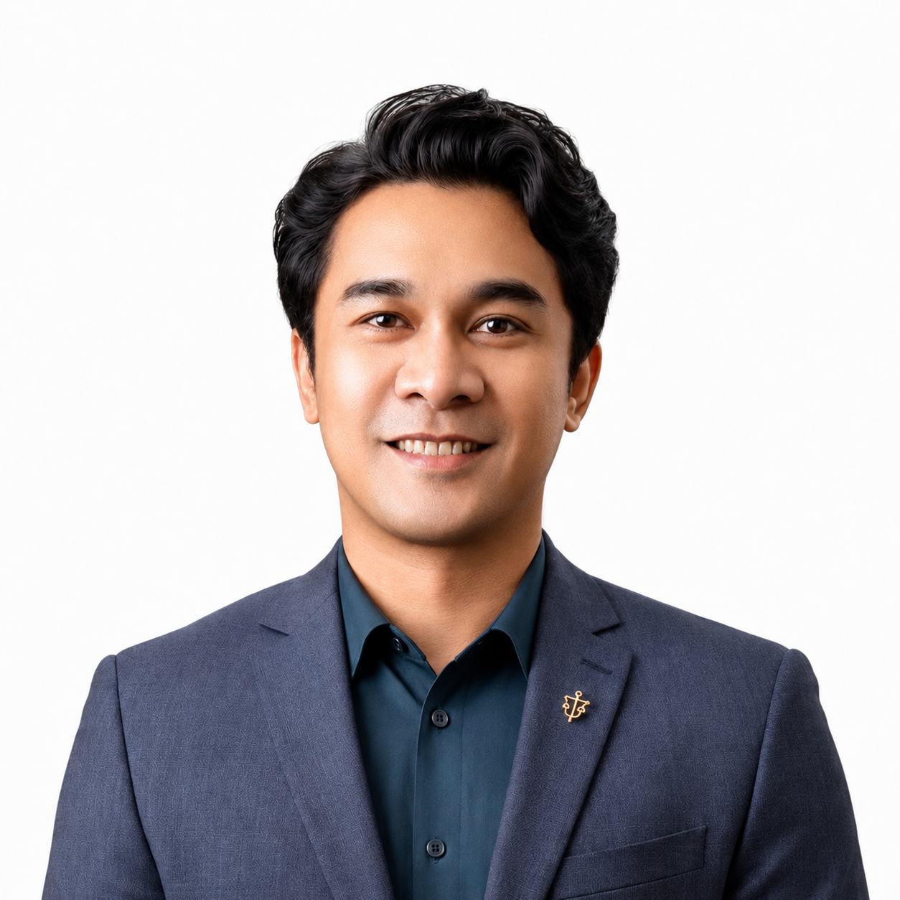
Speakers
Pank Sethi
Positive East
United Kingdom
Daisy Kwala
Bar Hostess Empowerment & Support Program
Kenya
Princess Jauan Durbin
Southern Legal Center for Youth, United States
Maria Felipe Medeiros
Instituto de Infectologia Emílio Ribas / Casa da Pesquisa CRT-SP
Brazil
Rodenie Olete
Sustained Health Initiatives of the Philippines (SHIP)
The Philippines

