Slide 1

Setting the scene
Clarice Pinto, World Health Organization, Switzerland
Barriers and facilitators of person-centred care for key and vulnerable populations

Slide 2


Declaration of Interests
No conflicts of interest to declare.
The content of this presentation has been developed through WHO's independent guideline and normative processes.
WHO’s participation does not imply endorsement of any organization, product, or service.

Slide 3

HIV Progress Is Real –
But Too Many People Are Still Left Behind
40.9 million
1.2 million
people living with HIV
new HIV acquisitions
32.1 million
570,000
people receiving ART
AIDS-related deaths
Progress is real, but important inequalities persist.
Why are some people still being left behind?
Source: UNAIDS Global AIDS Brief, 2026.
Notes:
The world is not on track to end AIDS as a public health threat by 2030, and important inequalities persist.

Slide 4

The Burden of HIV Extends Beyond the Virus
.
Social environment
Health-system experience
• Stigma
• Discrimination
• Violence
• Fragmented care
• Inflexible services
• Long waiting times
Legal & policy environment
Structural conditions
• Criminalization
• Restrictive policies
• Human rights barriers
• Poverty
• Mobility
• Transport costs
Person-centred care recognizes that health outcomes are shaped by people’s lived realities—not only by clinical needs.
Source: UNAIDS Global AIDS Brief, 2026; IAS PCC roadmap, 2025.
Notes:
Health outcomes are shaped by clinical, social, structural and health-system factors—not HIV alone.
This is why the response must be organized around people, communities and systems together

Slide 5

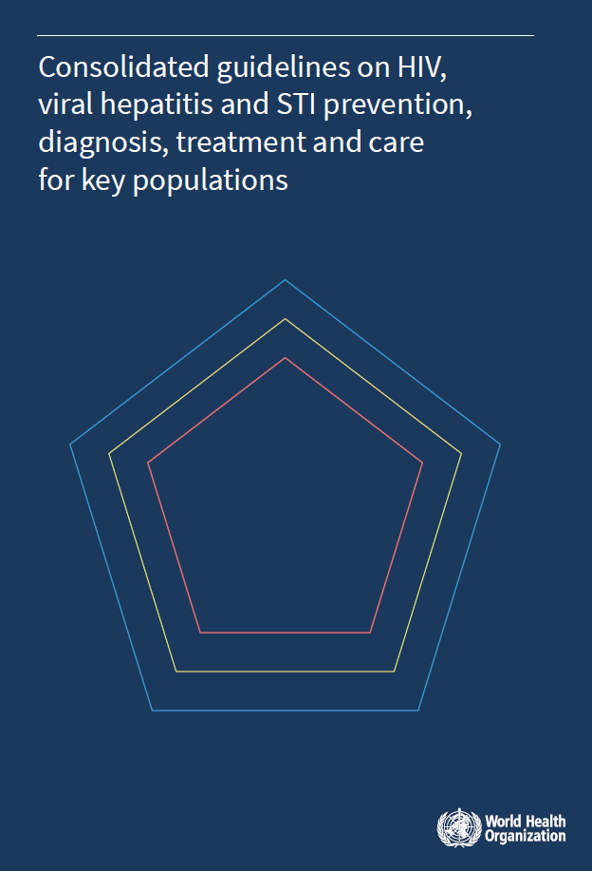
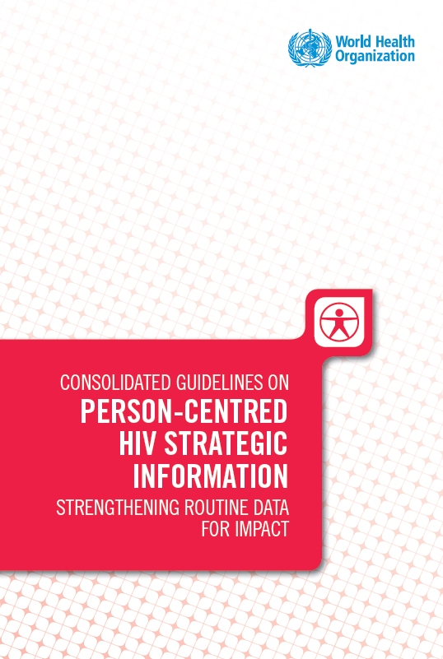
WHO guidance on People-centred care
WHO definition of people-centred health services
“People-centred health services are an approach to care that consciously adopts the perspectives of individuals, families and communities and sees them as participants and beneficiaries of trusted health systems that respond to their needs and preferences in humane and holistic ways.”
NEW
People-centred care: WHO good practice statements
Health systems should invest in people-centred practices and communication, including ongoing training, mentoring, supportive supervision and monitoring health-care workers, to improve the relationships between patients and health-care providers.
HIV programmes should:
provide people-centred care that is focused and organized around the health needs, preferences and expectations of people and communities, upholding individual dignity and respect, especially for vulnerable populations;
engage and support people and families to play an active role in their own care by informed decision-making;
offer safe, acceptable and appropriate clinical and non-clinical services in a timely fashion, aiming to reduce morbidity and mortality associated with HIV infection and to improve health outcomes and quality of life in general; and
promote the efficient and effective use of resources.
Consolidated HIV guidelines: service delivery. Geneva: World Health Organization; 2026.
WHO Consolidated guidelines on HIV, viral hepatitis and STI prevention, diagnosis, treatment and care for key populations, 2022
publications-detail-redirect/9789240055315
Strategic information recommendation supporting PCC
Use of person-centred patient data is recommended to continuously assess interruption of HIV treatment to improve re-engagement and retention in care.
Consolidated guidelines on person-centred HIV strategic information: strengthening routine data for impact, 2022
https://www.who.int/publications/i/item/9789240052390
Notes:
WHO guidance gives us a strong foundation. It calls for anti-discrimination and protective laws, engagement with civil society, accessible and acceptable services, recurrent training for health workers, and safe spaces for adolescents and people from key populations. Importantly, WHO defines people-centred health services as care that adopts the perspectives of individuals, families and communities, and sees them as active participants in trusted health systems. In short, people-centred care and stigma reduction are not separate agendas — together they build dignity, trust, access, quality and sustained engagement.

Slide 6









A roadmap to scale up person-centred care in the HIV response: recommendations from a global consensus-building process
Healthcare workers
Ask questions, listen to your clients and strengthen communication skills Collaborate across disciplines
Policy makers
Adopt and implement global normative guidance on PCC Establish national targets for HrQoL
Healthcare system administrators
Fostering systemic shifts Integrate HIV services into PHC Support community-based services Supporting the healthcare workforce Provide training and support to HCWs Remuneration of community and lay providers
Clients
Engage as a partner in healthcare Request and provide peer support
Researchers
Prioritize community-academic partnerships Advance research on client-reported outcomes
Community-based organizations
Prioritize engagement with clients and decision makers Share educational and advocacy resources widely
Source: Golob L, Williams EL, Bras M, Clifton B, Ford N, Geng EH, Green KE, Janamnuaysook R, Katz IT, Mworeko L, Olete RA, Pinto C, Rajasuriar R, Sikombe K, Tan DHS, Grinsztejn B. A roadmap to scale up person-centred care in the HIV response: recommendations from a global consensus-building process. J Int AIDS Soc., 28: e70071. https://doi.org/10.1002/jia2.70071
Notes:
Starting at AIDS 2022 in Montreal, the IAS Person-Centred Care programme conducted a multi-phase process to build consensus and prioritize recommendations to scale up person-centred care within the HIV response. This consisted of a literature review, five stakeholder consultations and a three-round Delphi survey with contributions from clients, healthcare workers, policymakers and researchers from all world regions. These priorities were synthesized into a roadmap which was published in the Journal of the International AIDS Society in December 2025.
Person-centred care requires coordinated action from communities, providers, health systems and policy-makers.

Slide 7
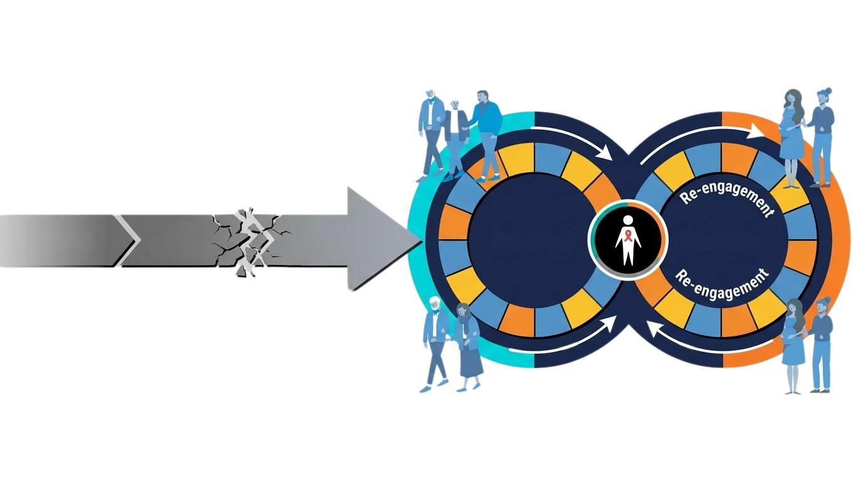
The HIV Care Journey Is Not Linear
Health systems should support people to continue, return and remain in care
Progress
Reality
HIV testing, ART initiation and viral suppression remain essential milestones.
Disengagement is common
20%–50% of people who present for ART in sub-Saharan Africa had already been exposed to ART
Testing
ART
Initiation
Viral
Suppression
Disengagement
Engagement
Response
Goal
Services should be flexible, non-punitive and ready to support return to care.
Sustained engagement supports viral suppression, better health outcomes and quality of life.
Source: World Health Organization. Supporting re-engagement in HIV treatment services. Geneva: WHO; 2024. https://www.who.int/publications/i/item/9789240097339 ; Euvrard J, Timmerman V, Keene CM, Phelanyane F, Heekes A, Rice BD, et al. (2024) The cyclical cascade of HIV care: Temporal care engagement trends within a population-wide cohort. PLoS Med 21(5): e1004407. https://doi.org/10.1371/journal.pmed.1004407.; Benade M, Maskew M, Juntunen A, Flynn DB, Rosen S. Prior exposure to antiretroviral therapy among adult patients presenting for HIV treatment initiation or reinitiation in sub-Saharan Africa: a systematic review. BMJ Open. 2023 Nov 19;13(11):e071283. https://pubmed.ncbi.nlm.nih.gov/37984944/
Notes:
To achieve global HIV targets, health systems must abandon punitive, linear expectations and design for the cyclical care cascade through Person-Centred Care.

Slide 8


The Road to Re-engagement:
A Roadmap for Person-Centered HIV Care
BARRIERS (Driving Disengagement)
Rigid clinic hours and inflexible appointment scheduling.
FACILITATORS (Driving Re-engagement)
TRANSITION TO PERSON-CENTRED CARE
Welcoming,
stigma-free
re-engagement
Punitive, stigmatizing response to those returning after disengagement.
Ensure holistic care, beyond HIV, including other chronic care.
Tailored support based on individual needs
Siloed HIV care separated from holistic primary health care.
TAILORED FOR KEY AND VULNERABLE POPULATIONS
Stigma toward key and vulnerable
populations.
Mobility, transport costs, and work responsibilities are major factors in service disengagement
Peer-led approaches:
Supporters and navigators
Flexible services that accommodate life circumstances
Reduce frequent clinical visits upon return.
Notes:
Re-engagement depends on adapting services, not blaming individuals.

Slide 9
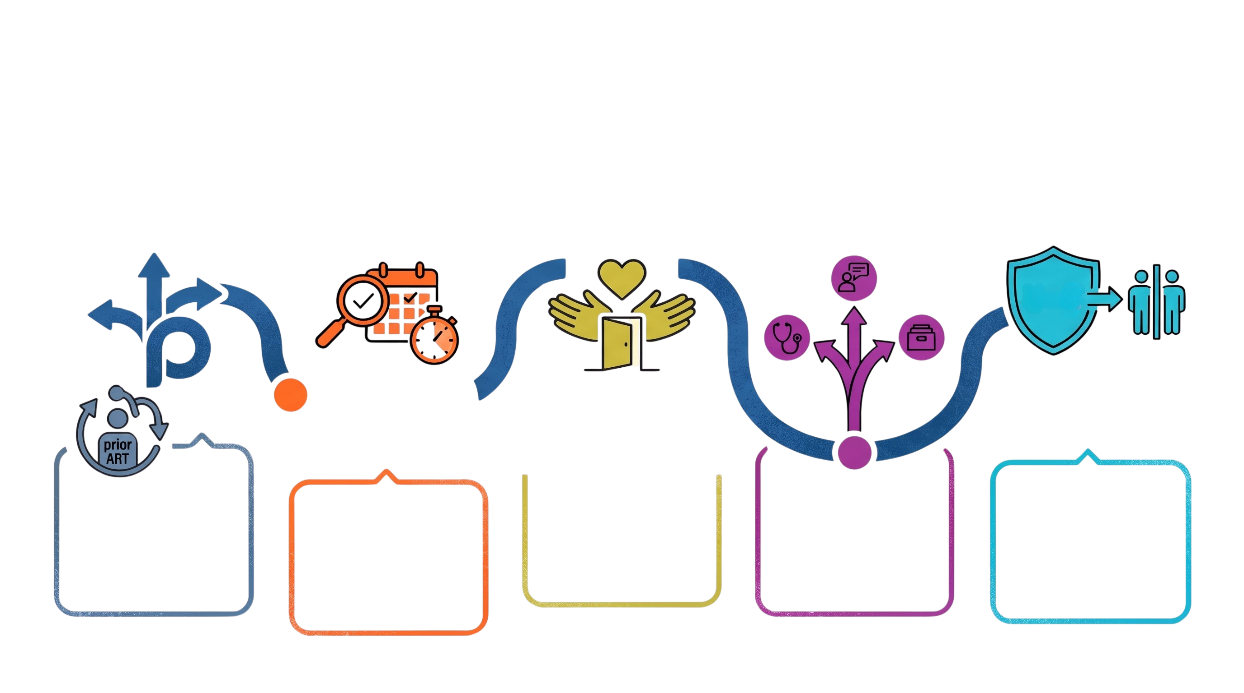
A PERSON-CENTRED PATHWAY BACK TO CARE
Re-engagement should be practical, welcoming and tailored to the person’s clinical and psychosocial needs.
Tailor support
1
2
Identify and reach
Welcome ALL
3
Create a safe, respectful and non-stigmatizing return to care
Match support to individual needs: clinical care, psychosocial support, adherence support and service delivery options.
Use agreed tracing criteria and consented outreach to reach people who may need support returning to care.
Source: World Health Organization. Supporting re-engagement in HIV treatment services. Geneva: WHO; 2024.

Slide 10
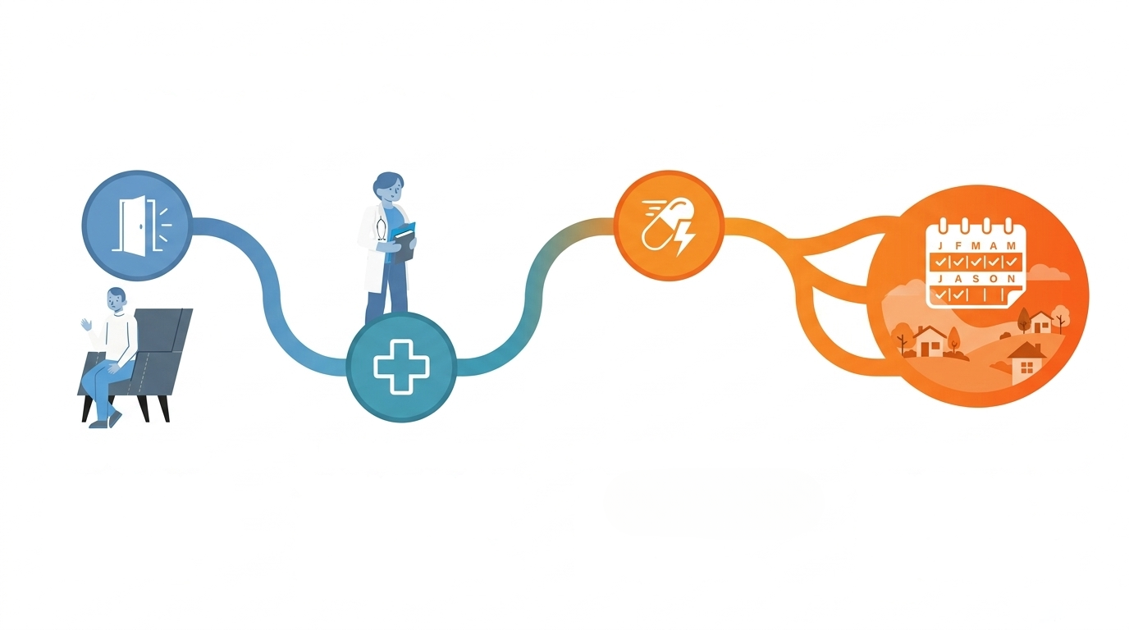
Differentiated Re-engagement:
Match Support to Need
Restart ART rapidly
Offer treatment reinitiation on the same day of return, following the principles of same-day ART initiation.
Differentiate support
Welcome the return
Clinical and psychosocial assessment
Adapt follow-up, dispensing and community-based support to reduce burden while maintaining quality.
Acknowledge the return positively. Remove punitive practices and unnecessary preconditions before care begins.
Conduct clinical assessment, including CD4 and relevant advanced HIV disease screening, alongside psychosocial and adherence support assessment.
Sources: WHO. Supporting re-engagement in HIV treatment services. Geneva: WHO; 2024.; WHO. Consolidated guidelines on HIV prevention, testing, treatment, service delivery and monitoring. Geneva: WHO; 2021.
Notes:
People-centred re-engagement should be welcoming, equitable, clinically safe and responsive to individual needs.

Slide 11
Key Messages
Person-centred care turns evidence into better HIV services.
Progress is real, but uneven
Barriers extend beyond the virus
PCC is a shared responsibility
HIV treatment scale-up has changed the epidemic, but new infections, AIDS-related deaths and inequities persist.
Stigma, discrimination, criminalization, poverty, mobility and fragmented services shape access and outcomes.
Communities, clients, health workers, systems, policy-makers and researchers all have roles to play.
Engagement is cyclical
Re-engagement should be differentiated
Services should be designed for lifelong care, including timely support after treatment interruptions.
Welcome without judgement, assess needs, restart treatment rapidly when appropriate and tailor long-term support.
People-centred. Rights-based. Evidence-informed.
Together, these approaches help sustain progress toward ending AIDS.

Slide 12



Need an overview of WHO's participation at AIDS 2026?
Download the WHO@AIDS 2026
highlights brochure
It features key events, technical sessions, new WHO normative products, scientific and community engagement activities

Slide 13

THANK YOU!

