Slide 1
Protecting HIV treatment gains for female sex workers during funding disruptions through person-centred transition support
Daisy Kwala, Bar Hostess Empowerment and Support Programme (BHESP), Kenya
Barriers and facilitators of person-centred care for key and vulnerable populations
Notes:
Hi everyone, My name is Daisy Kwala from Bar Hostess Empowerment and Support Programme, BHESP, in Kenya. Today I'll share how we are protecting HIV treatment gains for female sex workers through a funding crisis from STOP WORK ORDER, and what person-centred transition support means in practice.

Slide 2
Understanding key populations in Kenya
Around 13% of all new HIV acquisitions occur among key populations each year
Sex work, drug use and same sex relationships are criminalized in Kenya
Source: IBBS (2024)
Notes:
Around 13% of all new HIV acquisitions in Kenya each year occur among key populations yet sex work, drug use, and same-sex relationships are all criminalized. Female sex workers carry the highest burden: HIV prevalence of nearly 27%, compared to 22.5% among transgender people, 20% among men who have sex with men, and 8.8% among people who inject drugs. We're talking about over 285,000 female sex workers nationally. Kenya's epidemic is both concentrated and generalized, which is why prevention programming for key populations sits at the centre of the national HIV response.

Slide 3
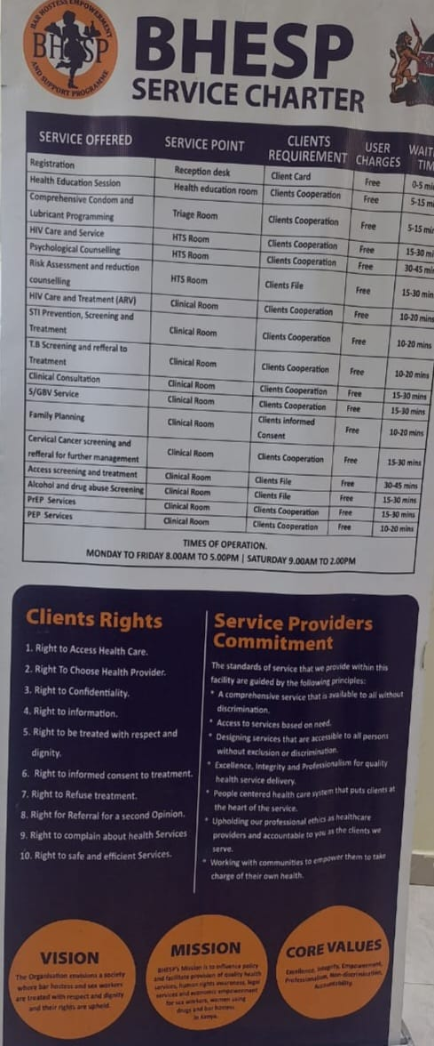
What is the Bar Hostess Empowerment Support Programme (BHESP)?
Established in 1998 in Nairobi, Kenya
Operates for and by female sex workers
Provides a voice for women vulnerable to sexual and gender-based violence to influence policy, reduce HIV acquisitions, support access to justice and reduce stigma and discrimination
Established four drop-in centres serving 42,976 female sex workers and their clients
Notes:
BHESP was established in 1998 in Nairobi as a community-based organisation led by and for female sex workers, and registered as an NGO in 2005. We give women a voice to influence policy, respond to sexual and gender-based violence, support access to justice, and reduce stigma and discrimination. Over the years we grew to four drop-in centres — Jogoo Road, Mowlem, Roysambu and Kariobangi, together serving nearly 43,000 female sex workers

Slide 4



VISION
A society where bar hostesses, vulnerable women, adolescent girls and young women and other key populations are treated with respect and dignity and their rights are upheld.
MISSION
To influence policy and facilitate access to quality health services, human rights
awareness, legal services and economic empowerment for female sex workers.
Notes:
Our vision is a society where bar hostesses, vulnerable women, adolescent girls and young women, and other key populations are treated with respect and dignity, with their rights upheld. Our mission is to influence policy and facilitate access to quality health services, human rights awareness, legal services, and economic empowerment for female sex workers.

Slide 5
Interventions implemented at BHESP
Behavioural
Risk assessment, risk reduction counselling and plans
Biomedical
HIV testing services
Structural
Policy environment: Healthcare worker sensitization and advocacy for stigma-free, person-centred services
Gender-based violence: Prevention education, screening, survivor support, and referrals for medical, legal and psychosocial services
Stigma and discrimination: Rights awareness, stigma reduction activities, and response to human rights violations
Alcohol and drug use: Risk-reduction education, counselling and referrals for treatment and support service
Support groups: Peer-led psychosocial, adherence and empowerment support groups
Health education package - Peer education
Condom education and demonstration
Outreach programmes
Demand creation / social mobilization
Adherence counselling
Male and female condom distribution
STI screening and treatment
Cervical cancer screening
Family planning
ART (HIV treatment)
Bio-medical prophylaxis
Pre-exposure prophylaxis
Post-exposure prophylaxis
Notes:
Here's a snapshot of the interventions we deliver across our drop-in centres - from HIV prevention, treatment, care and support, to human rights and advocacy, economic empowerment, research, and organisational strengthening. These are the foundations that everything I'll share next is built on.

Slide 6
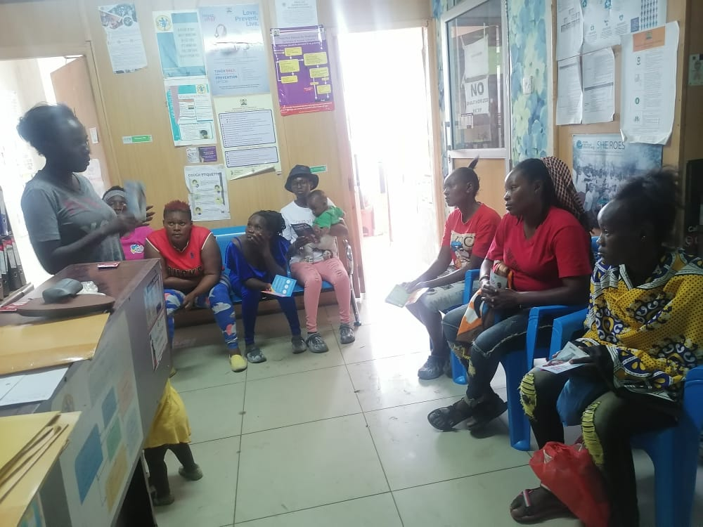
The day EVERYTHING changed:
PEPFAR stop work order shock
Two BHESP drop-in centres funded by PEPFAR since 2016 / 2017 received a stop work order in January 2025
14,511 female sex workers (33% of the total client base) lost access to BHESP drop-in centre services, including 2,364 clients living with HIV
Notes:
Then came 28th January 2025 ; the day everything changed. We woke up to news of a PEPFAR stop-work order. Two of our drop-in centres, funded since 2016 and 2017, were ordered to halt services overnight. Just like that, 14,511 female sex workers a third of our entire client base, including 2,364 living with HIV were at risk of losing access to care. We were in shock. A few clients 2% who had the news called asking where they would get their treatment. Staff and peer navigators searched for answers we didn't have. Our first thought wasn't funding , it was the thousands of women who depended on us every single day.

Slide 7
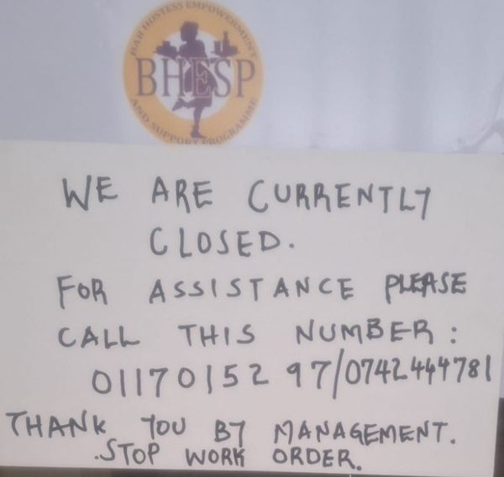
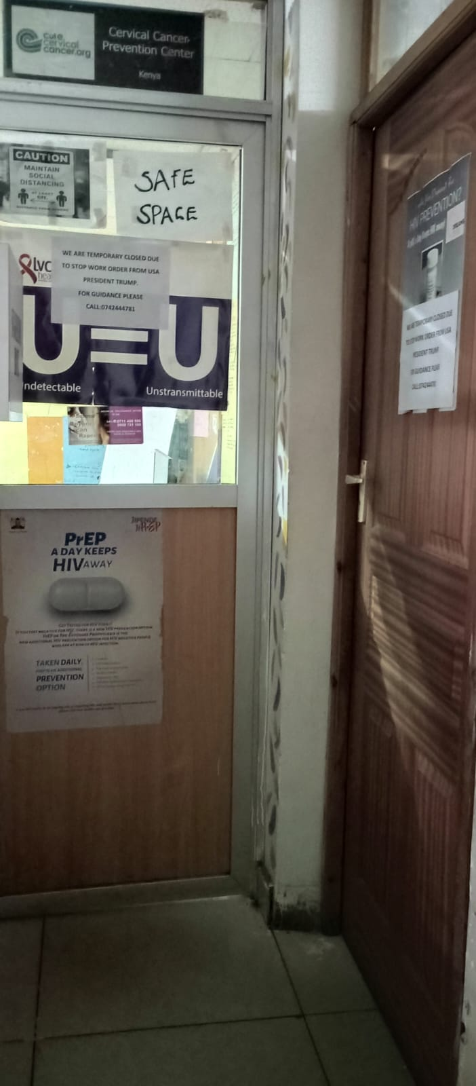
How do we protect treatment gains and ensure no one is left behind?
Fear, uncertainty and confusion spread across the community
Clients contacted us regarding ongoing treatment access
Staff and peer navigators were actively searching for answers, with no access to clear guidance
Notes:
The impact was immediate. Both drop-in centres were forced to close abruptly, clients arrived to locked doors and a sticker explaining the closure. Fear, uncertainty and confusion spread fast; over 90% of clients simply didn't understand what was happening. A few reached us on the number we'd left behind, asking what to do next. Our staff and peer navigators were searching for guidance with none available. One question sat at the centre of everything: how do we protect treatment gains and make sure no one is left behind?

Slide 8
Behind every interrupted service was a person trying to stay healthy, and a community trying not to lose hope
Impact on clients and community
Impact on staff, peers and BHESP
More than 2,300 female sex workers receiving HIV treatment were left uncertain about where to access their medication
Over 12,000 female sex workers vulnerable to HIV acquisition no longer had access to combination HIV prevention services
Trusted safe spaces disappeared overnight, leaving many clients feeling abandoned and afraid and over 87% of the recipients of care were lost to follow-up following the treatment interruptions
12% of clients had access to multi-month dispensing so were partly protected with longer refills
Mental health distress, fear and panic increased as trusted service points suddenly disappeared
Two deaths linked to treatment interruption were reported
31 staff and 165 peer educators who had dedicated over 8 years to service delivery suddenly found themselves without paid employment, and continue to do so
BHESP lost the ability to support clients through routine follow-up and adherence support
Years of investment in trust, retention and person-centred care were suddenly at risk
BHESP shifted into crisis response mode to protect treatment gains and prevent further loss
Notes:
Behind every interrupted service was a person trying to stay healthy, and a community trying not to lose hope. On our side: 31 staff and 165 peer educators, some with over eight years of service, suddenly lost their livelihoods and many still haven't recovered them. We lost the ability to provide routine follow-up and adherence support, and years of investment in trust and person-centred care were at risk overnight. On the client side: more than 2,300 people on HIV treatment didn't know where to get their medication, and over 12,000 lost access to prevention services entirely. Trusted safe spaces vanished overnight. Only 12% had multi-month refills to fall back on. Over 87% of clients were lost to follow-up. And tragically, two deaths were linked directly to the treatment interruption.

Slide 9
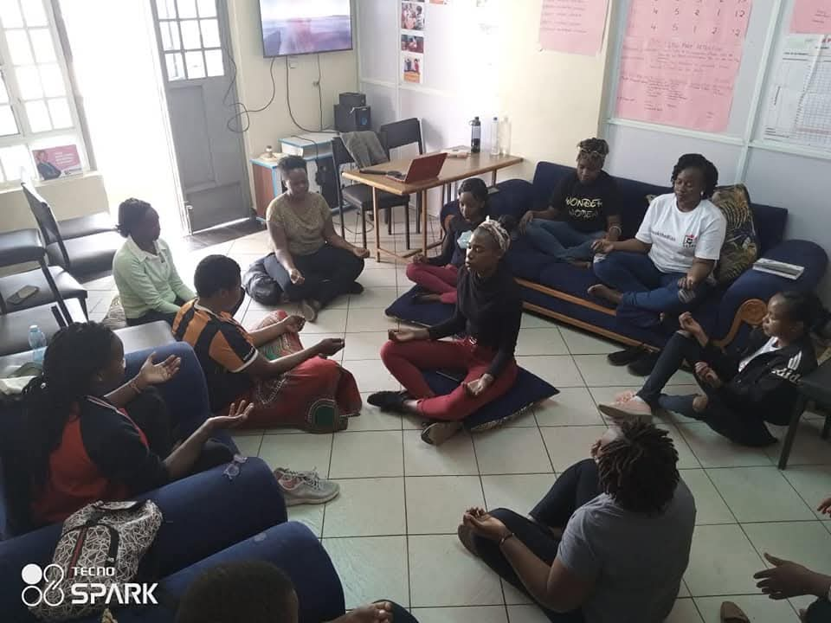

Supporting clients through their transition journeys
After 8 months of service disruption, we partially
re-opened two service points to provide short-term transition support using a micro-grant
A skeleton staff provided psychosocial and mental health support to 1,837 clients and conducted healthcare worker sensitization with 119 healthcare workers on person-centred care service delivery for key populations
Engaged directly with Ministry of Health and other stakeholders to strengthen transition support
98% of supported clients, including 78% of clients living with HIV, have been successfully re-linked to services and supported through their transition journey while 2%(267 out of the 12147 ) of the prevention Cohort supported to transition
Notes:
After eight months of disruption, and with support from the IAS PCC Seed Grant, we partially reopened two service points as safe entry points, using a seed grant for short-term transition support. A skeleton staff delivered psychosocial and mental health support to 1,837 clients and sensitised 119 healthcare workers on person-centred care for key populations. We engaged the Ministry of Health and other stakeholders to strengthen transition pathways, including at the national Health Integration Summit. Through clinic theme days, personalised follow-up and peer-led community tracing, we achieved real results: 98% of supported clients including 78% of those living with HIV were successfully re-linked to services, alongside 2% of the prevention cohort.

Slide 10
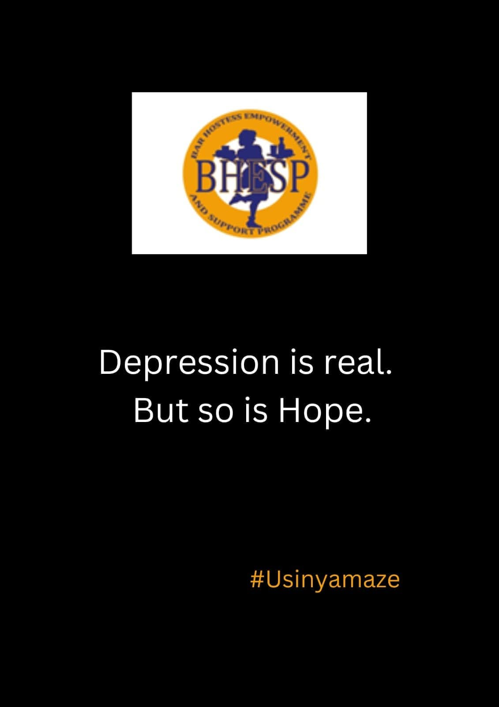
“The nurse told me, It is these behaviors of yours that are causing you to get HIV. In that moment, I felt I was being blamed rather than helped. I have not returned to that facility since.”
Female sex worker client of BHESP
Notes:
I want to share one client's words, because they capture what's at stake better than any statistic. 'The nurse told me it is these behaviours of yours that are causing you to get HIV. In that moment I felt I was being blamed rather than helped. I have not returned to that facility since.' This client has refused to transition to this day. She'd rather travel long distances to our other site than return to the facility that should be closer and easier for her to reach.

Slide 11

Barriers to PCC
Stigma and discrimination from the healthcare workers within public health facilities affecting access and retention
No structured transitional support for clients moving from community-led services to public facilities
Closure and erasure of community safe spaces limiting outreach and client trust
Limited awareness and understanding of PCC among key stakeholders and providers
Lack of integrated services within public health facilities leading to fragmented care
Notes:
So what did we learn about the barriers to person-centred care? Stigma and discrimination from healthcare workers in public facilities directly affects access and retention. There's no structured transition support for clients moving from community-led services into public facilities. The closure of community safe spaces erodes outreach and trust. Awareness and understanding of person-centred care remains limited among key stakeholders and providers. And services within public facilities are often fragmented rather than integrated.

Slide 12
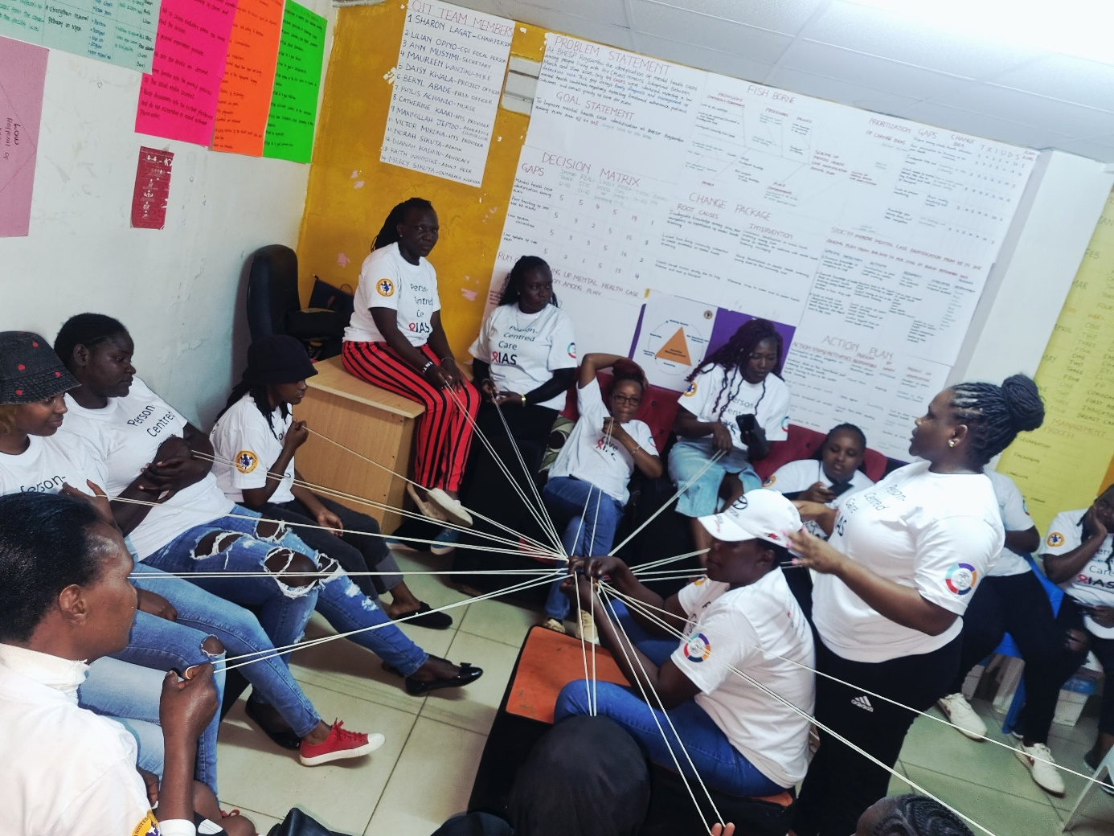
Facilitators of PCC
Strengthened transition systems linking community services to public health facilities
Re-establishment and recognition of community safe spaces for continuity of care
Continuous stakeholder sensitization and capacity building on PCC approaches
Integrated, one-stop service delivery models within public health facilities
Collaborative engagement between community-led organizations and public health systems
Integrate key population peer educators and community navigators into primary healthcare systems, supported through social contracting
Notes:
On the flip side, here's what actually works: strengthened systems that link community services to public facilities; re-establishing and recognising community safe spaces for continuity of care; ongoing sensitisation and capacity building on person-centred approaches; integrated, one-stop service delivery within public facilities; genuine collaboration between community-led organisations and public health systems; and integrating key population peer educators and community navigators into primary healthcare, supported through social contracting.

Slide 13
Call to action
1. Put people first
2. Fund person-centred care
3. Protect dignity in every transition
4. Do not leave anyone behind
Protect people, not programmes: health systems must exist to serve dignity, safety and continuity of care.
Invest in PCC transition models: peer support, mental health and enforce zero tolerance for stigma and discrimination.
Fund care that follows the person: not fragmented services, but real integration across community and public systems.
Integrate, don’t erase: community-led programmes are not optional; they are essential to survival, trust, and access.
Notes:
So here is our call to action. One: put people first. Two: fund person-centred care. Three: protect dignity in every transition. Four: do not leave anyone behind. Protect people, not programmes _ health systems must exist to serve dignity, safety and continuity of care. Invest in transition models: peer support, mental health, and zero tolerance for stigma. Fund care that follows the person, not fragmented services. And integrate, don't erase community-led programmes are essential to survival, trust and access.

Slide 14
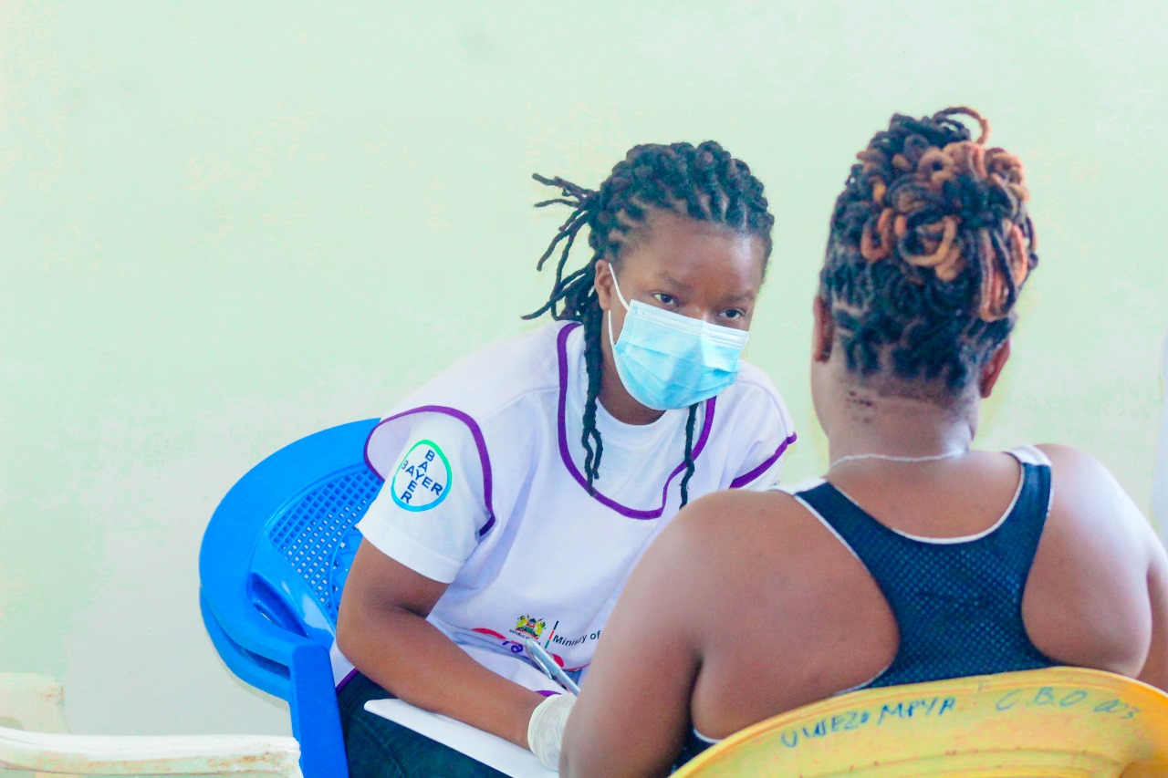
If care does not protect people during transitions, then it is not really care, it is system failure.
Person-centred care means ensuring that no one falls through the cracks during transitions. When systems fail to protect continuity of care, they fail the very people they were designed to serve.
Notes:
If care does not protect people during transitions, then it is not really care, it is system failure. Person-centred care means making sure no one falls through the cracks. When systems fail to protect continuity of care, they fail the very people they were designed to serve. Thank you.

