Slide 1
Systemic factors driving care quality for trans, travesti and non-binary populations
Maria Felipe Medeiros, Infectious Diseases MD and Transgender health researcher, Casa da Pesquisa CRT/DST Aids São Paulo, Brazil, Instituto de Infectologia Emílio Ribas
Barriers and facilitators of person-centred care for key and vulnerable populations

Slide 2
Disclosures / Conflict of Interest Declaration
Speaker Honoraria / Speaker’s Bureau: Bristol Myers Squibb (BMS), Janssen, GSK, Pfizer, MSD
Advisory Board Member: GSK, MSD
Travel Grants / Congress Sponsorship: GSK, IAS

Slide 3
Disclosures / Conflict of Interest Declaration
Beyond all of this:
I am a non-binary transgender woman.
My existence is political! To leave the house every day in the country that kills the most travestis and transgender people is a daily fight to be recognized as worthy of dignity.

Slide 4

Image Generated with AI
João is a 30-year-old bisexual transgender man who reports engaging in receptive vaginal and anal intercourse.
He scheduled a cervical cancer screening at the primary care clinic (UBS) after seeing another transgender man discussing the topic on an Instagram channel
Meet João Paulo

Slide 5

Image Generated with AI
At the reception desk, he presented his ID and informed the staff of his chosen name. However, he was told it could not be used at that facility and that he would be called by his legal name in the waiting room.
While sitting in the waiting area, taking in the signage and the people around him, he became highly distressed and uncomfortable.
The Sign:
Woman, take care of yourself with love! Get your Pap smear and protect your health

Slide 6
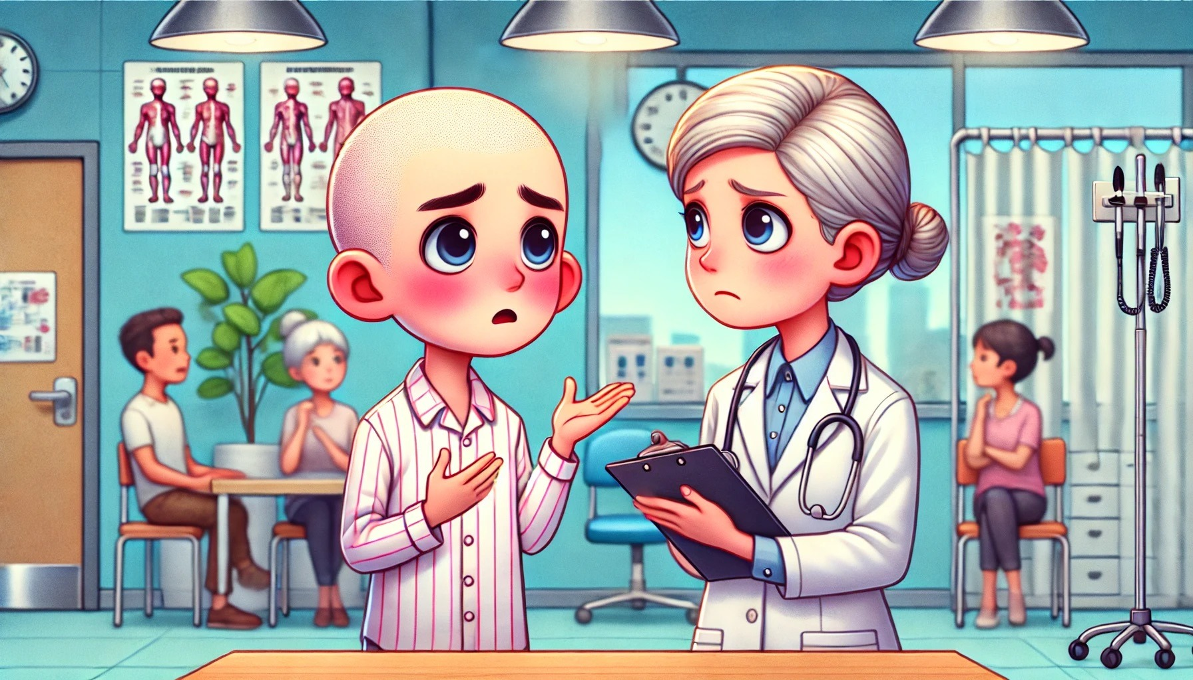
Image Generated with AI
He was then called by his deadname in the waiting room and taken to a corner of the clinic where other people were present.
There, the physician stated she could not treat him, as the facility only provided care for women, and that his presence would make the other patients in the waiting room uncomfortable.
He was also informed that this exam was performed exclusively on women who have vaginal intercourse.

Slide 7

Image Generated with AI
Deeply upset and angry, João left the facility. He knew his information was correct, but the doctor had not only denied him care, but also deadnamed him and spread medical misinformation.
Consequently, João never returned to the health center. He now tells others in his Community:
“None of us will ever get anything good out of there; they do not know how to treat us.”

Slide 8

Brazilian Transgender Community
Lack of information about gender identity in Brazilian largest Survey (CENSO 2022).
Spizzirri, G et al
  6.000 people | 129 Brazilian cities
  Transgender Women/Men: 0.69% - 1.090.000
  Non-Binary: 1.19% - 1.880.200
    Total: almost 3 million people (1.88%) identifying as gender-diverse in Brazil.
Spizzirri, G et al. Proportion of people identified as transgender and non-binary gender in Brazil. Sci Rep 11, 2240 (2021).

Slide 9
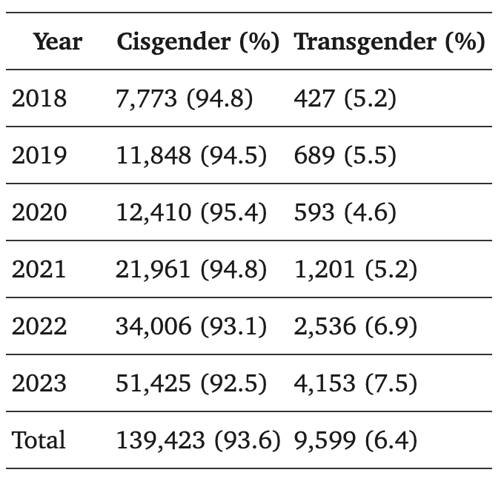
Transgender Health
Transgender people suffer significant health disparities in multiple areas
This disparities > less desire and ability to access appropriate care
  Grant et al, 2011: 19% reported being refused medical care
  Silva et al, 2025:
Safer JD, Coleman E, Feldman J, Garofalo R, Hembree W, Radix A, Sevelius J. Barriers to healthcare for transgender individuals. Curr Opin Endocrinol Diabetes Obes. 2016 Apr;23(2):168-71.
Grant JM, Mottet LA, Tanis J, Harrison J, Herman JL, Keisling M. Injustice at Every Turn: A Report of the National Transgender Discrimination Survey. Washington, DC: National Center for Transgender Equality and National Gay and Lesbian Task Force; Feb 03, 2011
Silva APMD, Pereira IO, Alencar TMD, Kamiensky BB, Moura MCM, França FÁP, Morelli TC, Pascom ARP. Access of transgender people and transvestites to pre-exposure prophylaxis for HIV in Brazil: a descriptive study, 2018-2023. Epidemiol Serv Saude. 2025 Jan 10;33(spe1):e2024322.

Slide 10
Transgender Health
Specifical care beyond usual:
  Gender-Affirming Hormonal Therapy (GAHT)
  Gender-Affirming Surgeries
  Appropriate mental health care
Common Barriers:
  Lack of providers with expertise
  Financial barriers, discrimination, lack of family support
[…] it basically takes many months or even years […] it is a waiting list that doesn’t know where it will lead you […] to get medication. [about GAHT]
Safer JD, Coleman E, Feldman J, Garofalo R, Hembree W, Radix A, Sevelius J. Barriers to healthcare for transgender individuals. Curr Opin Endocrinol Diabetes Obes. 2016 Apr;23(2):168-71
Oliveira, Ester Mascarenhas et al. Access to public healthcare services for transgender people: experiences in Brazil's capital. Revista da Escola de Enfermagem da USP, v. 60, e20250273, 2026.

Slide 11
HIV care-continuum among Transgender Community
Individual level risk Factors
Socially determined factors
Condomless sex, particularly receptive anal sex
Coinfection with other sexually transmitted infections
Transactional sex
Shared use of needles for hormone and/or silicon injections
Price premium for condomless sex work
Lack of formal work opportunities
Barriers to respectful and routine testing
Low knowledge and access of PrEP and others HIV preventions' methods
No wide availability of GAHT in healthcare systems
Entrenched gender norms within society, resulting in aesthetic pursuits rooted in dysphoria.
Sarah E. Stutterheim et al. The worldwide burden of HIV in transgender individuals: An updated systematic review and meta-analysis. PLoS One. 2021; 16(12): e0260063. Published online 2021 Dec 1

Slide 12
The Successful Actions
Retention Factors:
  Jalil et al, 2022: The use of one space for all health demands – PrEP and GAHT at the same place
  Da Silva, 2024; Bassichetto, 2023: Community Education with peers when the community sees through the professionals
    18% increase in the total number of transgender people in PrEP clinical trials
Motivation to attend the healthcare service:
  Grinsztejn et al, 2022: Transgender women are more likely to use PrEP correctly if they know about it and intend to use it
Jalil EM, Torres TS, Luz PM, Monteiro L, Moreira RI, de Castro CRV, Leite IDC, Cunha M, de Cássia Elias Estrela R, Ramos M, Hoagland B, Wagner Cardoso S, Anderson P, Veloso VG, Wilson E, Grinsztejn B; PrEParadas Study Team. Low PrEP adherence despite high retention among transgender women in Brazil: the PrEParadas study. J Int AIDS Soc. 2022 Mar;25(3):e25896.
Konda KA, Torres TS, Mariño G, Ramos A, Moreira RI, Leite IC, Cunha M, Jalil EM, Hoagland B, Guanira JV, Benedetti M, Pimenta C, Vermandere H, Bautista-Arredondo S, Vega-Ramirez H, Veloso VG, Caceres CF, Grinsztejn B; ImPrEP Study Group. Factors associated with long-term HIV pre-exposure prophylaxis engagement and adherence among transgender women in Brazil, Mexico and Peru: results from the ImPrEP study. J Int AIDS Soc. 2022 Oct;25 Suppl 5(Suppl 5):e25974.
Bassichetto KC, Saggese GSR, Maschião LF, Carvalho PGC, Gilmore H, Sevelius J, Lippman SA, Veras MASM. Factors associated with the retention of travestis and transgender women living with HIV in a peer navigation intervention in São Paulo, Brazil. Cad Saude Publica. 2023 May 1;39(4):e00147522.
V.F. Da Silva , P.A. De Souza , C.A.P. Alves , F.D.L.S. Da Rocha , J.R.C. Da Silva , J.V.R. Madruga , A.C.C. Iglessias , L.R. Ramos , P. De Lima e Menezes , R.S.Nogueira. Effective Strategies to Expand PrEP Use among Transgender Women in Brazil. IAS Conference, 2024 - Munique/AL

Slide 13
The role of Healthcare Workers
Always work with Person-Centered Care!
  Non-pathologizing care models (shared discussion)
  Coupled with facilitating factors and retention strategies (hormone dispensing, targeted referrals, social inclusion practices, etc.)
  Including peer navigation to assist in health education
  Incorporating continuing education for healthcare professionals regarding sexuality and gender
  Care that takes into account the lived experiences and knowledge built through grassroots social struggles
  In research: community-based research, with transgender people on the research team, as part of the discussion and construction of knowledge.

Slide 14
“Our [trans] existences has been demonized, pathologized, and criminalized, but today we are living the dreams of our ancestors”
Bruna Benevides, President of the National Association of Travestis and Transgenders of Brazil (ANTRA)

Slide 15
Thank you!
Instagram: @mafeinfectologista
Mail: maria.fmedeiros@emilioribas.sp.gov.br

