Slide 1
When the roadmap meets reality:
Operationalizing person-centred care in community-based clinics in the Philippines
Rodenie Arnaiz Olete, PhD, MSc, RN
Sustained Health Initiatives of the Philippines (SHIP)
Barriers and facilitators of person-centred care for key and vulnerable populations
Notes:
Good afternoon. I'm Rod Olete, from Sustained Health Initiatives of the Philippines, or SHIP.
The global consensus on person-centred care gave us a roadmap for the HIV response. My question today is simple: can a community-based organization actually operationalize it? And what happens when the roadmap meets reality?

Slide 2
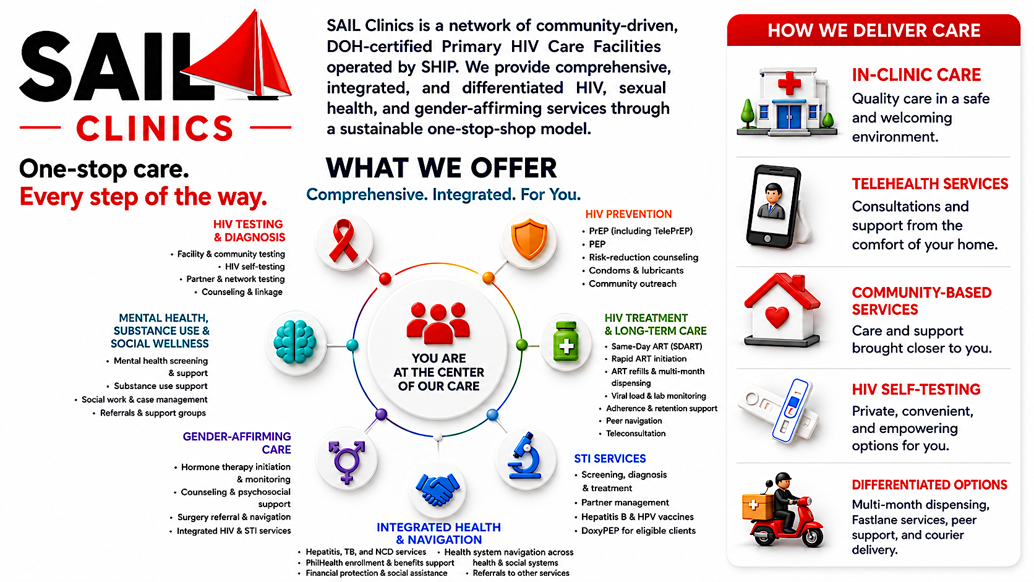

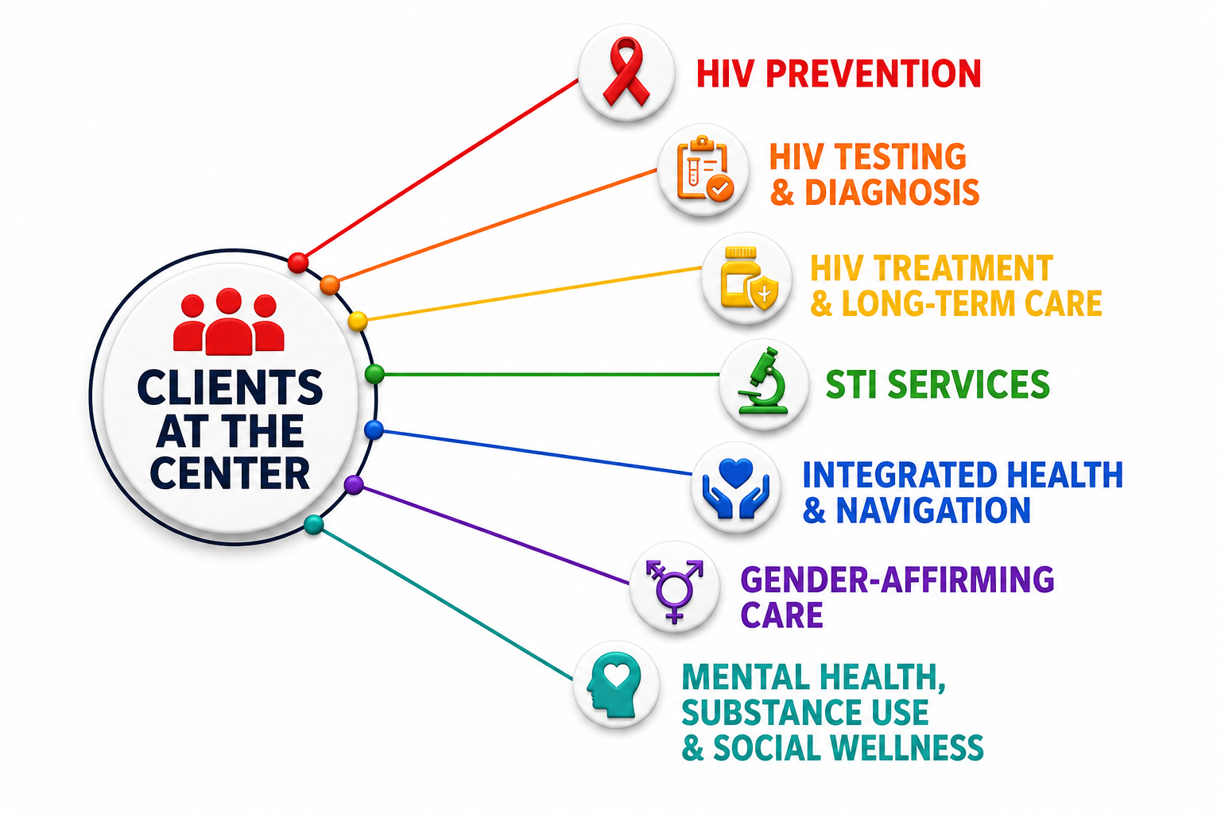
When the roadmap meets reality:
Operationalizing person-centred care in community-based clinics in the Philippines
Rodenie Arnaiz Olete, PhD, MSc, RN
Sustained Health Initiatives of the Philippines (SHIP)
Barriers and facilitators of person-centred care for key and vulnerable populations
Notes:
This is SAIL—SHIP's network of community-led, DOH-certified HIV clinics providing one-stop services from prevention to long-term care.
The client sits at the center of six integrated services: HIV testing, prevention, treatment, STI care, gender-affirming care, and navigation for hepatitis, TB, non-communicable diseases, and PhilHealth.
Throughout the continuum, we apply person-centred, differentiated care through clinic visits, telehealth, community outreach, HIV self-testing, multi-month dispensing, and medication delivery—making care more accessible, flexible, and responsive to clients' needs.

Slide 3
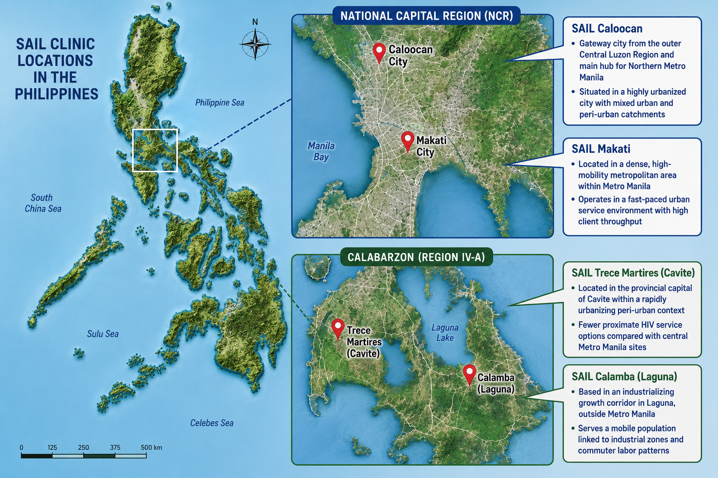
We evaluated how PCC & DSD would look like in CBO facilities
SAIL Caloocan
Gateway city from the outer Central Luzon and main hub for Northern Metro Manila
SAIL Makati
Located in dense, high mobility metropolitan area within Metro Manila
SAIL Cavite
Located in the provincial capital within a rapidly urbanizing peri-urban context
SAIL Laguna
Based in an industrializing growth corridor outside Metro Manila
Notes:
We wanted to know whether person-centred and differentiated care improve client outcomes—not just how they're implemented. That became the focus of my PhD dissertation.
We analyzed four SAIL clinics across the Greater Manila Area, each serving a different context. Caloocan serves many peri-urban and rural clients who travel long distances. Makati, our busiest clinic, serves a highly mobile urban population that requires fast, flexible care. Cavite and Laguna serve rapidly urbanizing peri-urban communities with different healthcare access and service demands.

Slide 4
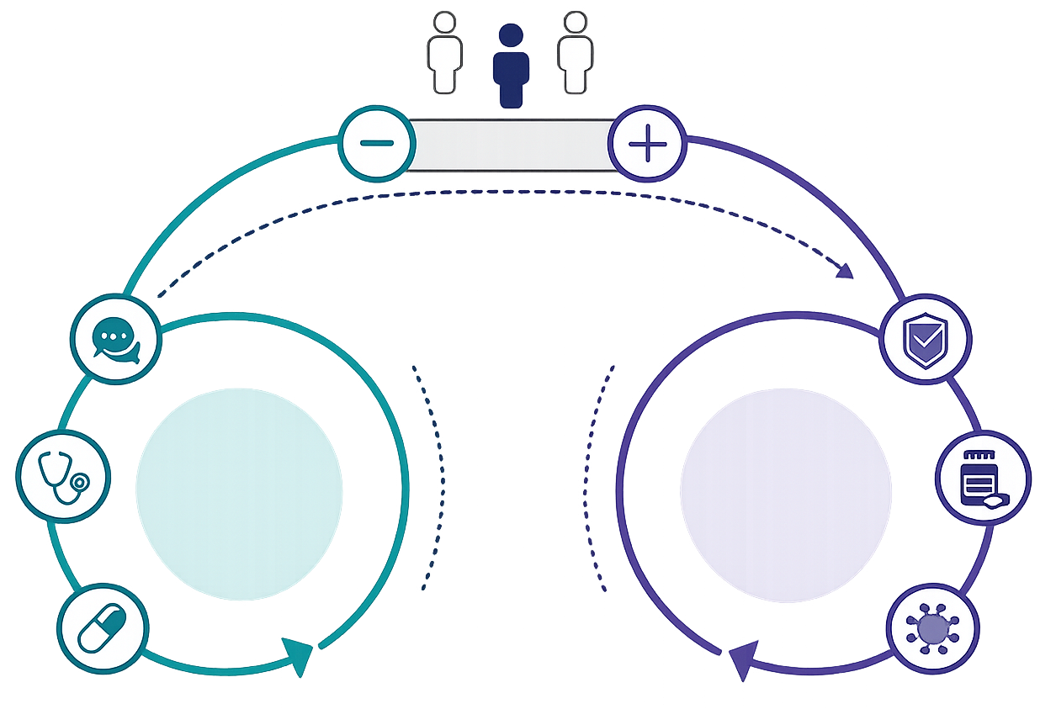
We wanted to understand how PCC would look like when operationalized from a status-neutral lens
Person-Centered Care Principles
Differentiated Service Delivery
HIV testing
Health systems and policies
PrEP
Uptake
Treatment
Engagement
Notes:
We adopted a status-neutral approach because HIV care is often split into separate prevention and treatment systems, even though people's journeys are not.
Instead, we built a single continuum with HIV testing as the entry point. Every client receives the same person-centred, differentiated care; only the next service changes—prevention or treatment.
The findings I'll present come from both ends of that continuum.

Slide 5

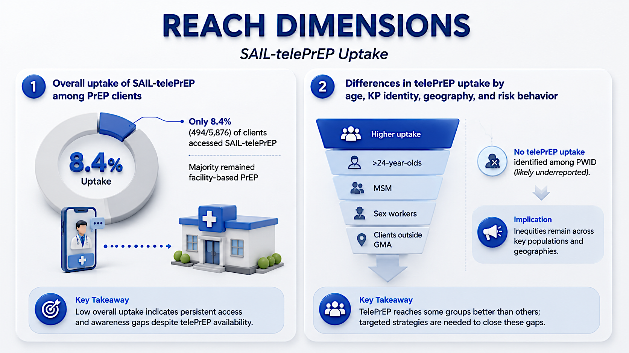
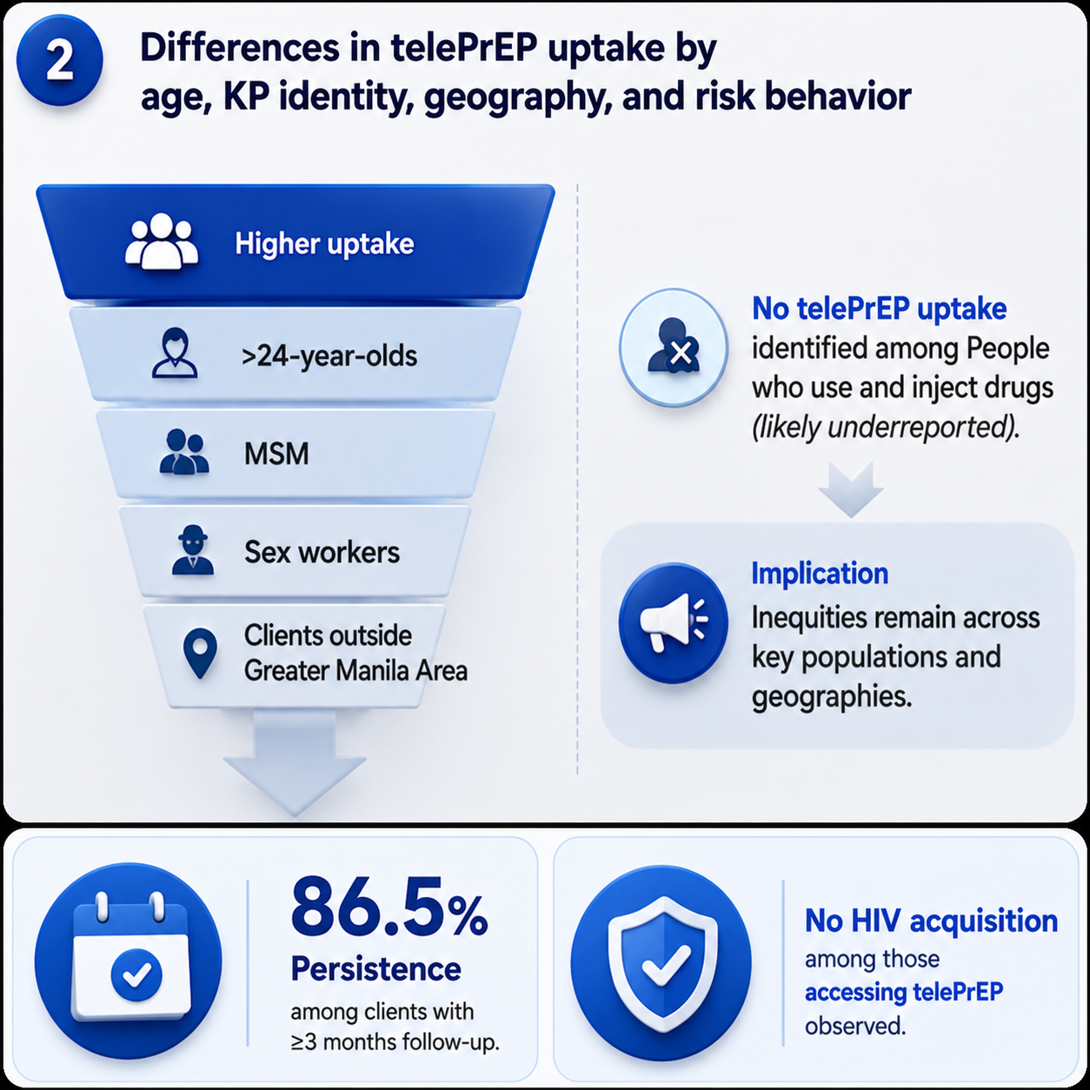
PrEP Uptake
SAIL teleprep pilot (Jan-Dec 2023)
National
Capital
Region
Region
III
10%
61%
Region
IV-A
17%
Region VII
5%
≤2%
The rest of the Visayas and Mindanao Regions
Notes:
PrEP uptake remains a challenge in the Philippines. Not everyone has the convenience of routinely visiting a clinic to get PrEP, and not all clinics have the capacity to serve every client at once. This gap is what led to the pilot of SAIL-telePrEP [CLICK].
SAIL-telePrEP was developed initially to decongest the high client volume at SAIL Makati. But we started to wonder if it could also help close the PrEP uptake gap nationally [CLICK]. Looking at December 2022 surveillance data, we found that clients in the central and southern provinces remained at 5% or lower in PrEP access. So [CLICK-CLICK], what if we started sending PrEP through courier instead?
Over that one year of evaluation [CLICK], we found that only about 8% of our clinic clients had ever accessed teleprep, and that the clients who did were more likely to be 24 years old or older [CLICK], men who have sex with men, sex workers, or living outside the four SAIL clinics. This told us telePrEP has real potential to reach the underserved.
But in this same one-year pilot, we still weren't reaching people who use or inject drugs. So I paused and asked myself: are we really not reaching them, or is this underreported because of the country's punitive drug laws?
Another key finding: a very high proportion of telePrEP clients persisted on PrEP through the end of the observation period, and no HIV acquisitions were recorded among that group.

Slide 6
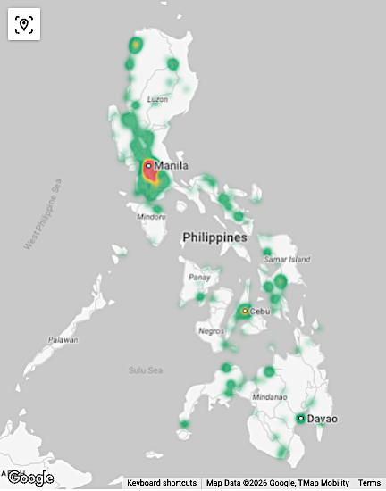
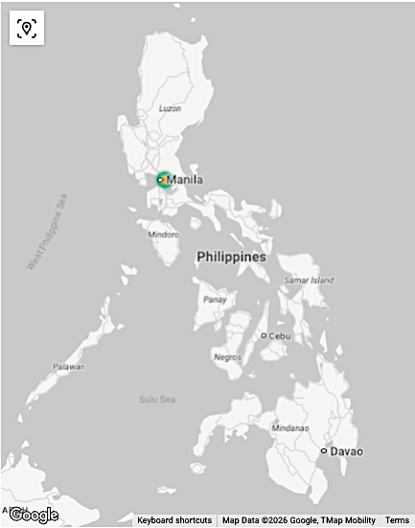
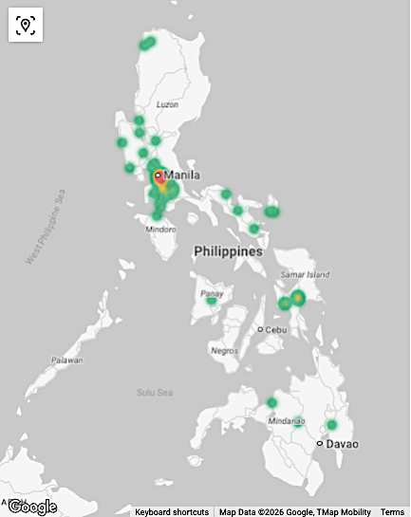
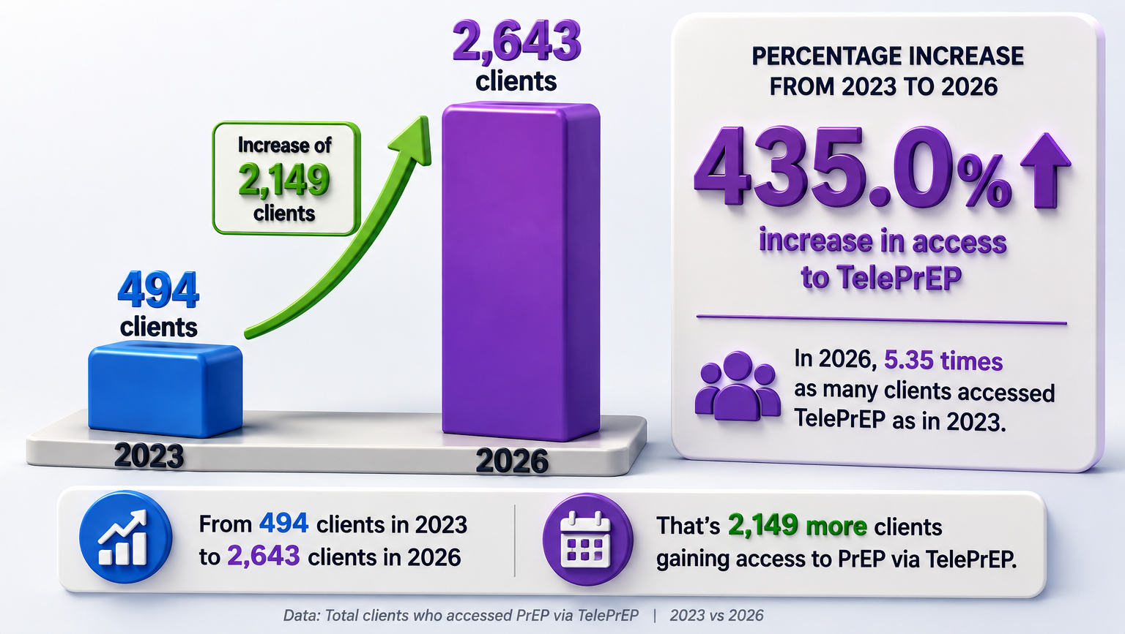
SAIL teleprep expansion
[Partnered with Elton John AIDS Foundation]
Notes:
Jumping to how far SAIL teleprep has expanded. Looking at the heatmap [CLICK], we have been expanding our reach to many provinces all over the country. Because Elton John AIDS Foundation believed in our teleprep model, we have opened one more teleprep headquarters in Cebu to cater to our PrEP clients from the central and southern provinces in the Philippines. [CLICK] This led to the 435% increase in our clients accessing HIV self-testing, PrEP initiation, and refill. We are also grateful to government health agency in Cebu for collaborating with us.

Slide 7
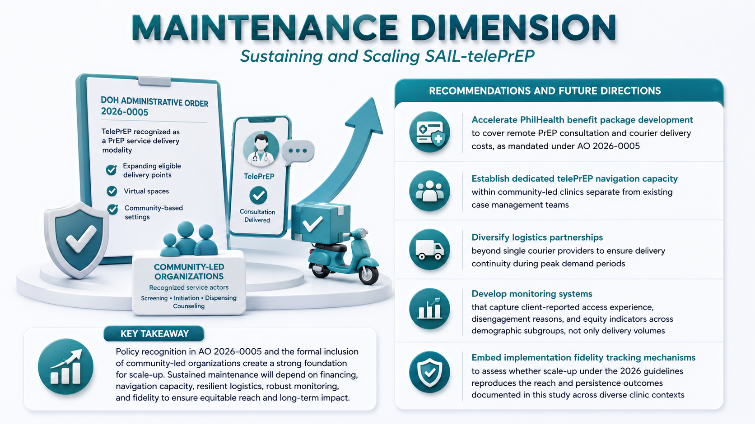
How can teleprep be sustained
[Partnered with Elton John AIDS Foundation]
Accelerate PhilHealth Benefit Package development
But recognition is not financing.
The components
of SAIL teleprep model
have no domestic funding pathway following the contraction of international funding.
Establish dedicated telePrEP navigation capacity
Diversify logistic partnerships
Develop monitoring systems and dashboards
Policy recognition in AO 2026-0005 and the formal inclusion of CBO in PrEP delivery is a strong foundation for scale-up/maintenance
Embed implementation fidelity tracking mechanisms
Notes:
Sustainability was the goal from the start. The evidence from our pilot got us a seat at the table with the Department of Health, and we pushed for telehealth-based PrEP delivery to be recognized as a valid DSD model in the newest guidelines.
That recognition came through: Administrative Order 2026-0005 now includes telehealth-based PrEP delivery [CLICK]. But recognition alone isn't enough. We still have to prepare for the day development partners exit, and make sure domestic funding covers PrEP delivery when they do.

Slide 8
We wanted to understand how PCC would look like when operationalized from a status-neutral lens
Person-Centered Care Principles
Differentiated Service Delivery
HIV testing
Health systems and policies
PrEP
Uptake
Treatment
Engagement
Notes:
Now moving to the other side of the continuum:

Slide 9
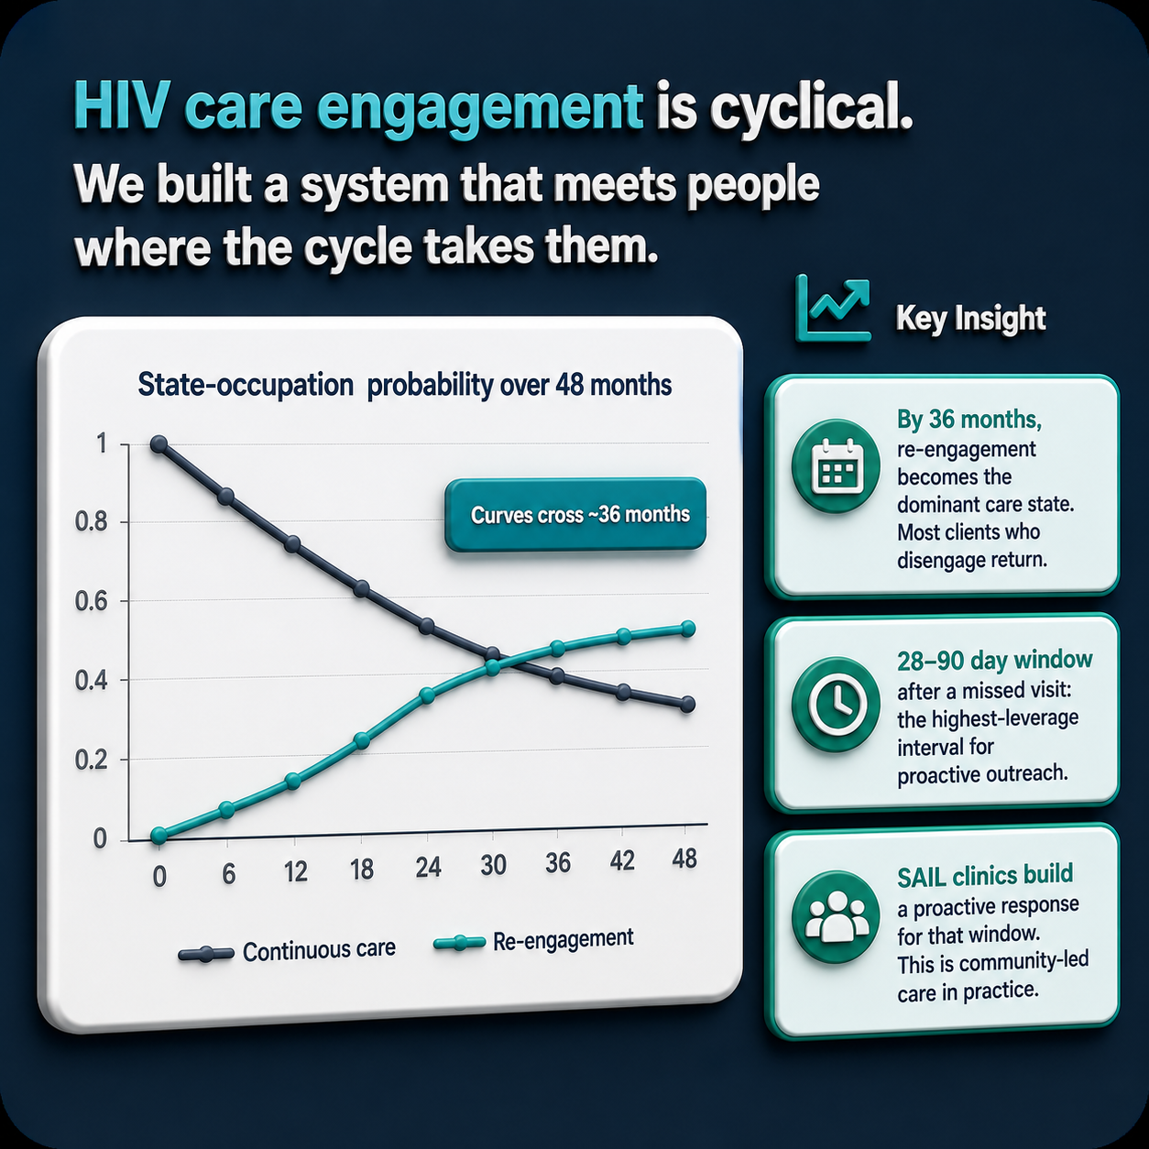
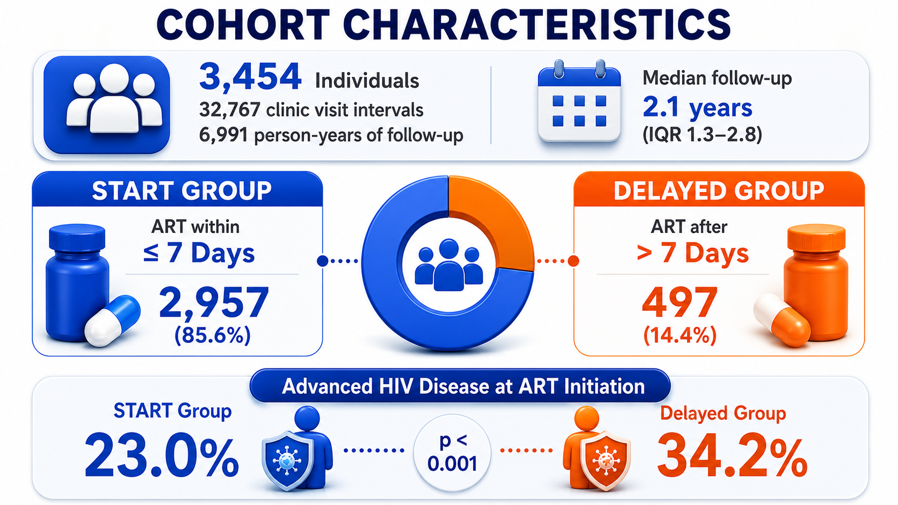
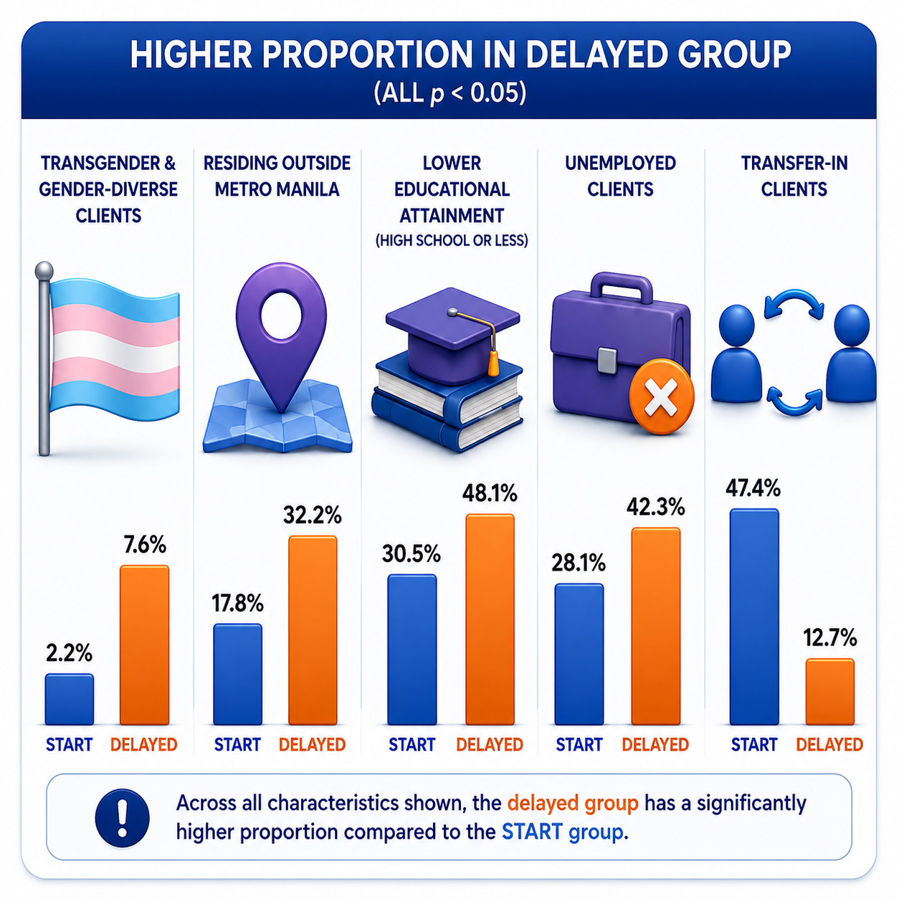
Treatment Engagement
SAIL START Program (Four-year evaluation of HIV care)
Probability of being in continuous care and those who re-engaged after a period of treatment interruption across 48 months
Notes:
SHIP also upholds the importance of same-day and rapid ART initiation. [CLICK] This is why we have our START Program, or Same-day and Timely ART Rapid Treatment ensuring that clients are linked to care within 7 days from their HIV diagnosis. We also evaluated how our SAIL clinics implemented this. [CLICK] Our four-year data from 2021 to 2025 showed that we have had about 3500 clients in our care with a median of 2.1 years of follow-up. It was a great achievement, in my humble analysis, to have majority of our clients who immediately started ART. And similar to available literature, clients who had advanced HIV disease (AHD) were more likely to delay their ART because our clinics had to manage their opportunistic infections.

Slide 10
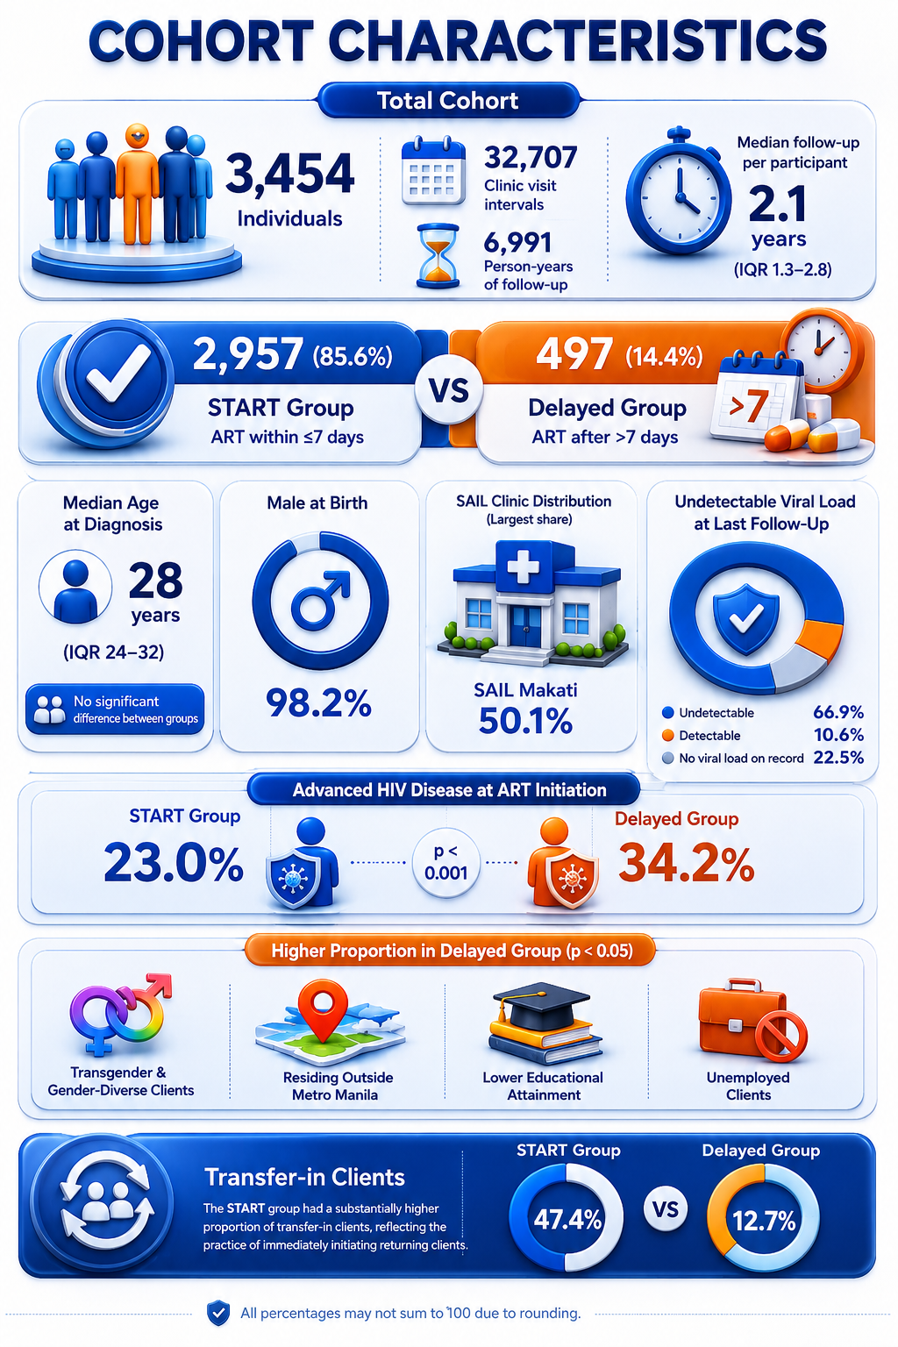
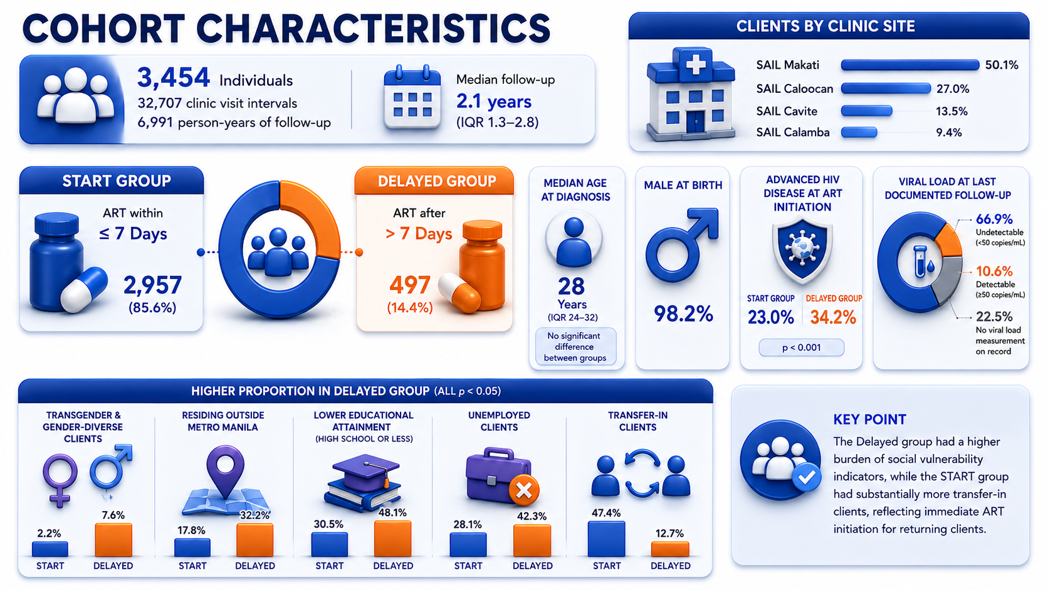
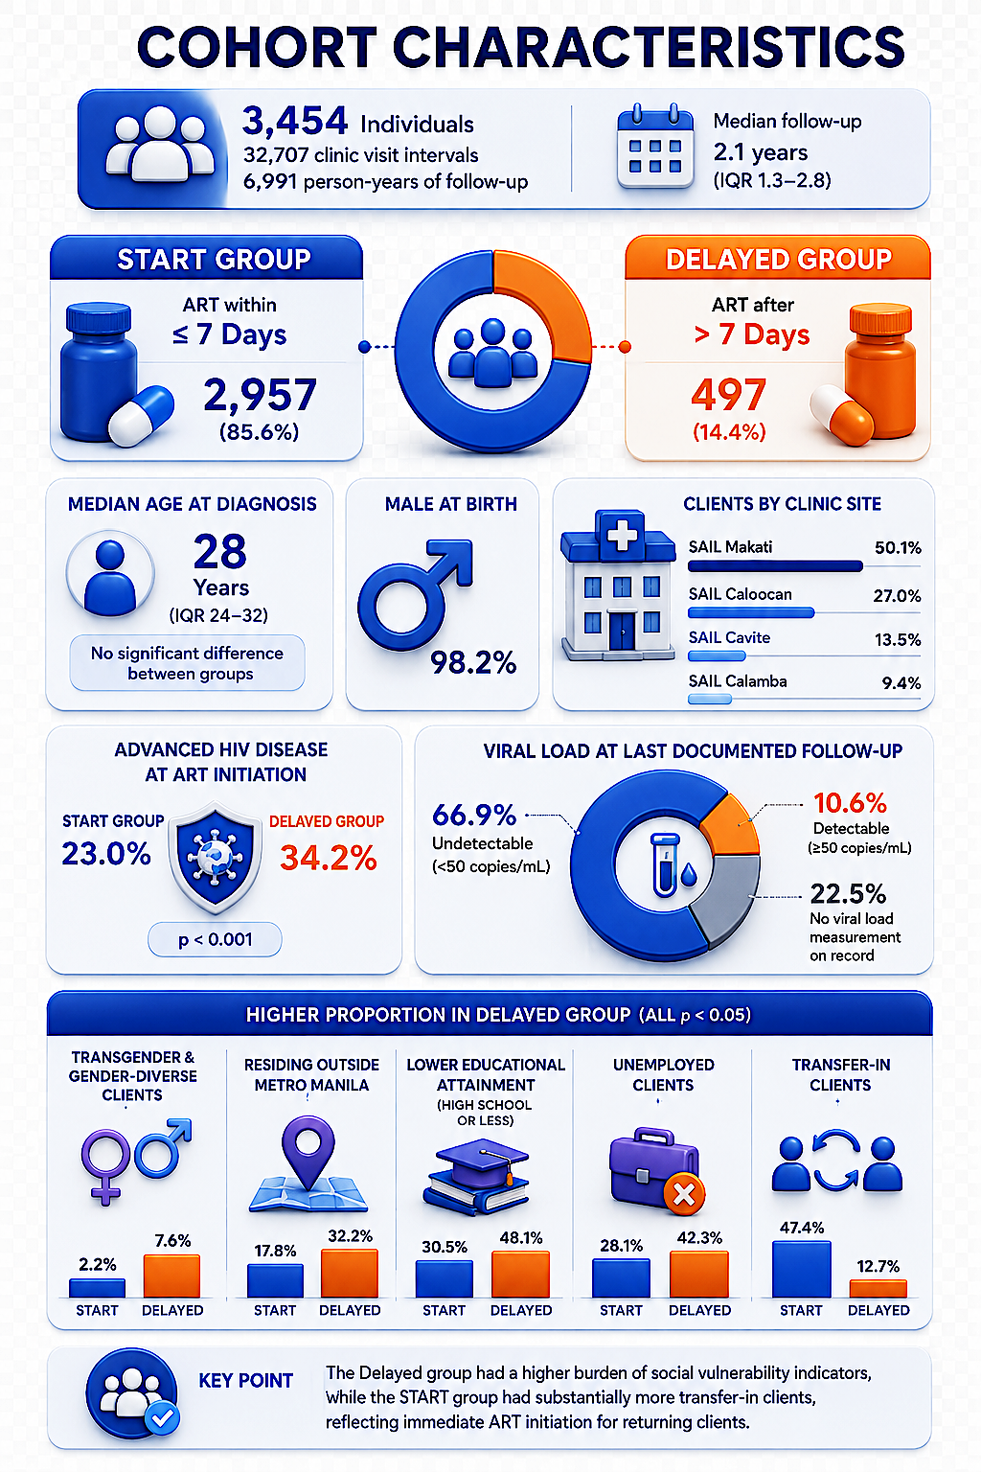
Treatment Engagement
SAIL START Program (Four-year evaluation of HIV care)
Probability of being in continuous care and those who re-engaged after a period of treatment interruption across 48 months
Notes:
Our analysis also showed that delayed ART initiation was more common among transgender and gender-diverse clients, those living outside Metro Manila, individuals with lower educational attainment, and those who were unemployed.
Through interviews with our clinic staff, we learned that some clients with AHD could not even afford transportation to the emergency room. In several cases, staff personally paid for their transport so they could receive urgent care. These experiences led SHIP to establish the Care Funds, a program that provides financial assistance to clients facing critical barriers to care.
One of our most important findings, shown on the right, is that HIV care engagement is not linear—it is cyclical. Rather than being permanently lost to care, many clients who disengage eventually return. By around 36 months, re-engagement becomes the dominant pattern, with most disengaged clients finding their way back into care.
This reveals a critical opportunity: the 29- to 90-day period after a missed visit is a key window for proactive outreach before disengagement becomes prolonged. The implication is clear. Instead of designing HIV services around perfect retention, we should expect interruptions, actively facilitate re-engagement, and meet people where they are in their care journey. That is exactly the model implemented across the SAIL community-led clinics.
But how can we do that when our national insurance reimbursement is stretched out to cover socioeconomic support and our clinic capacity handles 30 to 50 clients per day? My point is, the existing insurance package is not enough so we have to rely on development partners to augment this challenge.

Slide 11
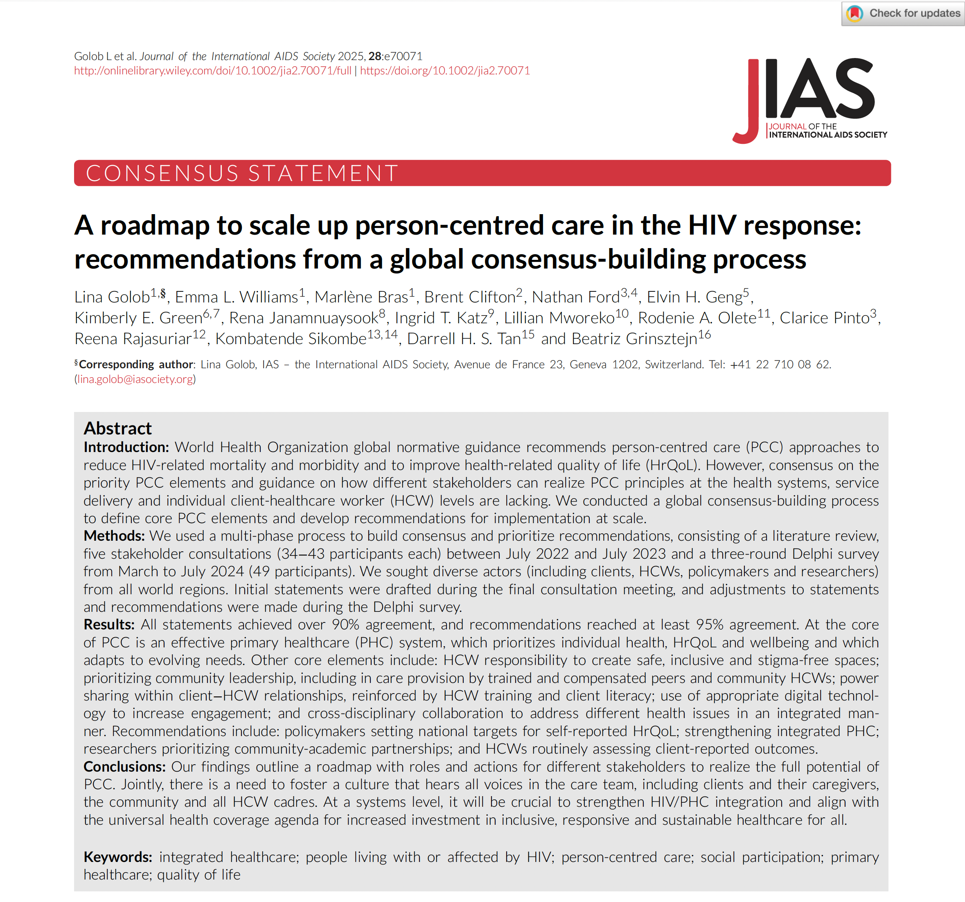
When the roadmap meets reality
Actor | Priority Action | What SHIP currently does
Community-Based Organizations | Diversify funding; advocate for social contracting; engage clients in governance | The national insurance reimbursement for Outpatient HIV and AIDS Treatment (OHAT) is stretched to cover prevention side.
Health Care Workers | Demand fair remuneration; advocate for PCC training; protect peer navigators | Aside from the standardized salary and fringe benefits, HMO is added and annual performance review is conducted to facilitate a salary increase
Health System Admin | Scale DSD; invest in community-based services; fund the cyclical care cascade | DSD approaches in prevention, treatment, and psycho-socioeconomic support, but these currently relies on OHAT and development partners.
Policymakers | Decriminalize; strengthen PHC integration; adopt PCC in national policy | Member of the Philippine National AIDS Council and actively collaborating with the Department of Health in policy and guidelines development
Notes:
Now going back to the main question. Is it doable to operationalize the PCC roadmap that Clarice presented earlier? Allow me to highlight the four actors that the roadmap included:
Based on the what we have leaned from our PrEP and Treatment analyses, you see that our HIV care framework aspire to provide holistic and differentiated services but it has been challenging so far. We try our best in diversifying our funding but the reimbursement we get from OHAT which is supposed to cover only people living with HIV is currently being stretched out to also cover for prevention-related services.
Our health care workers are remunerated well considering that our resources are coming from both national health insurance and developmental partners. Our organization ensures that the staff are with fringe benefits, including HMO coverage on top of their National Health Insurance. Our worry at this moment is that when development partners leave, how do we sustain all these great work that we have been doing.
But we are hopeful. Hopeful because as a member of the Philippine National AIDS Council, we continuously collaborate with the Department of Health in advocating for sustainability policies and guidelines. This gives us a pathway to lobby for better and more sustainable financing.

Slide 12
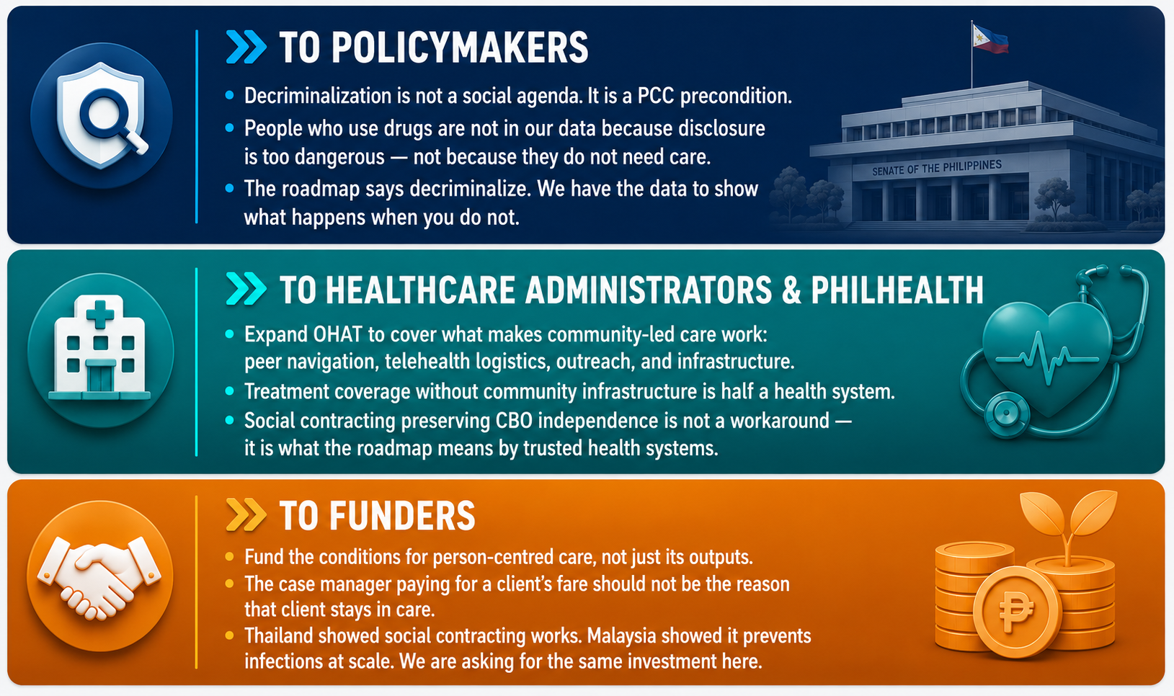
We have done so much.
Do not let it be taken away.
CALL TO ACTION
Notes:
To policymakers: decriminalization is not a social agenda. It is a precondition for the care you say you want. Every zero in our data for people who use drugs is not proof of absence. It's proof that your laws made disclosure too dangerous. The roadmap already told you to decriminalize. We just showed you the cost of waiting.
To healthcare administrators and PhilHealth: OHAT covers treatment. It does not cover what makes community-led care work: peer navigation, telehealth logistics, outreach, infrastructure. Treatment without that infrastructure is half a health system, not a whole one. When you protect CBO independence through social contracting, you are not creating a workaround. You are building what the roadmap actually means by a trusted health system.
To funders: fund the conditions, not just the outputs. A case manager should not be the reason a client's fare gets covered and that client stays in care. Thailand proved social contracting works. Malaysia proved it stops infections at scale. We are not asking you to take a risk. We are asking you to fund what already works. [CLICK]
We have done so much. Do not let it be taken away.
-----------------
Five facilitators worked in our favor. Insider community knowledge, no training program replicates that. Telehealth reaching people five times more effectively than facility-based care. A workforce that stayed because this is their community, not just a job. A clinic culture where re-engagement is expected, not penalized. And two national laws already on the books, waiting to be fully used.
Five barriers worked against us just as hard. Insurance covering treatment only, not prevention or community-level infrastructure. Drug enforcement that turns disclosure into a legal risk, so the zeros in our data mean suppressed need, not absence. A funding architecture built on development partners, not domestic financing. Integration pressure that could absorb CBOs into systems not built for key populations. And a 28 to 90 day re-engagement window the data calls critical, but staffing can't yet guarantee.

