Slide 1
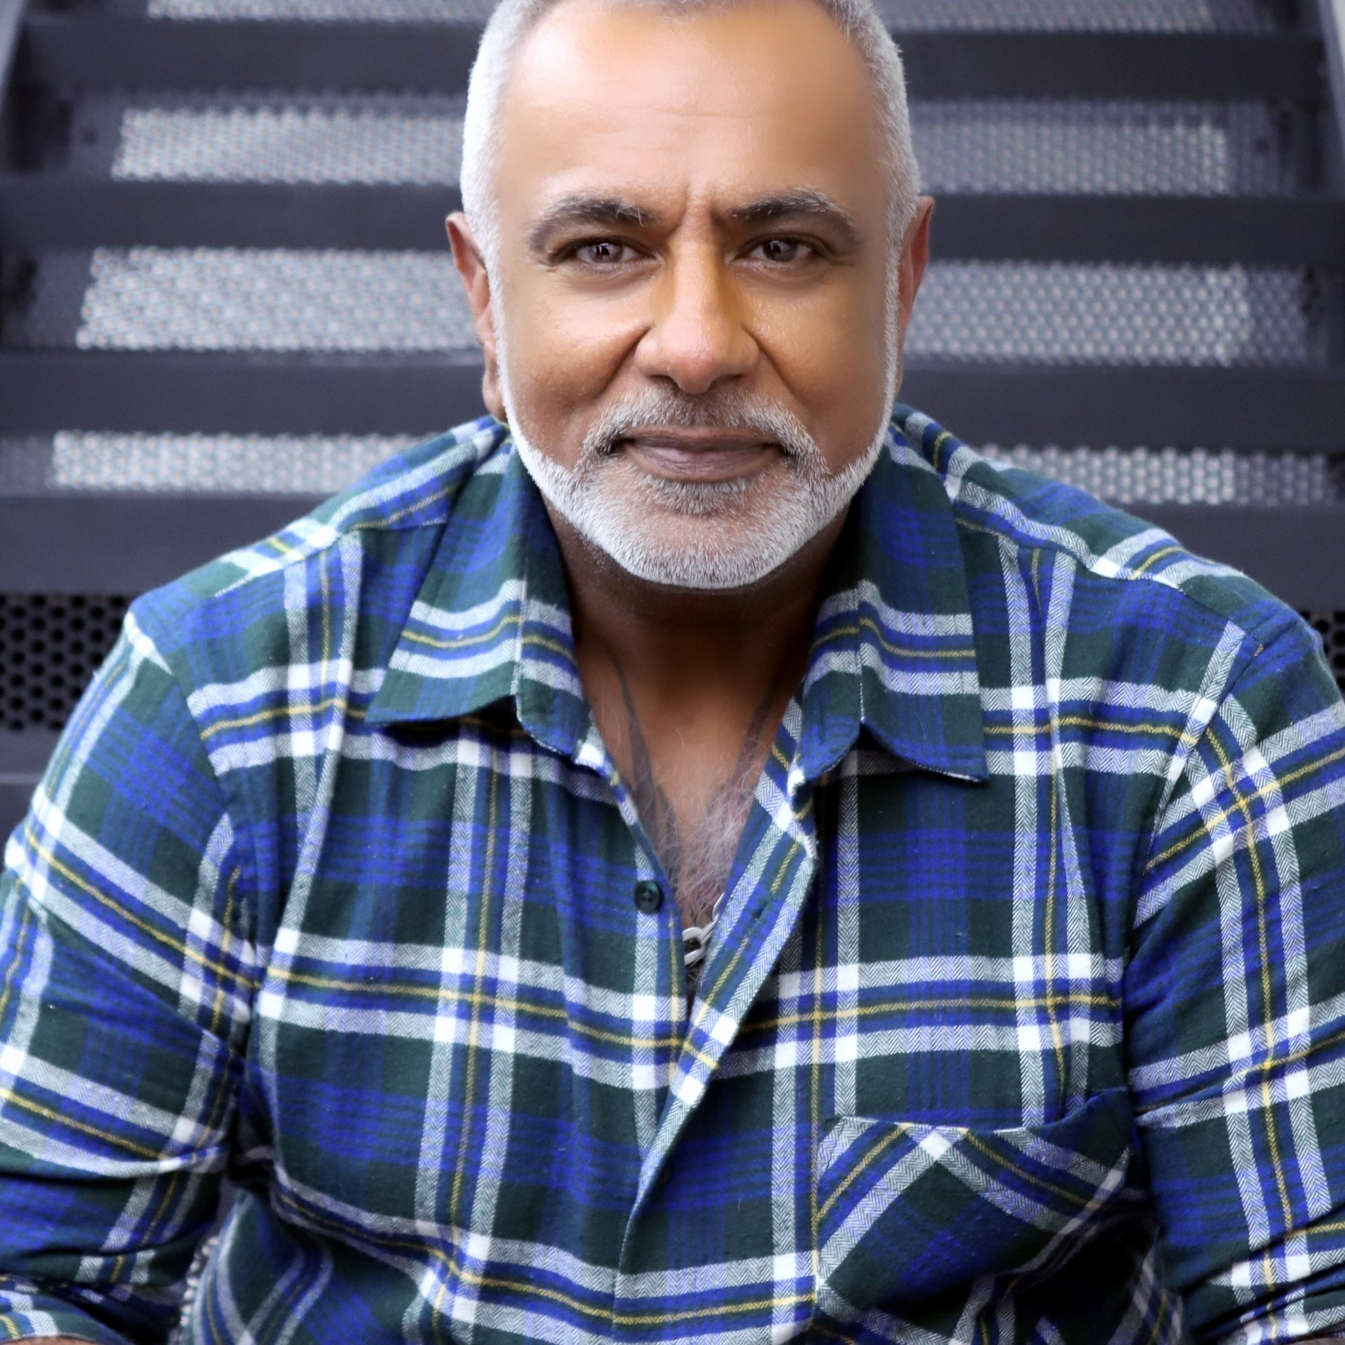
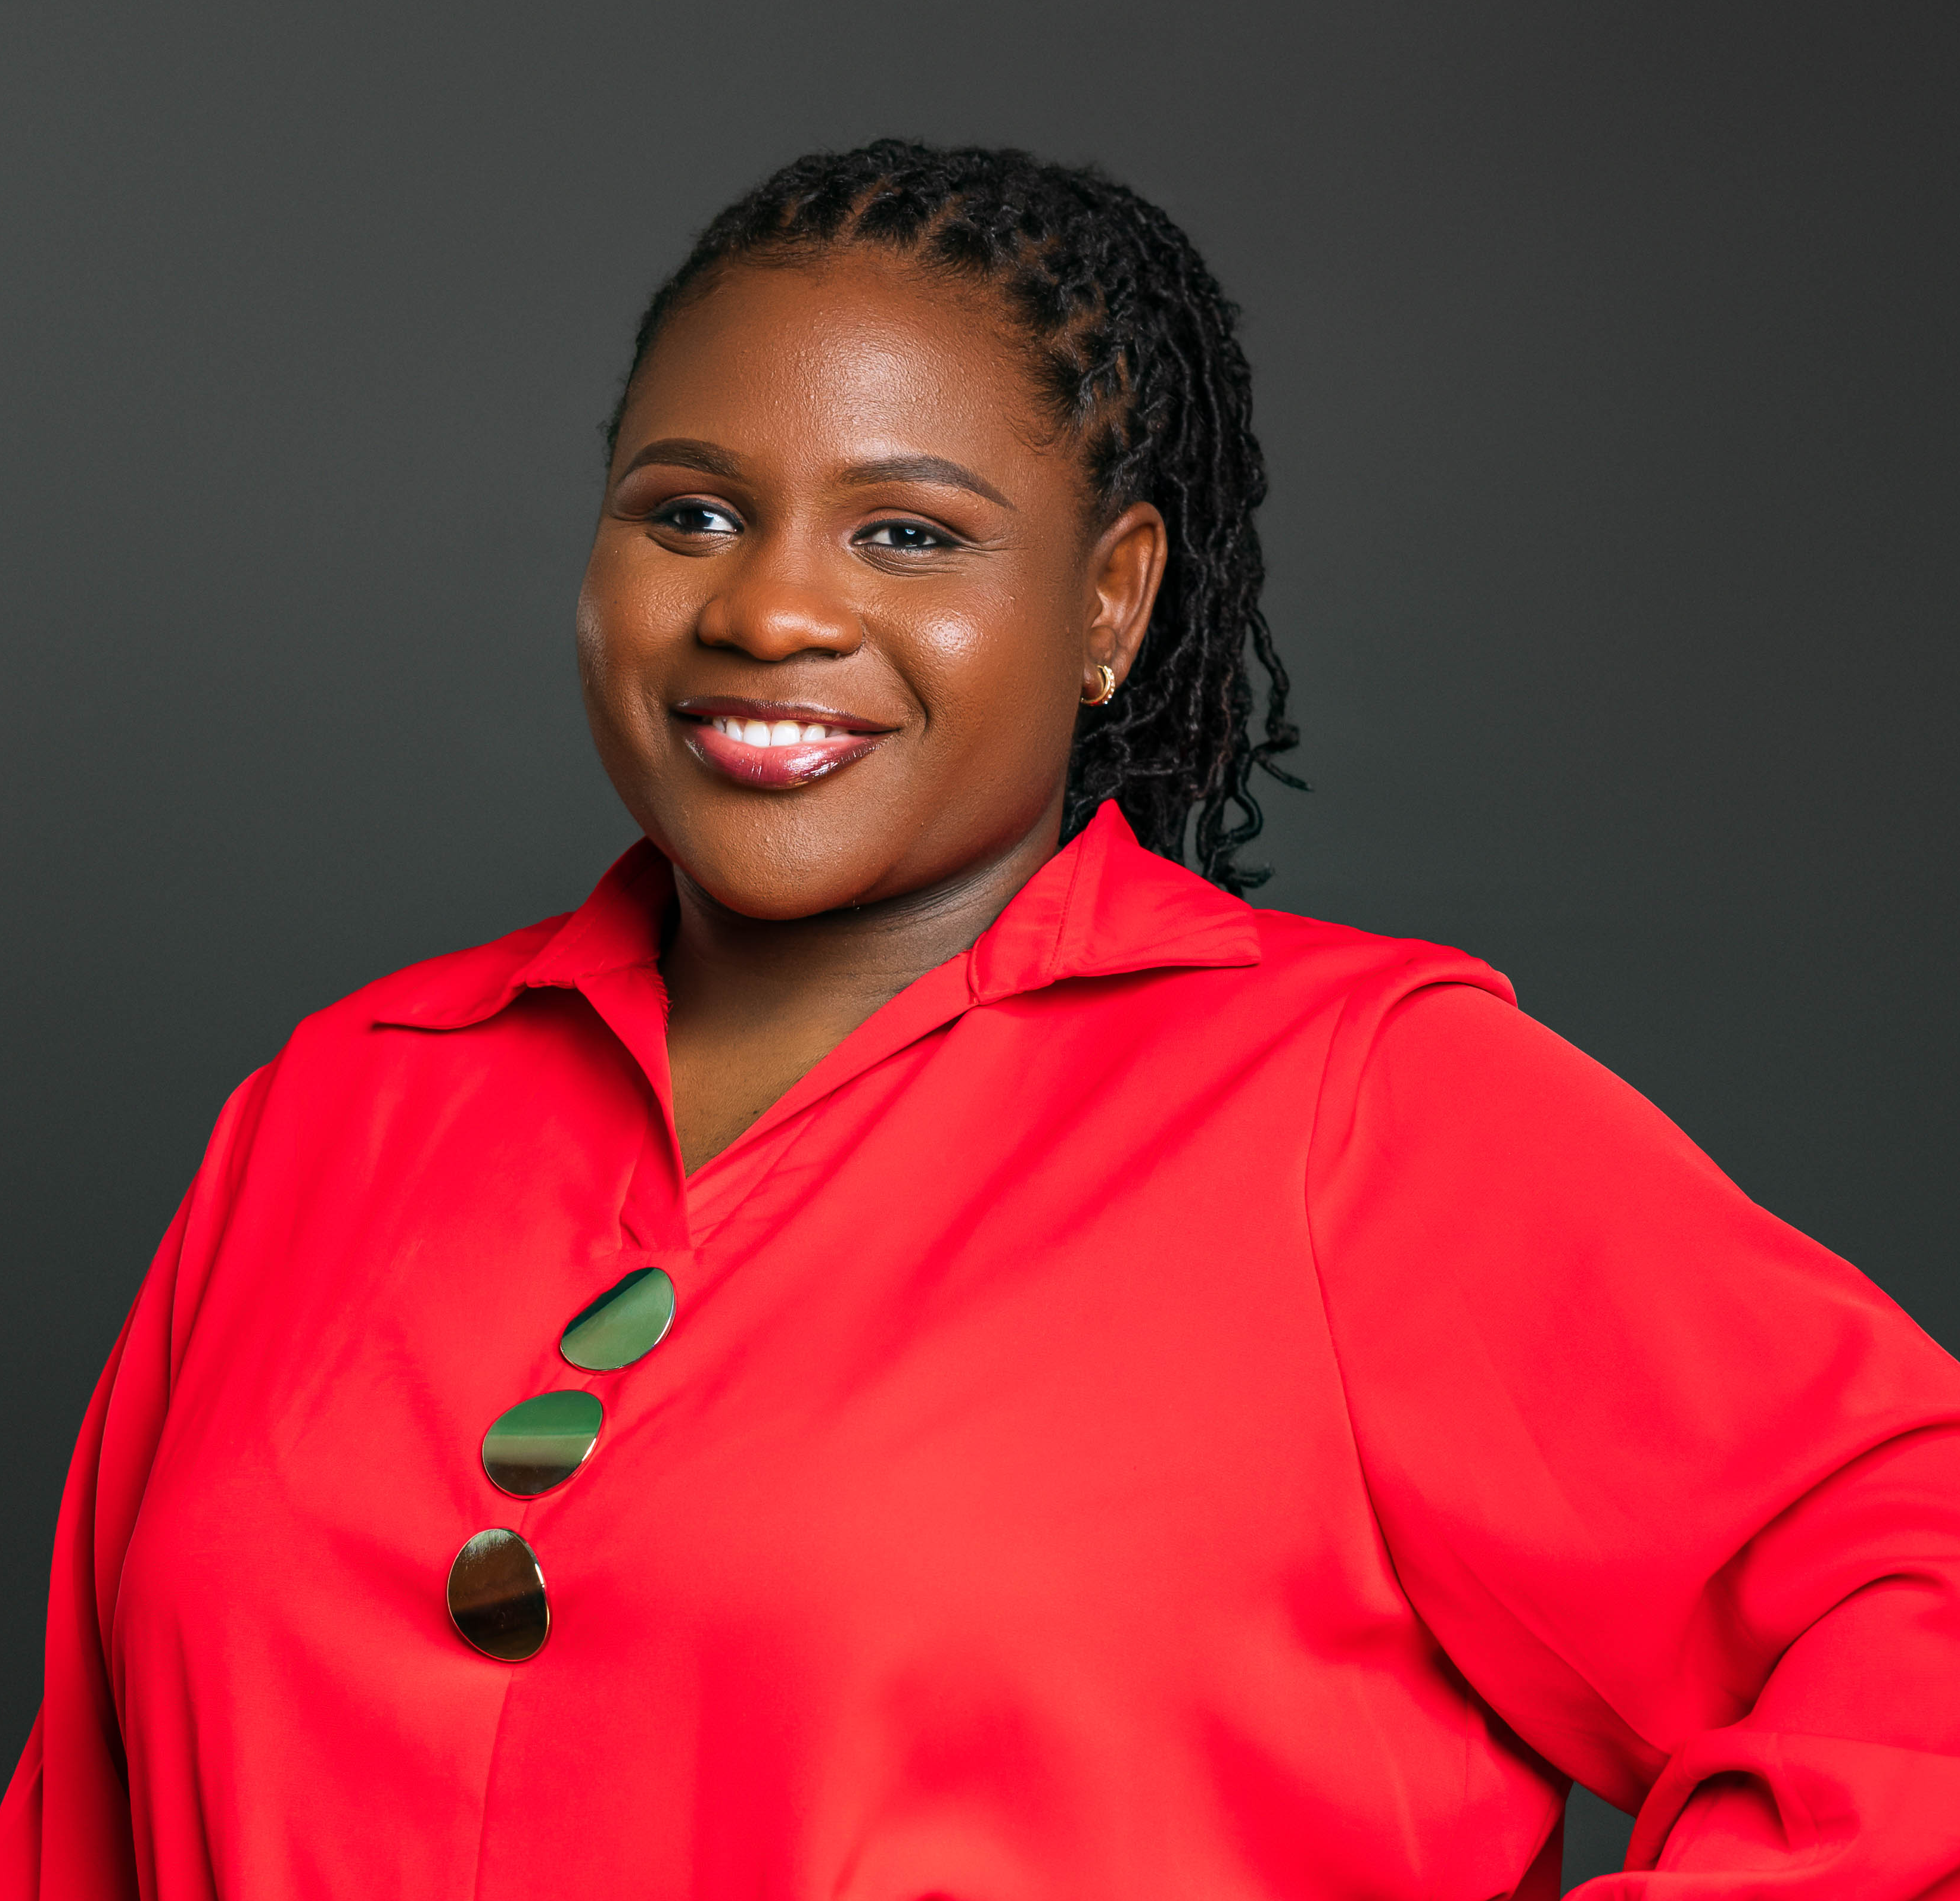
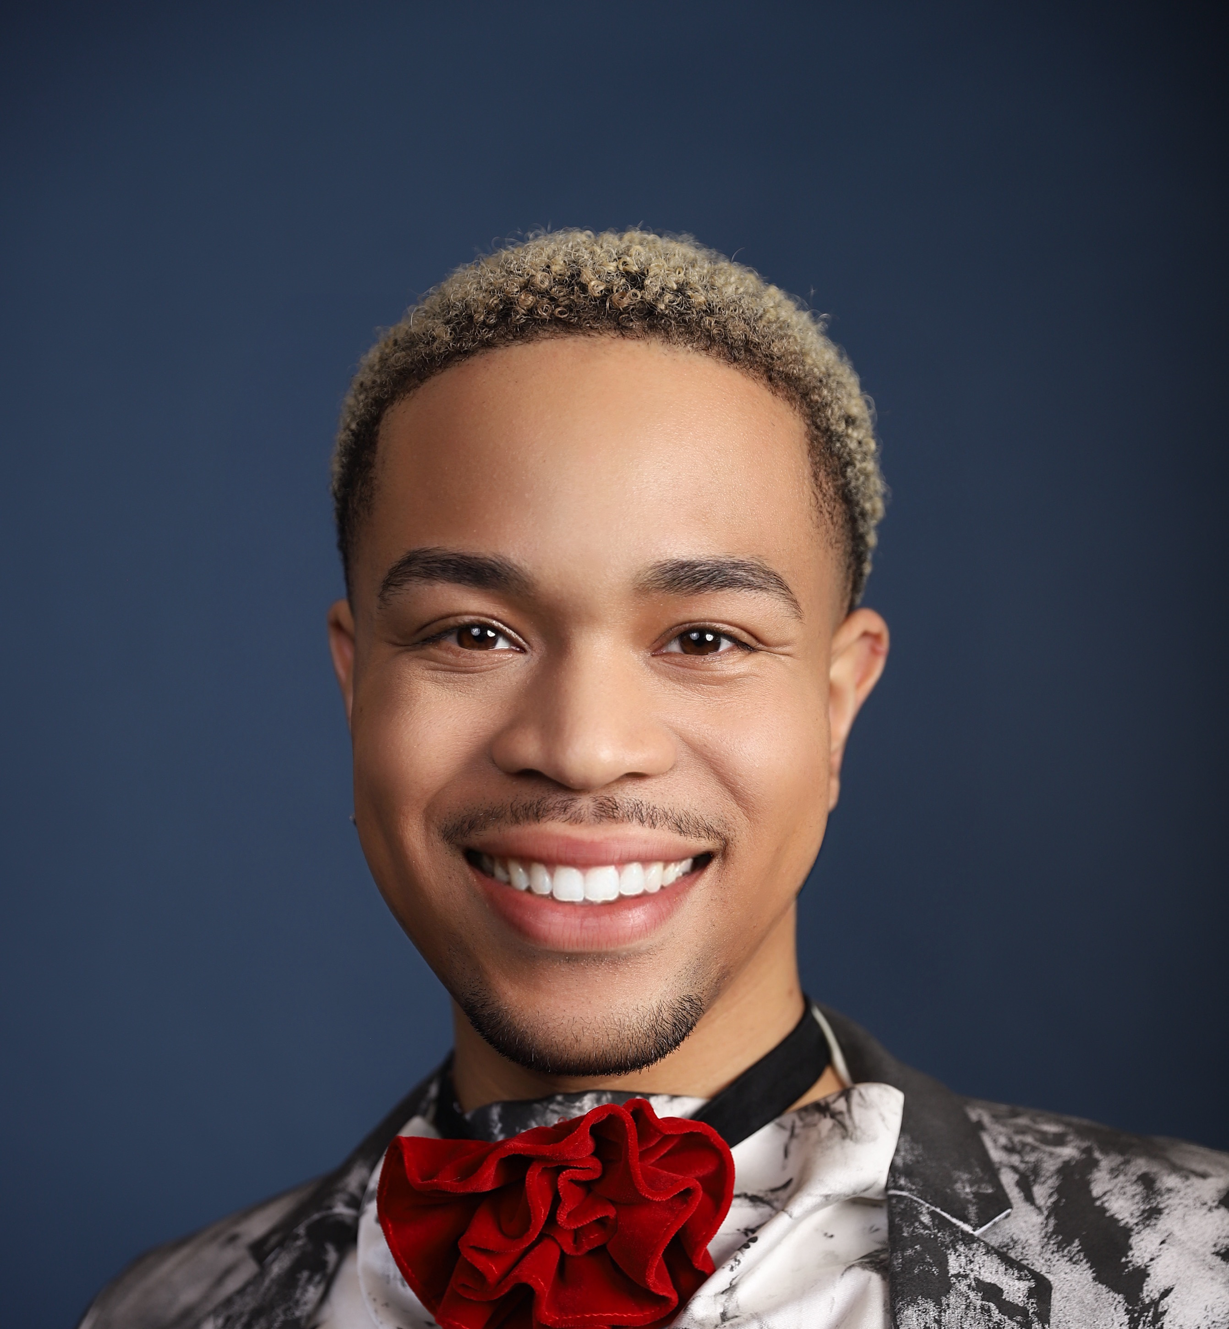
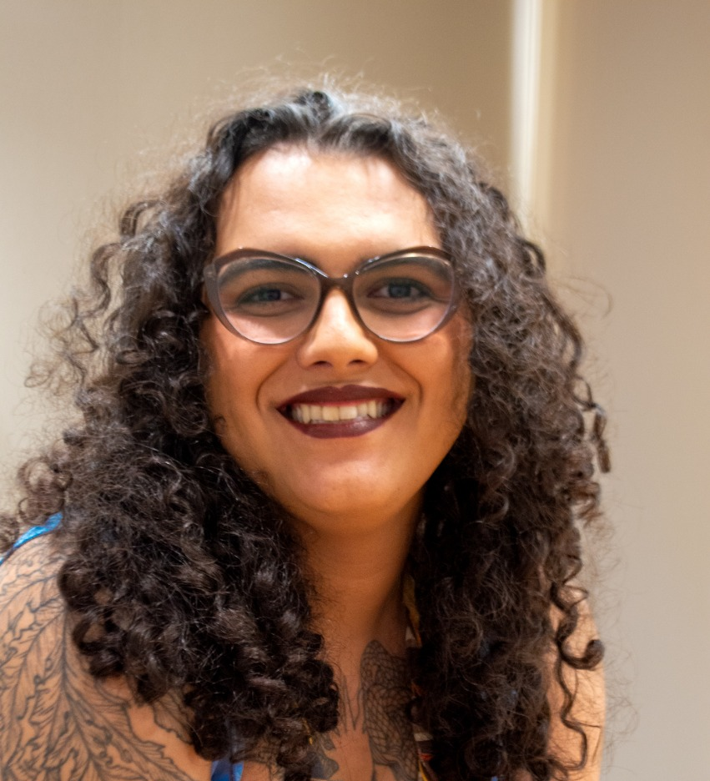
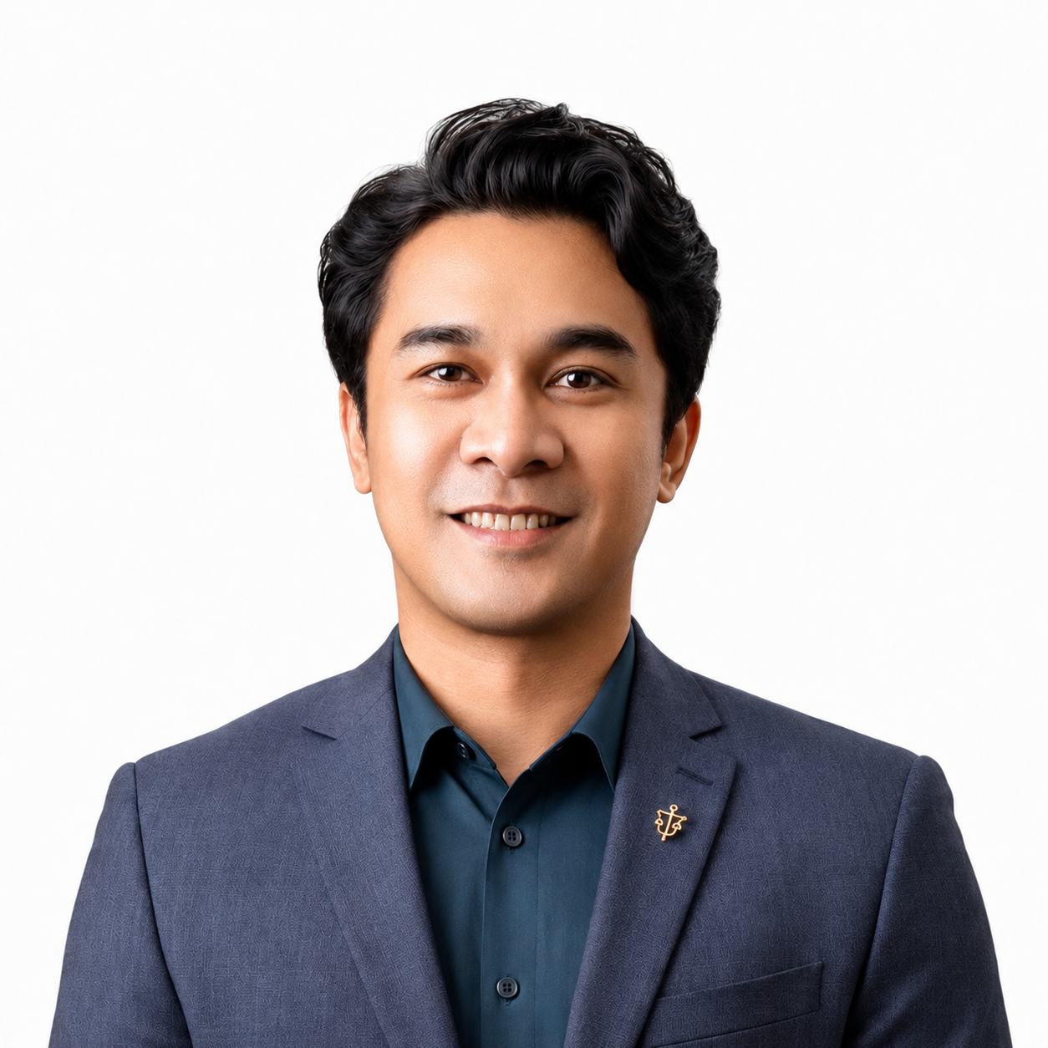
Q&A with speakers
Pank Sethi
Positive East
United Kingdom
Daisy Kwala
Bar Hostess Empowerment & Support Program
Kenya
Princess Jauan Durbin
Southern Legal Center for Youth, United States
Maria Felipe Medeiros
Instituto de Infectologia Emílio Ribas / Casa da Pesquisa CRT-SP
Brazil
Rodenie Olete
Sustained Health Initiatives of the Philippines (SHIP)
The Philippines

Slide 2
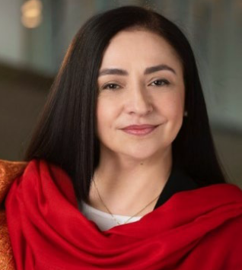
Tereza Kasaeva
World Health Organisation Switzerland

