Slide 1
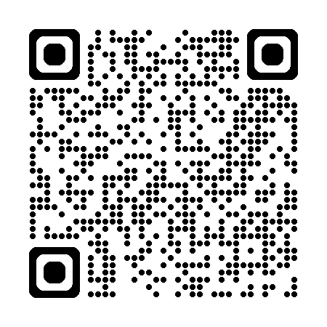
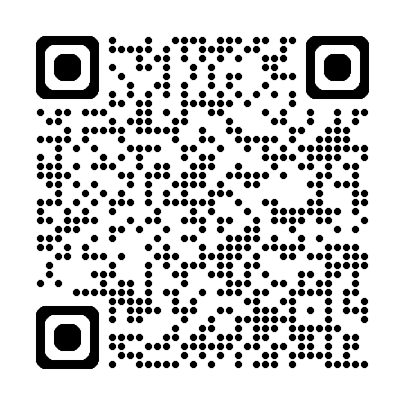
Stay in touch with the
IAS Person-Centred Care programme!
Join the PCC mailing list
Satellite tomorrow at 13:30 in room 103
“Person-centred HIV prevention for key and vulnerable populations in Latin America and the Caribbean”

