Slide 1
Person-centred HIV prevention for key and vulnerable populations in Latin America and the Caribbean

Slide 2





Organizers

Slide 3

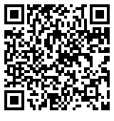
Translation for this session
Scan the QR code located at the entrance and around the session room
Select your preferred language, and
Click “Join”
Please use own headphones for the audio or read captions if you do not have headphones

Slide 4
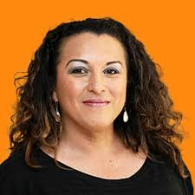
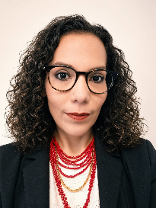
Moderators
Erika Castellanos
Global Action for Trans Equality (GATE), the Netherlands
Hortencia Peralta
Pan American Health Organization (PAHO/WHO), Nicaragua

Slide 5
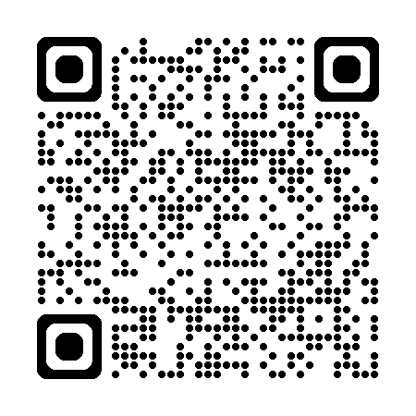
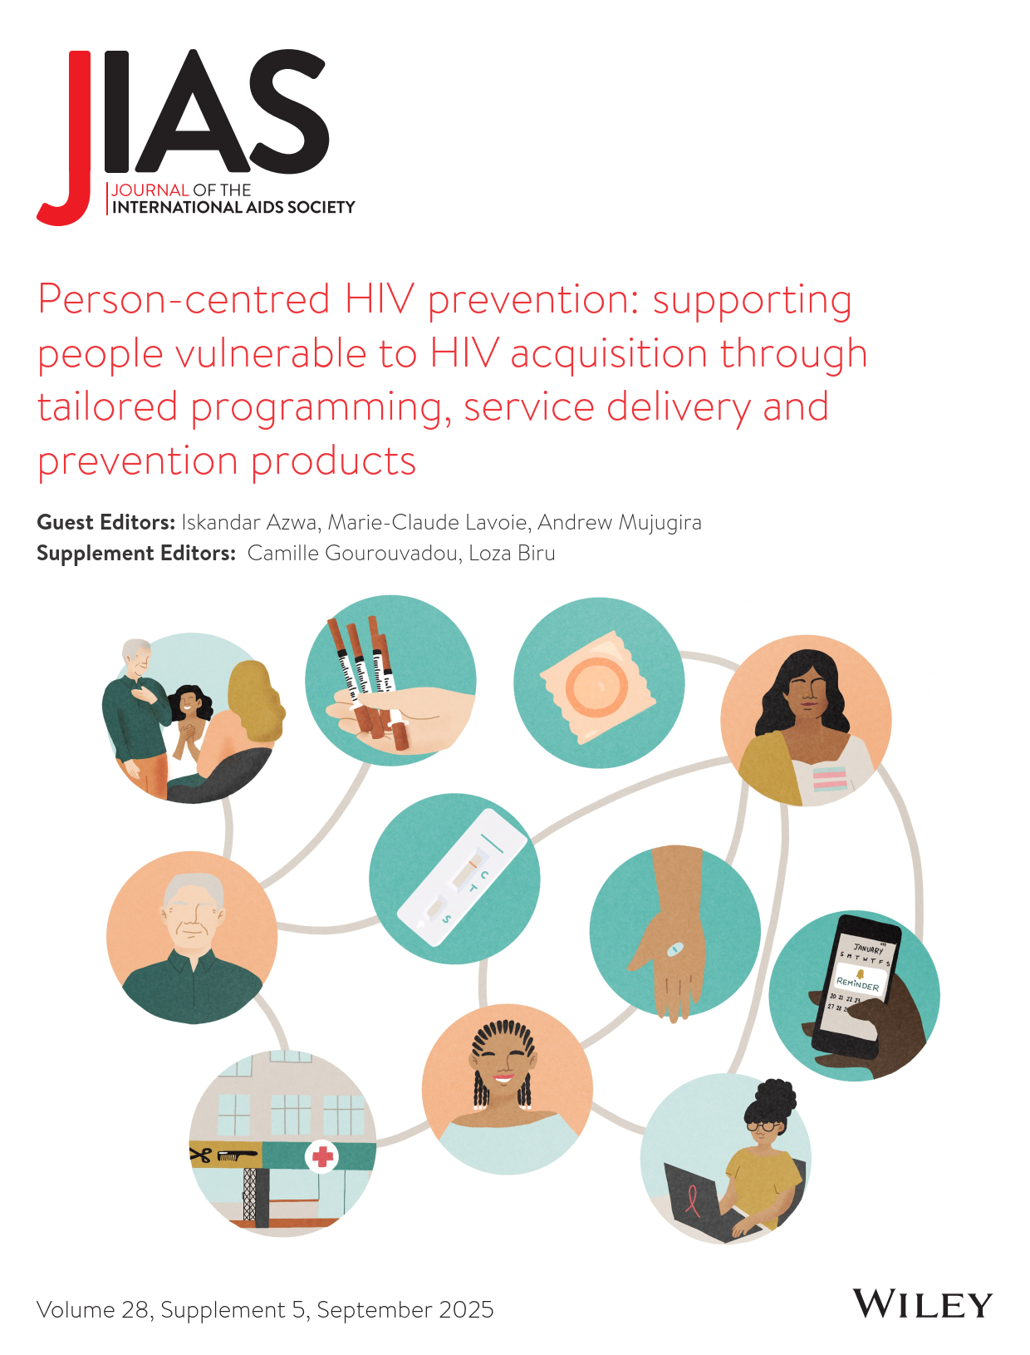
New evidence on person-centred HIV prevention
Strategies designed to overcome structural and health system barriers that impede access to HIV prevention services.
Good practice models to deliver appropriately integrated services beyond conventional health models to reach populations who infrequently seek HIV preventive services due to multi-level barriers, including stigma and discrimination, such as key populations and youth.
New technologies, including digital health solutions, data health systems and point-of-care testing.

Slide 6

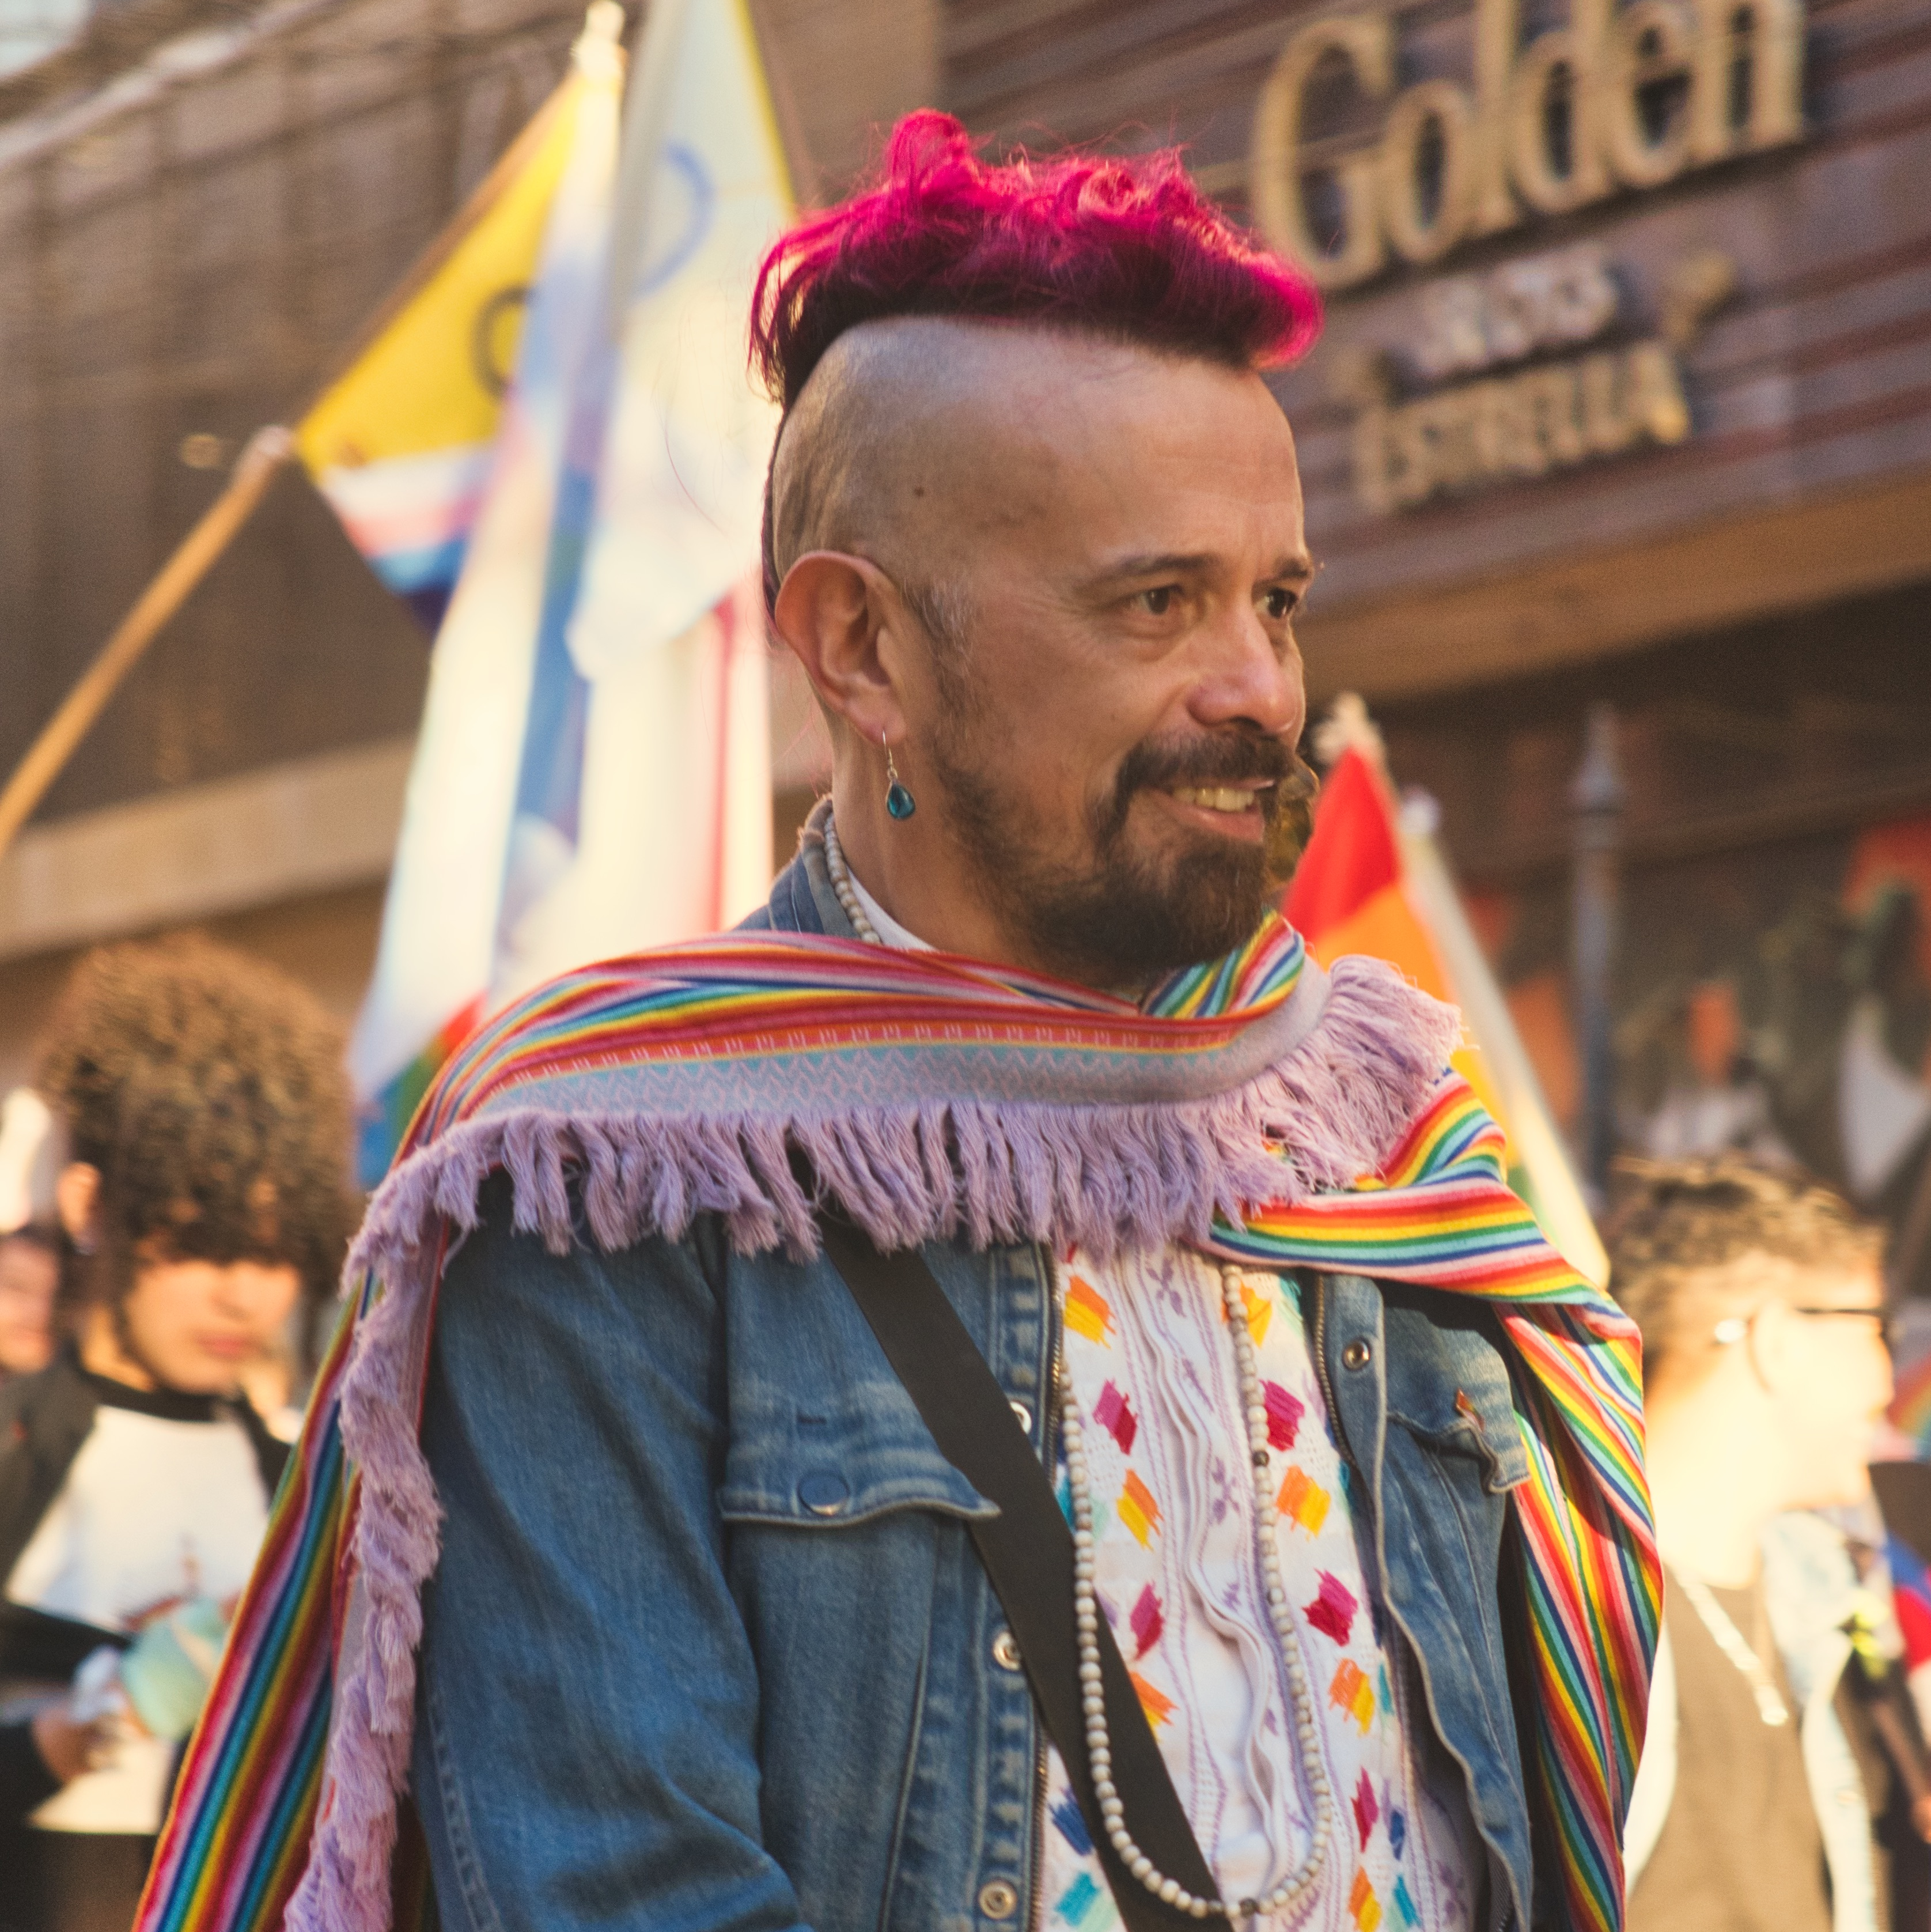
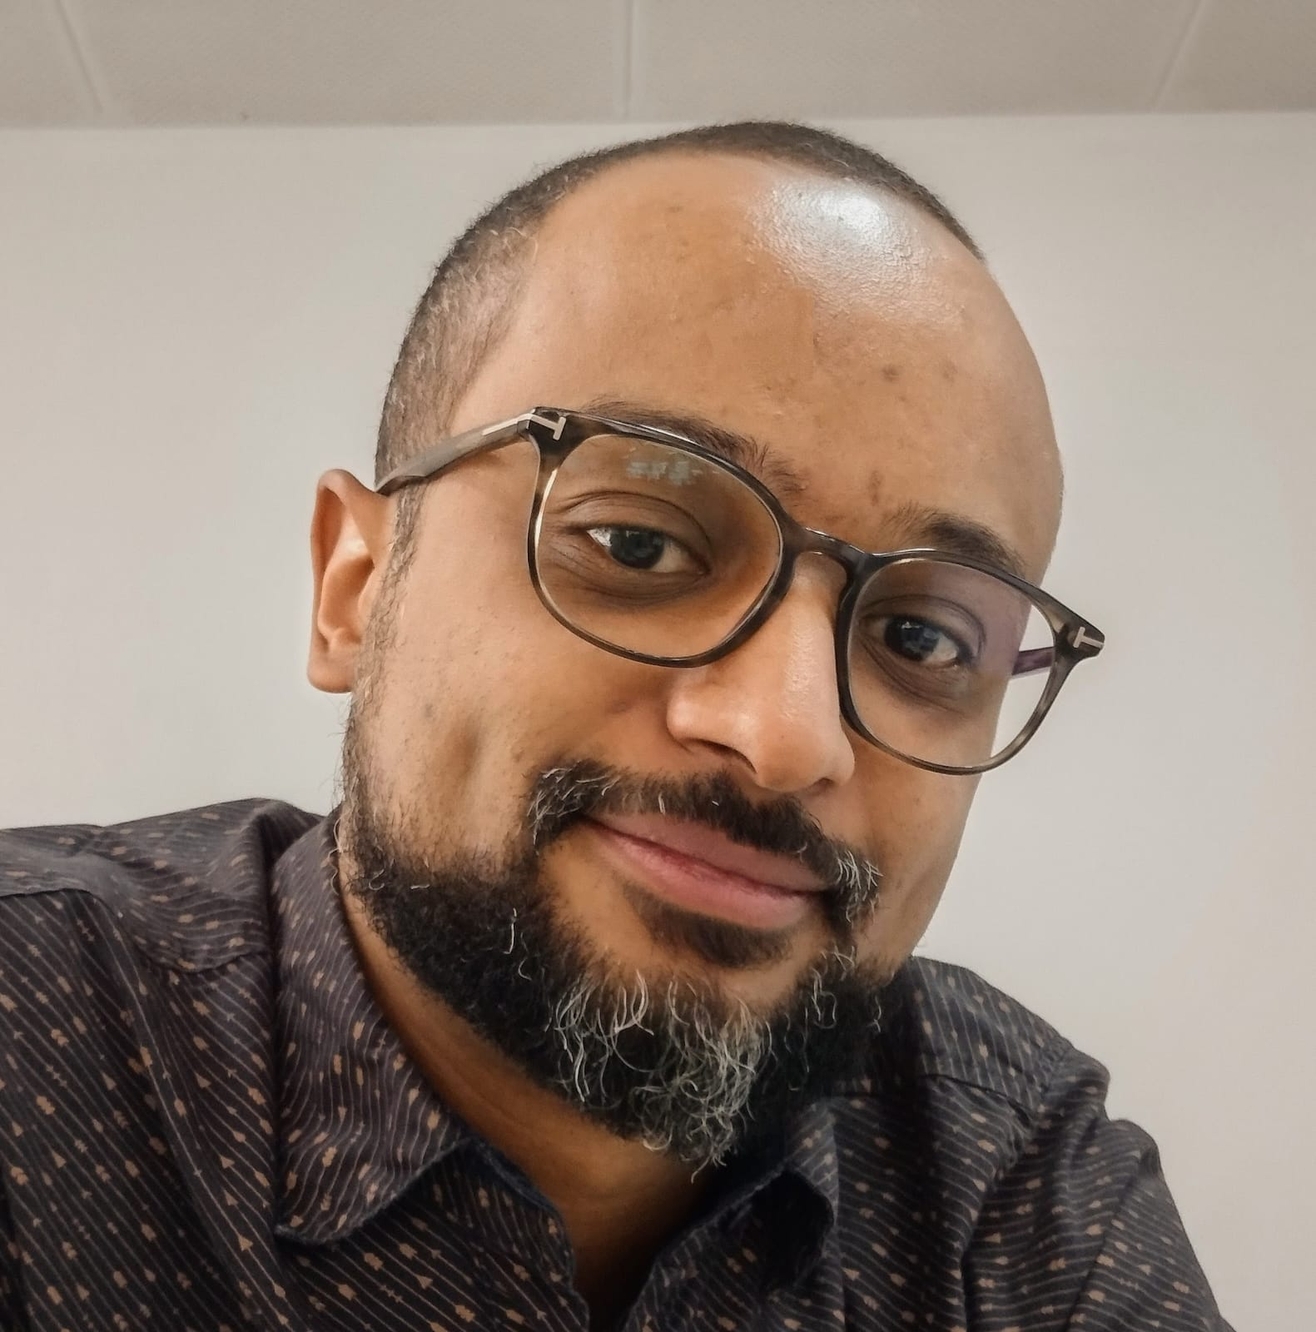
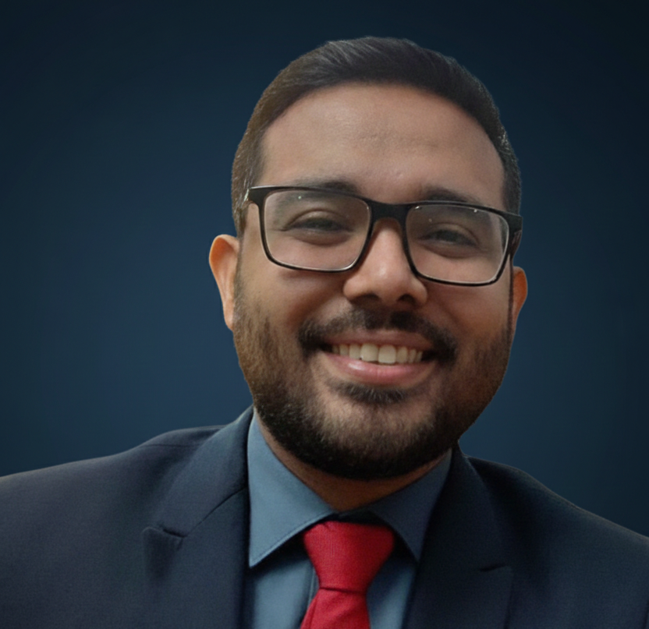
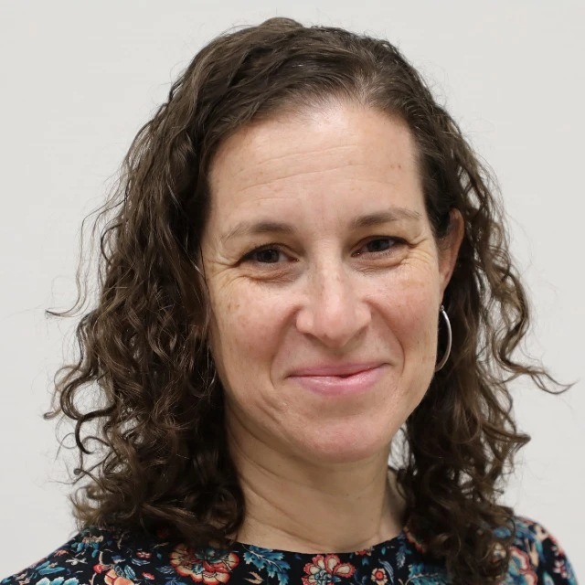
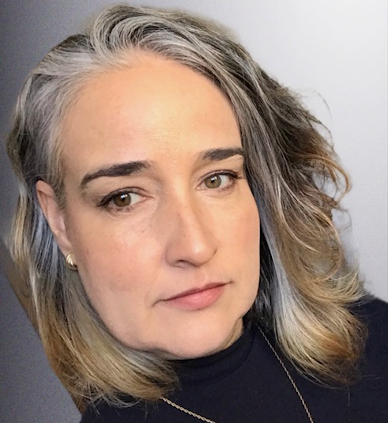
Speakers
Alexus D’Marco
United Caribbean Trans Network (UCTrans), The Bahamas
Simón Cazal
SomosGay, Paraguay
Adriano Queiroz Da Silva
São Paulo City Health Department, Brazil
Obed Jeovany Quiroz Murillo
PanAmerican Social Marketing Organization, Honduras
Valeria Fink
Fundación Huésped Argentina
Brenda Hoagland
Fundação Oswaldo Cruz, Brazil

