Slide 1
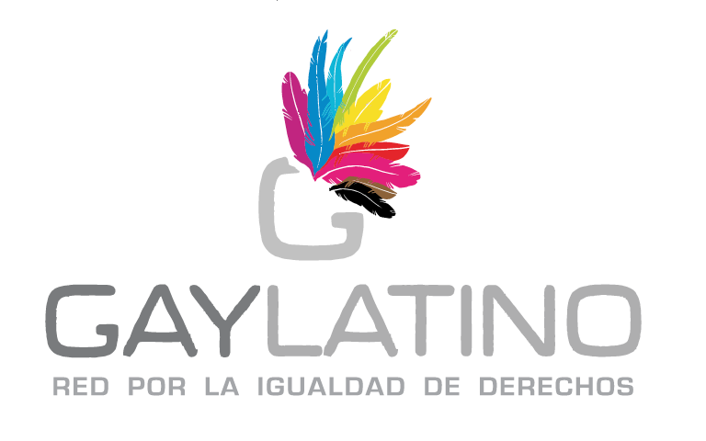
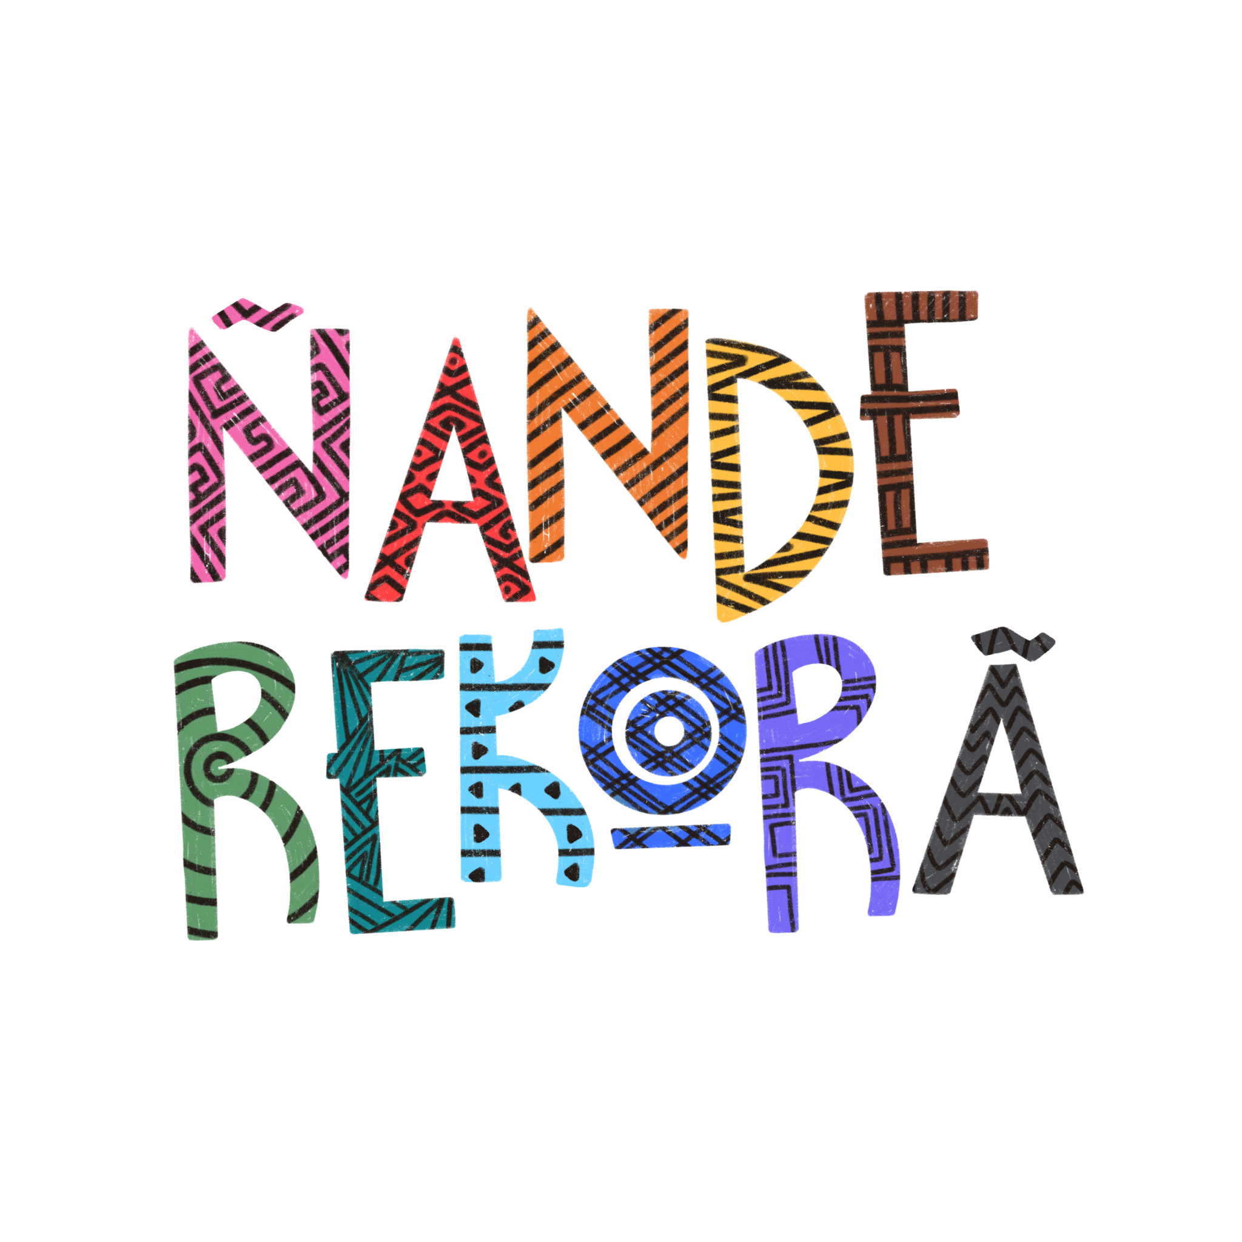
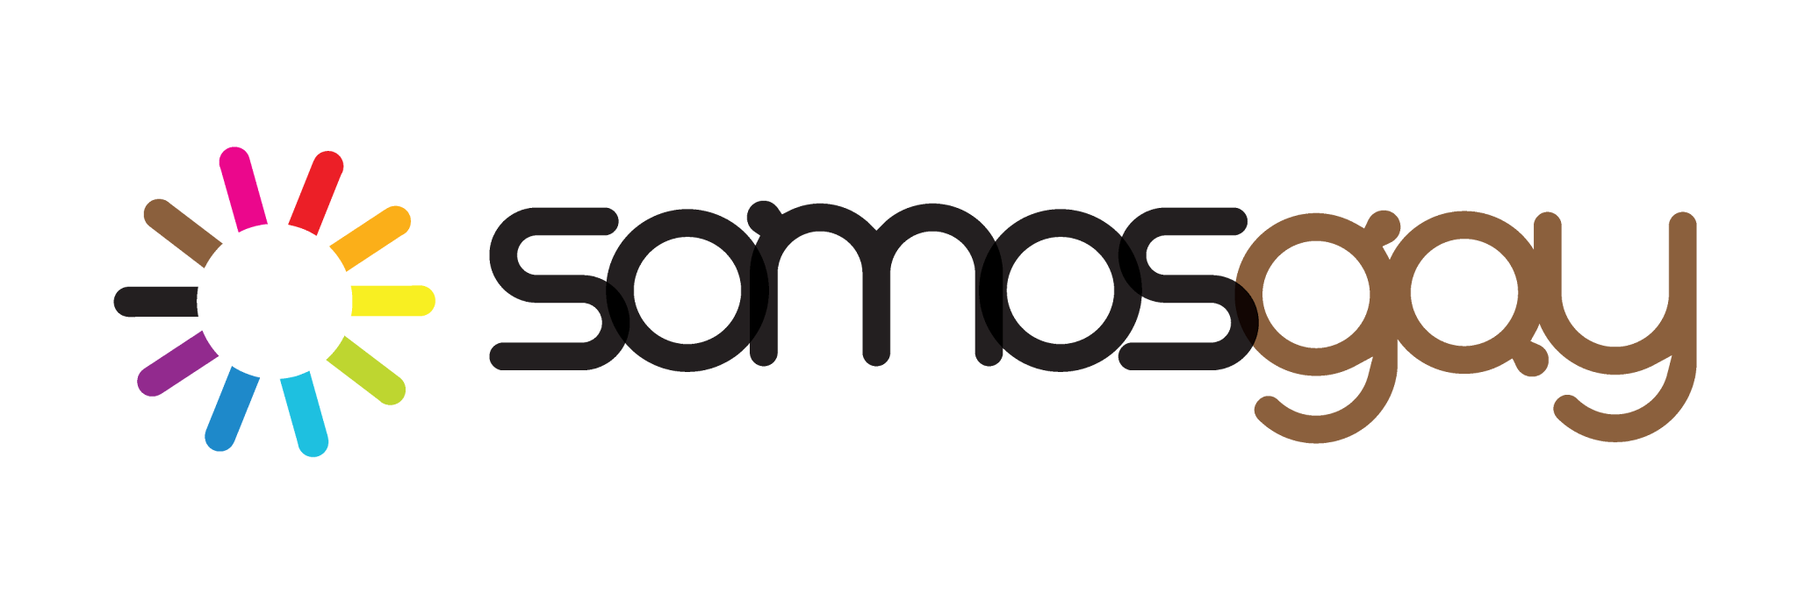
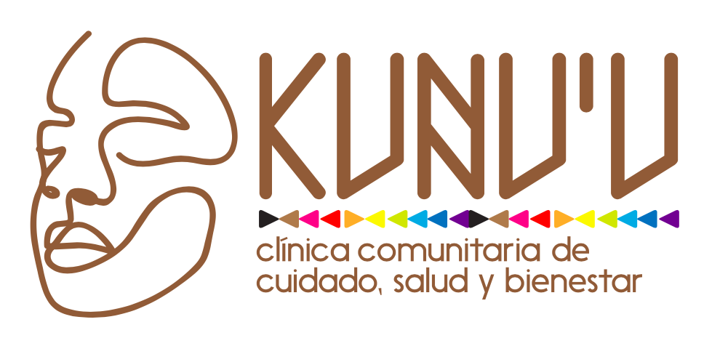
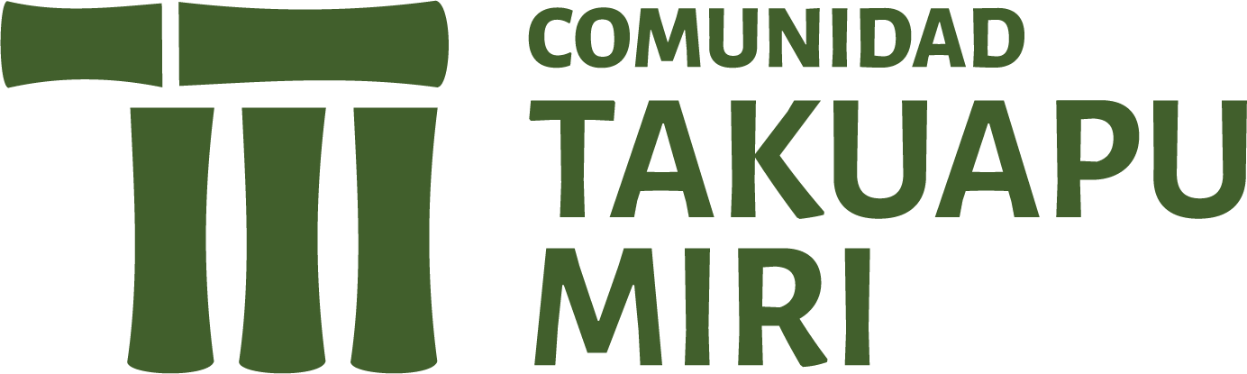
YRYVÔVÔ: THE GUARANÍ BRIDGE FOR REGENERATIVE COMMUNITY CARE
Simón Cazal Karai Poty, SOMOSGAY/GayLatino, Paraguay
Person-centred HIV prevention for key and vulnerable populations in Abya Yala/LAC

Slide 2
ABYA YALA/LAC: THE EPICENTRE OF INEQUALITY
The most unequal region in the world
- COVID-19 exposed fragile social protection systems
- Absence of comprehensive care at state level
- Systematic violence against LGBTI+ communities
Key Statistics:
- Trans women: Genocide in development
- LGBTI+ populations: Systemic exclusion from health systems
- Indigenous peoples: Continued pistemicide and dispossession
"We cannot talk about viral suppression without talking about housing, food security, mental health, and freedom from violence" GayLatino Strategy 2023-27

Slide 3
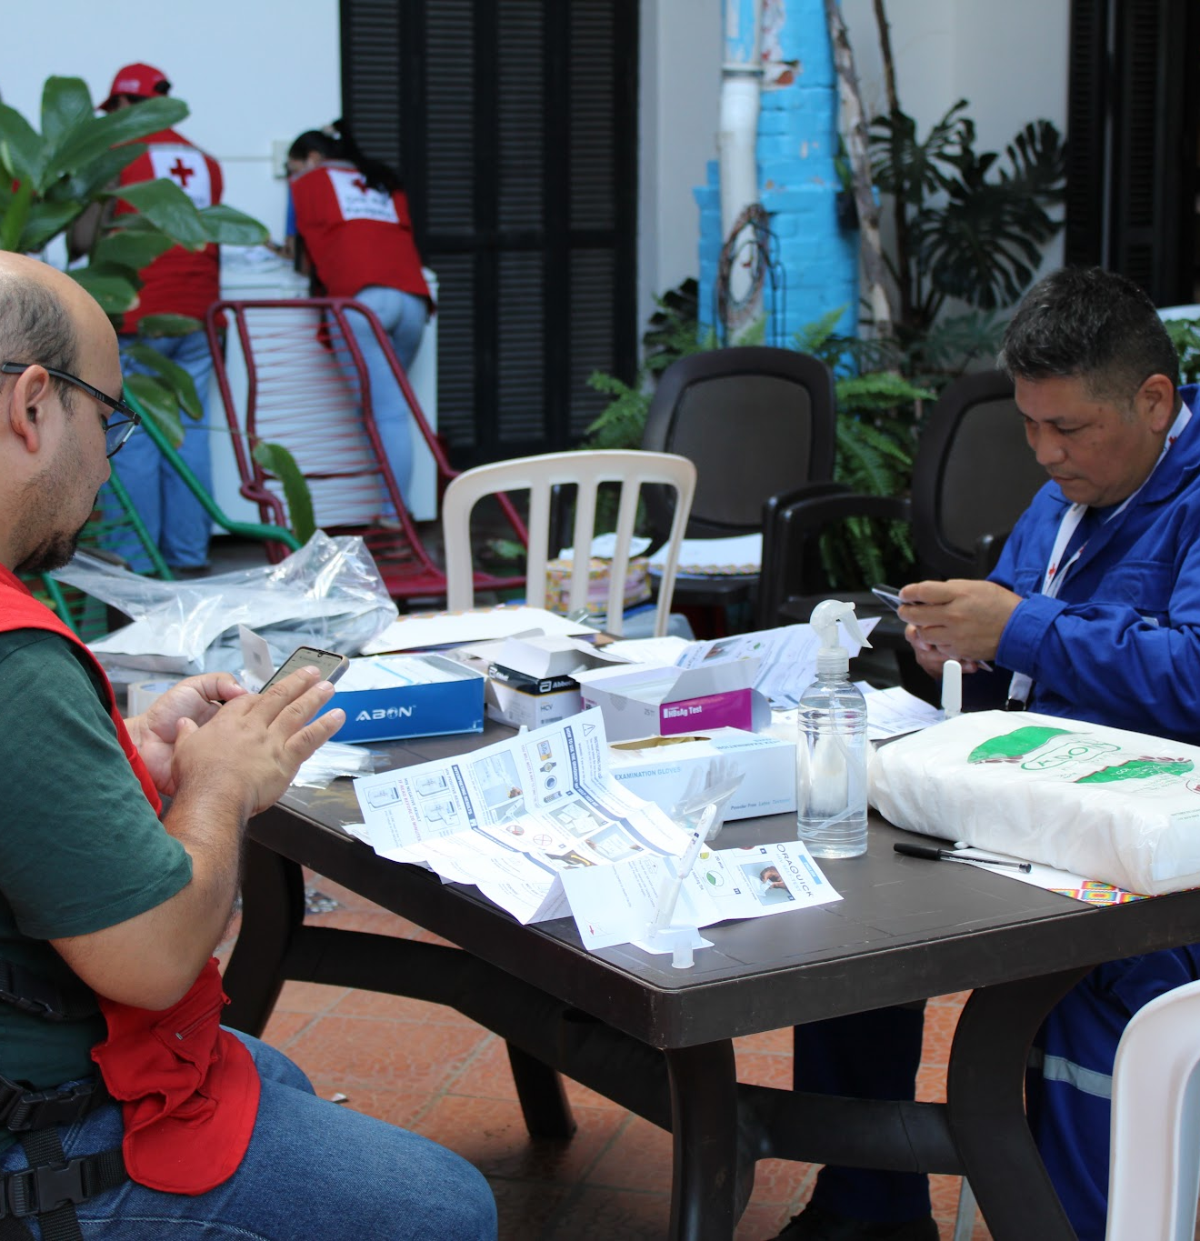
PARAGUAY: THE HIV CRISIS IN NUMBERS
A health system that fails the most vulnerable
- Over 22,000 people living with HIV
- At least 10% unaware of their status
- 74% of new cases among men and key populations
The Human Reality:
- Gay and bisexual men
- Trans people
- Sex workers
- People who use drugs
"The public health system is overstretched, underfunded, and operates within cultures of historical prejudice. It cannot reach the populations that need it most." Sergio López, SOMOSGAY 2025

Slide 4
THE DEEPER PROBLEM: THE EPISTEMIC GAP
Mainstream health interventions operate within a Western, biomedical framework that:
Key Concept:
Separates body from territory
Separates individual from community
Separates health from ecology
Treats Indigenous knowledge as folklore rather than science
Cuerpo-territorio has become both a concept and a methodology that circulates from Indigenous community feminisms. It forms part of their political proposals against capitalism, patriarchy, colonialism, and the violences of extractivism." — Astrid Ulloa (2024)
The health crisis cannot be solved within the epistemology that produced it

Slide 5
ENTER YRYVÔVÔ – THE GUARANÍ BRIDGE
Yryvôvô (Guaraní for "bridge") –
A living technology inherited from a civilization that has always understood the cosmos as a single, interconnected weave.
The Bridge Connects:
Guaraní ancestral wisdom ↔ Contemporary health policy
Logic of the forest ↔ Logic of the city
Dying paradigm of separation ↔ Fermenting paradigm of radical interdependence
Our Approach:
"We do not merely study Guaraní principles – we are guided by them. Our research, advocacy, and economic prototypes emerge directly from our cosmology." SOMOSGAY 2026
Pillar 1: TEKO PORÃ
The Good Life
Prosperity measured by watershed health, communal joy, biocultural diversity
Health measured by community well-being, not just clinical indicators
Pillar 2: MBORAYHU
Reciprocal Love
The economic law of the open hand
Care is a relationship, not a transaction
Peer support, mutual aid, gift economies
Pillar 3: ÑOMONGETA
The Long Conversation
Horizontal dialogue until consensus emerges
Patients are co-creators of their care plans
Restorative justice, not punishment
Pillar 4: YVY MARANE'Y
The Land Without Evil
A permanent migratory impulse toward a perfect state of being
Radical critique of every status quo
Motor for ceaseless transformation

Slide 6
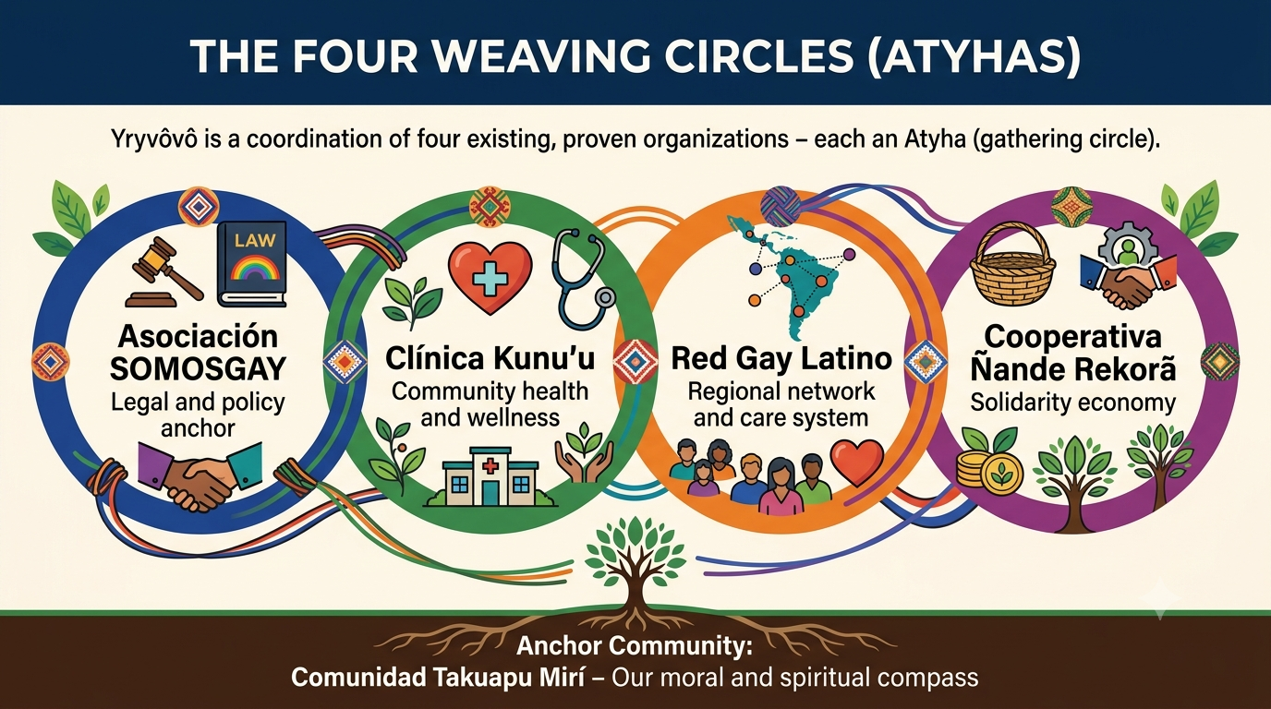
THE FOUR WEAVING CIRCLES (ATYHAS)

Slide 7
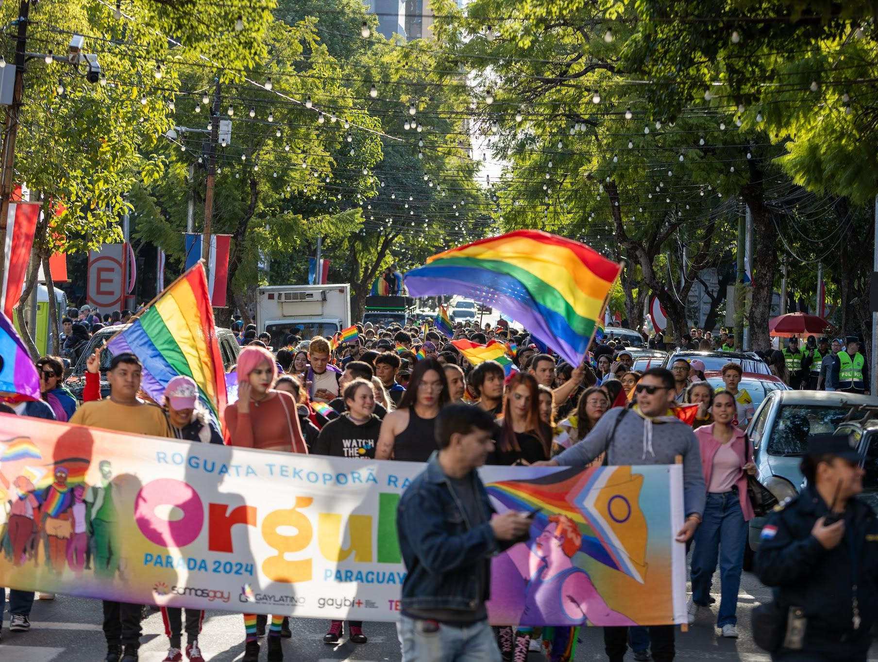
CIRCLE 1: SOMOSGAY
Legal and Policy Anchor
Founded in 2009 - Member of CONASIDA and the Country Coordination Mechanism
2026 Statutory Reform Codifies Guaraní Governance:
Council of the Word – Elders who hold ancestral wisdom and veto power
Council of Coordination Ñemongeta – Executive body operating by horizontal dialogue
Committee of Care and Reparation – Restorative justice, not punishment
Our Guaraní Lema: "Ñande Rete Porãjey Haguã" – "For our collective body to be beautiful and whole"
11 Program Framework: Ñande Rekorã – Operationalizing Guaraní principles across health, education, economy, and culture

Slide 8
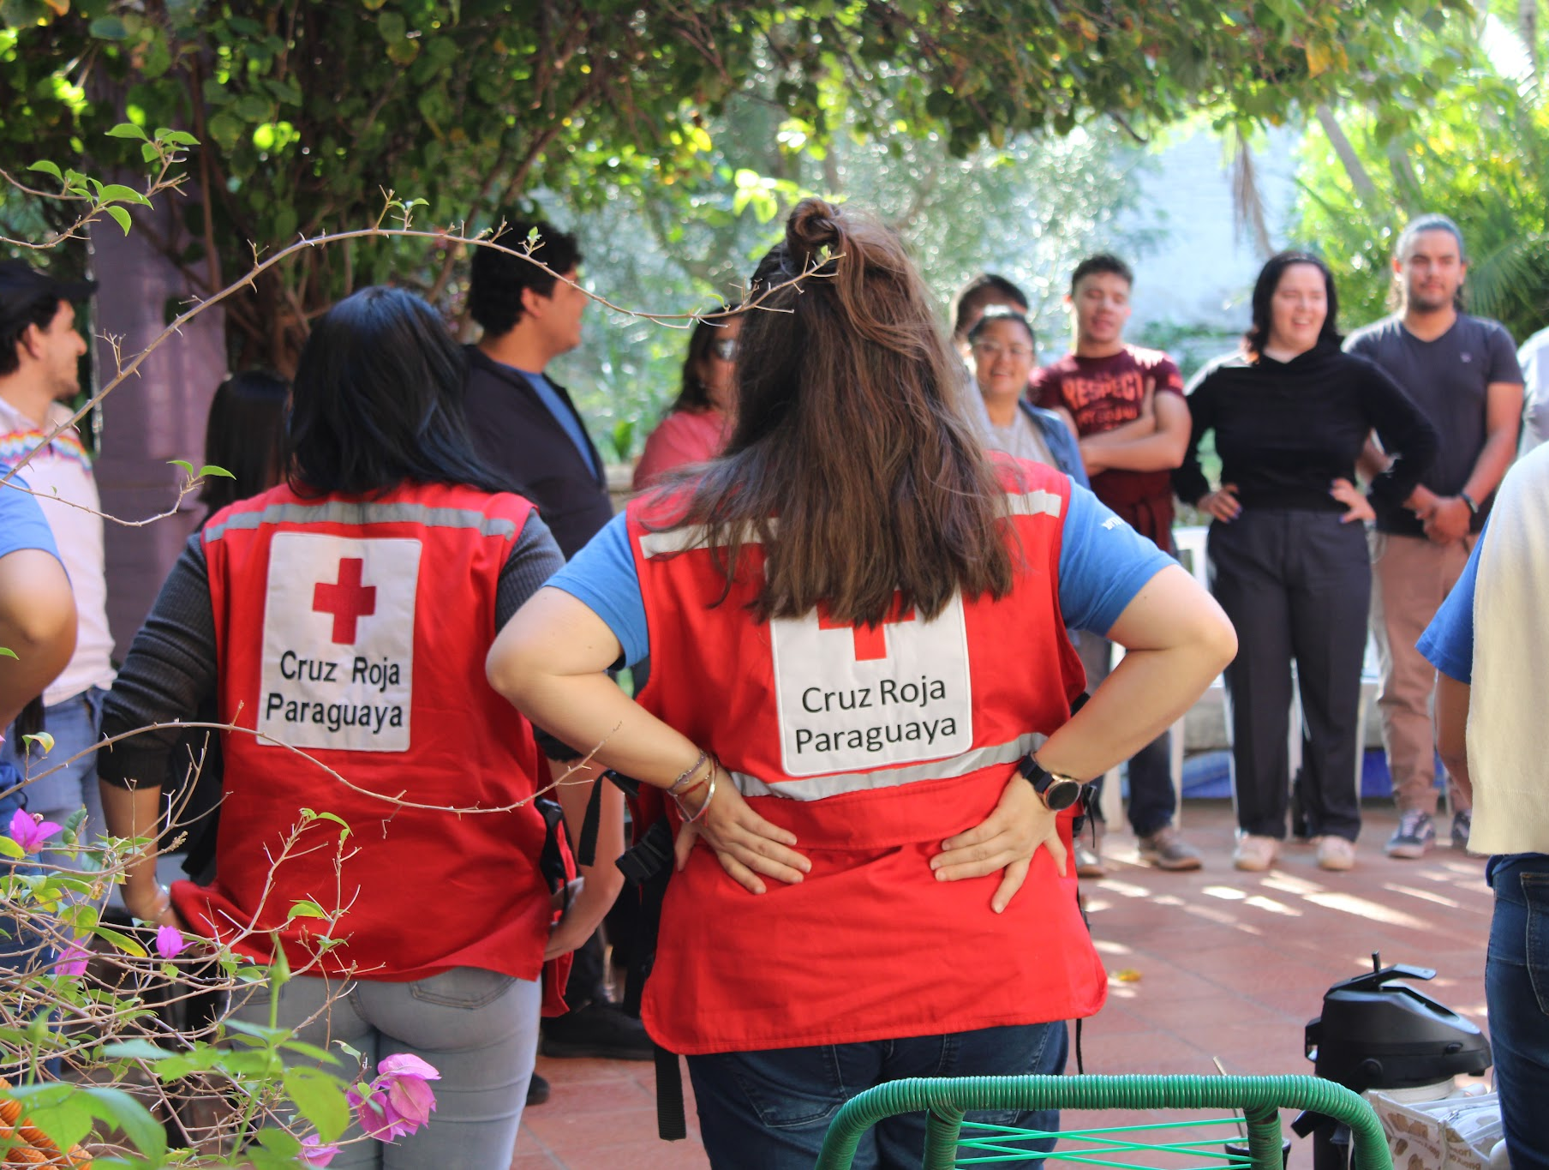
CIRCLE 2: CLÍNICA KUNU'U
Community Health and Wellness Centre
Founded in 2013 as Kuimba'e (change its name to "Kunu'u" Tenderness that germinates to be more inclusive)
What Makes Kunu'u Different:
HIV/STI testing, ART, mental health, transgender care, harm reduction, PrEP, PEP
Evenings and weekends – when the public system is closed
Over 22,000 patients served
Expanding: Own laboratory, pharmacy, mobile clinic
Core Values:
Trust, respect, and dignity
A place where LGBTI+ and Guaraní people can be themselves without fear
Stigma-free care protocols co-designed with communities
"Kunu'u is not just a clinic. It is a space of trust, respect, and dignity." Gabriel Grommeck, Executive Director

Slide 9
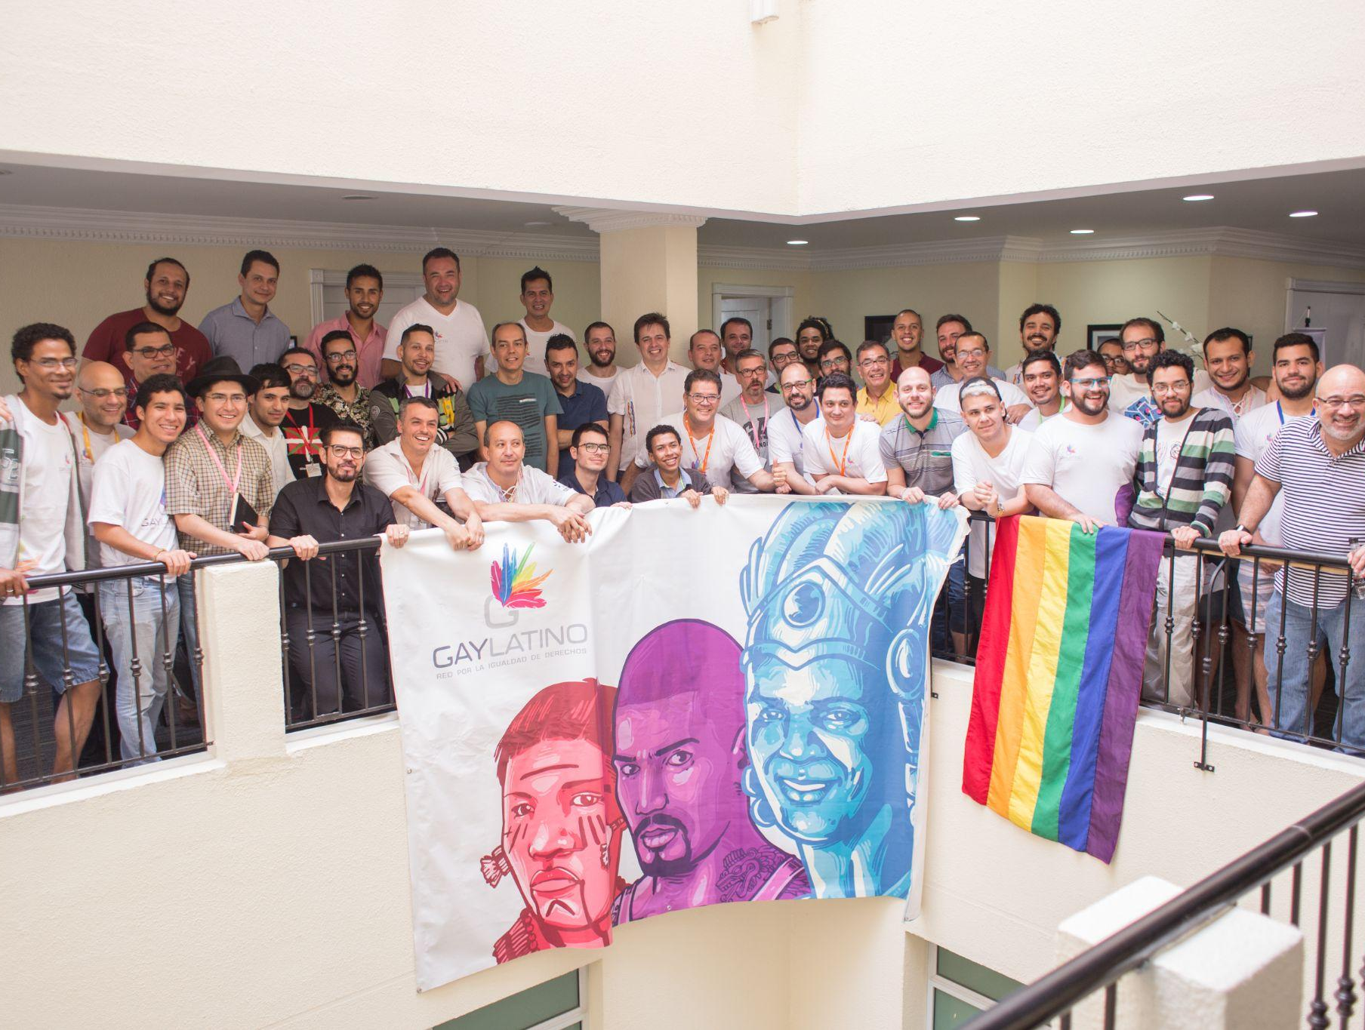
CIRCLE 3: RED GAY LATINO
Regional Network and Care System
Founded in 1997 as ASICAL. Change its name in 2015. Active in 15+ countries across Abya Yala/LAC
13-Program Care and Repair System:
Community health and wellness
Education and popular pedagogy
Housing cooperatives
Community transport
Legal defence and strategic litigation
Economic solidarity and fair trade
2023-27 Strategy:
Community-based monitoring
Participatory research
Coordinated advocacy
Core Belief
"The solutions to our poli-crises must come from the communities themselves." Gay Latino Strategy 2023-27

Slide 10
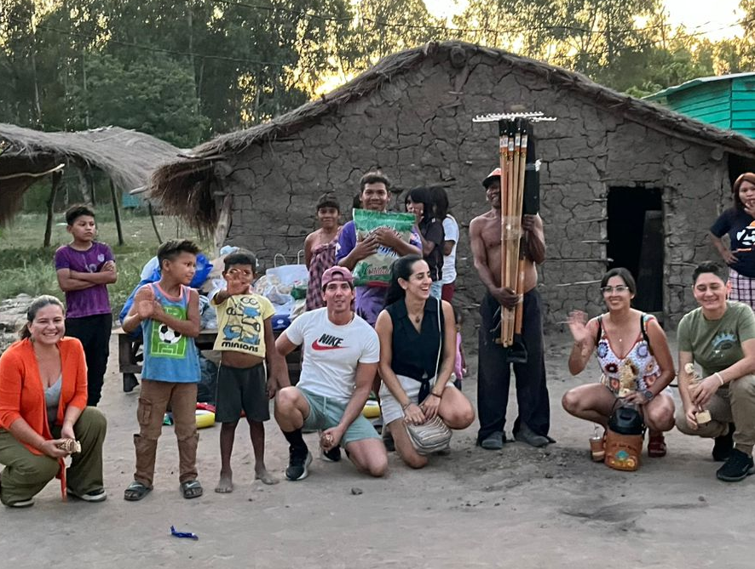
CIRCLE 4: ÑANDE REKORÃ COOP & TAKUAPU MIRÍ VILLAGE
Solidarity Economy & Anchor Community
Cooperativa Ñande Rekorã (Founded 2025):
Solidarity economic arm
Self-managed employment in care, research, education, restoration
Preferred operator for fair trade, community transport, food programs
Comunidad Takuapu Mirí (Villeta, Paraguay):
Anchor community – living reservoir of Guaraní language, sacred chants, agricultural and medicinal cycles, spiritual practices and traditional healing.
Co-authors of our research agenda
First testing ground for our prototypes
Moral and spiritual compass
Key Principle:
“The Council of the Word, which includes Takuapu Mirí elders, holds absolute veto power over any research output that distorts or commodifies Guaraní knowledge." Gary Galván, President of Ñanderekorâ Cooperative

Slide 11
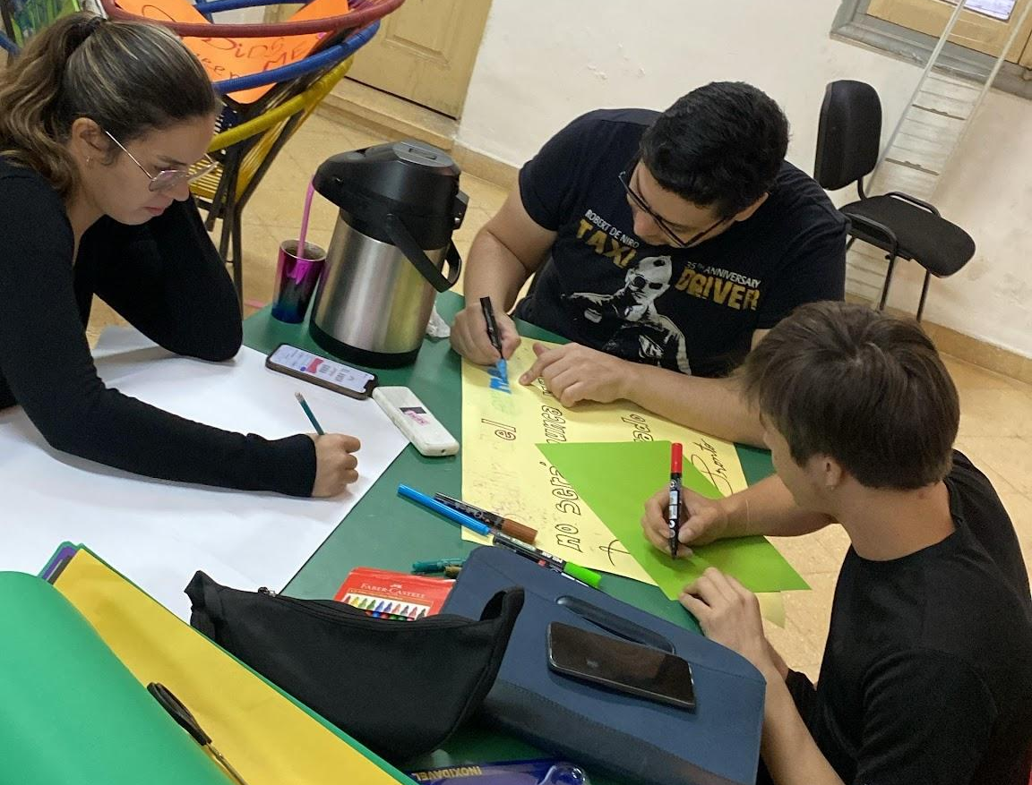
INTEGRATED INNOVATION IN ACTION
Scientific/Technological Innovation:
Mobile clinics with point-of-care diagnostics (HIV, dengue, malaria, NCDs)
Integrated digital health records
Nande Reko Index – Biocentric health metric
Social Innovation:
Ñomongeta deliberative health councils
Peer health navigators
Stigma-free care protocols
Restorative justice for health grievances
Business Innovation:
Cross-subsidization: 30% of commercial revenues fund free care
Solidarity economy cooperatives
Ethical knowledge services (consulting fees subsidize community services)

Slide 12
THE BRIDGE TO THE FUTURE
Pathway to Scale and Sustainability
Our 3-Year Vision:
Scale to 10 communities across Paraguay
Reach over 10,000 vulnerable individuals
Integrate Ñande Reko Index into national health monitoring
Train 120 "Bridge Weavers" (community health workers)
Influence regional policy through 15-country network
Generate global evidence for climate-resilient, community-led health systems
Sustainability Model:
Ethical Knowledge Services (50%)
  Advising governments and impact funds on operationalizing the Ñande Reko Index
Commons-Based Licensing (20%)
  Open-source tools with paid certification for enterprises meeting regenerative standards
Philanthropic Alignment (30%)
  Partnerships with donors committed to innovate in community healthcare
“The bridge is already built. It is anchored in the soil of Takuapu Mirí”
Karai Eustaciano, Takuapu Mirî’s Leader

Slide 13
Che Aguijevete!
(May the full well-being be with you, and with the land that still remembers being forest)– and with every body that, in caring for itself, cares for the territory
contacts:simon@redgaylatino.org
Web: www.redgaylatino.org - www.somosgay.org

