Slide 1
Investing in the integration of HIV prevention into daily life in São Paulo, Brazil
Adriano Queiroz da Silva, São Paulo City Health Department, Brazil
Person-centred HIV prevention for key and vulnerable populations in Latin America and the Caribbean

Slide 2
Conflict of interest disclosure
I, Adriano Queiroz da Silva, declare that I have no conflict of interest for this presentation.

Slide 3
Regional context
São Paulo is the largest city in Brazil, with approximately 12 million inhabitants
Challenges:
Concentrated epidemic among populations in contexts of greater vulnerability
Expansion of prevention to populations that have less connection with healthcare services and lower adherence to prevention methods

Slide 4
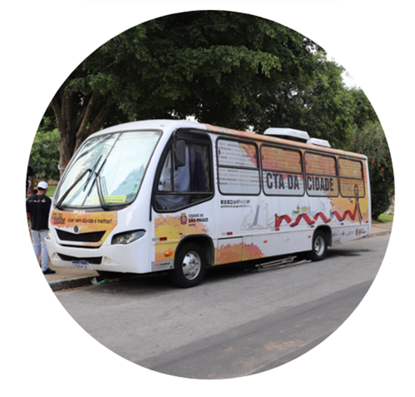
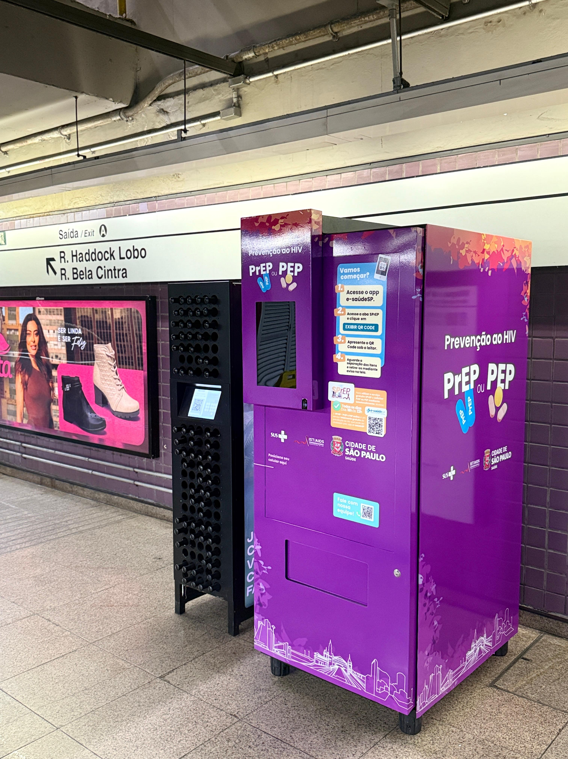
Services and strategies
10 testing and counseling centres (CTA):
  1 mobile CTA in the city
17 specialized care services (SAE)
1 prevention station – Jorge Beloqui
SPrEP – PrEP and PEP online:
  PrEP, PEP and ART dispensing machines
  24-hour pharmacies for medication pickup

Slide 5
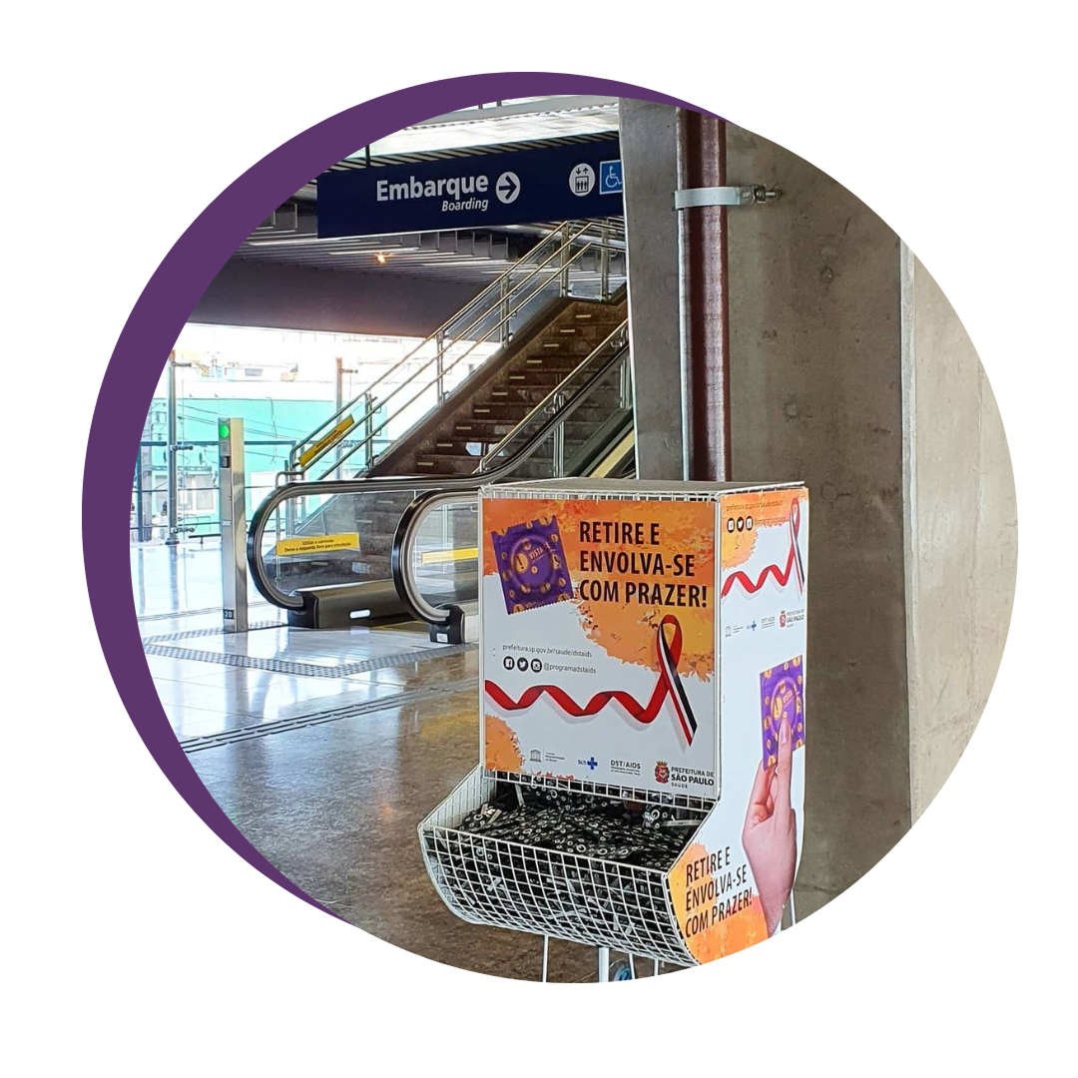
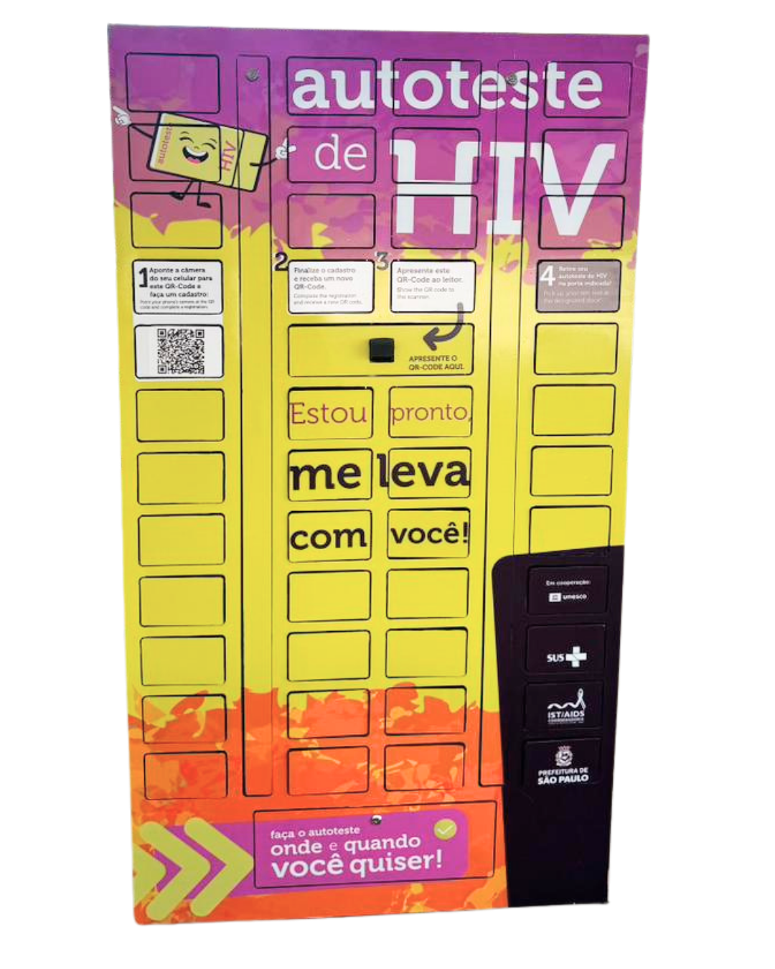
Community outreach activities
4 mobile units
5 automated self-test lockers
90 prevention supplies dispenser at subway stations and bus terminals

Slide 6
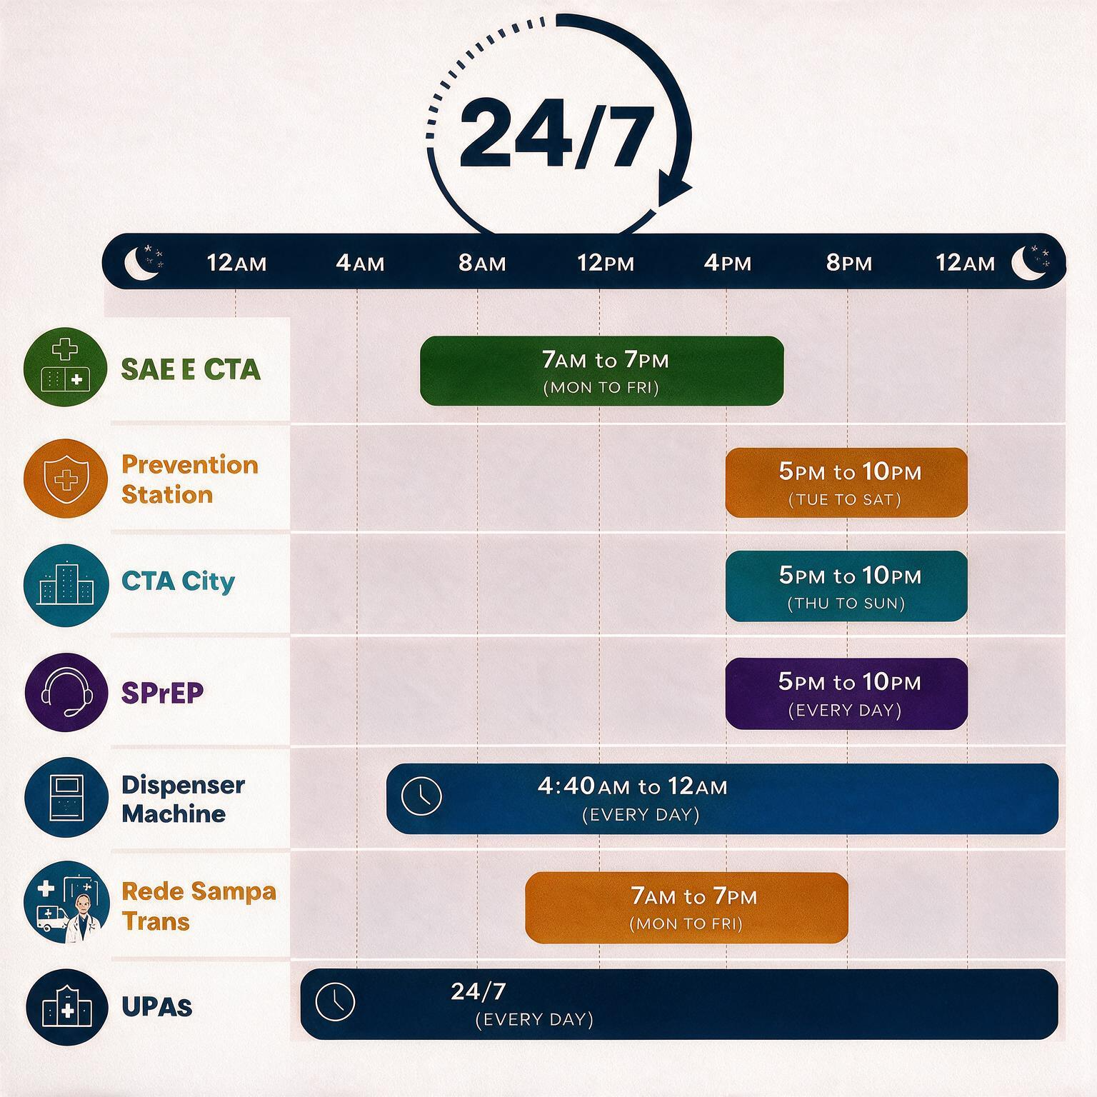
24-hour access to PrEP and PEP
PrEP
67 health units that prescribe PrEP
89 PrEP pickup points, including 17 24-hour health units and 5 dispensing machines
PEP
116 health units that prescribe
Plus 5 machines for PEP pickup
The SAEs and CTAs carry out extramural actions offering rapid testing for HIV and other STIs, as well as same-day enrollment and dispensing of PrEP.

Slide 7
Testing and prescription professionals
Who can prescribe
PrEP and PEP
Physicians
Nurses
Pharmacists
Dentists
Who can prescribe antiretroviral therapy
Physicians
Nurses (standard initial prescription)
Who can test
Physicians
Nurses
Pharmacists
Dentists
Nutritionists
Occupational therapists
Psychologists
Speech therapists
Nursing assistants and technicians (Cannot certify test results)
Currently, PrEP users and people living with HIV on ART are receiving WhatsApp reminders to help reduce treatment interruption.

Slide 8
PrEP in the community
How?
Territory mapping carried out by professionals and peer educators
Relationship building with party organizers, movement leaders, NGOs and collectives
Rapid tests for HIV, syphilis, hepatitis B and hepatitis C
PrEP
PEP
Initiation of antiretroviral treatment
HIV self-tests
Internal and external condoms
Lubricating gel in sachets or tubes
Guidance on prevention
Where?
Parties, bars, sex worker venues, saunas and sex cinemas, subway stations and bus terminals, NGOs, Afro-Brazilian religious houses, public social assistance facilities.
Using the local partners' own infrastructure, tents or mobile units adapted for this type of service.

Slide 9
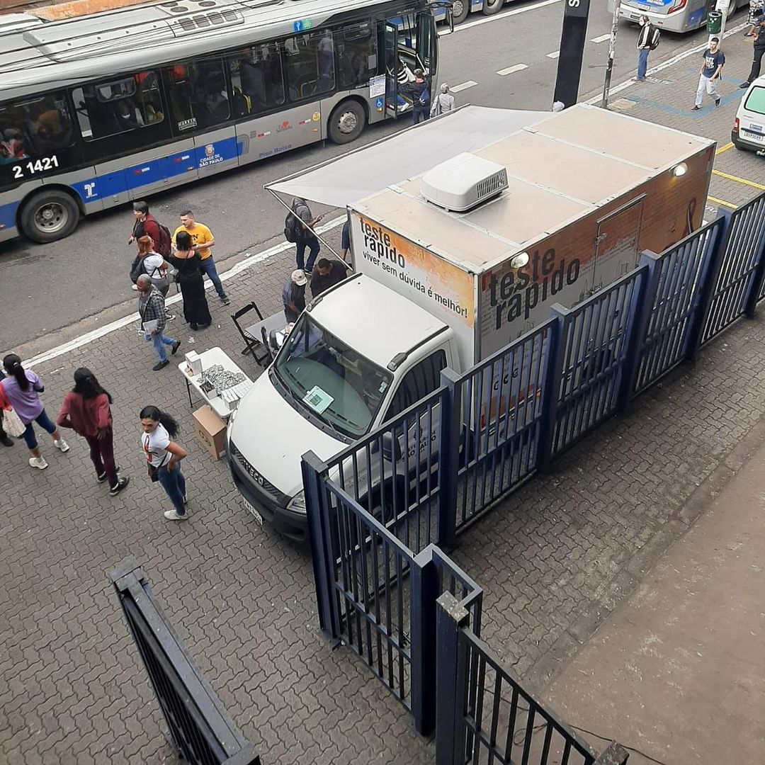
Extramural activities
3,400 activities since 2022
218,000 rapid tests for HIV, syphilis,
hepatitis B and C
Over 9,300 new PrEP enrollments
Over 1,800 PEP courses dispensed
Over 84,000 HIV self-tests distributed
Highest percentage of PrEP consultations at sex parties
Over 50% PrEP continuity rate in sex work venues
A health mobile unit offering rapid testing, PrEP, PEP, HIV self-tests, condoms, and lubricants close to a subway station. São Paulo, 2024.

Slide 10
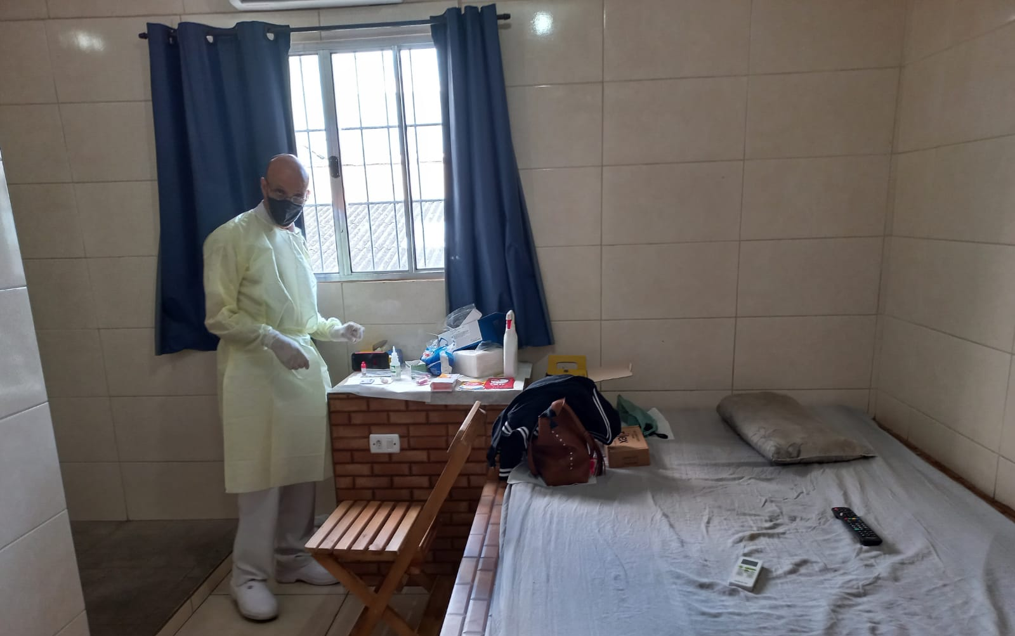
Extramural activities
Over 50% PrEP continuity rate in sex work venues
A nurse using a room inside a sex worker's house to offer rapid testing, PrEP, PEP, HIV self-tests, condoms, and lubricants. São Paulo, 2025.
Source: STI/Aids Coordination, São Paulo City Health Department

Slide 11
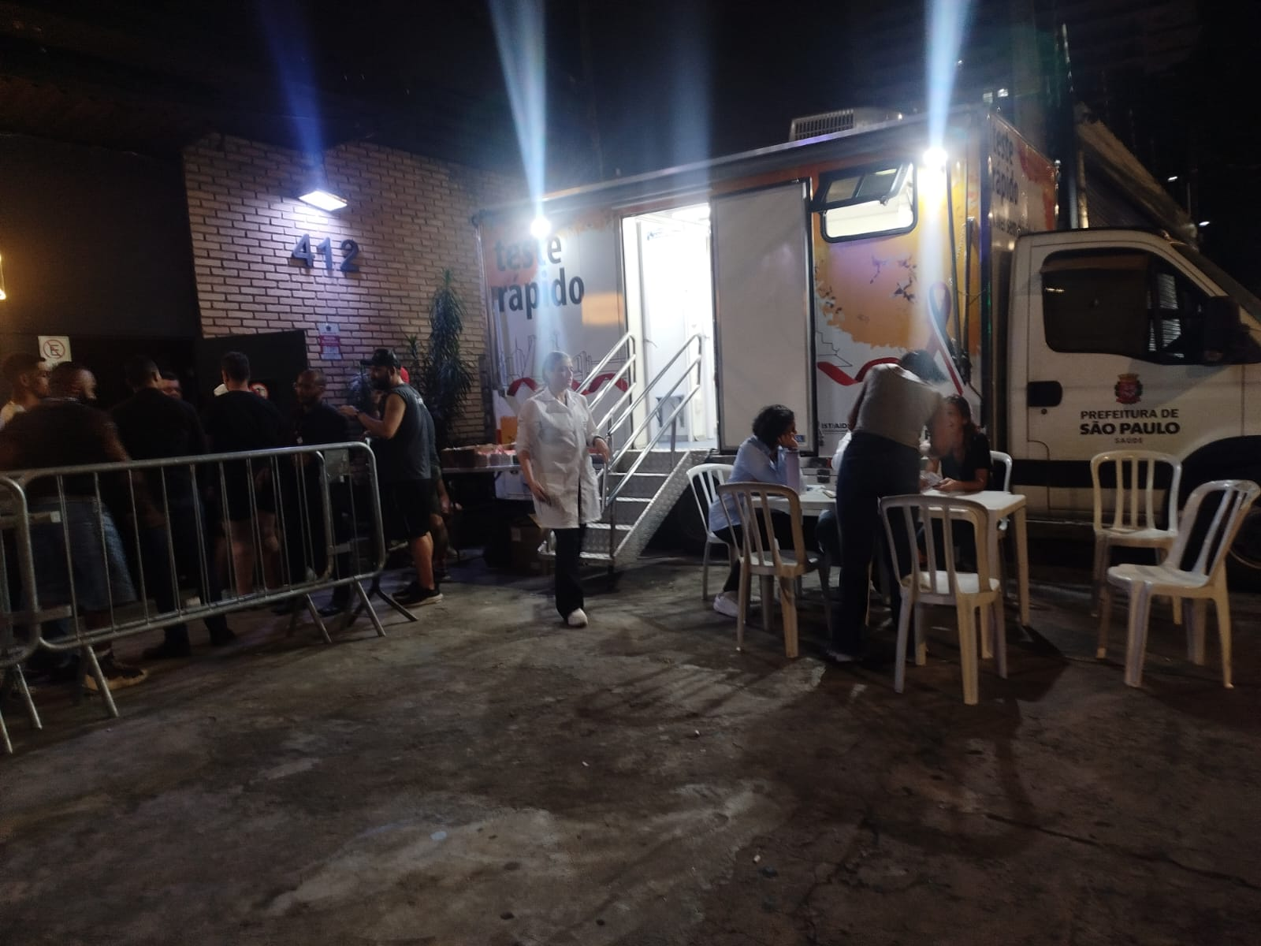
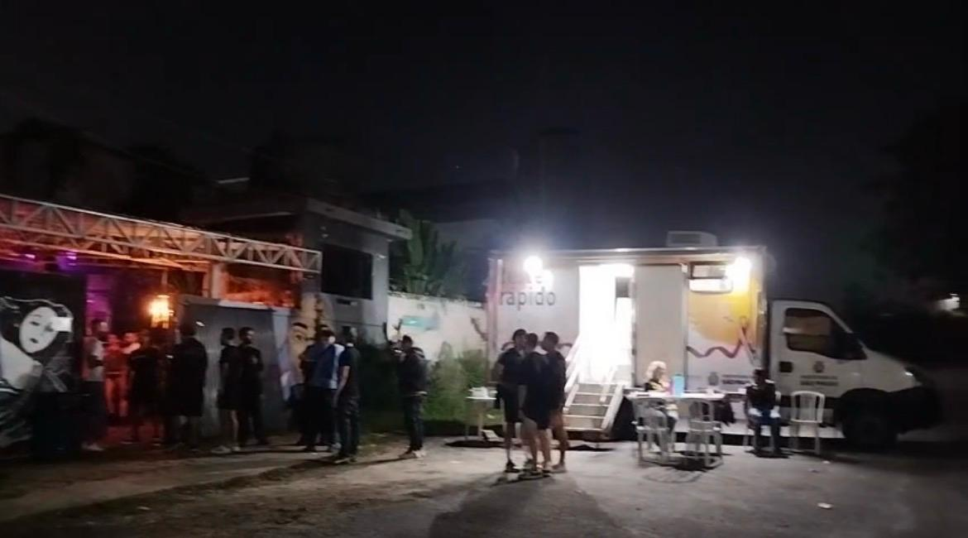
Extramural activities
80% of HIV rapid test done at sex parties result in PrEP initiation
Extramural actions in two sex parties (F*CK and Apt 1205) to offer rapid testing, PrEP, PEP, HIV self-tests, condoms, and lubricants. São Paulo, 2026.
Source: STI/Aids Coordination, São Paulo City Health Department

Slide 12
Results
The integration of services and strategies created with the aim of reducing barriers and expanding access has contributed to the reduction of new HIV acquisitions and increased the population's knowledge regarding combination prevention.
Approx. 88,000 PrEP enrollments since 2018.
Over 21,500 consultations at SPrEP – PrEP and PEP online.
More than 14,000 pickups at dispensing machines.
Over 206,000 PEP courses have been dispensed since 2018.
Around 50 million condoms distributed in 2025.
Test and Treat: approximately 95% of people diagnosed with HIV receive treatment on the same day.
55% reduction in new HIV acquisitions between 2016 and 2025 (from 3,138 to 1,662).

Slide 13
Public health, access and information
Toward the elimination of the HIV epidemic in the city of São Paulo.

Slide 14

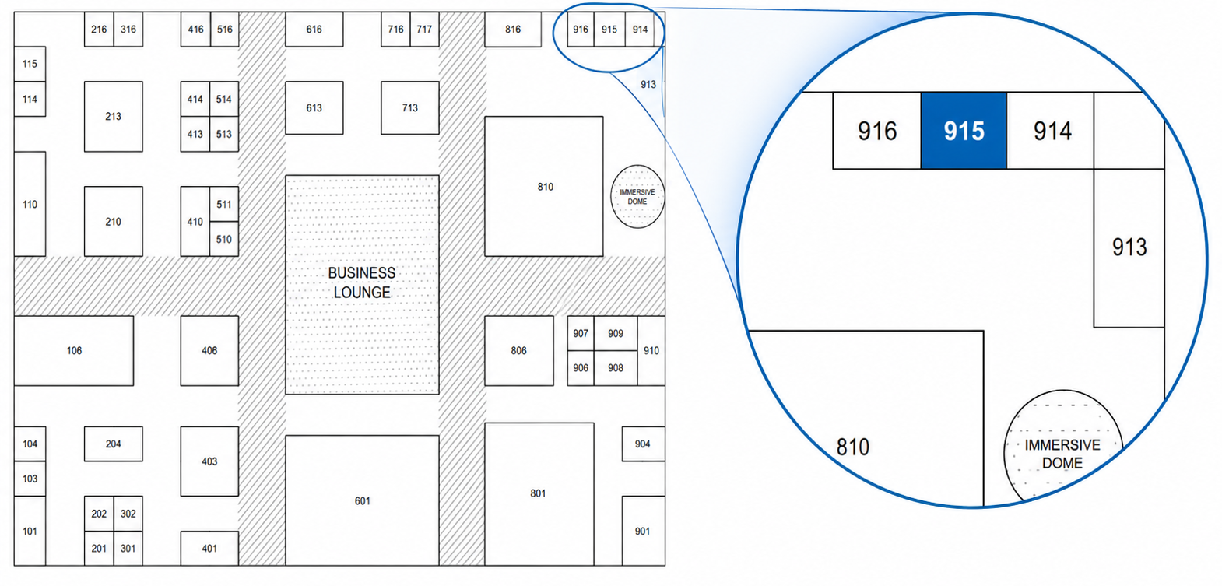

Visit us at our booth!
You'll find us at Booth 915, directly opposite the Immersive Dome.
We look forward to welcoming you!

Slide 15
Thank you!
Adriano Queiroz da Silva
STI/Aids Coordination of São Paulo
São Paulo City Health Department, Brazil
adrianosilva@prefeitura.sp.gov.br

