Slide 1
PrEP delivery in underserved rural communities – experiences from Central America
Obed Quiroz, Organización Llaves/Asociación PASMO, Honduras
Person-centred HIV prevention for key and vulnerable populations in Latin America and the Caribbean

Slide 2
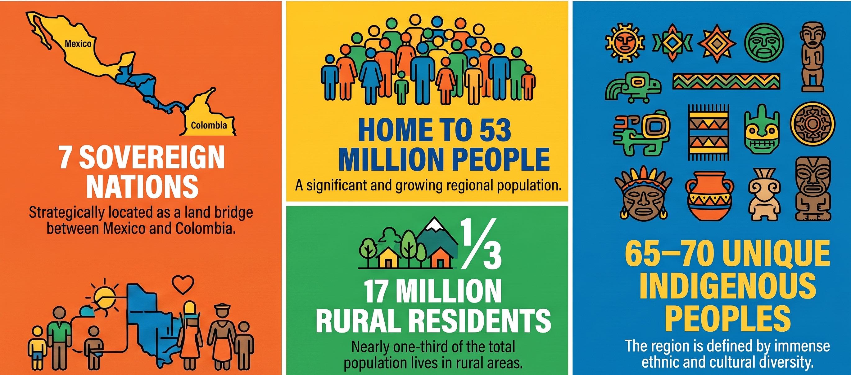
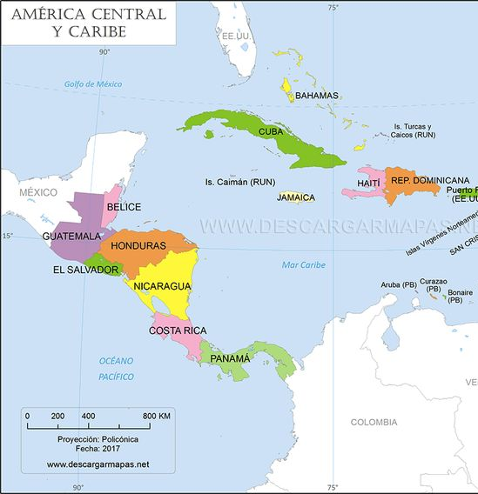
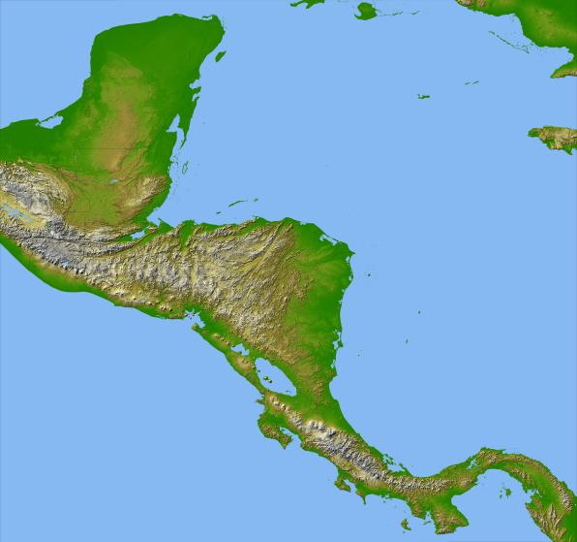
Central America

Slide 3
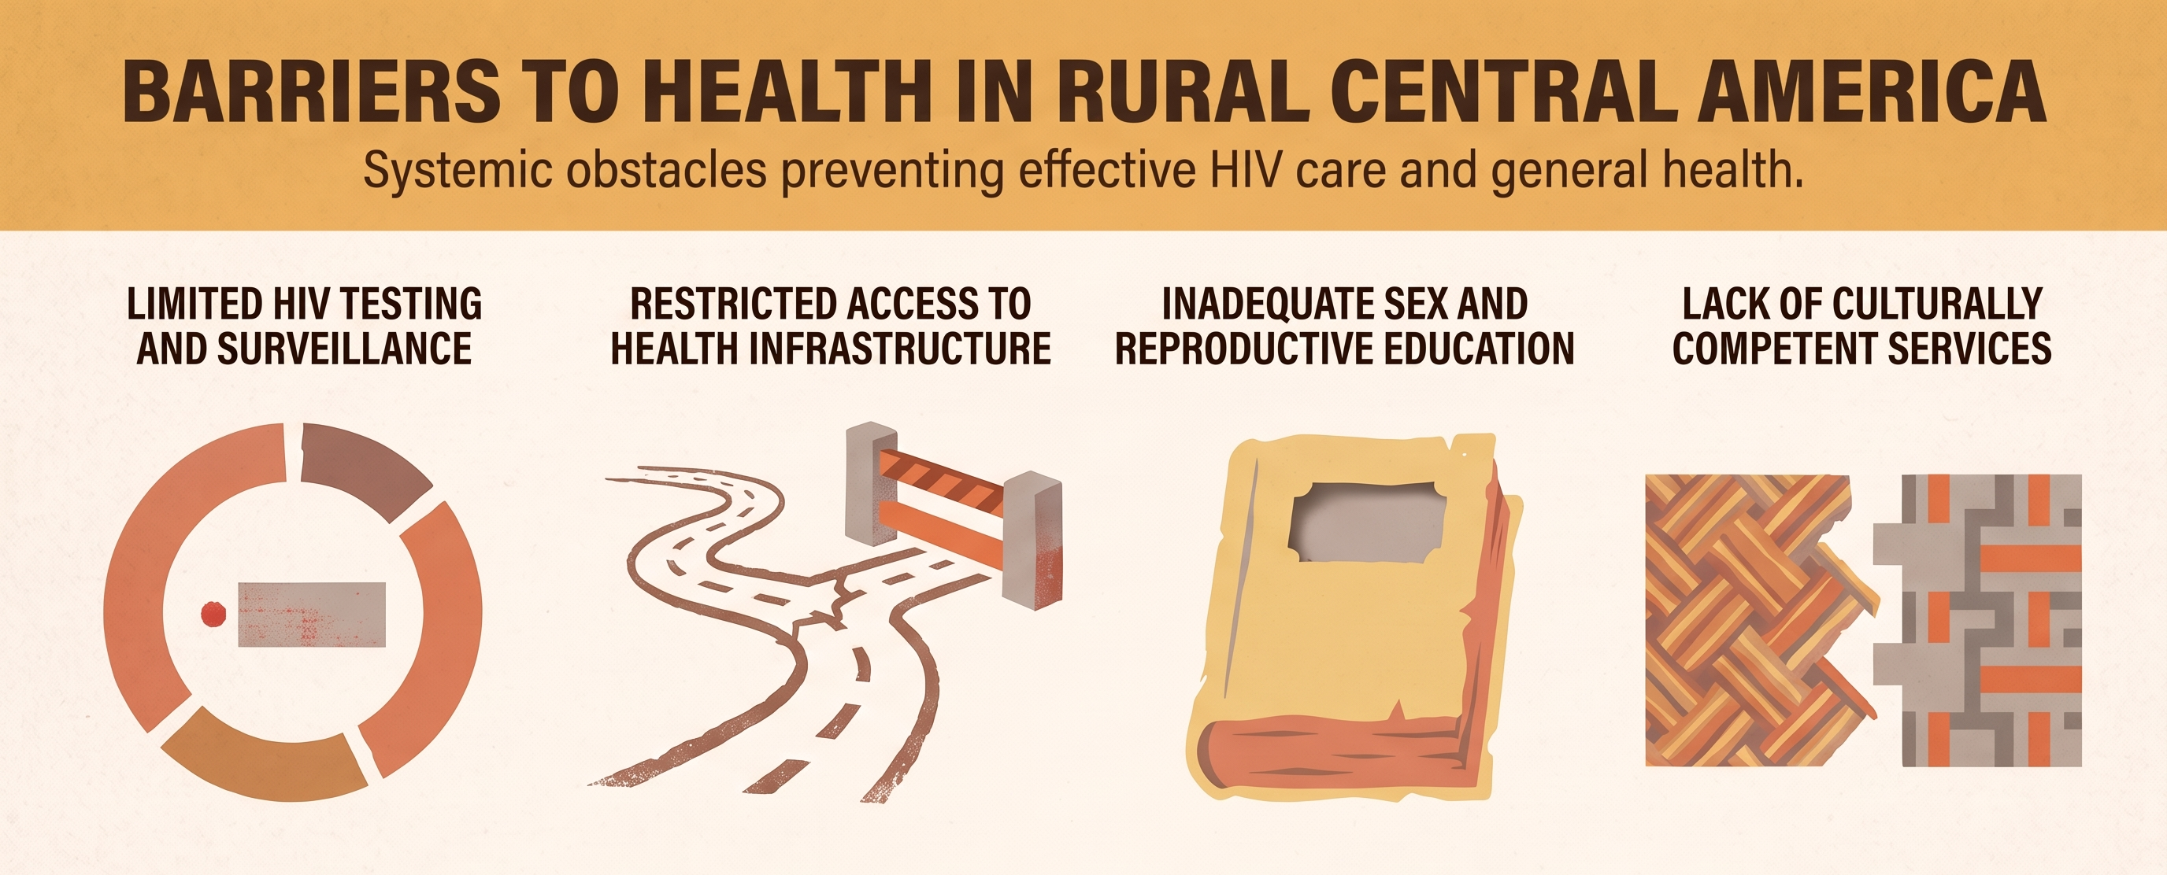
Healthcare Facilities in Central America

Slide 4
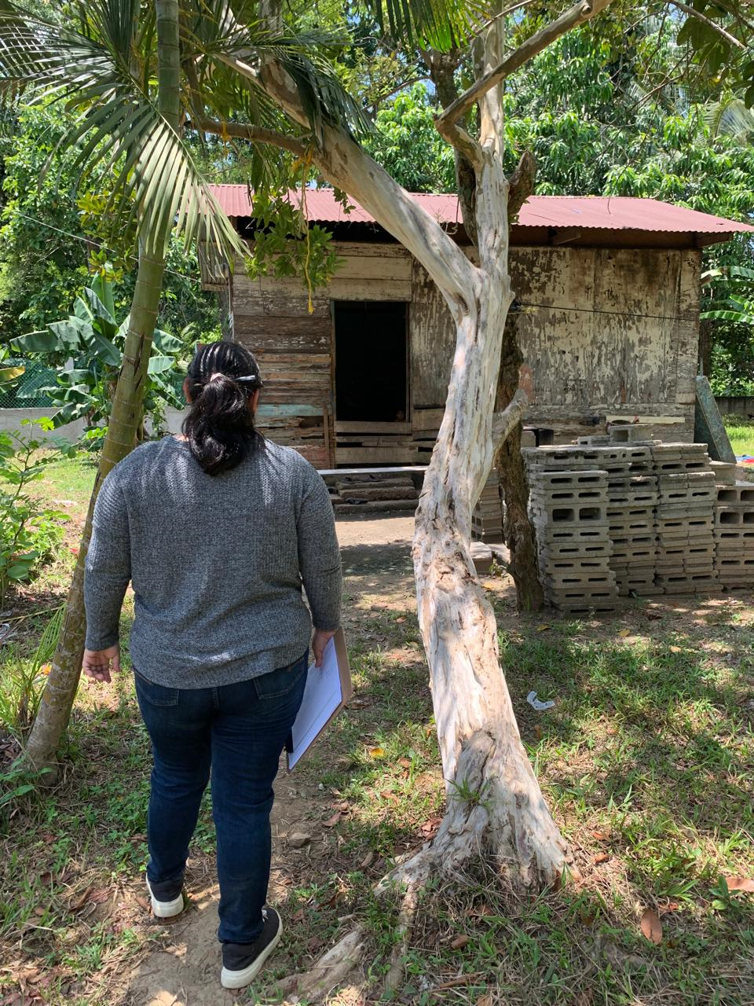
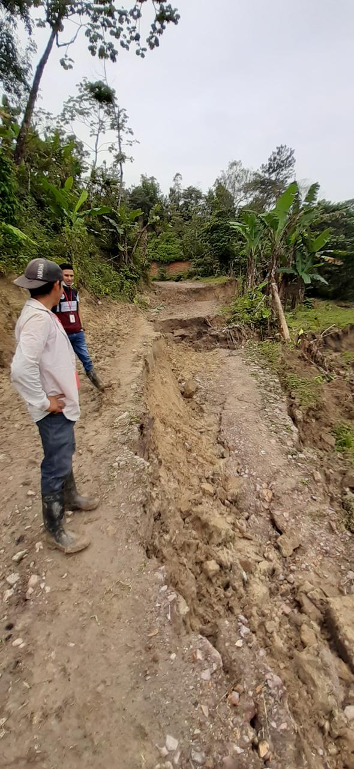
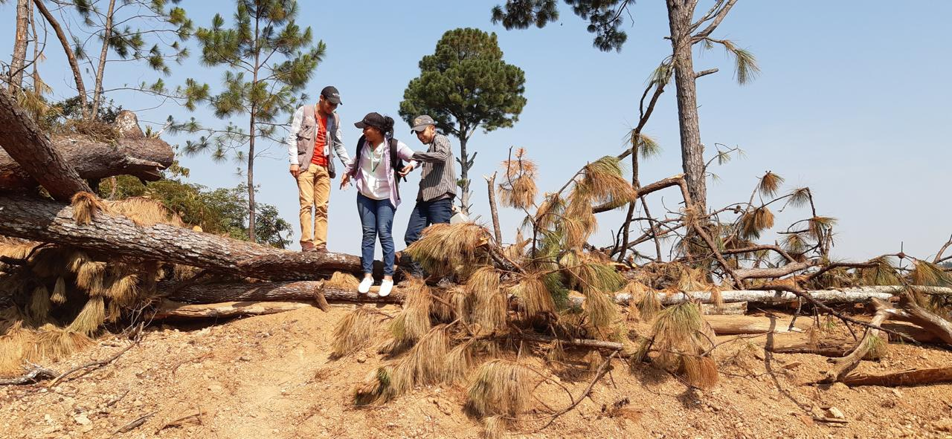
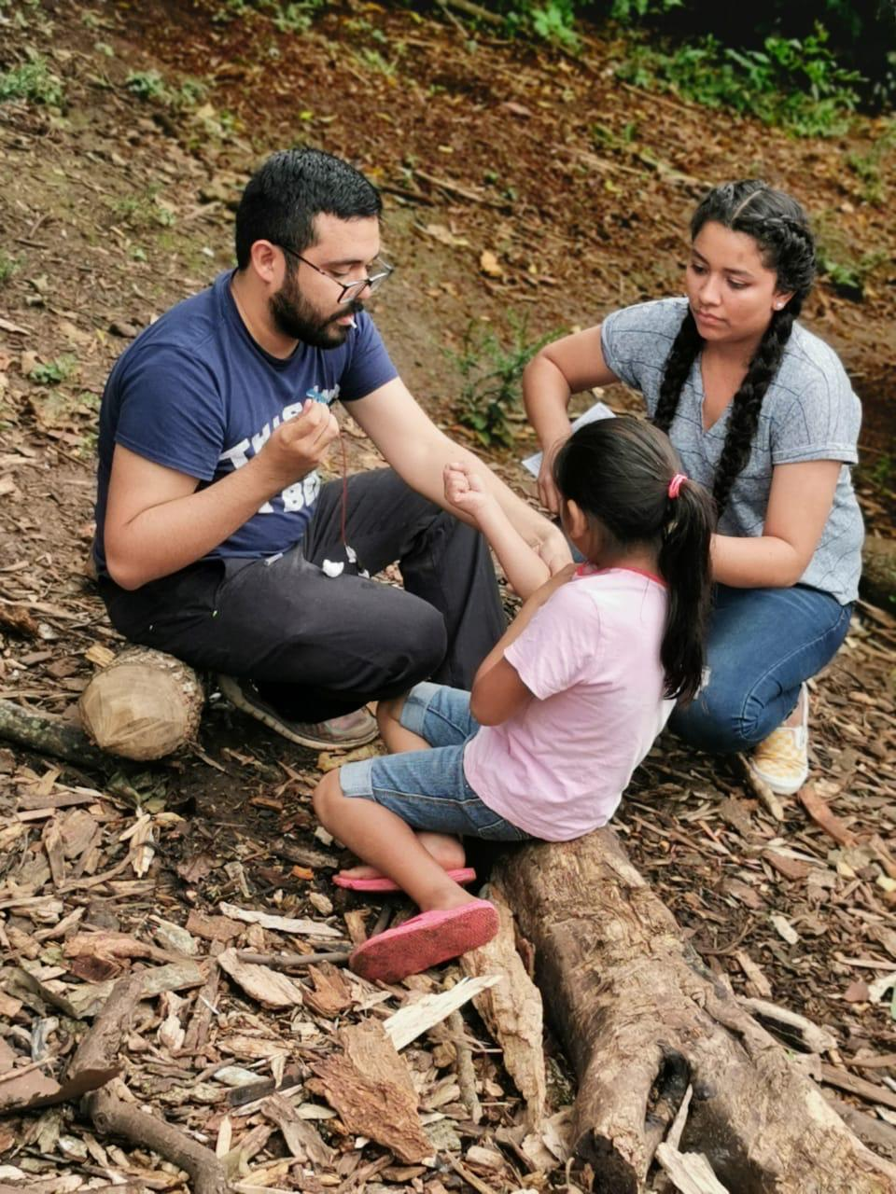
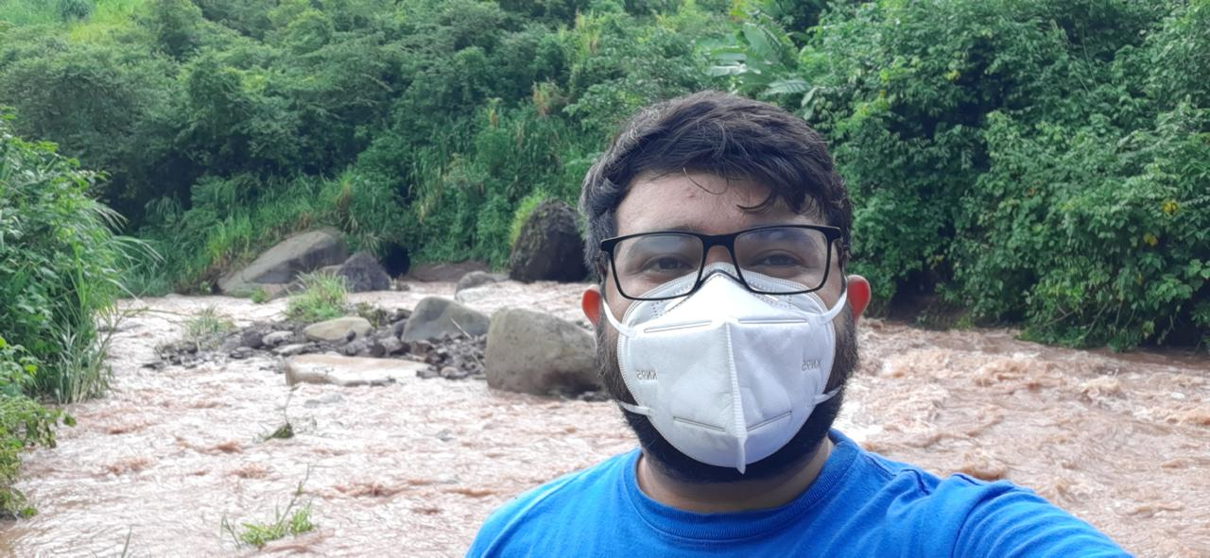
What do these barriers look in real life?

Slide 5
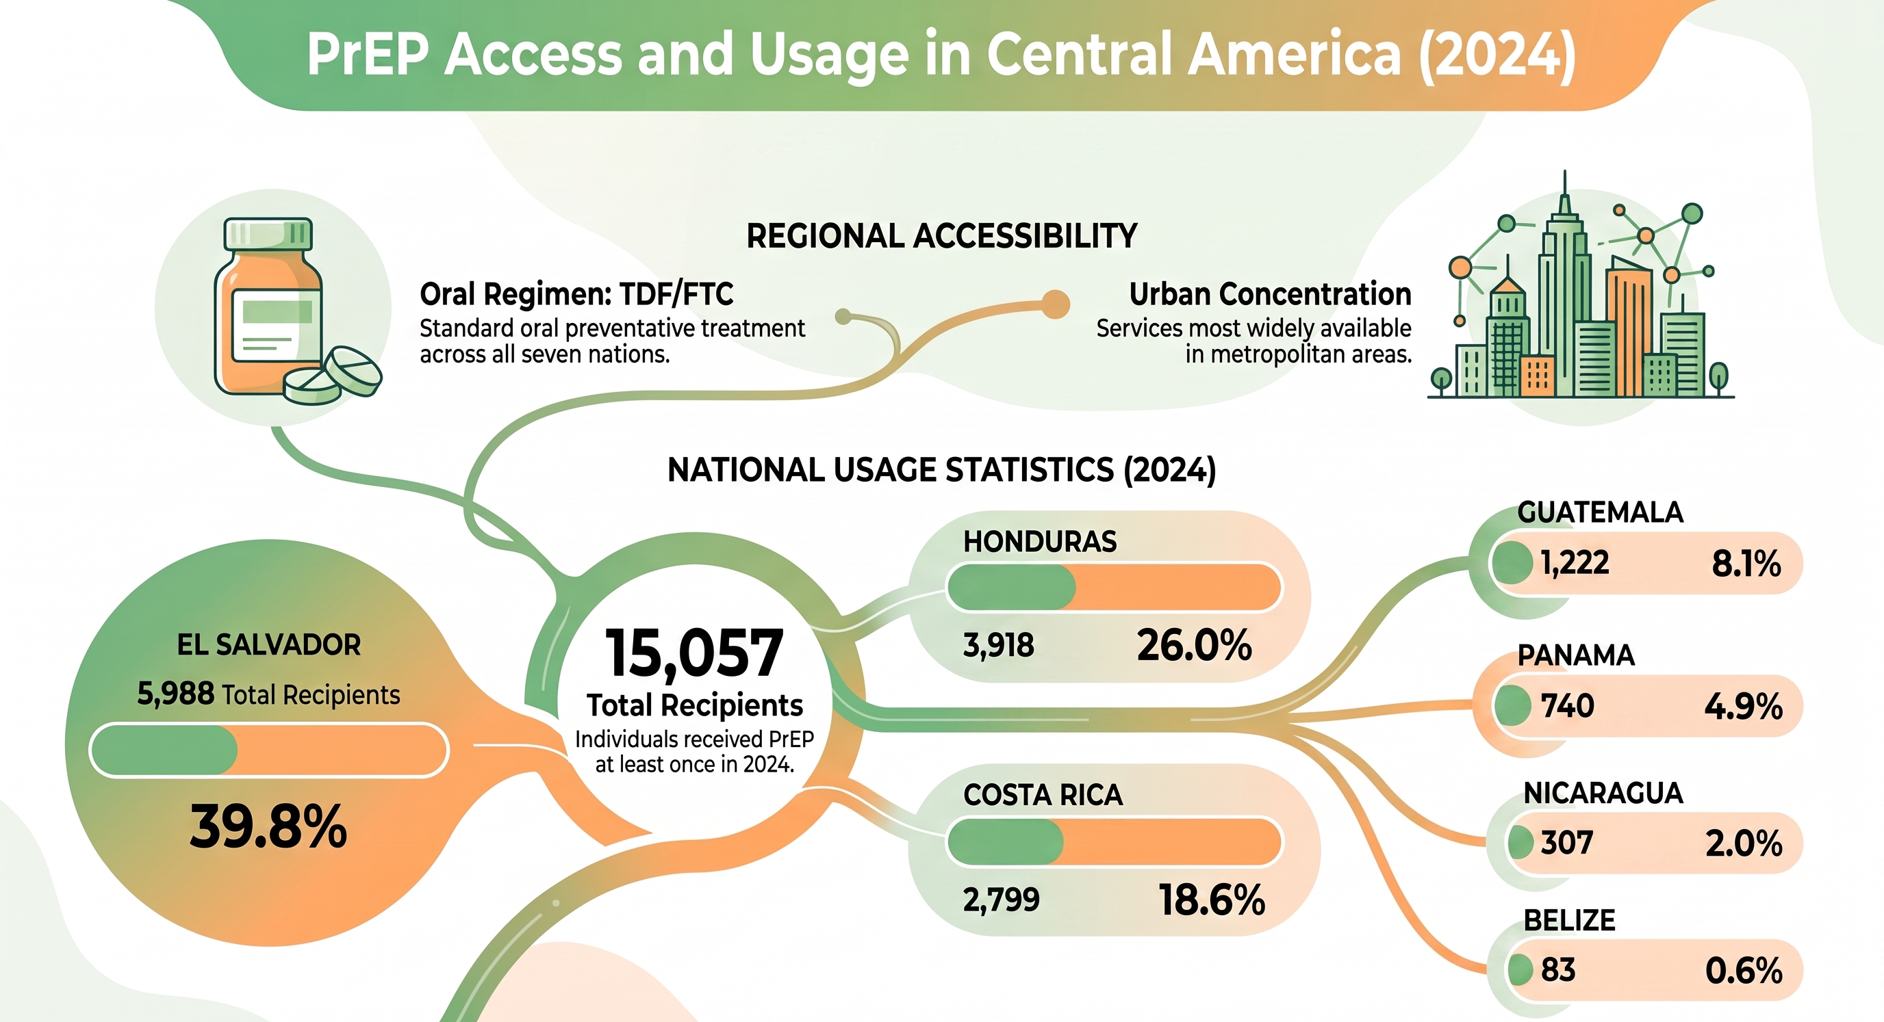
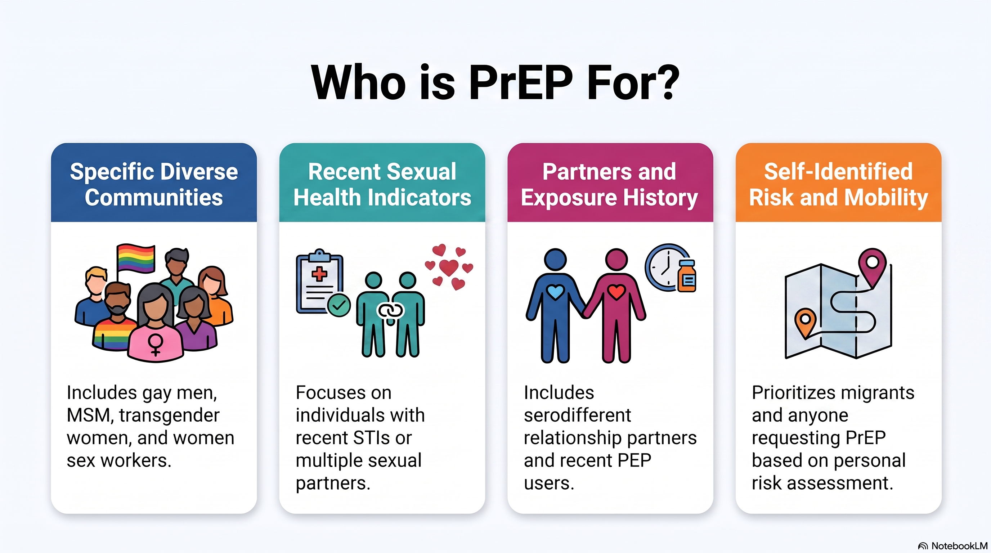
PrEP delivery in Central America

Slide 6
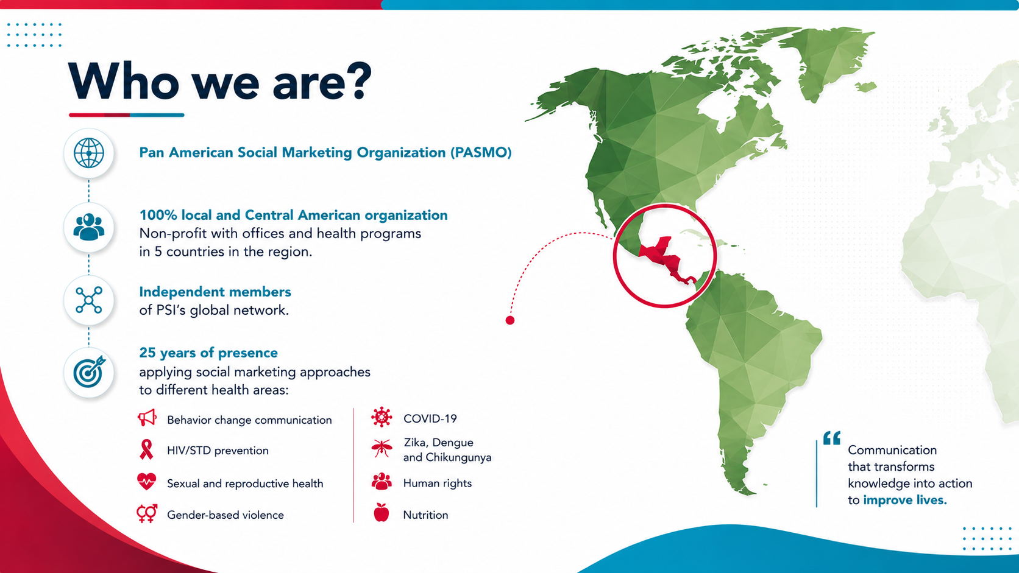
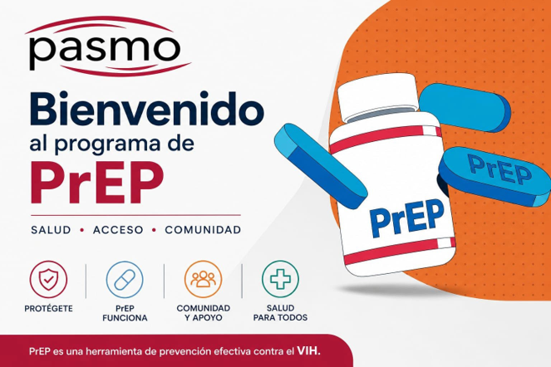
PASMO PrEP delivery model

Slide 7
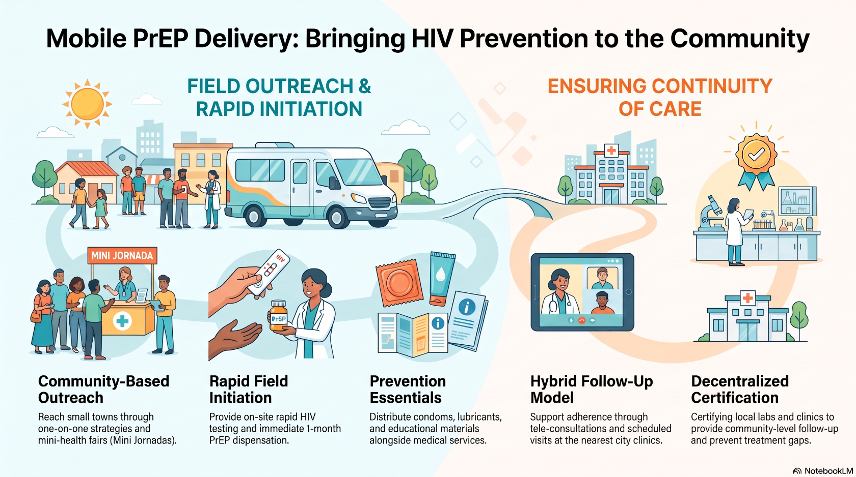
PASMO PrEP delivery model

Slide 8
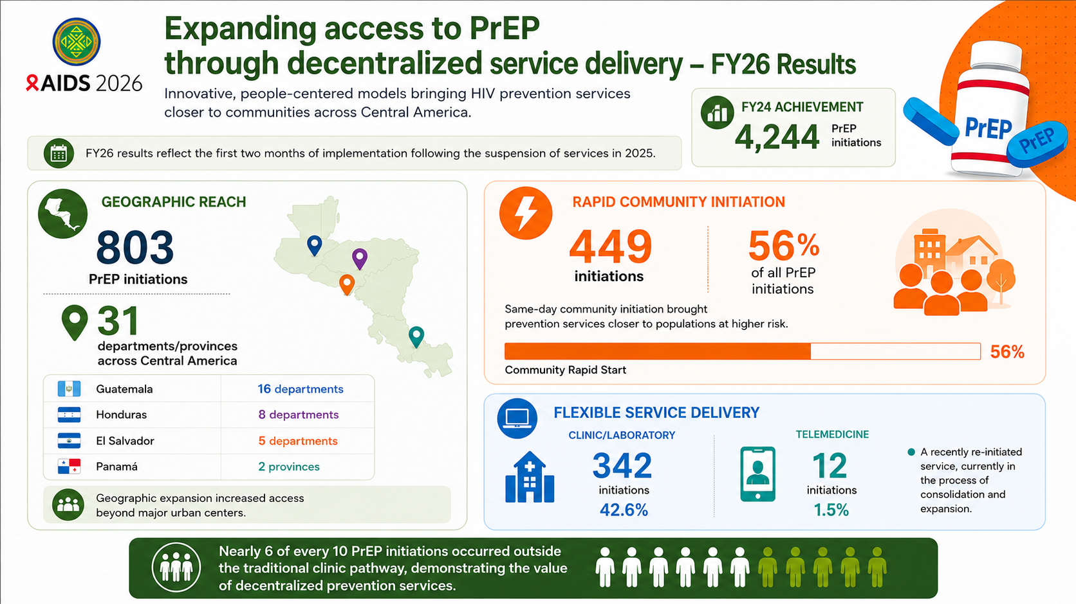

Slide 9
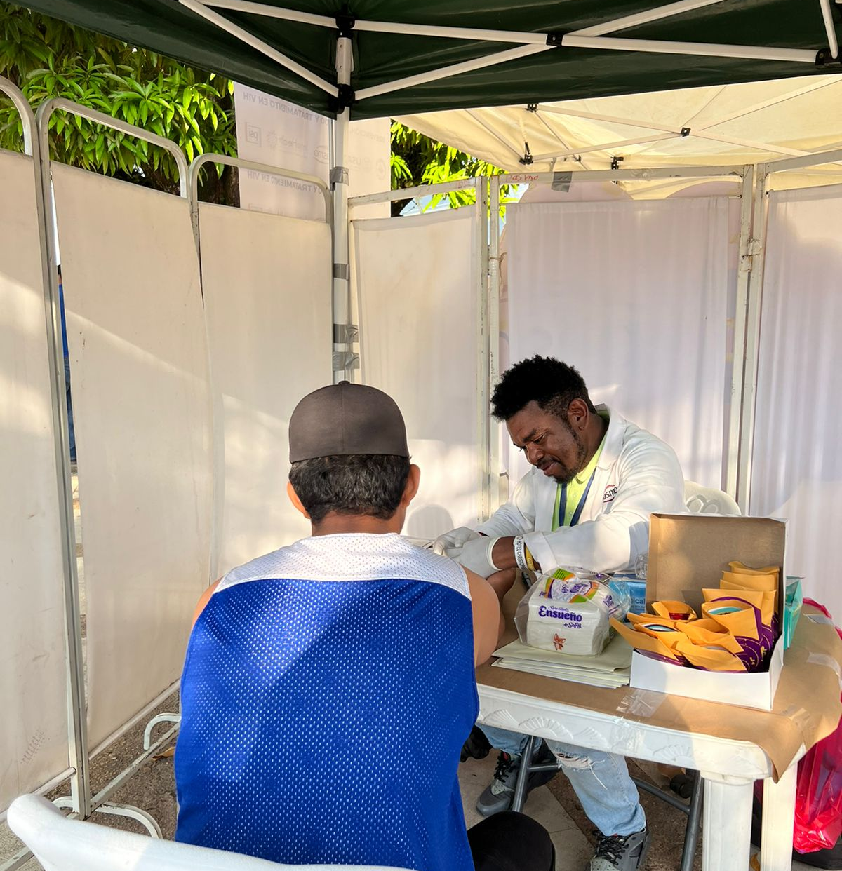
Lessons learned
Mobile outreach effectively expands access to PrEP in underserved rural communities.
Long-term PrEP success depends on decentralized follow-up services, not only on PrEP initiation.
Strengthening rural health facilities is essential for sustainable and equitable PrEP delivery.
Culturally appropriate care is especially important in rural settings because it addresses fears and myths, reduces stigma, and educates with understanding and compassion.
“It brings me great joy to provide HIV education and PrEP services to my Garifuna community in my own language, as the message is clearer and more meaningful, and it strengthens trust and the bond with my Garifuna brothers and sisters”
Omar Guerro
Health promoter

Slide 10
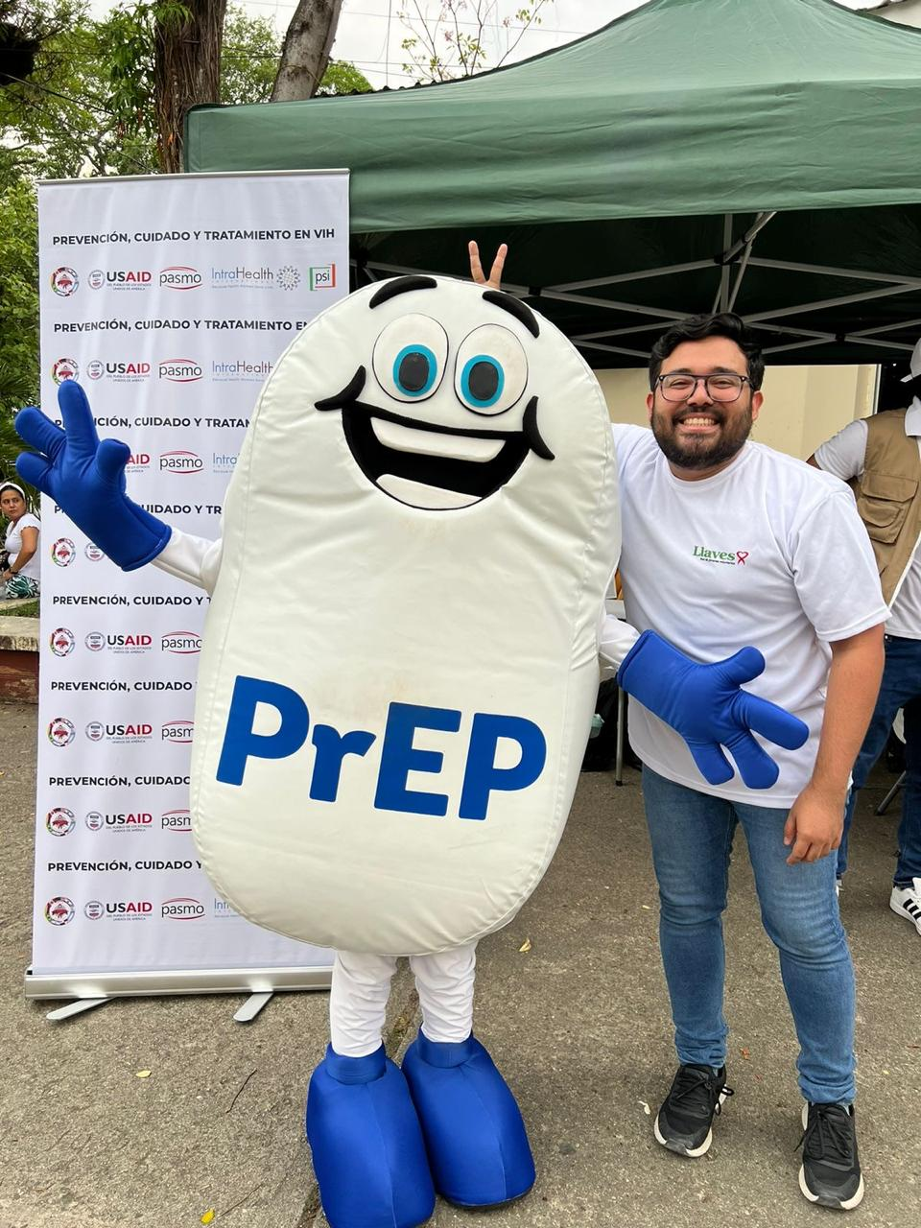
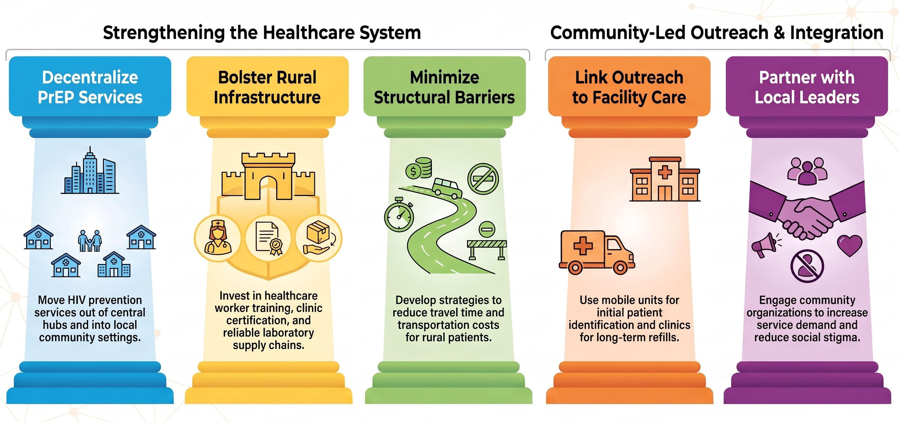
Recommendations

Slide 11
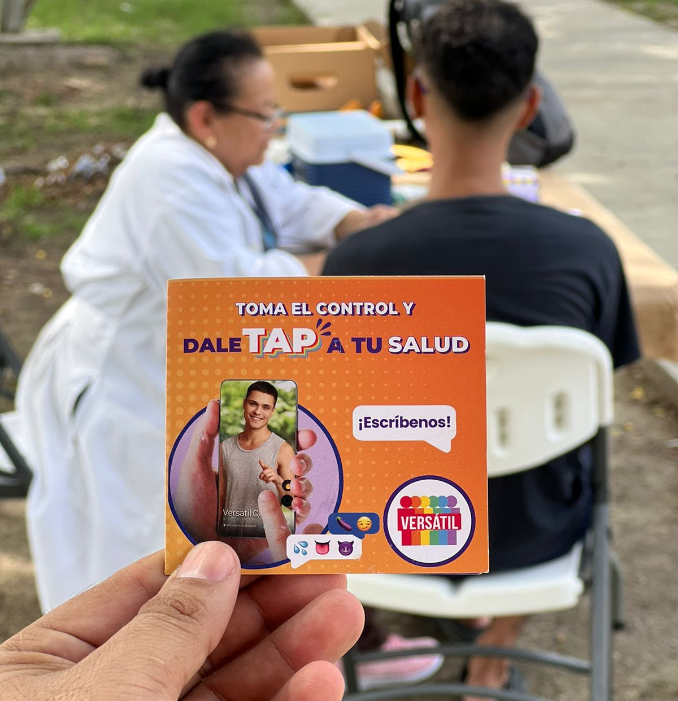
Conclusion
Mobile outreach can successfully initiate PrEP
in rural communities, but sustainable HIV
prevention requires decentralizing services by
strengthening local healthcare systems.

Slide 12




Acknowledgements
Organización LLAVES
Asociación PASMO
Erika Castellanos – GATE
PCC Team – IAS

Slide 13
“Wake up, humanity! There is no more time”
Berta Caceres

