Slide 1
MAS por Nosotras – comprehensive sexual and reproductive health for female sex workers
Valeria Fink, Fundación Huésped, Argentina
Person-centred HIV prevention for key and vulnerable populations in Latin America and the Caribbean

Slide 2

Conflicts of interest
Speaker and travel support for AIDS 2026: Provided the IAS Person-Centred Care programme, funded by Gilead Sciences.
Project funding: This project was funded under the Women RISE initiative supported by International Development Research Centre (IDRC), Canadian Institutes of Health Research (CIHR) and Social Sciences and Humanities Research Council (SSHRC).

Slide 3
Background
Female sex workers (FSW), both cisgender and transgender, are among the most marginalized and criminalized groups in Argentina.
FSW face multiple barriers accessing sexual and reproductive health (SRH) services as well as economic support.
The COVID-19 pandemic has exacerbated gender, economic, social, and health inequalities for FSW.
In preparation for future emergencies, it is important to identify novel healthcare models for vulnerable populations.
Comprehensive approaches to health care have shown in other populations to facilitate access to care.

Slide 4
Research study: “Sexual and reproductive health of female sex workers in the post-COVID-19 era in Argentina”
Purpose:
To assess the feasibility of a comprehensive prevention and care package to tailor and sustain health care strategies for this important and vulnerable population in the post-COVID era and for future health emergencies.
Modelo de Atención en Salud

Slide 5







Methodology: Research team
Immunodeficiency Clinic, University Health Network, University of Toronto, Canada
(Dr Walmsley)
Fundación Huésped
(Dr Fink)
Coordination of Sexual Health, HIV and Sexually Transmitted Infections of the Ministry of Health of Buenos Aires, Buenos Aires City (Dr Durán)
Sex Workers of Argentina Union (AMMAR)
Association of Travestis, Transsexuals and Transgender people of Argentina (ATTTA)

Slide 6
Methodology: Approach
Participatory qualitative research with stakeholder mapping, interviews with key informants as healthcare workers, policy makers and FSW focus groups.
Prospective cohort of 200 FSWs (101 cisgender, 99 transgender women), through peer navigator support and facilitated referrals.
Policy brief and deliberative dialogues: based on the information of the qualitative research and prospective cohort and advice of the MoH, a policy brief was developed to guide deliberative dialogues with policymakers.

Slide 7
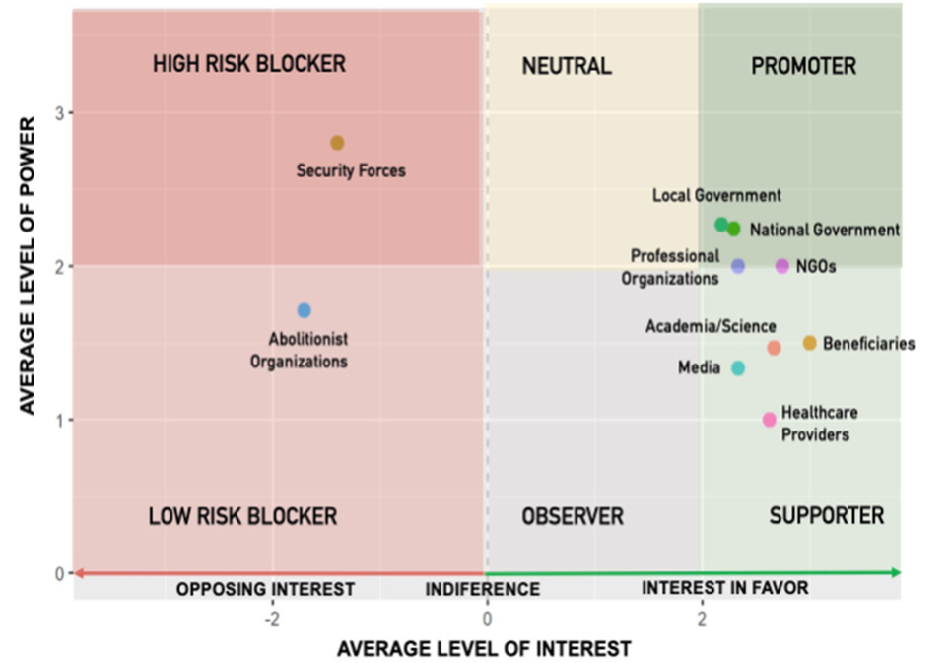
Results: Qualitative study
Two focus groups discussions with female sex workers:
            13 cisgender women at Casa Roja, AMMAR, Sex workers union of Argentina
    15 transgender women at Casa Trans, ATTTA, Asociación de Trasvestis, Transgénero y Transexuales de Argentina
Key findings
Intersectional stigma
Discrimination
Failed intersectional articulation
Emergence of community assets as facilitators
Stakeholder mapping
35 key informant interviews
9 interviews with healthcare providers
26 interviews with decision makers and other key informants
Participatory qualitative analysis (DEPICT model), collaboratively reviewing and interpreting data with the community (Nvivo, teams of one researcher and one peer navigator).

Slide 8
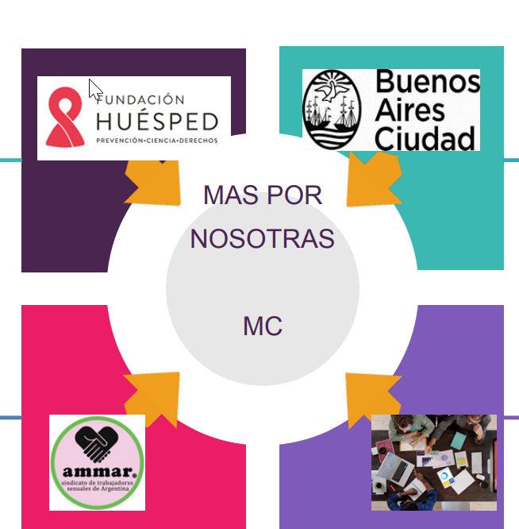



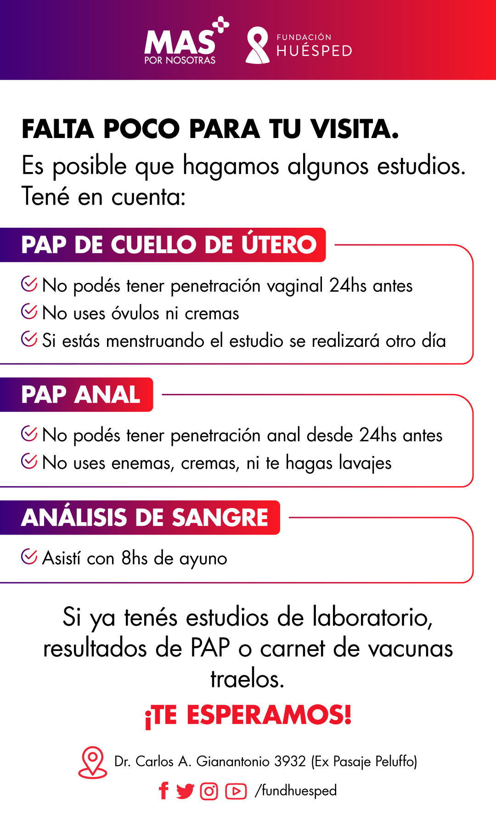
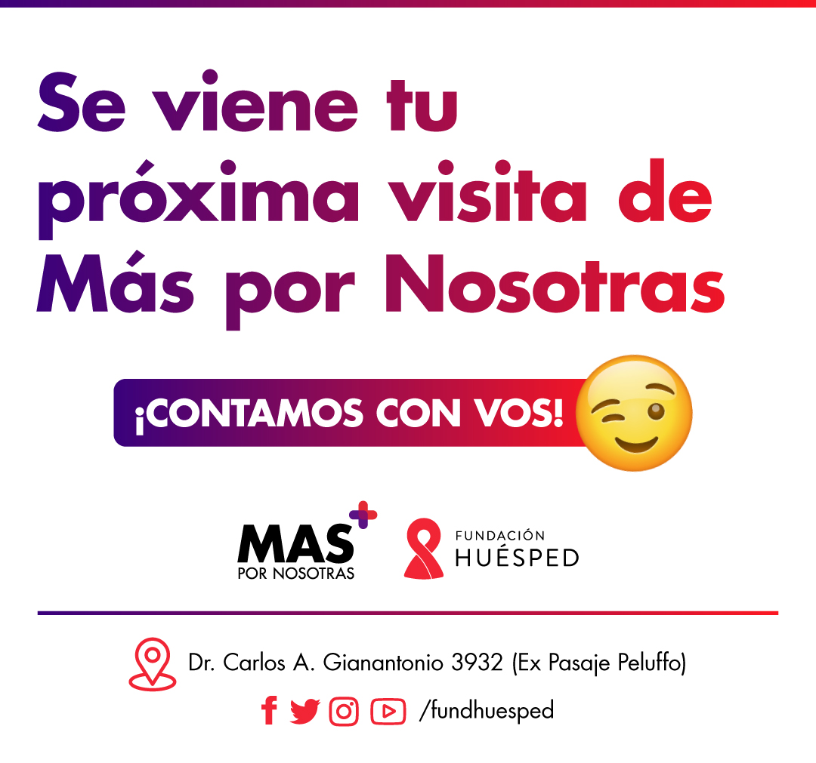
Results: Cohort study (1/2)
Cohort of 200 FSW: 101 cisgender and 99 transgender women (June 2023-March 2024)
Peer navigator support
Medical assessments:
including HIV/ STI testing, cervical, anal and breast cancer prevention and contraception.
Psychosocial interviews
Retention at 6 months
133 (67%) participants

Slide 9
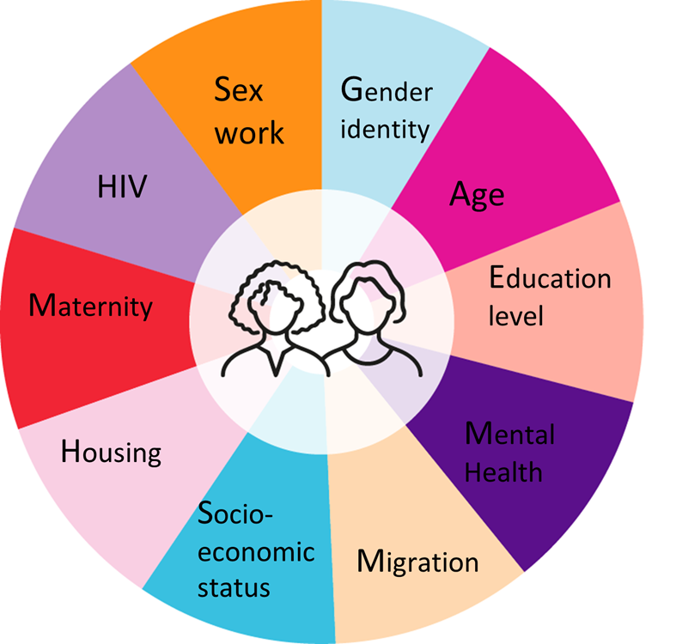
Results: Cohort study (2/2) demonstrate intersectionality
Physical health
HIV
34% Transgender women (TGW) and 3% Cisgender women (CGW)
Syphilis
22% TGW and 4%CGW
Cervical HPV
41% CGW
Undiagnosed SRH conditions
41% CGW
Mental health
Hazardous alcohol use
80.2% TGW and 61.6% CGW
Cocaine use in the past year:
62.1% TGW and 52% CGW
Post-traumatic stress
8% TGW and 10.1% CGW
Depressive symptoms
52.9% TGW and 45.5% CGW
Food insecurity
51.7% TGW and 52.6% CGW
External migrants: 31.6% TGW and 27.6% CGW
Internal migrants: 83.3% TGW and 21.2% CGW

Slide 10
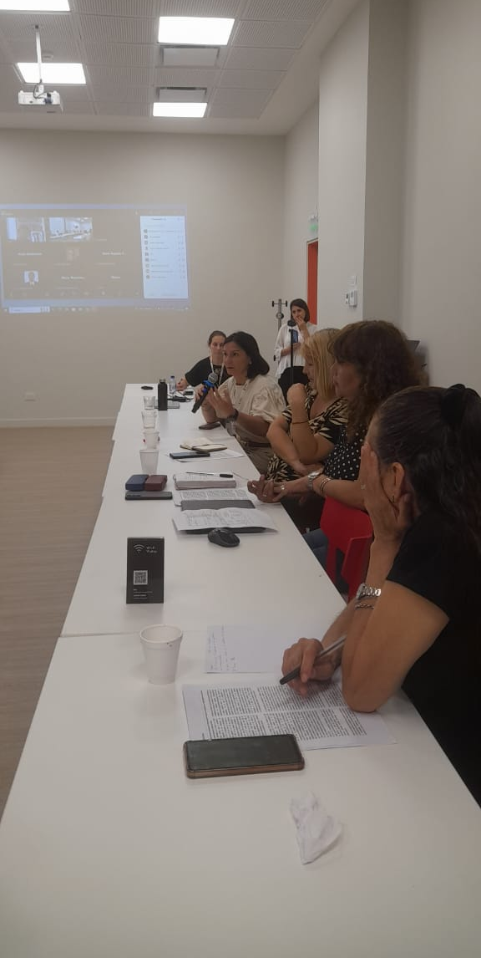
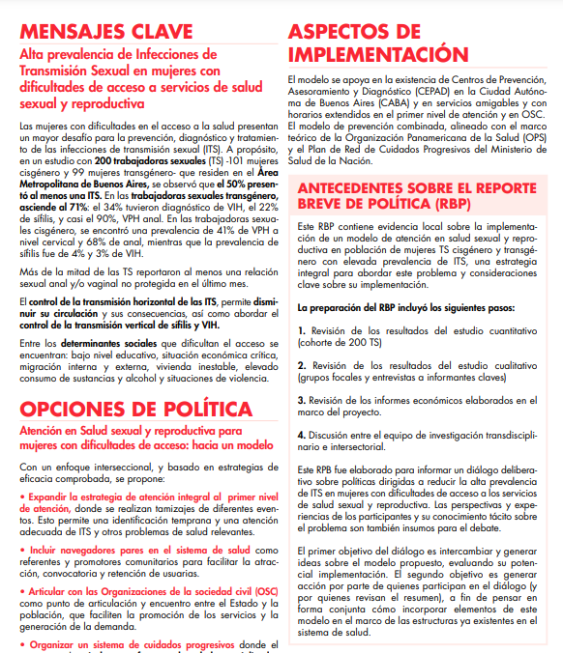

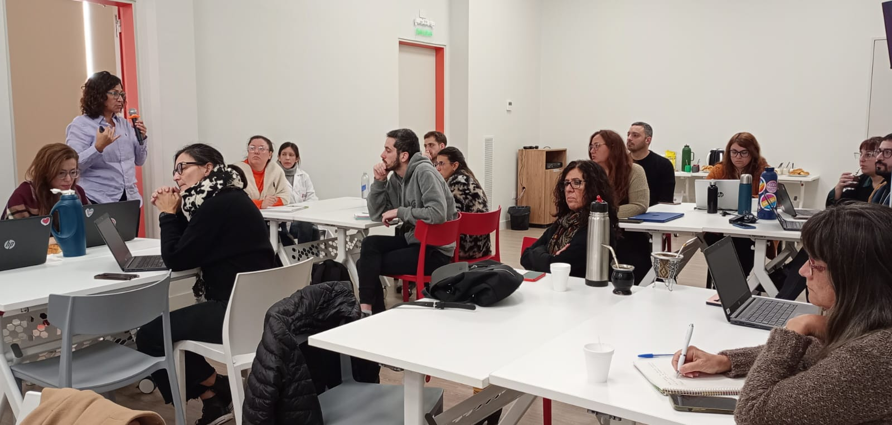
Results: Policy brief and deliberative dialogues
qualitative research
prospective cohort

Slide 11
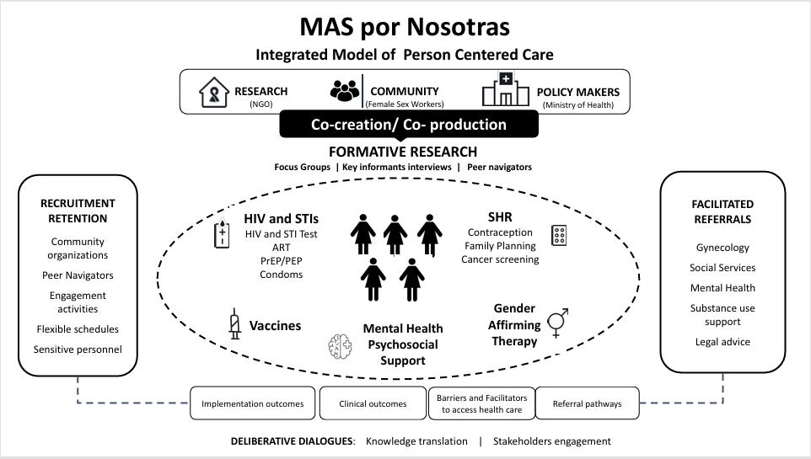
Results: Integrated model of person-centred care

Slide 12
Conclusion
MAS por Nosotras created a unique opportunity to work with FSWs, a vulnerable and understudied population, addressing gaps in data to inform public policies in Argentina.
Strong partnerships between FSW organizations, a NGO, a research centre and the MoH were key to provide a better understanding and ensure equity.
Next steps
Rethink Evaluating longer term outcomes
Rebuild Implementing in other settings
Rise Escalating this model of care to other women in situation of vulnerability

Slide 13
Study team
Adriana Durán Sharon Walmsley Valeria Fink Inés Aristegui Marcela Romero Georgina Orellano
Virginia Zalazar Macarena Sandoval Nadir Cardozo Agustina Arguello Mona Loufty Silvina Vulcano
Carolina Pérez Ana Gun Carina Cesar Eugenia Esandi Emilia Frontini Ana Zeltman Camila Serrao Romina Caballero Maria Celia Trejo Rodrigo Acuña Estefanía Panizoni Mariana Duarte Solange Fabian Ariadna Exner Susana Cahn Daniela Parera Jonathan García
Cecilia Valeriano Amelia González
Debora Fiore Florencia Gadea Rocío Isaurralde
Valeria Álvarez Julián Ylarri Javier Mariani Gissella Mernies Mariela Ceschel Agustín Nava
Oscar Cetrángolo Ariela Goldsmith
Adriana Corera Gabriela Paz Raffo Ana Inés Alvarez
Leandro Cahn Mar Lucas Carmen Ryan
Pedro Cahn Zulma Ortiz María Inés Figueroa
and more…..

Slide 14
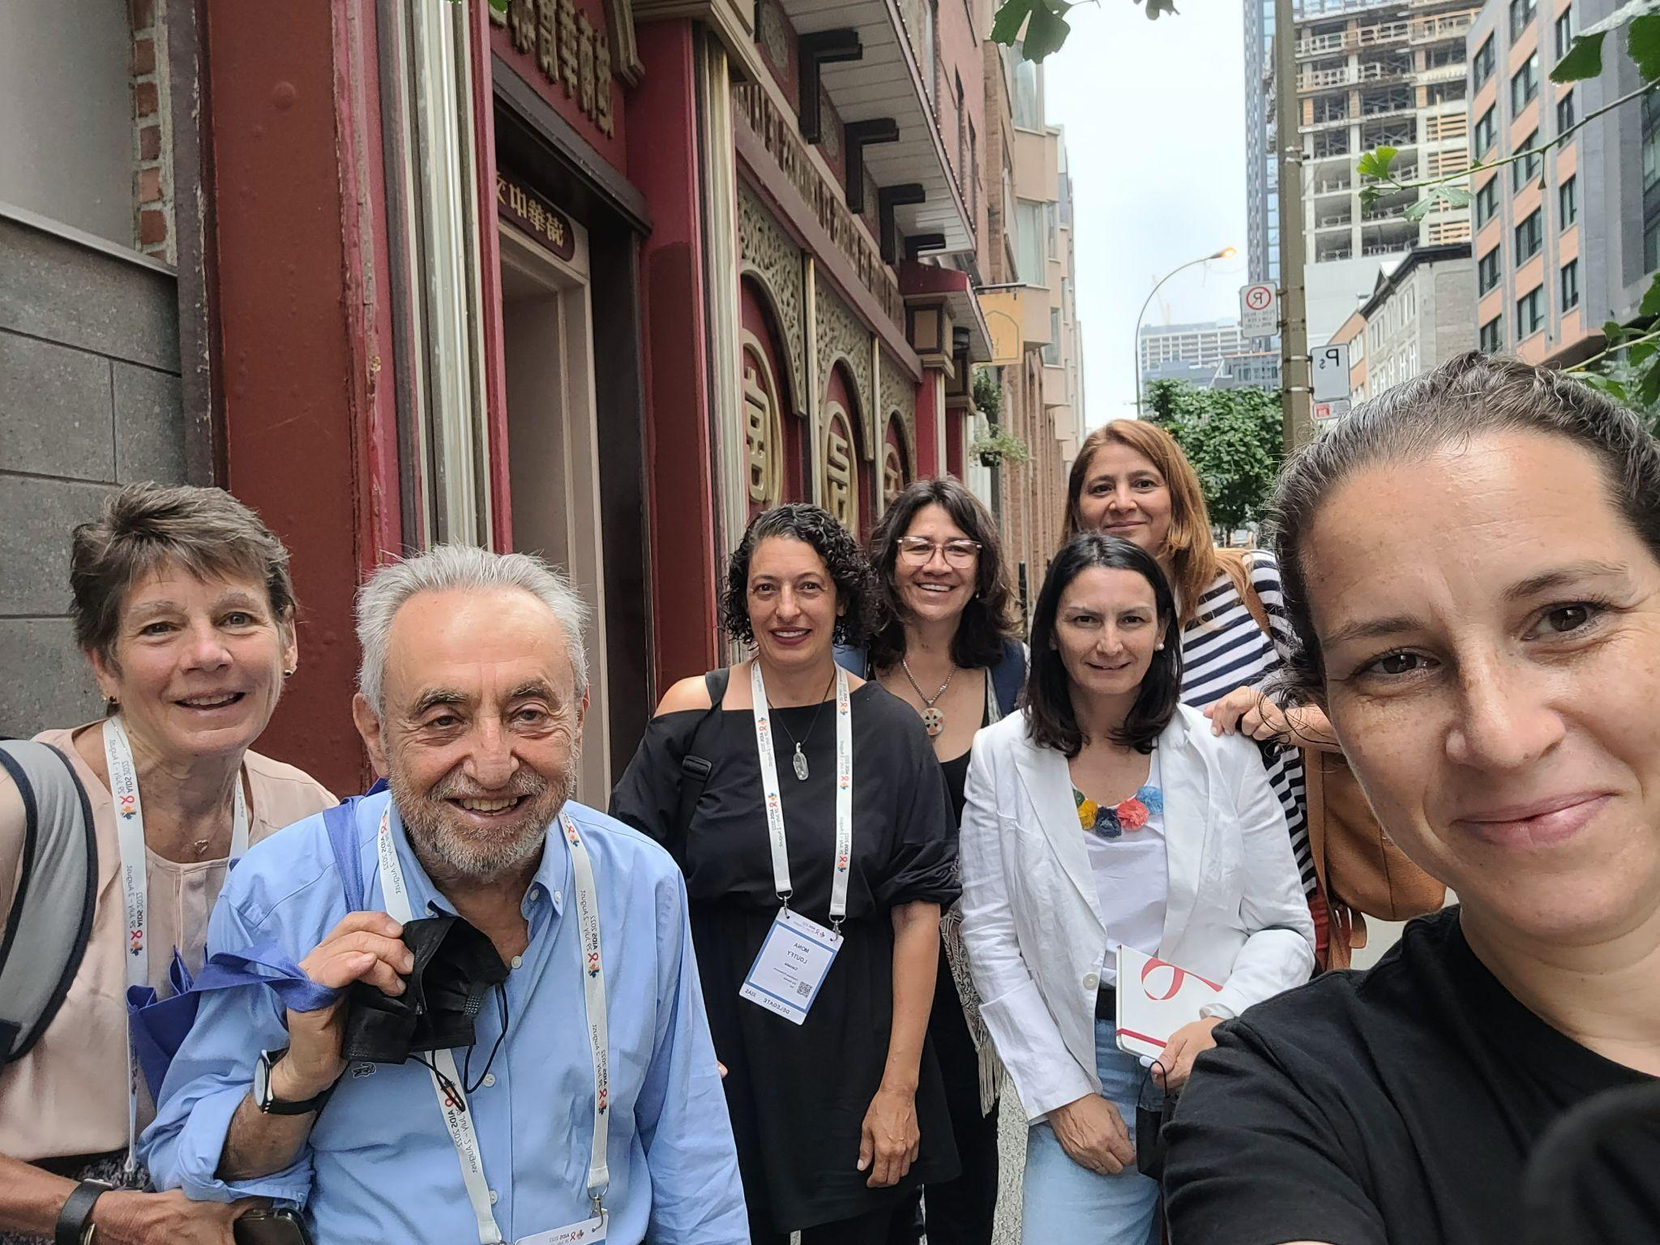
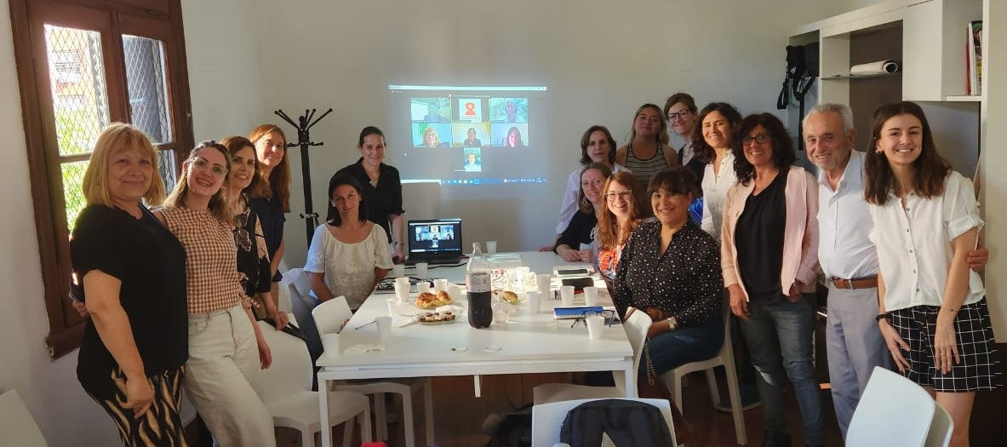
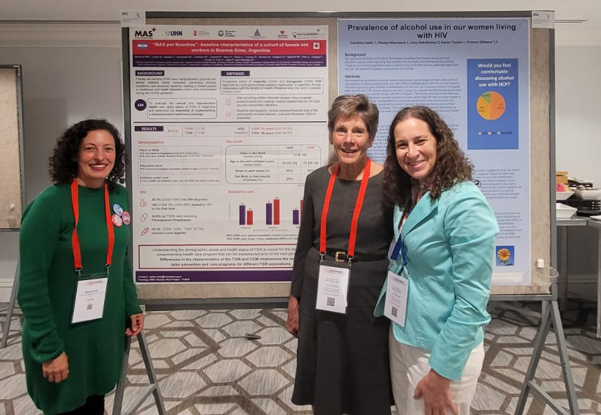
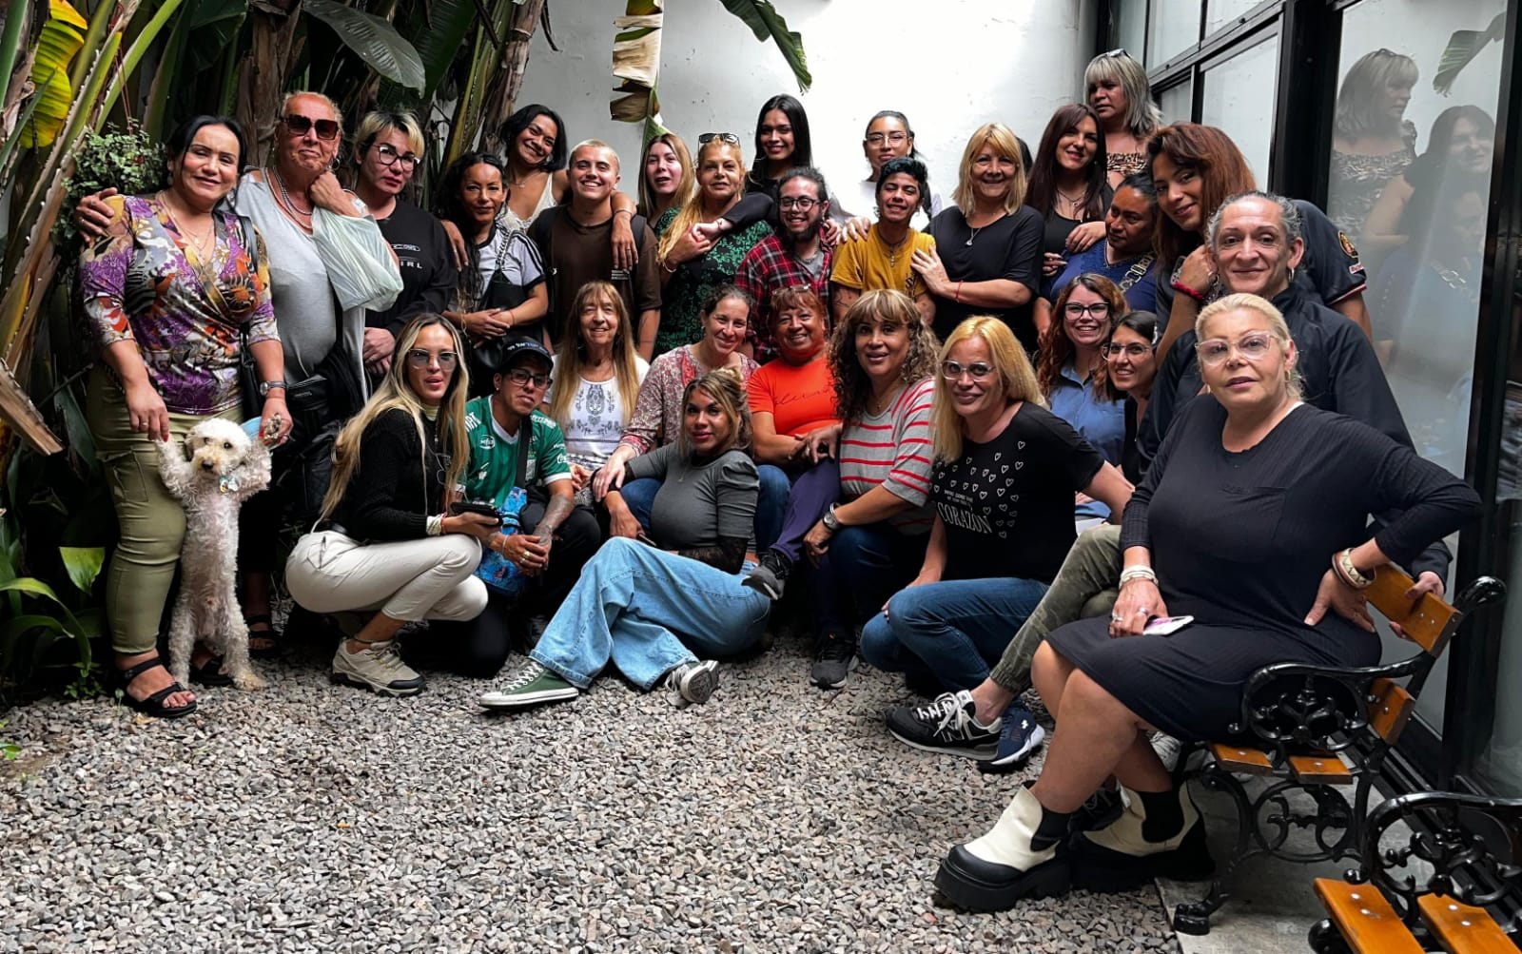

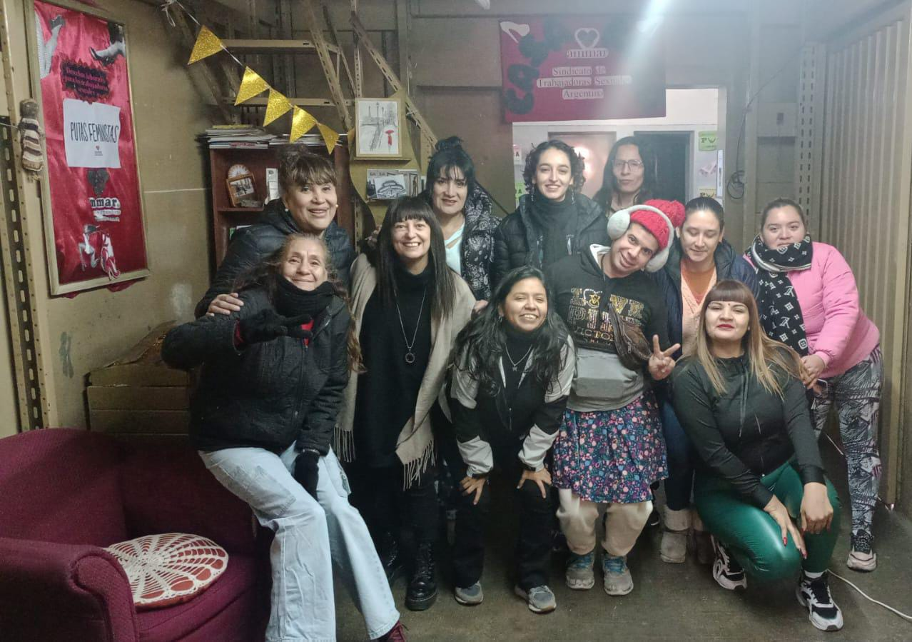



GRACIAS THANK YOU OBRIGADA
Contact: valeria.fink@huesped.org.ar
Funding: This project was funded under the Women RISE initiative supported by IDRC, CIHR and SSHRC.

